Slide 1
DepreechX A Mechanism for Screening Patients Vulnerable to Depression using Speech 24-07-25

Slide 2
Paper : Enhanced speech emotion recognition using averaged valence arousal dominance mapping and deep neural networks

Slide 3
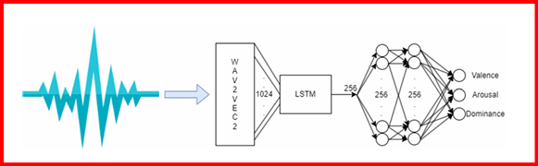
Model Architecture
Wav2Vec2 feature extractor process the audio in chunk of 25ms and that is fed into wav2Vec2 to generate embedding of size 1024 for each chunk.

Slide 4
Model Training and Testing
Model is trained on an 80:20 train-test split of RAVDESS dataset.
Used MSE as loss function, Adam optimizer and learning rate is set to 1e-3.
Further tested on following datasets –
CREMA-D ( English )
EmoDB ( German)
TESS ( English)
IESC ( Hindi ) ( Indian Emotional Speech Corpora) (Not in the paper)

Slide 5
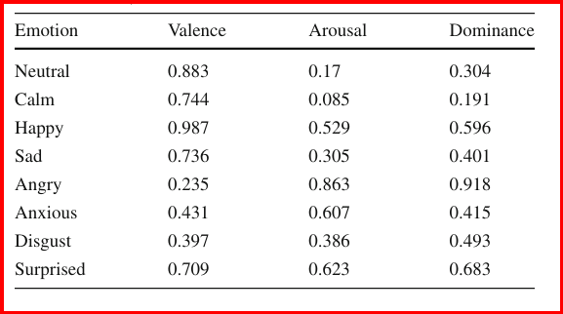
Ground Truth Valence, Arousal and Dominance
Generated by averaging the results of three pre-trained VAD networks on the RAVDESS dataset –
1) Wav2Vec2.0-L-Robust-12 on MSP Podcast Corpus
2) LSTM model with 3 layers (512, 256, 128) on Quechua Collao Corpus
3) CNN model with 3 layers (512, 256, 128) on Quechua Collao Corpus

Slide 6
Accuracy Results Comparison
Dataset | Accuracy % (paper) | Accuracy % ( VAD 1NN / 2NN / 3NN ) | Accuracy % (VAD 1NN / 2NN / 3NN) w/ Huber Loss Function | Accuracy % (Testing w/ batch size 32) (VAD 1NN) | Accuracy % (emotion) | Avg. Euclidean Dist. (VAD-1NN / paper)
RAVDESS | 93.98 | 94.67 / 96.00 / 98.33 | 92.89 / 95.70 / 98.25 | 94.67 | 95.33 | 0.0452 / 0.0469
CREMA-D | 77.00 | 43.72 / 62.23 / 76.83 | 45.19 / 61.88 / 76.03 | 40.97 | 36.35 | 0.2986 / 0.1360
EMODB | 86.34 | 65.79/ 76.26 / 87.48 | 62.24 / 74.02 / 85.98 | 61.68 | 61.12 | 0.1712 / 0.0980
TESS | 85.52 | 46.64 / 59.89 / 67.04 | 43.39 / 53.18 / 68.32 | 46.29 | 42.79 | 0.2234 / 0.0870
IESC | _____ | 41.17 / 50.33 / 69.67 | 39.83 / 48.83 / 68.67 | 39.67 | 31.83 | 0.3383 / ______

Slide 7
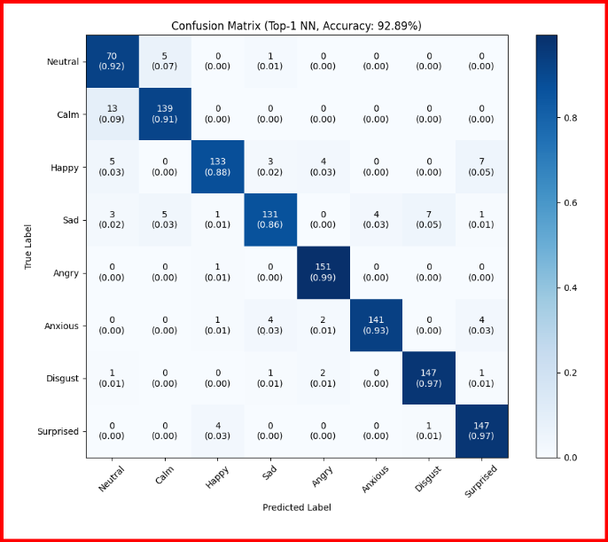
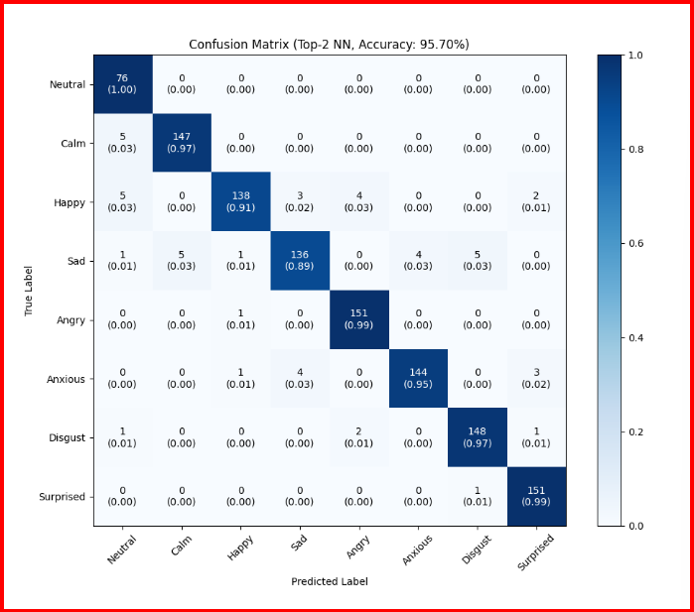
Accuracy Results on RAVDESS with Huber Loss

Slide 8
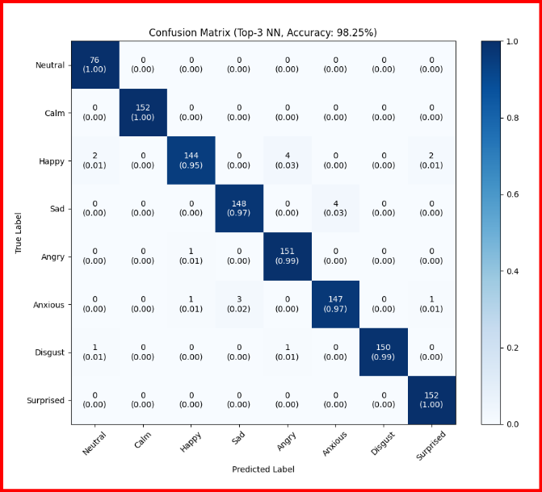
RAVDESS (Top-3NN-Accuracy) w/ Huber Loss

Slide 9
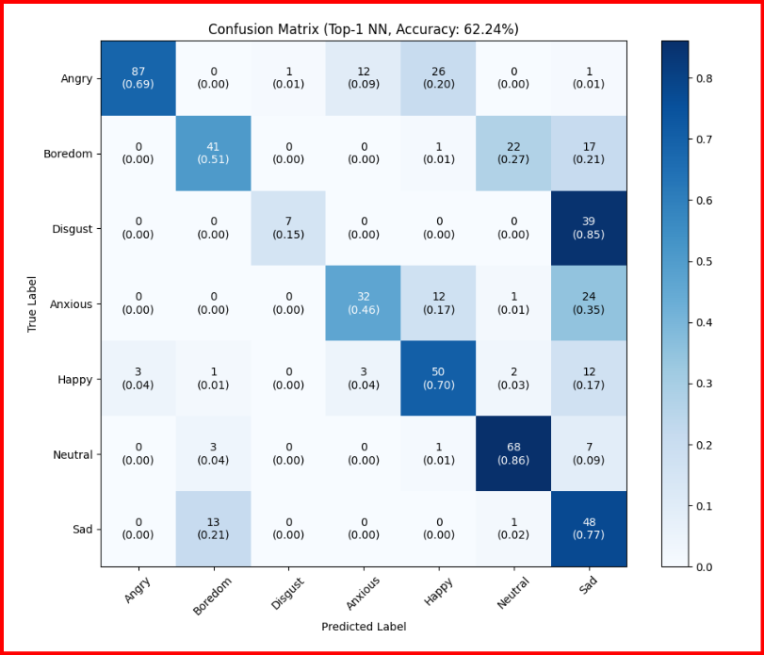
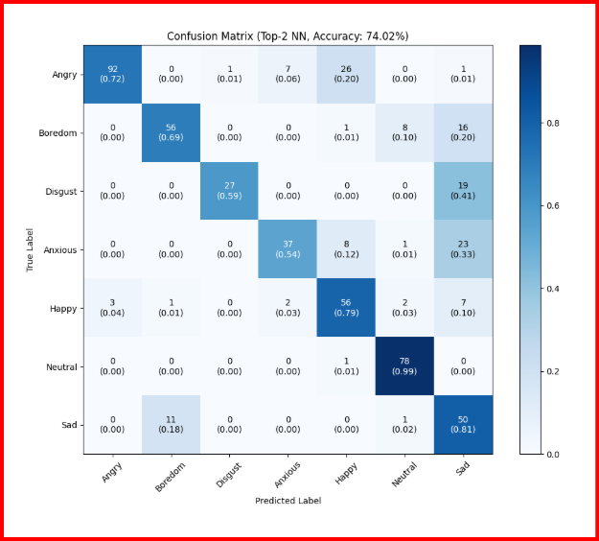
Results on EmoDB (7 emotions) Dataset with Huber Loss

Slide 10
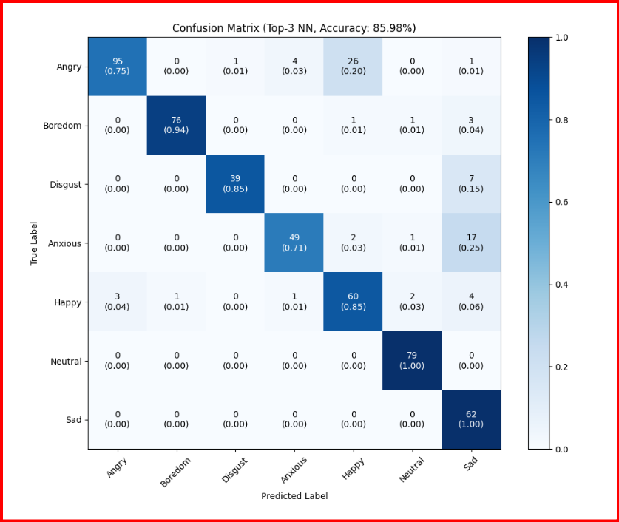
EmoDB (Top-3NN-Accuracy) w/ Huber Loss

Slide 11
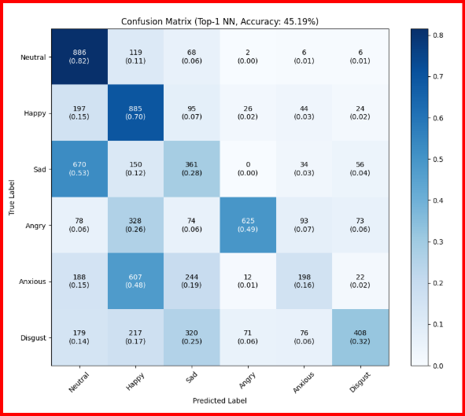
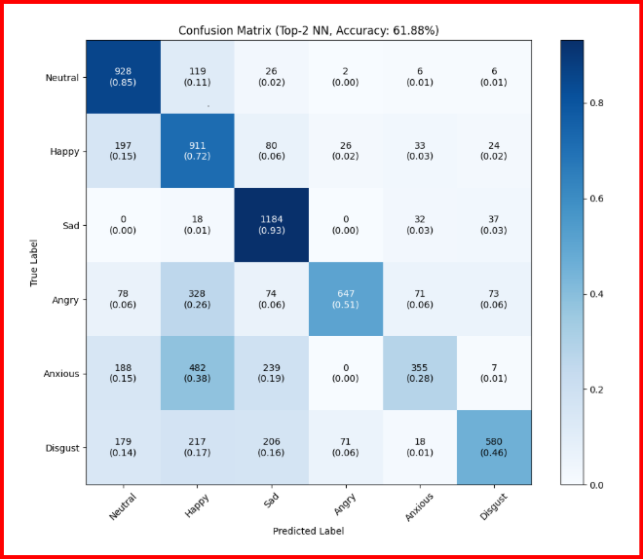
Results on CREMA-D (6 emotions) Dataset w/ Huber Loss

Slide 12
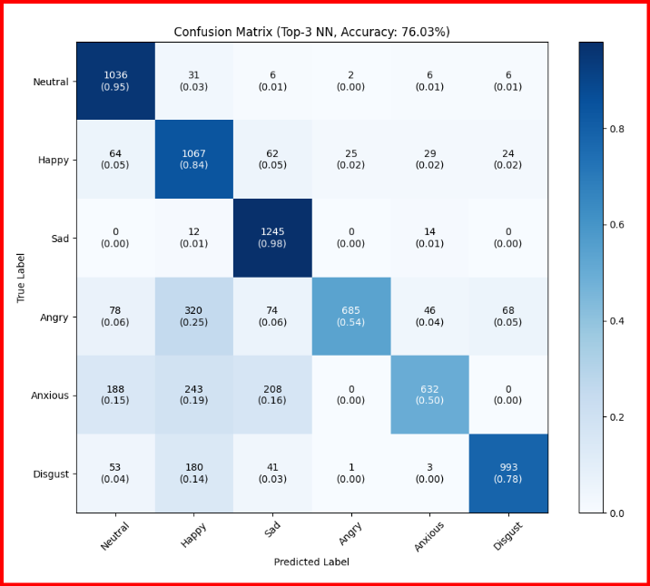
CREMA-D Dataset ( Top-3NN- Accuracy) with Huber Loss

Slide 13
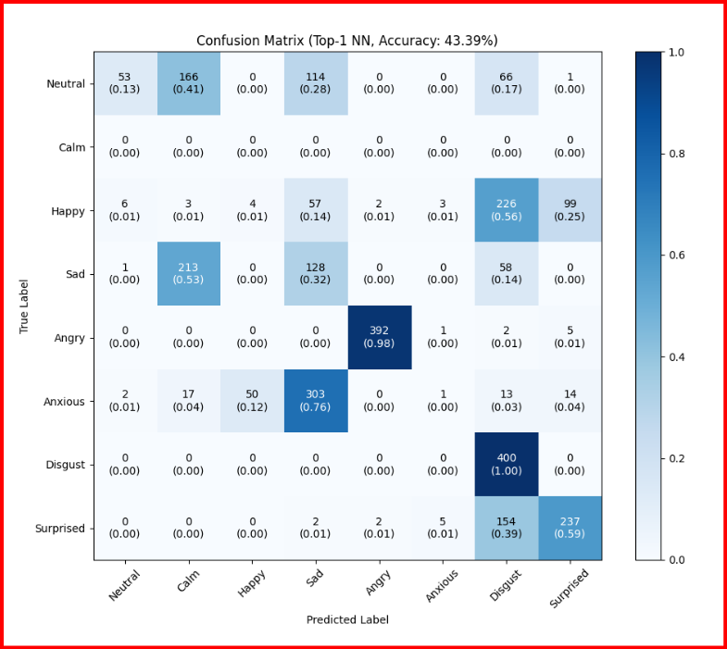
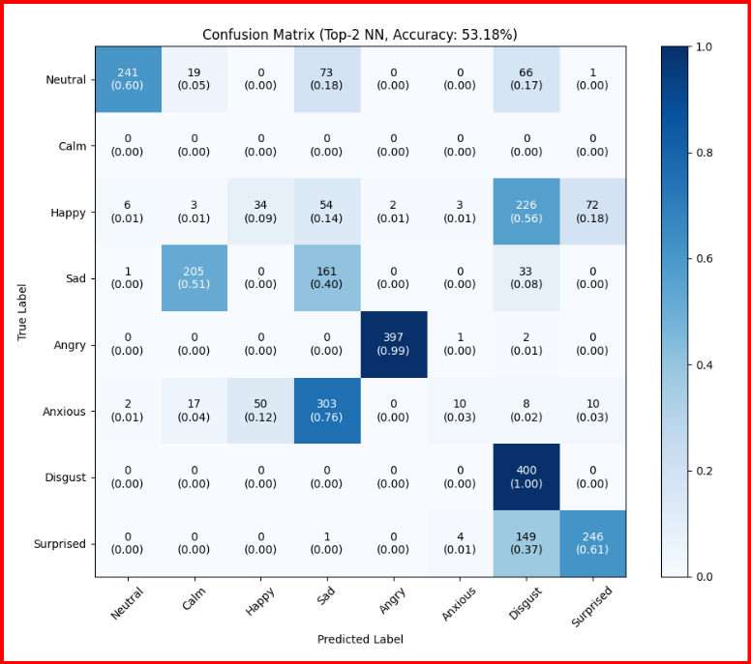
TESS Dataset (7 emotions) with Huber Loss

Slide 14
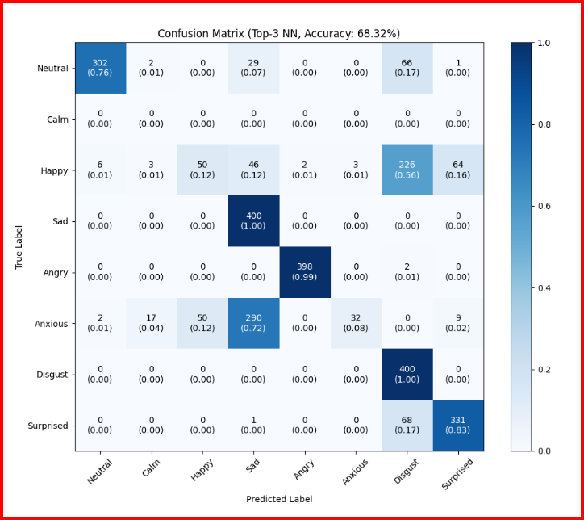
TESS Dataset ( Top-3NN- Accuracy) with Huber Loss

Slide 15
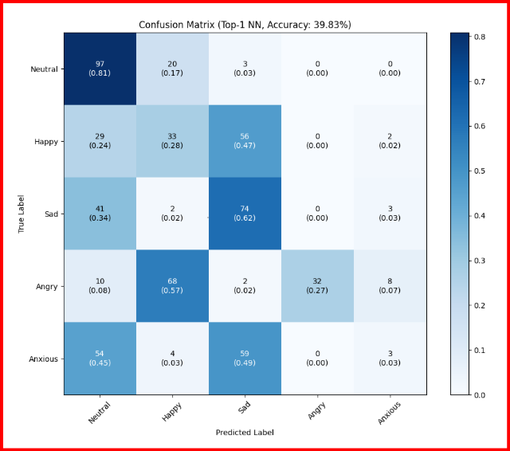
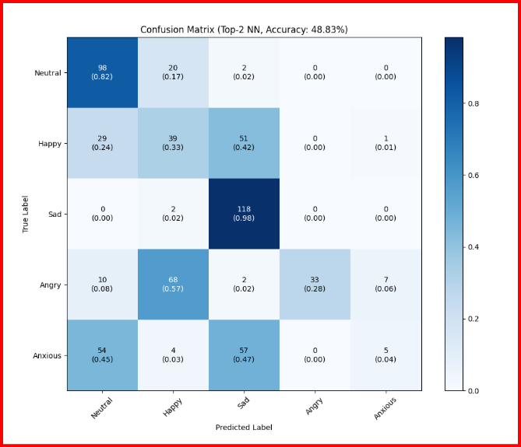
Results on IESC Dataset ( 5 emotions ) with Huber Loss Function

Slide 16
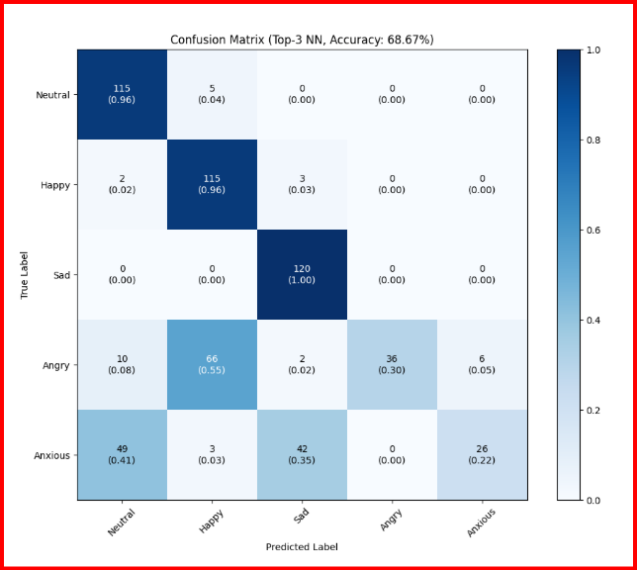
IESC Dataset ( Top-3NN- Accuracy) with Huber Loss Function

Slide 17
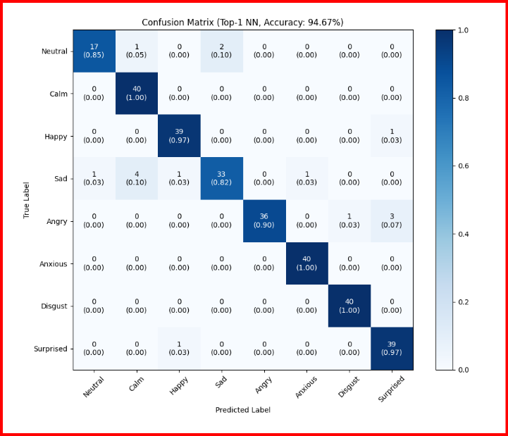
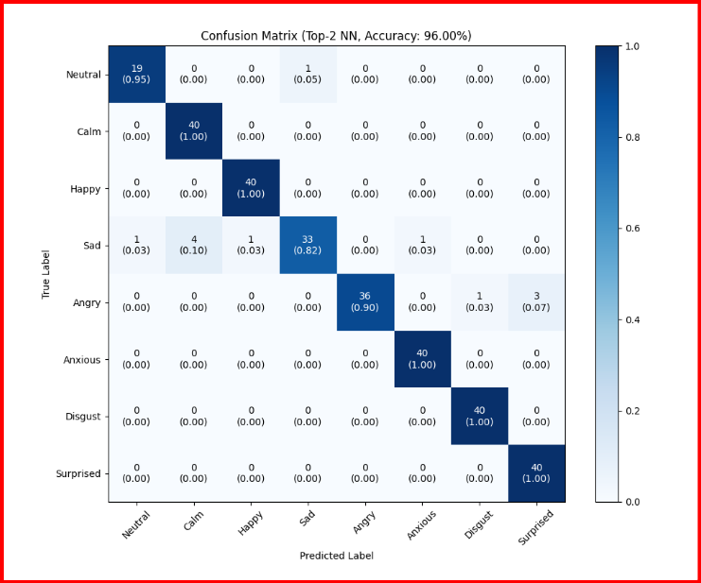
Accuracy Results on RAVDESS ( 8 emotions )

Slide 18
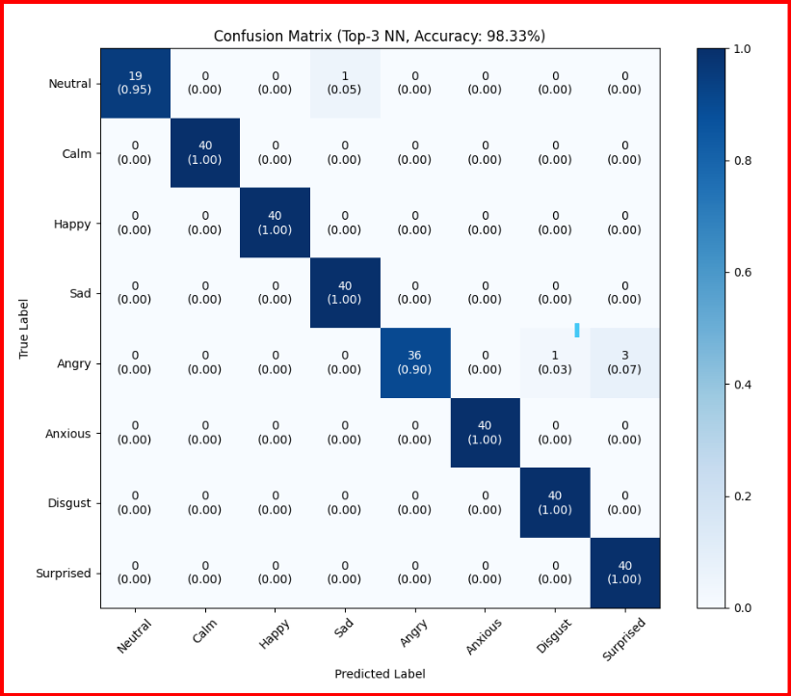
RAVDESS (Top-3NN-Accuracy)

Slide 19
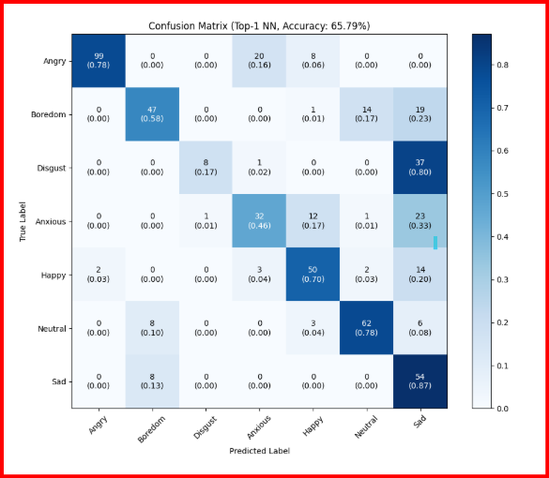
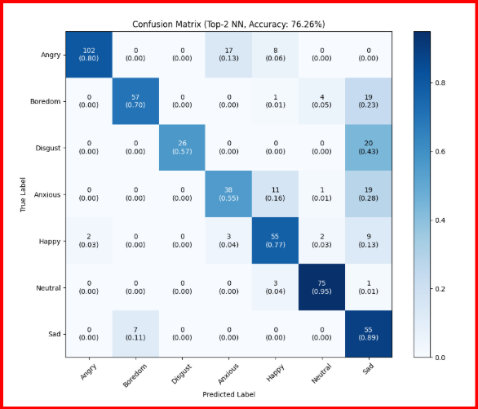
Results on EmoDB Dataset ( 7 emotions )

Slide 20
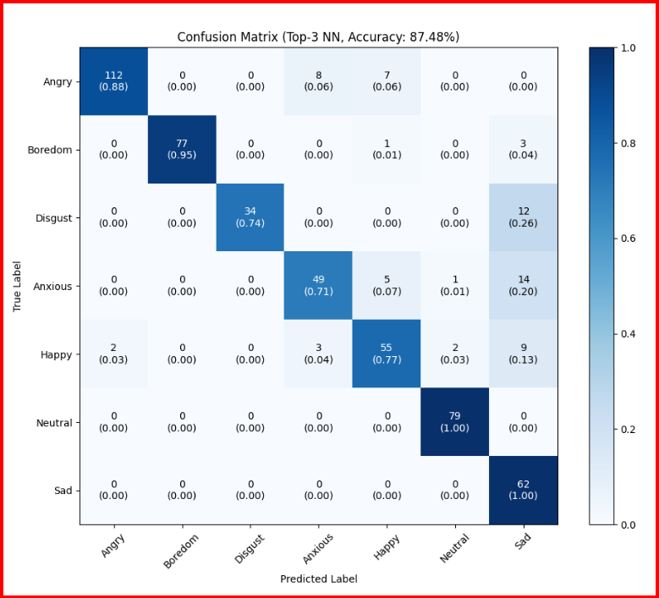
EmoDB (Top-3NN-Accuracy)

Slide 21
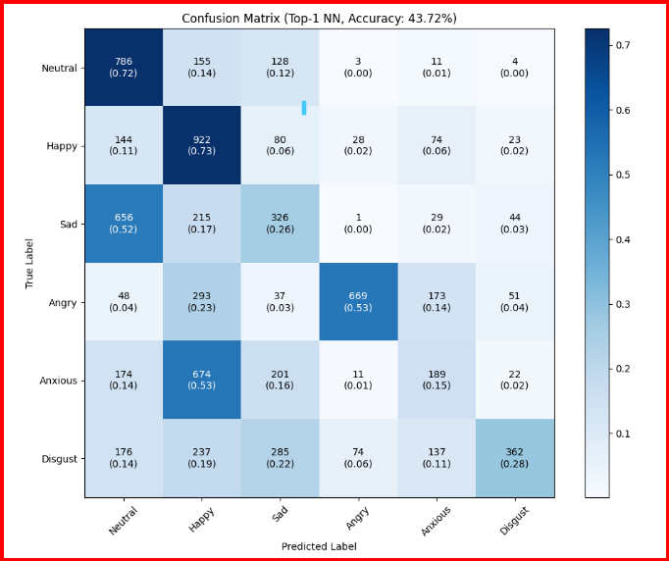
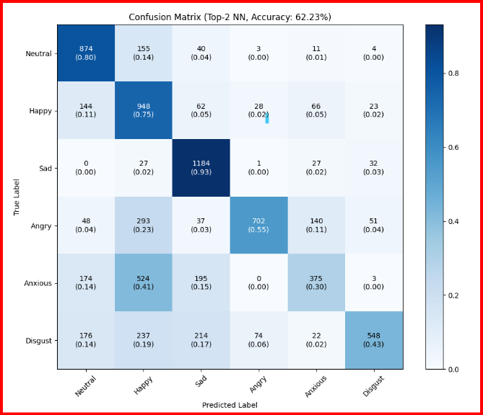
Results on CREMA-D Dataset ( 6 emotions )

Slide 22
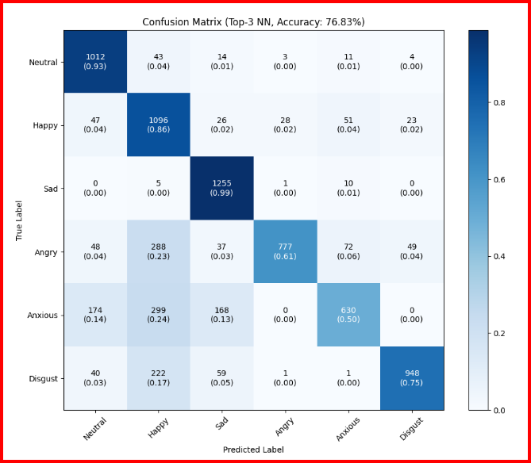
CREMA-D Dataset ( Top-3NN- Accuracy)

Slide 23
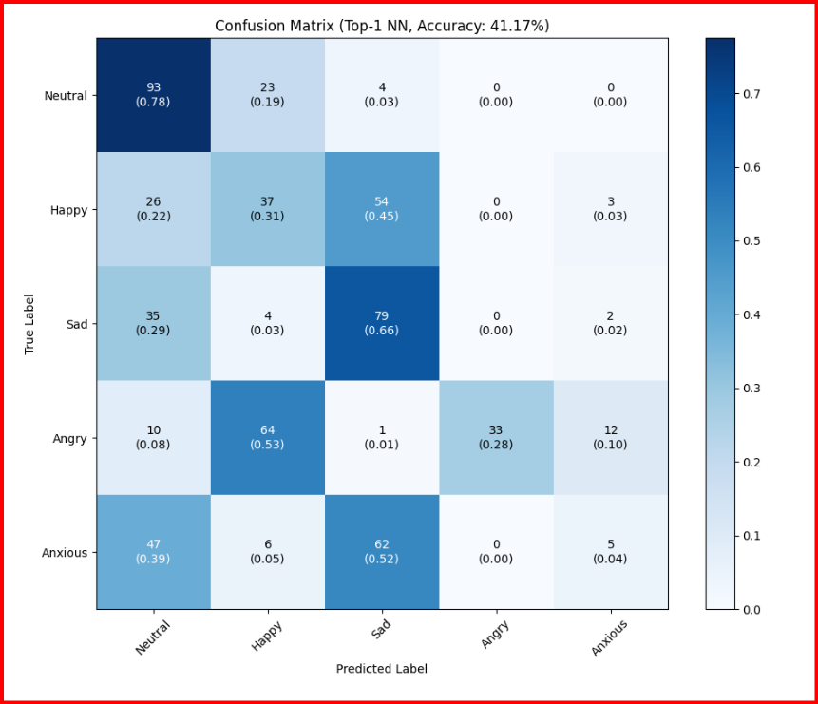
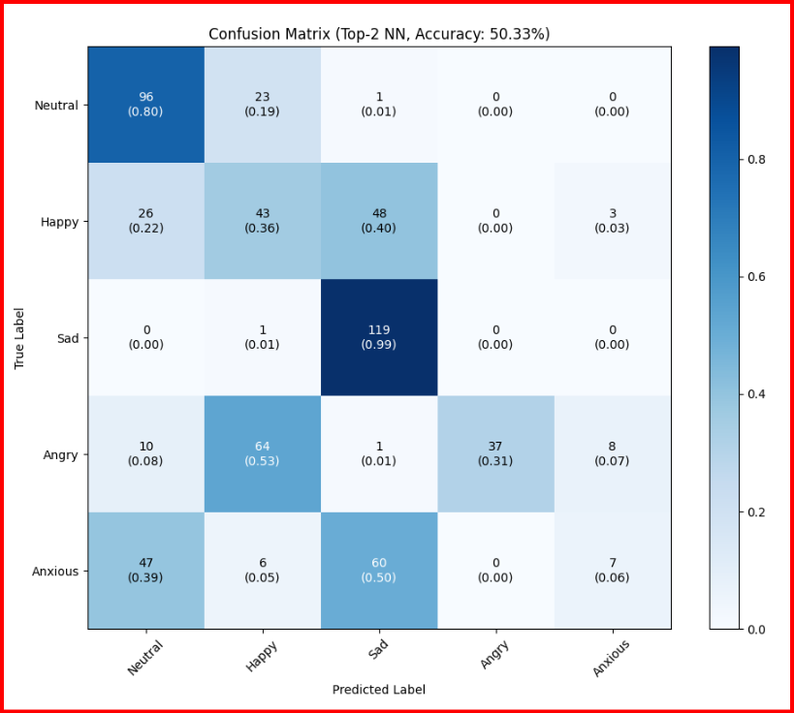
Results on IESC Dataset ( 5 emotions )

Slide 24
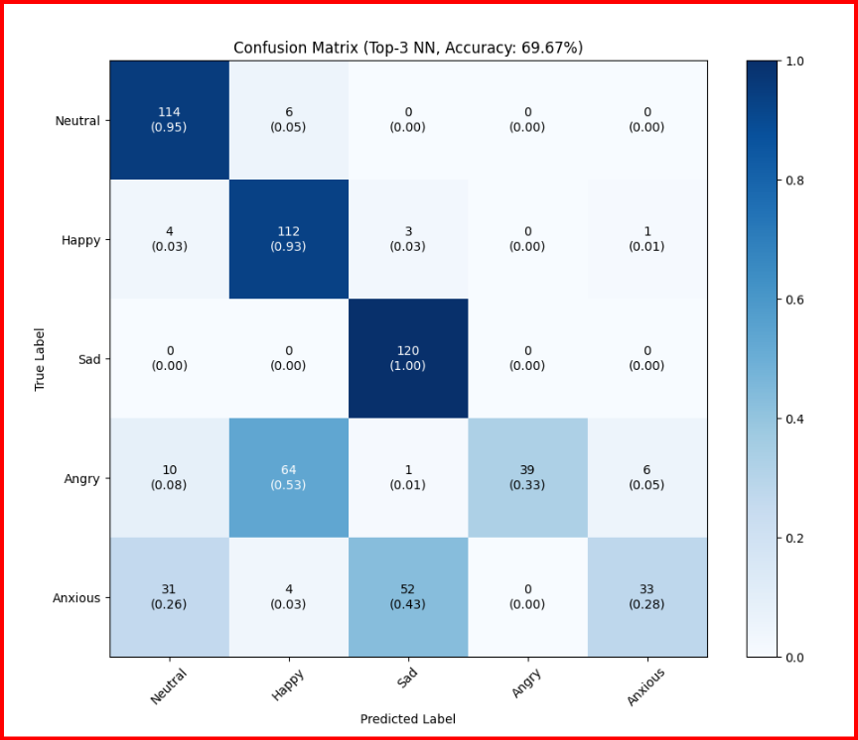
IESC Dataset ( Top-3NN- Accuracy)

Slide 25
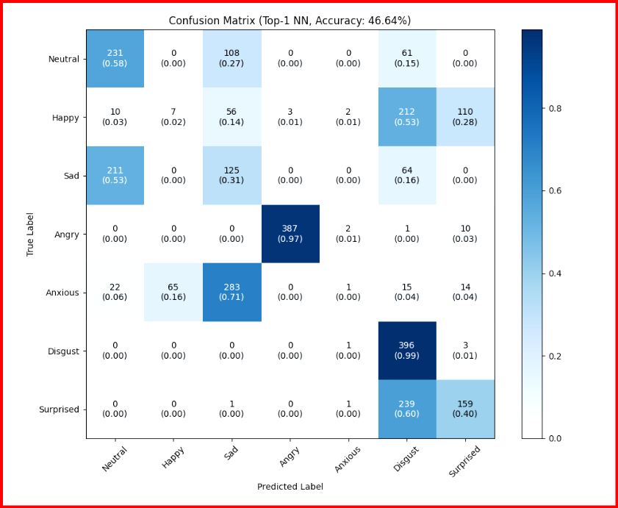
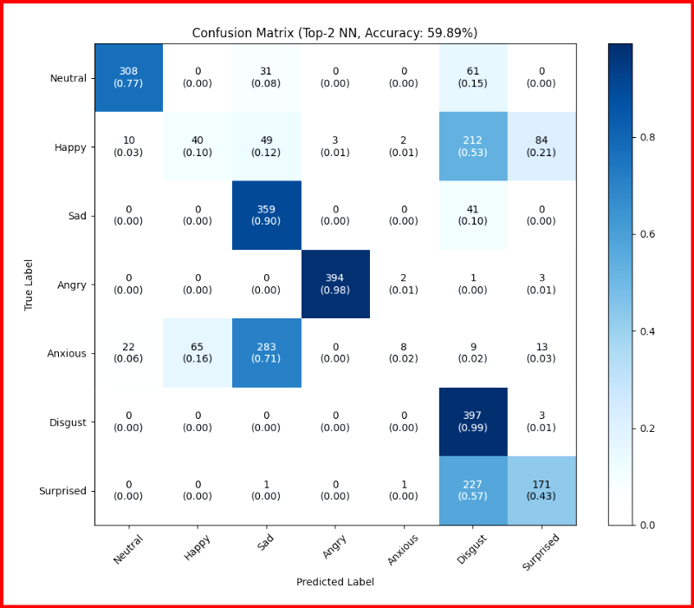
TESS Dataset (7 emotions)

Slide 26
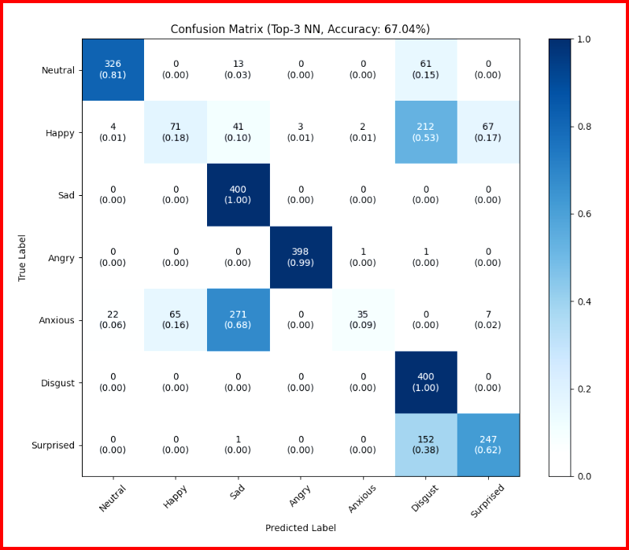
TESS Dataset ( Top-3NN- Accuracy)

Slide 27
Accuracy Results (o/p head predicting emotion)
Dataset | Accuracy (my) %
RAVDESS | 95.33
CREMA-D | 36.35
IESC | 31.83
TESS | 42.79
EMODB | 61.12

Slide 28
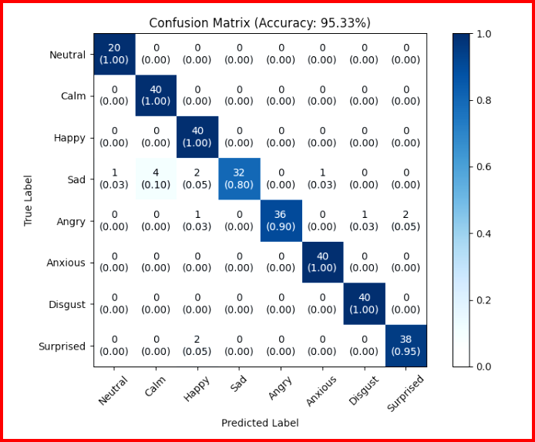
Accuracy on RAVDESS Dataset (95.33%)

Slide 29
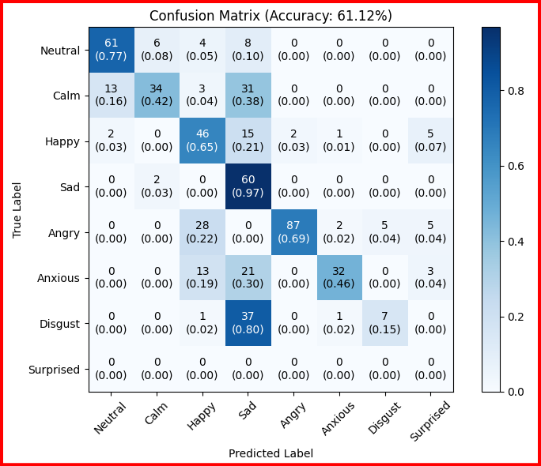
Accuracy on EmoDB Dataset (61.12%)

Slide 30
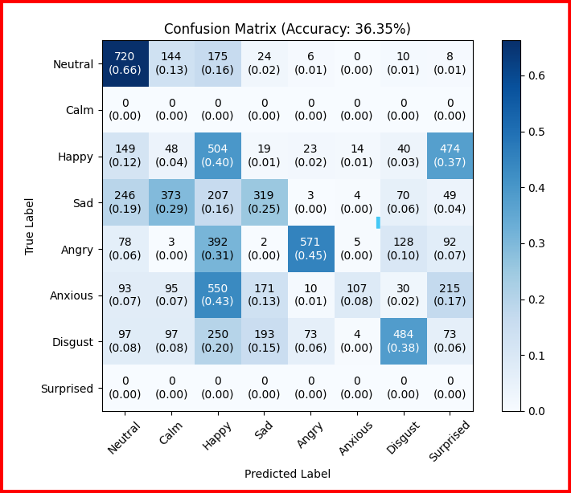
Accuracy on CREMA-D Dataset (36.35%)

Slide 31
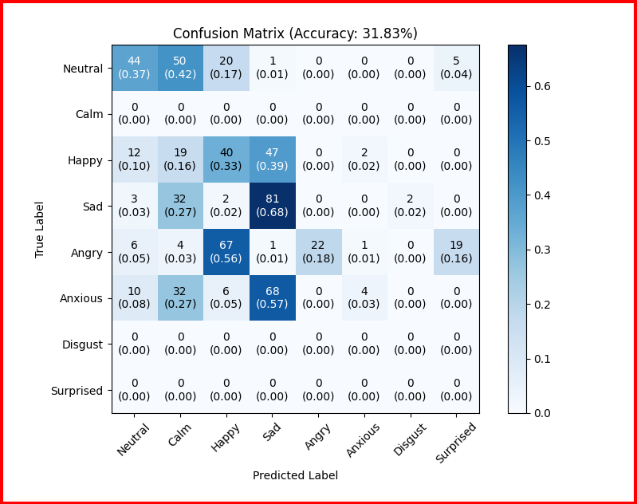
Accuracy on IESC Dataset (31.83%)

Slide 32
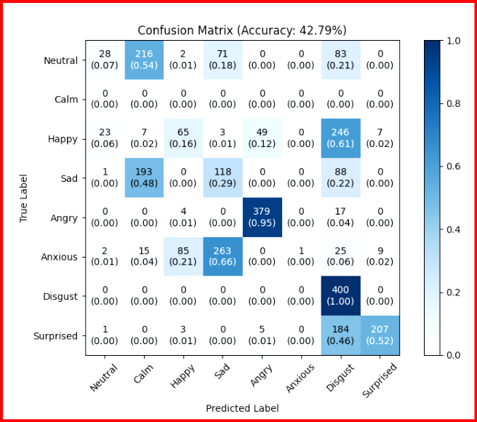
Accuracy on TESS Dataset (42.79%)

Slide 33
Thank You

