Slide 1

DepreechX
Towards Interactive Systems for Interpretable Depression Screening via Speech
27 March, 2025

Slide 2
Domain Driven CNN-based Model
Mel Spectrogram
CNN Layer
CNN Layer
Concatenate
CNN Layer
Pause Histogram
Logits
Mean pooling and FC layer

Slide 3
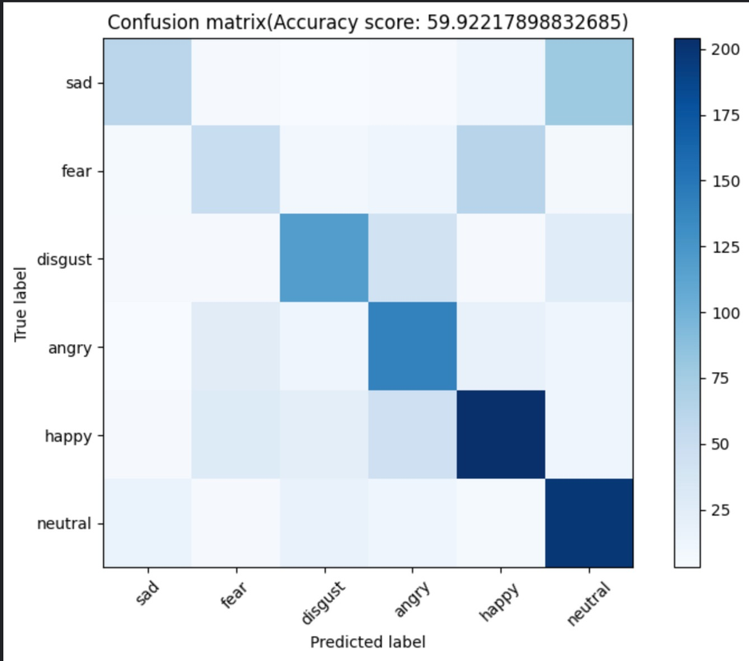
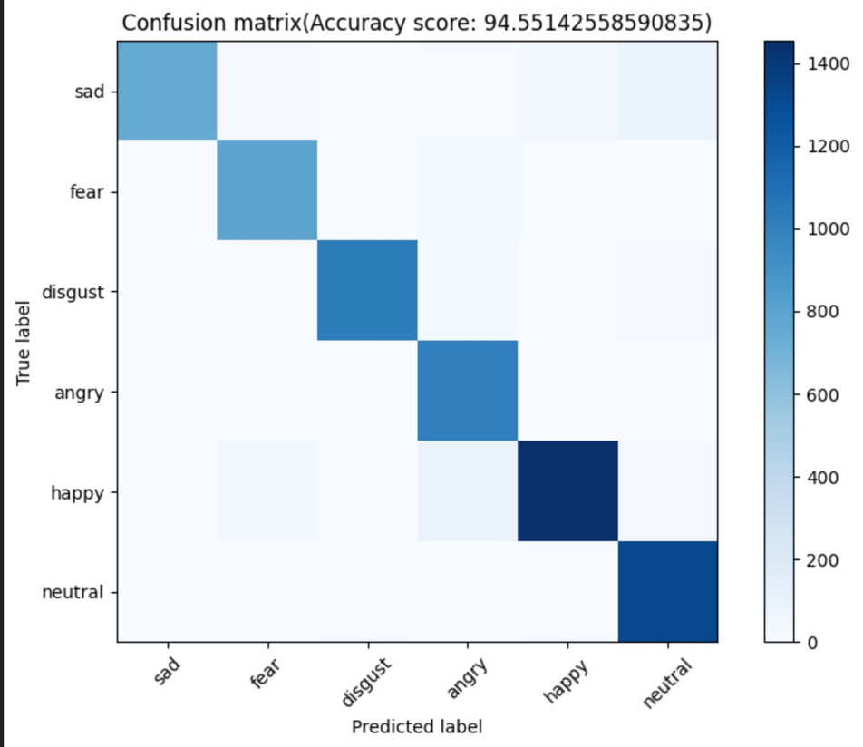
Results
Validation Set
Training Set

Slide 4
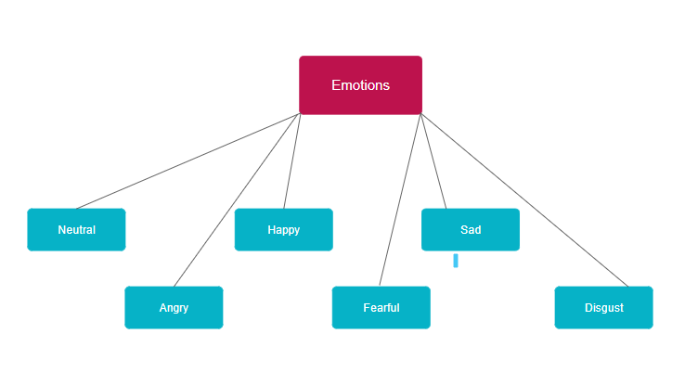
Data Collection Plan
Data collection from 50 users.
2 minutes of data recording per emotion per user.
Total 12 minutes of speech data per user.
Plan to have 10 hrs of total audio data.

Slide 5
Data Collection Plan
Demographic data collection factor
Gender ( 25 Boys + 25 Girls)
Regional (
One way → 10 Hindi + 10 English + 10 Gujrati + 10 Tamil + 10 other some language
Another way → 25 Hindi + 25 English )

Slide 6
Data Collection Plan
Script for different emotions will be given in advance to speak. (or)
Provide questions in advance and ask the speaker to simulate specific emotions in their responses.
Data augmentation by introducing environmental sounds, time stretching, and fundamental frequency.

Slide 7
Thank you

