Slide 1
A Mechanism for Screening Individuals Vulnerable to Depression using Speech
29-01-26

Slide 2
Improving speech depression detection using transfer learning with wav2vec 2.0 in low‑resource environments
Authors - Xu Zhang, Xiangcheng Zhang, Weisi Chen, Chenlong Li & Chengyuan Yu

Slide 3
Overview
To overcome shortage of samples, this paper introduces transfer learning approach by finetuning wav2vec 2.0 to obtain depression related feature.
To capture temporal relationship within an audio frame, 1D-CNN and attention pooling is integrated which helps in capturing the advanced feature at segment level.
For capturing temporal relationship among frames, we have integrated LSTM and integrated self-attention mechanism (for capturing dependencies among segments) to assign greater weights to segments associated with depression.

Slide 4
DAIC Dataset
Train set consist of 107 interviews -
30 depressed
70 non-depressed
Dev set consist of 35 interviews-
12 depressed
23 non-depressed
Test set consist of 47 interviews-
14 depressed
33 non-depressed

Slide 5
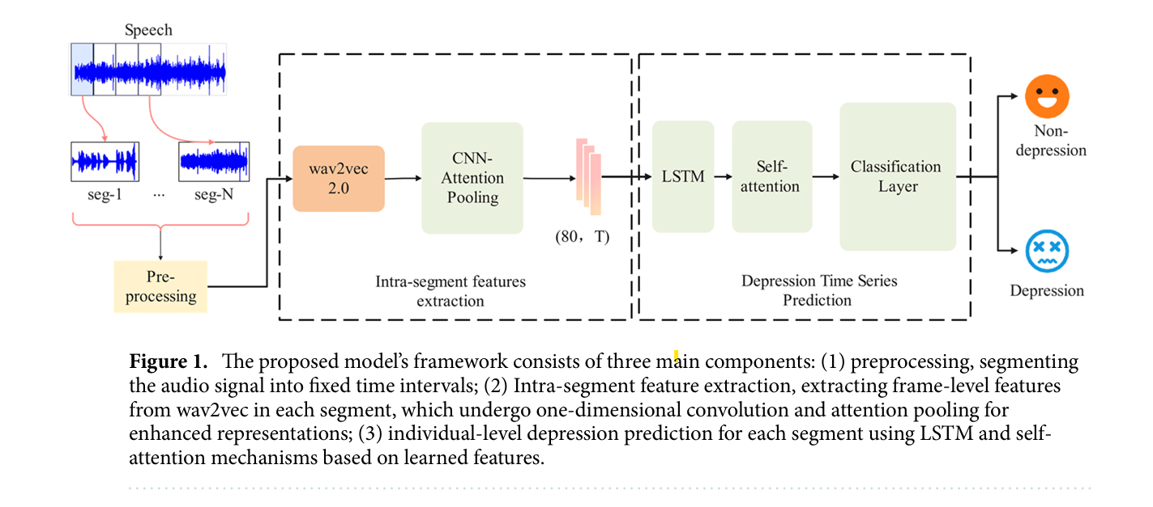
Methodology

Slide 6
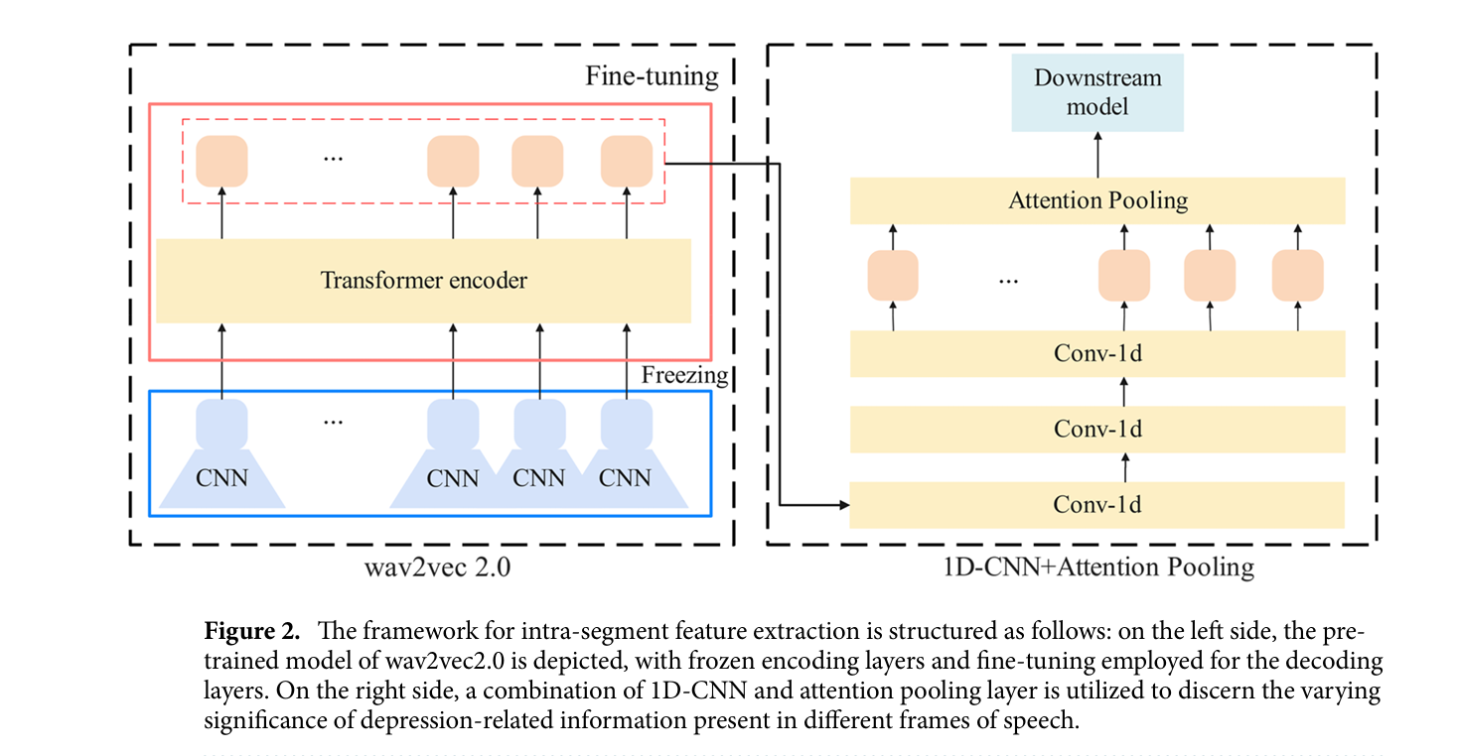
Methodology (continued)

Slide 7
Experimental Settings
For finetuning of the audio pre-training model, a small learning rate of 1e-5 is utilized.
Adam optimizer with a weight decay of 0.001 and a learning rate of 0.006 is used.
Batch size: 32
Training Epochs: 200

Slide 8
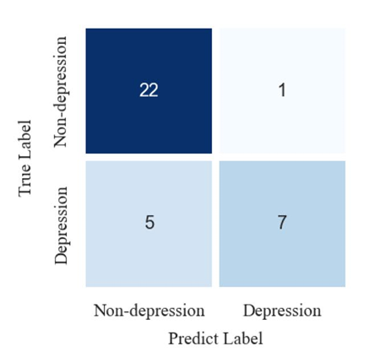
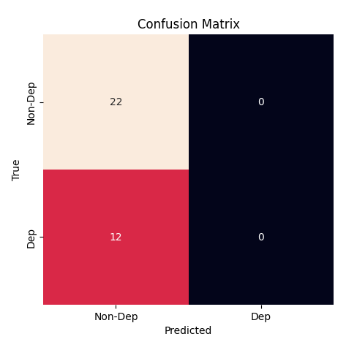
Results
F1(D): 0.70
F1(ND): 0.88
Macro F1: 0.79
F1(D): 0
F1(ND): 0.79
Macro F1 : 0.40

Slide 9
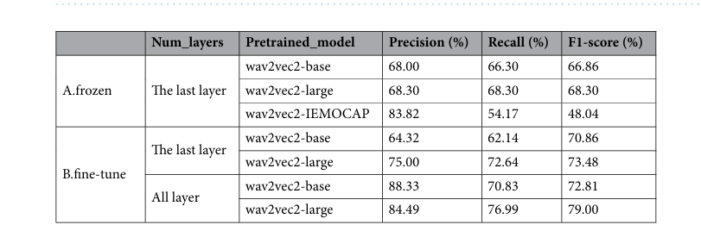
Ablation Analysis (Comparison of fine-tuning strategies)

Slide 10
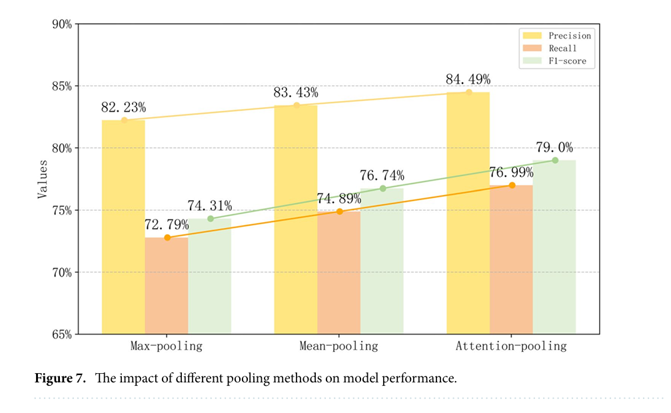
Ablation Analysis (Comparison with different pooling strategies)

Slide 11
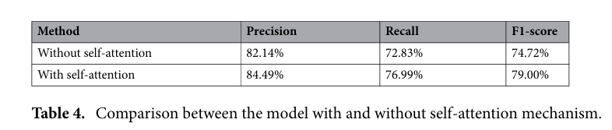
Ablation Analysis (Comparison with and w/o self attention mechanism)

Slide 12
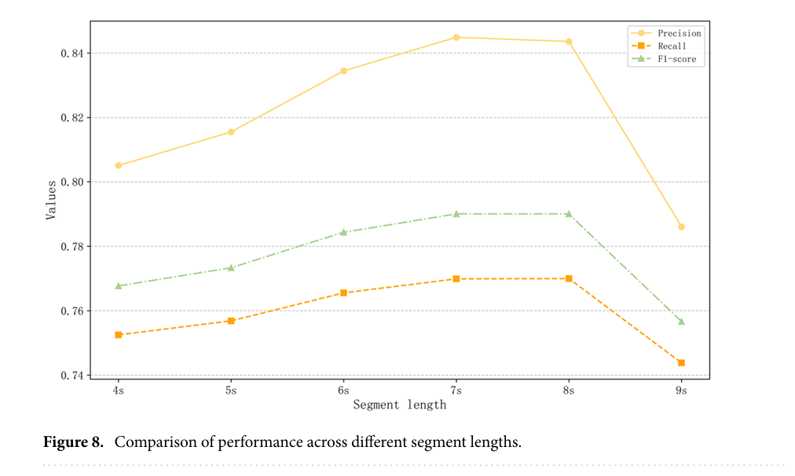
Ablation Analysis (Comparison of performance across different segment length)

Slide 13

Thanks

