Slide 1

DepreechX
Towards Interactive Systems for Interpretable Depression Screening via Speech
29 May, 2025

Slide 2
Results
RNN | LSTM | BiLSTM | GRU | BiGRU
1 layer Accuracy (30 epochs) Test Acc Train Acc | 48.65 52.20 | 64.06 76.22 | 83.09 99.95 | 83.97 99.97
3 layer Accuracy (30 epochs) Test Acc Train Acc | 48.65 48.65 | 48.03 49.96 | 87.04 99.98 | 88.54 99.81

Slide 3
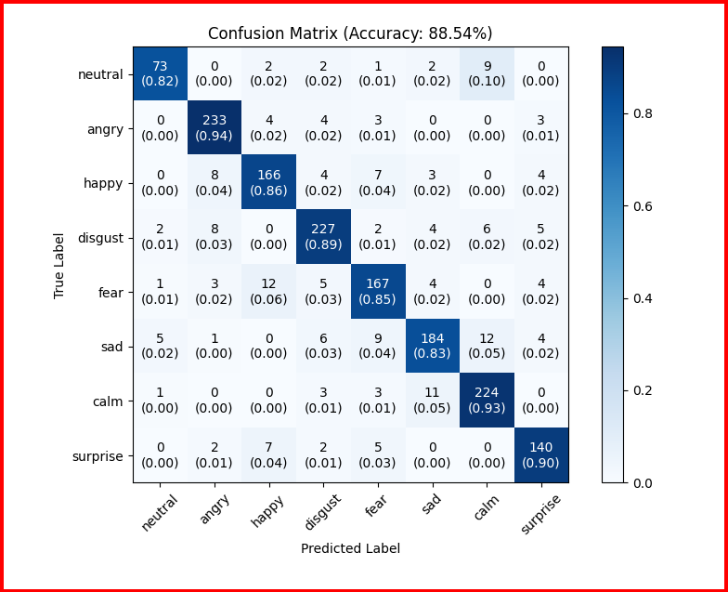
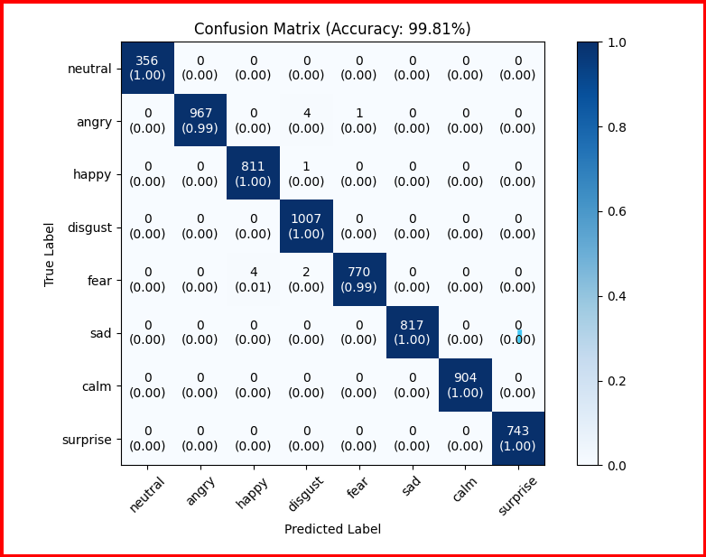
1DCNN + 3-layer-BiGRU model - Confusion Matrix
Validation Set
Training Set

Slide 4
Testing on own dataset
#10 participants
#10 audio samples from each participant
#11 sad audio samples
#4 happy audio samples
#85 neutral audio samples

Slide 5
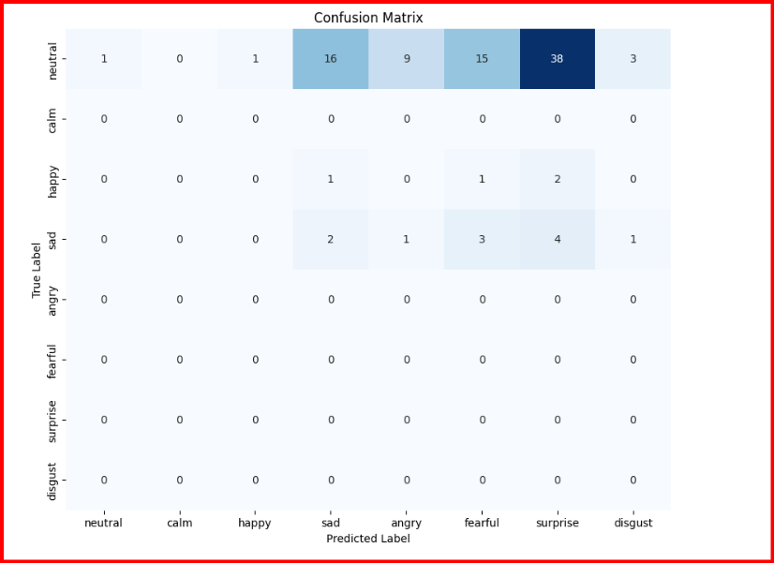
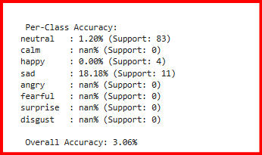
Result on own dataset
Accuracy per class

Slide 6
Testing on Indian Emotional Speech Carpora (IESC) dataset
#8 participants(5 males + 3 females)
#10 audio samples from 4 participants for each of the five emotions
#20 audio samples from 4 participants for each of the five emotions
#5 emotions are: angry, fear, happy, neutral, and sad
Total #600 samples

Slide 7
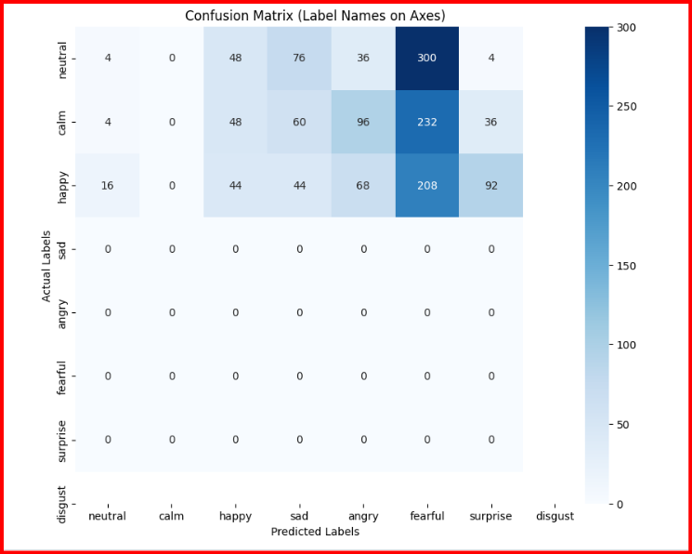
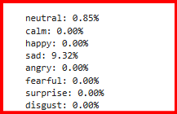
Result on IESC dataset
Accuracy per class

Slide 8
Thank you

