Slide 1
SOLVING TRANSPORTATION PROBLEMS USING THE BEST CANDIDATES METHOD
Shivansh Jagga, 13BCE0188 Operations Research, MEE437, E1 Slot

Slide 2
Introduction
The optimization processes in mathematics, computer science and economics are solving effectively by choosing the best element from set of available alternatives elements. The most important and successful applications in the optimization refers to transportation problem (TP), that is a special class of the linear programming (LP) in the operation research (OR).
In this study we use the best candidate method (BCM), in which the key idea is to minimize the combinations of the solution by choosing the best candidates to reach the optimal solution.
Comparatively, applying the BCM in the proposed method obtains the best initial feasible solution to a transportation problem and performs faster than the existing methods with a minimal computation time and less complexity

Slide 3
Problem Description
Most of the currently used methods for solving transportation problems are trying to reach the optimal solution, whereby, most of these methods are considerd complex and very expansive in term of the execution time.
In this study we use the best candidate method (BCM), in which the key idea is to minimize the combinations of the solution by choosing the best candidates to reach the optimal solution.

Slide 4
METHODOLOGY
Transportation model: In a transportation problem, we are focusing on the original points. These points may represent factories to produce items, and to supply a required quantity of the products to a certain number of destinations. This process must be done successfully in such a way as to maximize the profit or minimize the cost transportation.
Therefore, the places of production and supply are collected as the original points and the destinations respectively. Sometimes the original and destinations points are also termed as sources and sinks. However, to illustrate a typical transportation model, suppose that m factories supply certain items to n warehouses. As well as, let factory i (i = 1, 2, …, m) produces a_{i} units, and the warehouse j (j = 1, 2, …, n) requires b_{j} units.
Furthermore, suppose the cost of transportation from factory i to warehouse j is c_{ij}.

Slide 5
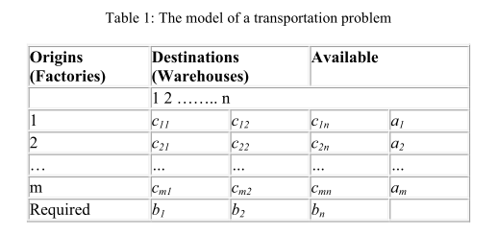
The decision variables x_{ij} is being the transported amount from the factory i to the warehouse j. Typically, our objective is to find the transportation pattern that will minimize the total of the transportation cost.
(see Table 1)

Slide 6
PSEUDO ALGORITHM
In this study, we proposed a new solving method for transportation problems by using BCM. The proposed method must operate the as following:
Step1: We must check the matrix balance, If the total supply is equal to the total demand, then the matrix is balanced and also apply
Step 2. If the total supply is not equal to the total demand, then we add a dummy row or column as needed to make supply is equal to the demand. So the transportation costs in this row or column will be assigned to zero.
Step3: Appling BCM to determine the best combination that is to produce the lowest total weight of the costs, where is one candidate for each row and column.
Step4: Identify the row with the smallest cost candidate from the choosen combination. Then allocate the demand and the supply as much as possible to the variable with the least unit cost in the selected row or column. Also, we should adjust the supply and demand by crossing out the row/column to be then assigned to zero. If the row or column is not assigned to zero, then we check the selected row if it has an elemnt with lowest cost comparing to the determined element in the chossen combination, then we elect it.
Step5:Elect the next least cost from the choosen combination and repeat Step 3 untill all columns and rows is exhusted.

Slide 7
Choosing best combination using BCM
Step1: Prepare the matrix. If the matrix unbalanced, we balance it and don't use the added row or column candidates in our solution procedure.
Step2: Election the best candidates, that is for minimization problems minimum cost and for maximize profit max cost: Elect the best two candidates in each row, if the candidate repeated more than two times elect it also. Check the columns that not have candidates and elect one candidate for them, if the candidate repeated more than one time elect it also
Step3: Find the combinations. Determine only one candidate for each row and column starting from the row that have least candidates and delete that row and column If there is situation that have no candidate for some rows or columns elect directly the best available candidate. Repeat step3 (1, 2) by determining the next candidate in the row that started from. Compute and compare the total sum of candidates for each combination to determine the best combination that give the optimal solution

Slide 8
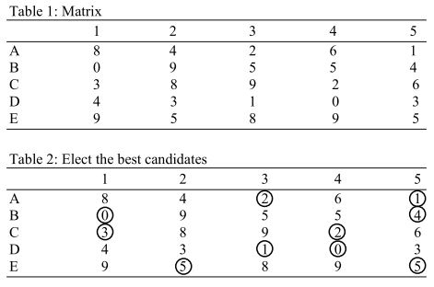
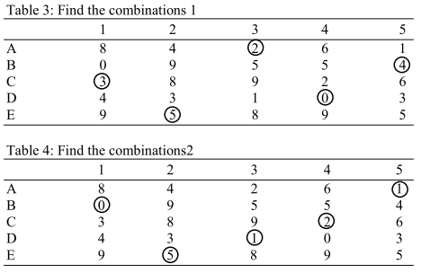

Consider the problem of assigning five jobs to five persons. The assignment costs are given as follows.
Example for BCM

Slide 9
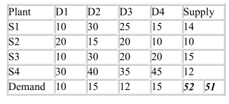
PROBLEM TO SOLVE
Finding the optimal cost for the problem of assigning five jobs to five persons.

Slide 10
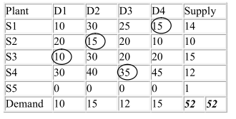
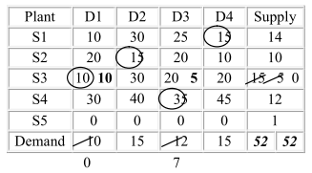
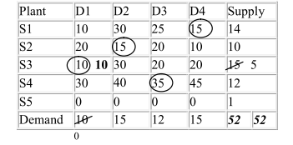
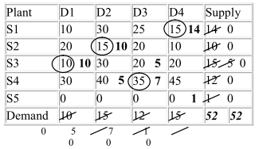
Step 1: Use BCM to get candidates
Step 3: Follow 3 of pseudo algo and repeat
Step 2: Choose smallest candidate first
Step 4: Do this till demand and supply =0
Step 5: Result that we get using proposed method

Slide 11
PROGRESS after review 2
Solved the problem stated using BCM and applied proposed method for transportation .
Implementing it on C++ using backtracking and dynamic programming
Checking the BIG-O complexity of the BCM on the gcc compiler which comes out to be O(n³)

Slide 12
RESULTS AND DISCUSSION
Actually, using BCM based on the best candidates election is to minimize the number of combinations solutions.
As we can obtain the combinations without any intersect means, such that; one candidate for each row and column. Eficentaly, BCM works to obain the optimal solution or the closest to optimal solution than other available methods. Since it has a better starting solution.

Slide 13
CONCLUSION
In this study, we have proposed a BCM for solving transportation problems, because of its wideapplicability in different area. Whereby, it refers to choose the best distrubtion of cost or time.
The BCM obtained the optimal solution or the closest to optimal solution with a minimum computation time.
As well as, using BCM will reduces the complexity with a simple and a clear solution manner which is can be easily used on different area for optimization problems.

Slide 14
REFERENCES
[1] Elaine L.Y. Man and Adam Baharum , 2011. A Qualitative Approach of Identifying Major Cost Influencing Factors in Palm Oil Mills and the Relations towards Production Cost of Crude Palm Oil. American Journal of Applied Sciences, 8: 441-446. DOI: 10.3844/ajassp.2011.441.446.
[2] Sudha, S.V. and K. Thanushkodi, 2012. A genetic based neuro fuzzy technique for process grain sized scheduling of parallel jobs. J. Comput. Sci., 8:48-54. DOI: 10.3844/jcssp.2012.48.54
[3] Amir, S., H.Z. Aashtiani and K.A. Mohammadian, 2009. A Shor-term Management strategy for Improving transit network efficiency. Am. J. Applied Sci., 6: 241-246. DOI: 10.3844/ajassp.2009.241.246.
[4] Zuhaimy Ismail , Diyana A. Mahad and Tan S. Ching , 2011. Modeling of Multi-Level Capacitated Lot-Size Scheduling Problem. American Journal of Applied Sciences, 8: 290-296. DOI: 10.3844/ajassp.2011.290.296.

Slide 15
Thank you
Shivansh Jagga
13BCE0188

