Slide 1
Design of Distributed Network with the integration of Diesel Generator and PV using MATLAB
SHIVANSH KUMAR JHA(12114138@nitkkr.ac.in)
ADITYA RAJ RANA(12114117@nitkkr.ac.in)

Slide 2
ABSTRACT
The integration of renewable energy sources into the existing power grid has become a crucial aspect of energy management. The increasing demand for electricity and the need for reducing carbon emissions have forced power companies to shift towards cleaner and more sustainable energy sources. In this regard, the integration of solar photovoltaic (PV) systems and diesel generators (DGs) in a distributed network has gained significant attention.
The design of a distributed network with the integration of a DG set and PV system is aimed at achieving an efficient, reliable, and cost-effective power system. The incorporation of a DG set in the system provides backup power supply during peak demand or when there is an outage in the grid. On the other hand, a PV system generates power from renewable energy sources, which reduces carbon emissions and dependence on fossil fuels.
The design process involves identifying the optimal location and capacity of the DG set and PV system at each node in the network. The capacity of the PV system and DG set is determined by considering the load demand, available roof area, and local weather conditions. The installation of a PV system on the rooftop of buildings enables the generation of power in a distributed manner, reducing the load on the grid.

Slide 3
ABSTRACT
The performance of the system is analyzed before and after the installation of the DG set and PV system. The analysis is carried out by measuring the power quality parameters such as voltage, current, and power flow. The results show that the integration of a DG set and PV system in a distributed network leads to improved power quality, reduced carbon emissions, and lower energy costs.
In conclusion, the integration of a DG set and PV system in a distributed network is a promising solution for achieving sustainable energy management. The design process involves careful consideration of the location and capacity of the DG set and PV system to ensure maximum efficiency and reliability. The analysis of the system performance before and after installation demonstrates the benefits of incorporating renewable energy sources into the power grid. The adoption of this approach by power companies can lead to a more sustainable and resilient energy system.

Slide 4
INTRODUCTION
The design of distributed networks involves the planning and optimization of power systems that generate and distribute electricity to consumers. These systems can incorporate various sources of power generation, such as conventional power plants, renewable energy sources like solar and wind, and energy storage devices.One of the key challenges in designing distributed networks is to ensure that the system operates efficiently and reliably while meeting the energy demands of consumers. This involves careful consideration of factors such as load balancing, voltage control, and power quality, power flow among others.
To address these challenges, various techniques and algorithms have been developed. One such approach is the backward forward sweep method, which is used to calculate the power flow in distribution networks. This technique is particularly useful for designing networks that incorporate multiple sources of power generation, such as diesel generators and photovoltaic (PV) systems.
By using the backward forward sweep method, engineers can optimize the design of distributed networks to improve their efficiency, reliability, and resilience. The integration of diesel generators and PV systems, for example, can provide a flexible and reliable power supply that can meet the demands of consumers even in challenging conditions.

Slide 5
METHODOLOGY AND MATERIALS USED
QUES: The electrical maintenance section of the NIT Kurukshetra is planning for to install a new power distribution system in the campus. The source of the power will be the UHBVN substation near the Kirmach Road. It is connected to the substation at NIT Kurukshetra. The location of the buses and impedance of the conductor is given as:

Slide 6
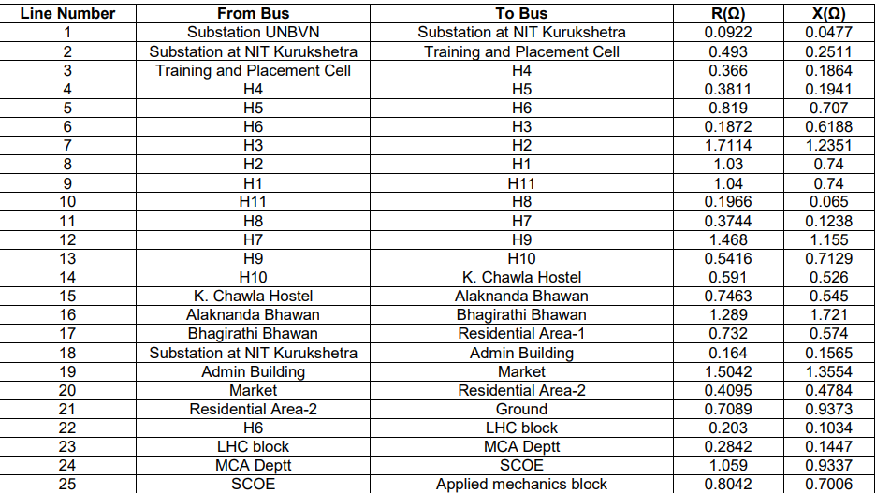

Slide 7
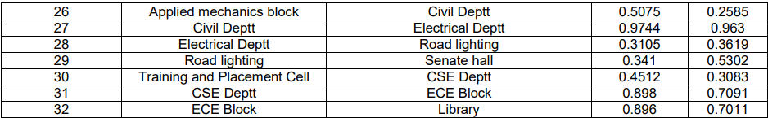
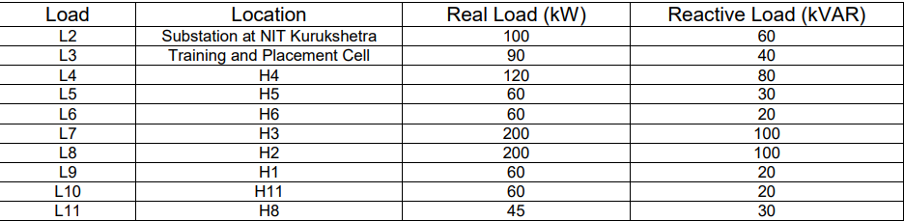
The load connected and their location is given as:

Slide 8
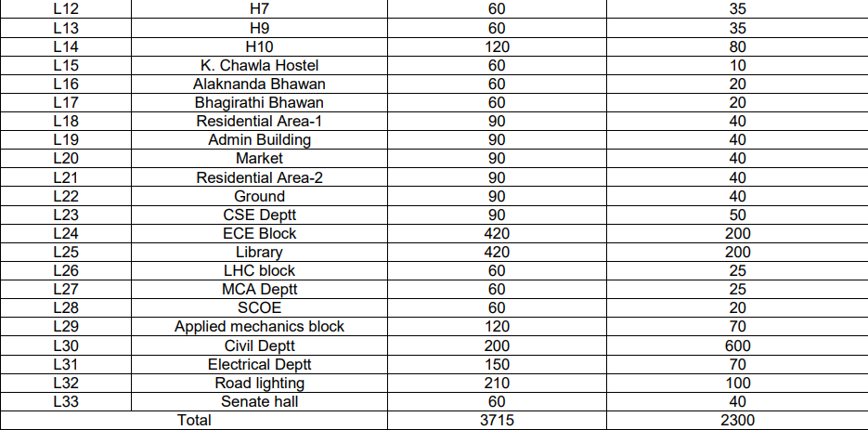

Slide 9
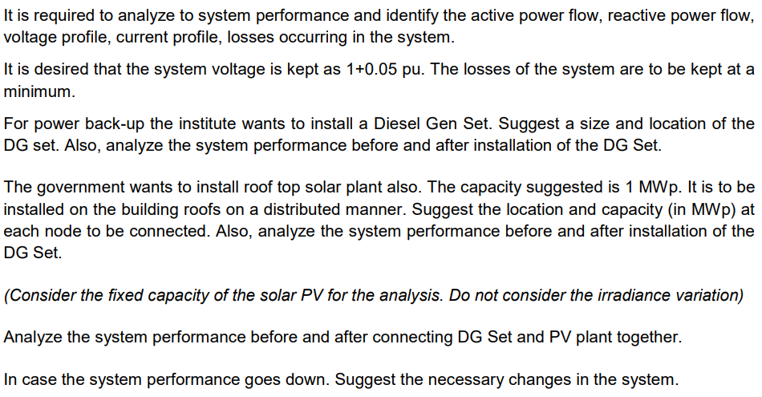

Slide 10
Load Flow Studies In Distribution System
Power systems are analysed by efficient algorithm and software.
Load flow analysis is pre-requisite for many planning and operational problems.
    Network reconfiguration: Loss reduction,load balancing,service restoration
    Volt-var control:Voltage profile improvement,Volt-Var Optimisation
    DG and capacitor placement:Loss reduction,Renewable Integration,reactive power management
    Regulator placement and control settings
These task should be completed without violating the system constraints.
Load flow studies is integral part of these studies.

Slide 11
Load Flow Studies In Distribution System
Standard algorithms like of Newton-Rhapson or Gauss-Siedel can be used for the solution of distribution systems.
However,it is better to use programs designed for radial systems for two main reasons.
    Programs designed for power systems normally assume a high X/R ratio.
    A program developed specifically for distribution systems will me more efficient and simpler than those developed for high-voltage systems.
Thus,it will lead to low memory requirement and has good accuracy.
Moreover,it is simple in implememtation and has good convergence speed.

Slide 12
Backward/Forward Sweep Power Flow
The Backward/Forward Sweep Power Flow(BFS) method is an iterative algorithm used to solve power flow problems in power systems.
It is particularly useful for radial networks,where power flows in one direction from the substation to the load ,and there are no closed loops.
The BFS method solve the power flow problem by breaking the system down into individual nodes and branches.
It then applies a series of calculations to determine the voltage and power at each node.

Slide 13
Backward/Forward Sweep Power Flow
The method operates in two steps :
  The forward sweep calculates the voltages at each node starting from the substation and moving towards the loads. At each node , the method calculates the current and power flowing through that node based on the voltages and loads connected to it .
  The backward sweep calculates the voltages drop along each branch starting from the loads and moving towards the substation . At each branch , the method calculates the current and power flowing through that branch based on the voltage and loads connected to it.
The BFS method is an efficient way to solve radial networks as it only requires one iteration to converge to a solution. It also has the advantage of being relatively easy to implement in software, making it a popular method for power flow analysis in power system simulation software.

Slide 14
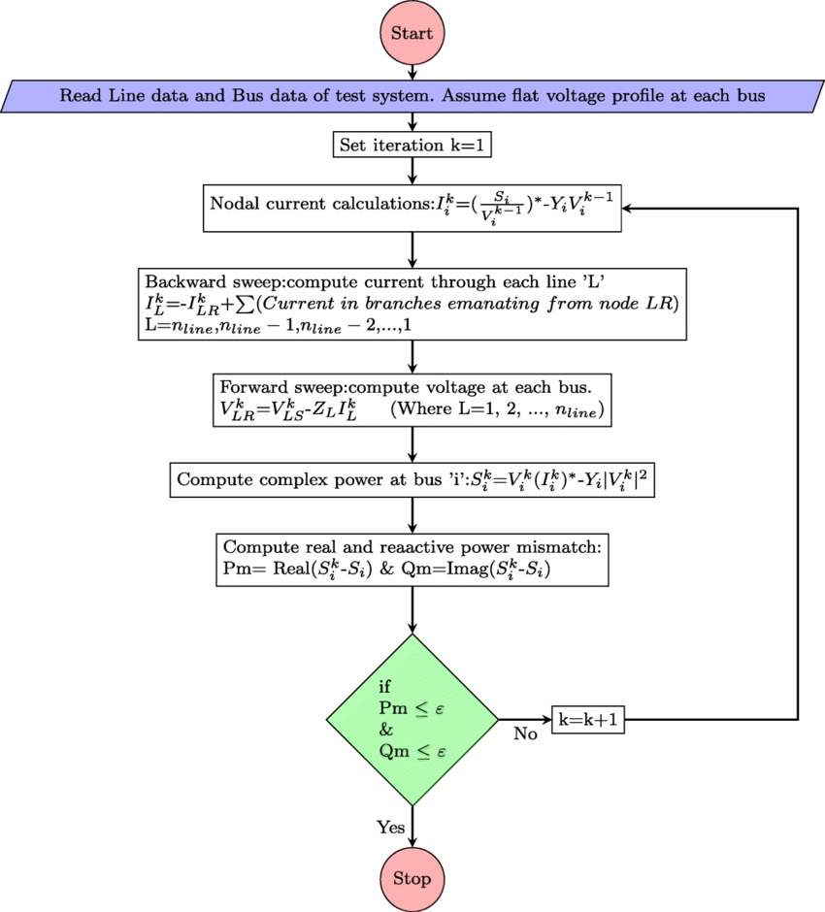

Slide 15

BUS AND LINE DETAILS
BUS DETAILS
LINE DETAILS

Slide 16
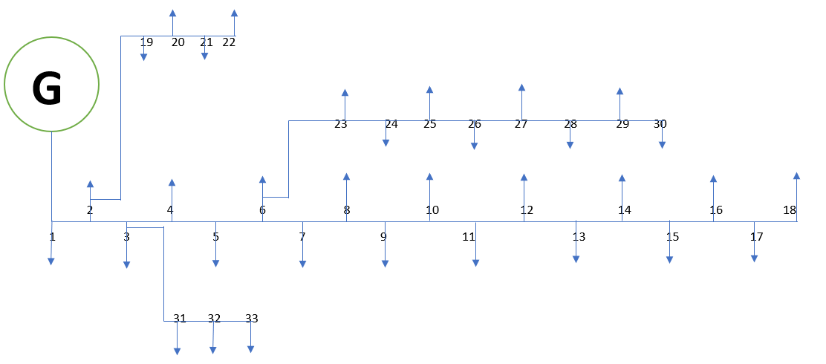
SINGLE LINE DIAGRAM

Slide 17
Voltage Profile Data Current Profile Data Power Profile

Slide 18
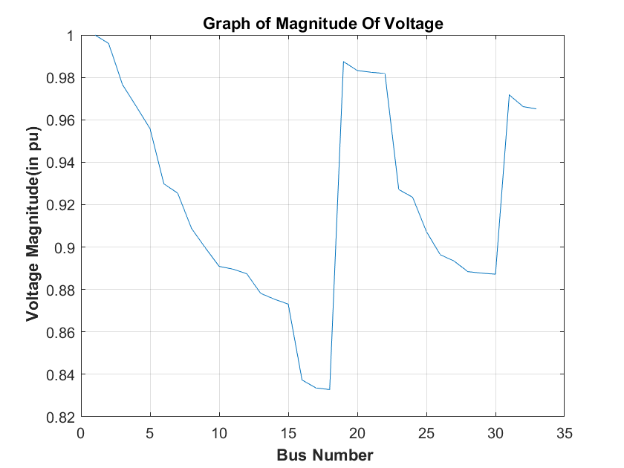
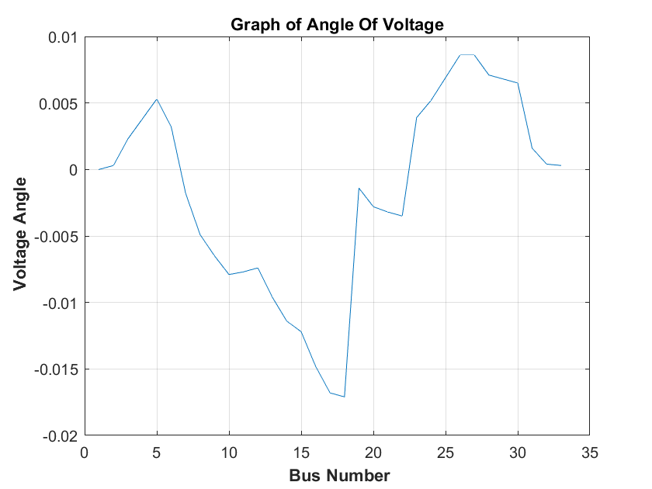
Voltage Magnitude Voltage Angle

Slide 19
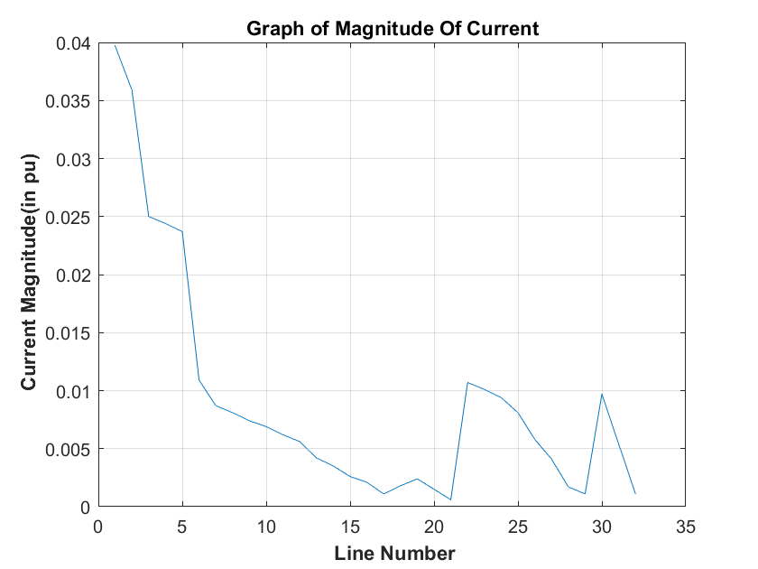
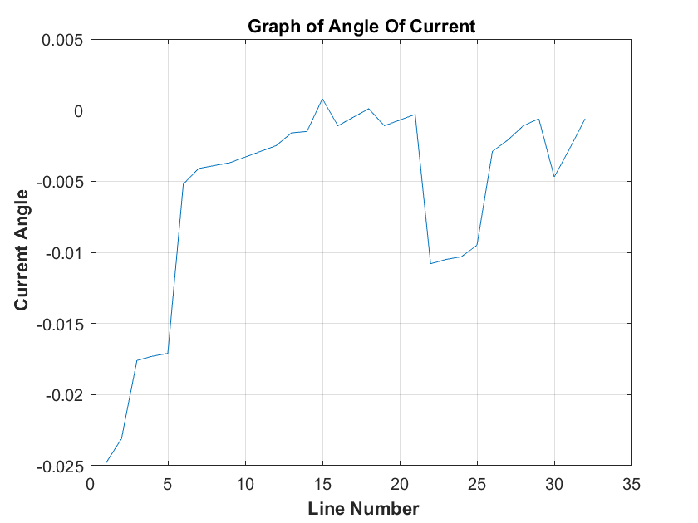
Current Magnitude Current Angle

Slide 20
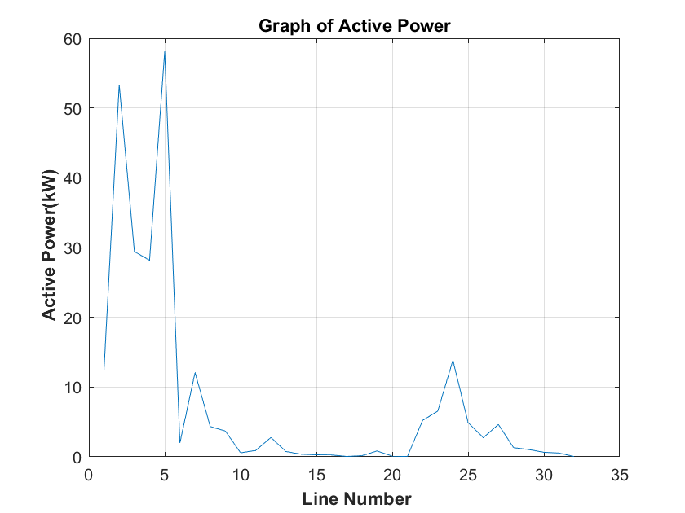
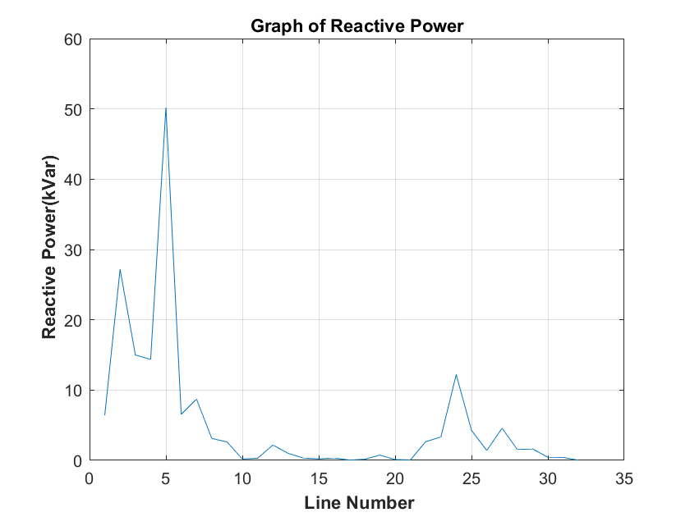
Active Power Reactive Power

Slide 21
Analysis of System Performance
From the obtained Voltage Profile,Current Profile and Power Profile,we can determined the total losses in the system.
Total Active Power Loss=252.04 kW
Total Reactive Power Loss=172.410 kVar

Slide 22
LOAD FLOW ANALYSIS(WITH DIESEL GENERATOR)
The installation of a DG set can lead to several changes in the system parameters, such as:
1. Voltage profile: The voltage profile of the system may improve after the installation of a DG set. This is because the DG set can provide reactive power support, which helps to maintain voltage levels within the acceptable limits.
2. Power factor: The power factor of the system may improve after the installation of a DG set. This is because the DG set can provide reactive power support, which helps to reduce the reactive power demand from the grid.

Slide 23
LOAD FLOW ANALYSIS(WITH DIESEL GENERATOR)
3. Frequency: The frequency of the system may improve after the installation of a DG set. This is because the DG set can provide additional power to the system, which helps to balance the supply and demand and maintain the frequency within the acceptable limits.
4.Power quality: The power quality of the system may improve after the installation of a DG set. This is because the DG set can provide clean and stable power to the system, which can help to reduce the levels of harmonic distortion and other power quality issues.
Overall, the installation of a DG set can have a positive impact on the system parameters and help to improve the overall reliability and stability of the power distribution system.

Slide 24
SYSTEM PERFORMANCE AFTER INSTALLING THE DG
The optimal location of the diesel generator to be installed is at the Bus No. 6 (H6) having the size of 2 MW
This will leads to the improvement of the pu voltage drop across each line.
Also after installing the Diesel Generator, Power Profile of the system improves hence the losses also decreases thus leading to more stability.

Slide 25
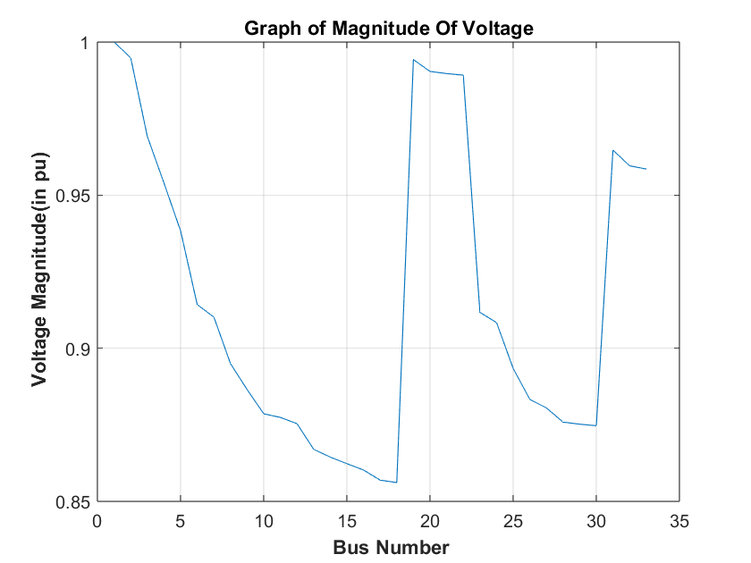
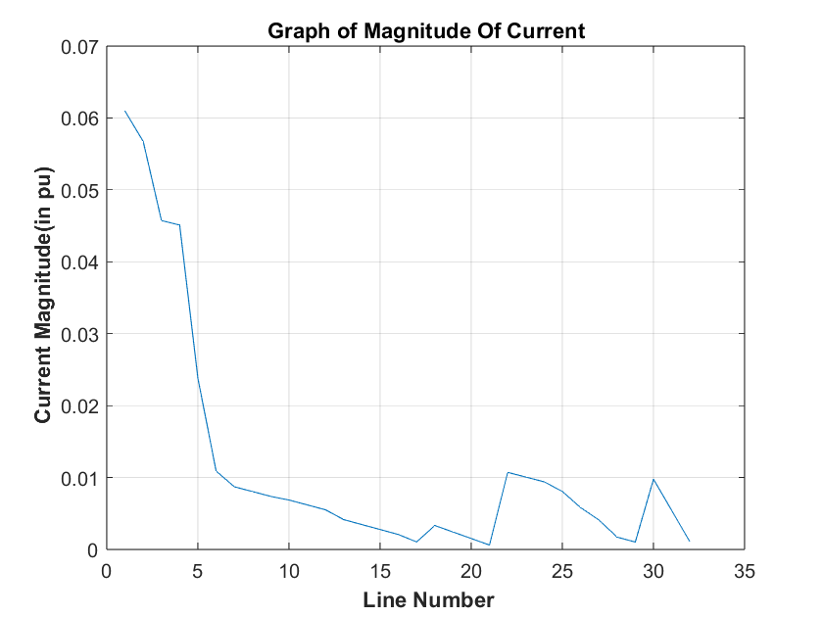
Voltage And Current Profile
Voltage Profile Current Profile

Slide 26
Power Profile
From the obtained Voltage Profile,Current Profile and Power Profile,we can determined the total losses in the system.
Power Profile
Total Active Power Loss=114.959 kW
Total Reactive Power Loss=83.662 kVar

Slide 27
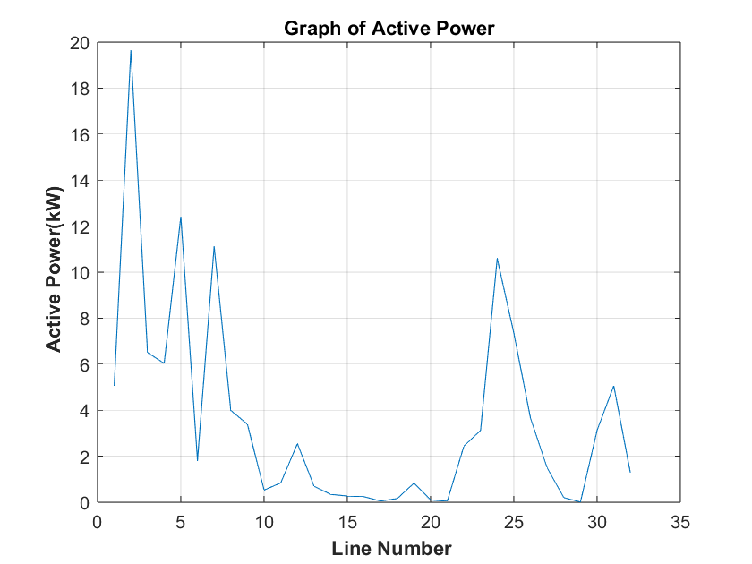
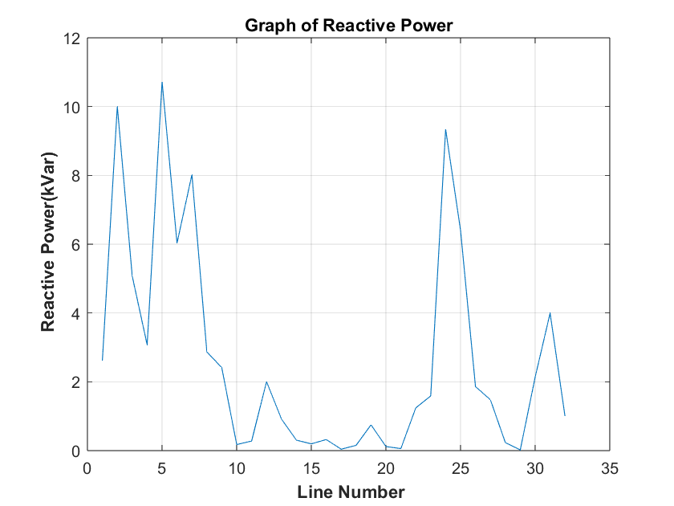
Active Power Flow Reactive Power Flow

Slide 28
LOAD FLOW ANALYSIS(WITH SOLAR PLANT)
After the installation of PV cells in a distributed network, the system parameters can change in the following ways:
1. Reduced Dependency on Grid: The distributed network with integrated PV cells can generate electricity locally, reducing the dependency on the grid. This can result in a reduction in the amount of electricity purchased from the grid, leading to cost savings.
2. Reduction in Emissions: The use of PV cells can significantly reduce the emissions associated with conventional power generation, which can lead to improvements in air quality and a reduction in greenhouse gas emissions.

Slide 29
LOAD FLOW ANALYSIS(WITH SOLAR PLANT)
3. Increased Efficiency: The integration of PV cells can also increase the overall efficiency of the distributed network. PV cells can generate electricity during the day, which can be used to power loads directly, or to charge batteries for use during times when the sun is not shining. This can reduce the need for diesel generators and increase the overall efficiency of the system.
4. Improved Reliability: The use of PV cells can also increase the reliability of the distributed network. Since PV cells can generate electricity locally, the system can continue to operate even during grid outages or other disruptions. This can help to improve the overall reliability of the system and reduce downtime.

Slide 30
SYSTEM PERFORMANCE AFTER INSTALLING THE SOLAR PLANT
We have installed the Solar Plants having total capacity be 1 MW and have installed at location.
    BUS 6(H6) Capacity : 1MW
This will leads to the improvement of the pu voltage drop across each line.
Also after installing the Solar Plant at different bus, Power Profile of the system improves hence the losses also decreases thus leading to more stability.

Slide 31
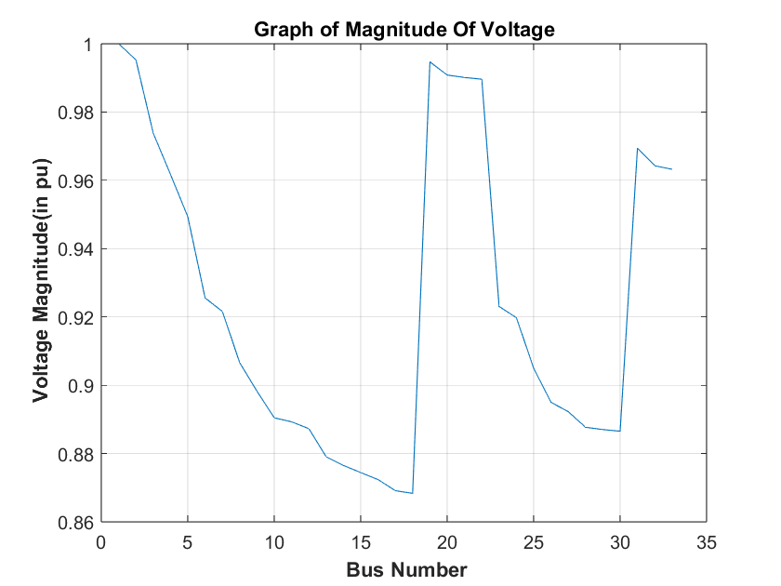
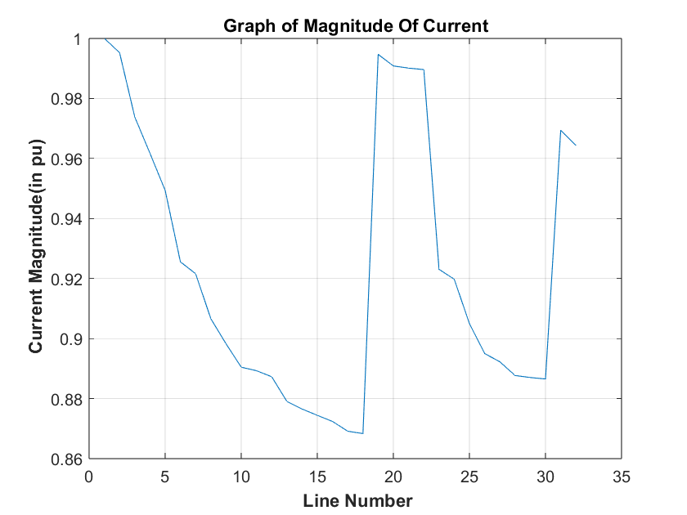
Voltage And Current Profile
Voltage Profile Current Profile

Slide 32
Power Profile
From the obtained Voltage Profile,Current Profile and Power Profile,we can determined the total losses in the system.
Power Profile
Total Active Power Loss=135.163 kW
Total Reactive Power Loss=96.679 kVar

Slide 33
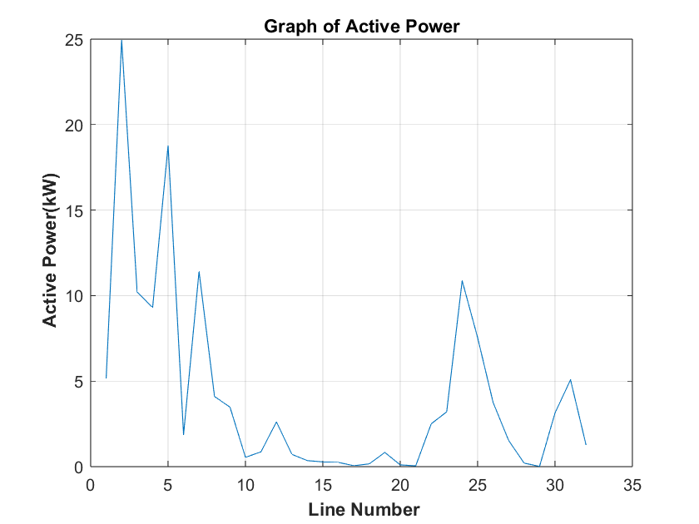
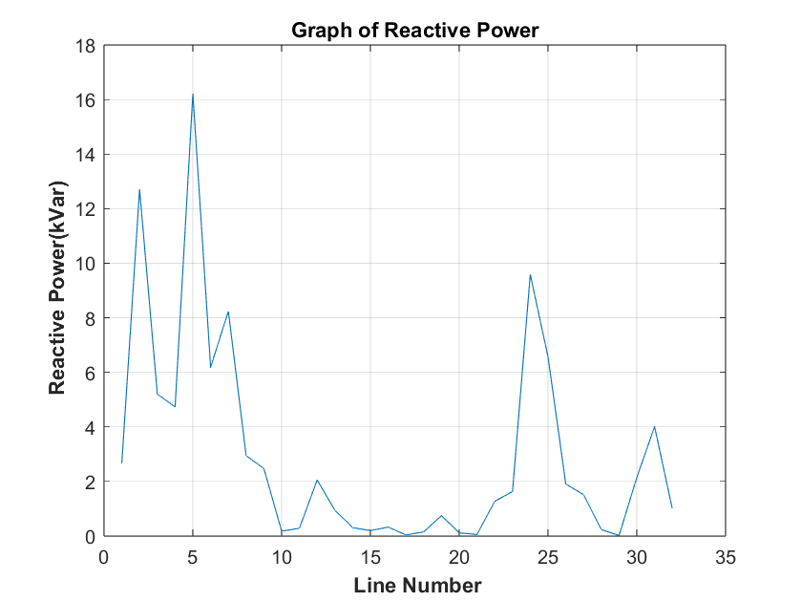
Active Power Flow Reactive Power Flow

Slide 34
LOAD FLOW ANALYSIS(WITH SOLAR PLANT AND DIESEL GENERATOR)
The integration of PV cells and a diesel generator in a distributed network can have significant impacts on the system parameters. Here are four points on how these changes occur:
1. With the installation of PV cells, the system's reliance on the grid reduces, leading to a decrease in the total energy consumption from the grid.
2. The addition of a diesel generator provides a backup source of energy in case of a grid failure, ensuring continuity of power supply.
3. Integration of PV cells and diesel generators result in a reduction of carbon footprint and a decrease in greenhouse gas emissions, contributing to environmental sustainability.
4. The implementation of a distributed network with a combination of renewable and non-renewable energy sources results in better energy management and greater control over the system.

Slide 35
SYSTEM PERFORMANCE AFTER INSTALLING THE SOLAR PLANT AND DG
We have installed the Solar Plants having total capacity be 2 MW and Diesel Generator having total capacity be 2 MW have installed at three locations.
  Bus 2( Substation at NIT Kurukshetra ) 0.5MW(SOLAR)
  Bus 3( Training and Placement Cell ) 0.5MW(SOLAR)
  Bus 6( H6 ) 2MW(2MW-DG)
This will leads to the further improvement of the pu voltage drop across each line.
Also after installing the Diesel Generator and Solar Plants simultaneously, Power Profile of the system improves hence the losses further decreases thus leading to more stability and more performance.

Slide 36
Voltage And Current Profile
Voltage Profile Current Profile

Slide 37
Power Profile
From the obtained Voltage Profile,Current Profile and Power Profile,we can determined the total losses in the system.
Power Profile
Total Active Power Loss=113.096 kW
Total Reactive Power Loss=83.58 kVar

Slide 38
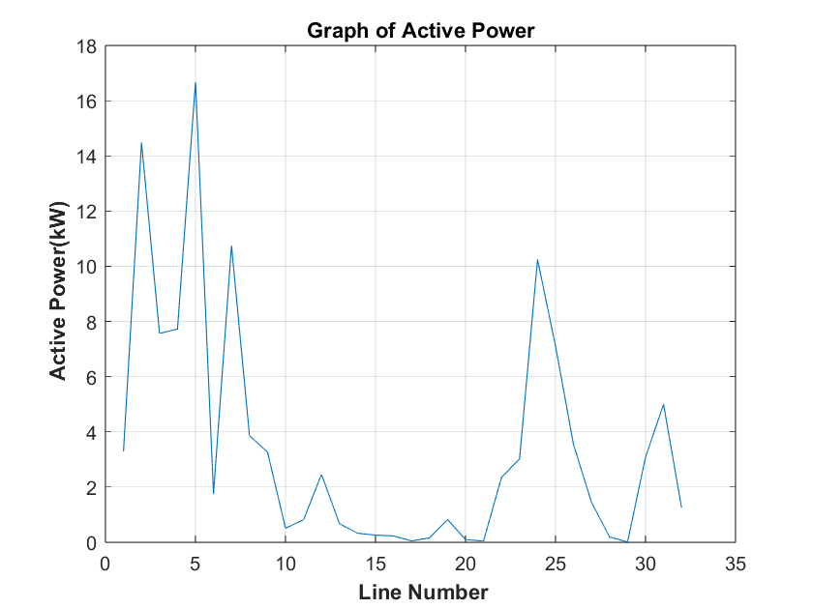
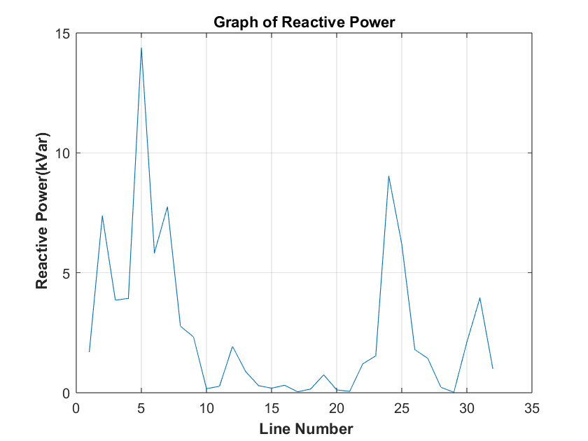
Active Power Flow Reactive Power Flow

Slide 39
CONCLUSION
The integration of a diesel generator and photovoltaic cells in a distributed network can provide significant benefits in terms of cost savings, energy efficiency, and sustainability. In this study, a backward-forward sweep method was used to analyze the performance of a distributed network with the integration of a diesel generator and PV cells.
The results showed that the addition of PV cells can significantly reduce the reliance on the diesel generator, resulting in a decrease in fuel consumption and carbon emissions. Additionally, the integration of PV cells and a diesel generator can provide a reliable and resilient power supply by ensuring uninterrupted power supply in the event of a grid outage.
Furthermore, the location and capacity of PV cells were optimized to ensure maximum energy production and distribution efficiency. The backward-forward sweep method provided a robust analysis of the network's performance and allowed for accurate optimization of system parameters.
Overall, the integration of PV cells and a diesel generator in a distributed network can offer a reliable, cost-effective, and sustainable energy solution. This study demonstrates the effectiveness of the backward-forward sweep method for the design and optimization of distributed networks with multiple power sources.

Slide 40
REFERENCES
H. Akbari and M. Alizadeh, "Optimal design of hybrid renewable energy systems with battery storage using HOMER software: A review," Renewable and Sustainable Energy Reviews
M. A. Adhikari and M. R. Islam, "Design and performance analysis of a hybrid power system using HOMER for off-grid electrification in Bangladesh," Renewable and Sustainable Energy Reviews
B. K. Gupta and D. Singh, "Design and simulation of a hybrid power system using PV, wind, and diesel generator for a remote telecom station," International Journal of Renewable Energy Research

Slide 41
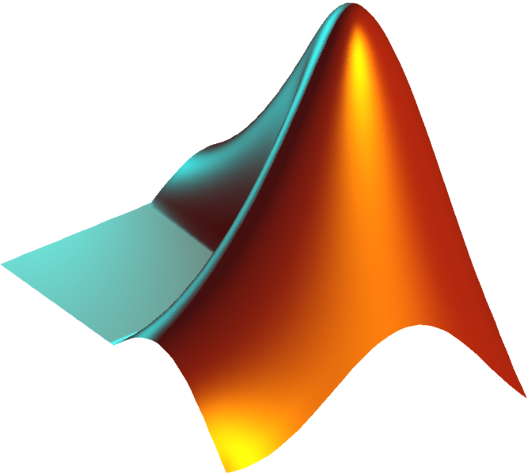
BFS CODE
Now we will code the BFS in matlab to obtain the voltage profile,current profile,active power flow,reactive power flow and total losses in the system.
BusData.m LineData.m

Slide 42
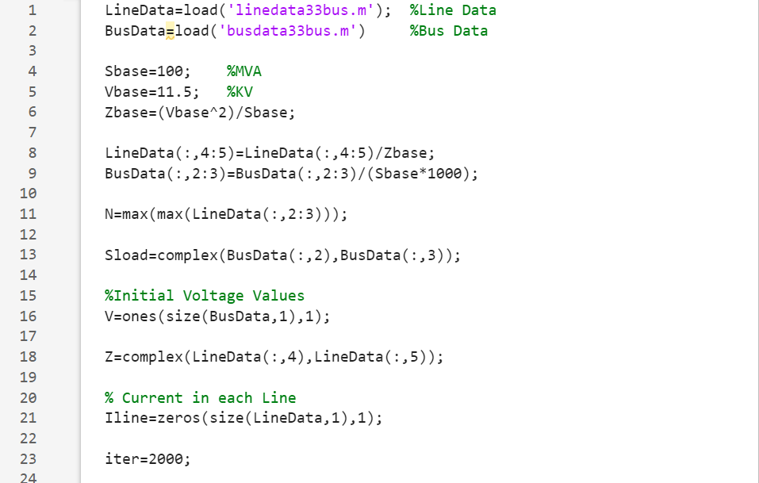

Slide 43
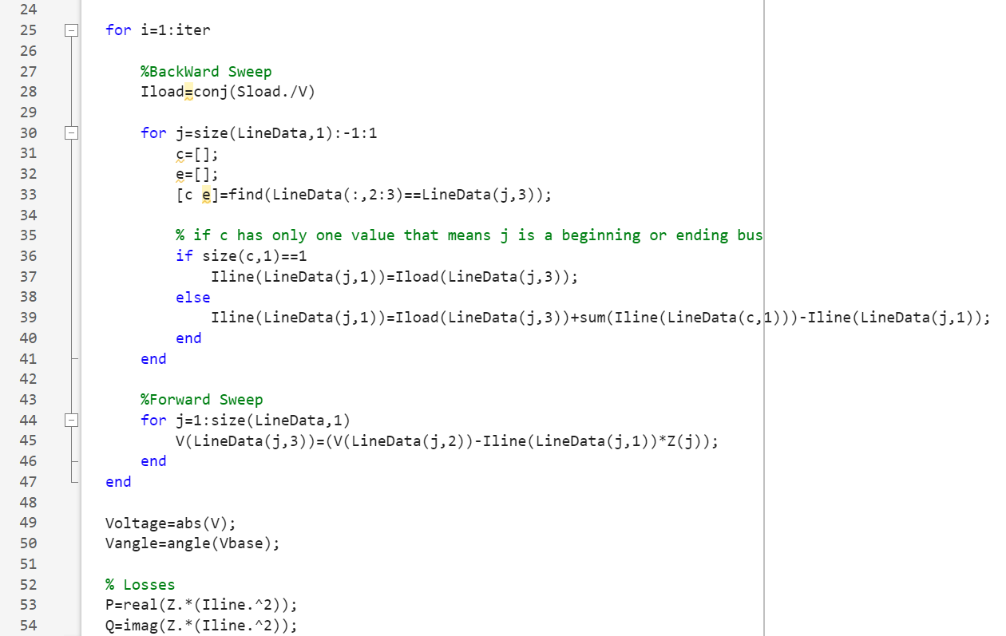
`

Slide 44
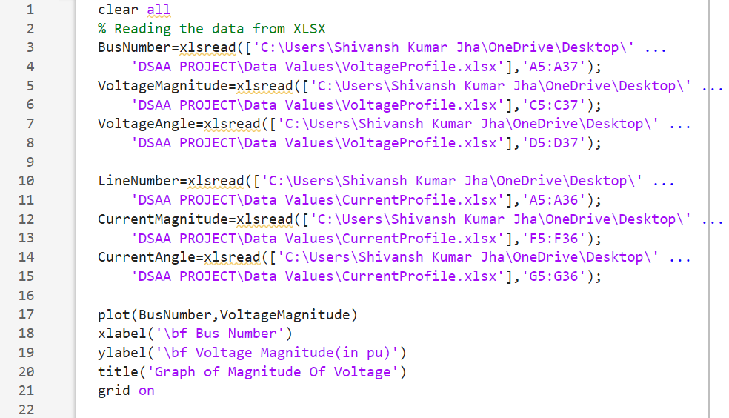
VOLTAGE AND CURRENT PROFILE

Slide 45
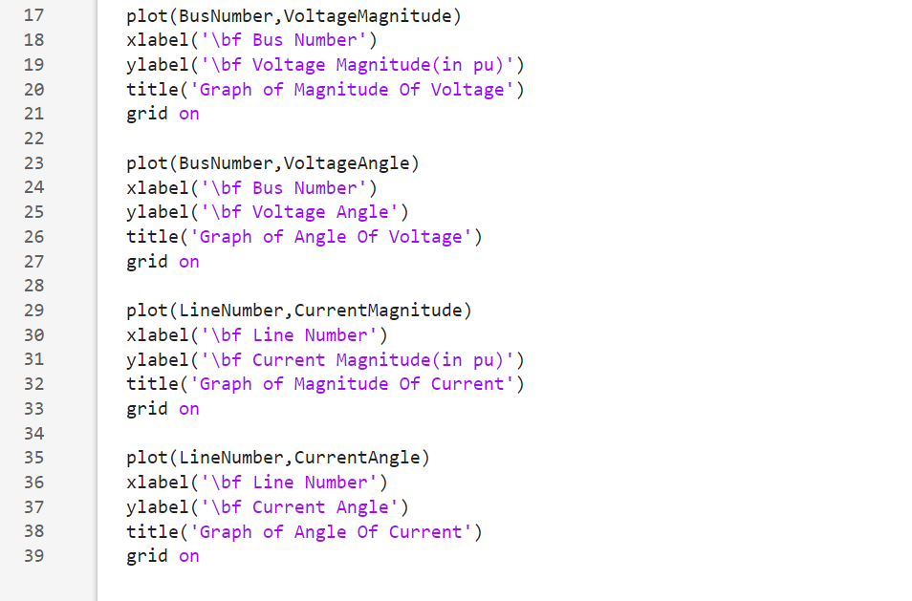

Slide 46
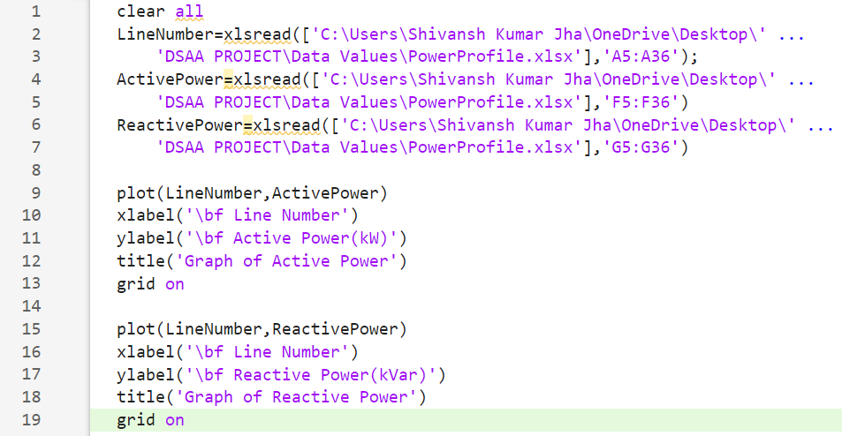
POWER PROFILE

