Slide 1

Chaos Theory
Evolutionary Game Theory Dynamics
Kartikeya Saxena
180101034

Slide 2


Evolutionary Game Theory
A gene is a pattern of DNA whose copies exists inside organisms and determine its one trait.
An organism only lives once, gene is potentially immortal In the long run the competition is between genes.
Genes which determine traits that are more suitable for survival and reproduction in a given environment will tend to win (have more “fitness” in darwinian notion) by increasing the organisms’ representation in the overall population in the environment.

Slide 3

10
SMALL
LARGE
VS
(5, 5) | (1, 8)
(8, 1) | (3, 3)
5
5
SMALL
VS
LARGE
1
8
VS
3
3

Slide 4
Dynamics of Evolutionary Games
Proportion of Small beetle (S₁) = x , Large beetle (S₂) = 1 - x
Expected Payoff S₁: 5x + (1-x) = 4x + 1
Expected Payoff S₂: 8x + 3(1-x) = 5x + 3
Expected Payoff of S_{i}: U(S_{i}) = Σ_{j} pr(S_{j})U_{ij}
Average Expected Payoff of the population = x(4x + 1) + (1 - x)(5x + 3) = -x² + 3x + 3

Slide 5
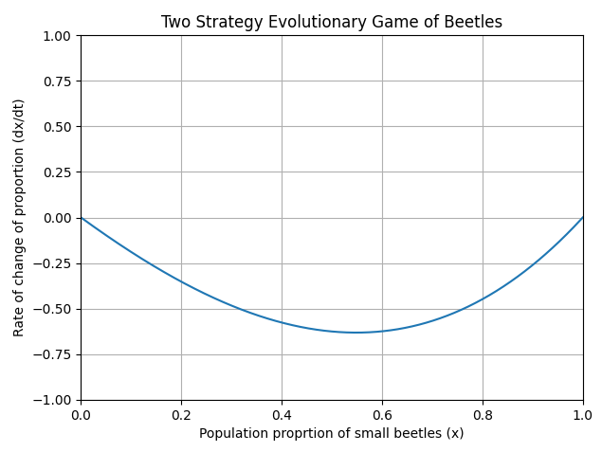
Dynamics of Evolutionary Games
The proportion of beetles changes depending upon how much expected payoff they have relative to the average expected payoff of the population and is governed by the following equation proposed by Taylor and Jonker.
dpr(S_{i})/dt = pr(S_{i})(U(S_{i}) − U(avg))
dx/dt = x(U(S₁) − U(avg)) = x(4x + 1 − (−x² + 3x + 3)) = x(x − 1)(x + 2)

Slide 6
Mixed Strategy
It is possible that both of the strategies considered in the above two player game are not evolutionarily stable. In such a case a mixed strategy is evolutionarily stable. There are basically two viewpoints in defining what a mixed strategy is:
Each organism is hardwired to follow a pure strategy (S₁ or S₂), but some portion of population follows one while the rest follows the other and have the same payoff.
Each organism follows either of the strategy with a certain probability.

Slide 7
Three Strategy Evolutionary Games
Proportion of Strategy S₁ = x, Strategy S₂ = y, implying Strategy S₃ = 1 − x − y
dx/dt = x(U(S₁) − U(avg)) = x(x² + (1 − a)y² − 2xy − 3x − 2y + 2)
dy/dt = y(U(S₂) − U(avg)) = y(x² + (1 − a)y² − 2xy + 5x + (a + 2)y − 3)
 | S₁ | S₂ | S₃
S₁ | 2 | 1 | 5
S₂ | 5 | a | 0
S₃ | 1 | 4 | 3

Slide 8
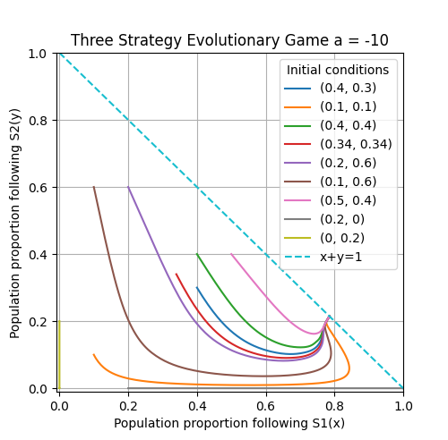

Slide 9
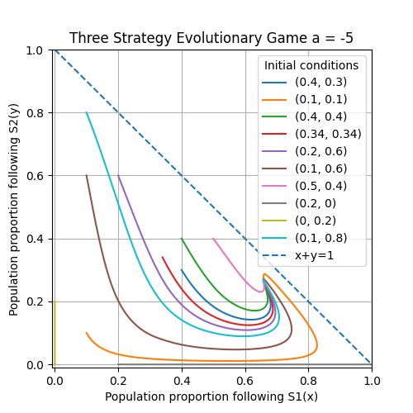

Slide 10
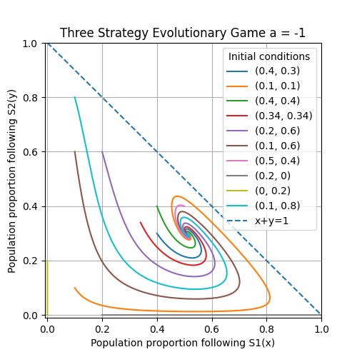

Slide 11
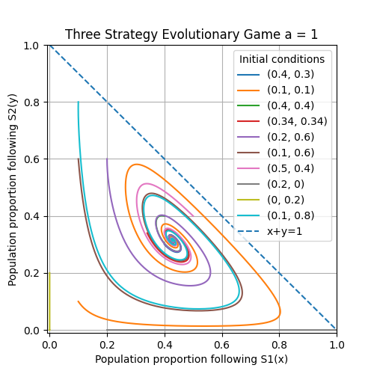

Slide 12
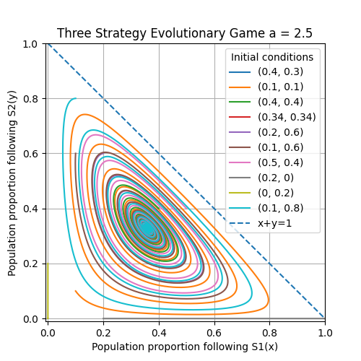

Slide 13
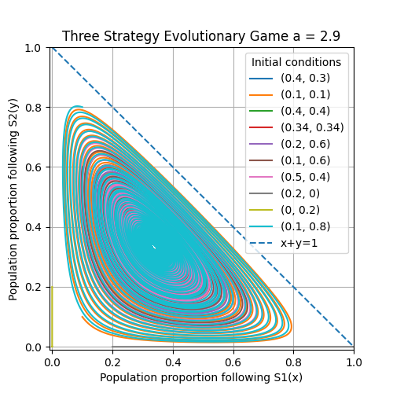

Slide 14
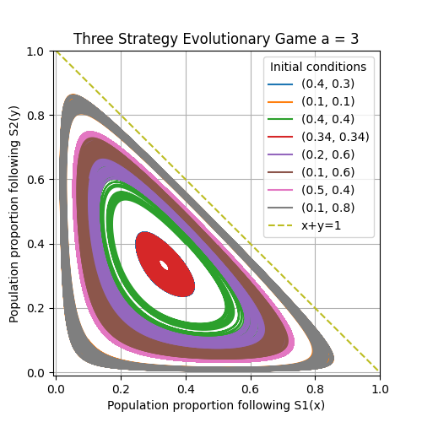

Slide 15
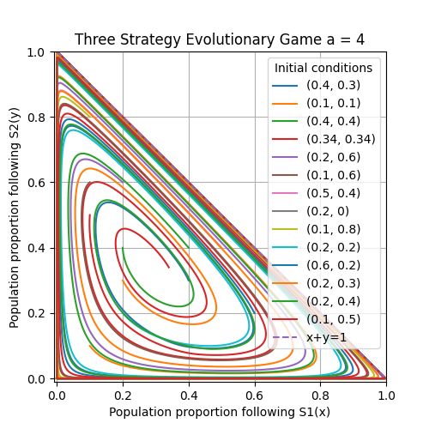

Slide 16
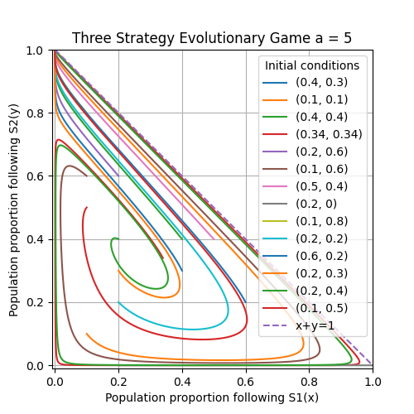

Slide 17
Degenerate Hopf Bifurcation
At a = 2.94,
e₁ = 0.0119 - 1.1126i e₂ = 0.0119 + 1.1126i
At a = 3.06
f₁ = -0.0020 - 1.1088i f₂ = -0.0020 + 1.1088i
where i = √ −1 and e₁ and e₂ are the eigenvalues of the jacobian at the fixed point (0.3421, 0.3151, 0.3428). And f₁ and f₂ are eigenvalues of the jacobian at the fixed point (0.3431, 0.3141, 0.3435)
Real value tends to 0 as a -> 3
Above dynamics when solved numerically showed degenerate hopf bifurcation near a = 3.
It is structurally unstable and any small perturbation of the value of a destroys the closed orbits.
This degenerate case typically arises when a nonconservative system suddenly becomes conservative at the bifurcation point. The fixed point becomes a nonlinear center, rather than the weak spiral required by a Hopf bifurcation.
It is very difficult to demonstrate such system numerically since any approximation tend to blow up the closed orbit structure.

Slide 18
Four Strategy Evolutionary Games
dx/dt = x(U(S₁) − U(avg)) = −x(−1001x² − 1001y² + 1000z² − 2002.5xy + (a − 10)xz − 0.5yz + 2001x + 2001y + 10z − 1000)
dy/dt = y(U(S₂)−U(avg)) = −y(−1001x² −1001y² + 1000z² −2002.5xy + (a−10)xz −0.5yz + 2001.5x+ 2001y + z − 1000)
dz/dt = z(U(S₃)−U(avg)) = −z(−1001x²−1001y²+1000z² −2002.5xy+(a−10)xz−0.5yz−ax−0.5y−2000z+1000)
 | S₁ | S₂ | S₃ | S₄
S₁ | -1 | -1 | -10 | 1000
S₂ | -1.5 | -1 | -1 | 1000
S₃ | a | 0.5 | 0 | -1000
S₄ | 0 | 0 | 0 | 0

Slide 19
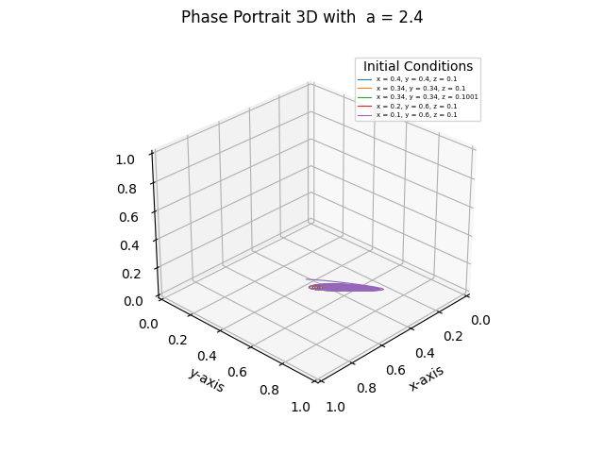
a = 2.4
Fixed point: (x*, y*, z*, 1−x*−y*−z*) = (0.3640, 0.6145, 0.0202, 0.0012)
e₁ = −0.975777446278604 e₂ = −0.00211522973261581 − 0.150224998796878√ 3i e₃ = −0.00211522973261581 + 0.150224998796878√ 3i where i = √ −1 and e₁, e₂ and e₃ are the eigenvalues of the jacobian at the above fixed point.
The eigenvalues indicate a stable spiral.

Slide 20
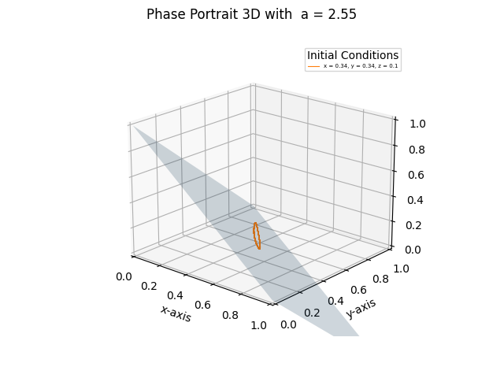
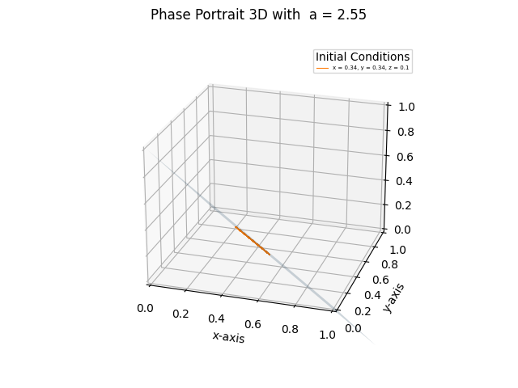
a = 2.55
The limit cycle is almost planar elliptical lying on the plane x + y + z = 1 with a root mean square radius of about 0.154.
R₁
R₅
R₄
R₂
R₃
R = √R₁² + R₂² + R₃² + R₄² + R₅²

Slide 21
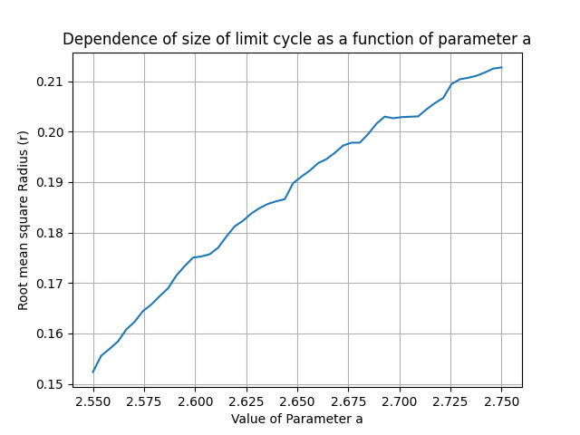
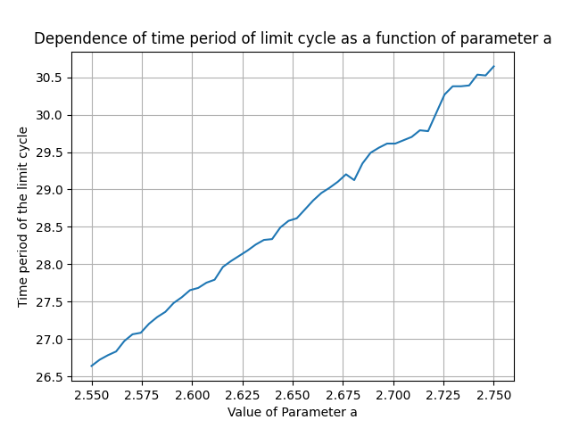
a = 2.55
On further varying a from 2.55 to 2.75, the size of the limit cycle (represented as the root mean square distance from the centroid) grows proportional to √ a and time period grows linearly with a. In Hopf bifurcations radius of the limit cycle generally have O( √µ) dependence on the parameter µ = |r_{c}-r|, this system also follows this trend.

Slide 22
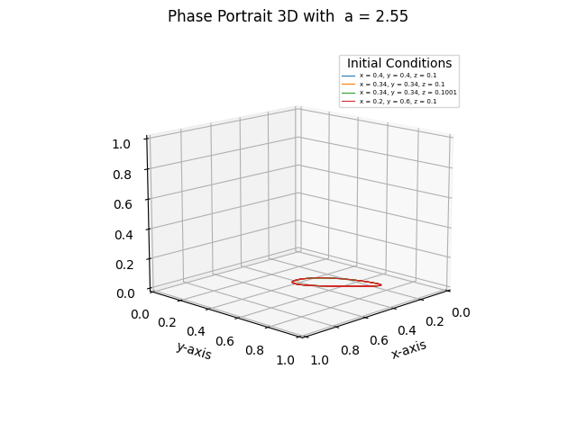
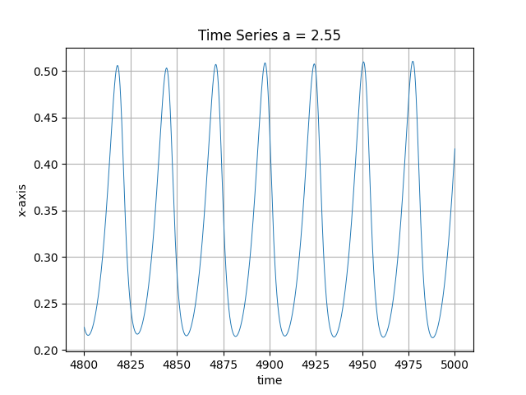
a = 2.55

Slide 23
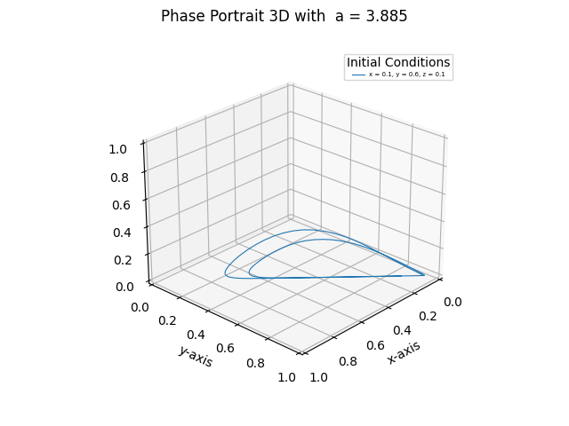
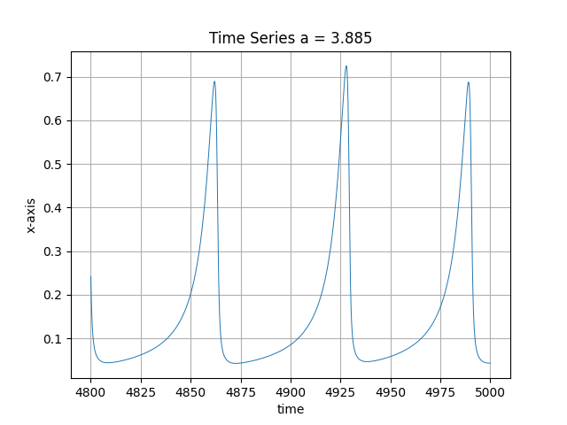
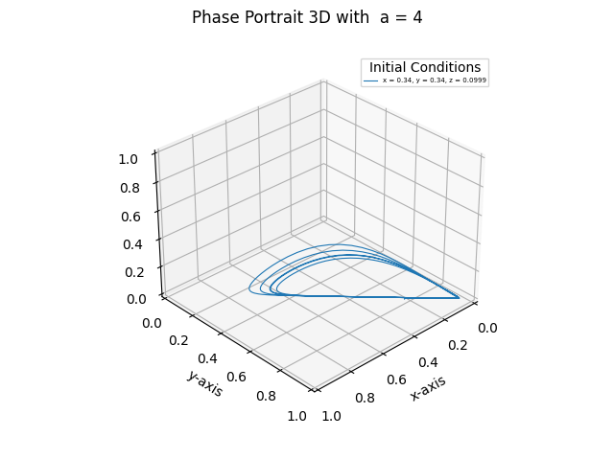
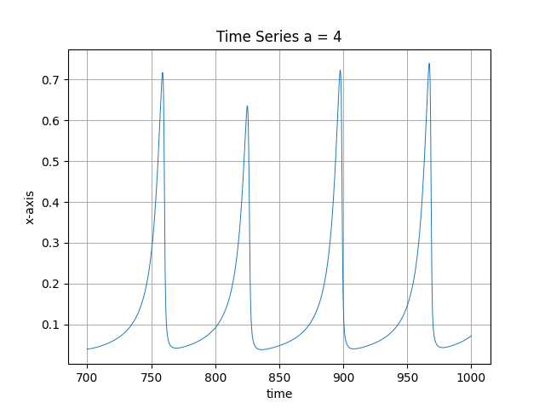
a = 3.885 and a = 4
Period doubling

Slide 24
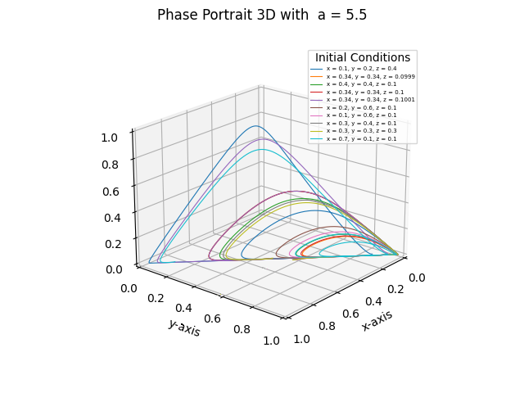
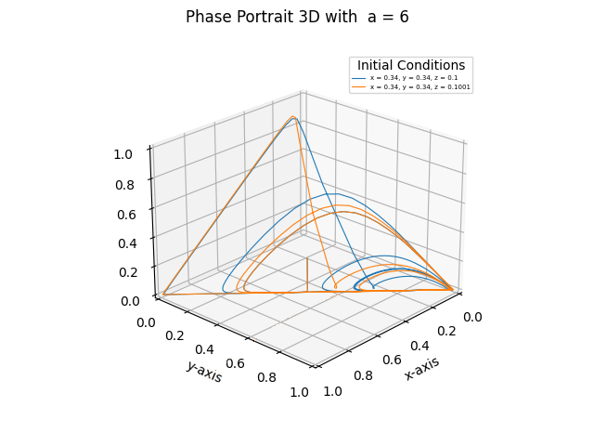
a = 5.5 and a = 6

Slide 25
Analysis and Conclusions
Numerical Computation Tools:
Phase portrait snapshots drawing: python’s Matplotlib library.
Numerical Integrations: scipy’s integrate module with default RK45 (Explicit Runge-Kutta method of order 5).
Eigenvalues: sympy module by solving the equation det(A − λI) = 0
Python floats have a 16 digit precision and all the calculations are performed under this precision. The four strategy evolutionary game becomes quite sensitive to precision a > 4.
All the code of the analysis can be found at https://gitlab.com/anexa_s/chaotic_simulator
Chaos emerged in the four strategy game through hopf bifurcation and period doubling of the limit cycle in the form of a strange attractor which looked similar to a single flap of the lorentz attractor.

Slide 26



