Slide 1
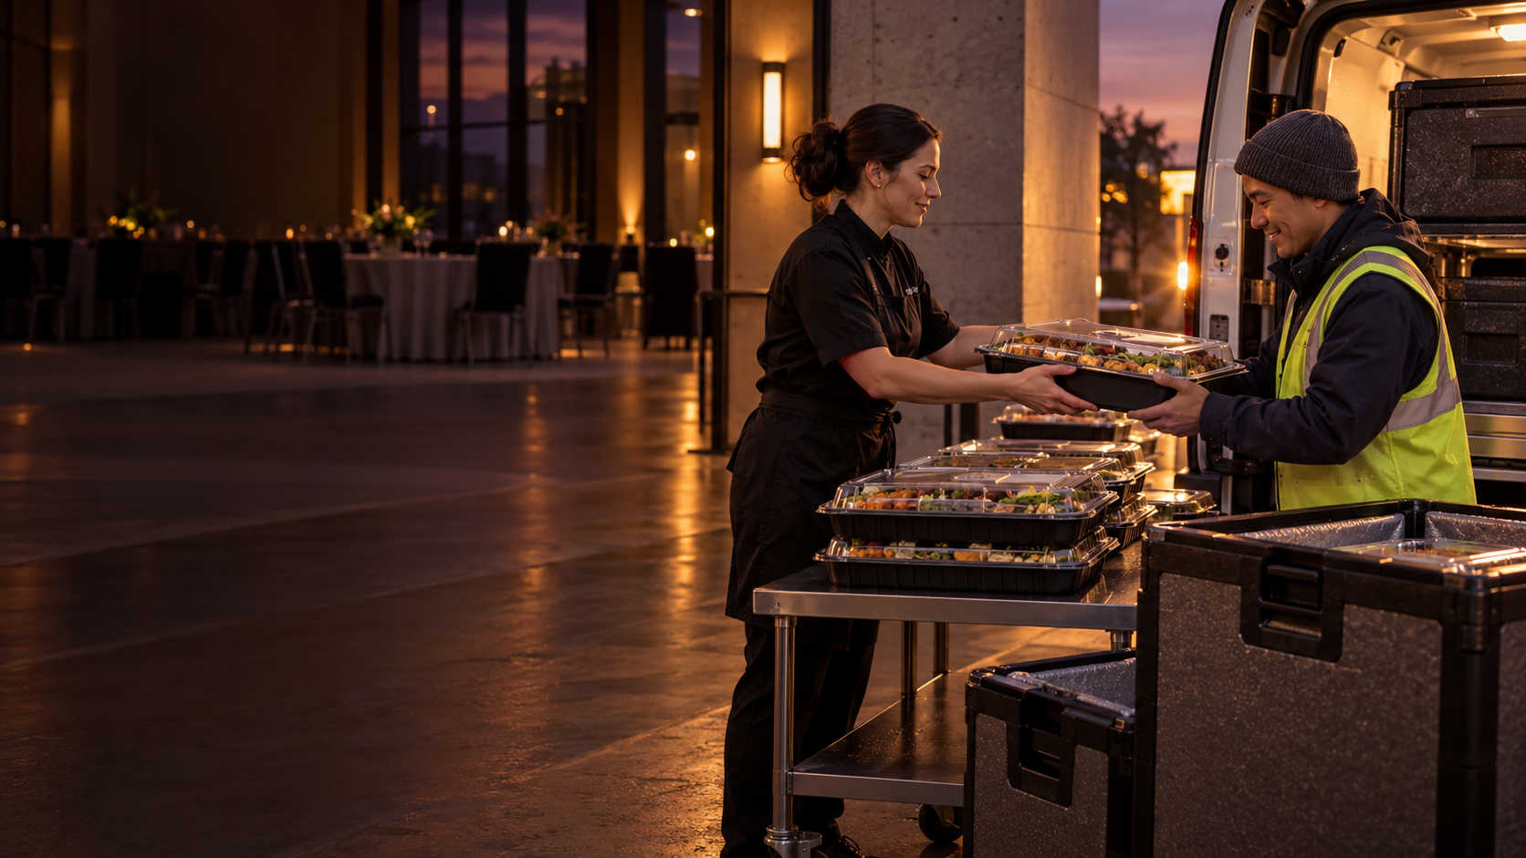

VANDY HACKS / ORACLE CHALLENGE
Not
Wasted.
Surplus saved.
Not wasted.
PREDICT · MATCH · MOVE
Illustrative image
Notes:
TIME: 0:00–0:20. Start the skit before the presenter explains the product. Team member A: ‘Great event. Want to take these leftovers home?’ Team member B: ‘No, I can’t take them all.’ A: ‘Should we donate them?’ B: ‘Who can take them tonight, and who is picking them up?’ A pauses with an empty tray near a bin. Presenter: ‘Potentially usable food is still here, but no recipient or pickup has been arranged. Not Wasted sets up that handoff before teardown.’ Treat this as an illustrative scenario, not a reported event. The image is illustrative. TRANSITION: ‘Here’s why that moment keeps happening.’

Slide 2
ONE EVENT, ONE PLANNED RESCUE
One tap to confirm. Pickup already planned.
Example flow: the recipient and pickup are lined up before the host confirms what is left.
EVENT OFFER / HOST VIEW
BEFORE
Partner + backup verified
At event close
60–90 MIN
Confirm what’s available.
Add a quick photo.
Host gets a heads-up
AT CLOSE
One tap + photo confirms actuals
CONFIRM SURPLUS →
PICKUP
Illustrative interface
Partner arrives in agreed window
No new hub. No last-minute search for a driver.
04 / 07
Notes:
TIME: 1:10–2:00. Demonstrate the prototype if it is working: event offer, host confirmation, recipient/backup, and pickup status. The screen on this slide is an illustrative interface, not a claim that these exact controls have been built. Replace it with your real app screenshot or click-through if available. Explain that the 60–90 minute reminder gives the partner time to prepare; it is not a promise that a driver waits at the venue. External pickup follows the partner’s actual ETA. A 30-minute claim hold is only an optional campus-student flow, not a general food-bank pickup deadline. TRANSITION: ‘AI helps prepare the offer, while people verify the food.’

Slide 3
AI + OCI
AI prepares the offer. People verify the food.
AI reduces listing work while people check food and partner requirements.
1
2
3
4
EVENT SIGNALS
AI ASSIST
HUMAN CHECK
MATCH + ROUTE
RSVP estimate
Catering order + menu
Past event outcomes
Estimate a likely range
Structure order details
Suggest photo tags
Confirm quantity
Check packaging + labels
Apply partner rules
Food acceptance
Capacity + open hours
Pickup time + distance
Use only operational details needed for pickup. Never infer “allergen-free” or food safety from a photo.
05 / 07
Notes:
TIME: 2:00–2:25. Explain the AI narrowly. RSVP, catering order, and past outcomes can support a likely surplus range; the host confirms actuals. OCI Generative AI can help structure event/order text; OCI Vision can suggest image tags or read visible packaging. A person verifies servings, handling, ingredient/label details, and partner acceptance. Do not describe AI vision as an allergen detector or food-safety certifier. Minimize data: food, timing, quantity, location, and pickup status; no attendee lists. Sources: Oracle OCI Vision documentation, https://docs.oracle.com/en-us/iaas/Content/vision/using/home.htm ; Oracle OCI Generative AI overview, https://docs.oracle.com/en-us/iaas/Content/generative-ai/overview.htm ; FDA Food Allergies: What You Need to Know, https://www.fda.gov/media/180903/download . TRANSITION: ‘We can test this with one complete loop.’

Slide 4
THE FIRST PILOT
Start with one complete pickup loop
One site, one event type, one verified recipient, and one scheduled transport pool.
MEASURE THE HANDOFF
PROVE THE WORKFLOW
Facility opts in at booking
Forecast vs. confirmed quantity
Offers accepted and picked up
Recipient + backup accept the rules
Volunteer route has a real window
Time from confirmation to arrival
Organizer effort + recipient acceptance
Host confirms actuals at close
Funding hypothesis: host facilities / CSR support coordination; food-recovery partners pay nothing per donation.
06 / 07
Notes:
TIME: 2:25–2:50. Pitch a narrow pilot, not a citywide rollout. These are measures we propose to collect, not achieved results. The initial funding hypothesis is that a host institution’s facilities, sustainability, or CSR program supports the coordination; the receiving nonprofit should not face a per-donation fee. This is unvalidated—say so and test willingness to fund the pilot. The route should use existing facilities and a confirmed pickup window, not a new hub or a driver asked to wait indefinitely. TRANSITION: ‘We’re looking for the right first partners to prove the loop.’

Slide 5
MEET THE TEAM
A small team. A practical first test.
Show the people behind the product and the work each person owns.
01
02
03
OUR ASK
[TEAM MEMBER]
[TEAM MEMBER]
[TEAM MEMBER]
Help us find one event host, one food partner, and one transport partner for a pilot.
[What I built / tested]
[Product / partner discovery]
[Logistics / operations]
Not Wasted. Surplus saved. Not wasted.
07 / 07
Notes:
TIME: 2:50–3:00. Replace every placeholder with the real team roster, contribution, and relevant skills. Remove unused cards or add a fourth if needed; do not leave placeholders in the presented deck. Make the ask concrete: introductions to one event host, one food-recovery partner, and one transport partner willing to explore a small pilot. Close on the project name and tagline. Do not imply any partner has agreed unless that is true.

Slide 6

Notes:
ESTIMATED TIME: 25 seconds
SPOKEN SCRIPT
Our user is the person who has to lock the doors: an event or facilities coordinator at a company or university. At teardown, donating adds three jobs: finding someone who can accept the food, checking their capacity and requirements, and arranging transport. How might we predict where and when usable surplus will appear, then arrange a recipient and pickup before event teardown?
TRANSITION
We move that planning earlier.
Visual: AI-generated editorial illustration, not a real event or team member. Built-in image generation tool. Prompt: One coordinator at the end of a catered campus event, holding a phone and keys beside covered catering trays, with stacked chairs, in a minimal flat editorial style using plum, cream, coral and pale sage. No text or logos.
Source: User-supplied Not Wasted pitch brief. Forecasts, partnerships, product functions and funding are proposals unless independently verified by the team.

Slide 7
VANDY HACKS / ORACLE CHALLENGE
Surplus saved
Not Wasted
Team “Oracle of Plenty”
01
Notes:
ESTIMATED TIME: 20 seconds
SPOKEN SCRIPT
[Two team members stand beside an EMPTY catering tray or takeout container. Use only a prop, never real food. This is an illustrative scenario, not a real event or measured result. Keep handoffs brisk.]
Person A: “That was a great event. We have some food left. Should we donate it?”
Person B: “To who? I don’t know who can take it tonight, and we don’t have a pickup.”
Person A: “I need to lock up. I guess we toss it.”
[Person A moves the empty tray toward a bin, then pauses. The presenter turns to the judges.]
Presenter: “The organizer cared. The recipient and pickup just weren’t arranged before closing. Not Wasted prepares that handoff earlier.”
TRANSITION
[Advance immediately. The next slide explains why teardown is too late.]
REHEARSAL: The requested opening is word-dense for 20 seconds. Practice the full dialogue with quick handoffs and no extra introduction. Do not make hunger or food waste the joke.
Source: User-supplied Not Wasted pitch brief. Forecasts, partnerships, product functions and funding are proposals unless independently verified by the team.

Slide 8
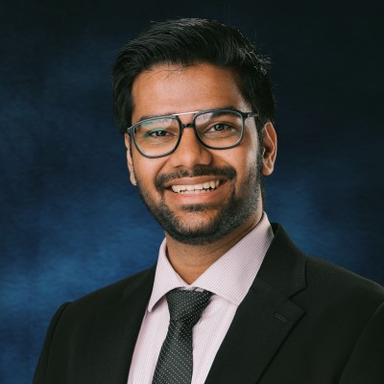
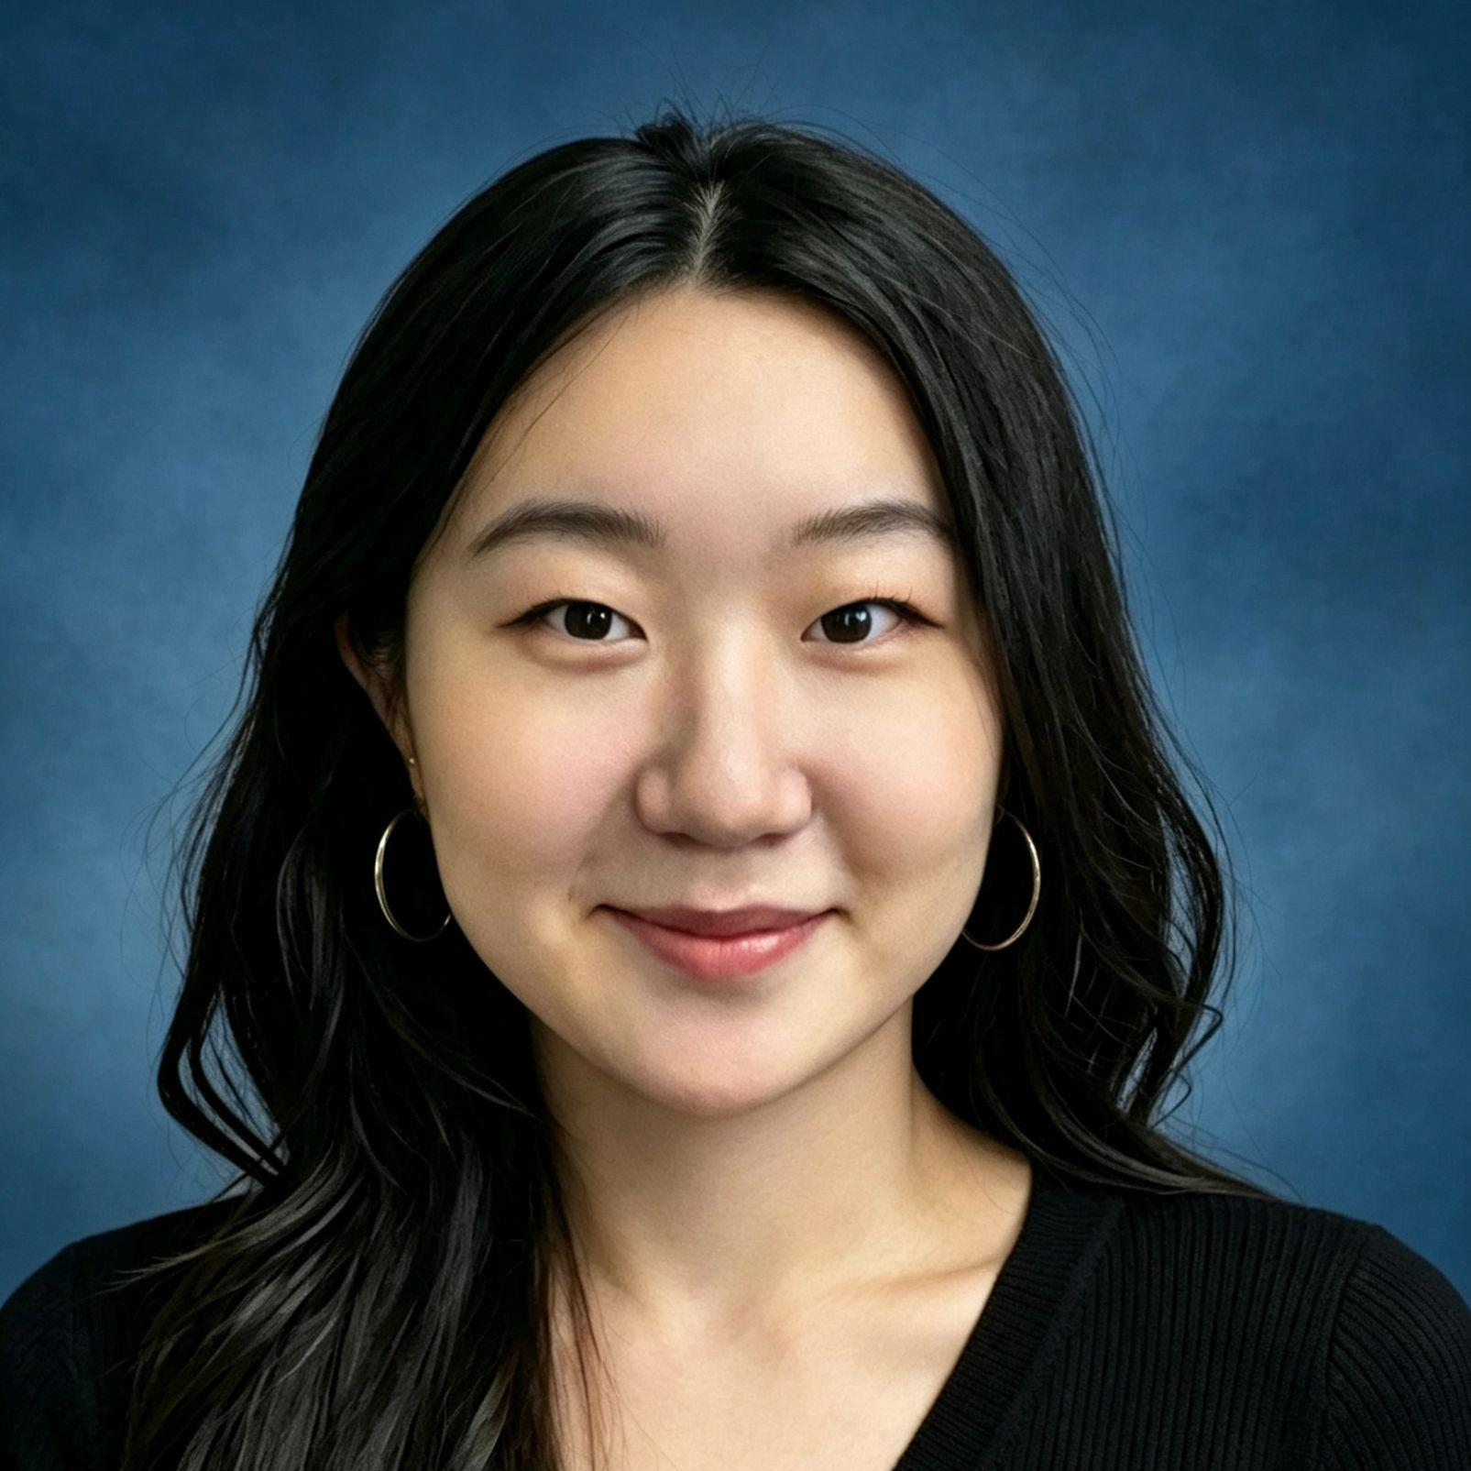
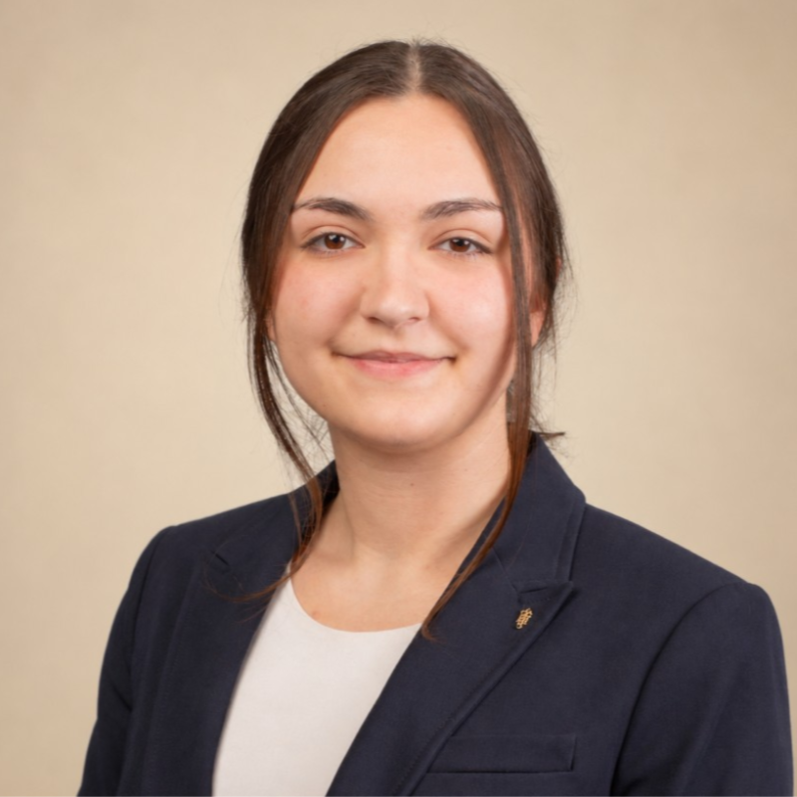

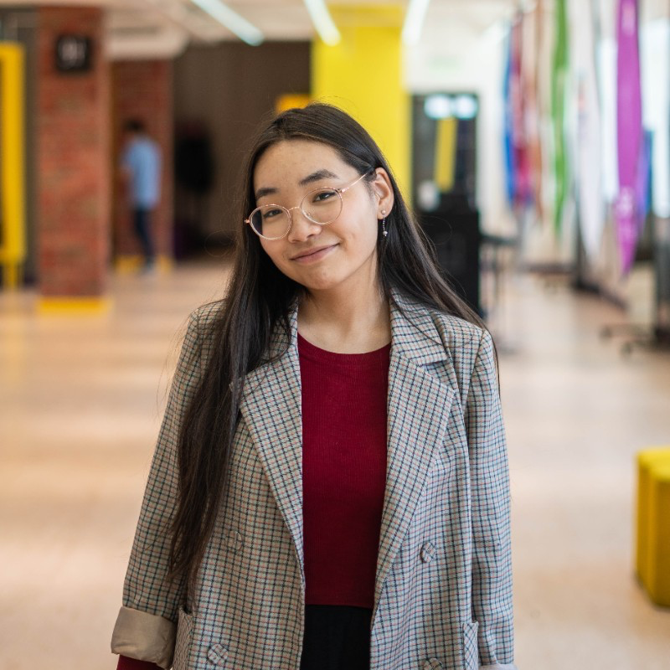
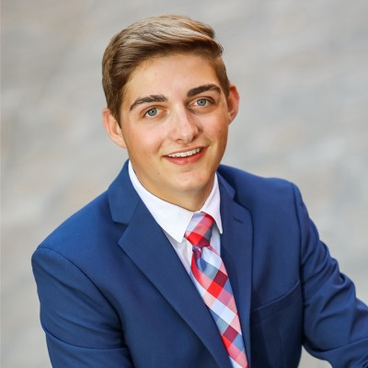
Meet the team
Shiv
Summer Shang
Gracie
PHOTO
Hacker / AI Engineer
PHOTO
Hacker / CS & Math Undergrad
PHOTO
Hacker / Major
Jisoo Sun
Namuun Zolbadrakh
Karver Repp
PHOTO
Hipster / UX Researcher
PHOTO
PHOTO
Hustler / Undergrad
Hipster / Undergrad

Slide 9
NOT WASTED
Both sides are ready before teardown.
Not Wasted pairs an event host with a food pantry, then confirms the actual surplus at close.
1
BEFORE EVENT
2
PLAN RESERVED
3
AT EVENT CLOSE
4
PICKUP
Share event details
Review the plan
Confirm the surplus
Stage the food
EVENT HOST
Venue / donor
Time, location, menu.
Forecast, pantry match, backup and pickup window.
(Ping 30 minutes before event end)
Place it at the pickup point.
Not Wasted matches food fit, capacity, distance and pickup time.
Set pickup rules
Accept a slot
Get final details
Collect and confirm
FOOD PANTRY
Recovery partner
Accepted foods, service area, capacity and hours.
Reserve a window or decline so the backup can respond.
Confirmed quantity, packaging and pickup location.
Partner pickups food!
The pantry and pickup window are lined up before the host confirms what is left.

Slide 10
Event volume points to a food recovery opportunity
Two Nashville venues show how event calendars can signal recurring surplus.
Vanderbilt University
Music City Center
Reunion & Homecoming 2025
Annual historical average, 2013–2025
EVENTS
POTENTIAL SURPLUS
EVENTS
POTENTIAL SURPLUS
~85
~300
~220
~3,300
in 4 days
servings per week*
per year
servings per year*
When the events end, where does the extra food go?
*Potential surplus servings are estimates.

Slide 11


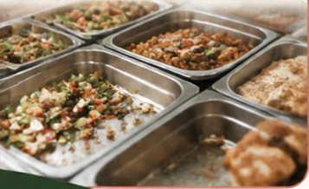

Product Overview
!
1. PROBLEM
◎
⚙
3. HOW “NOT WASTED”WORKS
2. GOAL
Leftover food after
events is often wasted
because donation
coordination is slow
and difficult.
1
Event organizers
post or schedule
surplus food.
♡
➜
➜
Local nonprofits
browse and
request it.
2
Make surplus
food redistribution
easy, fast, and
accessible.
3
We coordinate pickup
or delivery using location,
quantity, and availability.

Slide 12



Our Users: From Friction to Impact
♙
DONOR JOURNEY
♧
RECIPIENT JOURNEY
⌕
?
➜
➜
➜
➜
➜
➜
Event ends
Surplus
remains
No easy
donation path
Food may
be wasted
Community
need arises
Search for
reliable food
Coordinate
pickup
Serve more
people
!
PAIN POINT
!
PAIN POINT
Donors need a quick, simple way to donate.
Local communities need reliable, local food sources with clear availability.
↗
Not Wasted
connects the two journeys.

Slide 13

At closing, coordination is extra work
The event or facilities coordinator
01
Find an accepting recipient
02
Check capacity + food requirements
03
Arrange transport
HOW MIGHT WE
How might we predict where and when usable surplus will appear, then arrange a recipient and pickup before event teardown?
02
Notes:
ESTIMATED TIME: 25 seconds
SPOKEN SCRIPT
Our user is the person who has to lock the doors: an event or facilities coordinator at a company or university. At teardown, donating adds three jobs: finding someone who can accept the food, checking their capacity and requirements, and arranging transport. How might we predict where and when usable surplus will appear, then arrange a recipient and pickup before event teardown?
TRANSITION
We move that planning earlier.
Visual: AI-generated editorial illustration, not a real event or team member. Built-in image generation tool. Prompt: One coordinator at the end of a catered campus event, holding a phone and keys beside covered catering trays, with stacked chairs, in a minimal flat editorial style using plum, cream, coral and pale sage. No text or logos.
Source: User-supplied Not Wasted pitch brief. Forecasts, partnerships, product functions and funding are proposals unless independently verified by the team.

Slide 14
One event, from opt-in to handoff
Illustrative scenario: a catered university department event
PROPOSED JOURNEY
ACTUAL PROTOTYPE
1
Opt in + event details
2
Estimate a likely range
[Insert prototype screen
or click-through]
3
Recipient + backup
4
Reserve pickup window
5
Remind 60–90 min before end
[Build status: working / mockup / concept]
6
Confirm with tap + photo
[Demo URL]
7
Pickup to existing facility
Demo placeholder. Product capabilities and partner connections need team verification.
04
Notes:
ESTIMATED TIME: 50 seconds
SPOKEN SCRIPT
[Open the actual prototype or show the inserted screenshot. Point to the matching screen as you talk. Call each unfinished step a mockup or concept.]
Imagine a catered department event. The coordinator opts in and shares the time, location, RSVP estimate and available catering or menu details. The proposed system uses that information, plus past outcomes where available, to estimate a likely surplus range.
The plan matches a verified recipient and backup by food acceptance, capacity, timing and distance, then reserves a pickup window with a partner route or volunteer pool. A reminder arrives sixty to ninety minutes before the event ends. At close, the host confirms the actual food with one tap and a photo. Pickup happens within the agreed window, with delivery to the partner’s existing facility.
TRANSITION
Here is where AI helps, and where a person stays in control.
DEMO CUES: 0–12s event setup, 12–27s estimated range and recipient/pickup plan, 27–40s reminder and confirmation, 40–50s handoff. Replace this placeholder with actual product evidence. No prototype or build inventory was supplied with the brief. Do not describe a proposed step, integration or partner agreement as working until verified. Keep an offline screenshot backup. No universal 30-minute deadline applies to recovery partners.
Source: User-supplied Not Wasted pitch brief. Forecasts, partnerships, product functions and funding are proposals unless independently verified by the team.

Slide 15
AI helps organize. People confirm.
Proposed AI / OCI role
Event information
AI assistance
Human confirmation
Event + order details
Past outcomes, if available
Organize information
Estimate a likely range
Suggest photo tags
Actual quantity
Packaging
Relevant food information
OCI: [service used + demonstrated step]
A photo cannot prove safety or allergen status.
Only operational handoff data. No attendee lists or private event details.
05
Notes:
ESTIMATED TIME: 25 seconds
SPOKEN SCRIPT
AI has a specific job: organize event and order information, estimate a likely surplus range, and suggest photo tags to reduce typing. Our proposed OCI role supports information organization or image tagging. A person confirms actual quantity, packaging and relevant food details. A photo cannot prove safety or allergen status. We use only the operational data needed for the handoff, without attendee lists or private event details.
TRANSITION
We would test this with a deliberately small pilot.
Before presenting, replace the OCI placeholder with the exact service and demonstrated step. If OCI is only planned, say “planned” on the slide and in the script. Do not imply exact quantity prediction, food-safety certification or an existing integration.
Source: User-supplied Not Wasted pitch brief. Forecasts, partnerships, product functions and funding are proposals unless independently verified by the team.

Slide 16
A small pilot with clear measures
1
Facility or department
Type of event
Verified recovery partner
Scheduled volunteer pool
MEASURES TO COLLECT
Forecast vs. confirmed surplus
Offers accepted + picked up
Confirmation-to-arrival time
Organizer effort
of each
Recipient acceptance
FUNDING HYPOTHESIS TO VALIDATE
Host facilities, sustainability or CSR funding could support coordination.
Recipients should not pay per donation. Revenue is not yet validated.
06
Notes:
ESTIMATED TIME: 25 seconds
SPOKEN SCRIPT
Start with one facility or department, one event type, one verified recovery partner and one scheduled volunteer pool. We would measure forecast versus confirmed surplus, offers accepted and picked up, confirmation-to-arrival time, organizer effort and recipient acceptance. These are measures to collect. Revenue is unvalidated. Our hypothesis is that host facilities, sustainability or CSR funding could support coordination, without charging recipients per donation.
TRANSITION
To test it, we need a few introductions.
This is a proposed pilot scope and measurement plan, not an existing partnership or a report of pilot results. Validate who owns the host budget and whether they would pay.
Source: User-supplied Not Wasted pitch brief. Forecasts, partnerships, product functions and funding are proposals unless independently verified by the team.

Slide 17
Help us test one handoff
Connect us with
01
One event host
02
One recovery partner
03
One volunteer or route partner
OUR TEAM
[Names, roles and relevant skills]
Not Wasted.
Surplus saved. Not wasted.
07
Notes:
ESTIMATED TIME: 10 seconds
SPOKEN SCRIPT
Help us connect with one event host, one food-recovery partner, and a volunteer or route partner to test a pilot. Not Wasted. Surplus saved. Not wasted.
TRANSITION
[Pause, make eye contact, then take questions.]
Fill in all real team names, roles and relevant skills before presenting. Let the on-screen roster do the introductions to protect the ten-second close. Do not invent credentials.
Source: User-supplied Not Wasted pitch brief. Forecasts, partnerships, product functions and funding are proposals unless independently verified by the team.

