Slide 1





Notes:
SKIT — about 20 seconds. Only the logo is on screen.
Two teammates beside an EMPTY catering tray (prop only).
A: "Great event — we've got food left. Should we donate it?"
B: "To who? Nobody can take it tonight and we don't have a pickup."
A: "I need to lock up... I guess we toss it." (moves tray toward a bin, pauses)
Presenter: "The organizer cared. The recipient and pickup just weren't arranged before closing. Not Wasted sets that handoff up earlier."
(Advance — the logo morphs into the title.)

Slide 2
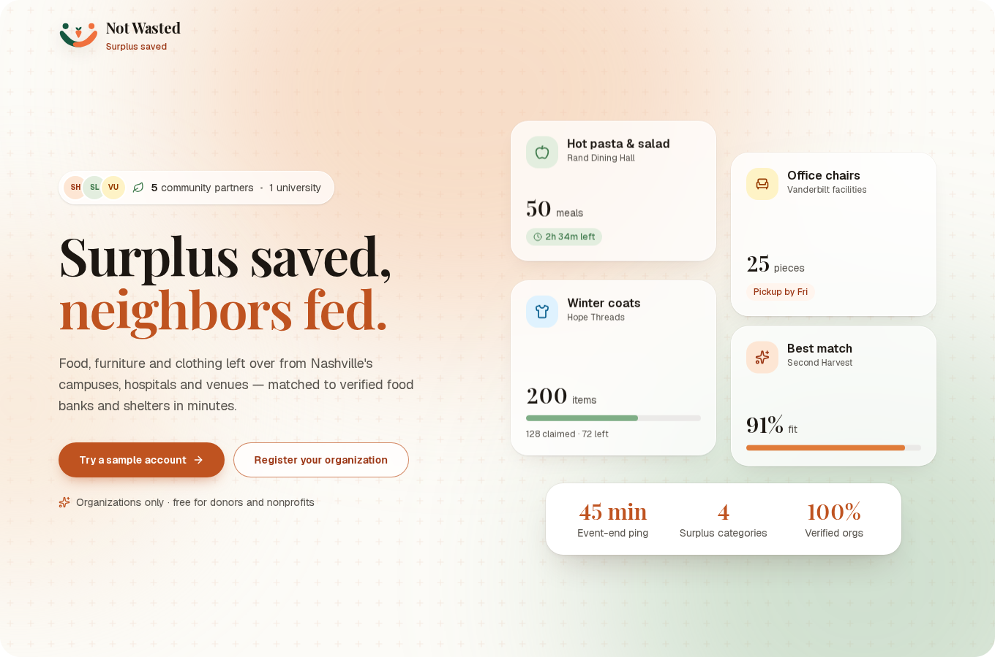
VANDYHACKS · ORACLE “BUILD FOR GOOD” CHALLENGE
Surplus saved,
neighbors fed.
Not Wasted routes leftover food, furniture and clothing from Nashville campuses, hospitals and venues to verified food banks — before it’s thrown out.
Team Oracle of Plenty
Notes:
About 15 seconds. "We're Team Oracle of Plenty. Not Wasted makes sure the surplus from an event, a renovation or a residence-hall clear-out reaches a food bank or shelter before it hits the bin — food first, plus furniture and clothing."

Slide 3



THE PROBLEM
At closing, donating is three extra jobs
01
02
03
Find someone who can take it
Check capacity and food rules
Arrange a pickup
Which pantry is open tonight and accepts prepared food?
Fridge space, allergens, halal or nut-free kitchens, quantities.
Someone has to drive — usually after the staff have gone home.
HOW MIGHT WE line up a recipient and a pickup before the event ends, so confirming leftovers takes one tap instead of three phone calls?
Not Wasted · Surplus saved
03 / 12
Notes:
About 20 seconds. Our user is the person who locks the doors — an events or facilities coordinator. At teardown, donating means three extra jobs: find a recipient, check what they can take, and arrange transport. So the food goes in the bin. How might we line all that up before the event ends?

Slide 4

THE OPPORTUNITY — PUBLIC DATA
The surplus already exists. It just isn’t routed.
324
1,990–10,634
17
schools & universities in the Nashville area listed by the EPA as excess-food generators
tons of excess food a year from those institutions (EPA estimate)
food banks, pantries and soup kitchens in the same map — the demand side
EPA Excess Food Opportunities Map
EPA Excess Food Opportunities Map
EPA Excess Food Opportunities Map
Vanderbilt Reunion & Homecoming 2025
~85 events in 4 days · ≈300 potential surplus servings / week*
Music City Center (2013–2025 average)
~220 events / year · ≈3,300 potential surplus servings / year*
*Event-calendar servings are our estimates from public calendars, not measured leftovers.
Not Wasted · Surplus saved
04 / 12
Notes:
About 20 seconds. These numbers come from public data the app pulls live. The EPA's Excess Food Opportunities Map lists 324 schools and universities here, together estimated at roughly 2,000 to 10,600 tons of excess food a year, and 17 food banks and pantries on the other side. Event calendars tell us when it appears: Vanderbilt's reunion weekend alone runs ~85 events in four days. The event-serving figures are our estimates.

Slide 5


OUR USERS
Two journeys that never meet — until now
Event ends
Surplus remains
No easy donation path
Food is binned
PAIN POINT
Needs a one-tap way to give, with pickup already planned.
Donor
Event & facilities coordinators
Need arises
Search for reliable food
Coordinate pickup
Serve more people
PAIN POINT
Needs reliable, local supply that fits their rules and capacity.
Recipient
Food banks, pantries, shelters
Not Wasted · Surplus saved
05 / 12
Notes:
About 20 seconds. Donors want to help but there's no quick path, so food gets binned. Recipients need reliable, local supply that fits their kitchen rules and capacity, but they find out too late. Not Wasted connects the two journeys before the event ends.

Slide 6




THE SOLUTION
Predict. Match. Move. Before teardown.
1
2
3
4
Register the event
45-minute ping
AI builds the listing
Matched and moved
Time, place, guests, catering — or post a photo of any surplus. Donor says whether they deliver or need a pickup.
Before it ends, the host confirms what’s actually left in one tap and snaps a photo.
OCI vision names items, flags quality and likely allergens. The donor reviews every field.
Ranked by fit, dietary rules, capacity, distance and neighborhood need. Food banks claim, edit or join a waitlist.
No new hub, no driver waiting around — just the handoff, planned early.
Not Wasted · Surplus saved
06 / 12
Notes:
About 25 seconds. Walk the four steps. The donor registers an event — or posts a photo of any surplus. Forty-five minutes before it ends we ping the host to confirm what's left. OCI vision drafts the listing; the donor checks it. Then it's ranked for nearby food banks by fit, dietary rules, capacity, distance and neighborhood need, and they claim it.

Slide 7
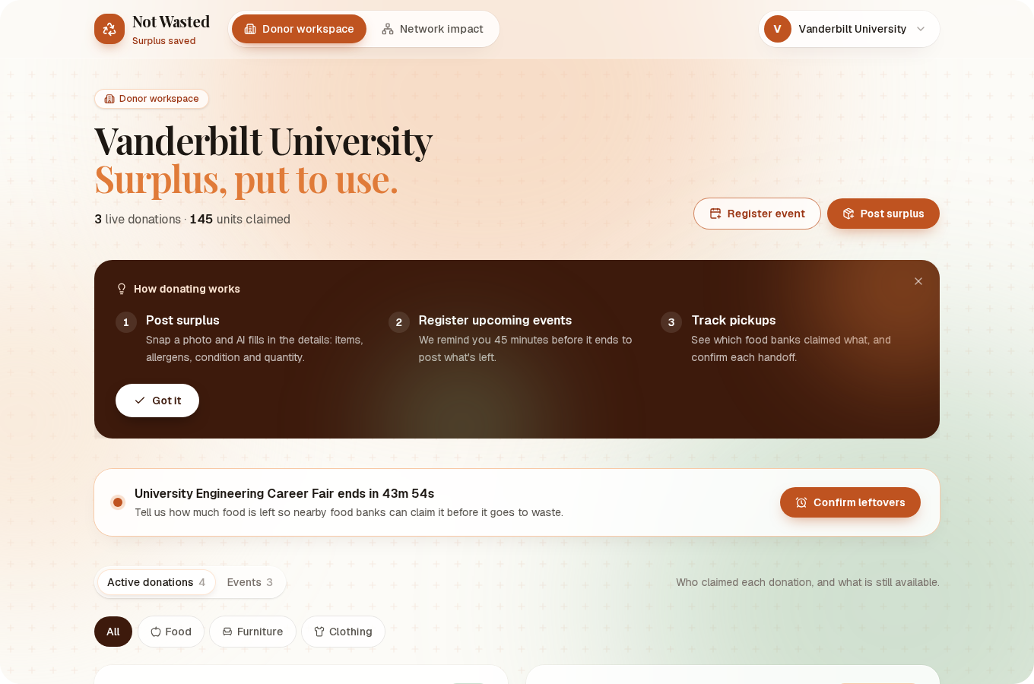
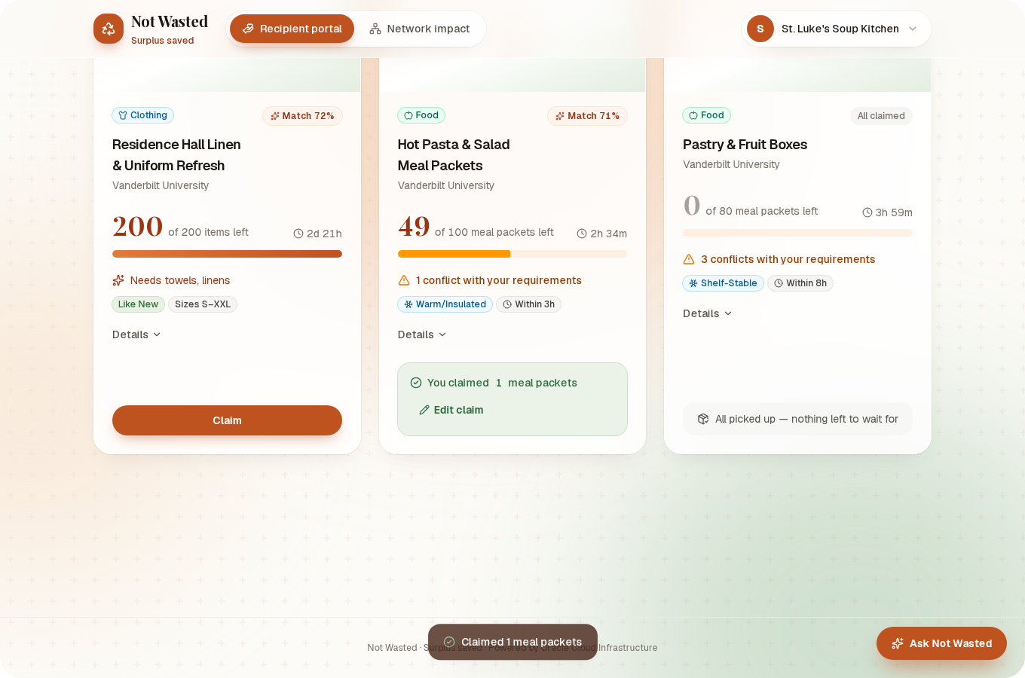
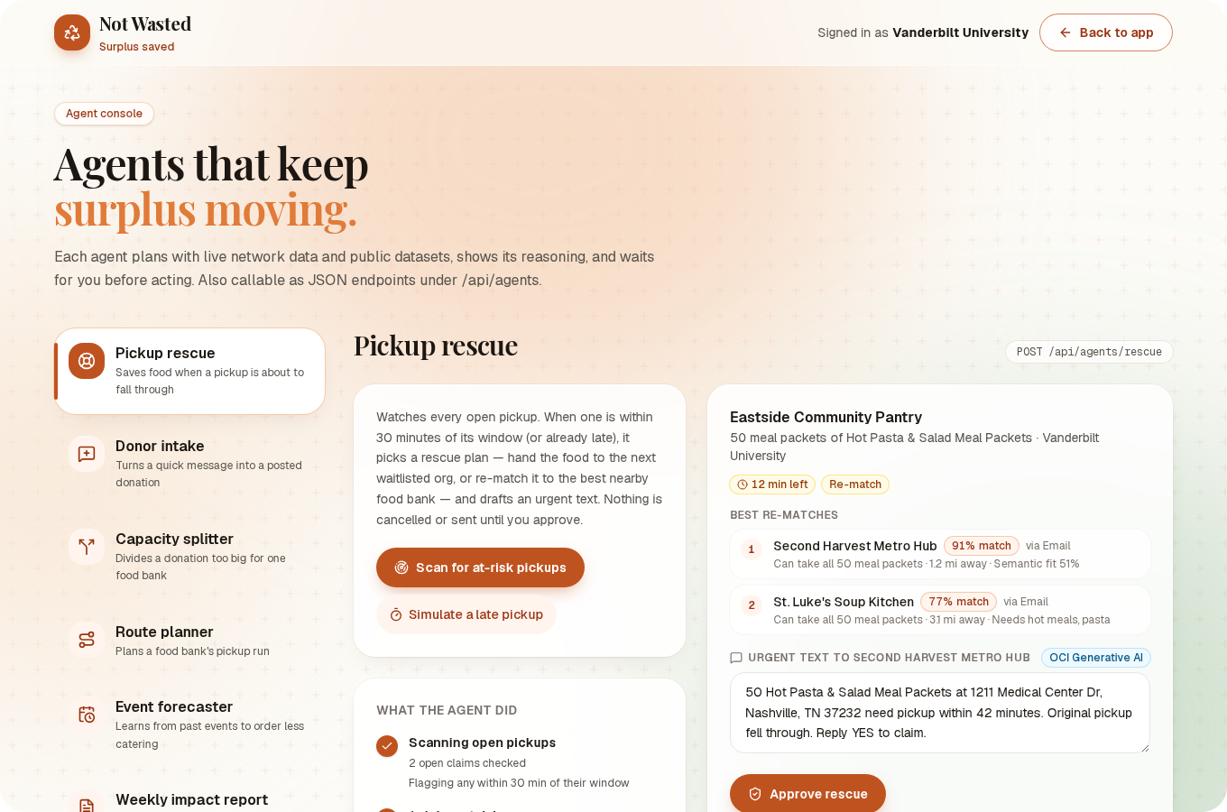
WORKING PROTOTYPE — LIVE ON OCI
It works today. Try it.
Donor workspace
Post surplus, track who claimed it
Food bank portal
Edit capacity, filter by diet, claim or edit a claim
Agent console
Rescue, routing, intake and more
Live demo https://147-224-193-213.sslip.io · sign in with a sample donor or food bank account
Not Wasted · Surplus saved
07 / 12
Notes:
About 40 seconds — switch to the live demo if time allows. Show: donor posts a photo → AI fills the listing → food bank sees it with dietary fit and quality → claims it, edits the claim, or joins a waitlist. Mention capacity editing and the agent console.

Slide 8




AI + ORACLE CLOUD INFRASTRUCTURE
AI drafts. People decide. OCI runs it.
OCI GENERATIVE AI
7 public datasets
EPA Excess Food Map
USDA Food Access Atlas
U.S. Census Geocoder
Open-Meteo weather
Open Food Facts
USDA FoodData Central
IRS nonprofit data (ProPublica)
Llama 4 Maverick (vision)
Photo → items, quality, allergens; reads event screenshots (only what’s visible)
Not Wasted app
Next.js on an OCI Compute VM, HTTPS via Caddy. The VM pulls its image from Object Storage with an instance principal — no stored keys.
Llama 3.3 70B (text)
Food-bank chat, outreach emails, reports, agent write-ups
Cohere Embed v4
Semantic match between donations and each food bank’s needs
Every AI field is reviewed by a person before anything is posted, and nothing is sent without approval.
Not Wasted · Surplus saved
08 / 12
Notes:
About 25 seconds. Three OCI Generative AI models: Llama 4 Maverick reads photos and screenshots, Llama 3.3 writes the chat answers, emails and reports, and Cohere embeddings power the semantic matching. It all runs on OCI Compute with Object Storage and instance-principal auth. Seven free public datasets ground it — EPA, USDA, Census, weather, Open Food Facts and IRS nonprofit data. AI drafts; people confirm.

Slide 9







AGENTIC WORKFLOWS
Seven agents that keep surplus moving
Pickup rescue
Donor intake
Capacity splitter
Route planner
Pickup about to fail? Offers it to the waitlist or the next-best food bank.
“80 sandwiches in Rand, gone by 3pm” becomes a posted donation.
Too much for one food bank? Splits it by capacity and fit.
Orders a pickup run by deadline and distance, with a driver checklist.
Event forecaster
Weekly impact report
Event outreach
Learns no-show rates and suggests ordering less catering.
Network summary plus a tax-acknowledgment letter per donor.
Finds upcoming catered events and drafts emails to organizers.
Each agent shows its reasoning step by step, waits for a human to approve, and is callable as a JSON endpoint (/api/agents).
Not Wasted · Surplus saved
09 / 12
Notes:
About 20 seconds. Beyond the core flow we built seven agents. The strongest is pickup rescue — the moment food would still be wasted: a pickup is about to fail, so it hands the food to the waitlist or re-matches it and drafts an urgent text. Every agent shows its reasoning and waits for approval.

Slide 10




RESPONSIBLE INNOVATION
Built for trust, not just speed
People confirm what AI suggests
Donors review every AI-filled field; recipients see the quality check and the photo.
No invented data
Screenshot reading copies only what is visible. If it can’t read it, the form stays blank.
Verified recipients
Nonprofit status checked against IRS exempt-organization data at sign-up.
Fair matching
Food banks in USDA low-income, low-access areas get a matching boost — and we say why.
Only operational details are shared: food, quantity, timing, place. No attendee lists.
Not Wasted · Surplus saved
10 / 12
Notes:
About 15 seconds. Trust is the product. People confirm everything AI suggests, we never invent data, recipients are verified against IRS nonprofit records, and matching favors under-served neighborhoods transparently. We only share what the pickup needs.

Slide 11




PATH TO SCALE
Start with one complete pickup loop
One host facility
One event type
One verified food bank
One volunteer pickup pool
WHAT WE’LL MEASURE
Pounds and meals moved vs. forecast
Offers claimed and actually picked up
Minutes from confirmation to pickup
Organizer effort and food-bank acceptance
FUNDING HYPOTHESIS
Host facilities and sustainability budgets fund coordination. Food banks never pay per donation.
Not yet validated — the pilot tests it.
Not Wasted · Surplus saved
11 / 12
Notes:
About 20 seconds. We'd start narrow: one facility, one event type, one food bank, one volunteer pool — and measure pounds moved, pickups completed and time to pickup. Funding hypothesis: the host's facilities or sustainability budget pays for coordination; food banks never pay. That's unvalidated, and the pilot tests it.

Slide 12
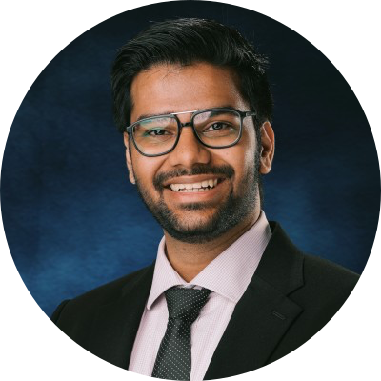

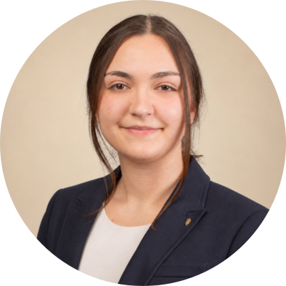


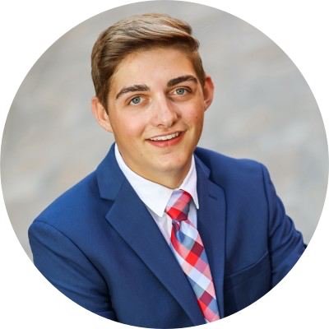
TEAM ORACLE OF PLENTY
Help us test one handoff
OUR ASK
Connect us with
one event host
one food-recovery partner
one volunteer or route partner
Shiv
Hacker · AI Engineer
Summer Shang
Hacker · CS & Math
Gracie
Hacker
Jisoo Sun
Hipster · UX Researcher
Namuun Zolbadrakh
Hipster
Karver Repp
Hustler
Not Wasted · Surplus saved
12 / 12
Notes:
About 15 seconds. We're Team Oracle of Plenty. Our ask is simple: introduce us to one event host, one food-recovery partner and one volunteer or route partner, and we'll prove the loop end to end. Not Wasted — surplus saved, neighbors fed.

