Slide 1
REVIEW III · FINAL DEMONSTRATION AND INNOVATION
GraphRAG-Powered Cyber Threat Intelligence Platform
A multi-model NoSQL approach: Neo4j · MongoDB · Redis · Qdrant · local LLM
Shivansh Sharma
23BCE0254
Himali Sharma
23BCE0317
Aayush Sinha
23BCE0558
Guide: Dr. Lydia Jane G · VIT Vellore · October 2026
Notes:
Introduce the team and the project in one sentence: a CTI workstation where each kind of threat data lives in the NoSQL engine built for it, and a GraphRAG layer that answers analyst questions with every sentence cited. Today: the complete system, a live demo, and the performance evaluation, including four scalability defects our benchmark found and we fixed.

Slide 2
THE PROBLEM
Threat intelligence is four different shapes of data
Relationships
Reports
Live indicators
Narrative
Which actors share C2 infrastructure with APT28?
→ graph
STIX bundles and analyst reports, each with different nested fields
→ document
Is 185.86.77.12 still on the blocklist? It must expire on time.
→ key–value + TTL
What else looks like this spearphishing lure?
→ vector similarity
One engine fits at most one of these. And an LLM answering CTI questions must not invent attributions: every claim has to be traceable to stored evidence.
GraphRAG CTI Platform · Review III
2
Notes:
An analyst's questions touch four data shapes at once. Who shares C2 with APT28 is a graph question; a STIX report is a document with fields that differ per report; a blocklist entry must expire on time and be checked in microseconds; and 'what looks like this lure' is a similarity question. One database is optimal for at most one of these, which is the literature's 'one size does not fit all' argument. And plain RAG over CTI can produce confident attributions that no stored evidence supports.

Slide 3
REVIEW III
A complete, measured system
4
35
31
100%
NoSQL engines
API endpoints
automated tests
gold evidence recalled
graph, document, key–value, vector — one job each
JWT roles, TLP on every read, fail-closed enforcement
16 unit + 15 integration, run in CI on every push
six acceptance questions, edges and reports
9.5 s
200×
185 ms
4
GraphRAG p95
corpus scaling tested
retrieval p95 at 200×
scalability defects fixed
target < 15 s (was 52.3 s)
15,012 nodes, 2,400 reports
was 14.7 s before the fixes
found by our own benchmark harness
GraphRAG CTI Platform · Review III
3
Notes:
What exists now: four stores each used for one job; 35 API endpoints behind JWT auth and TLP policy; an eight-page analyst console; 16 unit and 15 integration tests in CI; and a benchmark harness. The headline numbers: all gold evidence recalled on the six acceptance questions, GraphRAG p95 9.5 seconds with the local model, and retrieval p95 of 185 ms even at 200 times the corpus.

Slide 4
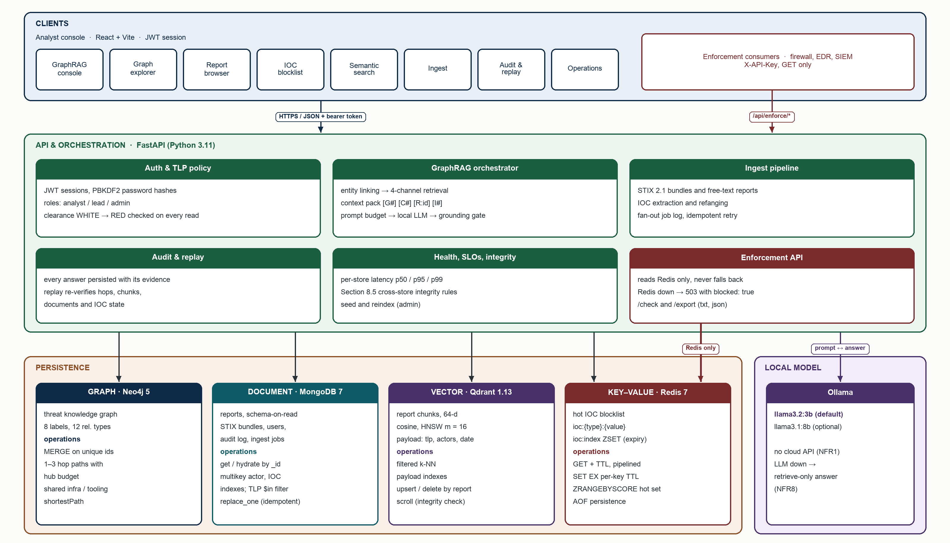
ARCHITECTURE
Each store does one job; the API owns policy
GraphRAG CTI Platform · Review III
4
Notes:
Walk top to bottom. Clients: the React console and enforcement consumers, which only ever reach the enforcement API. The FastAPI layer owns authentication, TLP policy, ingest, GraphRAG orchestration, audit and operations. The four stores each expose a closed set of operations. The enforcement API reads Redis only and fails closed. The local model is called only by the orchestrator and never writes to a store.

Slide 5
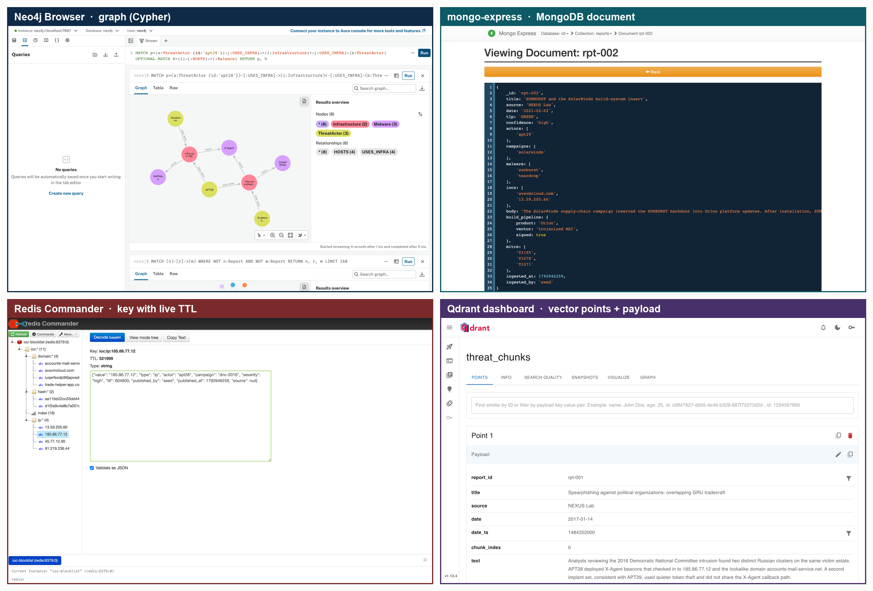
THE DATABASES
Four real database servers, each in its own console
Open them live
Neo4j :7474
MongoDB :8081
Redis :8082
Qdrant :6333/dashboard
make dbui starts the MongoDB and Redis consoles (read-only)
GraphRAG CTI Platform · Review III
5
Notes:
Before the application, show the databases themselves. Top left, Neo4j Browser running Cypher on the live graph: APT28 and Sandworm share a server. Top right, mongo-express showing report rpt-002 with its own nested build_pipeline field. Bottom left, Redis Commander: an IOC key with its value and a TTL counting down. Bottom right, the Qdrant dashboard: a vector point with its payload. All four run as Docker containers from the official images; make dbui opens the two consoles that are not built in, and review3/DATABASE_TOUR.md has the queries.

Slide 6
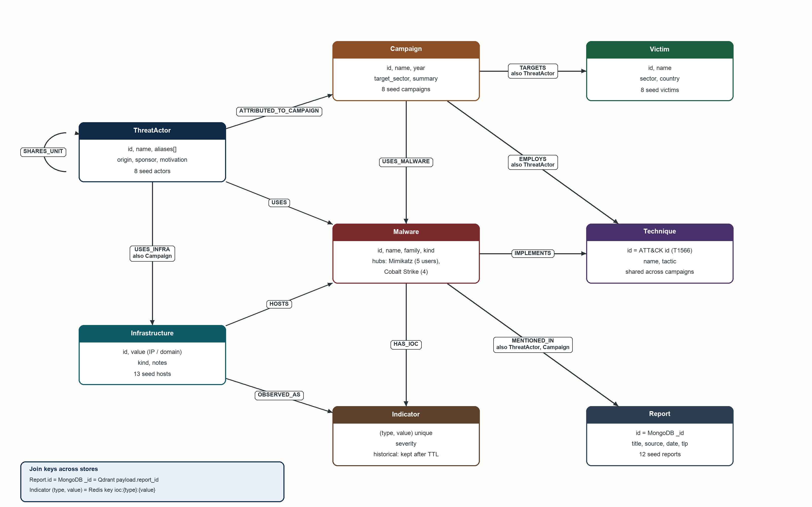
DATA MODEL
One graph, three join keys
Join keys
Report.id = MongoDB _id = Qdrant report_id
Indicator (type, value) = Redis key ioc:{type}:{value}
Indicators stay in the graph after their TTL: enforcement and history can disagree (UC4).
Integrity check: 3 hard + 2 informational cross-store rules.
GraphRAG CTI Platform · Review III
6
Notes:
The graph holds eight labels and twelve relationship types. Commodity tools such as Mimikatz are single shared nodes, which is what makes them hubs. Three keys join the stores: the report id is the Mongo _id, the Report node id and the Qdrant payload report_id; and an indicator's type and value is both the Indicator node key and the Redis key. Indicator nodes outlive their Redis key, so history and enforcement can legitimately disagree — that is use case UC4.

Slide 7
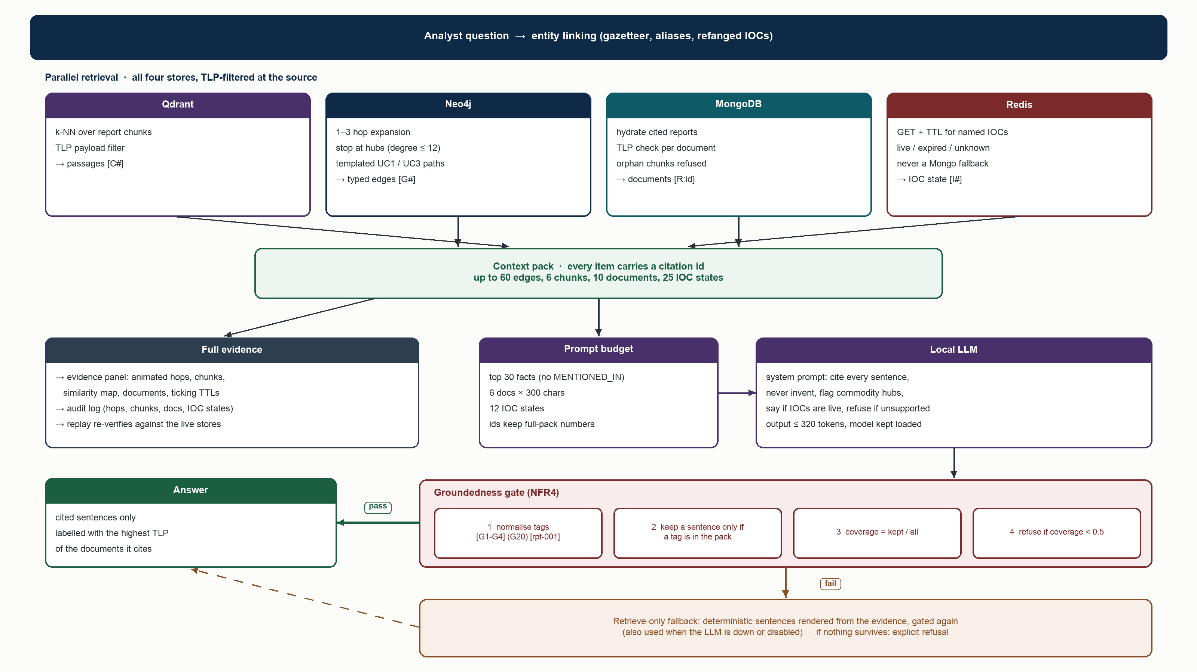
GRAPHRAG
Four-channel retrieval, a local LLM, and a gate
GraphRAG CTI Platform · Review III
7
Notes:
Entity linking maps names and IOCs in the question to graph ids. Four channels retrieve in parallel, each filtered by the analyst's TLP clearance at the source. Every item gets a citation id: G for a graph edge, C for a passage, R for a report, I for an IOC state. The full pack goes to the evidence panel and the audit log; the LLM sees a ranked, trimmed pack. The gate keeps only sentences with a valid tag and refuses below 50 percent; a refused answer is replaced by deterministic evidence sentences, never by an unsupported one.

Slide 8
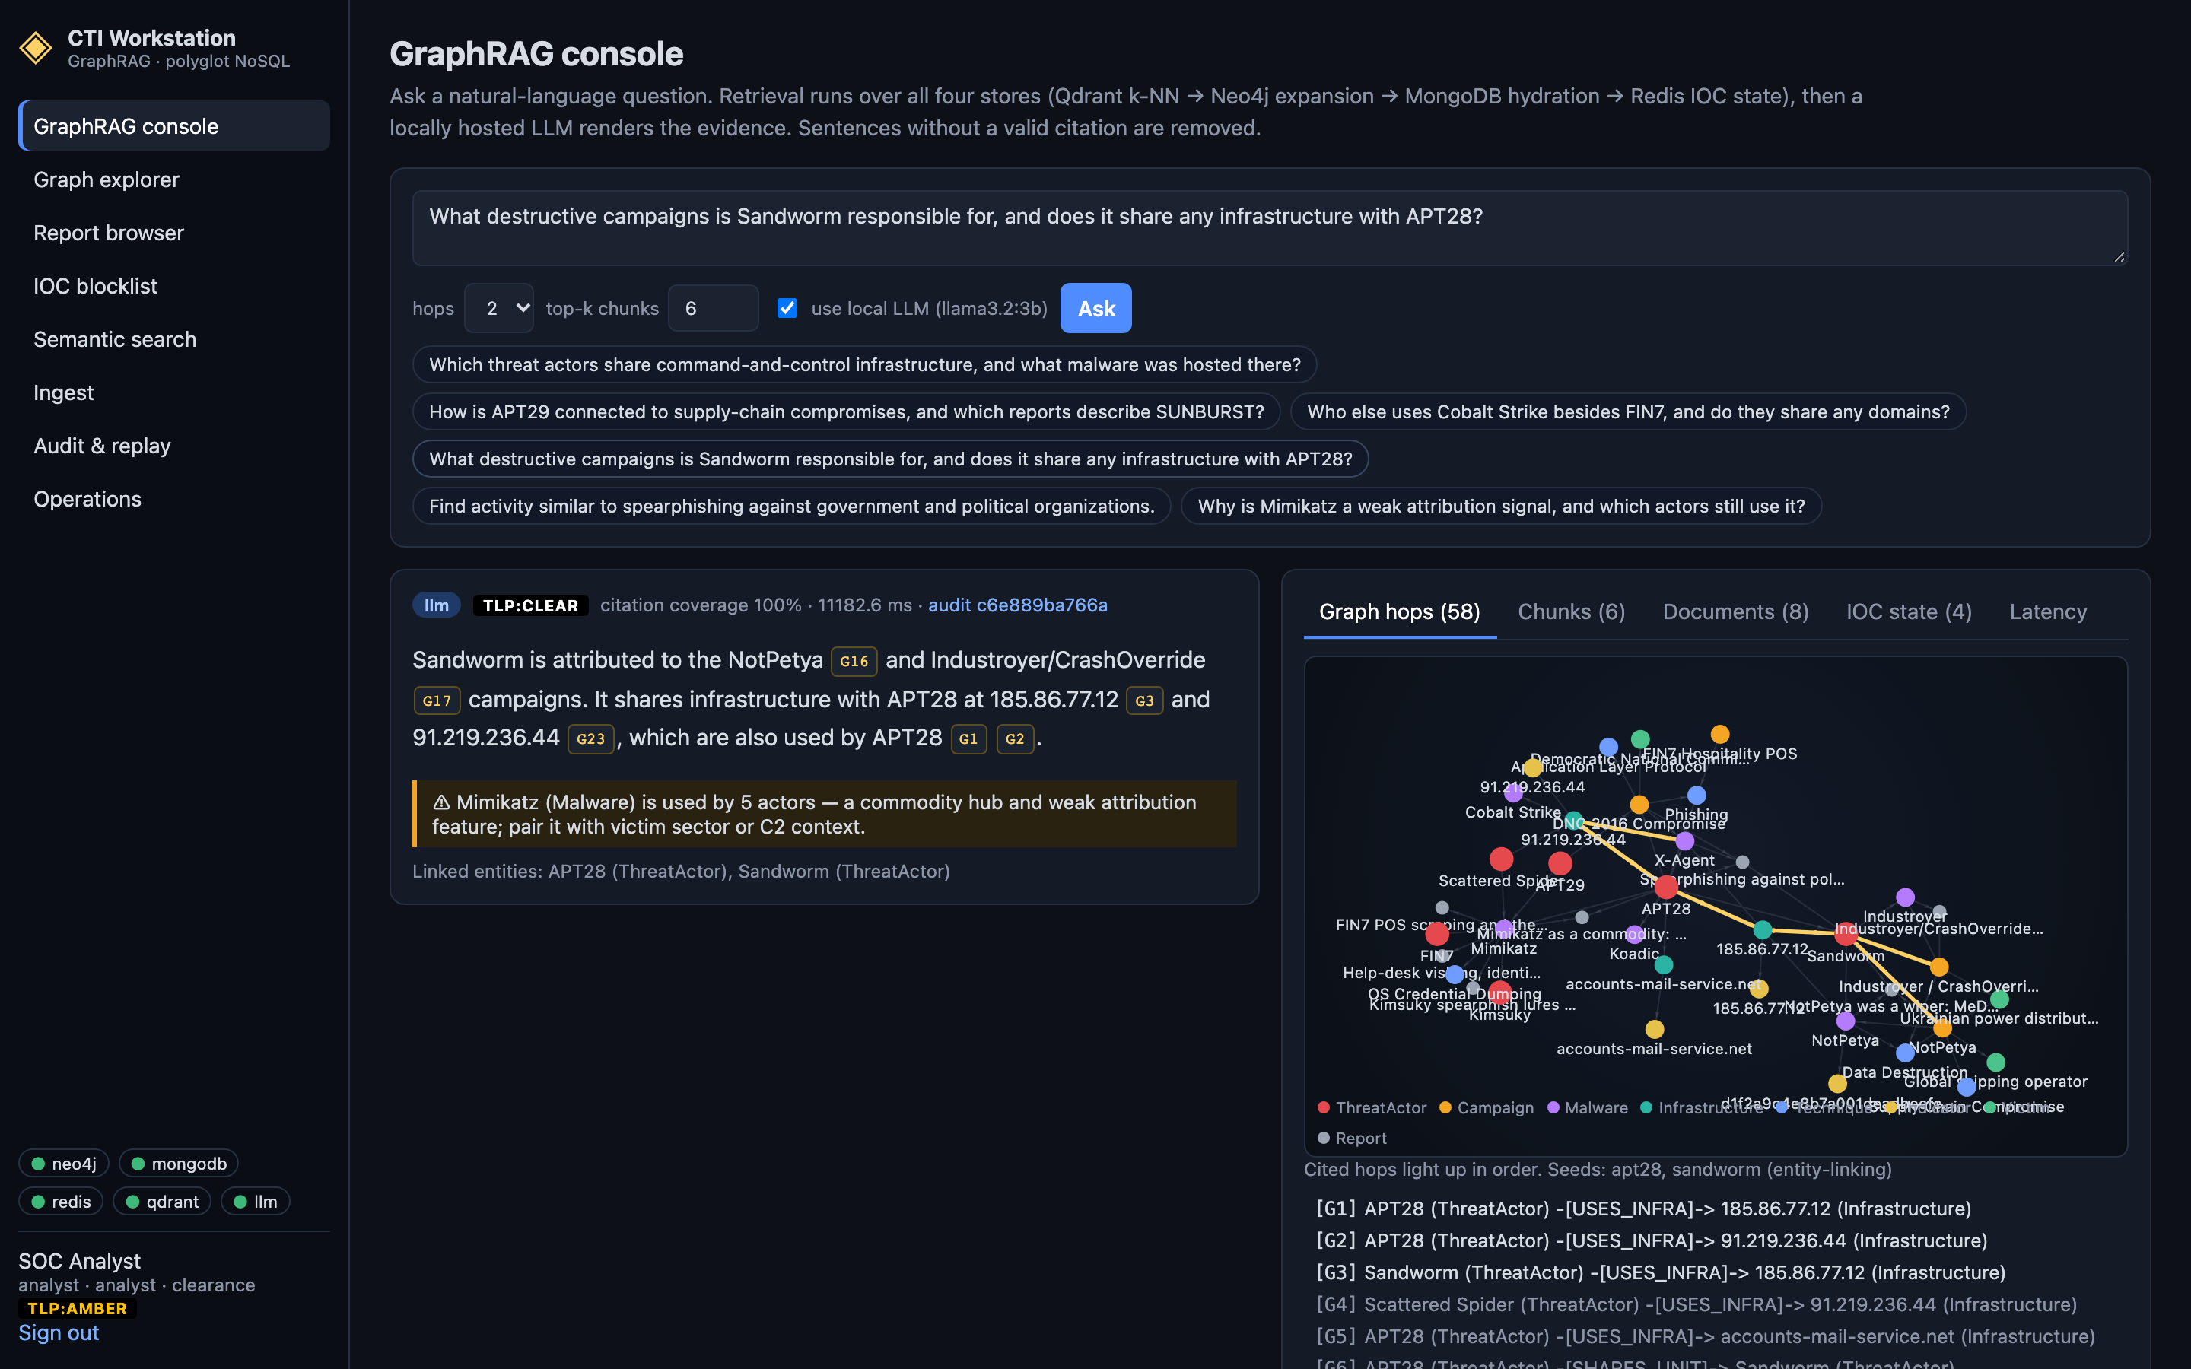
LIVE SYSTEM
Every sentence is cited and every hop is visible
Reading an answer
llm / retrieve-only mode
TLP label of the cited reports
citation coverage
G · C · R · I citation chips
⚠ commodity-tool caution
evidence: hops, chunks, documents, IOC state, latency
audit link → replay
GraphRAG CTI Platform · Review III
8
Notes:
This is acceptance question 4 answered live by llama3.2:3b. The chips under each sentence link to the evidence; G16 and G17 are the ATTRIBUTED_TO_CAMPAIGN edges for NotPetya and Industroyer. The amber box is the commodity-hub caution. On the right, the evidence panel animates the cited hops. Coverage is 100 percent; the answer took about 11 seconds.

Slide 9
INNOVATION
What is new in this design
Four-store GraphRAG
Groundedness gate
Hub-aware traversal
TLP inside retrieval
typed citations across graph, documents, vectors and cache
uncited sentences removed; refusal + evidence-only fallback
stops at commodity tools; weak-attribution caution
payload filter, $in filter, graph filter; answers labelled
Fail-closed enforcement
Replayable answers
Local AI, prompt budget
Self-measuring
Redis-only API; 503 blocked:true when Redis is down
re-verify every hop, chunk and IOC weeks later
3B model meets the 15 s SLO with no cloud API
evaluation gate + benchmark harness in the code base
GraphRAG CTI Platform · Review III
9
Notes:
Eight things set this apart from MISP, OpenCTI or a plain RAG chatbot. Emphasise the gate with its deterministic fallback, TLP enforced inside each store query rather than after generation, the separation of the fail-closed enforcement plane from the analyst read path, replayable answers, and a fully local model that meets the latency target because of the prompt budget.

Slide 10
ADVANCED NOSQL
Using each engine beyond CRUD
Neo4j
MongoDB
Redis
Qdrant
variable-length paths with COUNT {} predicates (hub budget)
weighted path ranking with reduce()
composite (type, value) uniqueness
UNION-of-labels index seeks
CALL … IN TRANSACTIONS bulk writes
schema-on-read report fields
multikey indexes on actors and IOCs
explain() to verify IXSCAN
idempotent replace_one upserts
collStats for index sizing
per-key TTL (SET EX)
sorted-set expiry index
pipelined GET + TTL
hot set via ZRANGEBYSCORE
AOF persistence
HNSW, cosine, m = 16
keyword + integer payload indexes
filtered k-NN
tunable ef (recall vs speed)
exact search as ground truth
Each claim is measured, not assumed: Neo4j PROFILE, MongoDB explain() and exact k-NN as ground truth back every index and traversal choice (Section 9).
GraphRAG CTI Platform · Review III
10
Notes:
One slide per store would be too much; these are the capabilities you can ask us about. Neo4j: variable-length paths with COUNT subquery predicates and weighted ranking, composite uniqueness, PROFILE-driven tuning. MongoDB: schema-on-read with multikey indexes verified by explain. Redis: TTL plus a sorted-set expiry index and pipelining. Qdrant: HNSW with tunable ef and payload-indexed filters, with exact search as ground truth.

Slide 11
VALIDATION
Tested at three levels, on every push
Test tiers
Acceptance question | Edges | Reports | Coverage
Shared C2 + hosted malware | 2/2 | 1/1 | 0.50
APT29 ↔ SUNBURST supply chain (gate fallback) | 1/1 | 1/1 | 1.00
Cobalt Strike users besides FIN7 | 2/2 | 1/1 | 1.00
Sandworm campaigns + APT28 infra | 2/2 | 1/1 | 1.00
Spearphishing analogue search | 0/0 | 1/1 | 0.67
Why Mimikatz is weak attribution | 2/2 | 1/1 | 0.60
16 unit tests — TLP, parsing, linker equivalence, gate
15 integration tests — real API, live stores
Evaluation gate — 6 questions, exits non-zero on a miss
Benchmarks — 6 experiments
CI — all of the above, fresh containers, every push
All gold evidence recalled · no refusals · mean coverage 0.79
GraphRAG CTI Platform · Review III
11
Notes:
Unit tests cover policy and parsing; 15 integration tests drive the real API against live stores and clean up after themselves; the evaluation gate runs the six acceptance questions and fails the build if any gold edge or report is missed. All of it runs in GitHub Actions on fresh containers. In the final run every question recalled its gold evidence; question 2's draft was caught by the gate and replaced by the evidence answer — that is the safety net working.

Slide 12
PERFORMANCE · SERVICE LEVELS
Every latency objective is met
Redis blocklist GET
Neo4j 1–3 hop
GraphRAG with LLM
1.08 ms
15.73 ms
9.5 s
p99 · target < 5 ms
3-hop p95 · target < 500 ms
p95 · target < 15 s
0.534 ms at 500,000 keys
1-hop 12.39 ms · 2-hop 35.52 ms
llama3.2:3b · was 52.3 s
Measured with make eval and make bench · Apple M3 Pro host, Docker VM with 2 vCPU / 4 GB shared by all engines
GraphRAG CTI Platform · Review III
12
Notes:
The three NFR2 targets. Redis p99 1.08 milliseconds against 5, and 0.534 at half a million keys. Neo4j three-hop p95 15.73 milliseconds against 500. GraphRAG end to end, with the LLM, 9.5 seconds against 15. Benchmarks ran on a 2-vCPU, 4 GB Docker VM, so these are conservative.

Slide 13
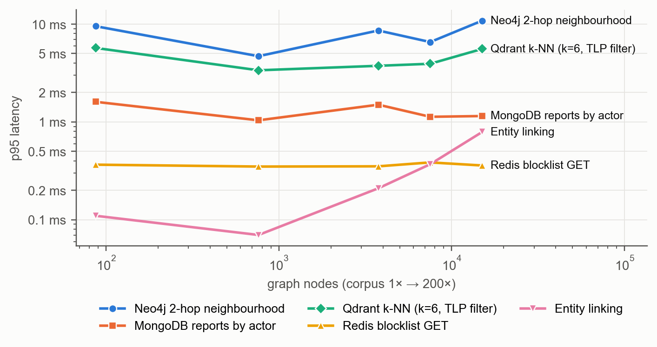
PERFORMANCE · SCALABILITY
1× → 200×: store queries stay flat
At 200× (15,012 nodes)
Neo4j 2-hop p95 10.8 ms
MongoDB by actor 1.15 ms
Qdrant k-NN 5.58 ms
Redis GET 0.36 ms
Entity linking 0.79 ms
Evidence capped at 60 edges by the hub budget
GraphRAG CTI Platform · Review III
13
Notes:
We cloned the corpus up to 200 times through the production loader: 15,012 nodes and 2,400 reports. Every store query stays within a few milliseconds. Neo4j traversal cost depends on the neighbourhood, not graph size, and the hub budget caps the evidence at 60 edges at every scale.

Slide 14
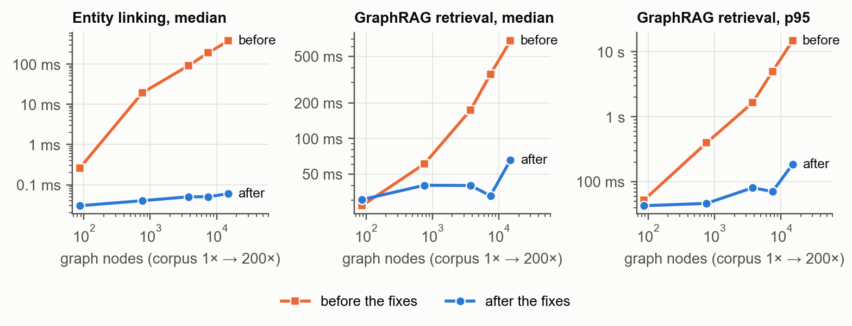
PERFORMANCE · WHAT THE BENCHMARK FOUND
Four defects, invisible at seed scale
At 200×
retrieval median
675 ms → 65.4 ms
retrieval p95
14.7 s → 185 ms
ingest
1.5 → 31.6 reports/s
Linear entity linking → inverted index
379 ms → 0.06 ms
Unbounded query + N+1 full scans → LIMIT + batched index seeks
p95 14.7 s → 185 ms
Whole-graph join on ingest → plan-scoped join
1.5 → 31.6 reports/s
Shared vector client under load → one client per thread
HTTP 500 → 0 errors
GraphRAG CTI Platform · Review III
14
Notes:
The first scaling run looked very different: retrieval grew linearly, to 14.7 s p95 at 200 times. Profiling found four causes. Entity linking ran one regex per gazetteer entry; we replaced it with an inverted index, proven identical by a test. A global query was unbounded and fetched nodes one at a time with a label-less match — a full scan each; we bounded it and batched the lookups through index seeks. Ingest re-joined the whole graph. And under concurrency a shared Qdrant client caused HTTP 500s; now each worker thread has its own client.

Slide 15
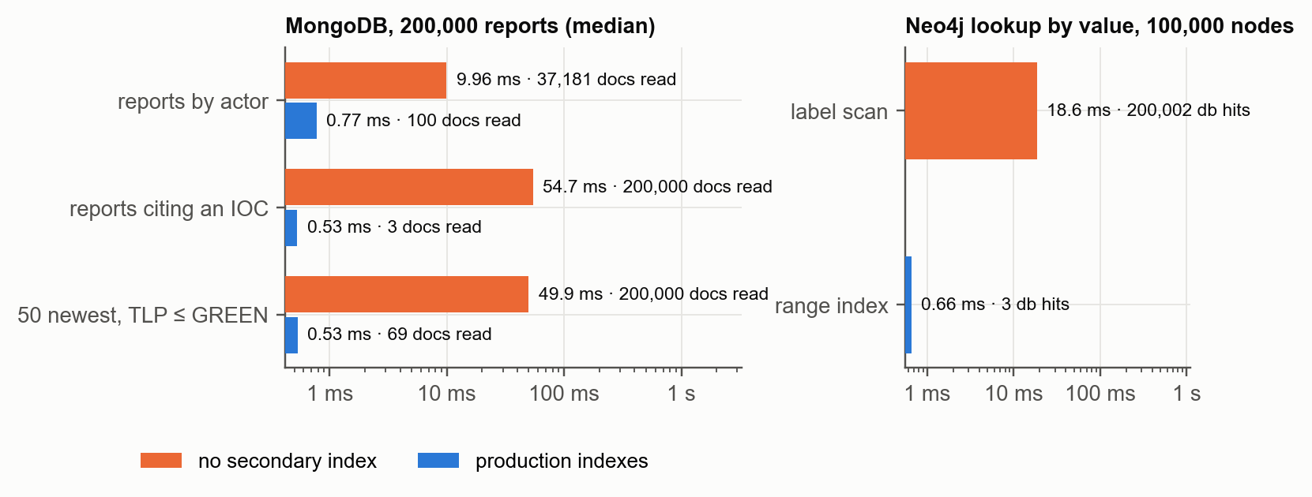
PERFORMANCE · INDEXING
Indexes turn scans into seeks
103×
MongoDB IOC lookup
200,000 → 3 documents read
28×
Neo4j lookup by value
200,002 → 3 db hits
Plans verified with MongoDB explain() (COLLSCAN → IXSCAN) and Neo4j PROFILE (NodeByLabelScan → NodeIndexSeek).
GraphRAG CTI Platform · Review III
15
Notes:
On 200,000 synthetic reports MongoDB without secondary indexes scans the collection: looking up the reports that cite an IOC reads all 200,000 documents in 54.7 ms; with the multikey index it reads 3 in 0.53 ms. In Neo4j a label scan over 100,000 nodes costs 200,002 database hits; the range index makes it 3. The production indexes cost about 14 MB on 44 MB of data.

Slide 16
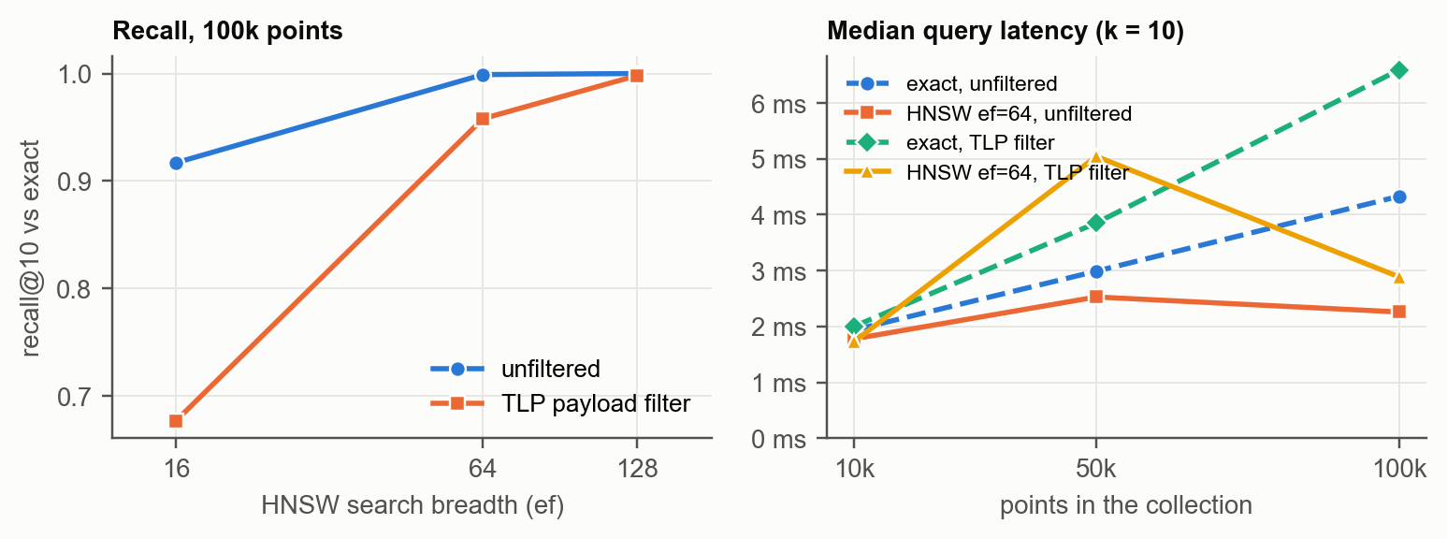
PERFORMANCE · KEY–VALUE AND VECTOR
O(1) enforcement, accurate vector search
Redis at 500,000 keys
0.29 ms
GET + TTL median
p99 0.53 ms · flat from 1k keys
1.0 s
full SCAN (non-key lookup)
grows linearly · 191.6 MB memory
Qdrant, 100,000 points: HNSW 2.26 ms vs exact 4.33 ms · recall@10 0.999 (ef 64)
GraphRAG CTI Platform · Review III
16
Notes:
Redis: the enforcement lookup is independent of key count — 0.29 ms median at half a million keys — while any lookup not by key is a full scan, a second at that size. That is why we never query Redis by attribute. Qdrant: exact search grows linearly; HNSW stays near 2.26 ms with recall 0.999. Filtering by TLP needs a wider search breadth, ef 128, to keep recall at 0.998.

Slide 17
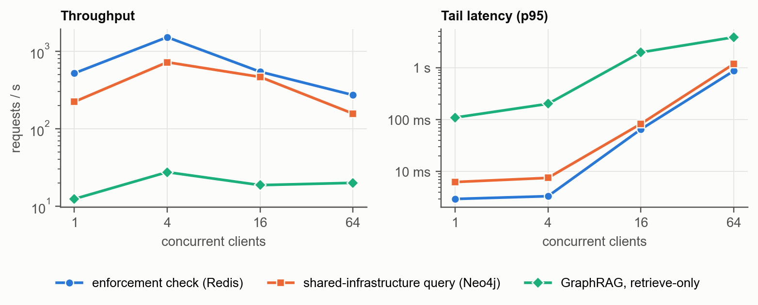
PERFORMANCE · CONCURRENCY
One worker: ~1,500 checks/s, then queueing
Takeaways
peak 1,512 enforcement checks/s
0 errors at 64 clients
knee at 4 clients: one Python worker on 2 vCPUs
scale out with workers or replicas — the stores are not the limit
GraphRAG CTI Platform · Review III
17
Notes:
With one Uvicorn worker the enforcement check peaks at about 1,512 requests per second with four clients, with zero errors at any level after the thread-safety fix. Beyond that the Python worker, sharing two vCPUs with the databases, is the bottleneck, so latency rises from queueing. The stores are not the limit; scaling out means more workers or replicas.

Slide 18
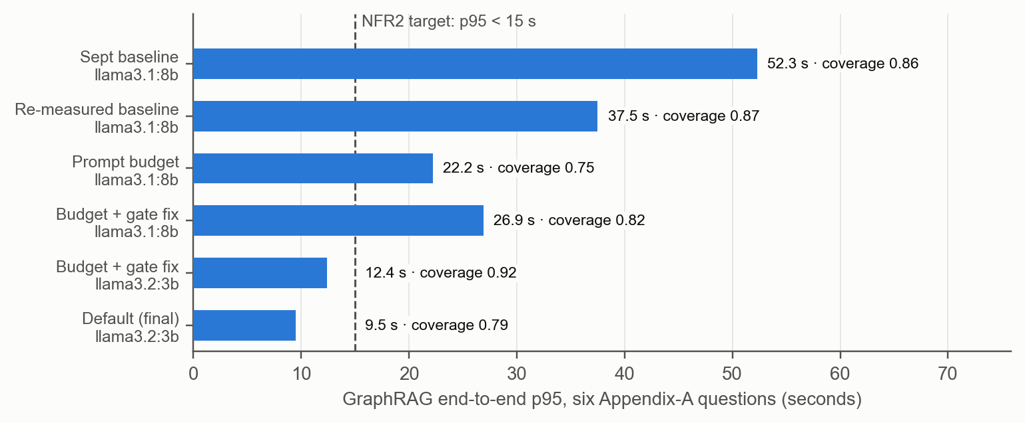
PERFORMANCE · LLM LATENCY
From 52.3 s to 9.5 s without a GPU server
Why it got faster
prompt evaluation was 17 s of a 24.5 s call
prompt budget: ~½ the characters
output cap 320 tokens, model kept loaded
default llama3.2:3b; llama3.1 is one setting away
GraphRAG CTI Platform · Review III
18
Notes:
Profiling showed the time went to reading the prompt: with the full evidence pack, llama3.1 spent 17 of 24.5 seconds evaluating 4,991 prompt tokens. The prompt budget — the top 30 facts, six short documents, twelve IOC states — halves the prompt; with the output cap and keep-alive llama3.1 reaches 21 to 27 seconds and llama3.2:3b 9.5 seconds. The gate fix stopped valid citations written as (G20) or G1-G4 from being thrown away.

Slide 19
REQUIREMENTS
All 20 requirements met, all 5 gaps closed
✓ FR1 ingest
✓ FR2 multi-hop
✓ FR3 blocklist
✓ FR4 search
✓ FR5 GraphRAG
✓ FR6 hydration
✓ FR7 evidence UI
✓ FR8 corpus
✓ FR9 health/SLO
✓ FR10 replay
✓ FR11 TLP
✓ FR12 publish
✓ NFR1 local only
✓ NFR2 latency
✓ NFR3 isolation
✓ NFR4 grounded
✓ NFR5 reproducible
✓ NFR6 ethics
✓ NFR7 usability
✓ NFR8 availability
Review I gaps closed: G1 one engine for four workloads · G2 no graph + enforcement plane · G3 no TTL cache or vectors beside the graph · G4 under-constrained RAG · G5 un-auditable answers
GraphRAG CTI Platform · Review III
19
Notes:
Every functional requirement maps to code and to a test or measurement; the full table is in Section 10 of the report. The five gaps from Review I are closed: four engines with closed operation sets, a graph with an enforcement plane, Redis and Qdrant beside the graph, a constrained four-channel GraphRAG, and replayable evidence.

Slide 20
LIVE DEMO
Six minutes, four use cases
UC1
Shared C2 with APT28
UC2
Similar spearphishing
UC3
Mimikatz attribution
Sandworm via 185.86.77.12; cited rpt-001; IOC state
Qdrant passages → APT28 / APT29 → reports
five users, commodity-hub caution
UC4
Indicator expiry
TLP
Sign in as junior
Ops
Ingest, replay, health
TTL hits zero; graph still remembers
AMBER reports vanish; 403 on rpt-001
STIX fan-out; replay re-verifies; SLO view
Before the demo: make seed 5 minutes ahead (fresh TTLs) · warm the model with one question · if the LLM stalls, untick “use local LLM” — answers stay cited
GraphRAG CTI Platform · Review III
20
Notes:
Run the demo from the runbook in review3/DEMO_RUNBOOK.md. Re-seed five minutes before so the short TTLs are fresh. If the LLM is slow or down, untick 'use local LLM' — retrieve-only answers are instant and still cited.

Slide 21
LIMITATIONS AND NEXT STEPS
What we would do next
Limitations
Next steps
single-node stores; one API worker
12-report curated corpus; 200× scaling is synthetic
3B model is terser than 8B
TF-IDF embeddings by default
lab secrets in .env.example
Uvicorn workers / replicas; Neo4j and Mongo clustering
TAXII feed connector for real volume
stream answers, gate on completion → 8B feels interactive
nomic-embed-text as default embedder
secrets from a vault; SSO for analysts
None of these needs a design change: each is configuration, scale-out or a new connector.
GraphRAG CTI Platform · Review III
21
Notes:
Be candid. Single-node stores and one API worker are deployment choices, not design limits. The corpus is small and the 200 times scaling is synthetic; a TAXII connector would bring real volume. The 3B model meets the SLO but writes terser answers; streaming would let the 8B model feel interactive. Neural embeddings are supported but not the default.

Slide 22
Each store does what it is best at — and every answer can be traced.
9.5 s
100%
185 ms
31
GraphRAG p95 (< 15 s)
gold evidence recalled
retrieval p95 at 200×
automated tests in CI
Thank you — questions?
github.com/Shivansharmaaaa/graphrag
Notes:
Close on the thesis: polyglot persistence plus constrained GraphRAG gives answers that are both useful and accountable, and the numbers back it. Then take questions — the likely ones and crisp answers are in review3/DEMO_RUNBOOK.md.

