Slide 1


M.Tech Program
Advanced Industry Integrated Programs
Jointly offered by University and LTIMindTree
GraphSafeAI: Spatial Intelligence System
A Graph Neural Network (GraphSafe) & Geospatial Intelligence Platform for Urban Safety Prediction in Smart Cities
Shivanshika Agarwal
T9978
Knowledge partner | Implementation partner

Slide 2
GraphSafeAI
Introduction
Cities generate massive spatial data via road networks, public amenities, and incident logs. Current platforms rely on static crime maps and isolated reports, failing to capture spatial connectivity.
Key System Gaps Addressed
Lack of Spatial Intelligence: Inability to model spatial dependencies between adjacent blocks
Poor Network Integration: Ignores road network topology and street connectivity.
Static Safety Maps: Static hotspots fail to predict emergent risk zones dynamically
Unused Amenities Data: Underutilizes emergency infrastructure (hospitals, police stations).

Slide 3
GraphSafeAI
Objective
Main Objective: To develop an AI-powered urban safety platform combining graph-based machine learning (GarphSafeAI) with geospatial analytics for Chennai City.
Extract and process road network topology from OpenStreetMap (OSM).
Divide city into spatial region graphs and compute structural features.
Incorporate emergency amenities and community incident reports.
Generate inductive region embeddings using GarphSafeAI GNN.
Identify structurally similar regions and detect high-risk safety zones.

Slide 4
GraphSafeAI
Scope
Geographic Scope: Chennai City Urban Region
Data Scope: OSM Road Network, Infrastructure Amenities, Spatial Grids & Citizen Incident Reports
Technical Scope: Graph Construction, Node Features, GarphSafeAI Embeddings & Unsupervised Clustering
Excluded: Real-time CCTV analytics, live traffic, facial recognition, predictive policing

Slide 5
GraphSafeAI
Literature Review
1. Geographic Information Systems for Urban Safety
GIS-based crime mapping
Spatial visualization
Urban analytics
2. Road Network Analysis
Graph representation of cities
Street connectivity analysis
Transportation network intelligence
3. Graph Neural Networks (GNN)
Node relationships
Spatial dependency modeling
Message passing
4. GarphSafeAI
Inductive graph learning
Neighborhood aggregation
Scalable graph embeddings
5. Smart City Safety Systems
Citizen reporting systems
Public safety monitoring
Emergency response support

Slide 6
GraphSafeAI
Summary of Literature
Key Takeaways from Literature
Urban environments are best modeled as dynamic topological networks.
Neighborhood relationships significantly influence spatial safety outcomes.
Infrastructure density (hospitals, police, lights) dictates regional resilience.
Existing solutions treat these domains in silos rather than unified models.

Slide 7
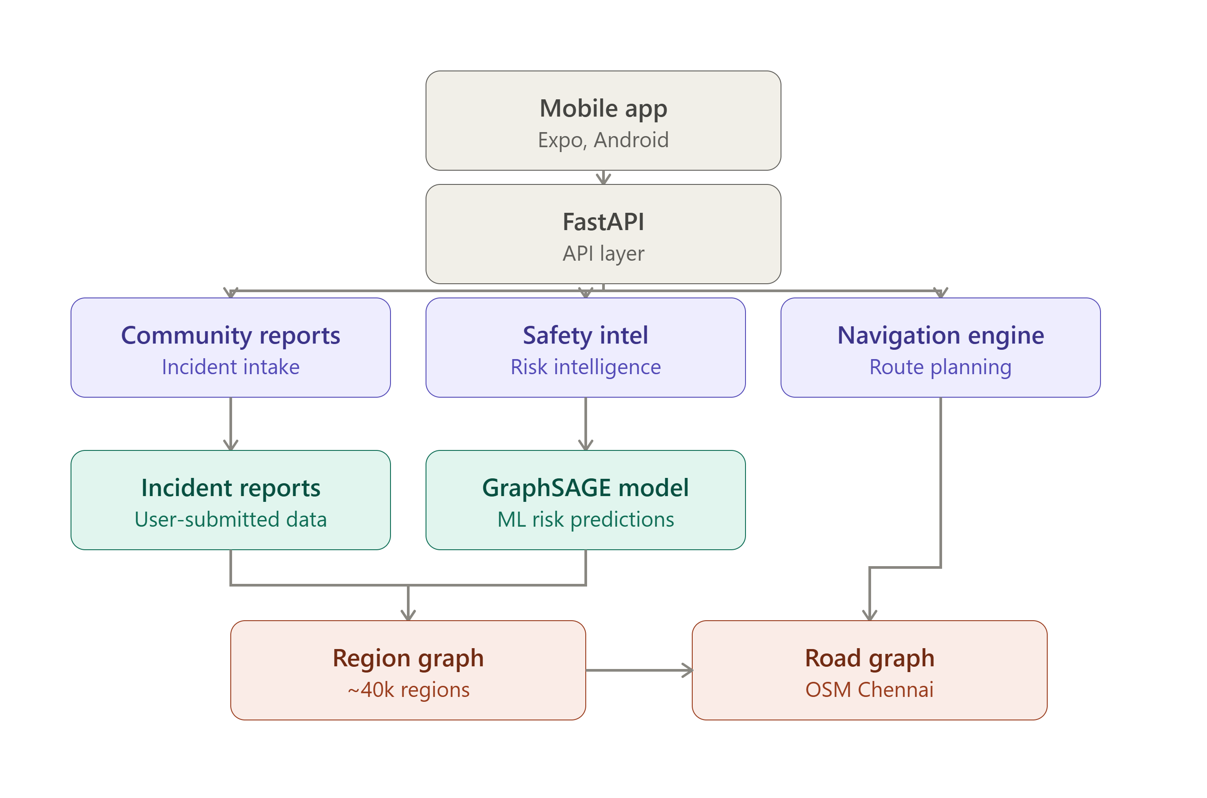
GraphSafeAI
System Architecture

Slide 8




GraphSafeAI
Modules to Cover
Road Network Processing
Region Generation
Region Graph Construction
Topology Feature Engineering
Infrastructure Intelligence
Accessibility Analysis
Safety Intelligence
GarphSafeAI Learning
Region Clustering
Safety Analytics

Slide 9
GraphSafeAI
1: Road Network Processing
OSM Data Extraction
Node Processing
Edge Processing
Road Graph Construction

Slide 10
GraphSafeAI
2: Region Generation
Spatial Grid Division
Region Creation
Node-to-Region Mapping
Regional Statistics

Slide 11
GraphSafeAI
3: Region Graph Construction
Region Connectivity Analysis
Adjacency Computation
Graph Edge Creation

Slide 12
GraphSafeAI
4: Topology Feature Engineering6
Node Count
Degree Analysis
Dead-End Detection
Intersection Analysis
Connectivity Scoring

Slide 13
GraphSafeAI
5: Infrastructure Intelligence
Amenity Extraction
Hospital Analysis
Police Station Analysis
Banking Accessibility
Educational Infrastructure
Emergency Infrastructure

Slide 14
GraphSafeAI
6: Accessibility Analysis
Nearest Hospital Distance
Nearest Police Distance
Nearest School Distance
Emergency Accessibility

Slide 15
GraphSafeAI
7: Safety Intelligence
Community Reports
Severity Analysis
Incident Diversity
Safety Feature Generation

Slide 16
GraphSafeAI
8: GarphSafeAI Learning
Graph Dataset Construction
Feature Encoding
GarphSafeAI Architecture
Embedding Generation

Slide 17
GraphSafeAI
9: Region Clustering
Embedding Analysis
Similar Region Detection
Cluster Formation

Slide 18
GraphSafeAI
10: Safety Analytics
Hotspot Framework
Similar Region Discovery
Risk Analysis
Future Prediction Framework

