Slide 1
Jason and Jaap PowerShell tips
Jason Yoder & Jaap Brasser
@JasonYoder_MCT @jaap_brasser
#psconfasia

Slide 2


About_jason
MCSE since Windows NT 4.0
Bachelors degree in Computer Science
Microsoft Certified Trainer
SAPIEN Technologies PowerShell MVP
Technical Reviewer for Microsoft’s official PowerShell training
Author of Advanced Windows PowerShell Scripting video training
@ JasonYoder_MCT

Slide 3

About_jaap
Dutch PowerShell User Group
Blogging
PowerShell Magazine
JaapBrasser.com
Slack
Reddit
GitHub
PowerShell Gallery
TechNet Forums/Gallery
@Jaap_Brasser

Slide 4
Download the Code
http://tinyurl.com/hwkq7h4

Slide 5
Get-ADGroupMemberDate
Uses the repadmin command to get information about users added to groups
Can be used to determine historical group membership
Can be used to identify malicious use of administrative groups

Slide 6
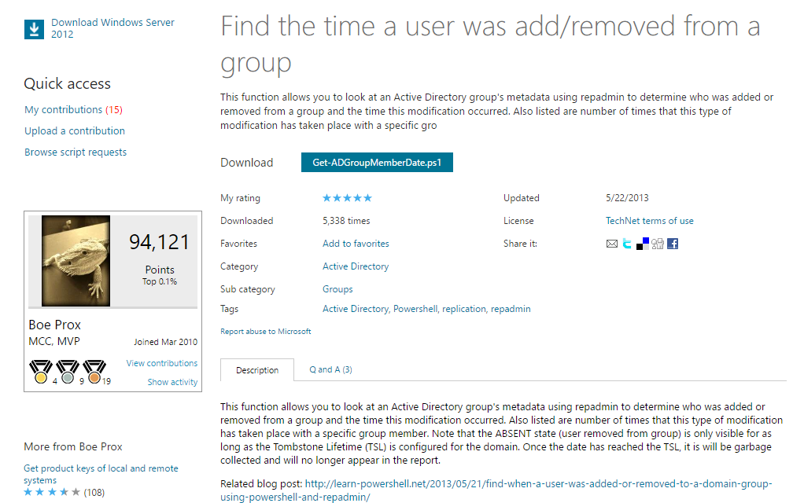
Script is available on TechNet

Slide 7
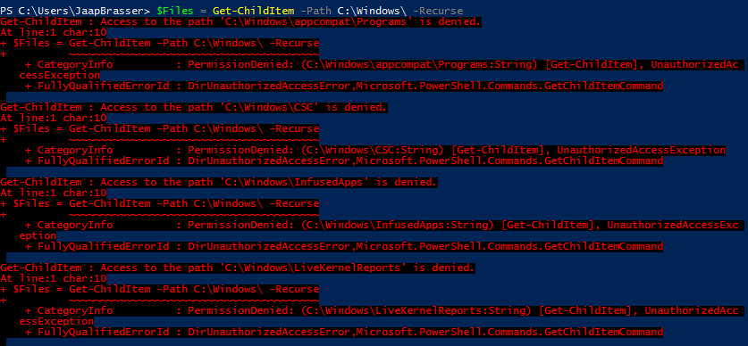
Demo – Get-ADGroupMemberDate

Slide 8
Demo Summary
Showed historical view of users added and removed from a group
Added and removed a domain admin to a group
Viewed the results
Showed how this information is gathered by repadmin

Slide 9
Posting message to Slack using PowerShell
Slack is a communication tool
Join psconfasia.slack.com
Slack can be used to combine information from multiple sources
Create automated reports

Slide 10
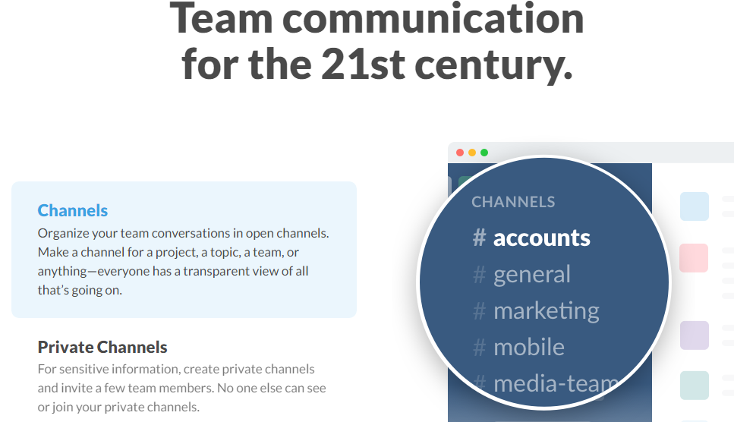
What is Slack

Slide 11
Demo – Slack and PowerShell

Slide 12
Demo Summary
How to setup a webhook in Slack
Showed how to write custom messages using JSON
How to request an API token
How to install and use the PSSlack module

Slide 13
Getting folder size using PowerShell
Getting folder size in PowerShell
Use different methods of getting this information
Disadvantage of using full objects

Slide 14
Demo – Getting folder size using PowerShell

Slide 15
Demo Summary
Showed three different methods of gathering folder sizes:
Get-ChildItem
The old dir command
Robocopy
Showed the performance difference

Slide 16
Accessing Active Directory
There are two type accelerators available in PowerShell
[adsi]
[adsisearcher]
Does not require the Active Directory module
Allows you to query Active Directory from any machine
Default permissions in Active Directory allows any user to query

Slide 17
Demo – Query Active Directory using [adsisearcher]

Slide 18
Demo Summary
Used [adsisearcher] to query for user accounts
Disabled a user account
Get all user accounts in an Organization Unit
Show how to enumerate a collection
Changed a user password
Enumerate users that has password does not expire flag set

Slide 19
Executing PowerShell from outside of PowerShell
PowerShell can be started by calling powershell.exe
There are two parameters available
File
Command
There are some limitations to using the –File parameter

Slide 20
Demo – Execute PowerShell

Slide 21
Demo Summary
File can be used for simple scripts and functions does not support arrays
Command allows you to specify the PowerShell code that should be executed
How to execute PowerShell 32bit or PowerShell 64bit

Slide 22
Creating loops in PowerShell
Show some common mistakes found in PowerShell samples found online
How to create PowerShell custom objects
How to optimize object creation and loops

Slide 23
Demo – Execute PowerShell

Slide 24
Demo Summary
File can be used for simple scripts and functions does not support arrays
Command allows you to specify the PowerShell code that should be executed
How to execute PowerShell 32bit or PowerShell 64bit

Slide 25
Additional topics open for discussion
Convert word document to pdf
Check compression of zip file
Check open folders in Explorer
Change a drive letter
Copy untitled tabs to clipboard
Create simple GUI messagebox
List non-administrative shares
Rename a local/mapped disk
Create GUI OpenFileDialog
Query MSDN from PowerShell
Test local credentials
List AD attributes in use

