Slide 1
PowerQuiz
DuPSUG presents – PowerShell Saturday PowerQuiz

Slide 2

Why?
Test your knowledge
Team up with others
Win Prizes!

Slide 3

Rules
No cheating

Slide 4
Format
Teamwork - Form teams of 3
Organize - Have one person record the answers
Automate - Submit answers on #PowerQuiz

Slide 5

Warm up
What is the name of the (now) Technical Fellow who is responsible for creating PowerShell?

Slide 6
Question #1
Which command is used to group objects together

Slide 7
Question #2
Which notation is used to indicate a hash table in PowerShell

Slide 8
Question #3
What was the name of the original manifest describing PowerShell?

Slide 9
Question #4
How many PowerShell profiles are there and can you name them all?

Slide 10
Question #5
What does [cmdletbinding()] indicate for a parameter block?

Slide 11
Question #6
Who is known as ‘the first PowerShell follower’?

Slide 12

Question #7
Can you write this more efficiently? Create a code sample that gives the same output without the pipeline

Slide 13
Question #8
What is the shortest code to kill the Outlook process in PowerShell

Slide 14
Question #9
Which of the following is NOT a ‘Snoverism’:
Did you just lick my cookie?
When in trouble, fear, or doubt - run in circles, scream, and shout.
PowerShell: like programming with hand grenades
Not upgrading is like the guy who jumps off a building, and on the way down says, so far so good.

Slide 15
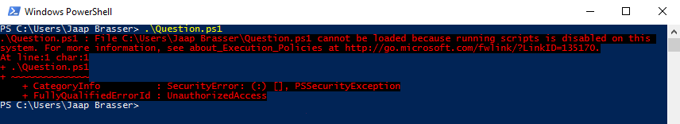
Question #10
How can you resolve the following error:

Slide 16
Question #11
In which PowerShell version was DSC introduced?

Slide 17
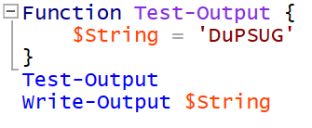
Question #12
Why is no output generated by this code:

Slide 18
Question #13
When using array indexing in PowerShell, which notation can be used to select the last 10 objects of an array?

Slide 19
Question #14
In PowerShell there are execution policies… Can you name them all?

Slide 20
Question #15
In which year was PowerShell released?

Slide 21

Question #16
What is the result of the following PowerShell code:

Slide 22
Question #17
Who wrote the PowerShell help documentation in the version 1.0/2.0/3.0?

Slide 23
Question #18
How can you view the StartType of a service in PowerShell?

Slide 24
Question #19
The percentage symbol, %, is an alias in PowerShell. What is a lesser known function of this symbol in the PowerShell language?

Slide 25
Question #20
How can you fix the following code:

Slide 26

Question #21
What does the following code do:

Slide 27

Get-Coffee

