Slide 1

Windows Server and PowerShell
Bert Wolters & Jaap Brasser

Slide 2
Module 1 – PowerShell fundamentals
What is PowerShell and how did it start
How to read the PowerShell language
Different versions of PowerShell
Help and command discovery in PowerShell
What are objects in PowerShell
The PowerShell pipeline

Slide 3

What is PowerShell and how did it start
Development started in 2001
First released in 2006
Created by a team led by Jeffrey Snover
Was initially codenamed Monad

Slide 4
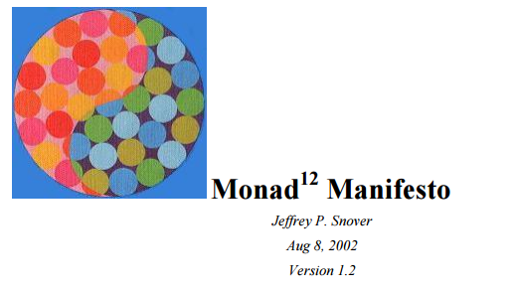

Monad Manifesto
Written by Jeffrey Snover in 2002
Set the definition for what would be PowerShell
The following 5 definitions:
Monad Automation Model
Monad Shell
Monad Management Model
Monad Remote Scripting
Monad Management Console

Slide 5
PowerShell naming
Verb-SingularNoun
Verb has to be ‘approved’
Noun should be descriptive, can contain a prefix

Slide 6
Demo Get-Verb

Slide 7
How to read the PowerShell language
Parameters
Positional parameters
Arguments

Slide 8
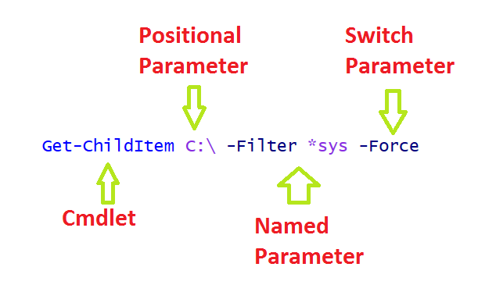
PowerShell language

Slide 9
Demo Get-ChildItem

Slide 10
PowerShell tools
Cmdlets
Functions
Aliases
External tools

Slide 11
Cmdlets & Functions
The core of PowerShell
Structured output
Pipeline aware

Slide 12
Aliases
Provide familiarity
Short hand notation
Customizability
Not just cmdlets, parameters can also have an alias

Slide 13
External tools
Can be executed in PowerShell like a command prompt
Output can be stored and manipulated using PowerShell
Does not adhere to PowerShell Language

Slide 14
Help and command discovery
Get-Help
Get-Command
Get-Member

Slide 15
Demo PowerShell Help

Slide 16
PowerShell objects
Everything in PowerShell is an object
The console displays objects
Objects can be displayed, stored, converted or exported

Slide 17
PowerShell pipeline
Can be used to transfer objects
The output from one cmdlet can directly be used in the next cmdlet
Output is transferred on a first out-first

Slide 18
Demo PowerShell Pipeline

