Slide 1
PowerQuiz
DuPSUG presents – PowerShell Saturday PowerQuiz

Slide 2

Why?
Test your knowledge
Team up with with others
Win Prizes!

Slide 3

Rules
No cheating

Slide 4
Format
Teamwork - Form teams of 3
Organize - Have one person record the answers
Automate - Submit answers on #PowerQuiz

Slide 5

Warm up
What is the name of the (now) Technical Fellow who is responsible for creating PowerShell?

Slide 6
Questions
Which command is used to group objects together

Slide 7
Questions
Which notation is used to indicate a hash table in PowerShell

Slide 8
Questions
What was the name of the original manifest describing PowerShell?

Slide 9
Questions
How many PowerShell profiles are there and can you name them all?

Slide 10
Questions
What does [cmdletbinding()] indicate for a parameter block

Slide 11
Questions
Who is known as ‘the first PowerShell follower’?

Slide 12

Questions
Can you write this more efficiently?

Slide 13
Questions
What is the shortest code to kill the Outlook process in PowerShell

Slide 14
Questions
Which of the following is NOT a ‘Snoverism’:
Did you just lick my cookie?
When in trouble, fear, or doubt - run in circles, scream, and shout.
PowerShell: like programming with hand grenades
Not upgrading is like the guy who jumps off a building, and on the way down says, so far so good.

Slide 15
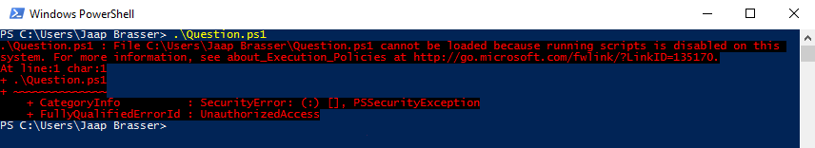
Questions
How can you resolve the following error:

Slide 16
Questions
In which PowerShell version was DSC introduced?

Slide 17
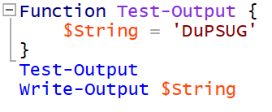
Questions
Why is there no output generated by this code:

Slide 18
Questions
When using array indexing, in PowerShell, which notation can be used to select the last 10 objects of an array?

Slide 19
Questions
In PowerShell there are execution policies… Can you name them all?

Slide 20
Questions
In which year was PowerShell released?

Slide 21

Questions
What is the result of the following PowerShell code:

Slide 22
Questions
Who wrote the PowerShell help documentation in the version 1.0/2.0/3.0?

Slide 23
Questions
How can you view the StartType of a service in PowerShell?

Slide 24
Questions
The percentage symbol, %, is an alias in PowerShell. What is a lesser known function of % in the PowerShell language?

Slide 25
Questions
How can you fix the following code:

Slide 26

Questions
What does the following code do:

Slide 27

Get-Coffee

