Slide 1
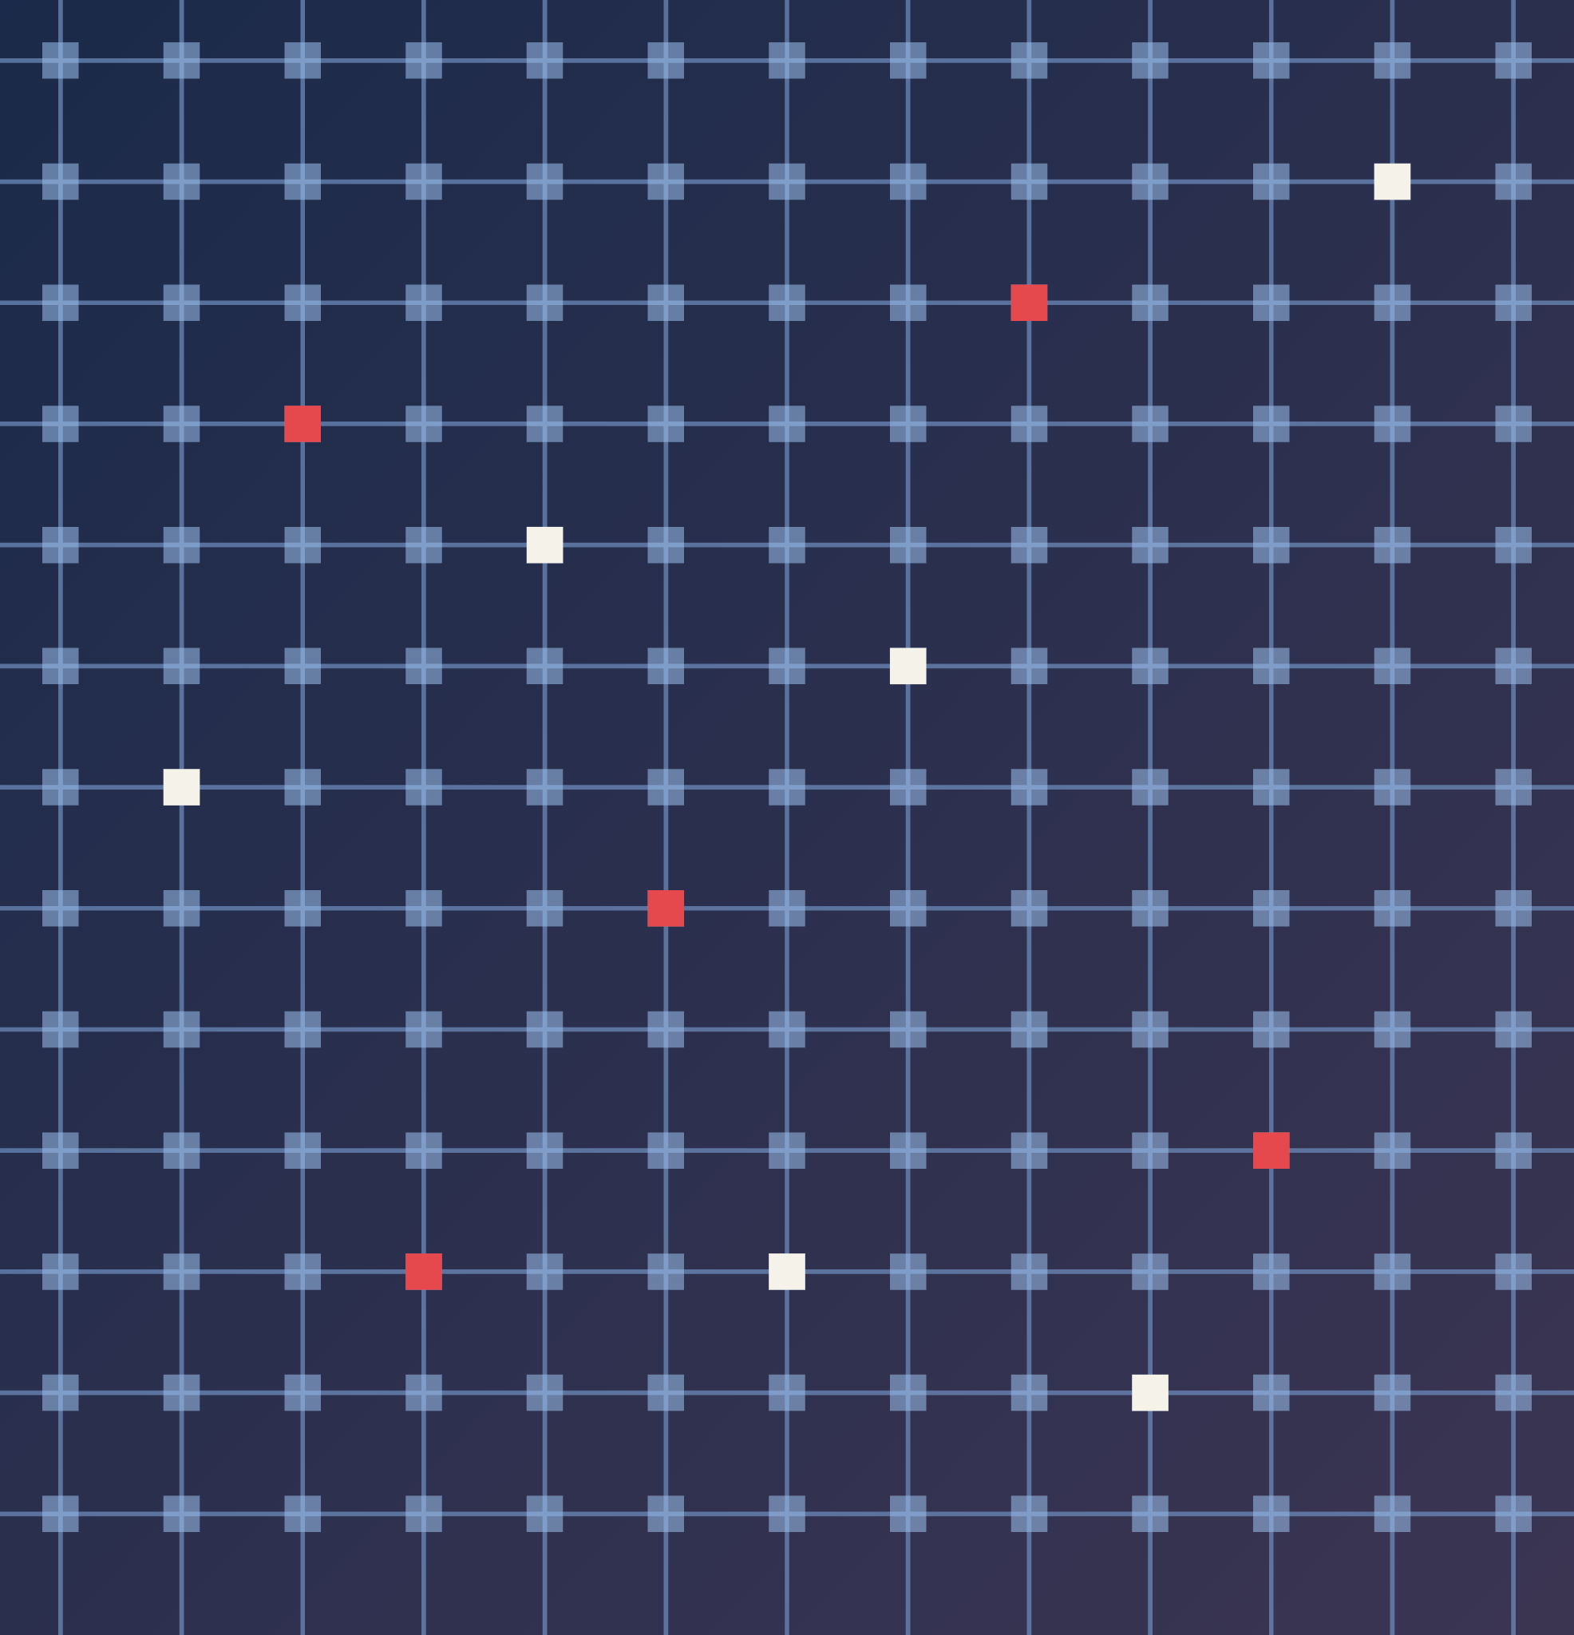
Reliable Hybrid SLC/MLC ReRAM Crossbars for Transformers
CS5290 | MEMORY-CENTRIC COMPUTER ARCHITECTURE | GROUP 7
Shivansh Mittal
Sarvesh Joshi
Thumati Naveen Chandra Chowdary
Aryan Chakravorty
Indian Institute of Technology Guwahati
Notes:
Introduce the project: we study how to make hybrid SLC/MLC ReRAM crossbars reliable for transformer inference (BERT-Base and DistilBERT on SST-2). Three ideas: which components to protect, how to map them around faulty cells, and how to train for the errors each tier will see.

Slide 2
Index
01
02
03
Aim
SVD tiering
Crossbar model simulator
04
05
06
Cell-level analysis: noise
Cell-level analysis: faults
Fault-aware mapping
07
08
09
Noise- and fault-aware training
Training results
Results on benchmarks
Notes:
Agenda for the talk. Aim and background first, then the SVD tiering method and the crossbar simulator, then the cell-level analysis of noise and of stuck-cell faults, followed by fault-aware mapping and tier-aware training for noise and for faults, and finally results on the benchmarks (SST-2 and MNLI).

Slide 3
Aim
01 SVD tiering
HyFlexPIM
Truncated SVD, with the gradient-ranked top share in SLC and the rest in MLC. We keep it unchanged.
02 Cell-level analysis
Our Extension
Model errors cell by cell: noise, stuck cells, ADC and IR drop. HyFlexPIM applies noise to whole weights at one level.
03 Fault-aware mapping
Our Extension
Reorder SVD components around a tested chip’s stuck cells, with no hardware cost.
04 Fault and noise-aware training
Our Extension
Train each component under the errors of its own tier. HyFlexPIM only fine-tunes the SVD factors; noise is applied at inference.
HyFlexPIM: C. E. Song, P. Bhatnagar, Z. Xia, N. S. Kim, T. S. Rosing and M. Kang, “Hybrid SLC-MLC RRAM mixed-signal processing-in-memory architecture for transformer acceleration via gradient redistribution,” Proc. 52nd Annu. Int. Symp. Comput. Archit. (ISCA), 2025.
Notes:
Aim: improve the reliability of a hybrid SLC/MLC crossbar along four lines. SVD tiering comes from HyFlexPIM and we keep it unchanged. Cell-level analysis, fault-aware mapping and fault- and noise-aware training are our extensions. Check against the paper: HyFlexPIM fine-tunes the SVD factors to concentrate the loss gradient (gradient redistribution), but hardware noise is applied only at inference, not during fine-tuning, and stuck cells are not modelled. Noise-aware training exists in general (Rasch et al., Chen et al., Xia et al.); our contribution is making it tier-aware for the hybrid layout.

Slide 4
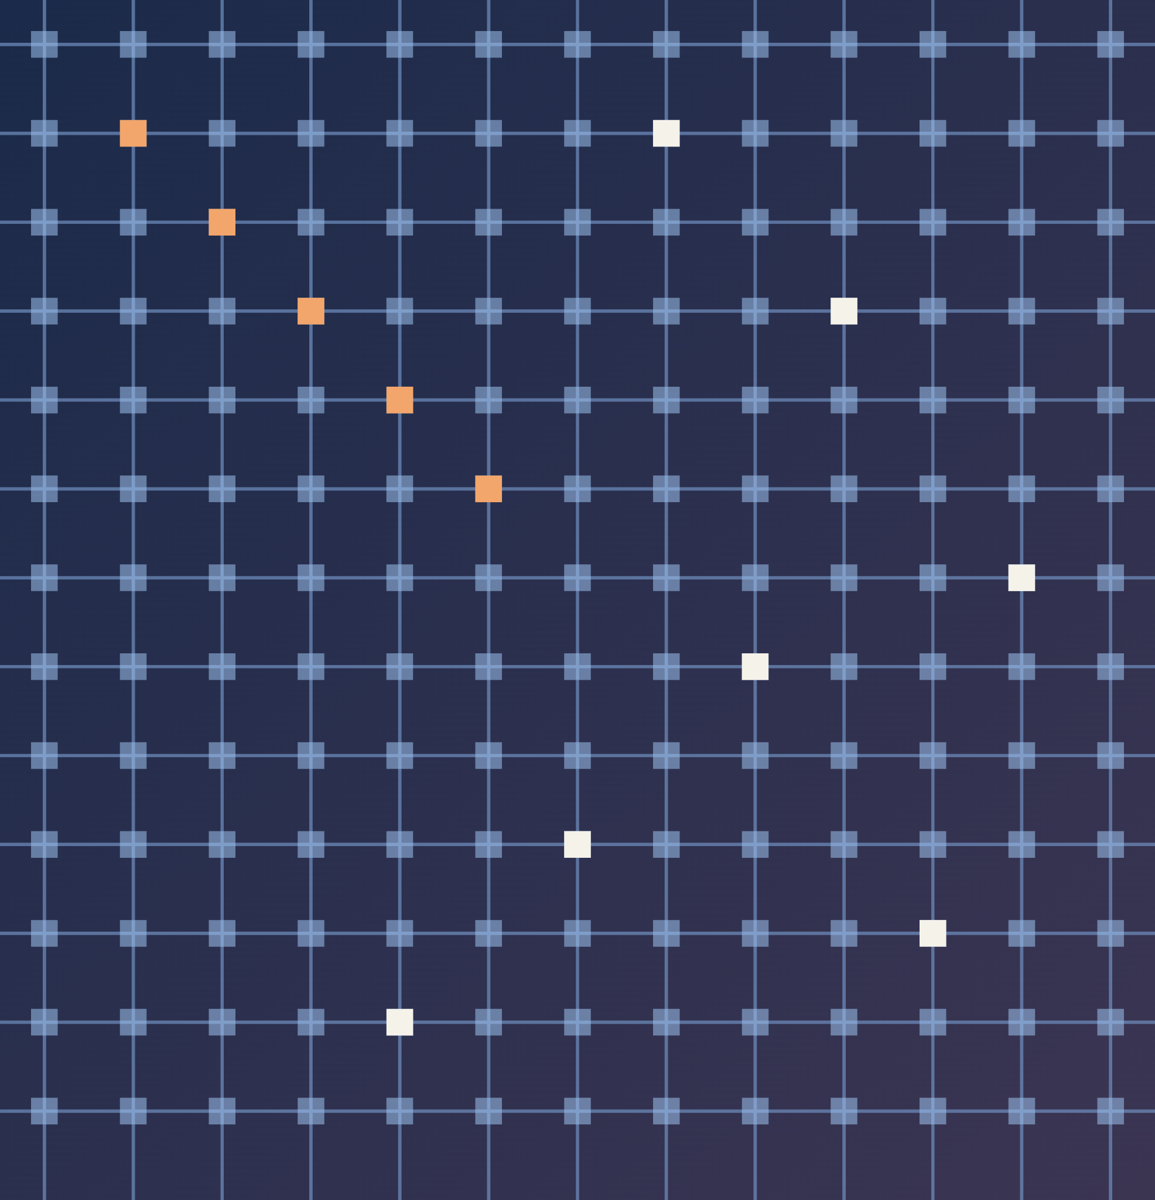
SVD Tiering
Splitting each layer across SLC and MLC crossbars
INDEX | 02
Reliable Hybrid SLC/MLC ReRAM Crossbars for Transformers
Notes:
Section divider: SVD tiering (item 2 in the index). Next: how each layer is factorised with a truncated SVD and split across an SLC tier and an MLC tier.

Slide 5
SLC / MLC
01 SLC · Single-Level Cell
02 MLC · Multi-Level Cell
One conductance level per cell: 1 bit, two states (Gmin or Gmax).
Several conductance levels per cell: we use 2 bits, four states.
0
1
00
01
10
11
Gmin
Gmax
Gmin
Gmax
one big gap: the whole range
three gaps, each 3× smaller
Accuracy
High. Only 2 levels, far apart, so a small error rarely reaches the wrong level.
Accuracy
Lower. 4 levels share the same range, 3× closer, so a small error can reach the wrong level.
Cost
Costly. 7 cells per weight sign, 14 per weight.
Cost
Cheap. 4 cells per weight sign, 8 per weight.
Density
Low. Only 1 bit stored per cell.
Density
High. 2 bits stored per cell.
Role
Holds the critical components.
Role
Holds the remaining components.
Our idea: find the important weights and store them in SLC, where they are accurate. Keep all the others in MLC, so the cost is reduced as well. It is a trade-off between accuracy and cost.
Notes:
SLC stores one bit per cell with two conductance levels; it is accurate but costly because a weight needs more cells (2 x 7 = 14 for an 8-bit signed weight). MLC stores 2 bits per cell with four levels; it is dense (2 x 4 = 8 cells per weight) but the level spacing is three times smaller, so the same conductance error corrupts three times more of the stored value. The hybrid design puts the critical components in SLC and the rest in MLC.

Slide 6
Singular Value Decomposition
01 Factorise each weight matrix
W
U
Σ
Vᵀ
=
×
×
weights, m × n
left vectors, m × k
singular values σ, k × k (diagonal matrix)
right vectors, k × n
02 One component
03 Finding the important ones
W = Σ σᵣ uᵣ vᵣᵀ
Fine-tune the factors: the loss gradient concentrates in a few components.
Component r = (σᵣ, uᵣ, vᵣ). The singular value σᵣ is its strength.
Rank k = mn/(m+n) keeps the parameter count unchanged.
Stored as one row of crossbar 1 and one column of crossbar 2.
Rank the components by using |σ|.
Top 20% go to SLC, the rest to MLC.
Based on this singular value σ, we have several methods to rank the components: magnitude, gradient and Fisher (next slide).
Notes:
How SVD finds the important weights (from the report). Each linear layer W is factorised with a truncated SVD, W ~ U Sigma V^T, whose rank k = mn/(m+n) keeps the parameter count (k = 384 for a 768 x 768 matrix, 614 for 768 x 3072). Placing raw weights in SLC gives little benefit because importance is spread over many weights. After fine-tuning the factors (gradient redistribution in HyFlexPIM), the loss gradient concentrates in a small subset of components, so those can be protected. A component (sigma_r, u_r, v_r) is stored as one row of the first crossbar and one column of the second. We rank components by singular value magnitude, which needs no data. This works because, with a fixed cell noise, the weight error of a component is proportional to |sigma_r|, so large components receive the largest errors; ranking by magnitude reaches the same accuracy as a Fisher-information estimate and beats the gradient score at high noise.

Slide 7

Ranking Methods
01 Score every component, keep the top 20% in SLC
Magnitude
Gradient
Fisher
|σᵣ|
gᵣ = Σ_b |∂L_b / ∂σᵣ|
Dᵣ = Σ F · (error)²
Size of the singular value itself. Needs no data.
HyFlexPIM-style: loss gradient with respect to σ, summed over batches of 32 sentences. Sees sensitivity to σ only.
Expected loss rise if the component is stored in MLC: error size times loss sensitivity (Fisher information F).
02 Finding the right SLC/MLC share
Simulate noise levels σ = 3%, 5% and 7.5%
Sweep the SLC share from 5% to 50%
20 chips per point, mean accuracy
Pick the smallest share within 0.5 point of all-SLC
Dataset: SST-2 (sentiment), on 2 models: BERT-Base and DistilBERT. Also compared: a random 20% (control), all-SLC and all-MLC (extremes).
Notes:
Based on the singular value we have several ways to rank components. Magnitude uses |sigma| directly and needs no data. The gradient score is the HyFlexPIM approach: absolute loss gradient with respect to sigma, summed over batches. The Fisher score estimates the expected rise in loss if the component is stored in MLC: under the cell model a fixed noise becomes a weight error proportional to |sigma|, and Fisher multiplies the squared error by the loss sensitivity. It ends up selecting the same components as plain magnitude, while the gradient sees sensitivity to sigma alone and ignores the error size, so it falls behind when errors are large. Every layer gets the same SLC share. To find the right share we simulated chips at several programming-noise levels (3%, 5% and 7.5%), swept the SLC share from 5% to 50% over 20 chips per point and picked the smallest share within half a point of all-SLC accuracy: 5% at sigma 3%, 5-10% at sigma 5%, and 30-50% at sigma 7.5%. Rank correlation with Fisher on MNLI is 0.96-0.97 for magnitude and 0.56-0.57 for the gradient.

Slide 8
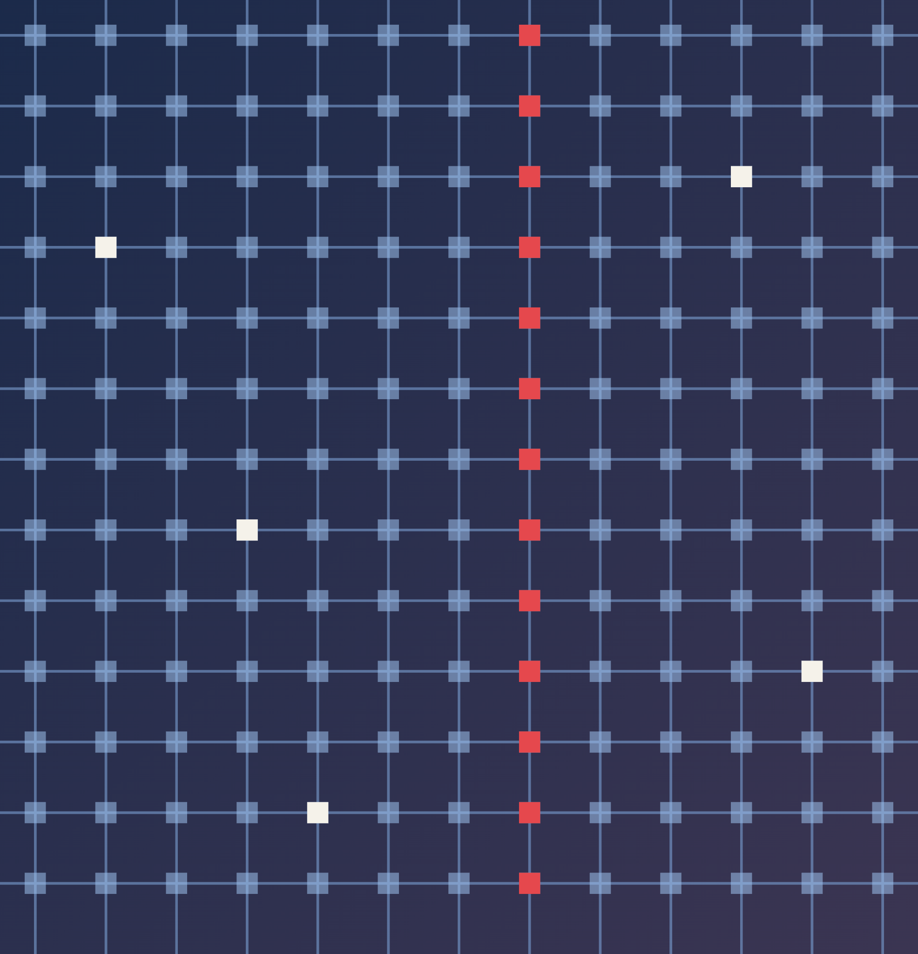
Crossbar Model Simulator
A bit-accurate model of the errors in a ReRAM crossbar
INDEX | 03
Reliable Hybrid SLC/MLC ReRAM Crossbars for Transformers
Notes:
Section divider: the crossbar model simulator (item 3 in the index). Next: how each error source is modelled, one at a time, in a PyTorch crossbar simulator.

Slide 9
Analog Computation in the Crossbar
01 One read = one matrix–vector product
02 Crossbar properties
I_j = Σ V_i · G_ij
Property | Value
Tile size | 128 × 128 cells
Weights | 8-bit signed, one scale per row
Inputs | 8-bit, applied one bit at a time
Cells per weight sign | 7 (SLC) or 4 (MLC)
Conductance range | Gmax = 1, Gmax / Gmin = 100
ADC | Ideal, or 3–8 bits with a fixed range
Weights are programmed as cell conductances G.
Inputs are applied as voltages V on the rows.
Each cell passes a current V · G (Ohm’s law).
The column wire adds the currents (Kirchhoff’s law).
An ADC digitises each column current.
A signed weight is a differential pair of cells. Its 7-bit magnitude is split into bit slices, 1 bit per SLC cell or 2 bits per MLC cell. Slice results are shifted and added digitally.
Notes:
Analog computation: the crossbar computes a full matrix-vector product in one read. Each cell sits at a row/column crossing, with conductance G. Row voltages V give a current V*G per cell (Ohm), and the column wire sums them (Kirchhoff): I_j = sum_i V_i G_ij. Weights are quantised row by row to signed 8-bit integers with one scale per row; the sign is handled by a differential pair (q = q+ - q-), and each 7-bit magnitude is split into base-L digits stored in separate cells, so an SLC weight uses 2 x 7 cells and an MLC weight 2 x 4. Inputs are 8-bit and applied bit-serially in sign-magnitude form; for every input bit and weight slice the 128-row column sum is quantised by the ADC and the results are combined digitally. The ADC full-scale range is fixed once from the largest column sum seen on 64 training sentences of an error-free chip. Conductance is normalised: Gmax = 1 and Gmax/Gmin = 100. Level spacing is delta = (Gmax - Gmin)/(L - 1) with L = 2^b levels, so a 2-bit MLC cell has levels three times closer than SLC.

Slide 10
Storing Weight Matrices
01 Quantise
02 Split
03 Store
04 Read back
q = clip(round(w/s), ±127)
s = max|w| / 127
q = q+ − q−
q± = Σ Lᵗ · dₜ
G = Gmin + d · Δ
d in {0, …, L − 1}
ŵ = s Σ Lᵗ (G+ − G−) / Δ
Gmin cancels in the difference. With no errors, ŵ = s · q exactly.
Each row gets its own scale s, so its largest weight maps to 127. The result is a signed 8-bit integer.
The sign goes to a differential pair. The 7-bit magnitude becomes S = ceil(7/b) digits d in base L.
Each digit sits in its own cell. An SLC weight uses 2 × 7 cells, an MLC weight 2 × 4.
Example
Weight w = 0.5 in a row whose largest weight is 1.27, so s = 0.01.
q = round(0.5 / 0.01) = 50, so q+ = 50 and q− = 0.
SLC (L = 2): digits 0 1 1 0 0 1 0, 7 cells.
MLC (L = 4): digits 0 3 0 2, 4 cells.
Inputs are quantised the same way: 8 bits, with one scale per tensor.
Notes:
Storing a weight matrix. Step 1: each row of W is quantised to signed 8-bit integers, q = clip(round(w / s), -127, 127), with a per-row scale s = max|w| / 127. Step 2: because conductance is never negative, the sign is handled with a differential pair of cells, q = q+ - q-, where q+ = max(q, 0) and q- = max(-q, 0); only one of the two is non-zero. The remaining 7-bit magnitude is split into S = ceil(7/b) digits in base L = 2^b, q = sum over t of L^t d_t, with each digit between 0 and L-1. Step 3: each digit is stored in its own cell at conductance G = Gmin + d * delta, where delta is the level spacing. An SLC cell (b = 1) therefore needs 7 cells per sign, an MLC cell (b = 2) needs 4, so a weight uses 2 x 7 or 2 x 4 cells counting both signs. Step 4: to read a weight back, subtract the conductances of the pair, divide by delta and shift-and-add with weights L^t. The Gmin offset cancels in the difference, so with no errors the stored weight equals s * q exactly. Worked example: w = 0.5 with row maximum 1.27 gives s = 0.01 and q = 50. In SLC 50 = 0110010 in binary (7 cells); in MLC 50 = 0302 in base 4 (4 cells). Inputs are quantised to 8 bits in the same way with one scale per tensor, and the layer output is the product of the quantised input with the stored matrix.

Slide 11
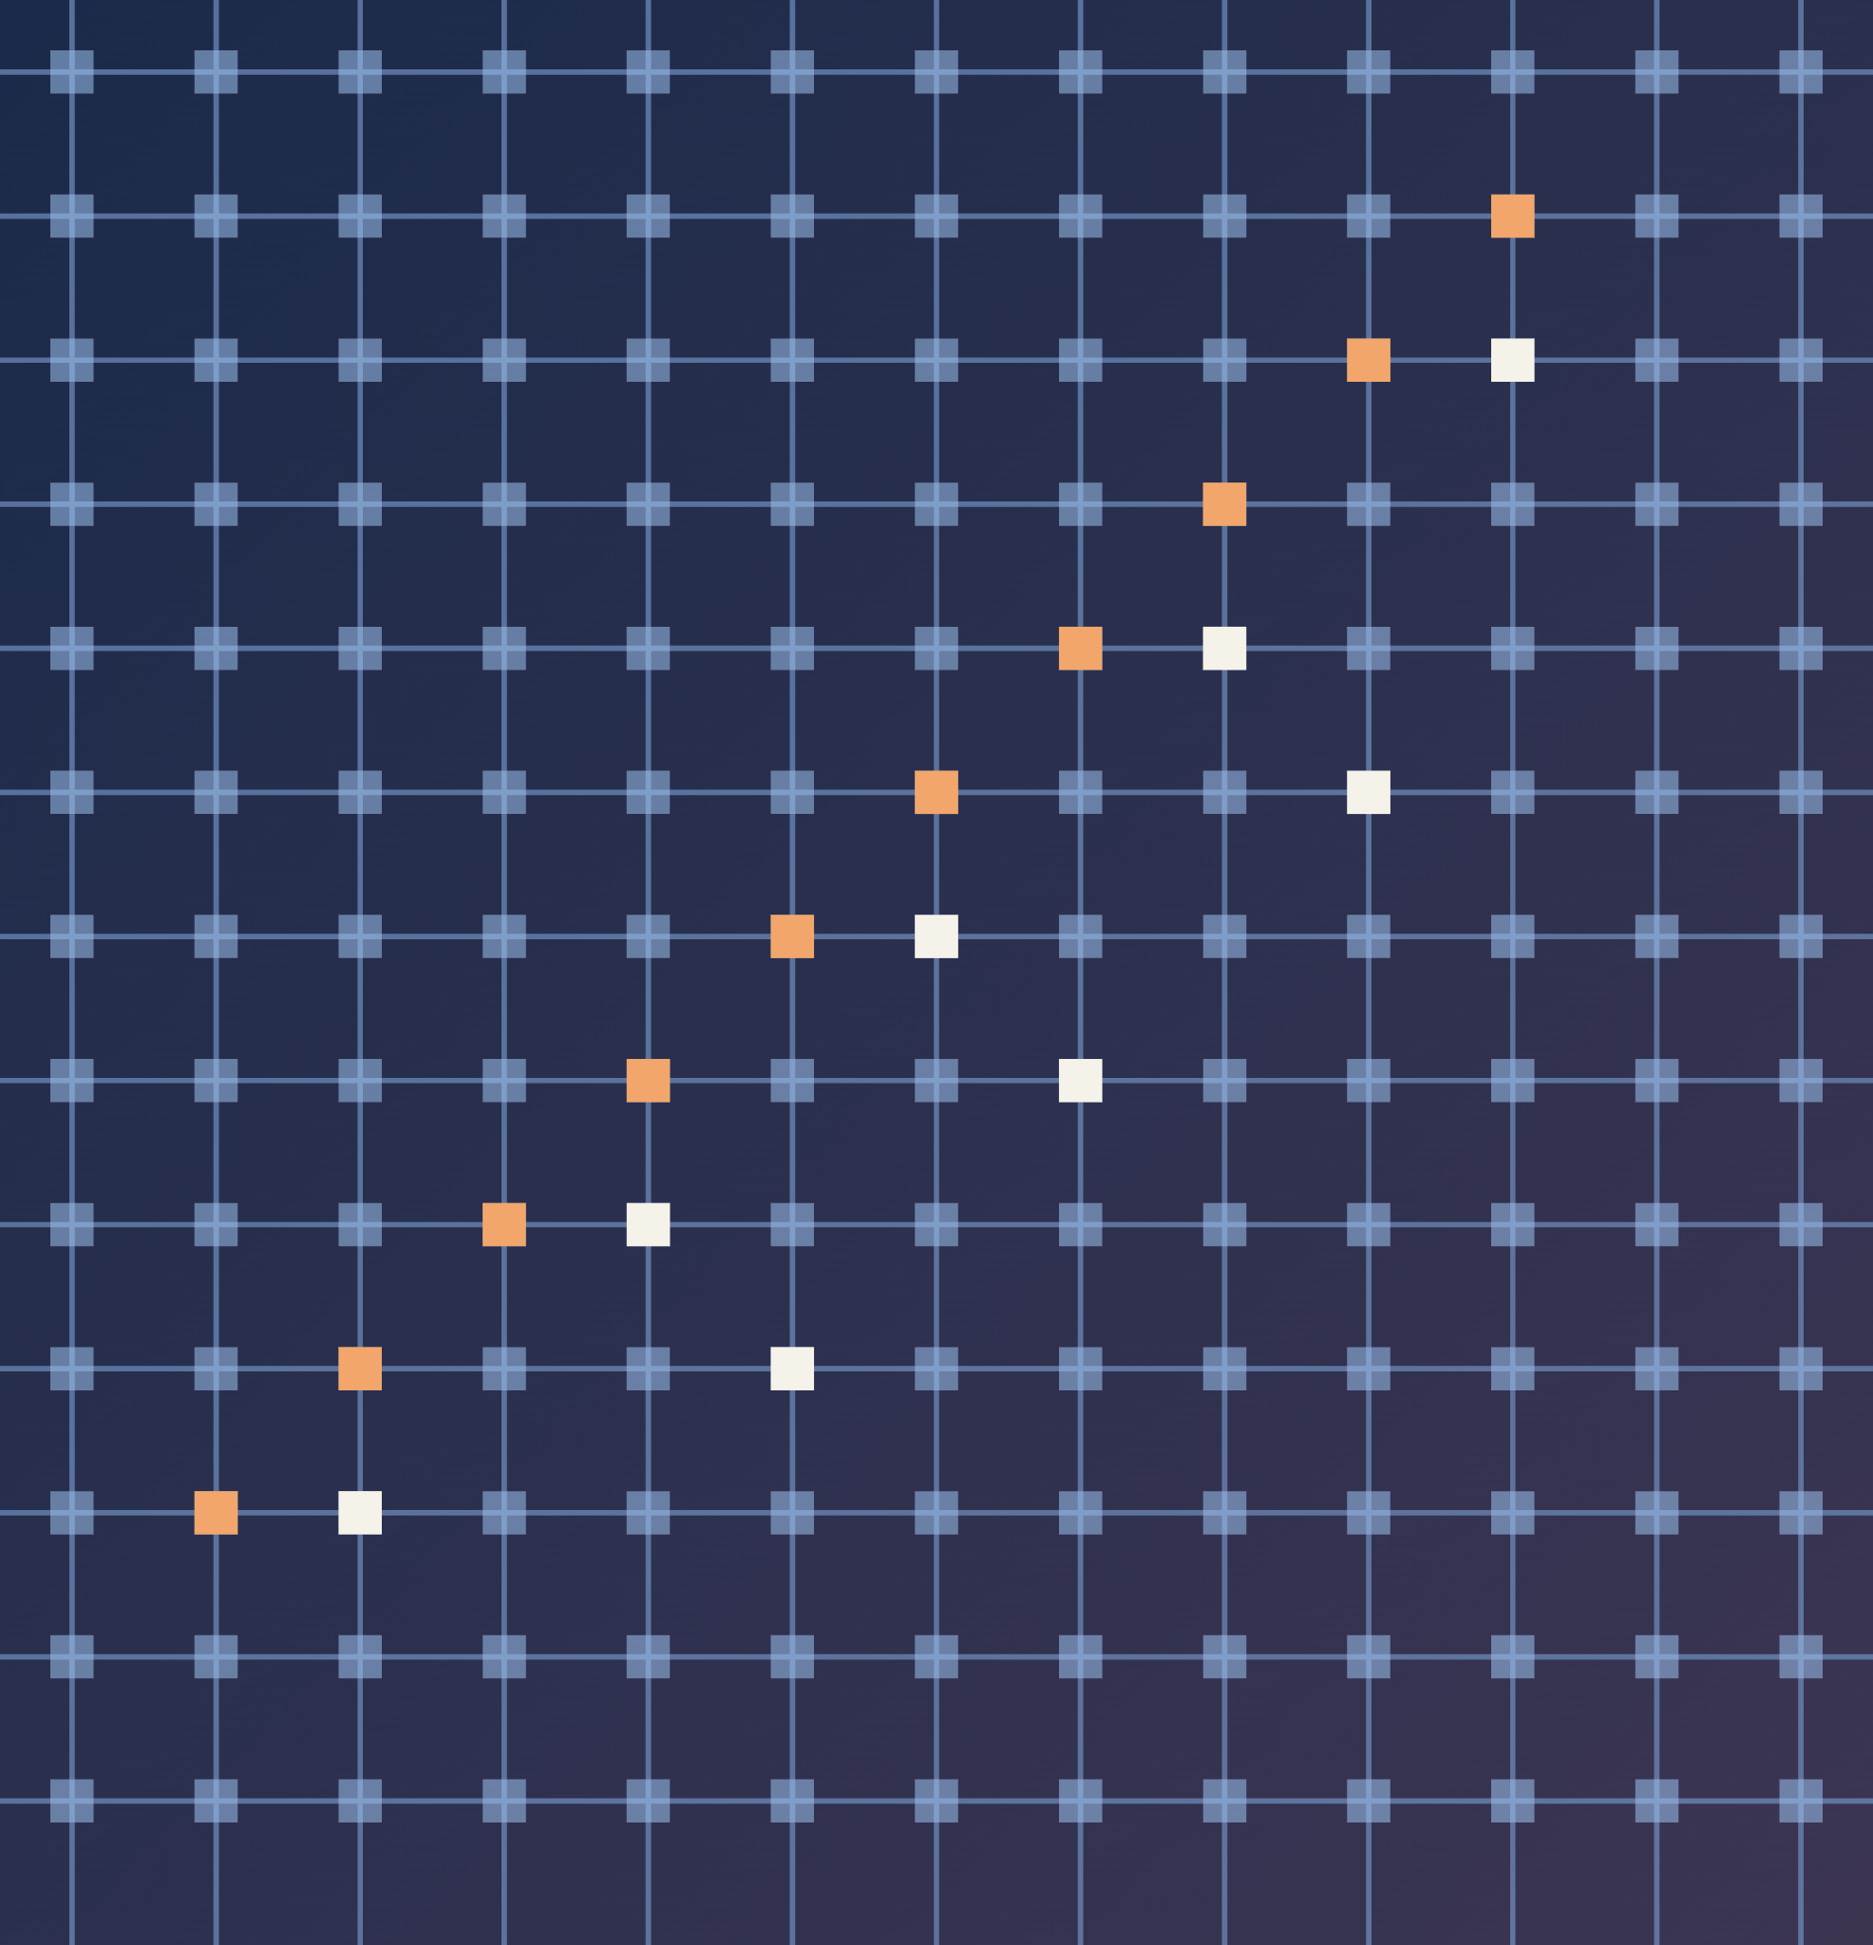
Cell-Level Analysis: Noise
How programming, read and level-dependent noise affect each placement
INDEX | 04
Reliable Hybrid SLC/MLC ReRAM Crossbars for Transformers
Notes:
Section divider: cell-level analysis of noise (item 4 in the index). Next: programming noise, read noise and level-dependent noise, and how each placement (all-SLC, all-MLC, magnitude, gradient, Fisher, random) holds up.

Slide 12
How Much SLC Do We Need?
01 Smallest SLC share that matches all-SLC
02 Counting the cells
Before looking at each error, we fix how much to protect. We varied the SLC share from 5% to 50% and found the smallest share within 0.5 point of all-SLC.
An SLC weight needs 14 cells and an MLC weight needs 8. With a share f of components in SLC:
cells per weight = 14 f + 8 (1 − f)
Noise | SLC share needed | Cells used | Saving
σ = 3% | 5% | 59% | 41% fewer
σ = 5% | 5% | 59% | 41% fewer
σ = 7.5% | 30% | 70% | 30% fewer
Example: f = 20%
0.2 × 14 + 0.8 × 8 = 9.2 cells per weight, which is 34% fewer than all-SLC.
Why we use 20%
It is a middle point: enough at low and moderate noise, and only slightly short at the highest noise we tested.
BERT-Base on SST-2, ranked by |σ|, 20 chips. Source: report Section VIII-C, Table IV.
σ = programming noise, explained on the next slides. Cells used: compared with all-SLC (100%).
Takeaway: the SLC share should follow the noise. Low noise: a small share is enough. High noise: protect more components.
Notes:
On the Ranking Methods slide we described the sweep over SLC shares. This is what it found. At 3% and 5% noise, just 5% of the components in SLC is enough to match the all-SLC chip on BERT-Base; that chip uses 59% of the cells. At 7.5% noise we need 30%, which uses 70% of the cells. Counting cells: an SLC weight uses 2 x 7 = 14 cells, an MLC weight 2 x 4 = 8, so a share f costs 14f + 8(1-f) cells per weight. At 20% that is 9.2 cells, 34% fewer than all-SLC. We use 20% for the rest of the study as a middle point. For DistilBERT the needed shares are slightly higher (10% at 5% noise, 50% at 7.5%); see the Results section.

Slide 13
Three Kinds of Noise
01 What can go wrong when a cell stores a value
Programming noise
Read noise
Level-dependent noise
target
where it lands
a new value at every read
wider spread at the middle levels
When we write a value, the cell lands near its target, not exactly on it. This error stays fixed once the chip is programmed.
Every time we read the cell, its current wobbles a little. The error is different at every read.
In MLC, the two middle levels (01 and 10) can be noisier than the two end levels.
Tested: σ = 0 to 10% of Gmax
Tested: σr = 2% and 5%
Tested: middle levels 1.5× and 2× noisier
How we test: one error source at a time, on many simulated chips (we report the mean), with the same chips for every placement.
Notes:
Before the results, what kinds of noise we model. Programming noise: when we write a value the cell does not land exactly on its target conductance; this error is fixed once the chip is programmed. Read noise: the current fluctuates at every read. Level-dependent noise: in MLC the two middle levels can be noisier than the end levels. We test one error source at a time on many simulated chips and report the mean accuracy; every placement is evaluated on the same chips. In this section we show BERT-Base on SST-2; the full tables for both models are in the Results section.

Slide 14
How Noise Is Applied: Per Cell, Not Per Weight
01 HyFlexPIM: noise on whole weights
02 Ours: noise on every cell
w̃ = w · (1 + η), η ~ N(0, σ²)
G̃ = max(0, G + σ · Gmax · ε), ε ~ N(0, 1)
Each weight gets one relative error, at a single noise level taken from a measured MLC bit-error rate.
How the weight is stored (cells, bit slices, row scale) plays no role.
1. A weight is stored in 14 SLC or 8 MLC cells (Storing slide).
2. Every cell gets its own random offset, drawn once when the chip is programmed.
3. Reading back adds up the cell errors, weighted by the bit slice (Lᵗ) and the row scale s.
03 Why per-cell noise is better
Closer to real hardware
Errors happen in cells, not in weights. Stuck cells, read noise and IR drop are added to cells the same way.
SLC vs MLC comes out naturally
The same σ hits both, but MLC levels are 3× closer, so the error is 3× larger. Nothing is assumed.
Shows which components to protect
The weight error grows with the row scale, which grows with |σ|. Weight-level noise hides this effect.
The other noises: read noise is added to each cell the same way but redrawn at every read; level-dependent noise makes σ 1.5× or 2× larger for the middle MLC levels.
Notes:
An important difference from HyFlexPIM is where the noise is applied. HyFlexPIM perturbs whole weights: each weight is multiplied by one plus a Gaussian error, at a single noise level derived from a measured MLC bit-error rate. How the weight is physically stored does not matter in that model. We instead add noise to every cell. A weight is split into a differential pair and bit slices, 14 cells in SLC or 8 in MLC, and each cell receives its own Gaussian offset, sigma times Gmax times a standard normal value, drawn once per chip; conductance cannot go below zero. When the weight is read back, the cell errors are combined with the weight of each slice and the row scale. This is better for three reasons. First, it is closer to real hardware: errors arise in cells, and stuck cells, read noise and IR drop can be added in the same place. Second, the SLC/MLC difference is not assumed: with the same sigma, MLC levels are three times closer, so the digit error is three times larger. Third, it shows which components need protection: because each row is scaled to its largest value, the weight error grows with the row scale, which grows with the singular value. Relative weight noise removes this effect, which is one reason our ranking result differs from HyFlexPIM. Read noise uses the same per-cell model but is redrawn at every read, and level-dependent noise multiplies sigma by 1.5 or 2 for the two middle MLC levels.

Slide 15
Programming Noise: What We Saw
01 BERT-Base accuracy (%) on SST-2
02 What this tells us
Placement | σ = 3% | σ = 5% | σ = 7.5%
All-SLC (most cells) | 89.2 | 88.0 | 85.7
Hybrid, ranked by |σ| | 89.8 | 88.7 | 84.1
Hybrid, ranked by Fisher | 89.8 | 88.8 | 84.2
Hybrid, ranked by gradient | 90.0 | 88.4 | 81.2
Hybrid, random 20% | 87.6 | 76.2 | 55.2
All-MLC (fewest cells) | 82.1 | 66.8 | 53.0
All-MLC breaks down
As the noise grows, accuracy falls from 82% to 53%, which is close to a coin toss.
Protecting 20% is almost enough
With the right 20% in SLC, the hybrid stays within about 1 point of all-SLC up to σ = 5%.
Which ones we protect matters
A random 20% barely helps (55% at σ = 7.5%). It is about choosing the right components, not how many.
Gradient ranking slips at high noise
At σ = 7.5% it picks slightly wrong components: 81% against 84% for |σ|.
Hybrids keep 20% of components in SLC. Mean of 20 chips. Source: report Table IV.
Random guessing gives 50% on this two-class task.
Why ranking by |σ| works: each crossbar row is scaled to fit its largest value. A component with a large σ gets a large scale, so the same cell error turns into a larger weight error. The large components get hurt the most, so they are the ones worth protecting.
Notes:
Here we add programming noise and compare the placements on BERT-Base. All-MLC is the cheapest chip but it breaks down quickly: 66.8% at 5% noise and 53% at 7.5%, almost random guessing. If we keep just 20% of the components in SLC, chosen by the size of their singular value, we stay within about a point of the all-SLC chip up to 5% noise. A random 20% barely helps, which shows that choosing the right components matters more than how many we protect. The gradient score from HyFlexPIM works at low noise but slips at 7.5%. Why |sigma| works: each crossbar row is scaled to its largest value. Component r is stored as sigma_r times v_r, so its scale grows with |sigma_r|. A fixed cell error then becomes a weight error proportional to |sigma_r|, so the large components are hurt most. Fisher reaches the same answer because it multiplies this error size by the loss sensitivity; the gradient looks only at sensitivity.

Slide 16
Other Error Sources
01 BERT-Base accuracy (%) on SST-2
02 What each one means
Condition | All-SLC | Hybrid | All-MLC
No errors | 89.7 | 90.6 | 90.4
Read noise, σr = 5% | 88.2 | 82.5 | 53.0
Middle levels 2× noisier (σ = 5%) | 88.2 | 88.4 | 62.5
ADC with 6 bits | 89.3 | 90.0 | 83.0
ADC with 5 bits | 51.1 | 51.1 | 51.1
Strong IR drop (r = 3×10⁻³) | 58.5 | 76.8 | 79.1
Read noise
Behaves like programming noise: all-MLC fails, while the hybrid holds up much better.
Noisier middle levels
All-MLC loses another 5 points. The hybrid barely notices, because its important components are not in MLC.
ADC resolution
The ADC turns each column current into a number. 6 bits are enough for the hybrid; all-MLC needs 7. With 5 bits, everything fails.
Hybrid = 20% in SLC, ranked by |σ|. Source: report Table VI.
IR drop
Wire resistance gives far cells less voltage. Only strong resistance hurts, and SLC most, since its cells at Gmax lose the most current.
Notes:
Next we add the other error sources one at a time, again on BERT-Base. Read noise behaves like programming noise: all-MLC falls to 53% while the hybrid keeps 82.5%. If the middle MLC levels are twice as noisy, all-MLC loses another 5 points but the hybrid loses only half a point, because its most important components are stored in SLC. The ADC converts each column current into a number; with a calibrated range 6 bits are enough for all-SLC and the hybrid, all-MLC needs 7, and at 5 bits every chip fails. Since ADCs use most of the energy in crossbar accelerators, this is worth studying in a cost analysis. IR drop: the wires have resistance, so cells far from the driver receive less voltage. Small wire resistance is harmless; strong resistance hurts all-SLC most, because an SLC cell storing a one sits at Gmax, and the highest conductances lose the largest share of their current.

Slide 17
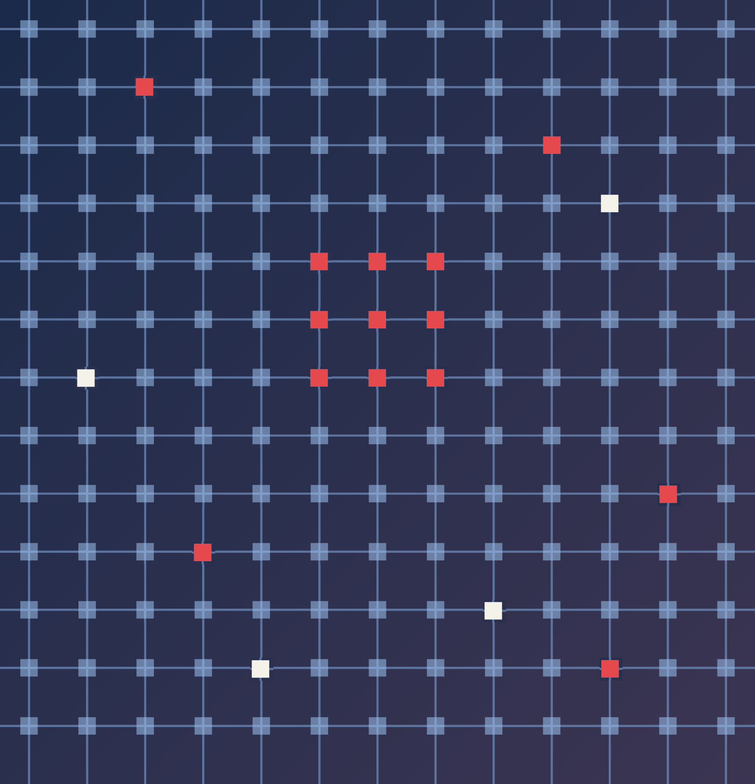
Cell-Level Analysis: Faults
What happens when some cells are stuck
INDEX | 05
Reliable Hybrid SLC/MLC ReRAM Crossbars for Transformers
Notes:
Section divider: cell-level analysis of faults (item 5 in the index). Noise moves a value a little; a stuck cell can move it a lot. Next: what a stuck cell is and how badly it hurts.

Slide 18
What Is a Stuck Cell?
01 A cell that ignores what we write
02 Three patterns we test
Some cells are permanently stuck at their highest (Gmax) or lowest (Gmin) conductance. Whatever we program, they keep that value. Half of our stuck cells sit at Gmax, half at Gmin.
Scattered
Each cell is stuck at random, with probability p.
Example
w = 0.5 (Storing slide) is written as q = 50 = 0110010, but the first cell is stuck at 1:
Clustered
Stuck cells come in 3 × 3 blocks.
64
32
16
8
4
2
1
1
1
1
0
0
1
0
← reads 1110010
The first cell is worth 64. If it is stuck at 1, q becomes 50 + 64 = 114, so the weight reads 1.14 instead of 0.5.
Noise moves a weight a little. A stuck cell in a high-order position moves it a lot, so stuck cells are far more harmful than noise.
Bit line
A whole column line inside one tile fails.
Stuck cells can be found: after fabrication we can write and read back every cell, so each chip’s stuck-cell map is known before we program it.
Notes:
A stuck cell is permanently stuck at its highest or lowest conductance; whatever we write, it keeps that value. In our model half are stuck at Gmax and half at Gmin. Example, using the weight from the Storing slide: w = 0.5 is stored as q = 50, which is 0110010 in seven SLC cells. The first cell is worth 64. If it is stuck at 1, q becomes 114 and the weight reads 1.14 instead of 0.5. Noise moves a weight by a small random amount; a stuck high-order cell moves it by a large fixed amount, which is why stuck cells are much more harmful. We test three patterns: scattered single cells, 3 x 3 clusters, and whole bit lines inside a 128-row tile. Stuck cells can be found after fabrication by writing and reading back every cell, which is what makes fault-aware mapping possible later.

Slide 19
Stuck Cells: What We Saw
01 BERT-Base accuracy (%) on SST-2, no other noise
02 What this tells us
Share of stuck cells | 0.2% | 0.5% | 1% | 2%
All-SLC | 85.4 | 80.1 | 60.9 | 51.1
Hybrid (20% SLC) | 88.5 | 76.6 | 55.9 | 50.1
A few stuck cells are fine
Up to 0.2%, the hybrid matches or even beats all-SLC.
Then accuracy falls fast and depends on luck
At 0.5%, chips vary a lot: the worst of 20 chips reached only 66%.
All-MLC already fails at 0.1%: one stuck cell in a thousand.
At 1% stuck cells | All-SLC | Hybrid
Scattered | 60.9 | 55.9
3 × 3 clusters | 66.5 | 53.7
Whole bit lines | 57.2 | 50.1
At 1%, even all-SLC breaks
It loses 14 to 27 points across our two models. Whole broken bit lines are the worst pattern.
All-MLC has no chance
One stuck cell in a thousand is enough to break it.
Both tables: report Table VII, no programming noise, mean of 10 chips.
What this means: choosing which components go to SLC is not enough. What matters now is where the stuck cells land, under an important component or an unimportant one. This leads to our next idea: fault-aware mapping.
Notes:
Now we make a share of the cells stuck, with no other noise. Up to 0.2% stuck cells the hybrid is fine, and even slightly above all-SLC. From 0.5% accuracy falls quickly and depends on luck: chips with the same number of stuck cells give very different results, and the worst of 20 BERT-Base chips reaches only 66%. At 1% even the all-SLC chip loses 14 to 27 points across the two models. All-MLC fails when only one cell in a thousand is stuck. Among the patterns, clusters hurt all-SLC least, because a cluster damages fewer distinct weights, and whole bit lines hurt most. The main lesson: no placement solves stuck cells. Since the damage depends on where the faults land, the next step is to control where each component is stored.

Slide 20
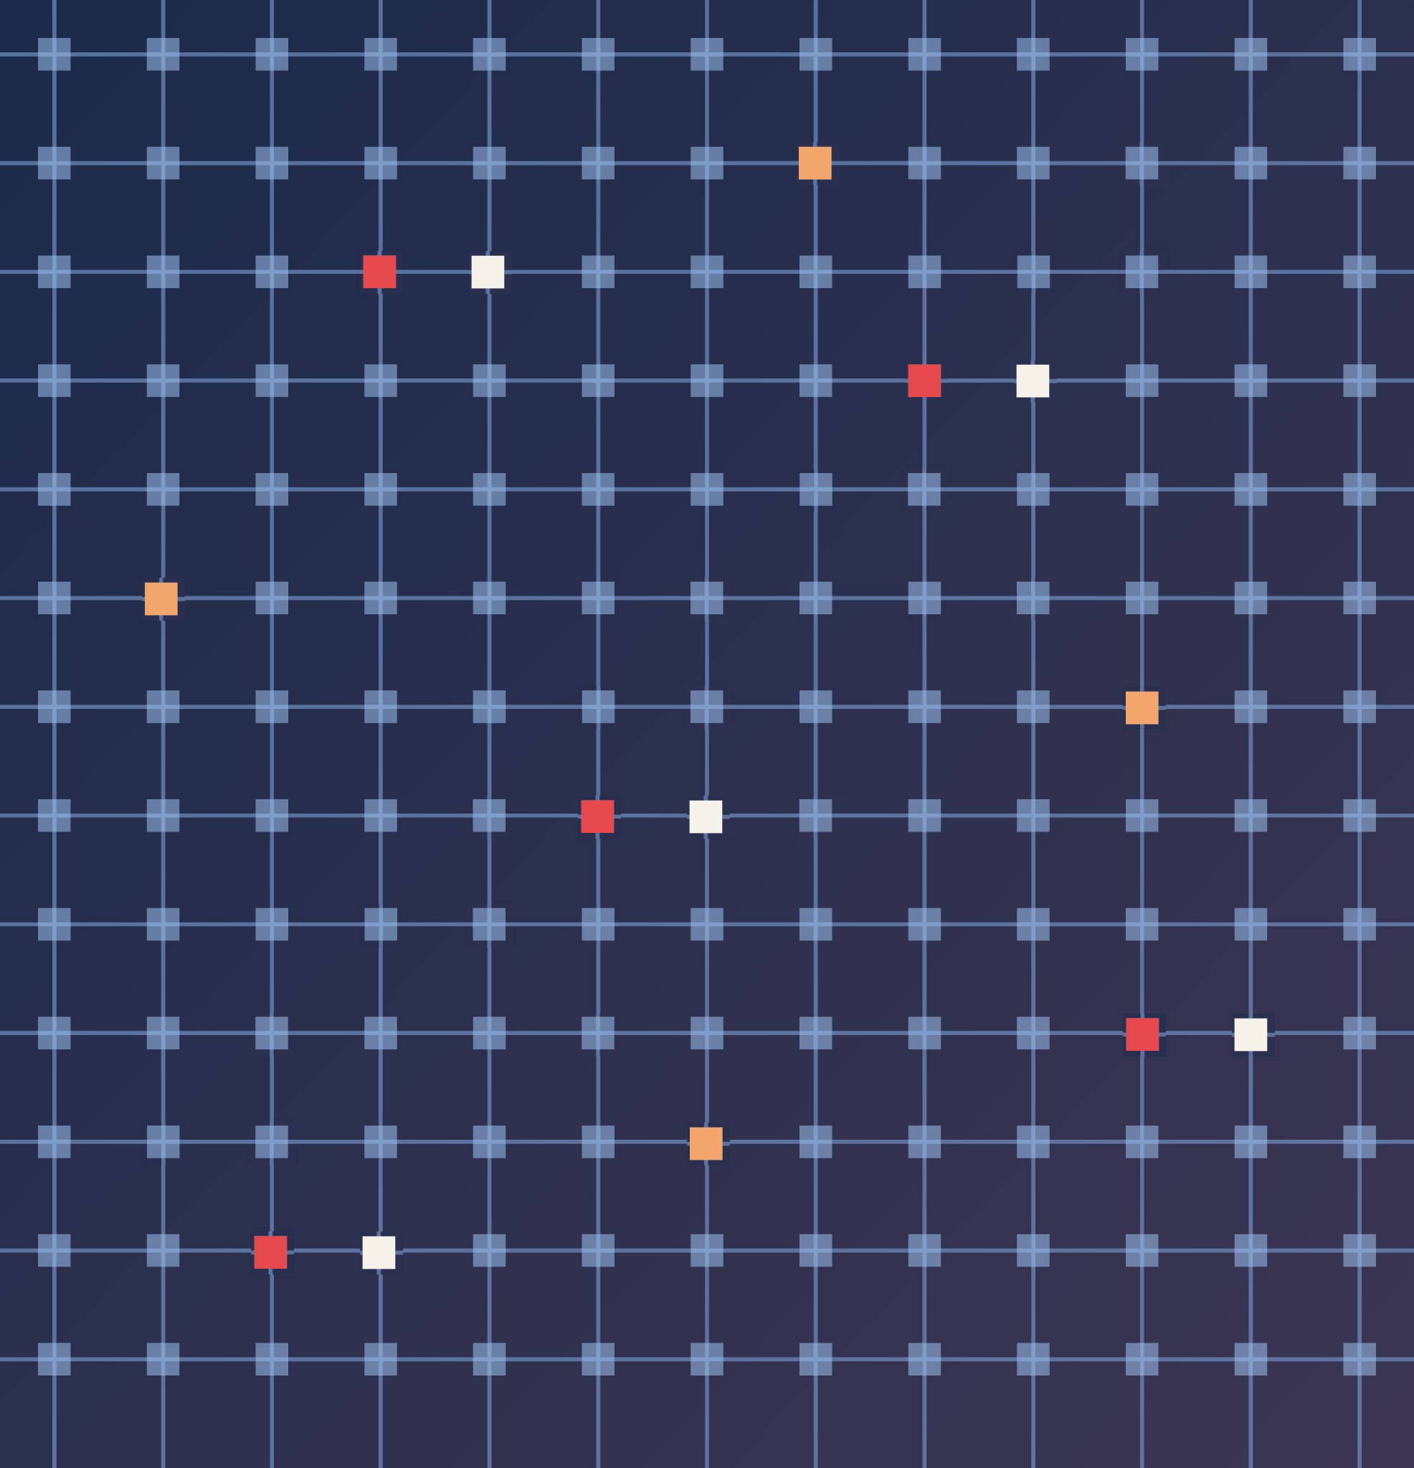
Fault-Aware Mapping
Moving important components away from stuck cells
INDEX | 06
Reliable Hybrid SLC/MLC ReRAM Crossbars for Transformers
Notes:
Section divider: fault-aware mapping (item 6 in the index). Placement chooses SLC or MLC for each component; mapping chooses the exact slot it uses on a tested chip.

Slide 21
The Idea Behind Mapping
01 Components can be stored in any order
W = σ₁u₁v₁ᵀ + σ₂u₂v₂ᵀ + … + σₖuₖvₖᵀ
Slot j = row j of crossbar 1 + column j of crossbar 2 (yellow): where one component is stored.
A stuck cell in a slot (red) damages whichever component we put there.
A layer is a sum of its components, and a sum gives the same answer in any order. So we can choose which slot holds which component.
crossbar 1
crossbar 2
02 How we use this freedom on each chip
1. Test
Write and read back every cell to find the stuck ones
2. Score
Every pair: importance of the component × damage in the slot
3. Assign
Put important components in clean slots; let unimportant ones absorb the damage
4. Program
Write the weights to the chip in that order
No extra hardware and no retraining: the order is simply fixed when the chip is programmed. We reorder only inside each tier, so the SLC/MLC split stays the same.
Notes:
The key observation behind mapping. After SVD, a layer is a sum of components, sigma times u times v transpose. A sum gives the same result in any order, so we can store the components in any order without changing what the layer computes. A slot is where one component is stored: row j of the first crossbar, which holds sigma_j v_j transpose, together with column j of the second crossbar, which holds u_j. A stuck cell in that row or column damages whichever component sits in the slot. On a real chip we can test every cell after fabrication and find the stuck ones. Then for each component and slot we estimate how much harm the stuck cells there would do, and we put important components in clean slots and let the unimportant ones absorb the damage. This costs no extra hardware and no retraining; the order is fixed once when the chip is programmed. We only reorder within each tier, so the SLC/MLC split chosen by |sigma| is unchanged.

Slide 22
Choosing the Slots: A Small Example
01 How important is each component?
02 How damaged is each slot?
Component | Size of σ | Importance
A | large | 6 (most important)
B | medium | 3
C | small | 1 (least important)
Slot | Stuck cells found by testing | Damage
Slot 1 | 0 (clean) | 0
Slot 2 | 1 | 1
Slot 3 | 3 | 3
From the Fisher score: how much the loss rises if this component is disturbed.
Damage = size of the weight errors the stuck cells would cause.
03 Cost of every pair = importance × damage
04 Pick the cheapest one-to-one matching
 | Slot 1 | Slot 2 | Slot 3
A (6) | 0 | 6 | 18
B (3) | 0 | 3 | 9
C (1) | 0 | 1 | 3
Best: A→1, B→2, C→3
Cost 0 + 3 + 3 = 6
A bad order: A→3, B→2, C→1
Cost 18 + 3 + 0 = 21
The most important component (A) gets the clean slot. Real layers have up to 614 components, so the Hungarian algorithm finds the best matching exactly.
Made-up numbers. Red = the slot each component gets.
score = Σ F × δ²
How the real score is computed: add up over every stuck cell in the slot. δ = how far that cell pushes the weight (wrong level × its bit position × the row scale). F = how sensitive the loss is to that weight (Fisher information).
Notes:
A small example with three components and three slots, step by step. Step 1: how important is each component. A has the largest singular value and the highest Fisher score, so it matters most to the loss; C matters least. Step 2: how damaged is each slot. Testing the chip finds no stuck cells in slot 1, one in slot 2 and three in slot 3. Step 3: the cost of putting a component in a slot is roughly its importance times the damage of the slot, which gives this table. In the real method the cost is the Fisher information of each affected weight times the squared error the stuck cell causes. Step 4: we pick the one-to-one matching with the lowest total cost. The best puts A in the clean slot and C on the most damaged slot, total 6; a bad order, for example the one we would get without mapping if A happened to sit on slot 3, costs 21. A real layer has up to 614 components, so we cannot try every order; the Hungarian algorithm (SciPy) finds the optimal matching exactly. Before every run we also check that the predicted cost matches the real error of a programmed crossbar within 10%.

Slide 23
Mapping: What We Saw
01 BERT-Base accuracy (%) on SST-2, no other noise
02 What this tells us
Stuck cells | Hybrid | Hybrid + mapping | All-SLC + mapping
0.2% | 88.5 | 90.1 | 89.6
0.5% | 76.6 | 85.6 | 83.7
1% | 55.9 | 65.1 | 75.8
Mapping always helps
At 0.5% stuck cells: 76.6% → 85.6%, now above all-SLC.
Chips become predictable
At 0.5%, the spread between chips drops from 6.7 to 1.2 points, so less depends on luck.
Choosing SLC or MLC per chip did not help
We also tried picking the tier and slot together. It gave no consistent gain.
We compare against all-SLC with mapping too, since mapping needs no hardware and could be used on any chip.
Hybrid = 20% of components in SLC, which uses 34% fewer cells. Mean of 10 chips. Source: report Table VII.
Not enough at 1%
65% against 76% for all-SLC, which has 5× more SLC slots to hide faults in.
Next question: if mapping cannot hide every fault, can the model learn to tolerate them? This leads to training.
Notes:
Mapping helps in every setting we tested, for both models. At 0.5% stuck cells the BERT-Base hybrid goes from 76.6% to 85.6%, now above the all-SLC chip. Chips also become more alike: the spread between chips falls from 6.7 to 1.2 points. Gains are biggest for clusters and broken lines. We also tried choosing the tier and the slot together for each chip; it won in some settings and lost in others, so we keep the tier choice fixed. Mapping alone is not enough at 1%: the hybrid reaches 65% against 76% for all-SLC with mapping, because the all-SLC chip has five times as many SLC slots to choose from.

Slide 24
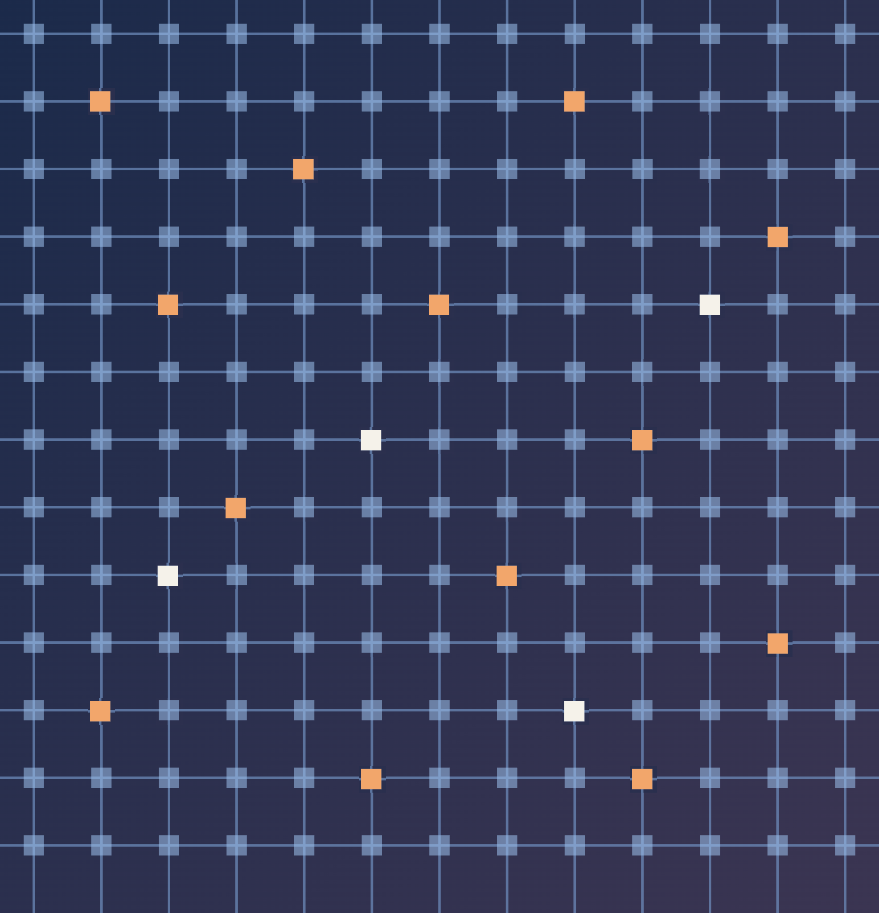
Noise- and Fault-Aware Training
Training on simulated chips so the model learns to tolerate errors
INDEX | 07
Reliable Hybrid SLC/MLC ReRAM Crossbars for Transformers
Notes:
Section divider: noise- and fault-aware training (item 7 in the index). Mapping moves the weights; training changes them so the model can tolerate the errors. This section explains how we train and the three variants we compare.

Slide 25
Training on Simulated Chips
01 The problem
Normal fine-tuning only sees perfect weights. On the chip the weights are noisy and some cells are stuck, so the model meets errors it has never seen before.
02 One training step: damaged forward, clean update
1. Program a fresh chip
New noise and stuck cells; the chip stores Ŵ
2. Forward and loss
Run the model with the damaged Ŵ
3. Backward
Pass gradients straight through the chip
4. Update W
Update the clean weights as in normal training
W_fwd = W + stopgrad(Ŵ − W)
Forward pass: W_fwd = Ŵ
The prediction and the loss see the damaged weights, just as on the chip.
Backward pass: ∂W_fwd / ∂W = 1
stopgrad blocks the gradient of the correction, so it flows straight to the clean W.
Applied to both factors: A = diag(s) Vᵀ and U, so the gradients reach U, s and Vᵀ.
Notes:
Normal fine-tuning sees clean weights. We start from the recovered SVD model of step 1, not the original full matrix. At each training forward pass the stored factors get fresh programming noise and, for the fault variants, scattered stuck cells. The straight-through estimator sends gradients to the clean factors. We train on all 67,349 SST-2 training sentences for 2 epochs with AdamW, batch 32, learning rate 1e-5 linearly decaying to zero over 4,210 updates. Dropout stays active. Programming noise is 5% of Gmax; stuck-cell probability is 0.5% except for noise-only training, where it is zero. Technical limit: the training forward uses damaged stored weights but does not quantise activations as Crossbar.forward does at evaluation. Source: training.py:63-69, 412-437, 721-762; report VI.
For a stored factor W, the chip gives W_hat. We use W_fwd = W + stopgrad(W_hat - W). Numerically this equals W_hat, so the prediction and loss see hardware damage. During differentiation the correction is treated as constant, leaving a derivative of one from W. It is a surrogate gradient, not the true derivative of quantisation or stuck cells. The code builds the correction under torch.no_grad instead of calling a stopgrad function explicitly. Apply it to A = diag(s)V transpose and U, so gradients reach all three clean factors. No weights are updated physically on a ReRAM chip; this is offline digital fine-tuning with simulated damage. The earlier storage slide already explains quantisation and cell slices. Sources: training.py:419-437; report VI.

Slide 26
Three Ways to Train
01 Noise only
02 Noise + faults
03 Tier-aware (ours)
Training chip
Every component on SLC cells, with programming noise only.
Training chip
Every component on SLC cells, with noise and stuck cells.
Training chip
Top 20% by |σ| on SLC, the rest on MLC, with noise and faults on the stored weights.
What it teaches
Plain noise-aware training, as used in earlier work.
What it teaches
The model also learns to live with stuck cells.
What it teaches
Each component sees the errors of the tier it will be stored in.
A controlled comparison: noise + faults adds stuck cells to noise only; tier-aware then adds the SLC/MLC split.
Notes:
The variants share the starting checkpoint, data, optimiser and schedule. Noise only uses all SLC with 5% programming noise and no faults. Noise plus faults adds 0.5% scattered stuck cells to that same all-SLC training layout. Tier-aware keeps those error settings but uses the top ceil(0.2k) components of each layer by current absolute singular value in SLC and the rest in MLC. This last comparison changes the tier split and the resulting error severity, so it is evidence for the whole tier-aware design rather than a perfectly matched noise-strength ablation. Tier membership is refreshed at step zero and every 200 steps; faults and noise are redrawn every forward. All models are evaluated as magnitude hybrids, with the same seeds; each checkpoint has its own learned weights and ranking. Refer back to the SVD and mapping sections for component storage and slot assignment. Sources: training.py:63-69, 700-713, 753-754; report VI.

Slide 27
Fresh Chips and the 200-Step Refresh
01 Two update schedules during training
Every forward pass
Draw new programming noise and new scattered stuck cells, so the model learns tolerance across many chips.
Every 200 training steps
Re-rank the current |σ| values: the top 20% of each layer go to SLC, the rest stay in MLC.
Note: fresh errors do not wait for the tier refresh. Noise and faults change at every step.
02 Why train the unaware variants on SLC?
03 Training settings
We first tried all-MLC
At σ = 5% and p = 0.5%, the loss stayed at about 0.70 ≈ ln 2: random guessing between two classes.
SLC gives a usable signal
On SLC cells the loss fell well below this level from the first steps.
Full SST-2 training set, 2 epochs
AdamW, batch 32
Learning rate 10⁻⁵, decaying linearly to 0
σ = 5%; p = 0.5% (fault variants only)
The all-MLC attempt is reported in the study; no loss curve was saved.
Notes:
There are two clocks. Every forward draws new programming noise and random scattered faults. This avoids fitting a single chip’s fault map; in a real inference run, programming noise and stuck faults stay fixed. Every 200 steps, including step zero, set_damage re-ranks the current absolute s values and refreshes which components receive SLC protection. This is a simulation policy, not a claim of moving physical cells every 200 writes. The report gives the reason for refreshing membership because s changes; it does not justify the exact interval of 200. We first tried all-MLC at 5% noise and 0.5% faults: the report describes loss around 0.70, near ln 2 = 0.693 for two equally likely classes. It motivates the all-SLC tier-unaware training layouts. There is no saved loss trace, so treat this as a reported failed attempt, not a plotted or independently reproduced result. Sources: report VI; 07_training/README.md; training.py:700-713, 753-754.

Slide 28
Testing the Trained Models
01 Each trained model is tested as a hybrid chip (20% SLC by |σ|)
Without fault-aware mapping
Components stay in index order within each tier.
With fault-aware mapping
Slots are chosen around each chip’s known stuck cells.
The ranking and the Fisher sensitivity are recomputed for every trained model, since training changes its weights.
02 Test settings
10 chips per point
Seeds 0–9: the same chip draws as in the mapping study.
SST-2 validation set
All 872 sentences, evaluation batch 128.
Which tests use mapping
Stuck-cell tests: both. Noise-only tests: no remapping.
Fair comparison: every training variant runs on the same chips, so accuracy is compared chip by chip.
Notes:
For every trained checkpoint we recompute its magnitude ranking and estimate stored-entry Fisher sensitivity from 2,048 training sentences. We then use a 20% SLC hybrid with either index order inside each tier or the fault-aware slot assignment explained earlier. The mapping is chosen per tested chip; training itself does not use fault-aware remapping. Seeds zero to nine reproduce the same physical fault maps and random noise draws across policies and variants and match step 6. This does not mean the programmed weight errors are numerically identical: learned weights and row scales differ. The base rerun at 0.5% faults reproduced 40 chip accuracies across two models and two policies. Fault-only tests sweep 0.2, 0.5, 1 and 2%; combined noise and faults use 0.2, 0.5 and 1% at sigma 5%; patterns use 1% clustered or line faults; programming-noise-only uses sigma zero, 5 and 7.5% without remapping. All use the same 872 validation sentences, batch 128. At sigma zero without faults, ten seeds produce a deterministic repeat, not ten independent uncertainty samples. Sources: training.py:876-928; report setup and VIII-G.

Slide 29
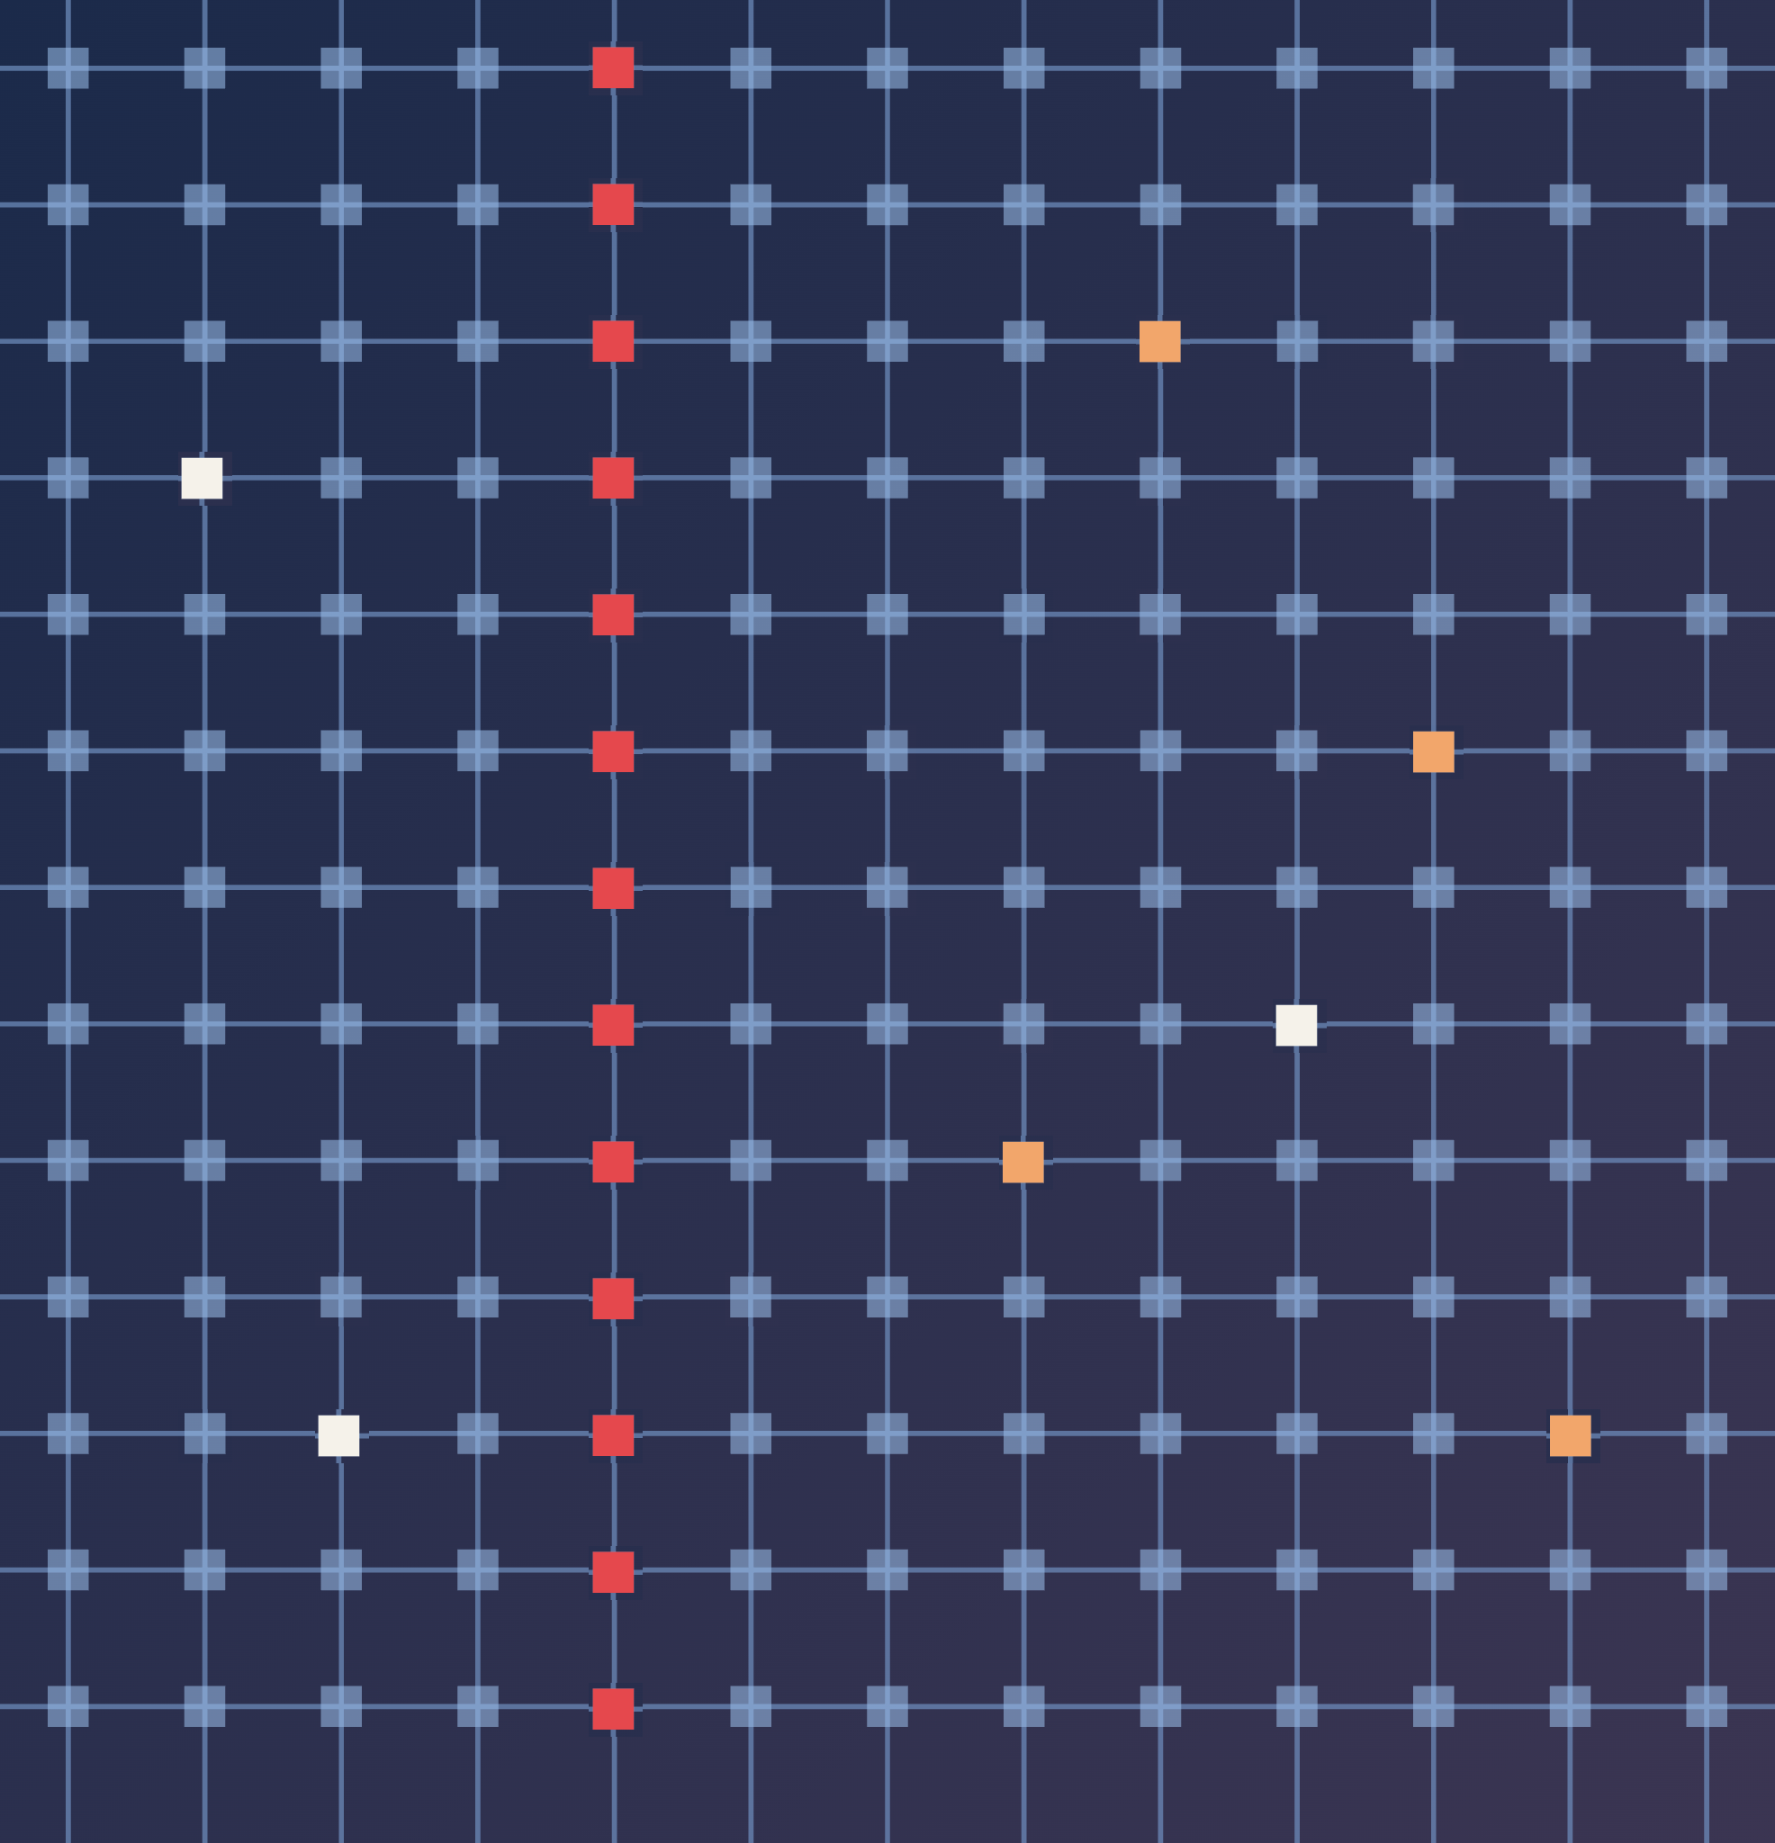
Training Results
How each training method holds up against noise and stuck cells
INDEX | 08
Reliable Hybrid SLC/MLC ReRAM Crossbars for Transformers
Notes:
Section divider: training results (item 8 in the index). First programming noise alone, then stuck cells, where training is combined with fault-aware mapping.

Slide 30
Training vs Programming Noise: What We Saw
01 BERT-Base accuracy (%) on SST-2, hybrid chip
02 What this tells us
Training | No noise | σ = 5% | σ = 7.5%
No training | 89.7 | 88.7 | 84.2
Noise only | 89.9 | 89.7 | 86.3
Noise + faults | 90.9 | 89.9 | 88.8
Tier-aware (ours) | 89.4 | 89.3 | 88.3
Training helps most at high noise
At σ = 7.5%: 84.2% → 88.8%, a gain of 4.6 points.
Training with faults helps here too
Noise + faults is the best variant, even though there are no stuck cells in this test.
Tier-aware is close behind
It is about half a point below the best at σ = 7.5%.
No stuck cells in this test; 20% SLC by |σ|, no remapping. Mean of 10 seeded chips. Red = best in each column.
Source: report Table VIII.
The tier-aware trade-off
With no errors it reaches 89.4% against 89.7% untrained: a 0.3-point cost.
Takeaway: under noise alone, any training that includes faults works well. The real test is stuck cells, on the next slide.
Notes:
This table is BERT-Base on the SST-2 validation set, on magnitude hybrids with 20% SLC. Only programming noise is swept: zero, 5% and 7.5%; no stuck cells and no remapping in this test. Each point averages seeds zero to nine. The no-training row is the recovered step-1 SVD model, not an unfactorised FP32 model. At 7.5% noise, noise plus fault training improves 84.243% to 88.842%, rounded to 84.2 and 88.8; the gain is 4.6 accuracy points. Tier-aware reaches 88.291%, which rounds to 88.3; it is close behind but not the best here. With no errors it reaches 89.450% versus 89.679% for the base; rounded table values show a 0.3-point cost, while the unrounded difference is about 0.23. We use the report’s displayed 0.3-point convention. The mechanism for why fault injection also helps noise-only evaluation is a plausible regularisation effect, not something these sweeps prove. DistilBERT’s best at 7.5% is tier-aware, 88.0 versus 85.6. The teammate’s original slide 36 has both models; do not repeat its full table here. Sources: report VIII-G; 07_training/results/*/noise/bert-base-sst2/sweep_summary.csv.

Slide 31
Training vs Stuck Cells: What We Saw
01 BERT-Base accuracy (%) on SST-2, all chips use mapping
02 What this tells us
Chip and training | 0.5% stuck | 1% stuck | 1% stuck + σ 5%
All-SLC, no training | 83.7 | 75.8 | 76.5
Hybrid, no training | 85.6 | 65.1 | 58.1
Hybrid, noise only | 87.0 | 67.6 | 58.0
Hybrid, noise + faults | 88.7 | 78.6 | 72.9
Hybrid, tier-aware (ours) | 88.3 | 82.9 | 80.5
Injecting faults adds the most
At 1%: noise + fault training gives +13.5 points over mapping only.
Tier-aware helps when faults are dense
At 1%: another +4.3 points over noise + faults, reaching 82.9%.
Training and mapping work together
Without mapping, tier-aware reaches 76.1%. Mapping adds +6.8 more.
All-SLC is the expensive reference. The hybrid uses 34% fewer cells. Mean of 10 chips.
Source: report Table VII.
The limit
At 2% stuck cells, BERT-Base stays near chance for every method.
Result: with tier-aware training and mapping, the hybrid beats all-SLC at 0.5% and 1% stuck cells, while using 34% fewer cells.
Notes:
All rows use fault-aware mapping and the table is BERT-Base only. The first two columns have scattered stuck cells and zero programming noise. The last column combines 1% stuck cells with 5% programming noise. Each number is the mean of ten chips, matched by seed to step 6. At 1% stuck cells, mapping alone is 65.1, noise-only training is 67.6, noise plus fault training is 78.6 and tier-aware is 82.9. The +13.5 is relative to mapping alone, not relative to noise-only training; the latter difference is 11.0. Tier awareness adds a further 4.3. Tier-aware without mapping is 76.1, so mapping contributes another 6.8 points on these trained weights. These are complementary gains, not an exact additive decomposition. At 0.5%, noise plus fault is slightly higher than tier-aware, 88.7 versus 88.3; avoid saying tier-aware wins everywhere. At 2%, the BERT means are near chance, not proof that each individual chip fails. All-SLC here is untrained but remapped: we did not compare against an all-SLC model with the same extra training budget. Refer back to mapping for how slots are chosen. Sources: report VIII-F/G; steps 6 and 7 fault/fault_noise sweep summaries.

Slide 32
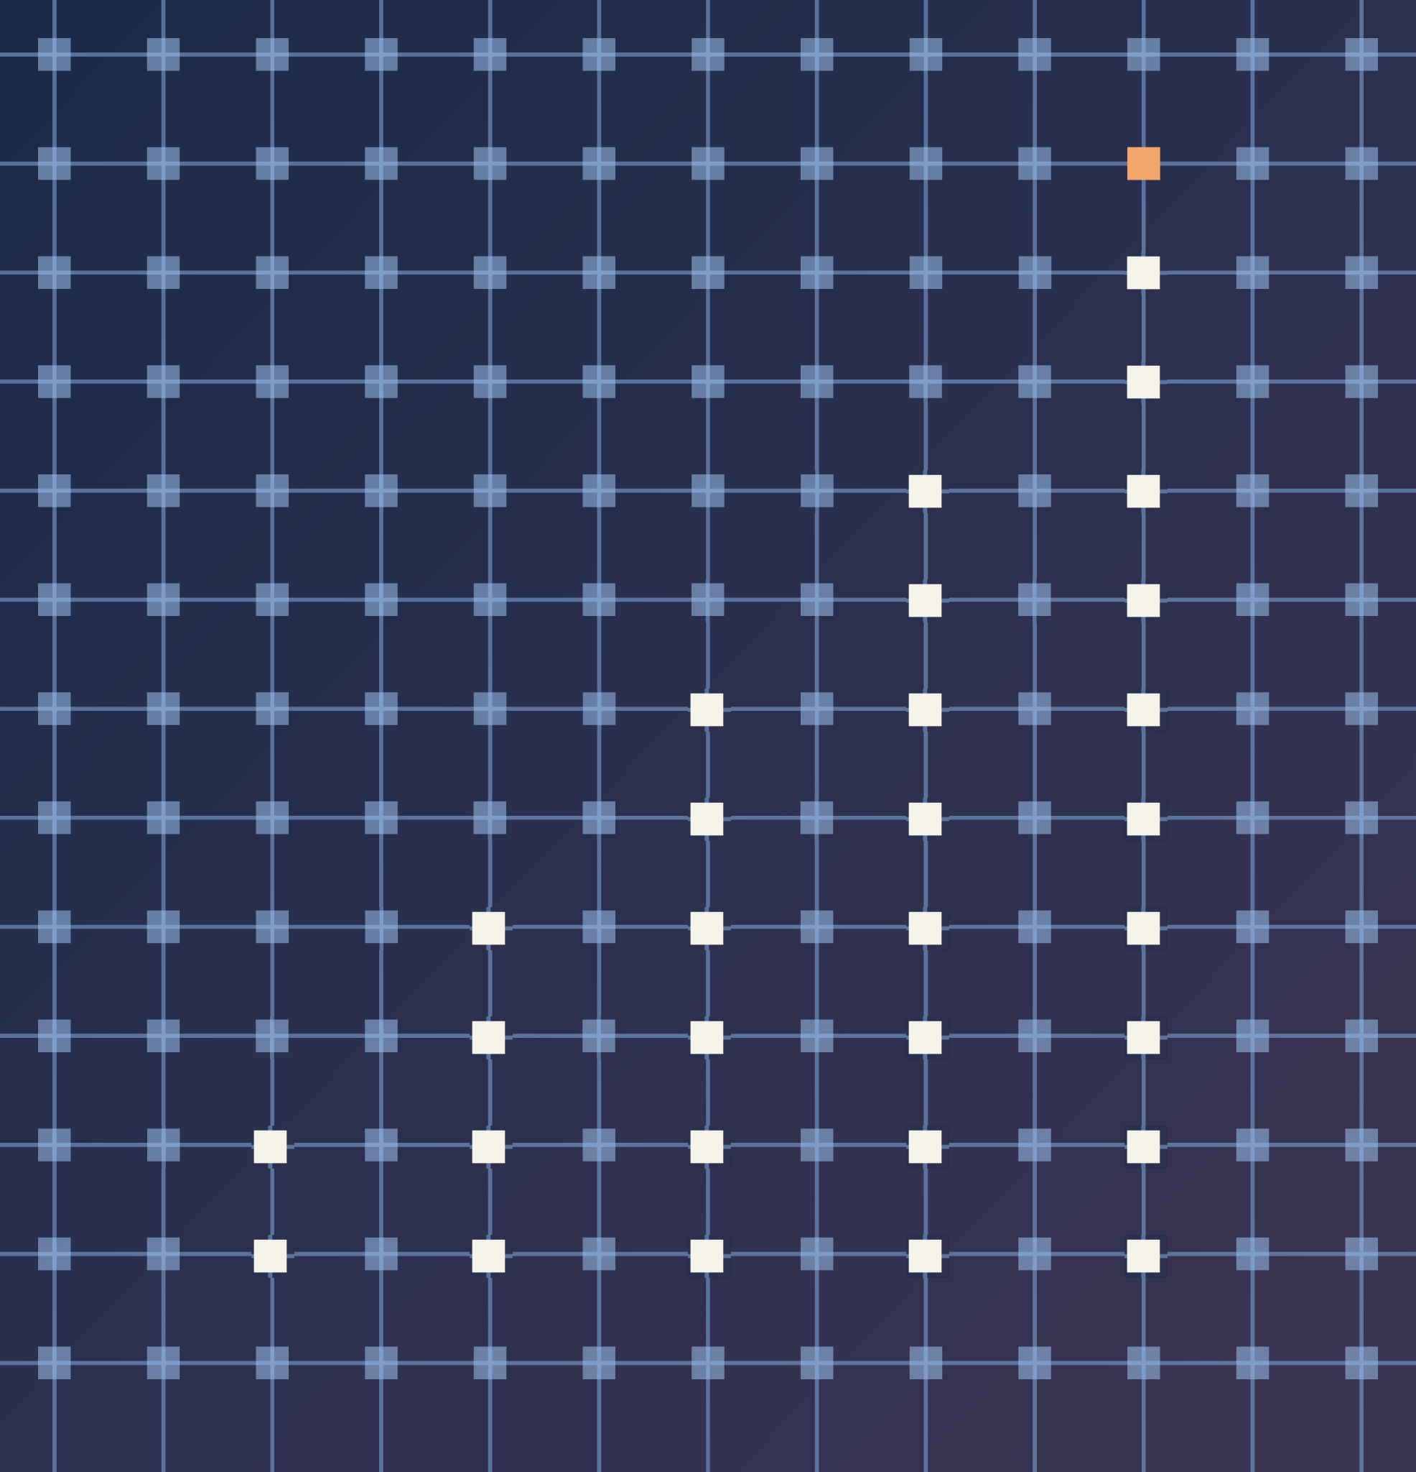
Results on Benchmarks
Complete results on SST-2, and a check on MNLI
INDEX | 09
Reliable Hybrid SLC/MLC ReRAM Crossbars for Transformers
Notes:
Section divider: results (item 9 in the index). The earlier sections showed BERT-Base examples; here are the complete SST-2 tables for both models and the MNLI check.

Slide 33
Results: Setup
01 Two datasets
02 Two models, accuracy (%) on SST-2 before errors
SST-2: main dataset
Movie-review sentences, positive or negative. We test on all 872 validation sentences. Random guessing: 50%.
Model | Layers | FP32 | 8-bit | SVD, fine-tuned
BERT-Base | 12 | 92.43 | 91.86 | 90.14
DistilBERT | 6 | 91.06 | 90.37 | 89.11
MNLI: generalisation check
Sentence pairs in 3 classes. We test on 2,000 validation pairs. Random guessing: 33.3%. Placement and mapping only.
8-bit storage costs under a point and the SVD step about two. This cost is paid once and is the same for every chip.
03 How to read the result tables
Accuracy
Percent of validation examples classified correctly, averaged over the simulated chips.
Hybrid
20% of components in SLC, chosen by |σ|, the rest in MLC. Uses 34% fewer cells than all-SLC.
Chips
5 to 20 simulated chips per setting. Every method runs on the same chips.
Colours
Green rows or columns mark our method. Red numbers are the best in their column.
Notes:
Before the tables, the setup. All main experiments use SST-2, a two-class sentiment task with 872 validation sentences, where random guessing gives 50%. MNLI is a harder three-class task used only to check that the placement and mapping results carry over. We use two models, BERT-Base with 12 encoder layers and DistilBERT with 6. Before any hardware error, 8-bit storage costs under a point and the SVD factorisation about two points; this is paid once for every chip. In all tables the hybrid keeps 20% of components in SLC chosen by singular value, accuracy is the mean over simulated chips, and every method runs on the same chips.

Slide 34
Headline Results on SST-2
01 Our full method (hybrid + mapping + tier-aware training) against all-SLC with mapping
BERT-Base
0.5% stuck cells
88.3%
all-SLC: 83.7%
1% stuck cells
82.9%
all-SLC: 75.8%
1% stuck + noise σ = 5%
80.5%
all-SLC: 76.5%
Memory cells
−34%
9.2 instead of 14 cells per weight, for both models
DistilBERT
0.5% stuck cells
88.1%
all-SLC: 87.6%
1% stuck cells
84.7%
all-SLC: 84.8%
1% stuck + noise σ = 5%
79.8%
all-SLC: 80.7%
What it means: on BERT-Base the hybrid beats all-SLC in all three settings. On DistilBERT it stays within about one point. In both cases it uses a third fewer memory cells.
Notes:
The headline numbers, all on SST-2. We compare our full method, the hybrid chip with fault-aware mapping and tier-aware training, against the expensive all-SLC chip, which also gets mapping since mapping costs no hardware. On BERT-Base the hybrid is ahead at 0.5% and 1% stuck cells and with programming noise added. On DistilBERT it is within about a point of all-SLC. In every case it uses 9.2 cells per weight instead of 14, a third fewer.

Slide 35
SST-2 Results: Programming Noise
01 Accuracy (%) on SST-2, 20% of components in SLC
02 SLC share needed to match all-SLC
 | BERT-Base |  |  | DistilBERT
Placement | σ = 3% | 5% | 7.5% | σ = 3% | 5% | 7.5%
All-SLC | 89.2 | 88.0 | 85.7 | 88.7 | 88.2 | 87.4
Hybrid, |σ| | 89.8 | 88.7 | 84.1 | 88.8 | 88.1 | 85.2
Hybrid, Fisher | 89.8 | 88.8 | 84.2 | 88.7 | 88.4 | 85.4
Hybrid, gradient | 90.0 | 88.4 | 81.2 | 88.6 | 87.7 | 83.1
Hybrid, random | 87.6 | 76.2 | 55.2 | 87.5 | 81.9 | 63.1
All-MLC | 82.1 | 66.8 | 53.0 | 86.0 | 74.8 | 56.9
Noise | BERT-Base | DistilBERT
σ = 3% | 5% | 5%
σ = 5% | 5% | 10%
σ = 7.5% | 30% | 50%
03 Gap to |σ| ranking, same chips
Ranking | BERT-Base | DistilBERT
Fisher | +0.4 ± 0.7 | −0.6 ± 0.7
Gradient | −17.3 ± 2.0 | −7.8 ± 1.1
Random | −116 ± 6 | −88 ± 5
Mean of 20 chips. σ = programming noise, as a share of Gmax.
Key point: ranking by |σ| and by Fisher give the same accuracy for both models. The gradient and a random choice fall further behind as the noise grows.
Correct sentences (of 872) vs |σ|; below 0 = worse.
Notes:
Full programming-noise results on SST-2 for both models, with 20% of components in SLC. Ranking by |sigma| and by Fisher give the same accuracy everywhere; the gradient and random choices fall behind as noise grows. The top-right table is the smallest SLC share that comes within half a point of all-SLC. The bottom-right table compares each ranking with |sigma| on exactly the same chips, as extra correctly classified sentences out of 872, averaged over 300 chips: Fisher is indistinguishable, the gradient loses 17 (BERT-Base) and 8 (DistilBERT) sentences on average, and random loses around 100.

Slide 36
SST-2 Results: Other Error Sources
01 Accuracy (%) on SST-2, each error source added on its own
 | BERT-Base |  |  | DistilBERT
Condition | All-SLC | Hybrid | All-MLC | All-SLC | Hybrid | All-MLC
No errors | 89.7 | 90.6 | 90.4 | 88.5 | 88.8 | 89.0
Read noise, σr = 2% | 89.0 | 90.1 | 77.3 | 88.3 | 88.4 | 83.8
Read noise, σr = 5% | 88.2 | 82.5 | 53.0 | 84.5 | 83.3 | 57.7
σ = 5%, all levels equally noisy | 88.2 | 88.9 | 67.3 | 88.4 | 88.4 | 75.7
σ = 5%, middle levels 2× noisier | 88.2 | 88.4 | 62.5 | 88.4 | 88.0 | 70.3
ADC with 7 bits | 90.0 | 89.3 | 89.2 | 88.4 | 89.0 | 87.8
ADC with 6 bits | 89.3 | 90.0 | 83.0 | 88.0 | 89.7 | 81.7
ADC with 5 bits | 51.1 | 51.1 | 51.1 | 71.0 | 70.6 | 56.5
IR drop, r = 3×10⁻⁴ | 88.9 | 90.4 | 89.8 | 89.4 | 89.7 | 89.1
IR drop, r = 10⁻³ | 87.0 | 88.1 | 90.6 | 85.3 | 86.6 | 89.9
IR drop, r = 3×10⁻³ | 58.5 | 76.8 | 79.1 | 70.1 | 73.4 | 77.9
Hybrid = 20% in SLC by |σ| (green). Evaluated in batches of 64, so the error-free row differs slightly from other tables.
Key point: for read noise, noisier MLC levels and a 6-bit ADC, the hybrid stays close to all-SLC while all-MLC does not. Only strong IR drop hurts the hybrid, and it hurts all-SLC even more.
Notes:
All other error sources on SST-2 for both models. The pattern is the same for DistilBERT as for BERT-Base: all-MLC is hurt by read noise and noisier middle levels, the hybrid stays close to all-SLC, 6 ADC bits are enough for the hybrid, and only strong IR drop hurts, mostly the SLC-heavy chips. DistilBERT drops to about 71% at 5 ADC bits rather than failing completely.

Slide 37
SST-2 Results: Stuck Cells, BERT-Base
01 BERT-Base accuracy (%) on SST-2 under stuck cells
02 Key points
 | No other noise |  |  |  | Noise σ = 5% |  |  | 1% stuck
Chip and method | 0.2% | 0.5% | 1% | 2% | 0.2% | 0.5% | 1% | clusters | lines
All-SLC | 85.4 | 80.1 | 60.9 | 51.1 | 85.6 | 78.4 | 64.6 | 66.5 | 57.2
All-SLC + mapping | 89.6 | 83.7 | 75.8 | 55.9 | 86.1 | 82.4 | 76.5 | 81.3 | 77.5
Hybrid | 88.5 | 76.6 | 55.9 | 50.1 | 84.9 | 70.3 | 52.1 | 53.7 | 50.1
Hybrid + mapping | 90.1 | 85.6 | 65.1 | 52.2 | 87.4 | 80.4 | 58.1 | 64.3 | 56.9
+ noise-only training | 89.8 | 87.0 | 67.6 | 51.7 | 88.0 | 82.7 | 58.0 | 65.8 | 58.9
+ noise + fault training | 89.9 | 88.7 | 78.6 | 50.8 | 89.7 | 87.4 | 72.9 | 78.8 | 72.6
+ tier-aware training | 88.8 | 88.3 | 82.9 | 53.0 | 89.1 | 87.8 | 80.5 | 85.0 | 77.7
The plain hybrid fails early
From 0.5% stuck cells, it drops well below all-SLC.
Mapping helps everywhere
For example 76.6% → 85.6% at 0.5% stuck cells.
Training with stuck cells adds most
Tier-aware training is best: 82.9% at 1%.
Our full method wins
From 0.5% upwards it beats all-SLC + mapping in every column. At 2%, all fail.
Column headers give the share of stuck cells. "mapping" = fault-aware mapping; training rows also use mapping. Mean of 10 chips.
Notes:
Complete stuck-cell results for BERT-Base on SST-2. Rows build up step by step: the all-SLC chip with and without mapping, the plain hybrid, then mapping, then each training variant on top of mapping. Column groups: stuck cells alone, stuck cells with 5% programming noise, and two spatial patterns at 1%. The last row is our full method. From 0.5% stuck cells upwards it beats all-SLC with mapping in every column, while using 34% fewer cells. At 0.2% without noise both are near the error-free level. At 2% every configuration fails.

Slide 38
SST-2 Results: Stuck Cells, DistilBERT
01 DistilBERT accuracy (%) on SST-2 under stuck cells
02 Key points
 | No other noise |  |  |  | Noise σ = 5% |  |  | 1% stuck
Chip and method | 0.2% | 0.5% | 1% | 2% | 0.2% | 0.5% | 1% | clusters | lines
All-SLC | 88.1 | 85.4 | 73.7 | 57.9 | 86.9 | 81.7 | 68.0 | 79.6 | 71.1
All-SLC + mapping | 88.0 | 87.6 | 84.8 | 62.3 | 87.6 | 86.8 | 80.7 | 85.6 | 81.5
Hybrid | 87.1 | 77.9 | 62.4 | 50.2 | 85.4 | 74.9 | 59.5 | 55.9 | 54.0
Hybrid + mapping | 88.4 | 85.1 | 67.0 | 53.3 | 87.7 | 83.0 | 65.1 | 68.5 | 68.0
+ noise-only training | 87.3 | 84.5 | 68.2 | 51.5 | 85.9 | 82.8 | 59.9 | 66.1 | 65.9
+ noise + fault training | 88.6 | 88.2 | 80.7 | 55.0 | 88.8 | 86.4 | 77.5 | 80.7 | 81.6
+ tier-aware training | 88.2 | 88.1 | 84.7 | 57.4 | 88.2 | 86.9 | 79.8 | 83.4 | 84.4
Same pattern as BERT-Base
The plain hybrid drops sharply from 0.5% stuck cells.
Mapping helps everywhere
For example 77.9% → 85.1% at 0.5% stuck cells.
Tier-aware training is best
It reaches 84.7% at 1% stuck cells.
Our full method matches all-SLC
Within about a point up to 1%. Ahead for bit lines, 2 points behind for clusters.
Column headers give the share of stuck cells. "mapping" = fault-aware mapping; training rows also use mapping. Mean of 10 chips.
Notes:
The same table for DistilBERT on SST-2. The pattern matches BERT-Base: the plain hybrid fails from 0.5%, mapping helps in every column, and training with stuck cells adds the most. With tier-aware training and mapping the hybrid stays within about one point of all-SLC with mapping up to 1% stuck cells, is ahead for broken bit lines (84.4% vs 81.5%) and two points behind for clusters (83.4% vs 85.6%), while using 34% fewer cells.

Slide 39
SST-2 Results: Training Under Noise
01 Hybrid accuracy (%) on SST-2, programming noise only
02 Key points
 | BERT-Base |  |  | DistilBERT
Training | No noise | σ = 5% | σ = 7.5% | No noise | σ = 5% | σ = 7.5%
No training | 89.7 | 88.7 | 84.2 | 89.1 | 88.2 | 85.6
Noise only | 89.9 | 89.7 | 86.3 | 87.4 | 87.6 | 85.6
Noise + faults | 90.9 | 89.9 | 88.8 | 89.9 | 89.3 | 87.6
Tier-aware | 89.4 | 89.3 | 88.3 | 87.8 | 88.4 | 88.0
Training helps most at the highest noise: +4.6 points on BERT-Base and +2.4 on DistilBERT at σ = 7.5%.
Including stuck cells in training helps here too, although this test has none.
Noise-only training helps BERT-Base but not DistilBERT.
Tier-aware training costs 0.3 and 1.3 points on an error-free chip.
No stuck cells in this test. Mean of 10 chips, 20% SLC by |σ|. Red = best in each column.
Notes:
Trained models tested on SST-2 under programming noise alone. Noise plus fault training is the best on BERT-Base at every noise level and on DistilBERT up to 5%; tier-aware training is best on DistilBERT at 7.5% (88.0%). Noise-only training helps BERT-Base but not DistilBERT. Training on the harsher hybrid chip costs 0.3 (BERT-Base) and 1.3 (DistilBERT) points when there are no errors.

Slide 40
MNLI Results: Do the Findings Hold?
01 MNLI accuracy (%); random guessing = 33.3%
02 Why we tested MNLI and what we found
Configuration | BERT-Base | DistilBERT
No errors
Digital SVD model | 83.2 | 80.9
Hybrid chip (|σ|) | 79.1 | 77.3
Programming noise σ = 5%
Hybrid, |σ| | 68.0 | 71.5
Hybrid, Fisher | 67.8 | 71.1
Hybrid, gradient | 63.3 | 71.3
Hybrid, random | 35.9 | 44.1
0.5% stuck cells
Hybrid | 40.0 | 49.1
Hybrid + mapping | 60.0 | 67.9
SST-2 is an easy two-class task. MNLI has three classes and is harder, so it checks that our conclusions are not specific to SST-2.
Ranking still works
|σ| and Fisher choose almost the same components. Random choice still fails.
Mapping still works
At 0.5% stuck cells, mapping recovers about 20 points on both models.
One limit of our simulator
All components of a tier share one 8-bit scale between the two crossbars, so small components get rounded away. This costs some accuracy even with no errors.
2,000 matched validation pairs. Hybrid = 20% in SLC.
Notes:
To check that our conclusions are not specific to SST-2, we repeated the placement and mapping study on MNLI, a harder three-class task. We did not repeat training or the other error sources. Ranking still works: |sigma| and Fisher pick almost the same components (rank correlation 0.96-0.97, against 0.56-0.57 for the gradient), and random choice fails. Mapping still works: MNLI is more fragile to stuck cells, but mapping recovers about 20 points at 0.5%. One limit we found: the vector between a tier's two crossbars is re-quantised to 8 bits with one shared scale, so small components are rounded away. On MNLI this costs up to 11 points even without errors, so we only compare chips with the same SLC share there.

Slide 41
Scope and Future Work
SCOPE OF THIS STUDY
FUTURE WORK
01
One error source at a time
Each effect can be traced to its exact cause.
01
Validate on IBM AIHWKit
Repeat our results on a widely used analog simulator.
02
Wide parameter sweeps
From harmless to failure, so trends hold across devices.
02
All error sources together
Placement, mapping and training on one chip.
03
Faults found by testing
Stuck cells are located once, before programming.
03
Hardware cost study
Energy, latency and area including ADCs, e.g. NeuroSim.
04
Cost in memory cells
A direct, device-independent measure of storage.
04
Finer activation scales
Per token or per group of components.
05
One training setting
A representative chip: σ = 5% and 0.5% stuck cells.
05
More workloads
Other GLUE tasks, CNNs and an FPGA emulation.
06
Two datasets
Full pipeline on SST-2; MNLI confirms placement and mapping.
06
Security
Robustness of stored weights to bit-flip attacks.
Notes:
The scope of this study. We varied one error source at a time so that every drop in accuracy has a clear cause, and swept noise levels and fault rates from harmless to failure, so the trends do not depend on one particular device. Fault-aware mapping assumes the stuck cells are found once by testing after fabrication. Cost is counted in memory cells, a direct measure of storage. Training used one representative chip setting, and the full pipeline ran on SST-2, with MNLI confirming the placement and mapping results. Future work: first, validate our results on a well-established simulator such as IBM's Analog Hardware Acceleration Kit (AIHWKit) for more credibility. Then evaluate all error sources together, measure energy, latency and area including the ADCs, use finer activation scales, extend to more tasks and models, and study security against bit-flip attacks.

Slide 42
Takeaways
01
A hybrid chip is necessary
All-MLC fails under noise and stuck cells, while all-SLC costs 14 cells per weight.
02
Ranking by |σ| is enough
It matches the Fisher estimate, needs no data, and beats the gradient at high noise.
03
Stuck cells need mapping and training
Moving components away from faults and tier-aware training recover most of the lost accuracy.
04
The payoff
Matches or beats all-SLC up to 1% stuck cells on SST-2, with 34% fewer memory cells.
Thank you | Questions?
Reliable Hybrid SLC/MLC ReRAM Crossbars for Transformers
Notes:
Close with the four takeaways. A hybrid layout is necessary: all-MLC fails, all-SLC is expensive. Ranking components by singular value is enough. Stuck cells are the hard case, and mapping plus tier-aware training handle them. The payoff: on SST-2 the hybrid matches or beats all-SLC up to 1% stuck cells with 34% fewer memory cells. Backup material: the full tables in the Results section and the report.

