Slide 1

SCIENTIFIC LITERATURE COLLECTION
&
FILTERING
HUMAN MICROBIOME RESEARCH PAPERS
SHIVANSHU KUMAR SINGH
AYUSH BATHRA

Slide 2
PROBLEM WE ARE SOLVING
Biomedical research publishes 3,000+ microbiome papers per month across dozens of databases.
Challenges:
No single database has complete coverage of all relevant literature
Papers are scattered across PubMed, Europe PMC, OpenAlex, Crossref, Semantic Scholar, CORE
Many papers mention 'microbiome' but study animals, soil, or food — not human health
Manual curation cannot scale to 100,000+ papers spanning 2024-2026
Duplicate papers appear across sources under different identifiers
Our Goal:
Build an automated pipeline that collects, deduplicates, and precisely filters
research papers to extract ONLY those studying the human microbiome with
sequencing data — feeding a Knowledge Graph for clinical research insights.

Slide 3
LAYER 1
Layer 1 is the first stage of a four-layer scientific literature pipeline.
Its job: Collect papers from 6 academic APIs, deduplicate them, filter for
relevance using 5 progressive stages, and output a clean dataset for Layer 2 (NLP).
Input: Search query 'human microbiome' across 6 databases (2024-2026)
Output: data/processed/collected_YYYYMMDD_HHMMSS.json (List[PaperRecord])

Slide 4
PIPELINE OVERVIEW:
HOW PAPERS FLOW
6 API
Collectors
Stage 1
MeSH
Stage 2
Keywords
Metagenomics
Gate
Stage 3
ML Classifier
Stage 3.5
Embedding
Stage 4
LLM
Dedupication &
Merge
Parallel fetch
from 6 sources
PubMed papers
only
Sequencing
terms check
Logistic Regression
F1=0.906
Cosine sim
10,975 vectors
gemma3:4b
Weighted rules
DOI→PMID→Title
1,500 raw → 1,450 after dedup → 1,027 kept (70%) | 394 rejected | 29 flagged for review
Where decisions are made:
Stage 1 (MeSH) 267 kept 0 rejected
Stage 2 (Keywords) 726 kept 332 rejected 3 borderline
Metagenomics Gate 15 flagged
Stage 3 (ML) 6 kept 41 rejected
Stage 4 (LLM) 28 kept 21 rejected 11 review

Slide 5
Data Collection: 6 Academic APIs
Each source covers unique strengths — together they maximize recall
Source | API | Unique Strength | Rate Limit
PubMed | NCBI E-utilities | MeSH terms, Humans filter | 0.4s (10 req/s with key)
Europe PMC | REST JSON API | Full text, preprints | 0.5s (2 req/s)
Semantic Scholar | Bulk search endpoint | Citation counts, AI tags | 1.0s (1 req/s)
OpenAlex | Works API + concepts | 250M+ works, funding data | 0.1s (10 req/s polite)
Crossref | Works endpoint | DOI authority, funders | 0.02s (50 req/s polite)
CORE | POST search API | Open-access full text | 0.6s
Why Rate Limits?
Academic APIs block IPs that exceed their request quotas.
PubMed: 3 req/s without key, 10 req/s with NCBI API key (free registration).
OpenAlex/Crossref: 'Polite pool' — unlimited rate if you include email in User-Agent.
Semantic Scholar: Strict 1 req/s — violators get 429 errors and temporary bans.
Our rate limiter enforces a minimum gap between requests per source.

Slide 6
TECHNICAL DETAILS: RESILIENCE & DEDUPLICATION
Automatic Retry on Network Failure
Content Hash Checking
Uses tenacity library with exponential backoff:
Attempt 1 fails → wait 2s → Attempt 2 fails → wait 4s → Attempt 3
Max retries: 3 | Backoff base: 2s | Max wait: 30s
429 (rate limited): respects Retry-After header
Connection errors: retries transparently
All failures logged but don't crash the pipeline
Uses tenacity library with exponential backoff:
Attempt 1 fails → wait 2s → Attempt 2 fails → wait 4s → Attempt 3
Max retries: 3 | Backoff base: 2s | Max wait: 30s
429 (rate limited): respects Retry-After header
Connection errors: retries transparently
All failures logged but don't crash the pipeline
Deduplication Strategy
Cursor Persistence (Offset Management)
Same paper appears in 2-4 sources. Dedup key priority:
1. DOI (most reliable): doi:10.1038/s41586-024-07999-z
2. PMID (PubMed-specific): pmid:38765432
3. Title (fuzzy fallback): title:gut microbiome
Result: 1,500 raw → 1,450 unique (50 duplicates removed)
Merge priority: PubMed > EuropePMC > S2 > OpenAlex > Crossref > CORE
Zenodo versions: deduplicated by normalized title (keeps latest version)
Each source saves its position after every run:
{"pubmed": 200, "europepmc": 300, "crossref": 300,
"openalex": 300, "openalex_cursor": "IlsxN...",
"semantic_scholar": 0, "core": 0}
Next run resumes from saved position — no re-fetching.
PubMed: monthly sub-ranges × WebHistory offset
OpenAlex: opaque cursor string for exact continuation
S2: token-based pagination saved between runs

Slide 7
SPEED:
PARALLEL COLLECTION WITH THREAD POOL EXECUTOR
All 6 collectors run simultaneously using Python's ThreadPoolExecutor(max_workers=6).
Why threads work here (despite Python's GIL):
Each collector spends 95%+ of its time waiting for HTTP responses (I/O-bound).
Python releases the GIL during network I/O → all 6 can wait concurrently.
No shared mutable state between threads — each Collector is independent.
Each source has its own rate limiter — parallel ≠ increased API pressure.
Result: 5 sources complete in ~30 seconds (would take ~2.5 min sequential).
PubMed is the slowest (XML parsing + monthly splits) — it gates total time.

Slide 8
THE DATA MODEL: PAPERRECORD
PYDANTIC MODEL — SHARED CONTRACT BETWEEN ALL LAYERS
Identity: doi, pmid, pmcid, arxiv_id, source
Content: title, abstract, authors, keywords
Publication: journal, publication_date, publication_year, volume, issue, pages
Classification: article_types (Journal Article, Review, Meta-Analysis, ...)
Access: is_open_access, full_text_url, pdf_url, full_text
Citations: citation_count, reference_count
PubMed-specific: mesh terms (controlled vocabulary — key for Stage 1)
Pipeline: content_hash (MD5), fetched_at (ISO timestamp), is_preprint

Slide 9
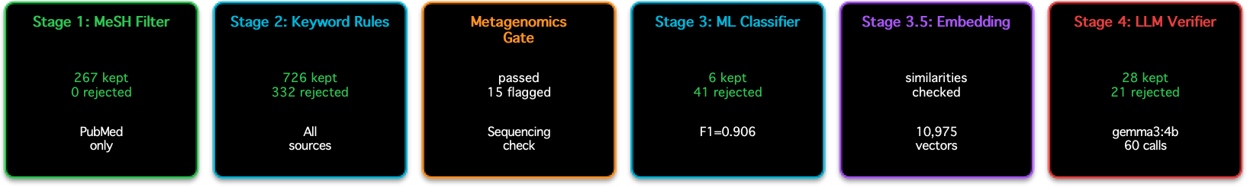
RELEVANCE FILTER PIPELINE: 5-STAGE FUNNEL
DESIGN PRINCIPLE: USE THE CHEAPEST STAGE FIRST, EXPENSIVE LLM ONLY FOR TRUE BORDERLINES
Routing Logic:
PubMed papers (have MeSH terms) → Stage 1 first → Stage 2 if borderline
All other sources (no MeSH) → Stage 2 directly → Stage 3 if borderline
Stage 2 confident keeps → Metagenomics Gate → if no sequencing terms → flagged
Stage 3 borderline → Stage 3.5 embedding → if disagreement → Stage 4 LLM
Each paper exits the pipeline the moment any stage gives a confident decision.

Slide 10
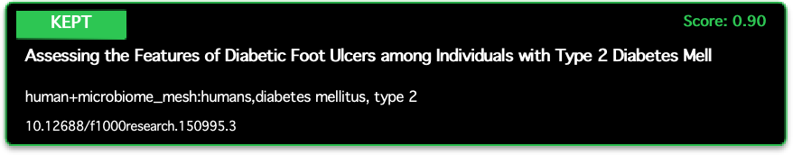
STAGE 1: MESH METADATA FILTER (PUBMED ONLY)
ZERO COST — PURE DICTIONARY LOOKUPS ON HUMAN-CURATED CONTROLLED VOCABULARY
What: MeSH (Medical Subject Headings) are assigned by NCBI librarians to every PubMed paper.
A paper about 'gut flora' is tagged 'Gastrointestinal Microbiome' even if those words don't appear.
Three term lists from config/stage1_mesh.yaml:
mesh_keep: 313 terms (microbiome-specific: dysbiosis, FMT, probiotics...)
mesh_human_signal: 120 terms (Humans, Adult, Child, Infant...)
mesh_animal_only: 248 terms (Animals, Mice, Rats, Zebrafish...)
Decision Logic:
IF has microbiome MeSH + human signal → KEEP (score=0.90)
IF has microbiome MeSH + no human/animal signal → KEEP (score=0.70)
IF has animal-only MeSH + no human signal → REJECT (score=0.10)
IF no microbiome MeSH at all → SKIP (passes to Stage 2)
Non-PubMed papers → skip Stage 1 entirely (no MeSH available)
Result: 267 papers kept at Stage 1 | 0 rejected (PubMed Humans filter already excluded animal papers)

Slide 11
STAGE 2: WEIGHTED KEYWORD SCORER
ALL SOURCES — SCANS TITLE + ABSTRACT + MESH + KEYWORDS + ARTICLE TYPES
Positive terms: 716 weighted phrases (human gut microbiome=0.8, probiotics=0.6, ...)
Negative terms: 281 weighted phrases (mice=-0.5, zebrafish=-0.7, in vitro=-0.35, ...)
Score = (sum of matched positive weights + sum of matched negative weights), normalized to [0,1]
Thresholds: KEEP ≥ 0.7 | REJECT < 0.4 | BORDERLINE: 0.40-0.69
Example:-
Top positive terms: 'human gut microbiome' (0.8), 'human intestinal microbiome' (0.75),
'human microbiome' (0.7), '16S rRNA' (0.65), 'fecal microbiota transplant' (0.65)
Top negative terms: 'mice' (-0.5), 'mouse model' (-0.5), 'zebrafish' (-0.7),
'in vitro' (-0.35), 'soil microbiome' (-0.6), 'marine' (-0.5)
Result: 726 kept | 332 rejected | 3 borderline (passed to Stage 3)

Slide 12

METAGENOMICS GATE
PROJECT-SPECIFIC REQUIREMENT: PAPERS MUST MENTION SEQUENCING TERMS
What: Applied AFTER Stage 2 confident keeps. Checks if the paper mentions any sequencing methodology, bioinformatics tool, or
data repository term.
Why a separate gate? A paper can be 'about human microbiome' (passes Stage 2) but be a pure clinical opinion piece with no sequencing data.
Terms: 228 substring-matched terms across 8 categories:
Sequencing Methods: metagenom, shotgun, 16s, amplicon, nanopore, illumina...
Taxonomic Tools: QIIME, DADA2, MetaPhlAn, Kraken, mothur...
Diversity Metrics: alpha diversity, beta diversity, Shannon, UniFrac...
Data Repositories: PRJNA, SRA, ENA, BioProject, 'data availab'...
Assembly Tools: SPAdes, MEGAHIT, binning, MAGs...
Study Design: cohort study, clinical trial, faecal sample...
Functional: KEGG, PICRUSt, resistome, pathway analysis...
Omics: multi-omics, virome, mycobiome...
Decision: IF no term found → paper flagged for manual review (not hard-rejected)
Result: 15 papers flagged for review (had good keyword score but no sequencing mention)

Slide 13
STAGE 3: ML CLASSIFIER
SENTENCE-TRANSFORMERS + LOGISTIC REGRESSION — HANDLES STAGE 2 BORDERLINE PAPERS
Architecture: all-MiniLM-L6-v2 → 384-dim embedding → Logistic Regression binary classifier
Training (self-supervised bootstrap):
Total samples: 11609 | Positives: 6539 | Negatives: 5070
Positives = papers with Stage 2 score > 0.85 (pseudo-labeled as relevant)
Negatives = papers explicitly rejected (hard/medium/easy tiers for balanced training)
Cross-validation F1 (5-fold): 0.9062 ± 0.002
Thresholds (auto-computed from probability distribution):
KEEP: probability ≥ 0.850 (high confidence relevant)
REJECT: probability ≤ 0.150 (high confidence irrelevant)
BORDERLINE: 0.150 – 0.850 → passes to Stage 3.5/4
Result: 6 kept | 41 rejected | borderline → Stage 3.5

Slide 14
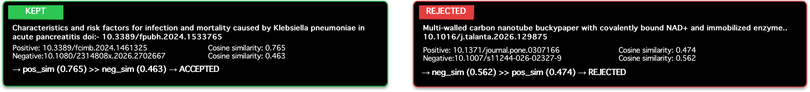
STAGE 3.5: EMBEDDING SIMILARITY FILTER
THE KEY INNOVATION — IT LEARNS FROM ITSELF, NO MANUAL LABELING NEEDED
What: Compares a paper's embedding to known-good (positive) and known-bad (negative) papers.
Embedding Store: 7,098 positive + 3,877 negative vectors (384-dim)
Grows automatically every run — confident keeps/rejects are fed back into the store.
Decision Logic (cosine similarity):
IF pos_similarity ≥ 0.85 AND neg_similarity < 0.60 → KEEP
IF neg_similarity ≥ 0.85 AND pos_similarity < 0.60 → REJECT
OTHERWISE → BORDERLINE (passes to Stage 4 LLM)
Disagreement Router: If Stage 2 says REJECT but Stage 3.5 says KEEP (or vice versa), the paper is routed to Stage 4 LLM for final arbitration.
Self-Learning Loop:
1. Paper gets final verdict (kept/rejected) with confidence > 0.80
2. Its embedding is added to the positive or negative partition
3. Next run, similar papers are classified faster (no LLM needed)
4. Store has grown from 50 initial seeds → 10,975 vectors

Slide 15
STAGE 4: LLM VERIFIER
ONLY FIRES FOR GENUINELY UNCERTAIN PAPERS
What: Local Ollama LLM classifies truly borderline papers with a structured prompt.
Model: gemma3:4b (3.3 GB) — runs locally, no API costs, no data leaves your machine.
Why local LLM?
No API costs or rate limits | Data privacy (papers never leave the machine)
Reproducible (temperature=0) | Cached — same paper never classified twice
Caching Strategy:
Hash cache: MD5(title + abstract) → stored in data/processed/llm_cache.json
Semantic cache: If a new paper's embedding is >0.97 similar to a cached paper, reuse that verdict without calling LLM (saves inference time on near-duplicates).
Current cache: 60 verdicts (28 keep, 32 reject)
Result: 28 kept | 21 rejected | 11 sent to human review (confidence < 0.70)

Slide 16
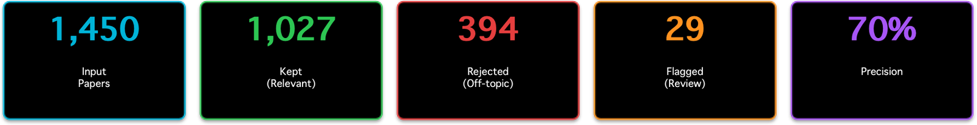
RESULT:
LAYER 1 FINAL OUTPUT
Stage Efficiency — Papers Resolved Per Stage:
Stage | Papers | % of Total | Latency | Cost
Stage 1 (MeSH) | 267 | 18.4% | 0 ms | Free — dict lookup
Stage 2 (Keywords) | 1062 | 73.2% | < 1 ms | Free — regex matching
Gate (Metagenomics) | 15 | 1.0% | < 1 ms | Free — substring search
Stage 3 (ML) | 47 | 3.2% | ~5 ms | Sentence-transformer inference
Stage 4 (LLM) | 60 | 4.1% | ~8-10 s | Local Ollama (gemma3:4b)

Slide 17
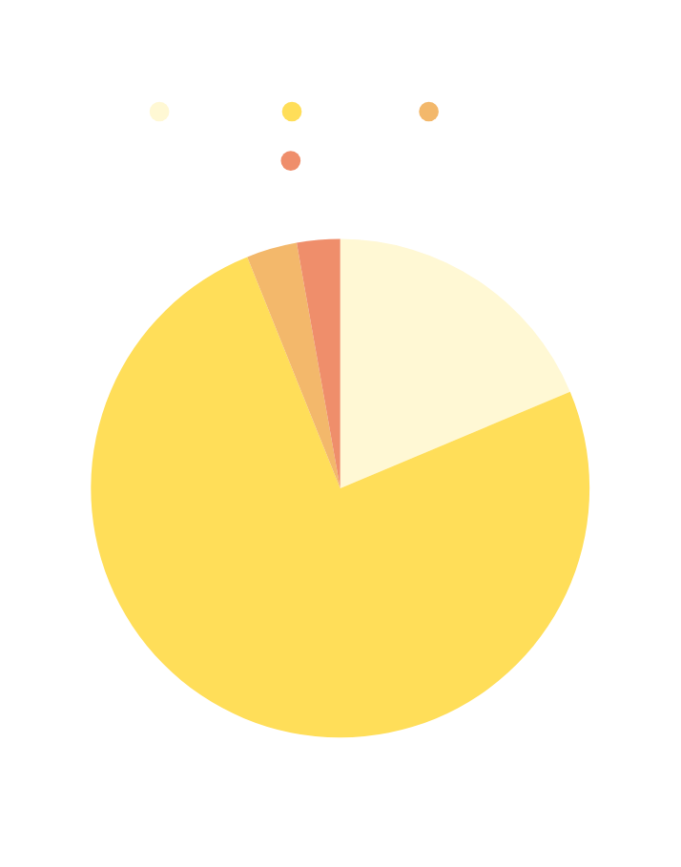
CONT.
97% of decisions made by free, instant stages (1+2+Gate+3). LLM only handles 4% — the truly ambiguous cases.
Output: data/processed/collected_20260720_205759.json → 1,027 PaperRecord objects → ready for Layer 2 NLP
Papers by year: 2024: 278 | 2025: 202 | 2026: 527 | Open access: 571 (55%)

Slide 18
AUDIT, OBSERVABILITY & CONTROLS
Every decision is logged — fully auditable pipeline:
Audit Files (data/audit/):
kept.json — all papers that passed all stages
rejected.json — all papers rejected at any stage
review.json — papers flagged for human review (gate + low confidence)
llm_verified.json — Stage 4 LLM verdicts with confidence + reason
rejected_report_*.csv — human-readable CSV with rejection_cause column
CSV File: List of all the rejected papers with stages, doi and reason of rejection.

Slide 19
ARCHITECTURE DECISIONS & FUTURE WORK
Key Design Decisions:
Cheapest first — 96% of papers never touch the LLM (saves hours of inference time)
Self-learning — embedding store grows every run, reducing LLM dependency over time
THE KEY INSIGHT: Every run makes the NEXT run cheaper and faster.
Graceful degradation — if ML model absent, pipeline still works (rules-only mode)
Future Work:
Stage 2 auto-calibration (needs 50+ Stage 1 negatives — requires broader PubMed query)
Hybrid classifier (stacked meta-learner, activates at 2000+ store vectors — threshold met)
Scalability:
Current architecture handles 100,000+ papers across multiple runs.
Monthly PubMed splits (36 sessions × 9,999 papers = 360,000 max capacity).
Cursor persistence enables incremental collection without re-fetching.

Slide 20
POST-PROCESSING: GROWTH, METRICS & REPORTING
After the relevance filter loop completes, three things happen:
1. EMBEDDING STORE GROWTH
Papers with confident verdicts are fed back into the embedding store:
• Score ≥ 0.80 → added to POSITIVE partition (currently 7,098 vectors)
• Score ≤ 0.20 → added to NEGATIVE partition (currently 3,877 vectors)
• 0.20 < score < 0.80 → skipped (no confident signal to learn from)
• Dedup check: papers already in store (by DOI/PMID) are not re-added
2. PIPELINE METRICS (data/metrics/pipeline_runs.jsonl)
Each run appends a JSON line with:
• Paper counts: total, per-stage kept/rejected/borderline
• LLM stats: calls made, semantic cache hits, avg latency
• Store sizes: positive count, negative count at run completion
• Embedding latency: avg_ms, p95_ms (monitors degradation at scale)
3. REJECTED PAPERS CSV EXPORT
Human-readable CSV with columns:
title, doi, pmid, doi_or_id, source, rejection_cause, stage, score, reason
rejection_cause explicitly differentiates:
'Stage 2: Score Too Low' vs 'Metagenomics Gate' vs 'Stage 3: ML Classifier Reject'
vs 'Stage 3.5: Embedding Similarity Reject' vs 'Stage 4: LLM Reject'

Slide 21
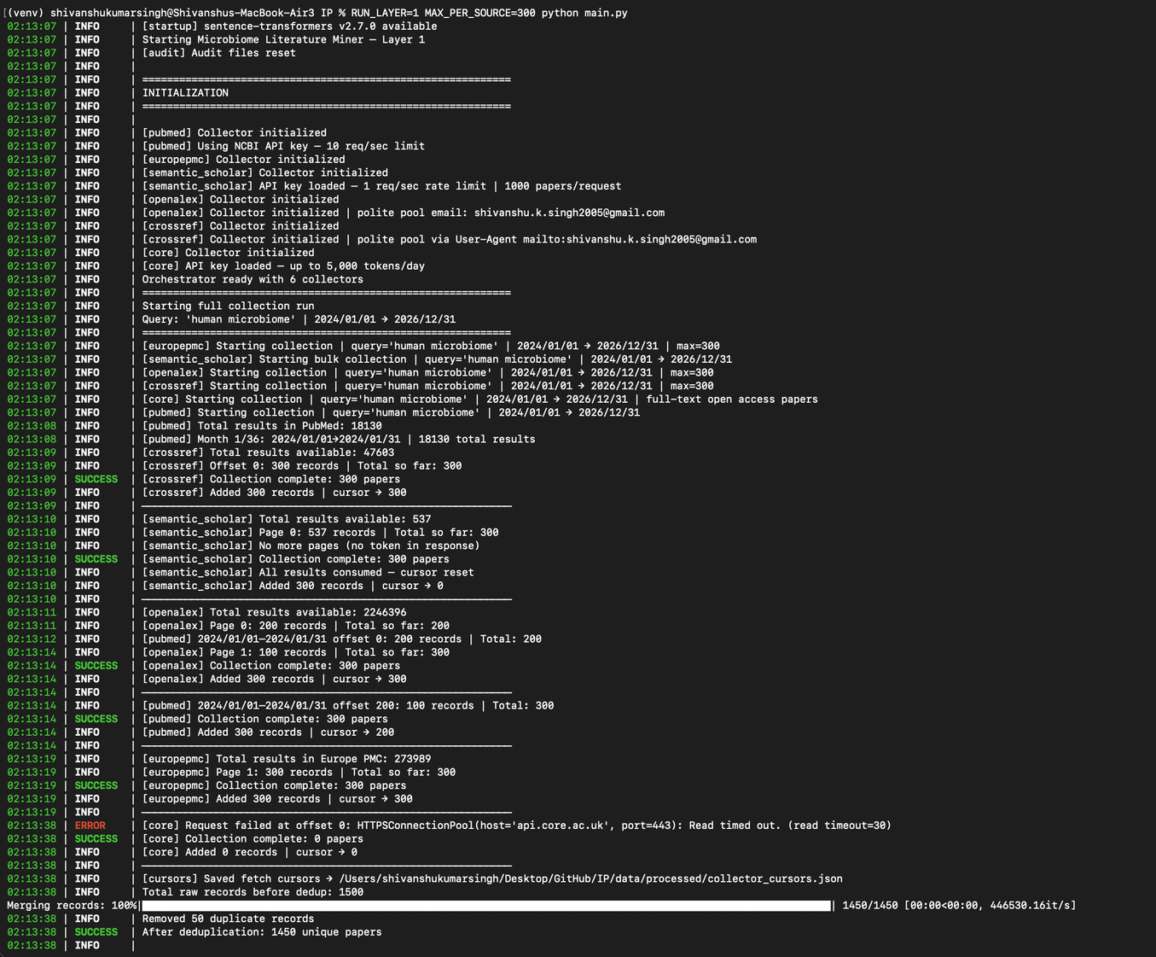
TERMINAL RUN

Slide 22
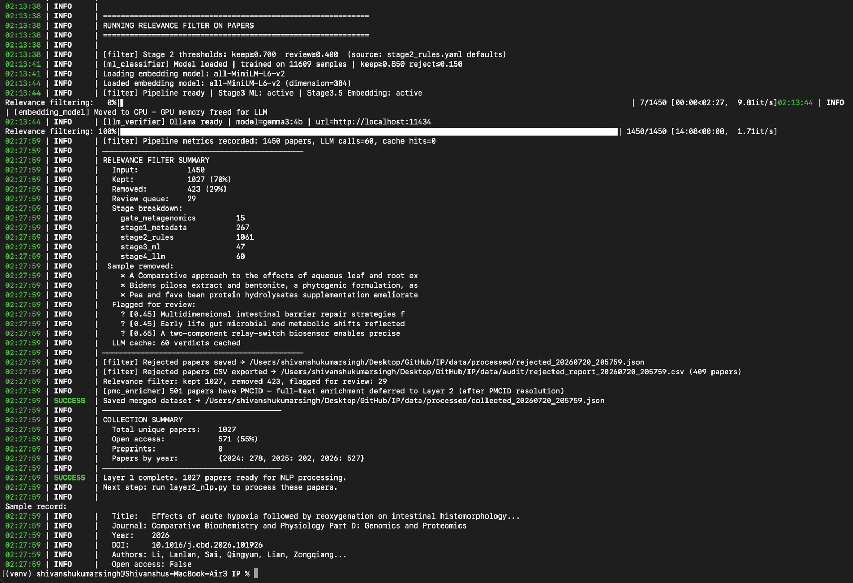
CONT.

Slide 23
THANK
YOU

