Slide 1
Project Presentation of CO-OP Project at Industry (Module-2) (22CS421)
On
Traffic Signs Recognition using Deep Learning
Shivanshu Saini
2210992331
Vishesh
2210992539
Sanya Bansal
2210992256
Sharad Jindal
2210992286
Department of Computer Science and Engineering,
Chitkara University, Punjab
Supervised By:-
Dr Simarjit Kaur ,Associate Professor

Slide 2
Introduction
Road safety is a major global concern, with traffic accidents causing significant loss of life and property.
Traffic signs provide critical information such as speed limits, warnings, and navigation guidance.
Manual recognition of traffic signs by drivers is prone to:
Human error
Fatigue
Distractions
Intelligent Transportation Systems (ITS) aim to automate driving tasks and improve safety.
Traffic Sign Detection and Recognition (TSDR) is a fundamental component of:
Autonomous vehicles
Driver assistance systems (ADAS)
With the rise of self-driving cars, automatic and real-time traffic sign recognition has become essential.
Deep learning techniques, especially CNNs, have revolutionized image recognition tasks due to their ability to learn complex patterns.
2

Slide 3
Problem Statement
Challenges in Traffic Sign Detection & Recognition (TSDR)
The Core Problem:
Recognition of traffic signs has not been fully explored by science, especially for Indian roads
Key Challenges:
Limited Datasets: Hardly any reasonable dataset exists for Indian traffic signs, unlike decent-sized datasets available for other countries worldwide
Model Performance Gap: Deep learning models like Mask R-CNN and Fast R-CNN — trained and tested only on foreign road datasets — may not show desired results when directly applied to Indian roads
High Variation: Many traffic sign categories exhibit high changes in appearance, inter and intra category variations
Environmental Factors: Scaling, orientation changes, varying lighting conditions, and occlusion affect detection accuracy
Limited Categories: Most existing TSDR work deals with a limited number of categories associated with Advanced Driver Assistance Systems (ADAS)

Slide 4
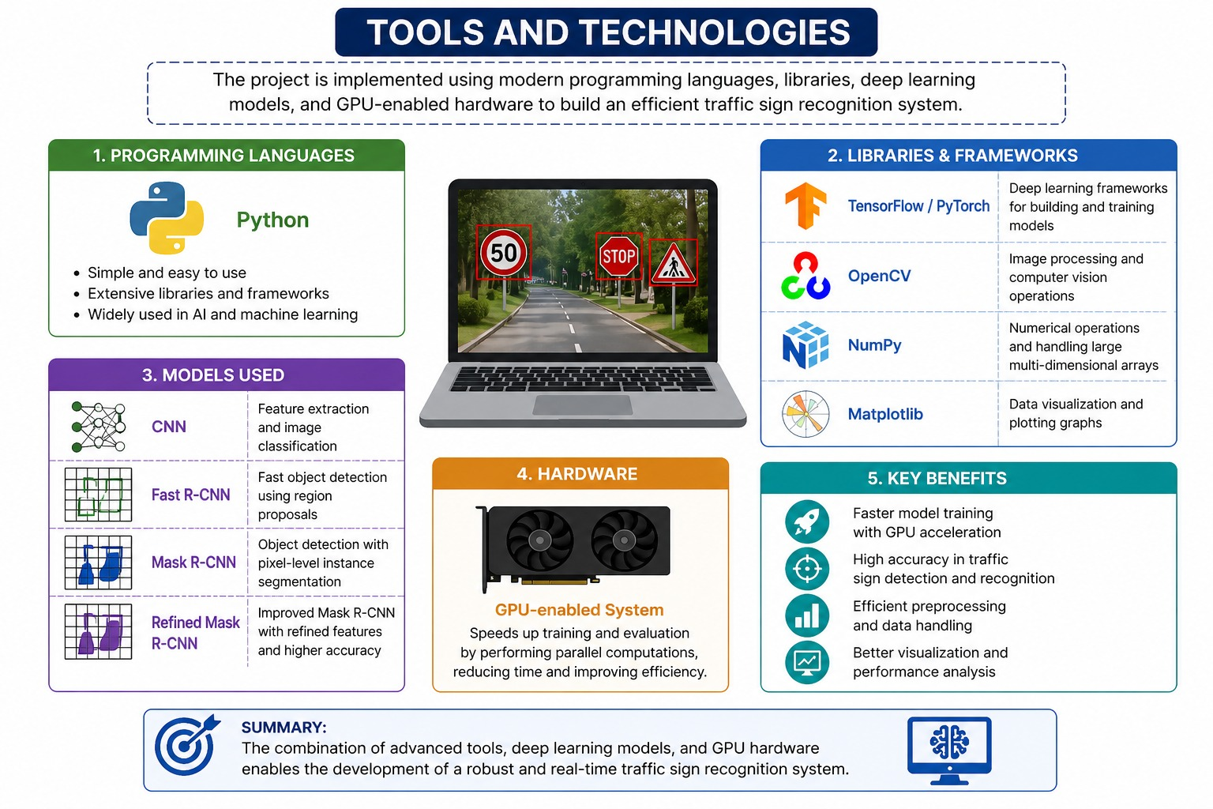

Slide 5
Problem Statement
Challenges
Increasing number of road accidents due to:
Ignored or unseen traffic signs
Poor visibility conditions
Challenges in automatic detection:
Diverse shapes (circle, triangle, rectangle)
Variations in color and size
Environmental conditions (rain, fog, lighting)
Occlusion and background noise
Existing systems:
Mostly trained on foreign datasets
Not suitable for Indian road conditions
Lack of:
Large-scale annotated datasets
Models capable of handling real-world complexity
Need for a system that:
Works in real-time
Provides high accuracy
Handles diverse traffic scenarios

Slide 6
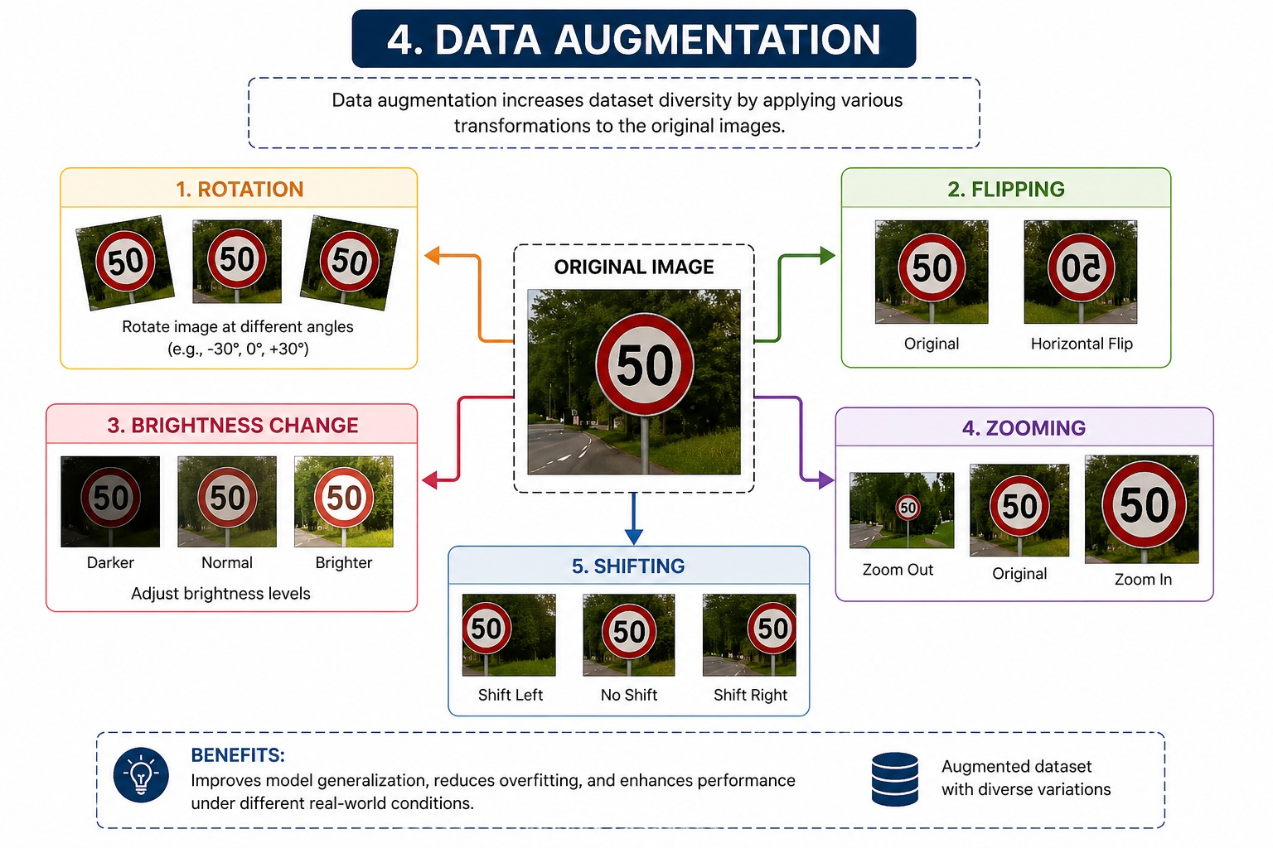

Slide 7
Objective
What This Research Aims to Achieve
Primary Objective:Identify measures that minimize traffic accidents through improved traffic sign recognition
Specific Goals:
Develop an original dataset for Indian traffic signs using deep learning techniques (first of its kind)
Deploy a refined deep learning RMR-CNN model incorporating improvements to the conventional Mask R-CNN system for a large number of Indian traffic signs
Handle challenging scenarios including:
Scaling and orientation changes
Variable lighting conditions
Inter and intra category variations
Evaluate and compare performance against conventional architectures like Fast R-CNN and Mask R-CNN
Achieve higher precision than existing state-of-the-art methods

Slide 8
Existing Methods & Their Limitations
Existing Methods
Traditional Methods
SVM (Support Vector Machine)
HOG (Histogram of Oriented Gradients)
Color-based segmentation
Deep Learning Methods
CNN (Convolutional Neural Networks)
Fast R-CNN
Faster R-CNN
Mask R-CNN
YOLO

Slide 9
Limitations
Limited number of categories in datasets.
Poor generalization across different countries.
High dependency on:
Image quality
Camera resolution
Computational complexity:
Slow processing speed in some models
Difficulty in detecting:
Small-sized traffic signs
Partially occluded signs
High false detection rates in cluttered environments.
Lack of real-time efficiency in some approaches.

Slide 10
Proposed Solution - Method Used (CNN / RMR-CNN)
Refined Mask R-CNN (RMR-CNN) Architecture
Why Mask R-CNN?
Faster R-CNN provides only bounding boxes (includes both object and background pixels)
Mask R-CNN outputs a binary mask to determine whether a pixel belongs to a particular object → higher precision
Our Refinements (RMR-CNN):
Architectural Improvements
Enhanced feature extraction layers
Optimized region proposal network
Parameter Tuning
Adjusted parametric values to adapt Mask R-CNN to Indian traffic sign requirements
Data Augmentation
Scaling, rotation, lighting variation simulation
Pre-processing Enhancements (3 key steps):
Shape detection (triangles, rectangles, circles)
Region of Interest (ROI) extraction
Color probability analysis
Result: Higher accuracy than standard Mask R-CNN and Faster R-CNN

Slide 11
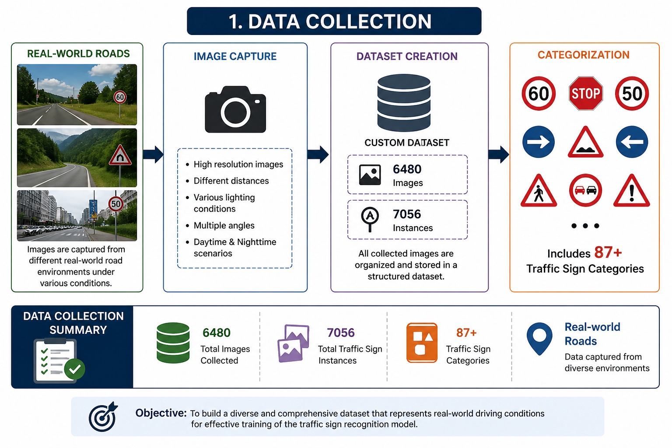

Slide 12
Dataset & Preprocessing
Custom Indian Traffic Sign Dataset
Dataset Statistics:
Parameter | Value
Total Images | 6,480
Total Traffic Sign Instances | 7,056
Categories (Indian signs) | 87
Categories (from standard datasets) | 13
Total Categories | 100
Data Sources:
4,544 images (70.12%) — Real-world capture from Indian roads
1,936 images — Public websites ( India Mart, SlideShare)

Slide 13
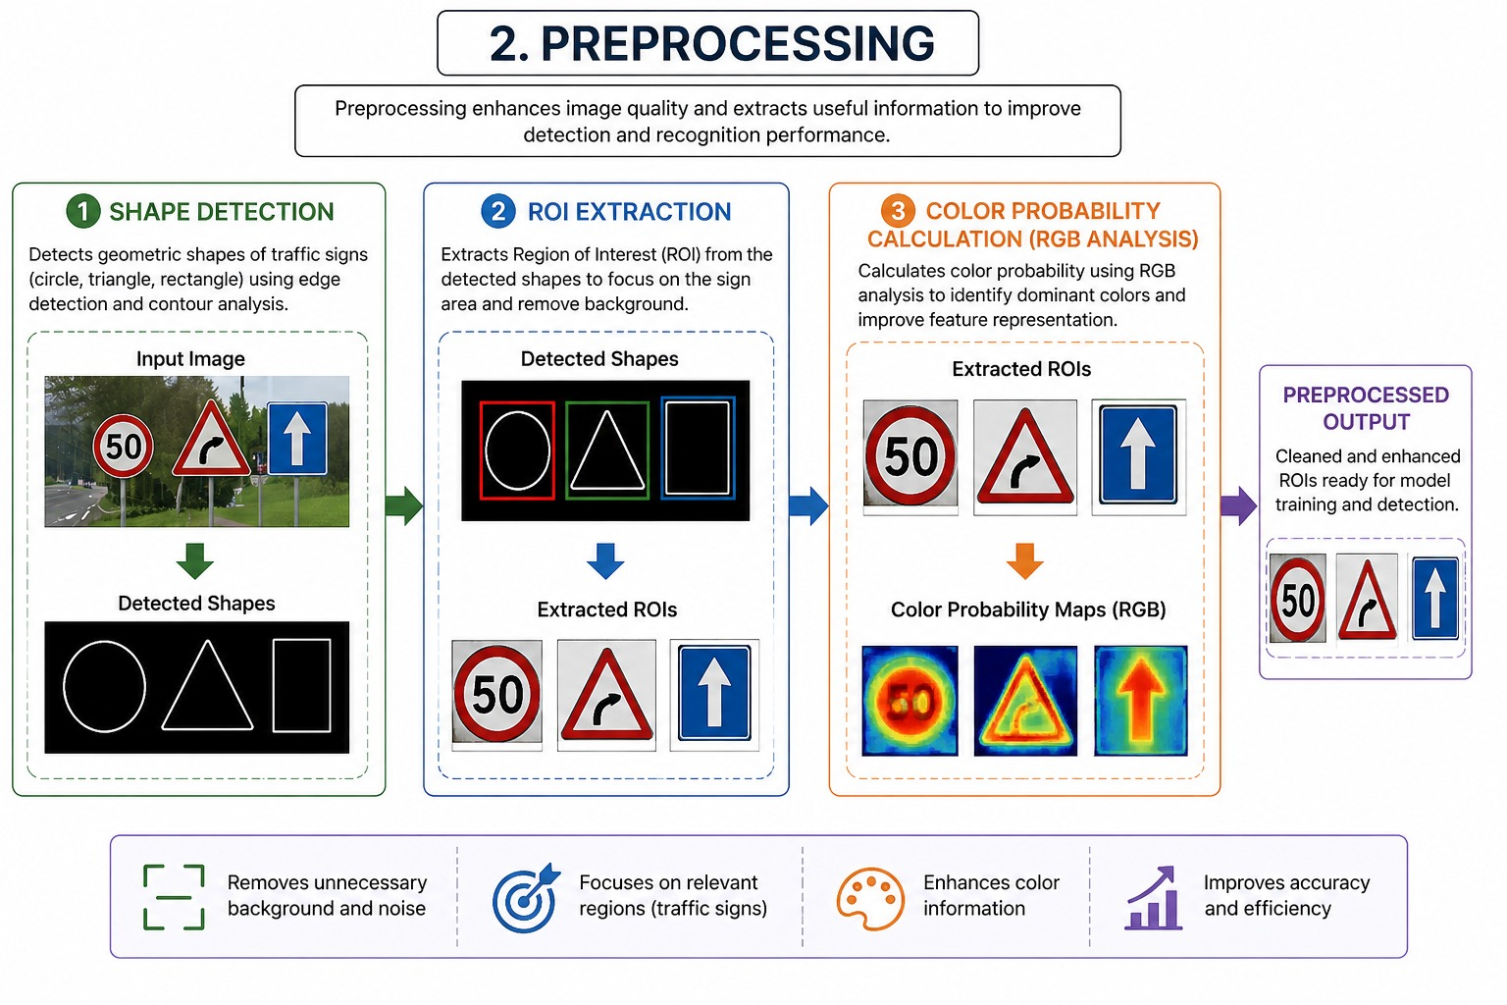

Slide 14
Image Resolution:
High resolution (4128×2322, 774×1032, 960×1280) → 70.12%
Low resolution (225×225, 200×200) → 29.8%
Train-Test Split (80:20):
Training: 5,664 images
Testing: 1,412 images
Preprocessing Steps:
Shape Detection — Convert to grayscale → Counter detection (OpenCV) → Area calculation → Shape identification
ROI Extraction — Hough Circle (circles) / Counter & Edge detection (triangles/rectangles)
Color Probability — Convert cropped images to color for next stage

Slide 15
Feature Engineering & Models
Technical Architecture of RMR-CNN
Traffic Sign Categories Targeted:
Category Type | Description
Mandatory/Regulatory | No option but to follow; non-compliance is illegal/chargeable offence
Cautionary/Warning | Alert users of slowdowns, roadwork, dangers, accidents ahead
Informative | Direction confirmation, destination information, roadside services (food, lodging, fuel, restrooms)

Slide 16
Models Compared:
Model | Key Feature | Limitation Addressed
Fast R-CNN | Uses region proposal network | Lower precision on Indian signs
Mask R-CNN | Outputs binary mask (object vs. background) | Baseline for comparison
RMR-CNN (Ours) | Refined architecture + pre-processing + data augmentation | Highest precision achieved
Handled Variations:
Scaling
Orientation changes
Lighting condition changes
Inter and intra category variations
Challenging categories not reported in previous works

Slide 17
Results
Comparative Analysis
Performance Metrics
Precision: 96.18%
Error rate: < 4%
Model | Precision | Performance
Fast R-CNN | Lower | Moderate
Mask R-CNN | High | Good
RMR-CNN | 96.18% | Best
Observations
Improved detection accuracy in:
Low visibility conditions
Complex backgrounds
Better handling of:
Multiple traffic signs
Small-sized objects
Faster and more reliable predictions

Slide 18
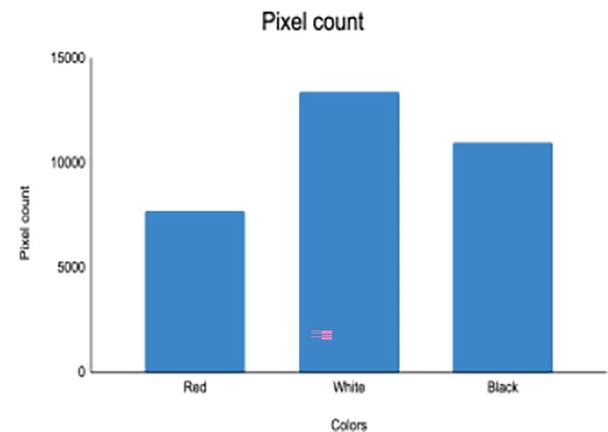
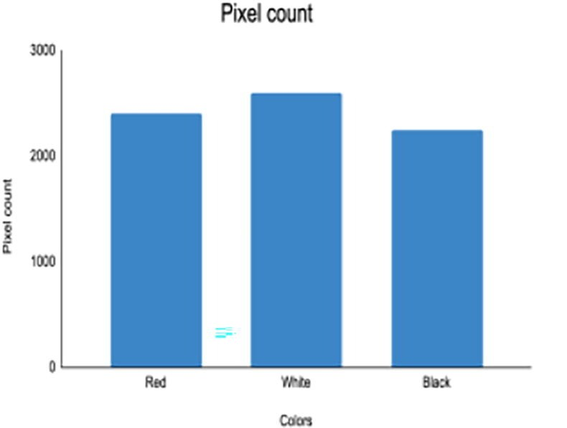
Graphs for two different images about their pixel count

Slide 19
Conclusion
Proposed RMR-CNN model significantly enhances traffic sign detection and recognition.
Custom dataset improves adaptability to real-world conditions.
Preprocessing plays a crucial role in boosting accuracy.
Achieved high precision with minimal error.
Suitable for integration into:
Autonomous vehicles
ADAS systems
Future Scope
Real-time deployment in smart vehicles
Expansion of dataset with more categories
Integration with GPS and navigation systems
Use of lightweight models for edge devices
Improvement in night-time and extreme weather detection

Slide 20
Thank You
20

