Slide 1
The Big Choice:
Google or Apple
(for your new app)
-- Shivanshu Sharma

Slide 2


The Proposition:
The choice between Google or Apple store for your application entails two important questions:
(i) Is there really any difference between the ratings on the two stores?
(ii) Which store should be preferred based on the difference?

Slide 3


Approach
The Data-Oriented approach for making this decision can be broadly directed into the following three steps :
Cleaning/Transformation Transforming Google and Apple DataFrames into workable data
Visualization Histograms, boxplots to assist clients
Modelling Perform permutation test to invalidate the null hypothesis

Slide 4
Cleaning/Transformation Phase:
-> Load the data and select the columns that we’ll be working on within each
dataframe
-> Remove the ‘$’ signs from prices and remove the
Inconsistent entries.
-> Modify the column names and merge the two
dataframes.
Functions Used:
- pd.read_csv()
- df.describe()
- str.replace()
- to_numeric()
- pd.merge()

Slide 5
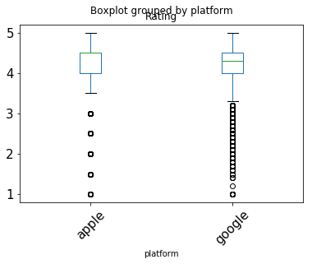
Visualization Phase:
-> Create a visual summary of the ‘Rating’ column, separated by different
platforms
-> Create Histograms to visualize the distribution of ratings
Across Google and Apple dataframes

Slide 6
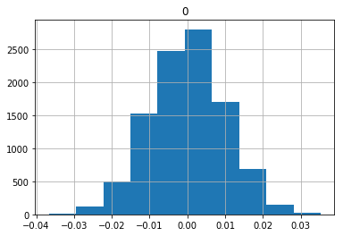
Modelling Phase:
-> Hypothesis formation, including an alternative hypothesis
-> Perform 10000 permutations and observe the difference
Between the means of ratings of Google and Apple
-> Visualize the difference and calculate its absolute
value.

Slide 7
Recommendation
By the end of this section, your audience should be able to visualize:
Does the difference exist? As presented by the observed difference - 0.14206054745123442, there is a statistically significant difference.
Which Store to prefer Based on the observed difference, the client should prefer Apple as the default store to host their application.

