Slide 1

Lio Cinema-Jotstar: Strategies for Growth
Shivanshu Tiwari

Slide 2
Problem Statement
Lio Cinema is merging with Jotstar to create a top OTT platform in India.
Lio's management wants to analyze user behavior and performance of both platforms (Jan–Nov 2024) to optimize content strategy post-merger.

Slide 3
Data Sources
LioCinema Data: User table, Content table, Content consumption table
Jotstar Data: User table, Content table, Content consumption table

Slide 4
Methodology
Data Collection – Extract .sql database file to python dataframe using mysql.connector
Exploratory Data Analysis (EDA) – Identify trends and patterns.
Visualization & Insights – Present key findings using charts/graphs.
Strategic Recommendations – Propose content and growth strategies.

Slide 5
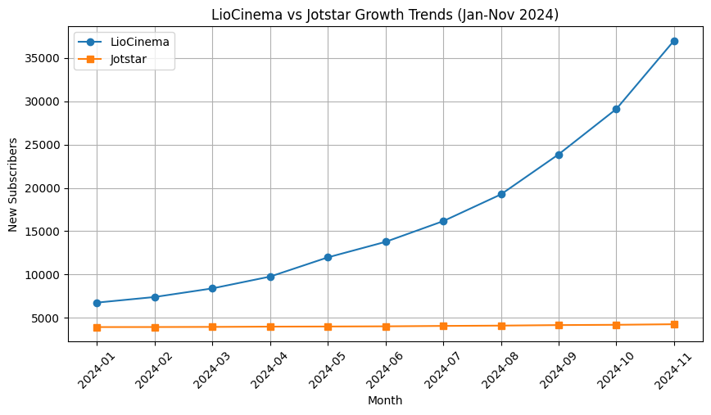
Total Users & Growth Trends
1,83,446 are the total Lio's users , 44,620 are Jotstar’s users.

Slide 6
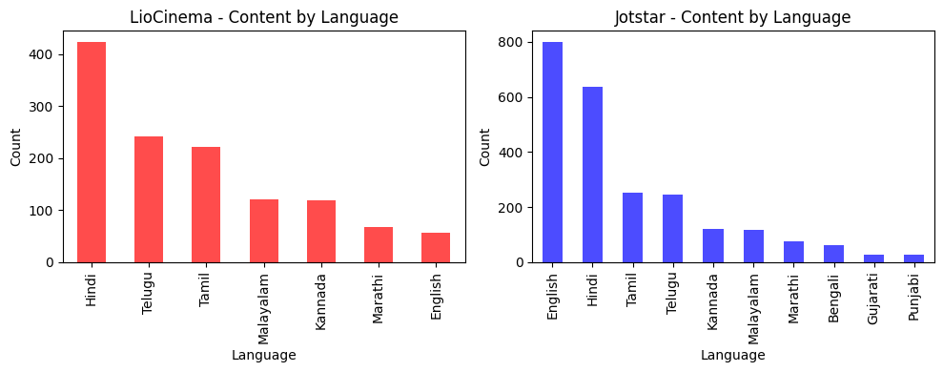
Content Library Comparison
Total Content on LioCinema: 1250, Total Content on Jotstar: 2360

Slide 7
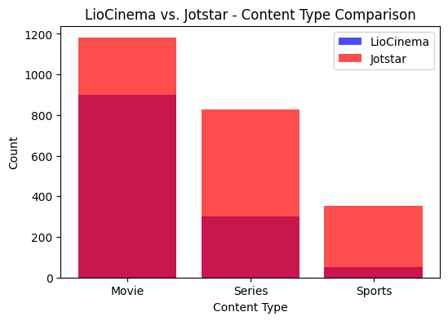
Content Library Comparison

Slide 8
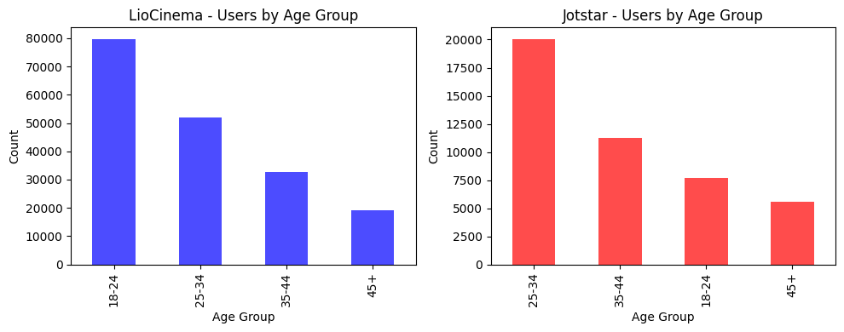
User Demographics

Slide 9
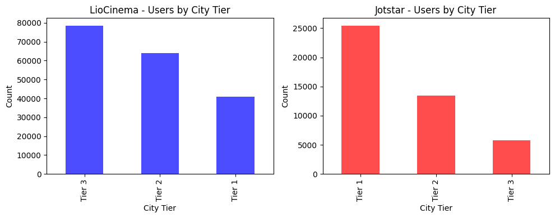
User Demographics

Slide 10
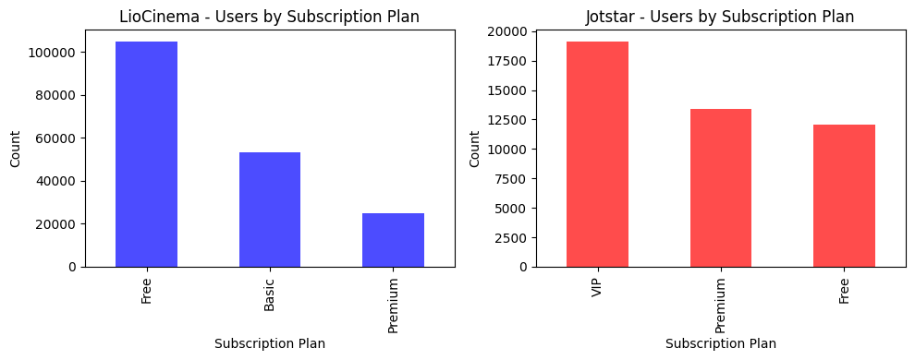
User Demographics

Slide 11
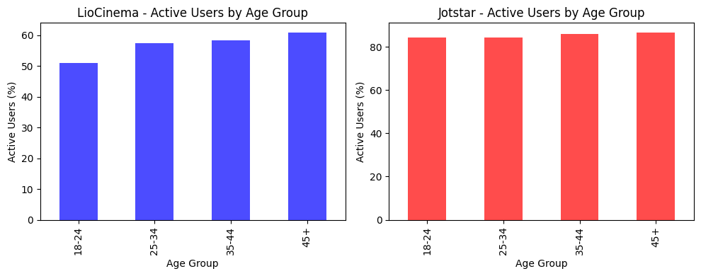
Active vs. Inactive Users
LioCinema - Active Users: 55.13%, Inactive Users: 44.87%
Jotstar - Active Users: 85.09%, Inactive Users: 14.91%

Slide 12
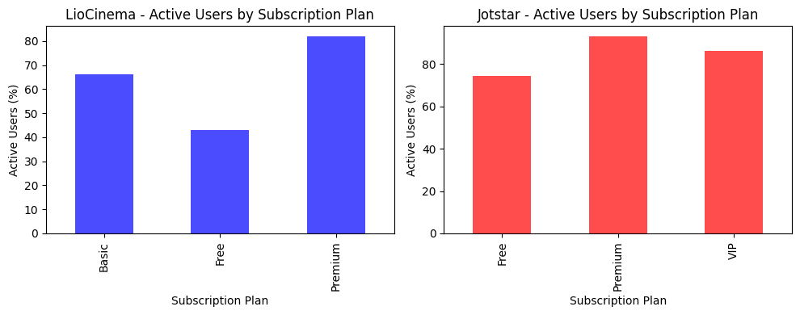
Active vs. Inactive Users

Slide 13
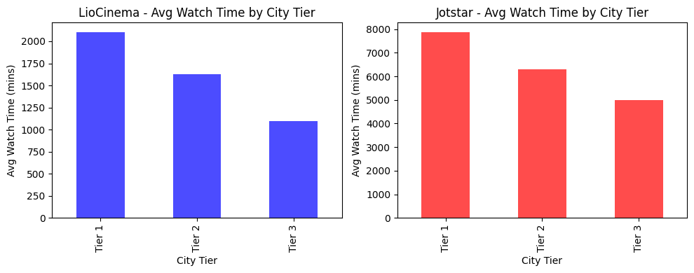
Watch Time Analysis
Average Watch Time on LioCinema: 1536.83 minutes
Average Watch Time on Jotstar: 7034.51 minutes

Slide 14
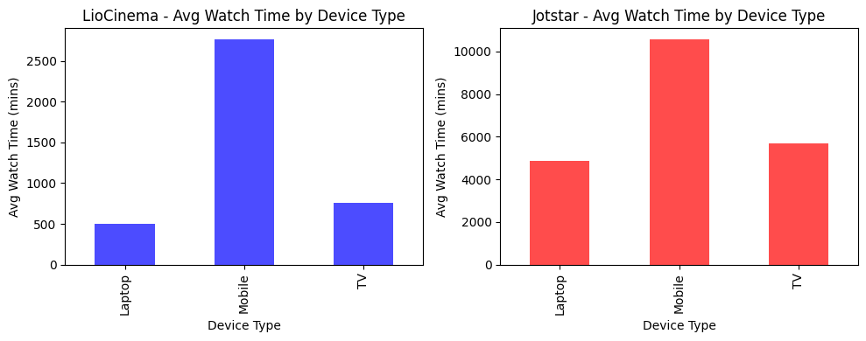
Watch Time Analysis

Slide 15
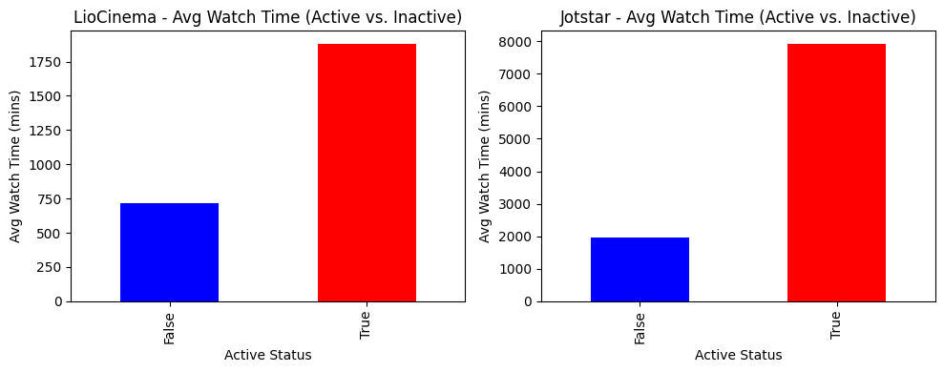
Inactivity Correlation

Slide 16
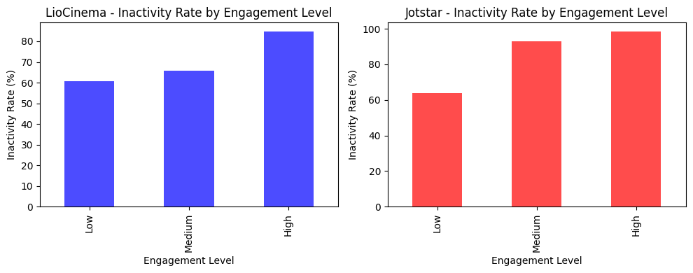
Inactivity Correlation

Slide 17

Downgrade Trends
Total Downgrades on LioCinema: 10550
Total Downgrades on Jotstar: 593
LioCinema Downgrade Rate: 5.75%
Jotstar Downgrade Rate: 1.33%

Slide 18
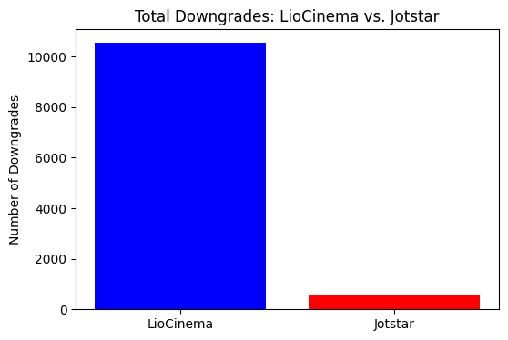
Downgrade Trends

Slide 19
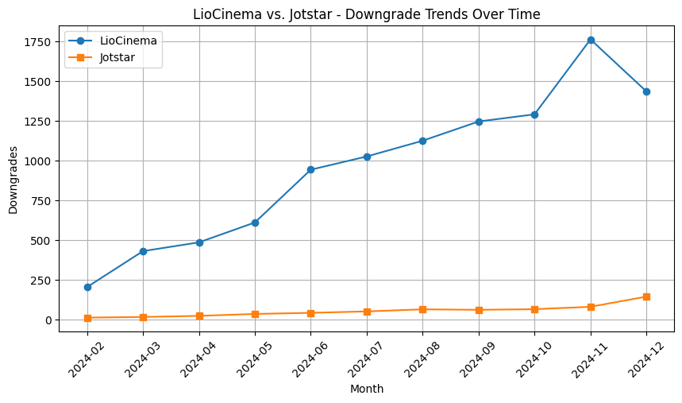
Downgrade Trends

Slide 20

Upgrade Patterns
Total Upgrades on LioCinema: 4155
Total Upgrades on Jotstar: 4348
LioCinema Upgrade Rate: 2.26%
Jotstar Upgrade Rate: 9.74%

Slide 21
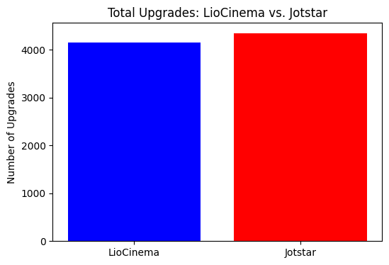
Upgrade Patterns

Slide 22
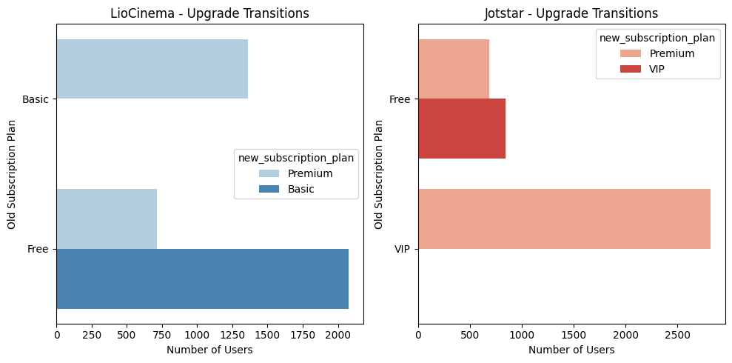
Upgrade Patterns

Slide 23
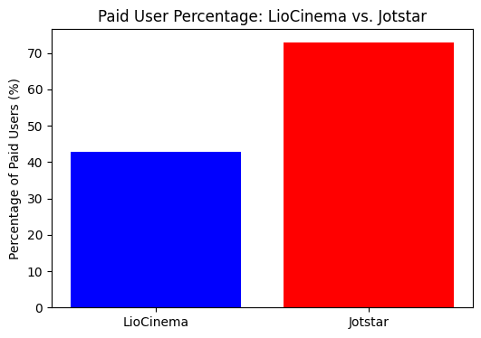
Paid Users Distribution
LioCinema Paid User Percentage: 42.77%
Jotstar Paid User Percentage: 72.89%

Slide 24
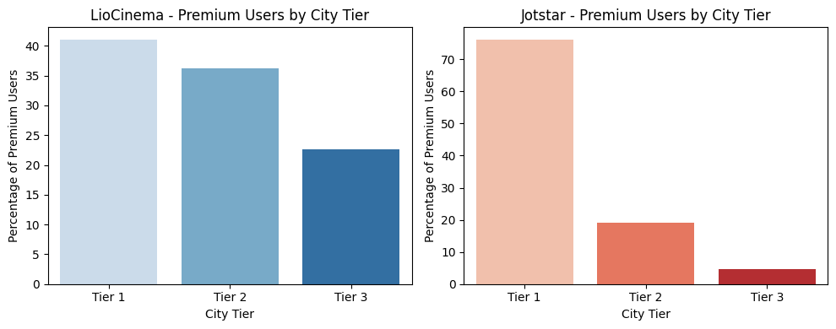
Paid Users Distribution

Slide 25
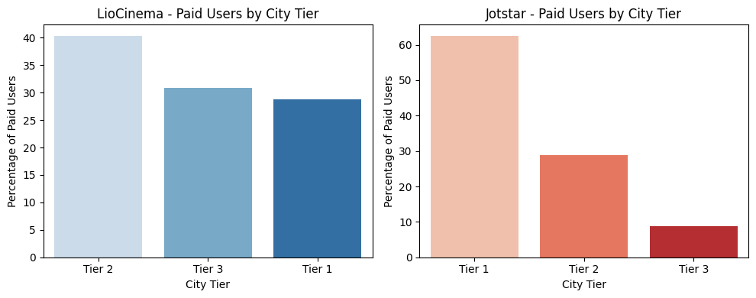
Paid Users Distribution

Slide 26
Revenue Analysis
Total Revenue for LioCinema (Jan-Nov 2024): ₹ 20,187,255.00
Total Revenue for Jotstar (Jan-Nov 2024): ₹ 42,184,236.00

Slide 27
Convert Inactive to Active Users.
Personalized Content Recommendations
AI-driven watch history analysis "Continue Watching" & "Because You Watched" features.
Free access to premium content for limited periods
Gamification: Loyalty points for watching
Weekly challenges to unlock features Push Notifications & Email Marketing
Personalized alerts: "Your favorite actor’s new movie is out!“
FOMO campaigns: "Trending show leaving in 3 days!“ Community Engagement & Social Features

Slide 28
"Bharat Ka Apna OTT" Campaign
Regional content in Hindi, Tamil, Telugu, Bengali, Marathi
Exclusive Bollywood & South Indian cinema collaborations
Blockbuster Premieres & Originals
First-day-first-show OTT premieres
High-quality crime, drama & comedy series
Celebrity-Driven Ad Campaigns
Brand films with Bollywood, Cricket & OTT stars

Slide 29
Subscription Pricing Strategy
Lower pricing in Tier 2 & Tier 3 cities
Metro city users pay full price Bundle Plans with Telecom & ISPs
Netflix-Airtel model: JioFiber / Vi / Airtel bundles
"Buy 6 months, get 1 month free" offer

Slide 30
Telecom Partnerships
Free LioCinema-Jotstar Premium with postpaid & fiber plans
"Free 3-month subscription with new 5G plans“ Free Trials with Recharge Packs
"Recharge ₹299, Get 1-Month Free OTT Access“ Co-Branded Marketing
Telecom companies promote OTT content via SMS & push notifications
Exclusive premier access for telecom customers

Slide 31
AI & ML for Personalization
Behavioral tracking to suggest movies & shows
AI-driven "What to Watch Next?" feature Smart Content Categorization
Emotion-based tagging: “Feel-Good Movies”
Real-time recommendations via chatbot Predictive Analytics for Content Acquisition
AI to analyze social media trends for licensing deals

Slide 32
Best Brand Ambassador
Shah Rukh Khan – Bollywood Mass Appeal
Allu Arjun – South Superstar, PAN-India reach
Alia Bhatt – Gen-Z & Women audience
Virat Kohli for sports & IPL streaming

Slide 33
Final Takeaways
Convert inactive users into active ones via personalized engagement & gamification.
Strengthen brand as "India’s Own OTT" with regional content & high-impact campaigns.
Implement affordable subscription plans & telecom partnerships.
Utilize AI-driven content discovery & recommendations.
Appoint top-tier brand ambassadors for maximum reach.

Slide 34
Your best quote that reflects your approach… “It’s one small step for man, one giant leap for mankind.”
- Neil Armstrong

