Slide 1





Chinook Data Analysis
By Shivanshu Verma

Slide 2

Chinook
Chinook Music, established in 1995, offers a range of musical instruments, accessories, and services, including rentals and repairs, to support musicians in North Central Washington.
In this presentation, we will explore the data behind Chinook Music, analyzing its trends, sales, and customer insights using SQL.

Slide 3
📌 Our Key Objectives:
Understand the sales patterns and customer preferences at Chinook Music.
Explore the most popular music genres and best-selling artists.
Analyze revenue distribution across different regions.
Identify factors influencing sales performance.
Utilize SQL to extract and interpret business insights effectively.

Slide 4
Unlocking Insights with Data
Which music genres and artists drive the highest sales?
How do customer preferences vary across different regions?
What factors contribute to high revenue generation?
Can data help optimize Chinook Music’s sales strategies?
How can SQL be leveraged to extract meaningful insights?
Through these questions, we aimed to decode Chinook Music’s success and explore how data shapes business decisions.

Slide 5
Data Overview
About the Dataset
Chinook Music’s database is a relational database with multiple linked tables.
It includes data on customers, sales, music inventory, and employees.
Key Tables Used
Tracks & Albums – Tracks, artists, albums, playlists and genres.
Invoices & Invoice_Items – Sales transactions and purchased tracks.
Customers & Employees – Customer and Employees details.
Why This Data?
Helps uncover sales trends & customer preferences.
Supports data-driven decision-making for Chinook Music.

Slide 6
Methodology – How We Analyzed the Data?
Step 1: Understanding the Dataset Explored the Chinook database structure and key tables.
Step 2: Data Extraction with SQL Used SQL queries to filter, join, and analyze relevant data.
Step 3: Identifying Patterns & Trends Focused on top genres, customer preferences, and revenue drivers.
Step 4: Visualizing Insights Transformed raw data into charts & graphs for better interpretation.
Step 5: Drawing Conclusions Connected findings to business strategies for Chinook Music.

Slide 7
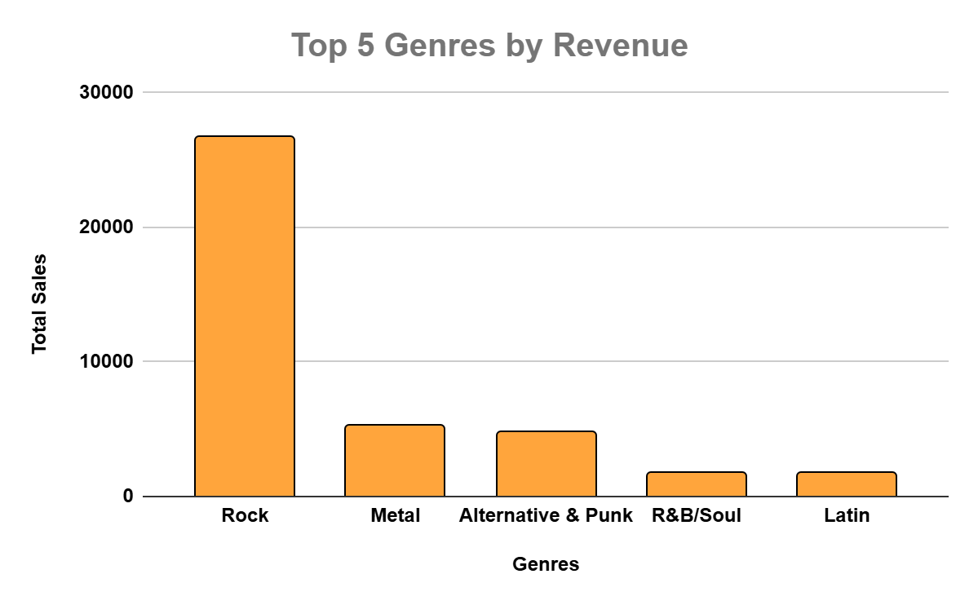
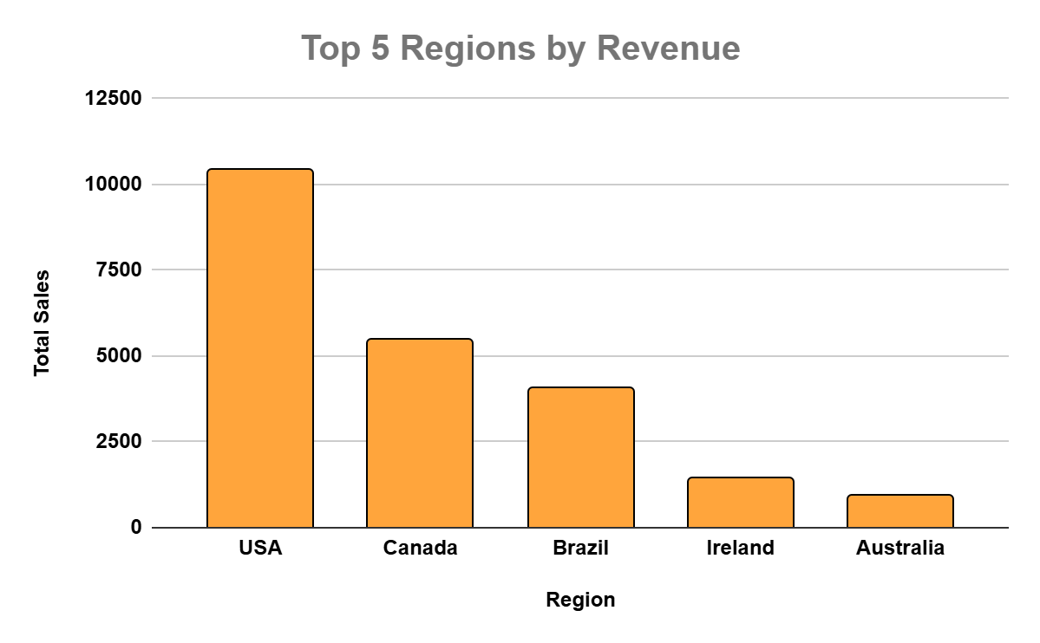
Sales Trends & Customer Insights
📌 Top-Selling Genres (top 5) 📌 Top Revenue by Region (top 5)
Rock leads in sales, followed by
Metal and Alternative.
North America and Europe contribute the highest revenue.

Slide 8
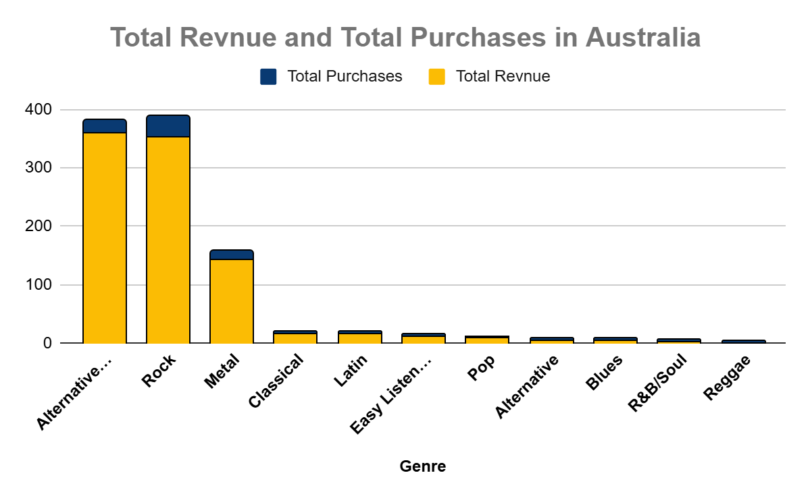
Customer Purchase Patterns
Data reveals strong genre preferences across different regions. The above chart is showing the results for “AUSTRALIA”
Inventory & marketing strategies can be optimized based on these sales trends to boost our sales more focusing on different countries.

Slide 9
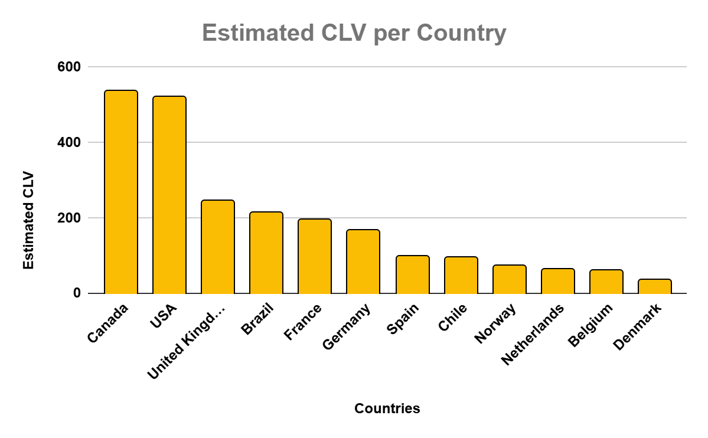
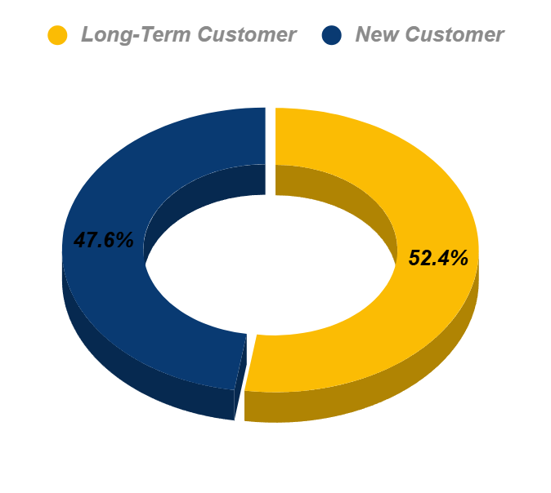
Customer Lifetime Value (CLV)
High CLV: Indicates loyal, repeat buyers.
Low CLV: Suggests one-time or occasional buyers.
.

Slide 10
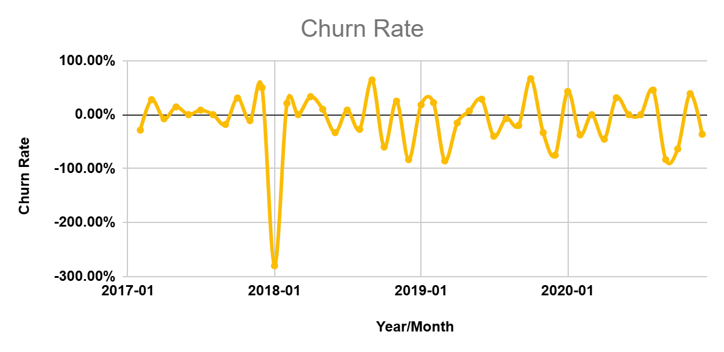
Churn Rate and Customer Purchase Behaviour
Most purchases occur on weekends and during festive seasons.
Customers tend to buy more albums at the end of the month.
Customers who purchase only singles tend to churn faster than album buyers.

Slide 11
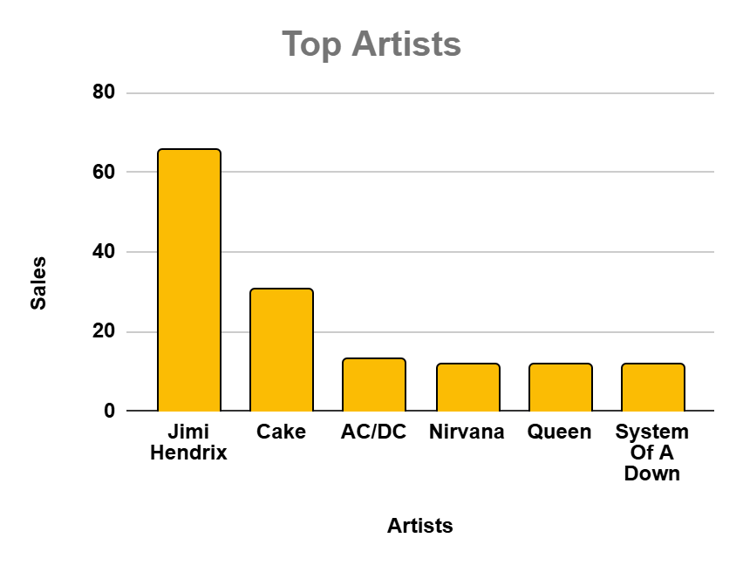
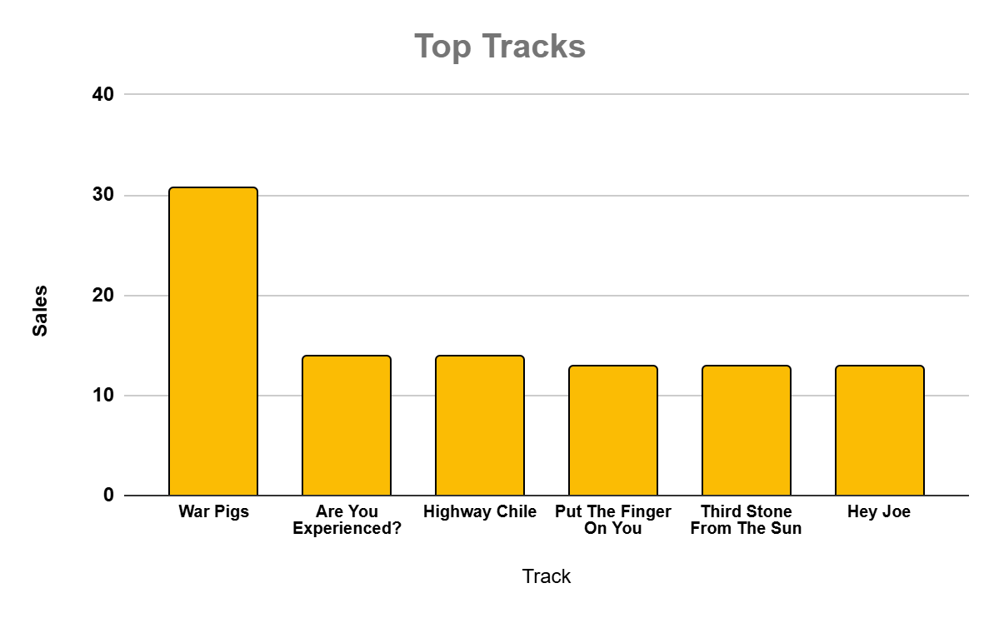
Top-Selling Artists & Best-Selling Tracks:
Rock & Alternative artists dominate the top 5.
Classical and Jazz have steady demand in niche segments.
The top 10 tracks contribute over 30% of total sales revenue.
Streaming-based purchases are rising for trending singles.

Slide 12
🔍 Conclusion: What We Discovered?
Top Genres Drive Revenue: Certain genres significantly outperform others, indicating strong customer preferences.
Regional Preferences Exist: Sales patterns differ across regions, highlighting the need for localized marketing.
Customer Loyalty Matters: High-value customers contribute significantly to revenue, making retention crucial.
Popular Artists & Tracks: A small percentage of artists and tracks generate the majority of sales.
Churn Rate is a Concern: Understanding why customers stop purchasing is key to improving retention.

Slide 13
Overcoming Key Concerns & Challenges
Addressing Genre Popularity & Sales Fluctuations
Music preferences evolve, and relying on a few top-performing genres may lead to revenue stagnation. To counter this, Chinook Music can diversify its catalog by introducing emerging genres and analyzing customer preferences to curate dynamic playlists. Additionally, periodic genre-specific promotions can boost interest in underperforming categories.
Enhancing Regional Sales Performance
Sales data shows varying regional preferences, indicating that a one-size-fits-all strategy may not work. Implementing localized marketing campaigns, exclusive regional discounts, and curated playlists based on geographical preferences can drive higher engagement. Furthermore, collaborating with regional artists can attract more customers and expand the market reach.

Slide 14
Strengthening Customer Retention & Loyalty
High-value customers contribute significantly to revenue, but maintaining loyalty is challenging. Chinook Music can introduce a tiered loyalty program, rewarding frequent buyers with discounts, early access to new releases, and exclusive content. Personalized emails with recommendations based on previous purchases can also enhance engagement and encourage repeat business.
Trackling Customer Churn & Inactivity
A major concern is the drop-off rate of customers after initial purchases. To reduce churn, Chinook Music can offer subscription-based plans with incentives, such as bundled discounts on bulk purchases. Additionally, automated follow-ups with personalized offers and limited-time deals can re-engage inactive users, ensuring consistent revenue flow.

Slide 15
Boosting Artist & Track Discovery
Relying on a few top artists limits growth. Chinook Music can use AI-driven recommendations, themed playlists, and featured artist campaigns to promote lesser-known talent, keeping customer interest diverse and fresh.
Optimizing Pricing & Revenue Strategies
Dynamic pricing, limited-time discounts, and bundle deals can drive higher sales. A/B testing price points for different regions and genres ensures competitive pricing while maximizing revenue.
Taking all these steps, we can efficiently improve the business and
and the services for the customer.

Slide 16


"Without music, life would be a mistake."
– Friedrich Nietzsche
Thank You for Your Time and Attention! 🙌
Got any questions? Feel free to reach out: 📧 shivanshuverma210901@gmail.com

