Slide 1
Project Presentation
Employee Name: SHIVANI SHARMA
EMPLOYEE ID : 207041

Slide 2
Agenda
Spring Boot
Eclipse IDE
GitHub
Jenkins
Docker
Project Implementation

Slide 3
Spring Boot
Spring Boot is an open-source Java framework used for programming standalone, production-grade Spring-based applications with a bundle of libraries that make project startup and management easier.
Spring boot Initializr generates spring boot project with just what you need to start quickly!
If you want to create your own Spring Boot-based project, visit Spring Initializr, fill in your project details, pick your options, and download.
To create Spring Boot Project.
Go in google Type Spring initializr and you will be directed to the page and click on Spring Initializr

Slide 4
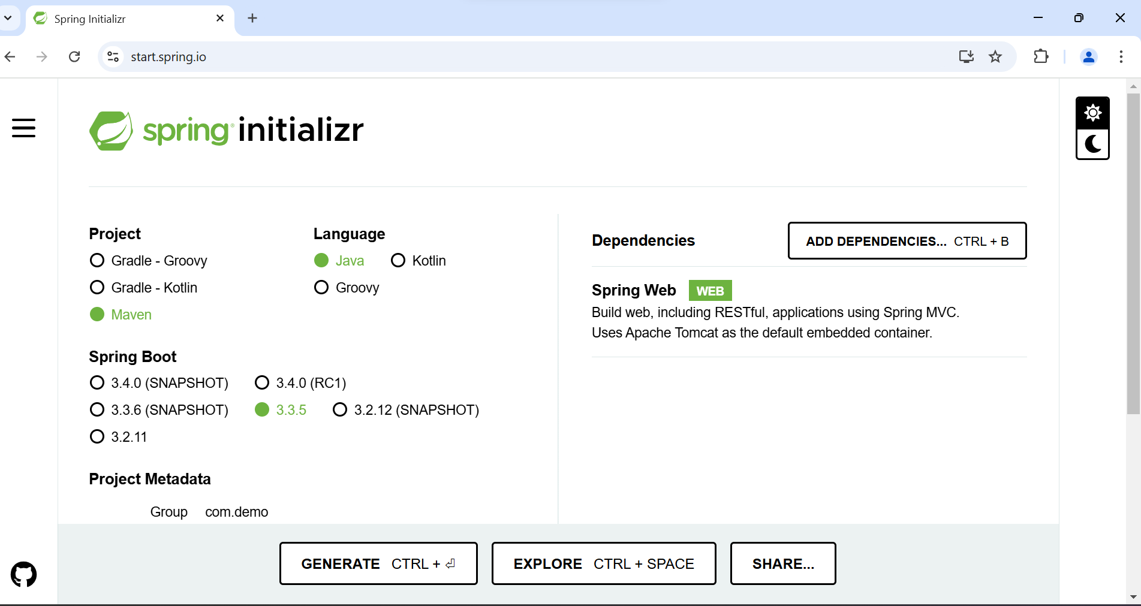
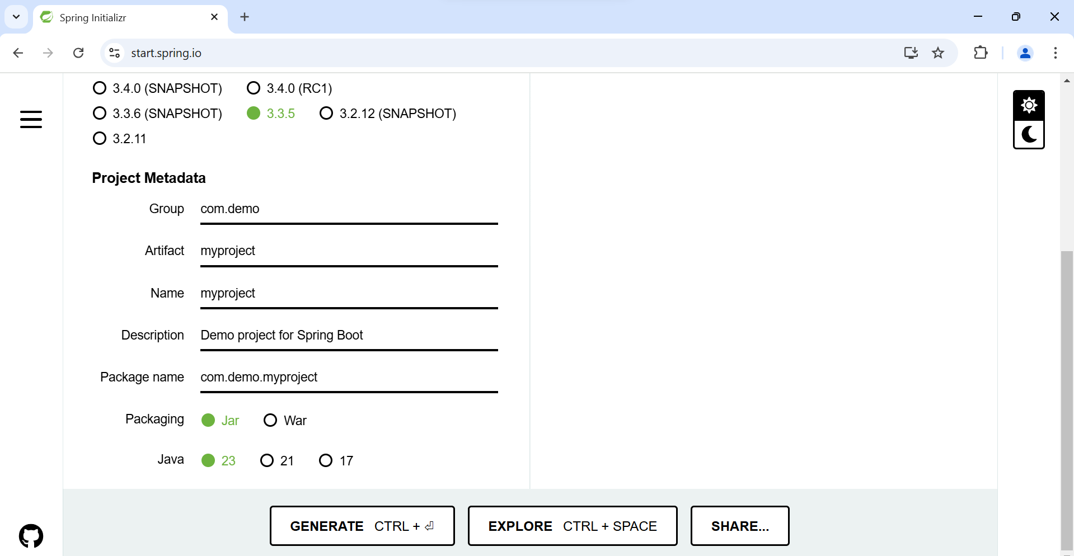
Spring Initializr

Slide 5
What is Eclipse IDE?
Multi-Language Support: Primarily used for Java, but supports many other languages (C++, Python, JavaScript, etc.) through plugins.
Powerful Code Editing: Offers features like syntax highlighting, code completion, and error detection to improve coding efficiency.
Integrated Debugging: Built-in tools for stepping through code, setting breakpoints, and inspecting variables to debug applications.
Extensive Plugin Ecosystem: Customize your IDE with plugins for tools like Maven, Gradle, databases, and more.
Project and Version Control Integration: Manage projects, organize code, and easily integrate with version control systems like Git.
Cross-Platform: Available on Windows, macOS, and Linux, making it accessible on various operating systems.

Slide 6
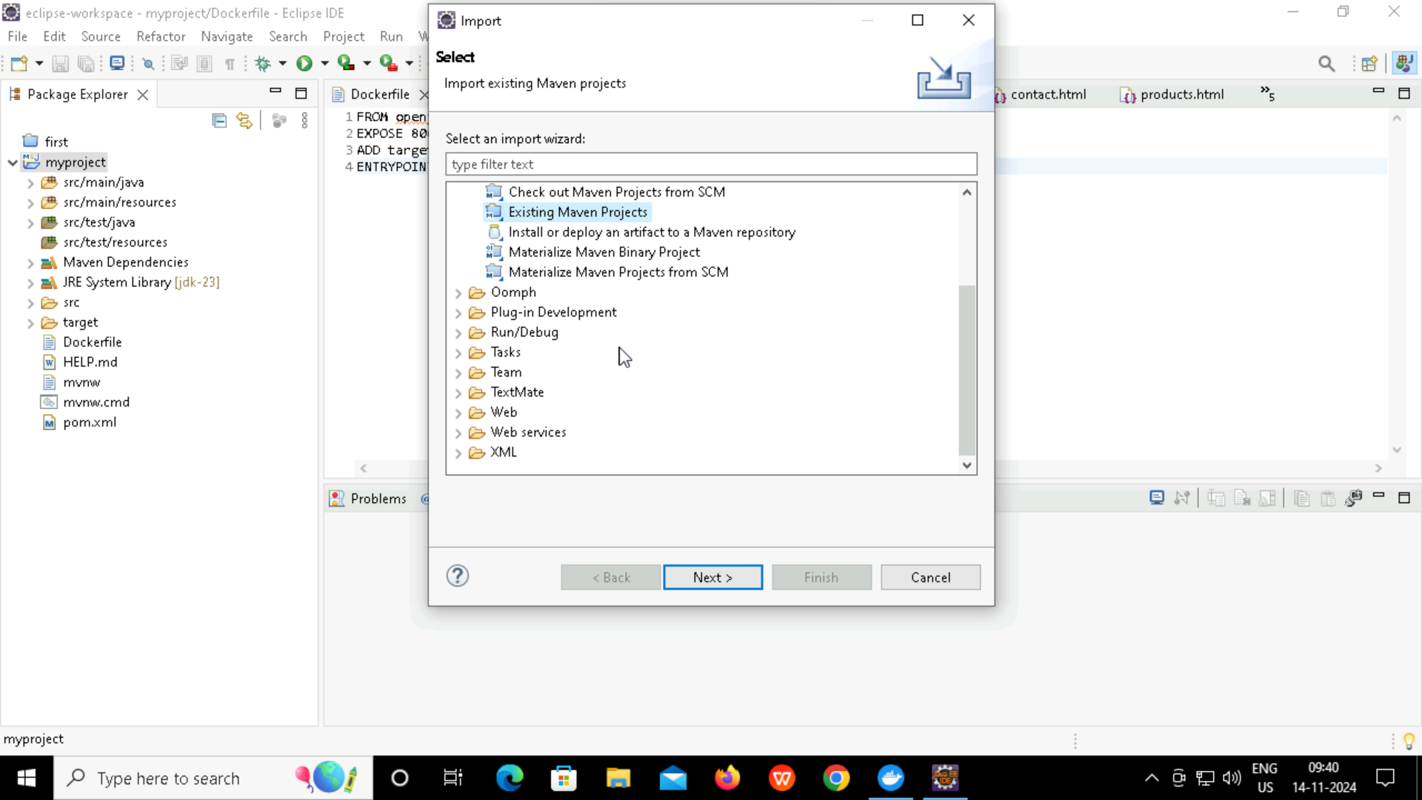
What is Eclipse?

Slide 7
What is Github?
Version Control: GitHub is a platform for managing code versions using Git, enabling tracking and collaboration on software projects.
Collaboration: It allows multiple developers to work on the same project, offering features like pull requests, code reviews, and branching.
Project Management: GitHub provides issue tracking, project boards, and documentation tools to organize and manage development workflows.
Hosting: It supports hosting code repositories, as well as static websites via GitHub Pages.
Integration & Automation: GitHub integrates with CI/CD tools like GitHub Actions for automated testing, deployment, and workflows.

Slide 8
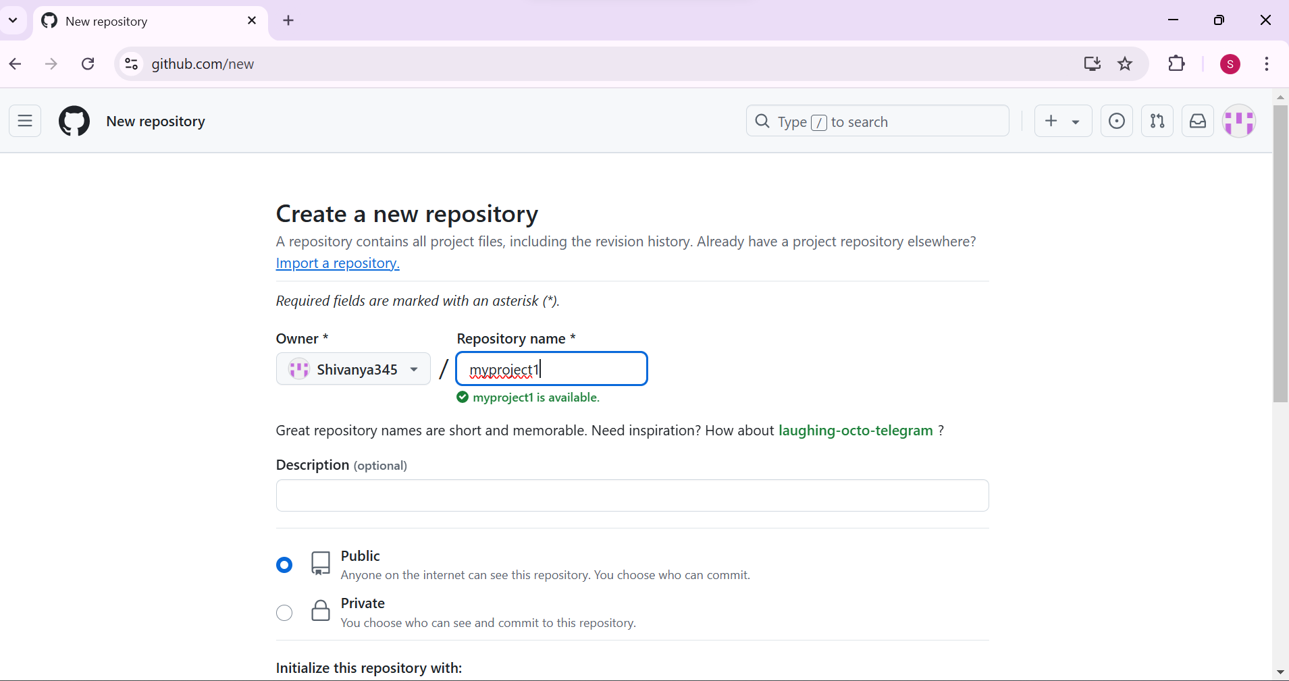
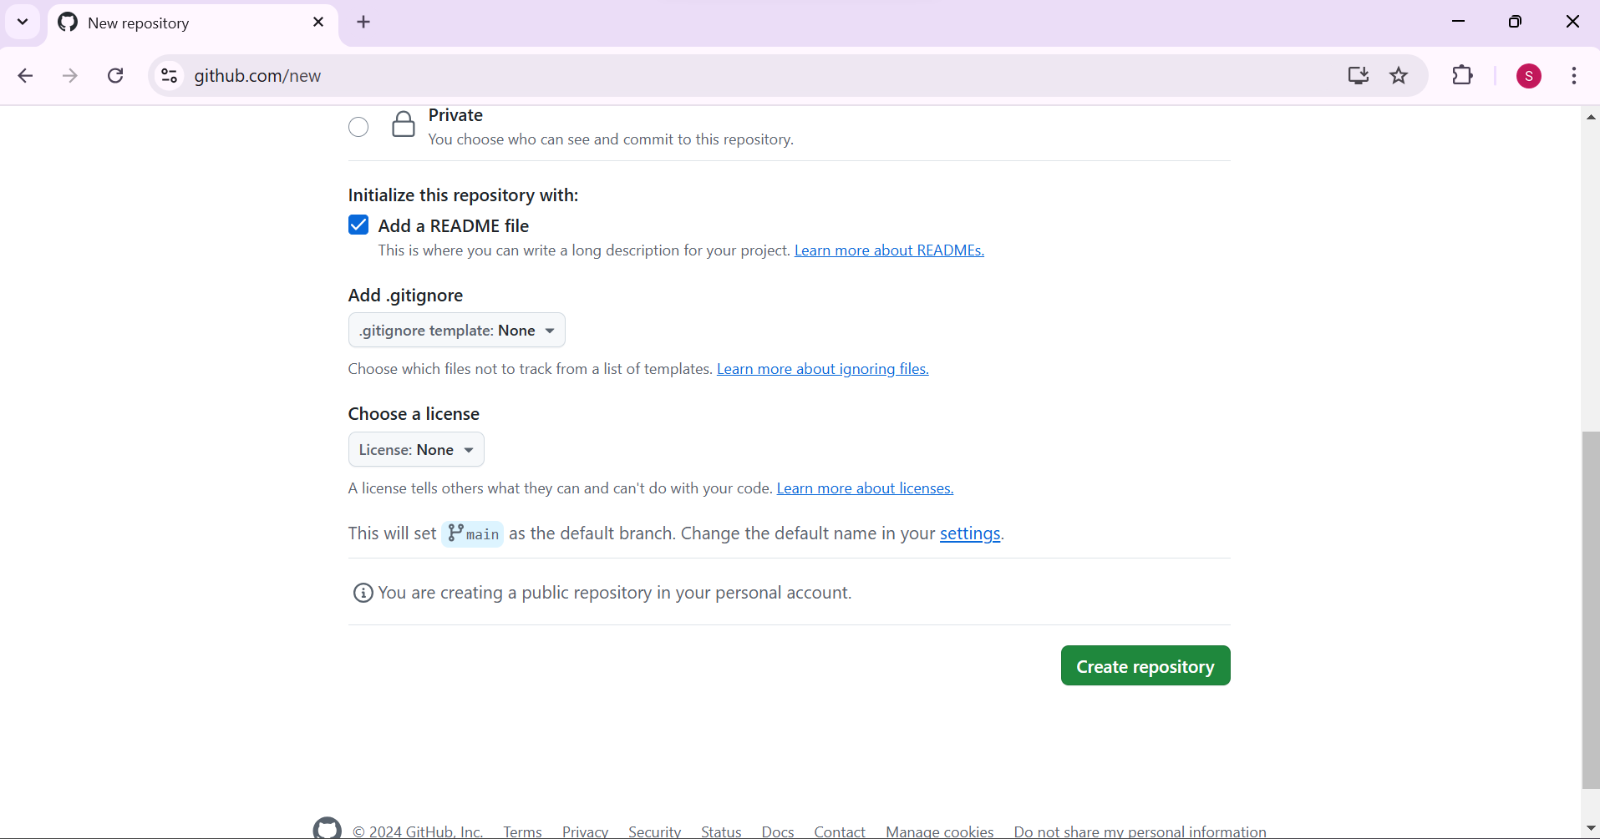
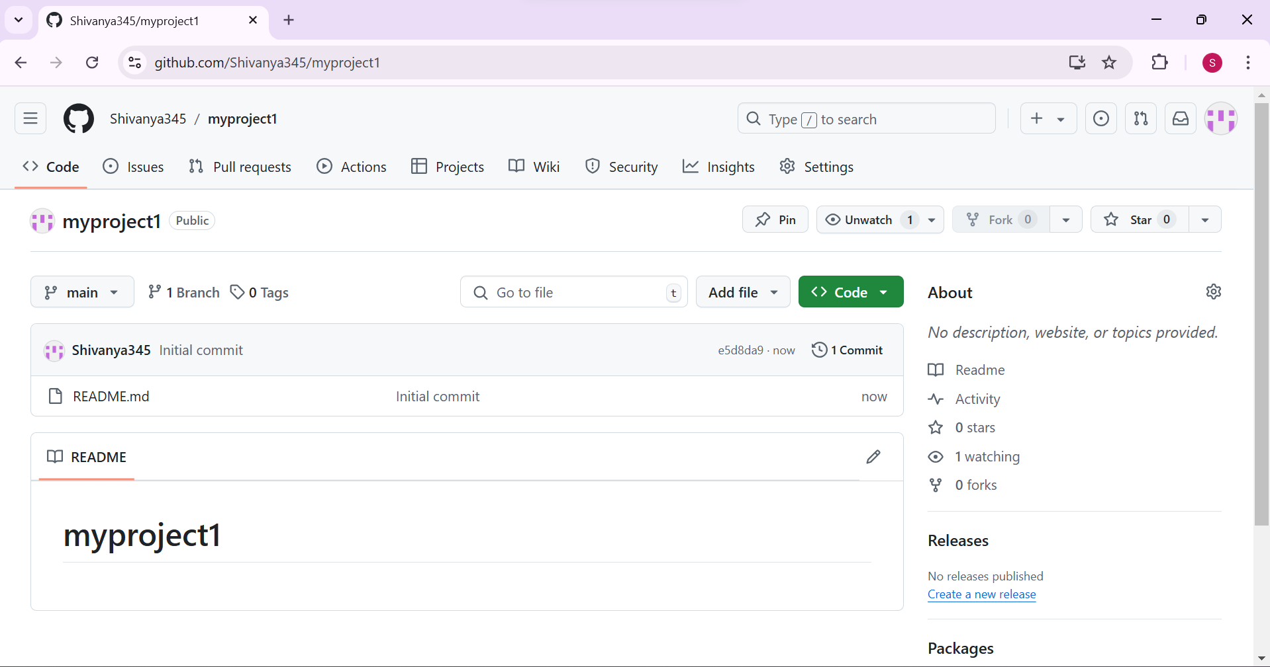
Project Repository

Slide 9
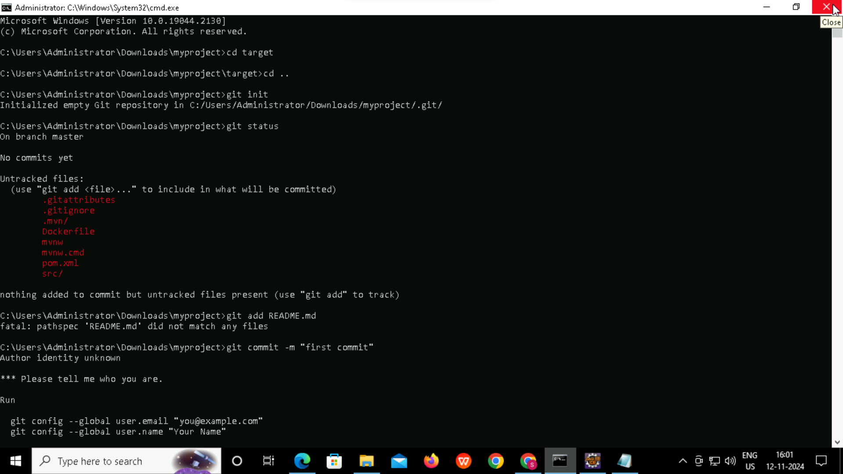
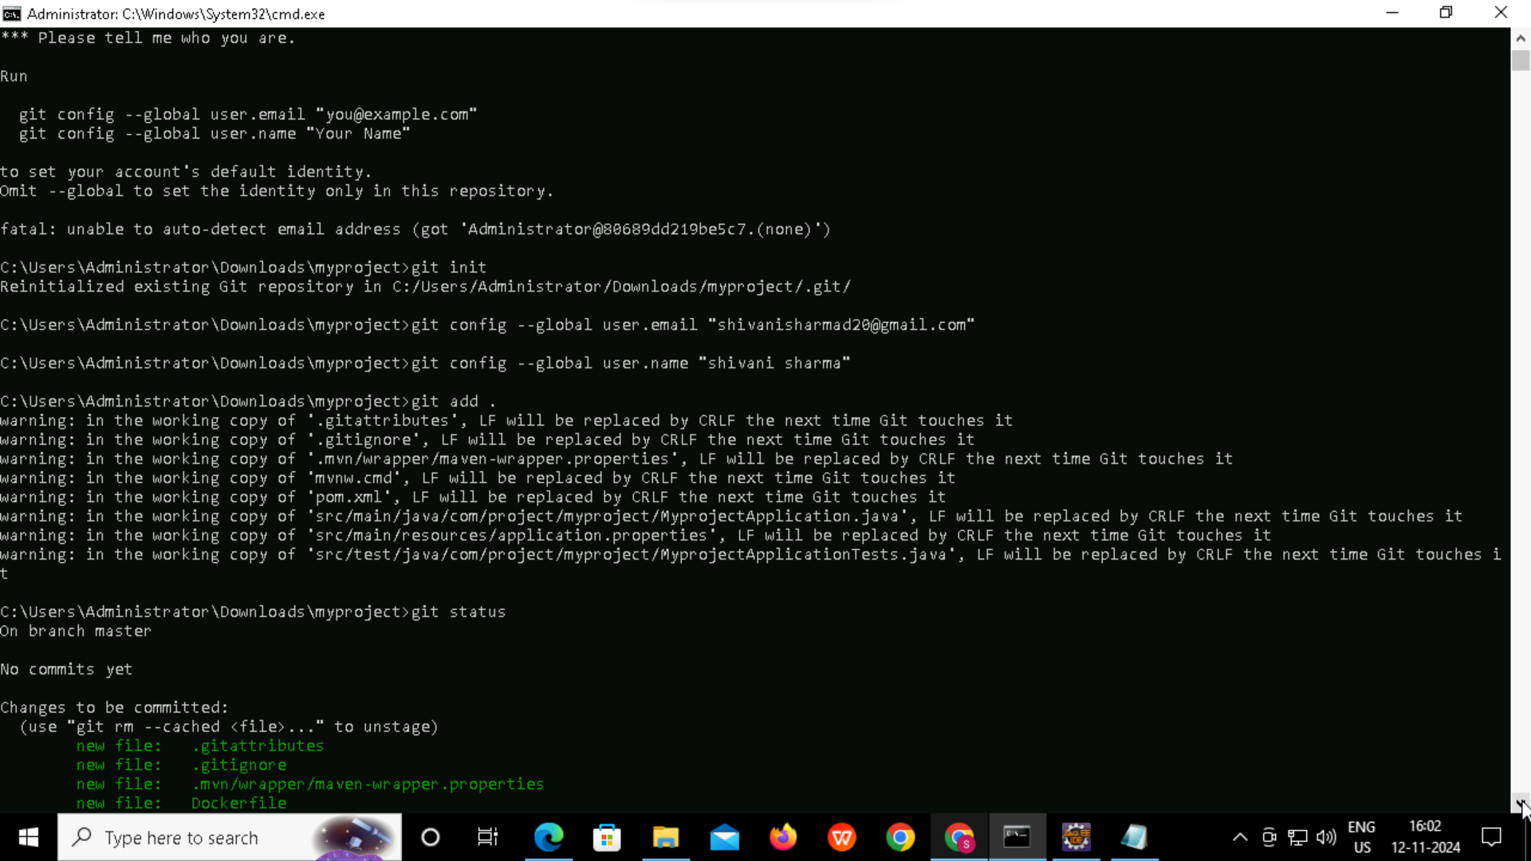
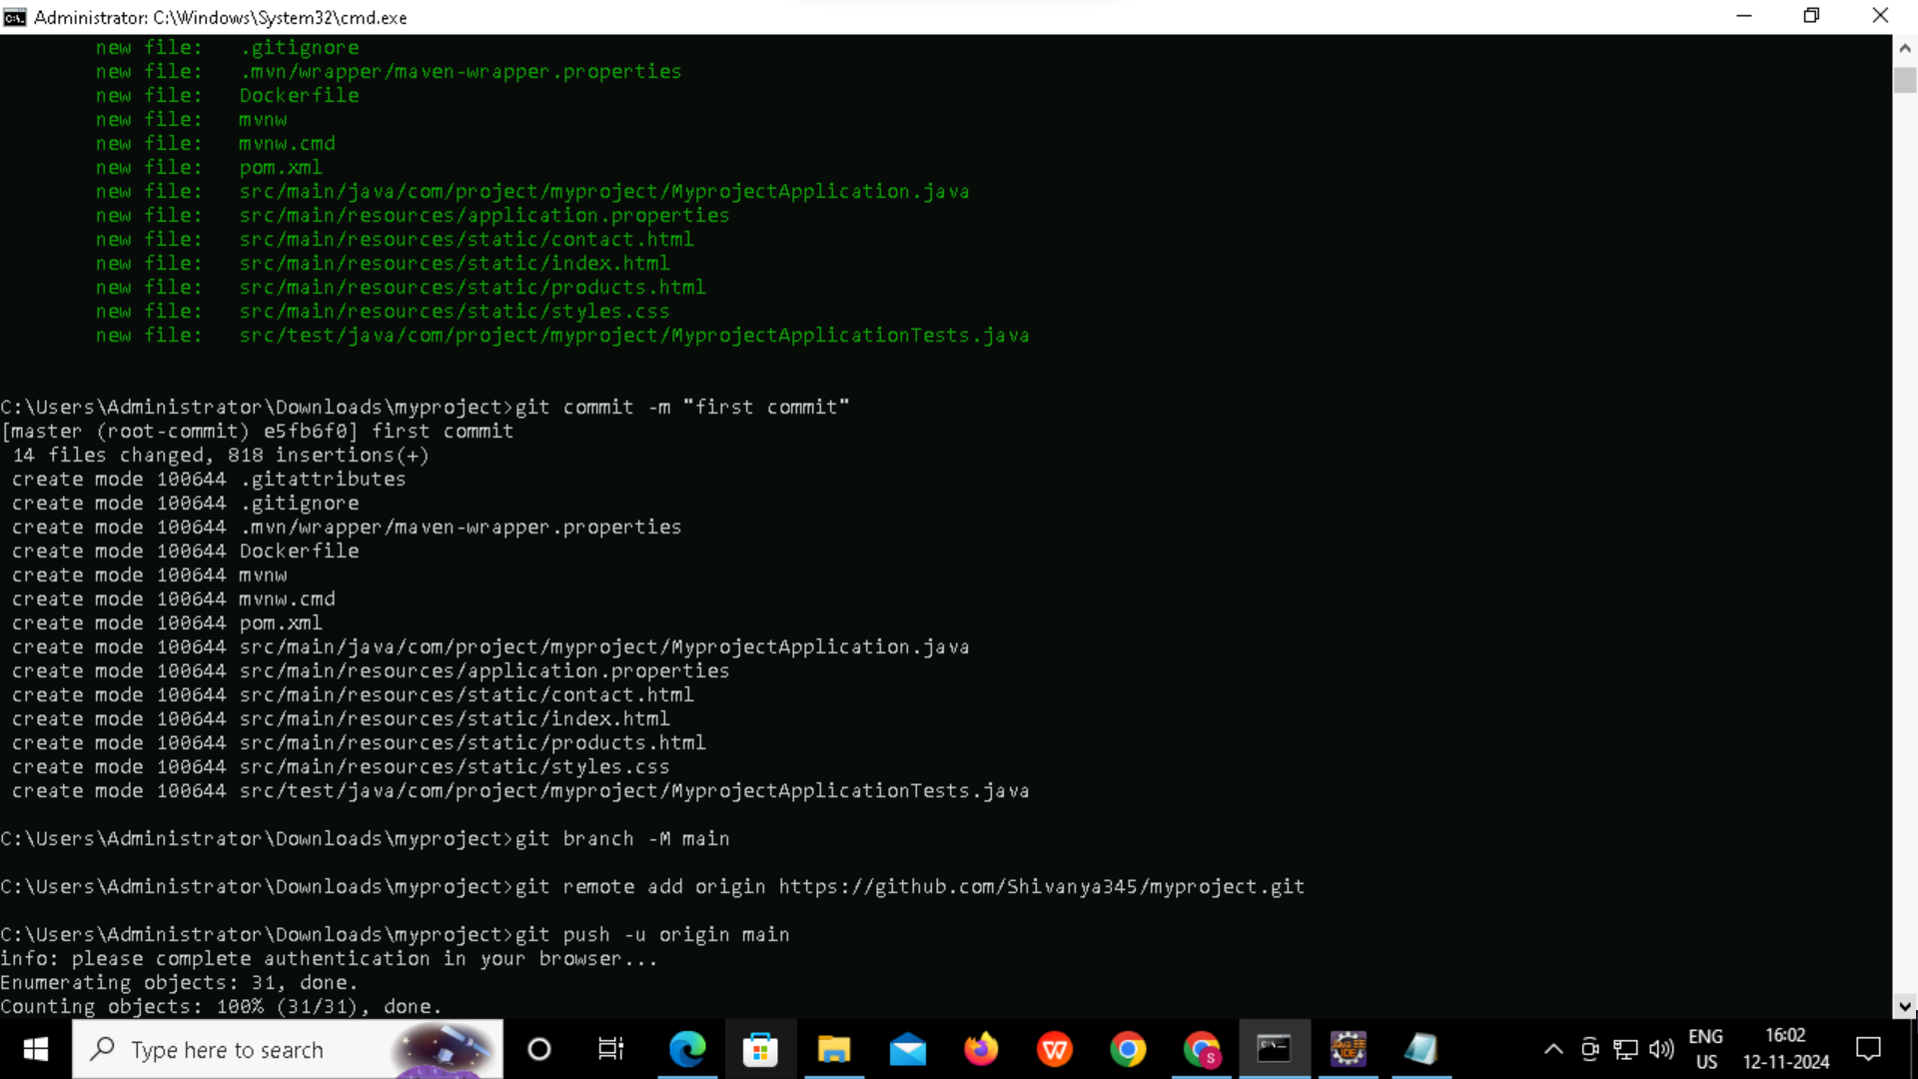
COMMAND TO PUSH THE PROJECT
ON TO THE GITHUB

Slide 10
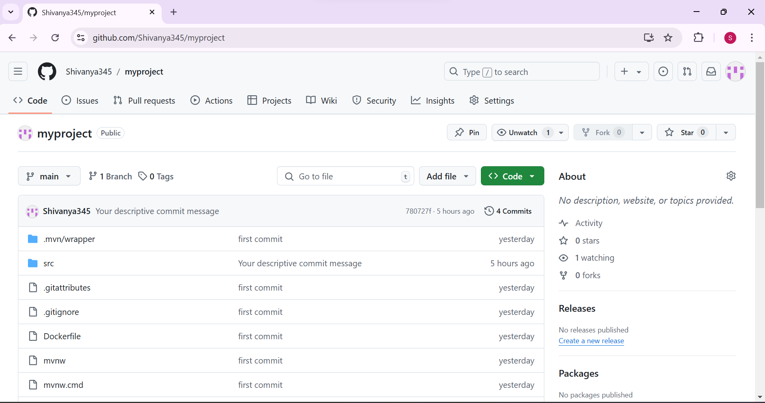
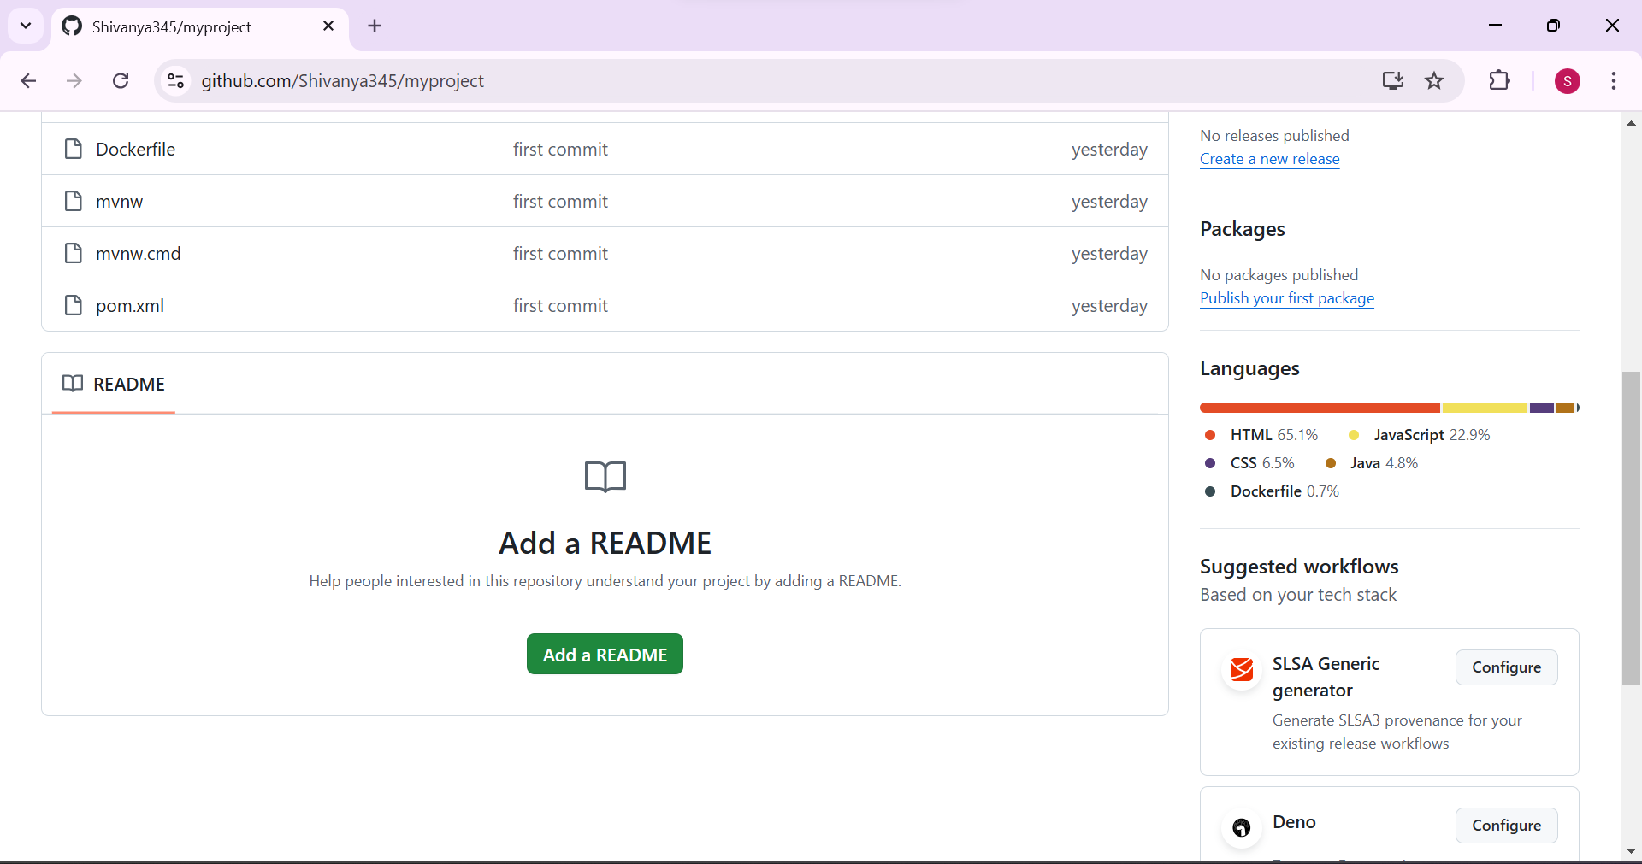
PUSHED THE PROJECT ON
TO THE GITHUB

Slide 11
What is Jenkins?
Automation Server: Jenkins is an open-source automation server used to automate tasks related to building, testing, and deploying software applications.
Continuous Integration/Continuous Delivery (CI/CD): It enables CI/CD practices by automatically integrating code changes into a shared repository and deploying them to various environments.
Pipeline Support: Jenkins uses "pipelines" to define and manage workflows for building, testing, and deploying applications.
Extensible with Plugins: Jenkins has a vast ecosystem of plugins, allowing integration with version control systems, build tools, cloud services, and more.
Distributed Builds: Jenkins supports distributed architecture, enabling you to run jobs across multiple machines, improving performance and scalability.
Easy Setup & Configuration: Jenkins has a web-based interface for easy setup, job configuration, and monitoring, making it accessible even to teams without dedicated DevOps resources.

Slide 12
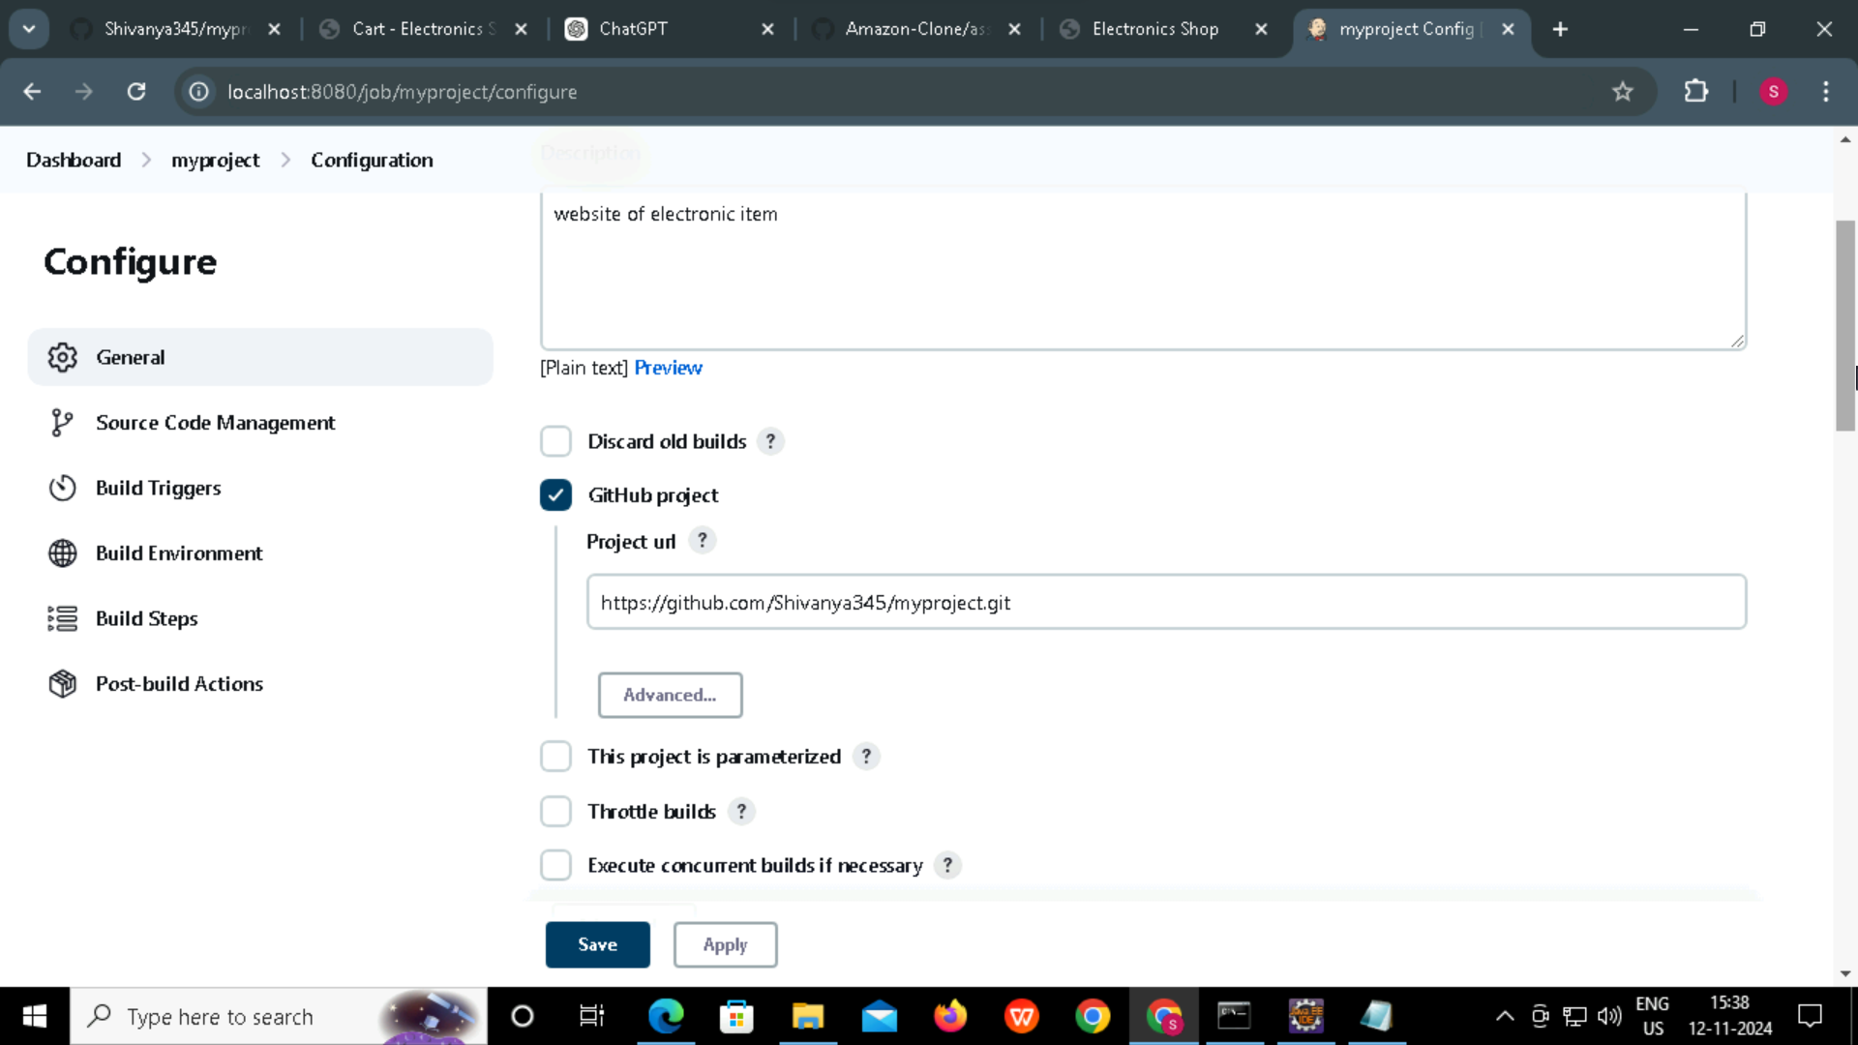
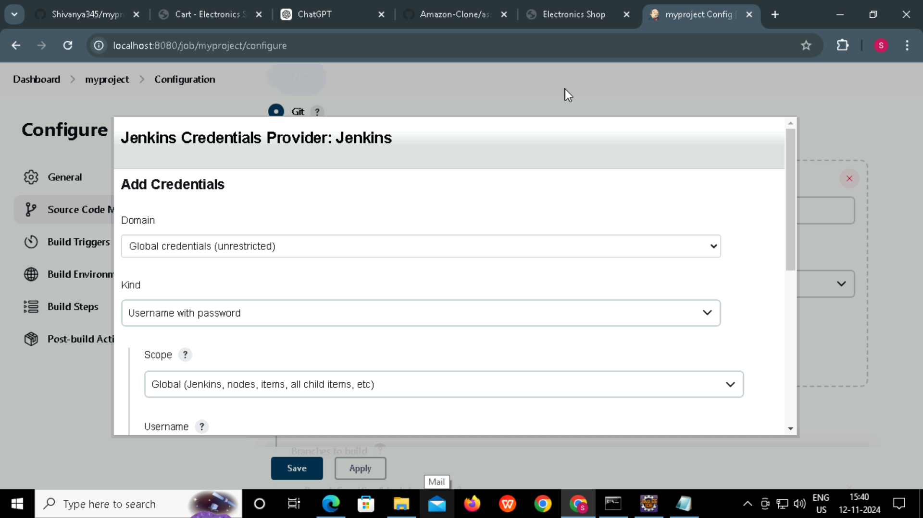
Jenkins

Slide 13
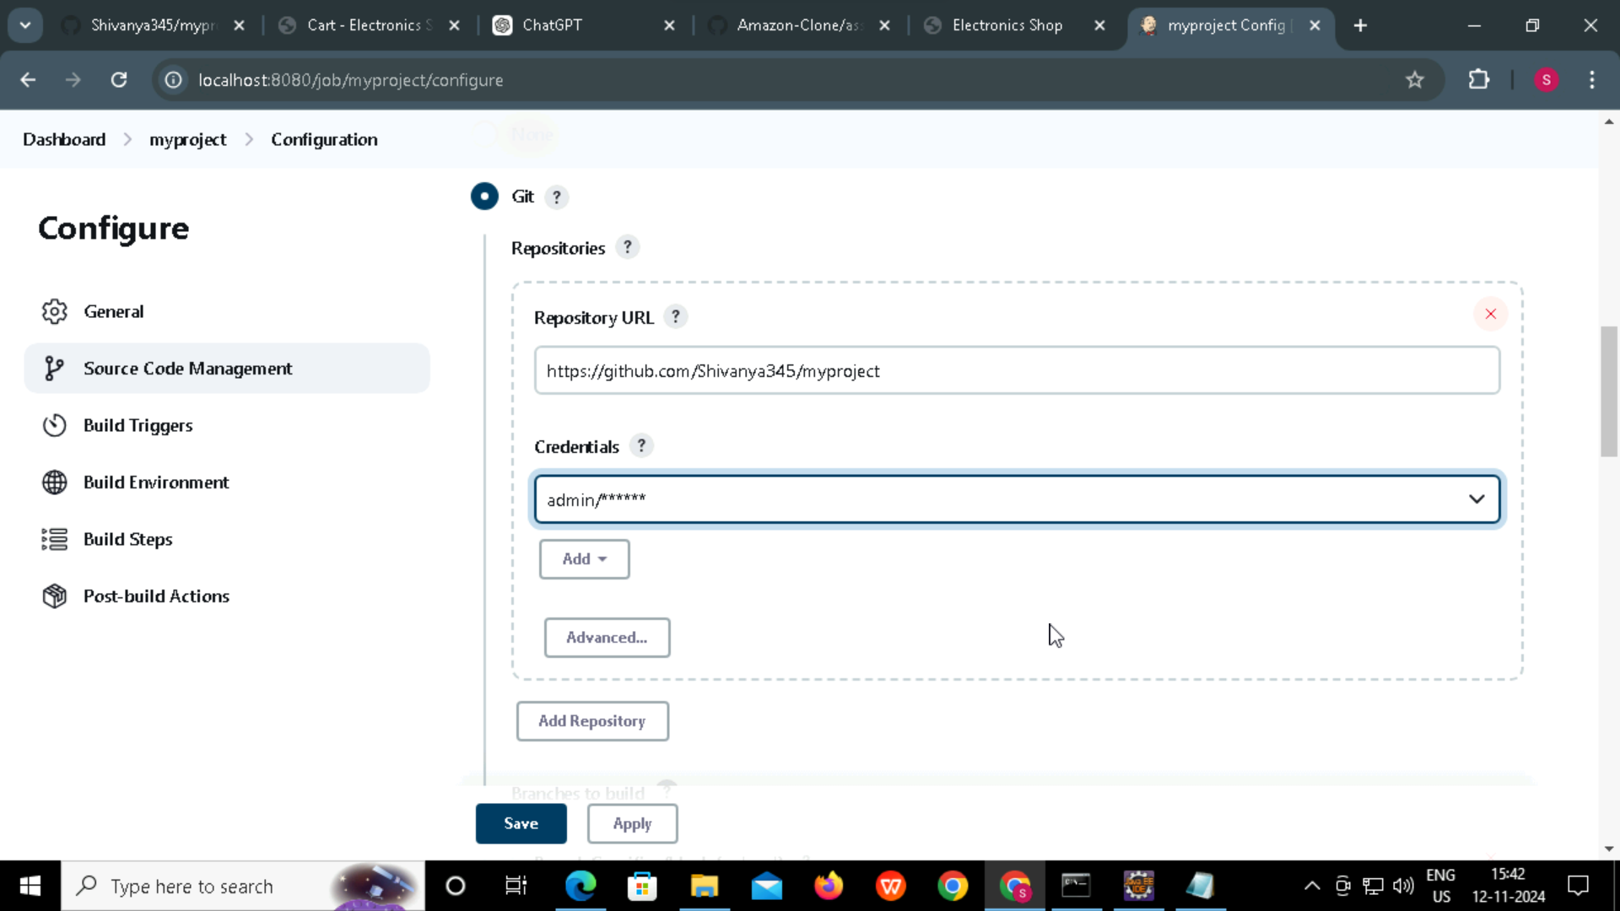
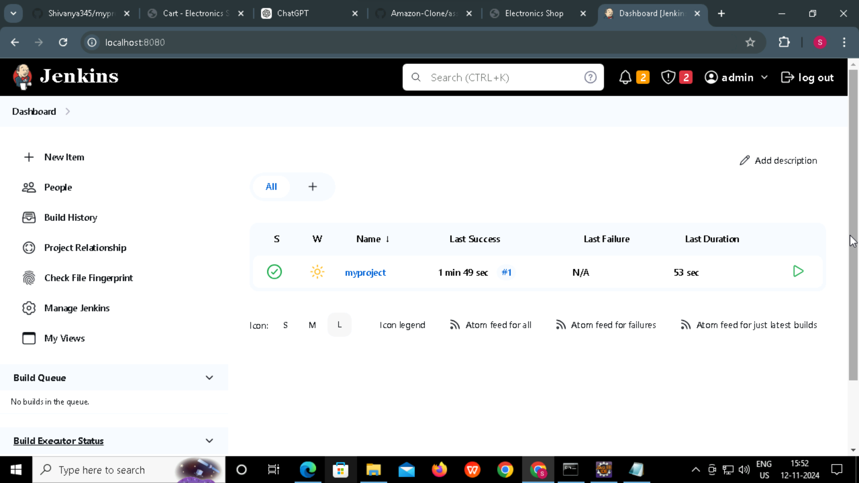
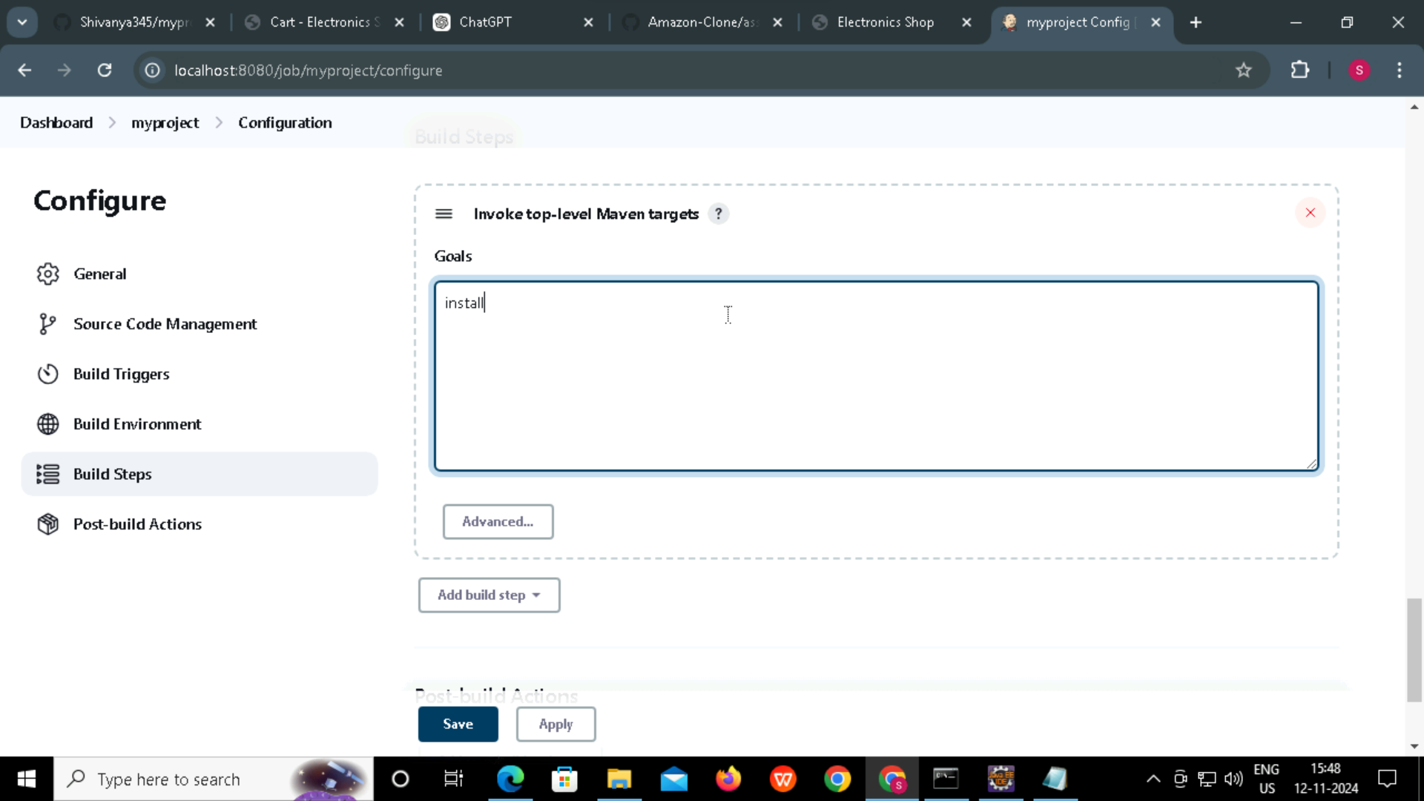
JENKINS STEPS

Slide 14
What is Docker?
Docker is a platform that enables developers to package applications into lightweight, portable containers that can run consistently across different environments. Containers isolate applications and their dependencies, making them easier to deploy, manage, and scale.
Containerization: Docker runs apps in isolated, portable containers.
Isolation: Containers are self-contained, avoiding conflicts.
Portability: Apps run consistently across any system with Docker.
Efficiency: Containers share the host kernel, using fewer resources.
Docker Hub: A registry for storing and sharing Docker images.
Orchestration: Docker works with tools like Kubernetes for scaling and
management.

Slide 15
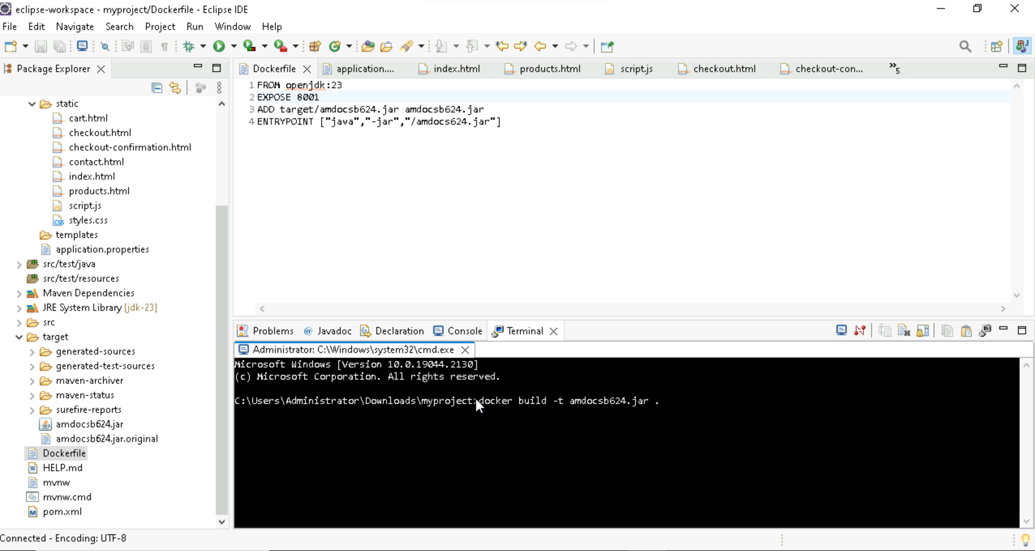
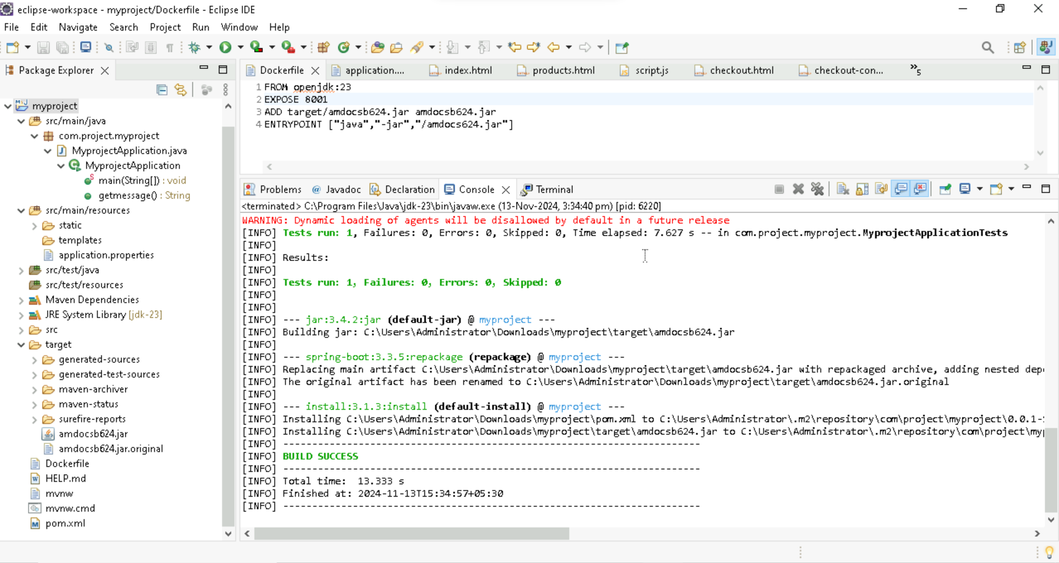
Steps to Create Docker Image
First create docker file in project folder
Then in pom.xml file give jar file name
Then click on project folder and select run in which select maven install

Slide 16
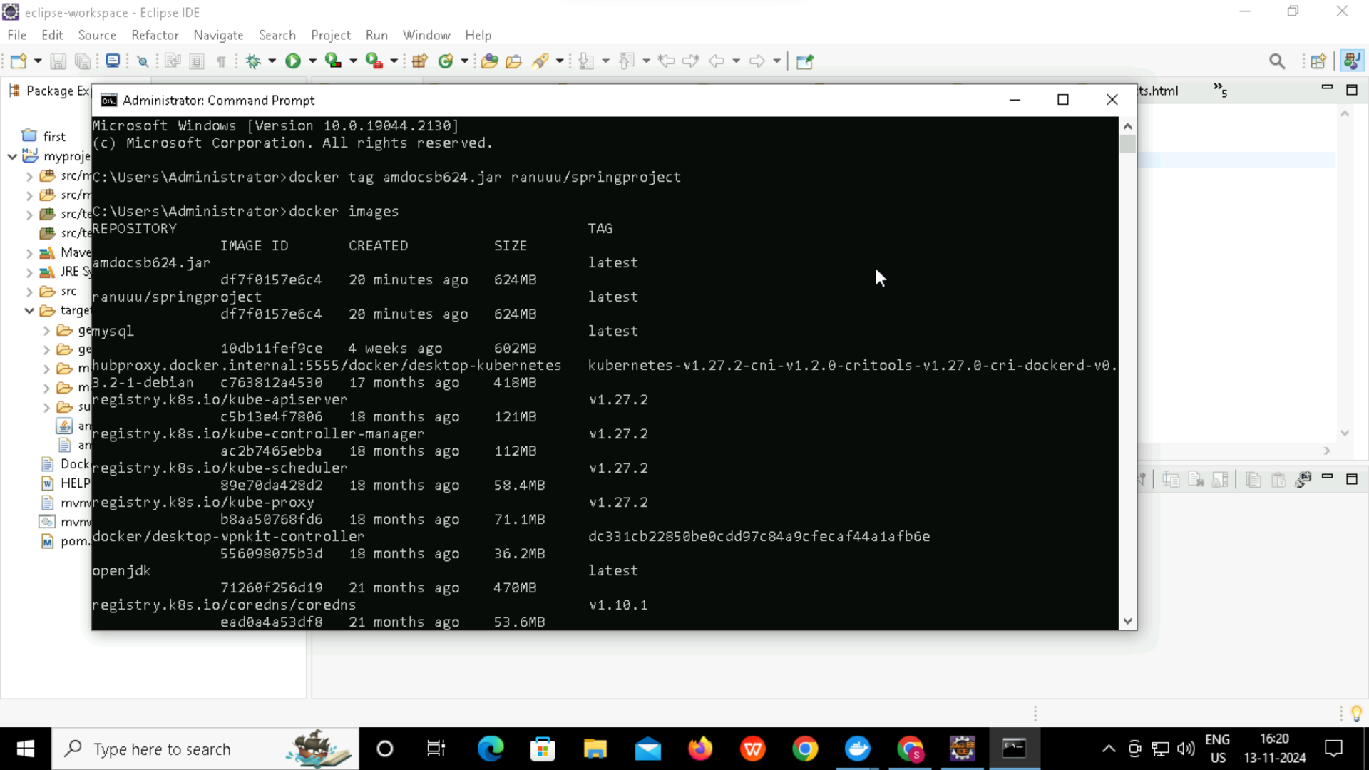
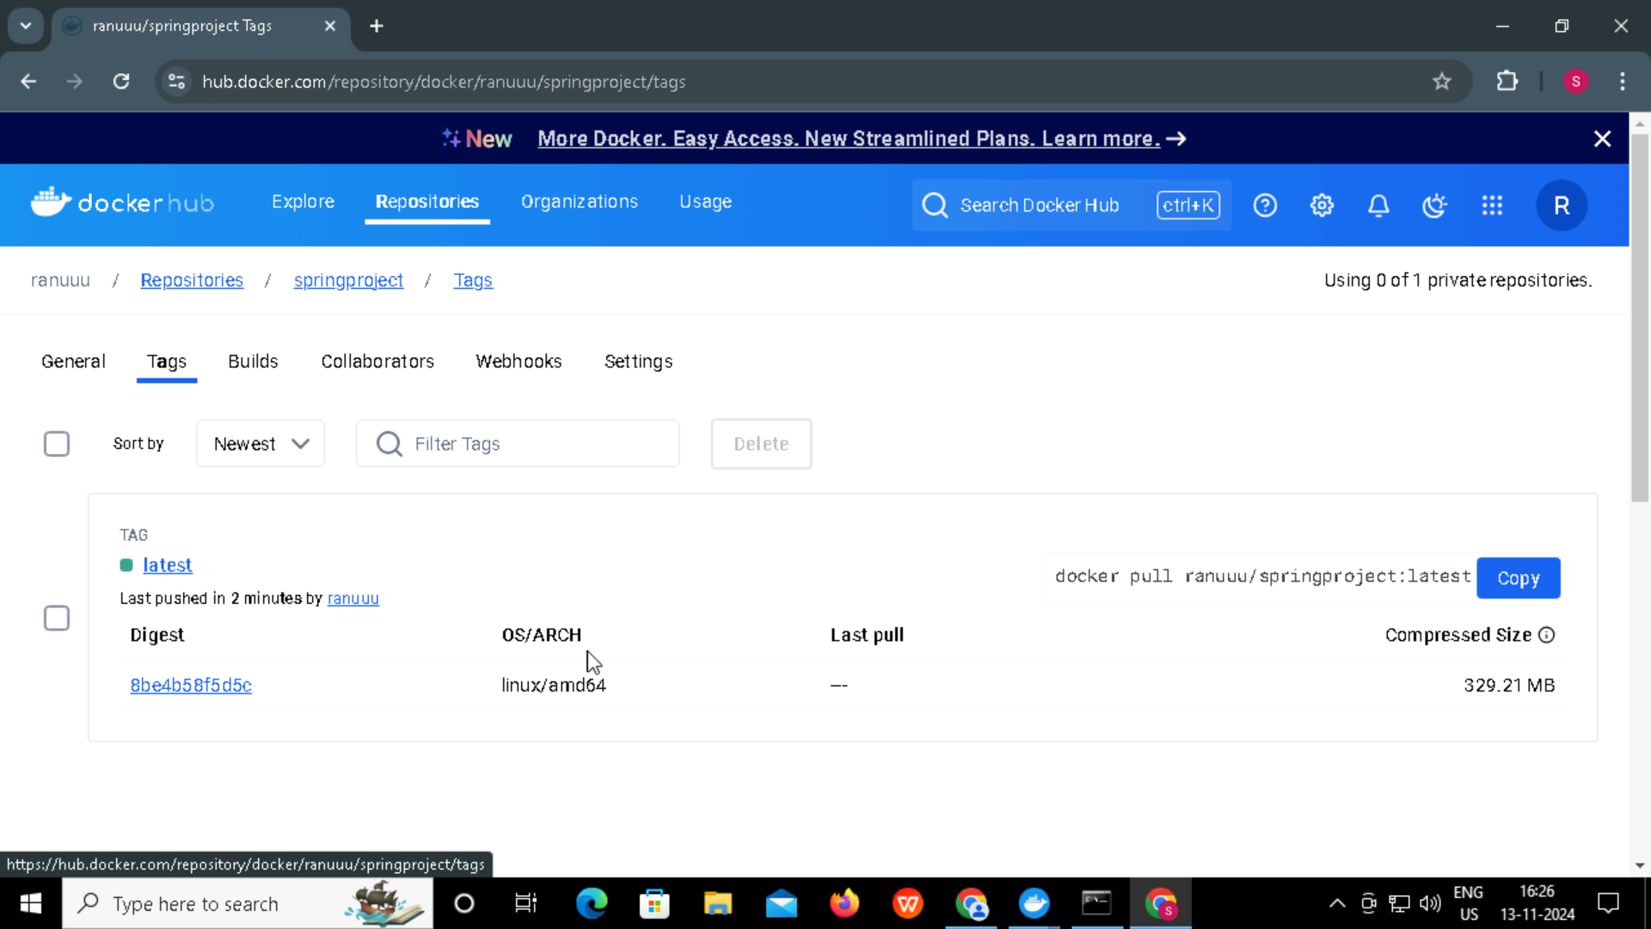
Steps to Create Docker Image
Open Terminal create docker image
Then enter command docker image to view the docker image that you have created.
Go to docker hub to see that the image is created in repository.

Slide 17
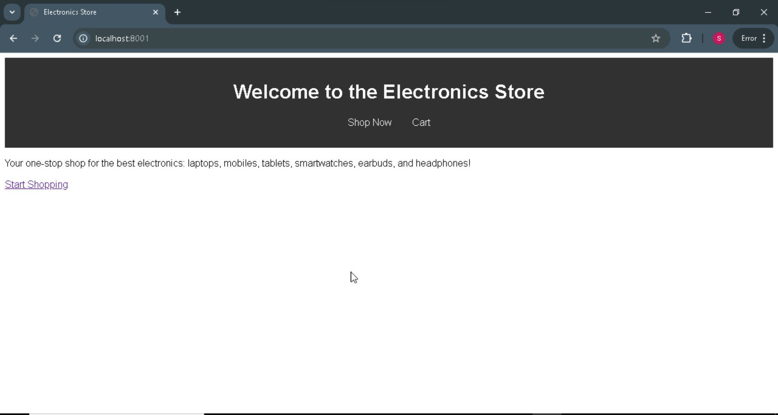
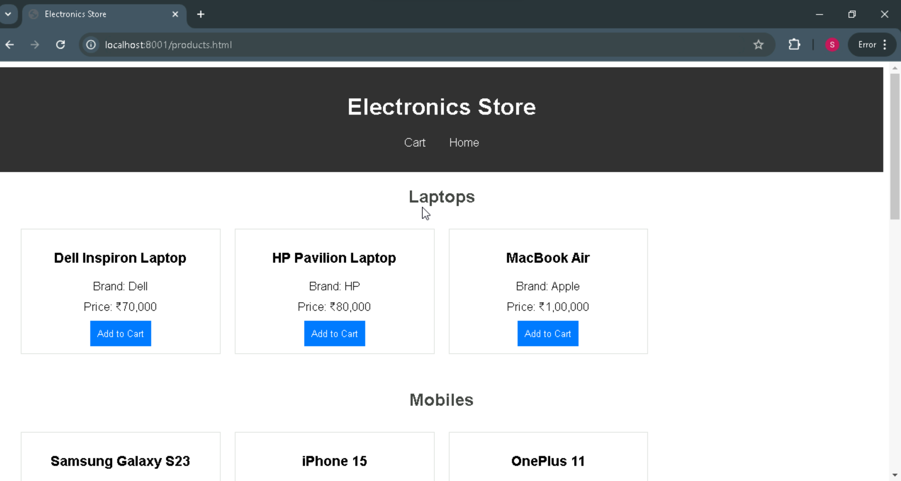
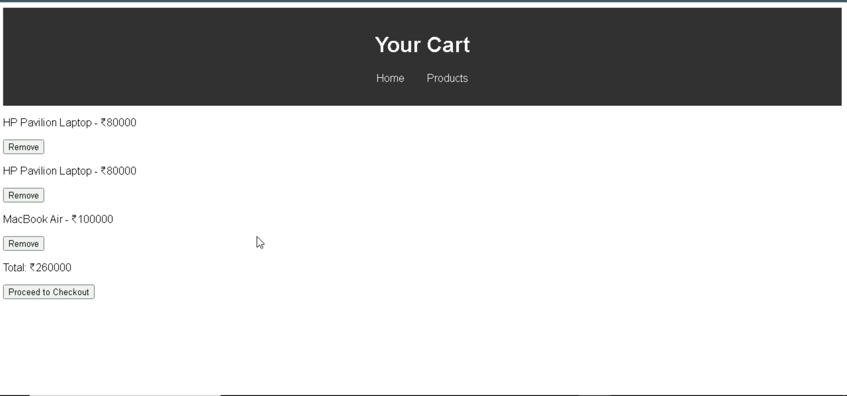
Implementation Of the Project

Slide 18


