Slide 1

HOUSE PRICE PREDICTION USING MACHINE LEARNING
SUMMER INDUSTRY INTERNSHIP - I
Department: CSE-Aiml
Name: Chidiri Shiva Prakash
Roll.No: 24311A6610
Internship Coordinator: Mrs.G.Anusha
Head Of the Department: Dr.T.Venkat Narayana Rao

Slide 2
ABSTRACT
The House Price Prediction project builds a machine learning pipeline to estimate residential sale prices from Kaggle’s House Prices: Advanced Regression Techniques (Ames Housing) dataset.
Built in Python with Scikit-learn, the pipeline uses a leakage-free custom preprocessor, an engineered TotalBathrooms feature, and a baseline Ordinary Least Squares (OLS) model on three features: GrLivArea, BedroomAbvGr and TotalBathrooms.
Model quality is measured with RMSE, MAE, R² and 5-fold cross-validation, and the baseline is compared with Decision Tree and Random Forest regressors.
The OLS baseline reaches RMSE $53,371.56 and R² 0.6286, while Random Forest improves this to RMSE $43,235.32 and R² 0.7563.

Slide 3
INTRODUCTION
Housing prices depend on many factors such as size, rooms, quality and location, which makes accurate valuation difficult for buyers, sellers and lenders.
The goal is to estimate SalePrice, a continuous value, from structural attributes of a house using supervised regression.
The project follows a modular, production-style layout with separate preprocessing, training, evaluation and prediction stages.
Developed as part of the SkillCraft Technology Machine Learning Internship to apply regression and model evaluation skills in practice.

Slide 4
EXISTING SYSTEM
Property valuation is often done manually through comparable-sales checks and spreadsheet estimates.
Such estimates depend heavily on individual judgment and are hard to reproduce or scale.
Limitations:
->Estimates vary from person to person and are difficult to audit.
->Manual methods cannot quickly process large numbers of listings.
->No measurable error metric such as RMSE or R² to judge accuracy.

Slide 5
OBJECTIVES
Build a reproducible machine learning pipeline to predict house sale prices instead of manual estimation.
Use structural features (GrLivArea, BedroomAbvGr and an engineered TotalBathrooms) to train a Multiple Linear Regression baseline.
Prevent data leakage by fitting imputation values on the training split only.
Evaluate with RMSE, MAE, R² and 5-fold cross-validation, and compare with tree-based models.

Slide 6
PROPOSED SYSTEM
Implements a modular Python pipeline: preprocessing.py, train.py, evaluate.py and predict.py.
Uses a custom HousingPreprocessor (BaseEstimator, TransformerMixin) with median imputation fitted on training data only.
Engineers TotalBathrooms = FullBath + 0.5 x HalfBath to capture bathroom capacity in one feature.
Trains an OLS baseline and compares it with Decision Tree and Random Forest regressors.
Saves model, preprocessor, plots and a Kaggle-compatible submission.csv to the outputs folder.

Slide 7
METHODOLOGY
Steps Followed:
1. Load train.csv and test.csv from the Kaggle dataset.
2. Exploratory data analysis: SalePrice skewness, correlations and outliers.
3. Preprocessing: median imputation fitted on the training split only.
4. Feature engineering: create TotalBathrooms from FullBath and HalfBath.
5. Split data 80:20 (random_state = 42) and train the OLS model.
6. Evaluate with RMSE, MAE, R² and 5-fold cross-validation.
7. Compare with Decision Tree and Random Forest, then generate predictions.

Slide 8
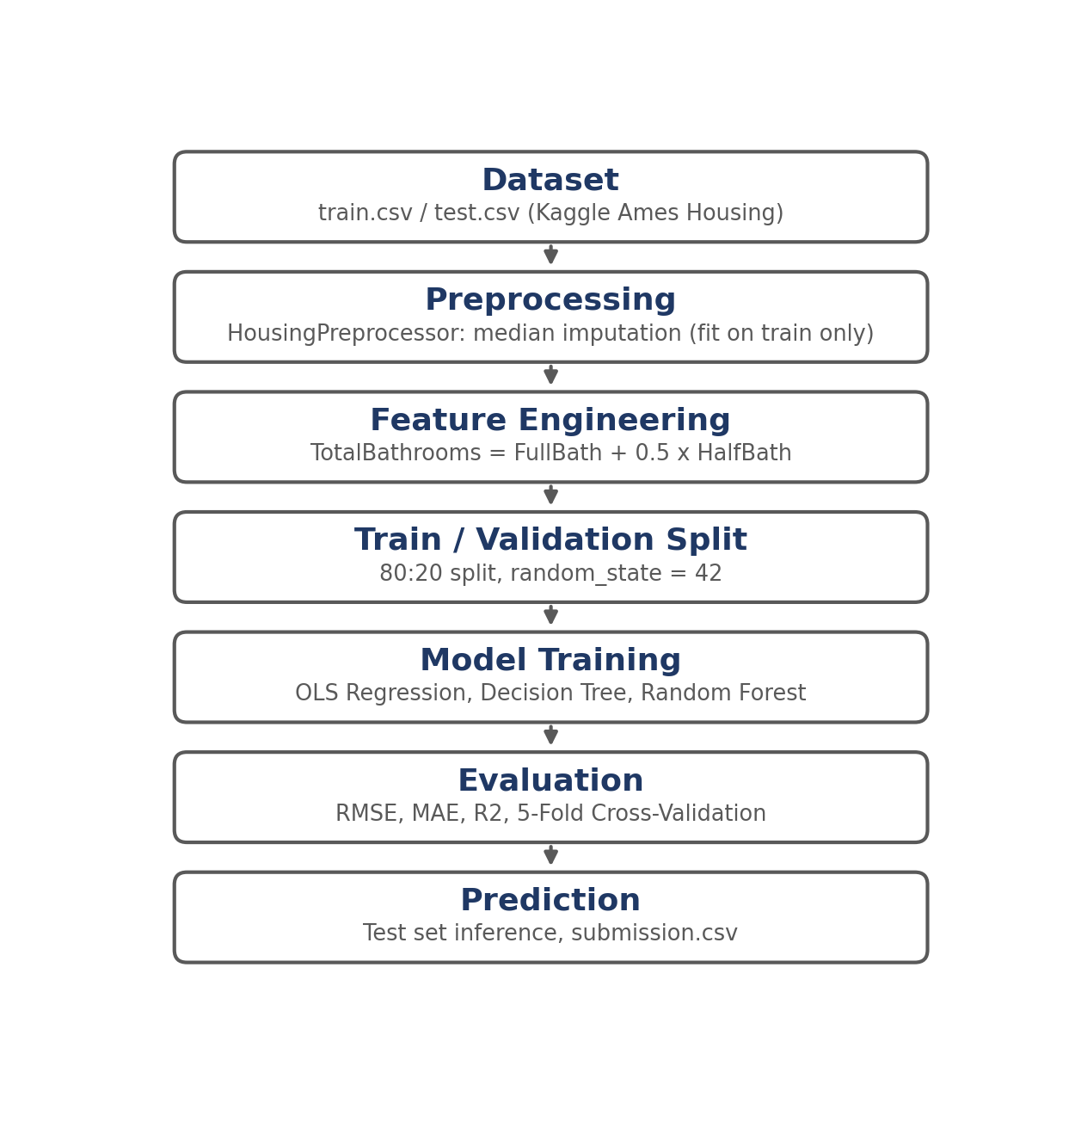
ARCHITECTURE

Slide 9
ANALYSIS
Dataset: Kaggle House Prices (Ames Housing), 1,460 training records; target variable is SalePrice.
SalePrice is right-skewed: median $163,000 vs mean $180,921.
GrLivArea and TotalBathrooms correlate strongly with price; bedroom count alone is weak.
Two high-leverage outliers (living area above 4,000 sq. ft. sold under $200,000) pull the OLS line down.
Correlation with SalePrice
GrLivArea: r = 0.709
TotalBathrooms: r = 0.631
BedroomAbvGr: r = 0.168
Target statistics
Median: $163,000
Mean: $180,921

Slide 10
IMPLEMENTATION
Tools and technologies used:
Python 3.12+
Pandas and NumPy
Scikit-learn (LinearRegression, DecisionTree, RandomForest)
Matplotlib (residual and prediction plots)
Jupyter Notebook (EDA) and VS Code
Git / GitHub
class HousingPreprocessor(BaseEstimator, TransformerMixin):
def fit(self, X, y=None):
# medians from the training split only
self.medians_ = X[self.cols].median()
return self
def transform(self, X):
X = X.copy().fillna(self.medians_)
X['TotalBathrooms'] = (X['FullBath']
+ 0.5 * X['HalfBath'])
return X[self.features]

Slide 11
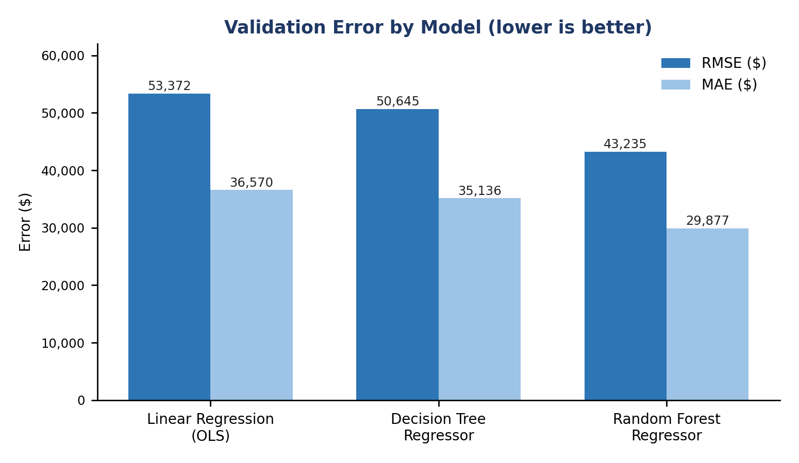
RESULTS AND DISCUSSIONS
Key Finding 1: Non-linear models win
Random Forest lowers RMSE from $53,371.56 to $43,235.32 and lifts R² from 0.6286 to 0.7563.
Key Finding 2: Stable generalization
5-fold CV gives average RMSE $52,093.49 (std $6,951.66), close to the single-split OLS result.
Key Finding 3: Room to improve
Only 3 features are used; quality and location are not yet included.

Slide 12
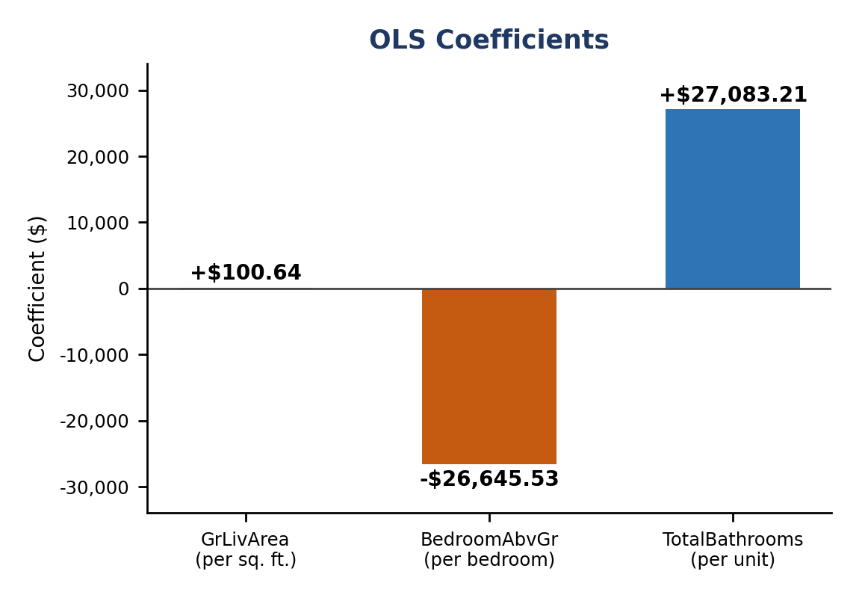
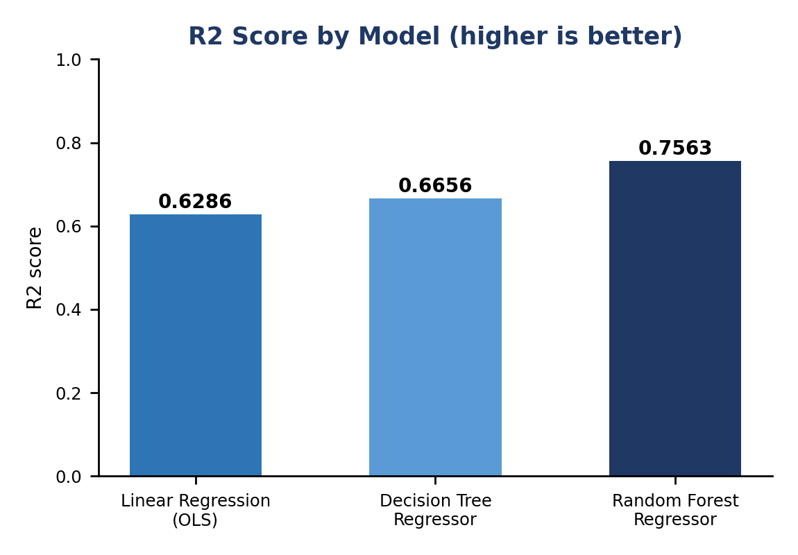
RESULTS AND DISCUSSIONS
Model: SalePrice = $56,862.58 + $100.64 x GrLivArea − $26,645.53 x BedroomAbvGr + $27,083.21 x TotalBathrooms | OLS: RMSE $53,371.56, MAE $36,569.64, R² 0.6286

Slide 13
CONCLUSION:
Successfully built a modular, leakage-free house price prediction pipeline in Python.
OLS baseline on three features achieved RMSE $53,371.56 and R² 0.6286; 5-fold CV RMSE was $52,093.49.
Random Forest performed best with RMSE $43,235.32 and R² 0.7563.
Can be extended with log-transformed target, outlier filtering, quality and neighborhood features, and Ridge/Lasso regularization.

Slide 14
REFERENCES
Kaggle — House Prices: Advanced Regression Techniques
https://www.kaggle.com/c/house-prices-advanced-regression-techniques
Scikit-learn Documentation
https://scikit-learn.org/stable/
Pandas Documentation
https://pandas.pydata.org/docs/
Dean De Cock — Ames, Iowa: Alternative to the Boston Housing Data (Journal of Statistics Education, 2011)
SkillCraft Technology — Machine Learning Internship Tasks
https://www.skillcraft.tech/

Slide 15
THANK YOU
Presented by: Chidiri Shiva Prakash

