Slide 1

PRINCIPLES AND TECNIQUES OF DATA SCIENCE PROJECT ON – Prediction of Calories Burnt Using Machine Learning
Submitted By:-
Shivanjani Acholu
Sravya Ravikanti
Shiva Priya Ummareddy
Suchitha Reddy Chinthireddy
Swathi Pasham

Slide 2
Mission & Vision
Mission:
Our mission is to predict the number of calories burnt during exercise of a person considering variables like Age, duration of exercise etc.. We are committed to utilizing the principles of data science and machine learning to provide a valuable tool for individuals who are interested in tracking their fitness progress and optimizing their workouts.
Vision:
Our vision is to empower people to make informed decisions about their health and fitness by providing accurate and reliable calorie burn predictions. We believe that by leveraging the power of data science and machine learning, we can help people achieve their fitness goals more effectively and efficiently.

Slide 3
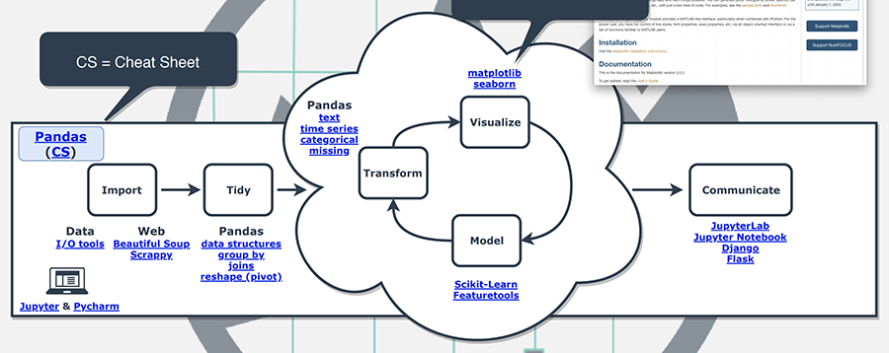
Project Design

Slide 4
Project Design
Data Collection:
Collect the data on exercise and calories burned from the given link.
Load the data into a pandas data frame.
Exploratory Data Analysis (EDA):
Perform EDA to understand the data and identify any issues or anomalies.
Check for missing values and handle them appropriately.
Identify and handle outliers using boxplots and scatterplots.
Check for zero correlation between variables and remove them.
Visualize the data using plots and histograms to get insights.
Data Processing and Feature Engineering:
Prepare the data for modelling by performing feature engineering and data processing.
Remove the user id column as it does not provide any value for the model.
Normalize the data using log square root transformation.

Slide 5
Continued…
Perform scaling using Min-Max and Max Absolute methods.
Compute the correlation matrix and identify highly correlated features for feature selection.
4. Model Building:
Build a model and split the data into training and testing sets.
Train the model using regression techniques like Linear Regression, Ridge Regression, Lasso Regression. Evaluate the performance of the model using R squared and adjust the model as necessary.
Identify the most important features using the regressor coefficients.
5. Model Deployment:
Deploy the model to a production environment for use by end-users.
Provide instructions for using the model and the appropriate input data format.

Slide 6
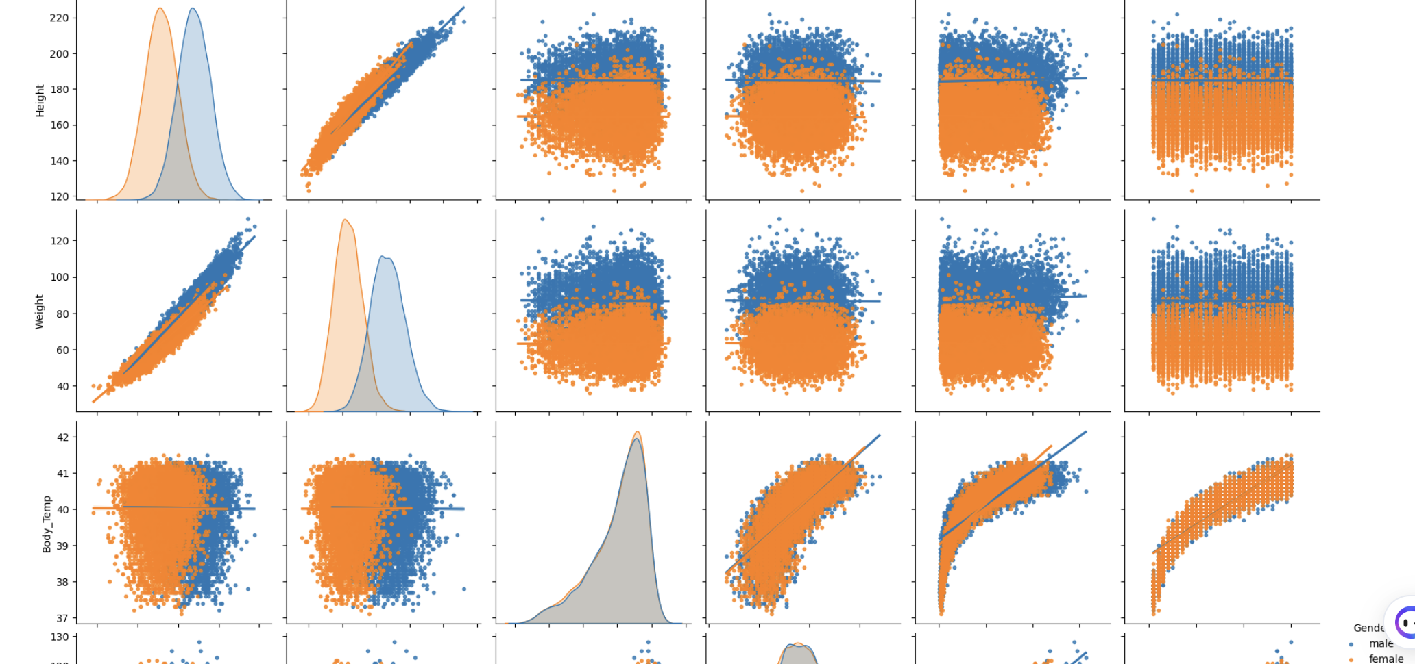
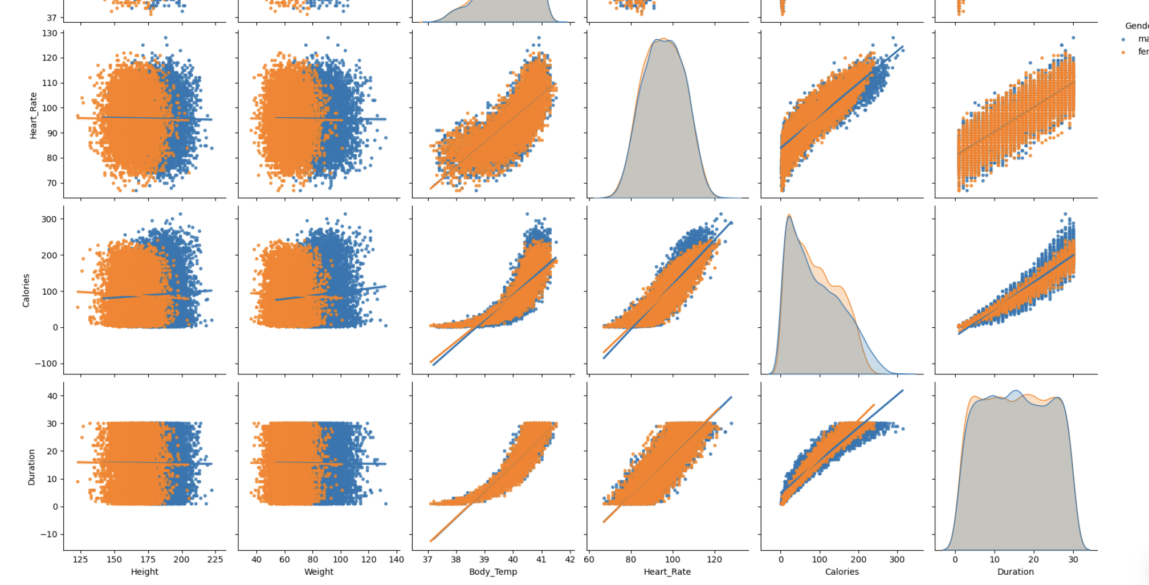
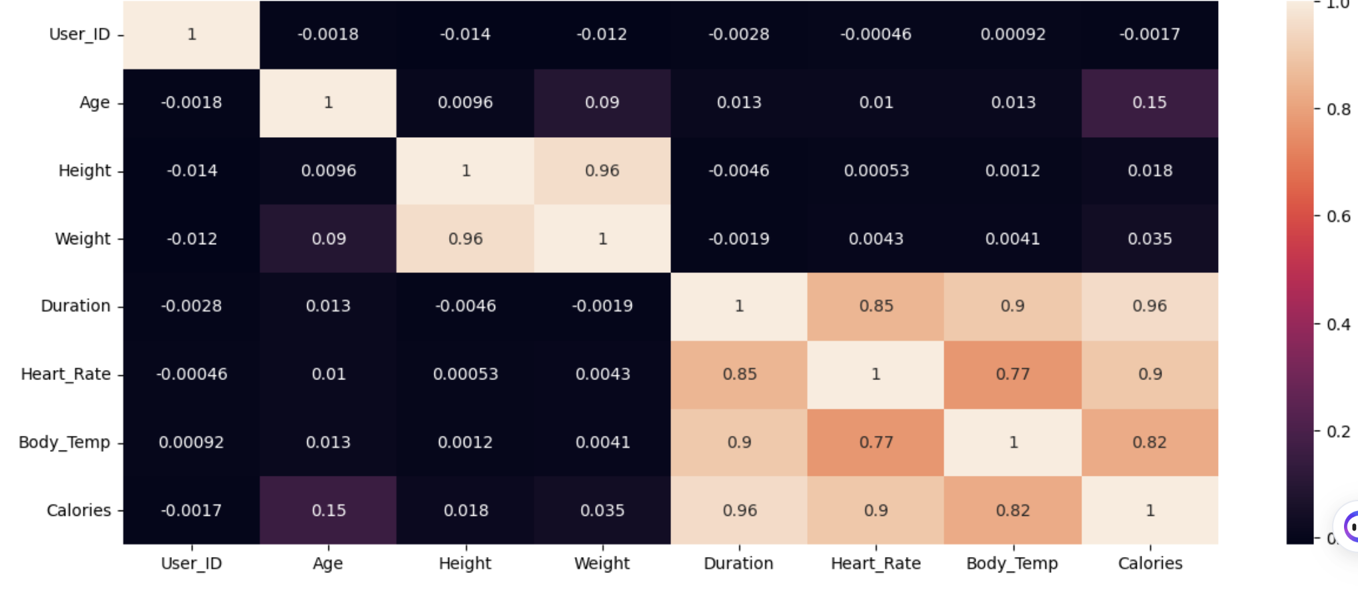
EDA (Exploratory Data Analysis)
EDA helps in understanding the data, identifying patterns, relationships, and anomalies, and ultimately in making better decisions.

Slide 7
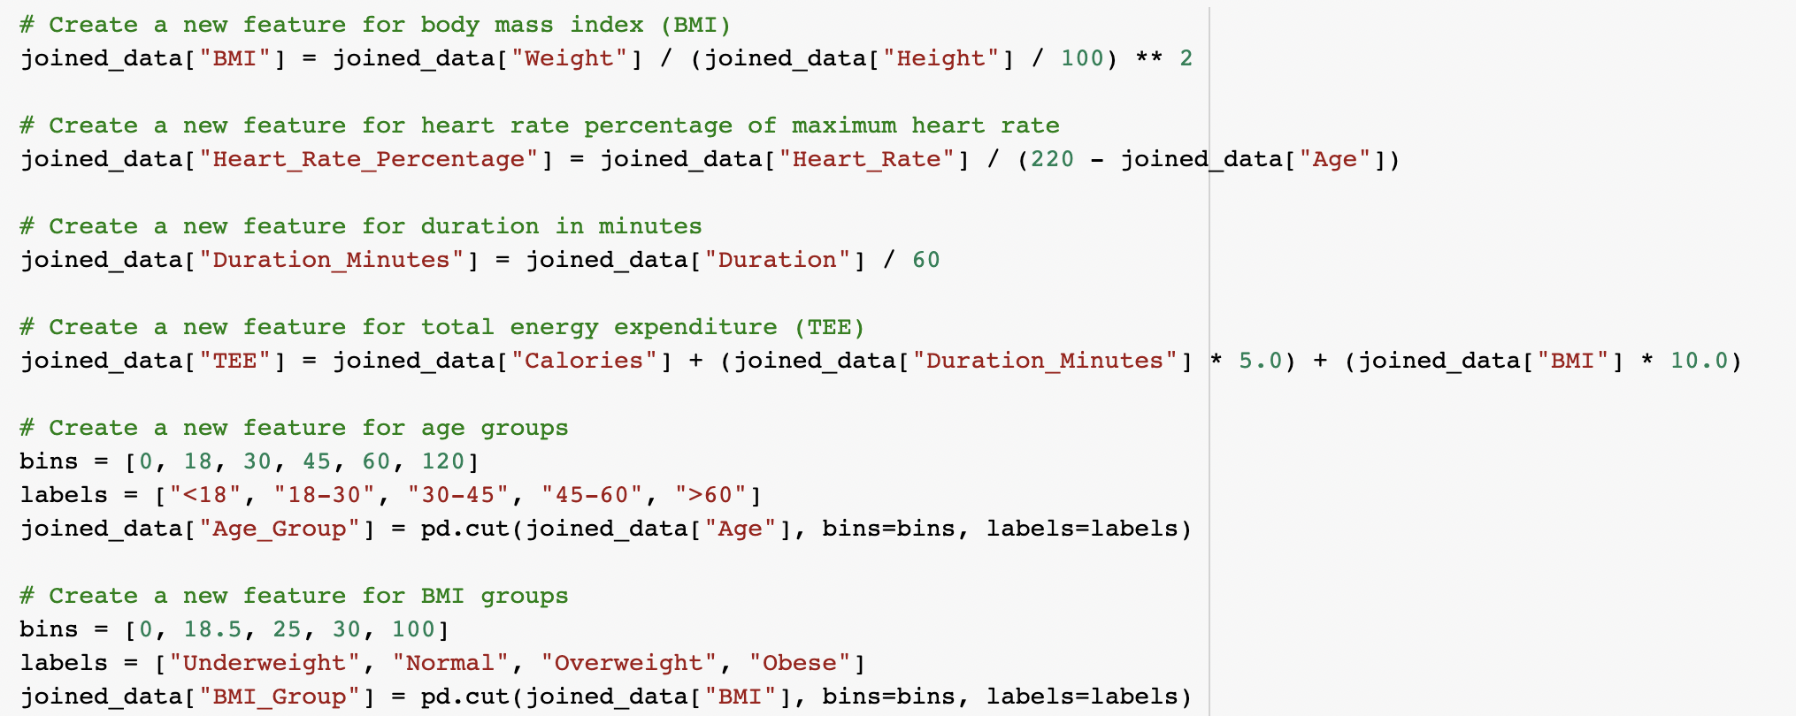
Feature Engineering
Feature engineering involves transforming raw data into a format that can be easily understood by a machine learning algorithm.
The goal of feature engineering is to make the machine learning model more effective by providing it with more relevant and informative input features. Good feature engineering can lead to improved model accuracy, reduced overfitting, and faster model training times
In the context of the calories prediction using exercise project, it can help us to extract meaningful information from the data and create new features that are more relevant to the prediction task.

Slide 8
Data Preprocessing
Remove the User ID Column
Handle Missing Values
Handle Outliers
Feature Engineering
Data Normalization
Scaling
Feature Selection
Train-Test Split
By following these steps, we can preprocess the data for calories prediction using exercise project and ensure that our model is accurate and efficient.

Slide 9
Model Selection
Steps:
Define the Evaluation Metric
Select the Candidate Models
Split the Data
Train the Models
Evaluate the Models
Refine the Model
Re-evaluate the Model
Finalize the Model
Performing model selection is crucial to ensure that the machine learning model built for the calories prediction using exercise project performs well and generalizes well to new, unseen data. By comparing and selecting the best-performing model, we can ensure that our model is accurate and reliable in predicting calories burned during exercise.
Here we are using Linear, Ridge, Lasso, SVR, XGB and Decision Tree Regression models.

Slide 10
Difference between the current and the previous code
The main difference is that in the previous code, Python was run on the raw data, whereas in the current code, the data was preprocessed and scaled before running Python.
Feature scaling involves scaling the numerical features of the data to a common scale, such as between 0 and 1 or between -1 and 1.
By pre-processing and scaling the data, the current code is likely to produce more accurate and reliable results compared to the previous code, which was run on raw data without any preprocessing or scaling.
Preprocessing refers to the various data cleaning and transformation techniques applied to the raw data to make it suitable for analysis. In the current code, the raw data was likely subjected to various preprocessing steps such as removing missing values, encoding categorical variables, and feature scaling.

Slide 11
References
GitHub: https://github.com/Kasra1377/calories-burned-prediction/blob/main/calories-prediction-streamlit.py
Kaggle: https://www.kaggle.com/code/fmendes/exercise-and-calories
Stack overflow: https://stackoverflow.com/questions/17071871/how-do-i-select-rows-from-a-dataframe-based-on-column-values/17071908#17071908
YouTube: https://www.youtube.com/watch?v=VqgUkExPvLY&ab_channel=CodingIsFun

Slide 12
THANK YOU

Slide 13
Appendix

Slide 22
Code for UI:

Slide 23
