Slide 1

Title: A Conversational Agent for Chest X-ray Summary Generation
SL.NO | NAME | SRN
1 | Swathi M K | 02FE23BCS164
2 | Shivshankareppa | 02fe22BCS123
3 | Priyanka A Totakar | 02fe22BCS074
4 | Supreetgouda H | 02fe22BCS161
Guided By:- Prof Vaishali Y Parab

Slide 2
AGENDA:
Introduction
Motivation
Literature Survey
Problem Statement
Objectives
Methodology

Slide 3
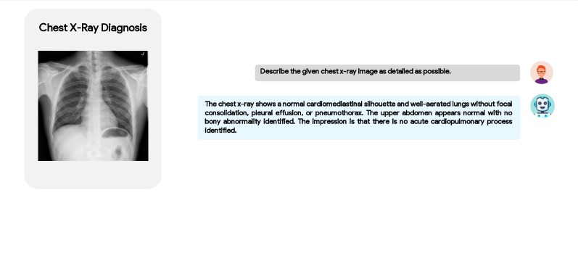
Introduction
Interpreting chest X-rays requires expertise and time-intensive.
Advances in Generative AI (GenAI), including NLP and vision-language models, allow machines to understand medical images
It provides summaries and supports interactive conversations for clinical decision-making.

Slide 4
Manual radiology report writing is time-consuming and error-prone.
Traditional NLP and CV models struggle with domain-specific understanding in medical imaging.
There is a need for intelligent systems that not only summarize chest X-rays but also allow interactive Q&A, improving accessibility and diagnosis support.
GenAI can bridge the gap between expert radiologists and scalable diagnostic tools.
Motivation
KLE Tech. Univ.’s Dr. MSSCET

Slide 5
Problem Statement
Statement
There is a need for an intelligent AI system that can understand chest X-rays, generate accurate summaries, and answer follow-up questions using Generative AI and NLP.

Slide 6
Literature Survey
SL. N0 | Authors | Year | Model Used | Methodology | Gaps | Results
1 | Daniel I. Morís et al. | 2021 | CycleGAN + DenseNet | Used 3 CycleGANs to generate synthetic X-rays for healthy, pathological, and COVID-19 cases, followed by classification using DenseNet. | Focused only on image generation and classification, no text/report generation or conversation. | Achieved 92.5% accuracy in COVID-19 screening using synthetic portable X-ray data.
2 | Chayan Mondal et al. (EfficienTransNet) | 2023 | EfficientNetB7 + Transformer | Combined CNN and Transformer models to generate chest X-ray reports with integrated clinical history for improved alignment with radiologists’ workflow. | No conversational ability; requires large dataset. | BLEU-1 = 0.488, ACC = 94.2%, FS = 63.9%.

Slide 7
Literature Survey
SL. N0 | Authors | Year | Model Used | Methodology | Gaps | Results
3 | Chayan Mondal et al. | 2024 | Swin Transformer | Used Swin Transformer to classify chest X-rays as normal or abnormal and explained predictions with Grad-CAM | Only classification; no report generation. | Accuracy = 88.2%, F1-Score = 93.4%.
4 | Omkar Thawkar et al. | 2024 | MedCLIP + Vicuna | Used MedCLIP to understand X-ray images and Vicuna to generate summaries, trained on 217,000 AI-generated examples. | Needs large curated data; limited to chest X-ray domain. | Outperformed MiniGPT-4 by +19% ROUGE-1; supports conversation.

Slide 8
Literature Survey
SL. N0 | Authors | Year | Model Used | Methodology | Gaps | Results
5 | Kiran Kumar Maguluri et al. | 2025 | Progressive GAN | Progressive GAN with PatchGAN for high-quality chest X-ray synthesis; used for data augmentation. | No text/summarization; focused only on image generation. | FID = 22.34, SSIM = 0.92 for synthetic image quality.

Slide 9
Objectives
Create a system to make summaries of chest X-rays.
Use Pre-trained models (like MedCLIP or CLIP) to understand X-rays.
Allow the system to answer simple medical questions about the X-ray.
KLE Tech. Univ.’s Dr. MSSCET

Slide 10
1. Image Understanding:
Use a pre-trained medical vision model (e.g., MedCLIP) to extract important features from chest X-ray images.
2. Feature Connection:
Convert these visual features into a format the language model can understand using a simple linear transformation. 3.Training with Real Data: Train the system using real chest X-rays paired with radiology reports or GPT-generated summaries.
Methodology
KLE Tech. Univ.’s Dr. MSSCET

Slide 11
4. Interactive Questioning:
Enable users to ask follow-up questions (e.g.,“Is there pneumonia?”) and receive meaningful, image-aware answers.
5. Evaluation & Explainability:
Evaluate summaries using metrics like ROUGE and BLEU, and visualize focus areas with Grad-CAM heatmaps.
Methodology

Slide 12
THANK YOU

