Slide 1

DeepShield : A Smart Web Platform to Spot Fake Images
SL.NO | NAME | SRN
1 | Priyanka A Totakar | 02fe22BCS074
2 | Shivshankareppa | 02fe22BCS123
3 | Supreetgouda H | 02fe22BCS161
4 | Swathi M K | 02FE22BCS164
Guided By : Dr.Prema T.Akkasaligar

Slide 2
Agenda :
Introduction
Motivation
Problem Statement
Literature Survey
Objectives
Dataset description
Methodology

Slide 3
Introduction :
Deepfakes are artificially generated media—primarily images or videos—where a person’s face or expressions are manipulated using Deep learning models.
They are made using AI techniques like Generative Adversarial Networks (GANs) or Autoencoders, which can create highly realistic fake images.
Deepfakes can be misused for spreading fake news, committing fraud, or harming reputations. As they become more realistic, our project focuses on detecting deepfakes from images to prevent misuse and protect people from harm.

Slide 4
There is a growing need for tools that can help people verify whether an image is real or fake.
Most existing deepfake detection tools are designed for researchers and are too complex for everyday users.
This project aims to develop a user-friendly, web-based tool that uses machine learning to help anyone detect deepfake images easily and quickly.
Motivation :
KLE Tech. Univ.’s Dr. MSSCET

Slide 5
Problem Statement
Statement
To design and implement a machine learning-based solution that can accurately detect deepfake images, and to deploy this solution as a web application that allows users to upload images and view the detection results in a simple and accessible way.

Slide 6
Literature Survey
SL. N0 | Authors | Model Used | Methodology | Gaps | Results
1 | Saskoro, Yudistira, Fatyanosa (2024) | Gated CNN (Ensemble of ResNet-50) | Ensemble of expert CNNs with gated network to optimize cross-generator performance | Difficulty in generalizing to completely unseen generators like Midjourney and Wukong | >96% average accuracy, good generalization across known generators, robust to small datasets
2 | Anjuman Ara, Md Sajadul Alam, Kamrujjaman, Afia Farjana Mifa (2024) | Hybrid approaches (AI + Human Moderation) | Systematic review of academic literature, social media policies, and expert interviews. Comparative study across Facebook, Instagram, Twitter, TikTok, and YouTube. | False positives/negatives, lack of transparency, reliance on user reports, limited interpretability in AI models. | Facebook/Instagram use AI + human moderation; Twitter uses ML + user reports; TikTok uses embedded AI tools + user education; YouTube uses Content ID + AI.

Slide 7
Literature Survey
SL. N0 | Authors | Model Used | Methodology | Gaps | Results
3 | Baraheem, S.S.; Nguyen, T.V. (2023) | EfficientNetB4 (best); also VGG19, ResNet, Inception, etc. | Used RSI dataset (real vs synthetic), fine-tuned CNNs, CAMs & LIME for explainability | Hard to generalize across GANs; subtle artifacts in high-quality fakes | EfficientNetB4: 100% accuracy; others up to 98%; strong generalization
4 | David C. Epstein, Ishan Jain, Oliver Wang, Richard Zhang (2023) | ResNet-50, FCN (for pixel detection) | Used ResNet-50 with online learning on 14 AI image models. Tested generalization to new, unseen models. Applied FCN with CutMix for pixel-level detection. | Accuracy drops for different architectures (e.g., Firefly). Needs frequent updates for good generalization. Pixel detection depends on inpainting tools or data. | ~100% accuracy for seen models. History boosts unseen model detection. CutMix + inpainting gives 99.2% pixel accuracy.

Slide 8
Literature Survey
SL. N0 | Authors | Model Used | Methodology | Gaps | Results
5 | Ruipeng Sun et al. (2023) | SPNet (Sequential-Parallel Network) | A lightweight deep video model that sequentially and then in parallel extracts spatial and temporal features for deepfake detection | Struggles slightly as model complexity increases; balancing performance and computational cost is crucial | Achieved 91.13% accuracy
6 | Qasim Jaleel, Israa Hadi Ali (2022) | GAN Discriminator (only) | They used just the discriminator part of GAN to check if a video is fake or real. It looks at face expressions, eye and head movements to decide. | It works best only on high-quality videos. Low-quality videos may confuse it. | Accuracy: 94.65%

Slide 9
Literature Survey
SL. N0 | Authors | Model Used | Methodology | Gaps | Results
7 | Lakshmanan Nataraj et al.(2020) | CNN with Co-occurrence Matrices | Computed pixel co-occurrence matrices on RGB channels and trained a CNN for detecting GAN-generated images | Slight drop in accuracy on JPEG-compressed images; struggles with highly compressed inputs | Got over 99% accuracy on both datasets and worked well even on new, unseen data
8 | Brian Dolhansky and team (2020) | DFAE, MM/NN, NTH, FSGAN, StyleGAN | Made a huge dataset (DFDC) with over 100,000 fake videos and ran a competition. | Some methods don't work well in real-world videos. Eye movement and lighting are hard. | DFAE worked best. Best model had good accuracy with log loss of 0.4279.

Slide 10
Literature Survey
SL. N0 | Authors | Model Used | Methodology | Gaps | Results
9 | Du Tran et al. (2018) | R(2+1)D CNN | They split 3D convolutions into two easier steps: first a 2D layer for space (images), then a 1D layer for time (motion), using a ResNet mode | Full 3D convolutions are harder to optimize and less efficient | Worked really well on video tasks and was better and faster than older models
10 | Yuezun Li, Siwei Lyu (2018) | VGG16, ResNet variants (50, 101, 152) | Used CNNs to detect DeepFakes via face warping artifacts (no DeepFake data required). | Prior models overfit to training data and lacked cross-dataset robustness. | ResNet50 achieved top AUC scores: 97.4% (UADFV), 99.9% (TIMIT LQ), 93.2% (HQ).

Slide 11
Objectives
To train a model capable of distinguishing between real and fake content in images.
To create a user-friendly web application that allows users to upload images and receive deepfake detection results
To optimize the system for high accuracy and fast performance, enabling real-time deepfake detection.
KLE Tech. Univ.’s Dr. MSSCET

Slide 12
Dataset Description :
We used the publicly available "AI vs Human Generated Dataset" from Kaggle.
Dataset Link
Size of the dataset : 11.69 GB.
Total training and test images are 79950 and 5540 .
Two classes: AI-generated images and Original images.
Labels are provided in train.csv with filenames and their corresponding class.
KLE Tech. Univ.’s Dr. MSSCET

Slide 13
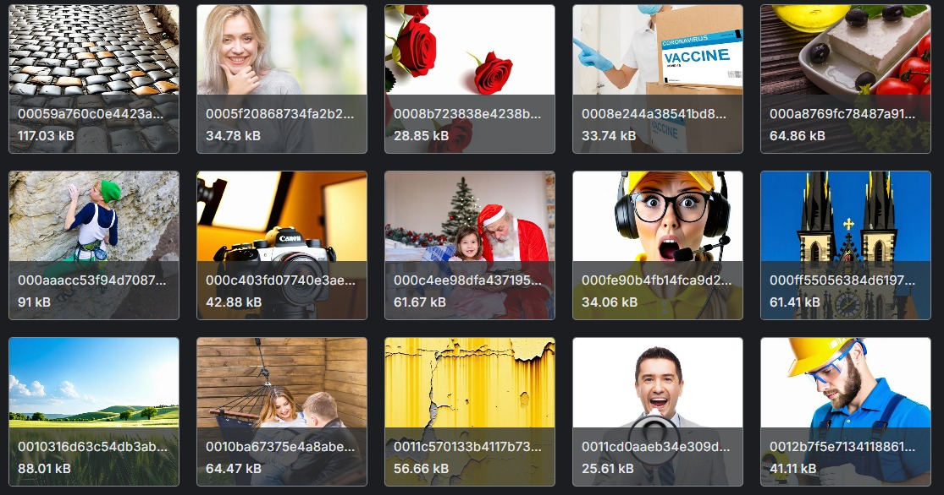
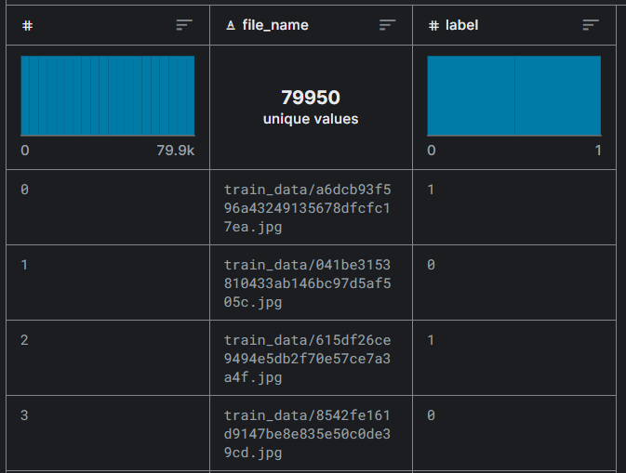
Fig 1: Sample images Fig 2: Sample csv file
Sample Dataset :

Slide 14
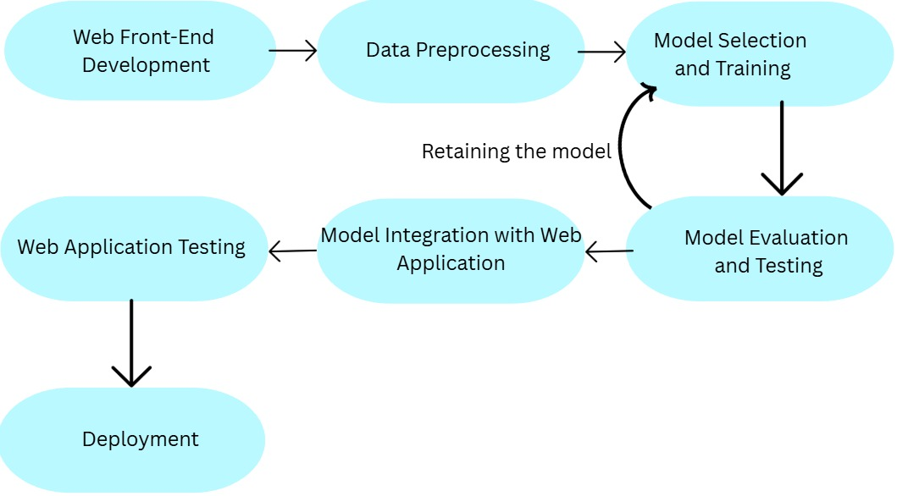
Methodology:

Slide 15
1. Web Front-End Development :
Design and build a user-friendly interface using HTML, CSS, JAVASCRIPT.
Enable users to upload videos or images for deepfake detection.
Provide real-time feedback and results visualization.
2. Data Preprocessing :
Image resizing and normalization
Data augmentation (flipping, rotation, brightness, etc.)
Final dataset split into training, validation, and test sets.
Methodology:
KLE Tech. Univ.’s Dr. MSSCET

Slide 16
Methodology :
3. Model Selection and Training :
Use EfficientNetV2 on preprocessed real and AI face images with cross-entropy loss.
Use Adam optimizer with a scheduled learning rate; monitor accuracy, F1 score, and confusion matrix.
Apply early stopping, augmentation, and dropout; fine-tune using validation data.
4. Model Evaluation and Testing
Test the model on unseen data and review the confusion matrix.
Tune hyperparameters and retrain to boost accuracy.

Slide 17
5. Model Integration with Web Application
Convert the trained model to a web-compatible format (e.g., ONNX, TorchScript).
Use Flask or FastAPI backend to serve the model.
Connect frontend to backend via API endpoints for prediction.
6. Web Application Testing
Perform unit, integration, and end-to-end testing.
Ensure fast upload, prediction, and result delivery.
Methodology:
:

Slide 18
7. Deployment
Deploy the complete web app on cloud platforms like AWS.
Integrate cloud storage (e.g., S3) for user uploads and report generation.
Monitor system performance and scale based on demand.
Methodology:
:

Slide 19
References :
1] R. A. F. Saskoro, N. Yudistira, and T. N. Fatyanosa, “Detection of AI-Generated Images From Various Generators Using Gated Expert Convolutional Neural Network,” IEEE Access, vol. 12, pp. 147772–147783, Sep. 2024, doi: 10.1109/ACCESS.2024.3466614.
2] A. Ara, M. S. Alam, K. Kamrujjaman, and A. F. Mifa, “A Comparative Review of AI-Generated Image Detection Across Social Media Platforms,” Global Mainstream Journal of Innovation, Engineering & Emerging Technology, vol. 3, no. 1, pp. 11–22, Feb. 2024
3]S. S. Baraheem and T. V. Nguyen, “AI vs. AI: Can AI Detect AI-Generated Images?,” J. Imaging, vol. 9, no. 10, p. 199, Sep. 2023. doi: 10.3390/jimaging9100199

Slide 20
References :
4]D. C. Epstein, I. Jain, O. Wang, and R. Zhang, “Online Detection of AI-Generated Images,” in Proc. IEEE/CVF Int. Conf. on Computer Vision Workshops (ICCVW), Paris, France, Oct. 2023, pp. 382–392.
5]Sun, R., Zhao, Z., Shen, L., Zeng, Z., Li, Y., Veeravalli, B., & Yang, X. (2023). An efficient deep video model for deepfake detection. In 2023 IEEE International Conference on Image Processing (ICIP) (pp. 351–355). IEEE. https://doi.org/10.1109/ICIP49359.2023.10222682
6]Q. Jaleel and I. H. Ali, “Facial Behavior Analysis-Based Deepfake Video Detection using GAN Discriminator,” in Proc. Int. Conf. Data Sci. Intell. Comput. (ICDSIC), Karbala, Iraq, 2022, pp. 36–40. doi: 10.1109/ICDSIC56987.2022.10075660
7]Dolhansky, B., Bitton, J., Pflaum, B., Lu, J., Howes, R., Wang, M., & Canton Ferrer, C. (2020). The DeepFake Detection Challenge (DFDC) dataset. arXiv preprint arXiv:2006.07397. https://arxiv.org/abs/2006.07397

Slide 21
References :
8]B. Dolhansky, J. Bitton, B. Pflaum, J. Lu, R. Howes, M. Wang, and C. C. Ferrer, “The DeepFake Detection Challenge (DFDC) Dataset,” arXiv preprint arXiv:2006.07397, 2020. [Online]. Available: https://arxiv.org/abs/2006.07397
9]Tran, D., Wang, H., Torresani, L., Ray, J., LeCun, Y., & Paluri, M. (2018). A closer look at spatiotemporal convolutions for action recognition. In Proceedings of the IEEE Conference on Computer Vision and Pattern Recognition (CVPR) (pp. 6450–6459). https://doi.org/10.1109/CVPR.2018.00675
10]Y. Li and S. Lyu, “Exposing DeepFake Videos by Detecting Face Warping Artifacts,” arXiv preprint arXiv:1811.00656, 2018. [Online]. Available: https://arxiv.org/abs/1811.00656

Slide 22
THANK YOU

