Slide 1

Virtual Keyboard Implementation
NAME | SRN
Priyanka A Totakar | 02FE22BCS074
Swathi M K | 02FE22BCS164
Supreetgouda Hiregoudra | 02FE22BCS161
Shivshankareppa | 02FE22BCS123
Under the Guidance of
Prof.Shankar Biradar

Slide 2
Flow
Background
Motivation
Literature survey
Gaps in literature
Objectives
Gantt chart
Functional Requirements
Non-Functional Requirements

Slide 3
Flow
9.Non-Functional Requirements
10.User case Diagram
11.High-Level Design
12.Low-Level Design
13.Implementation
14.Test Cases

Slide 4
Traditional Physical Keyboards:
Physical keyboards have been the main way to type on computers for years. They’re reliable, familiar, and good for fast, long typing sessions.
Rise of Virtual Keyboards:
As smartphones and tablets became popular, virtual keyboards became necessary. They save space, work well on small screens, and make typing easier on touchscreens.
Bringing Virtual Keyboards to Desktops:
With virtual keyboards working well, there is interest in using them on desktop computers, especially with touchscreens and styluses.
Background:

Slide 5
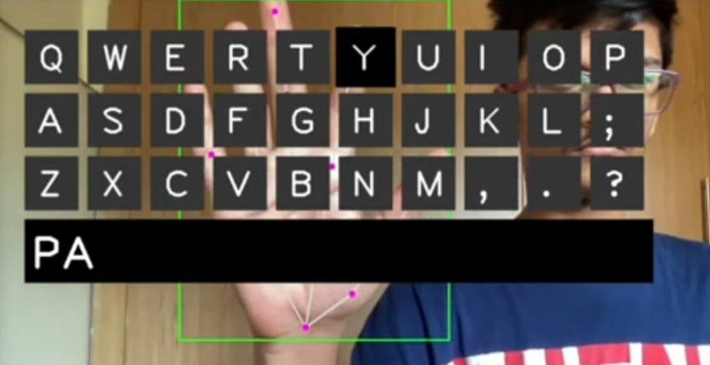

Slide 6
Motivation
Problems with Traditional Keyboards:
Physical keyboards are hard to carry around, difficult to keep clean, and not always easy to use for everyone. They aren't great for places where space, cleanliness, or convenience are important.
Problems with Current Virtual Keyboards:
Current virtual keyboards need touch or physical input, meaning you still have to touch the screen, which can be messy or uncomfortable.

Slide 7
Literature Survey:1
Author | Year | Study Objective | Methods | Limitation | Advantages
Miroslav Hagara, Jozef Pucik | 2013 | To develop methods for fingertip detection for virtual keyboard systems using a camera, focusing on three distinct algorithms for fingertip localization. | 1. Detection using local maxima of finger contours. 2. Curvature function-based fingertip localization. 3. Fingertip detection via contour angle. | First method does not detect the true fingertip, only the point closest to the camera. | Curvature and angle-based methods can distinguish individual fingers and interfinger points.

Slide 8
Literature Survey:2
Author | Year | Study Objective | Methods | Limitation | Advantages
Y.Zhang, W. Yan, and A. Narayanan | 2017 | Development of a virtual keyboard using finger recognition, enabling typing on any plane without a physical keyboard. | System based on fingertip recognition and customized keyboard recognition Smartphone camera images processed with Gaussian filters and various recognition algorithms. | Limited by the need for more sophisticated software and hardware; only tested with a small number of users. | Portable, customizable, environmentally friendly, adaptable to multiple environments, no need for extra hardware.

Slide 9
Literature Survey:3
Author | Year | Study Objective | Methods | Limitation | Advantages
Bakhrom Kabulov, Nadira Tashpulatova, Marguba Akbarova | 2019 | To develop a new input technology called VKF (Virtual Keyboard and Fingers), improving convenience over projected virtual keyboards. | VKF technology tracks finger movements and displays virtual fingers on an on-screen keyboard, improving data entry on mobile devices. | Issues with projected keyboards, such as poor visibility in daylight, energy consumption, and the need for a flat surface. | More compact, no need for a projector, low energy consumption, flexible customization, and works on uneven surfaces.

Slide 10
Literature Survey:4
Author | Year | Study Objective | Methods | Limitation | Advantages
Yan-Mei Li, Tae-Ho Lee, Jin-Sung Kim, Hyuk-Jae Lee【19+source】 | 2021 | To develop a CNN-based real-time hand and fingertip recognition system for virtual keyboard applications, improving accuracy and performance. | Hand gesture recognition using YOLOv3, skeleton modeling with Openpose for fingertip detection, achieving real-time performance with 38.26 FPS. | Requires high computational resources for processing, as demonstrated with the use of an Intel Xeon Gold CPU and TITAN XP GPU. | Five to six times more accurate than traditional object detection-based methods, real-time performance with 38.26 FPS, suitable for AR/VR applications.

Slide 11
Literature Survey:5
Author | Year | Study Objective | Methods | Limitation | Advantages
Shobhan Kumar, Munesh Chandra Trivedi, Arun Chauhan | 2023 | To develop a real-time system for recognizing air-written mathematical expressions to enhance children's learning. | 1. Hand detection using YOLOv 4. 2. Fingertip tracking for trajectory estimation. 3. CNN for digit and operator classification. | Noise in multi-digit recognition, challenges in handling overlapped air-written characters. | Hardware-independent, low-cost system using webcams, promotes self-learning for children without the need for pen-paper or tutors.

Slide 12
Gaps in Literature
Many systems struggle with varying lighting conditions,such as poor visibility in daylight or needing a dark background.
Privacy and security concerns are not addressed in studies, which is important when using cameras in public or sensitive spaces.
Most studies focus on predefined gestures and keyboard layouts, without considering adaptability to user preferences or specific needs.

Slide 13
Objectives
Develop a Contactless Typing Solution:
Create a virtual keyboard system that allows users to type using hand gestures, reducing the need for physical touch and improving hygiene.
Portability and Compact Design:
Design a compact and portable keyboard that can be used in environments where physical space is limited, such as healthcare settings or on-the-go scenarios.
Device Wear Reduction:
Minimize the wear on devices by eliminating the need for frequent physical interaction, helping extend the lifespan of touchscreens or input hardware.

Slide 14
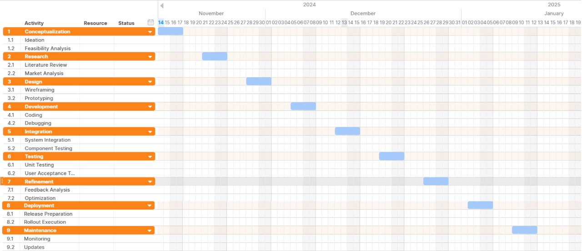
Gantt Chart

Slide 15
Functional Requirements:
Camera Interaction:
Input: Activate the camera to detect hand position and finger movements.
Output: Real-time detection and tracking of hand and finger positions for gesture control.
Hand Gesture Recognition:
Input: User performs gestures with hands and fingers.
Output: System identifies gestures, simulates corresponding actions.

Slide 16
Functional Requirements:
Virtual Keyboard Display:
Input: If the system detects a hand in the camera's field of view.
output: Display a virtual keyboard on the screen.
Typing with Hand Gestures:
Input: User Gestures with fingertips to interact with the virtual keyboard.
Output: The corresponding text for the pressed key is displayed in the ouput field (e.g., "A," "B," "C").

Slide 17
Functional Requirements:
Voice Typing:
Input: User taps the "Mic" button and speaks into the microphone.
Output: Converts spoken words into text and displays them in the input field.

Slide 18
Non-Functional Requirements:
Performance and Accuracy
Hand recognition latency: <100ms; Voice-to-text: <(2-5) second.
Gesture accuracy: ≥90%; Voice recognition: ≥90%.
Scalability
Adapts to various screen sizes and resolutions.
Supports future updates for new gestures and features.
Ease of Use/Usability
The interface should allow users to understand and operate features easily, with natural gestures.

Slide 19
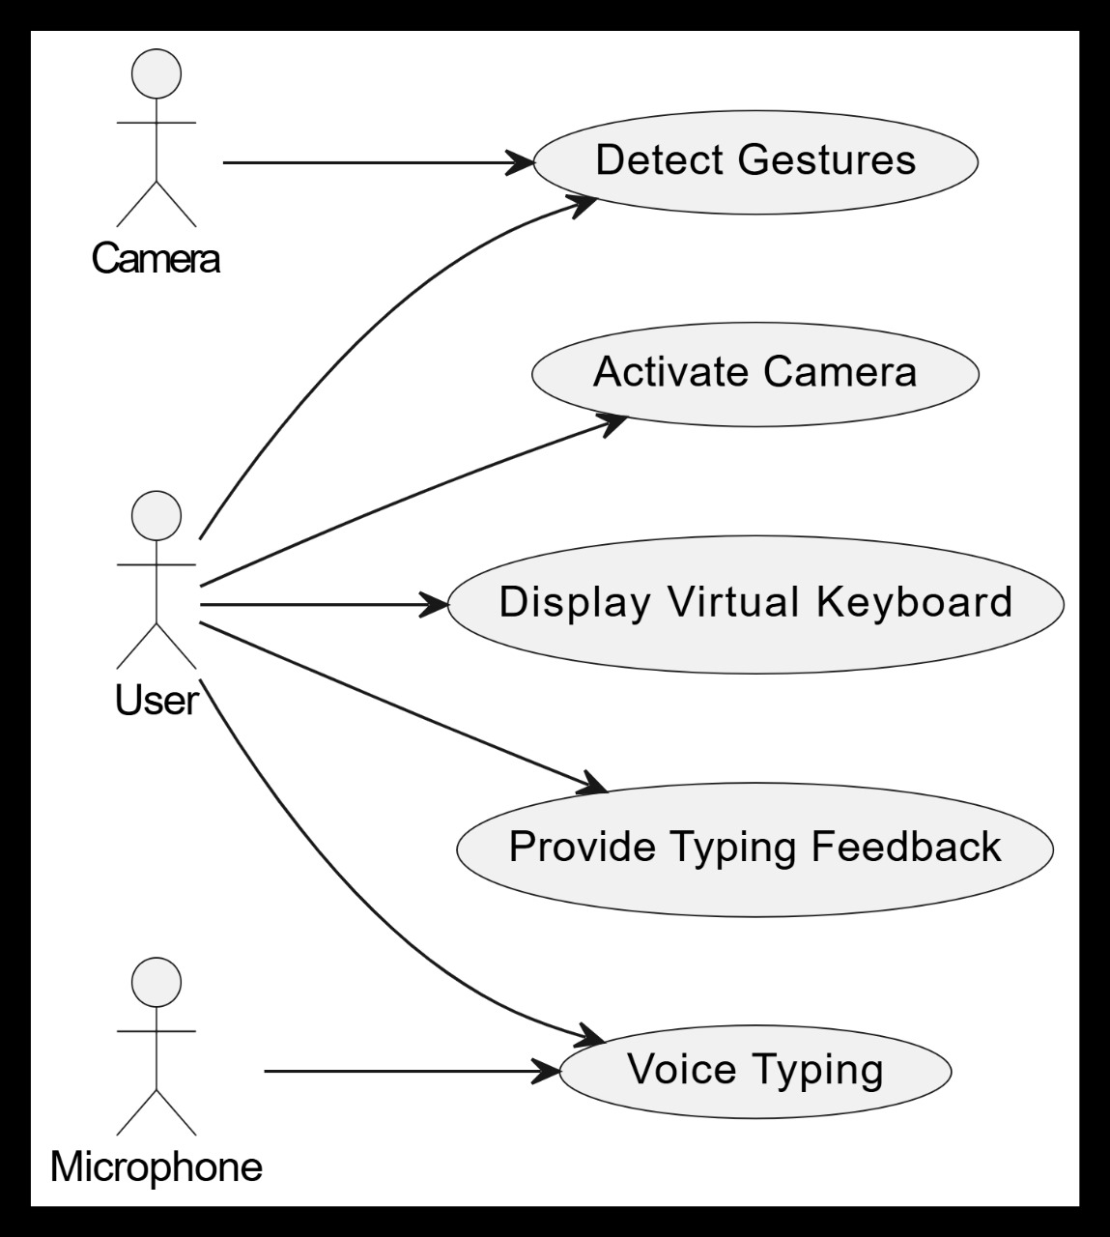
User case Diagram

Slide 20
Use Case Diagrams & Description:
Actors:
User
Camera
Microphone
Use Cases:
Activate Camera
Detect Gestures
Display Virtual Keyboard
Provide Typing Feedback
Voice Typing

Slide 21
Use Case Diagrams & Description:
Relationships:
The User initiates all use cases.
The Camera is responsible for detecting gestures and feeding data into the system.
The Microphone is involved in the voice typing process to capture and process speech.

Slide 22
High-Level Design:
The virtual keyboard uses a webcam to detect hand gestures for typing and integrates speech recognition for voice input.
Key Components:
Camera Module: Captures real-time video for hand tracking.
Hand Tracking Module: Detects hand landmarks using Mediapipe.
Virtual Keyboard UI: Displays a virtual keyboard with clickable buttons.
Speech Recognition Module: Activates microphone for text input through voice commands.
Text Display Module: Shows typed text in a designated area on the screen.

Slide 23
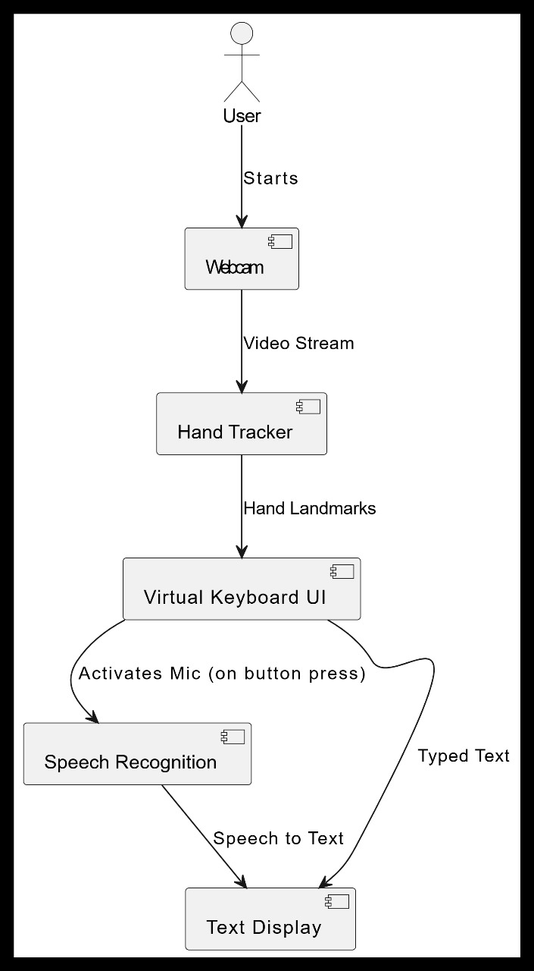
High-Level Design:
System architecture diagram

Slide 24
High-Level Design:
Camera Interaction:
The user interacts with the camera.
The camera processes the video feed to detect hand landmarks.
Hand Tracking:
Hand tracking detects the position and movement of the user's hands.
The hand landmarks provide input for the virtual keyboard interface.

Slide 25
High-Level Design:
3. Virtual Keyboard UI:
The virtual keyboard updates in response to detected hand positions.
The keyboard generates text output based on hand input.
4.Speech Recognition:
The microphone captures voice input from the user.
The speech recognition component processes the voice input when activated.

Slide 26
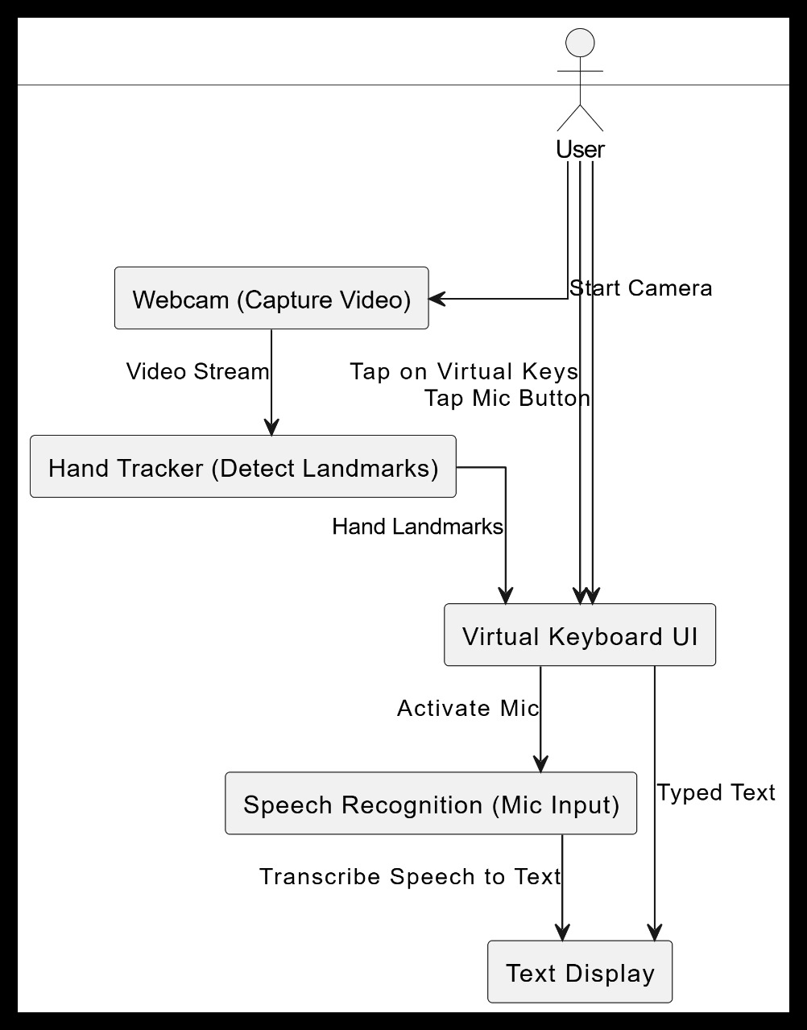
High-Level Design:
DFD (Data Flow Diagram) Level 1

Slide 27
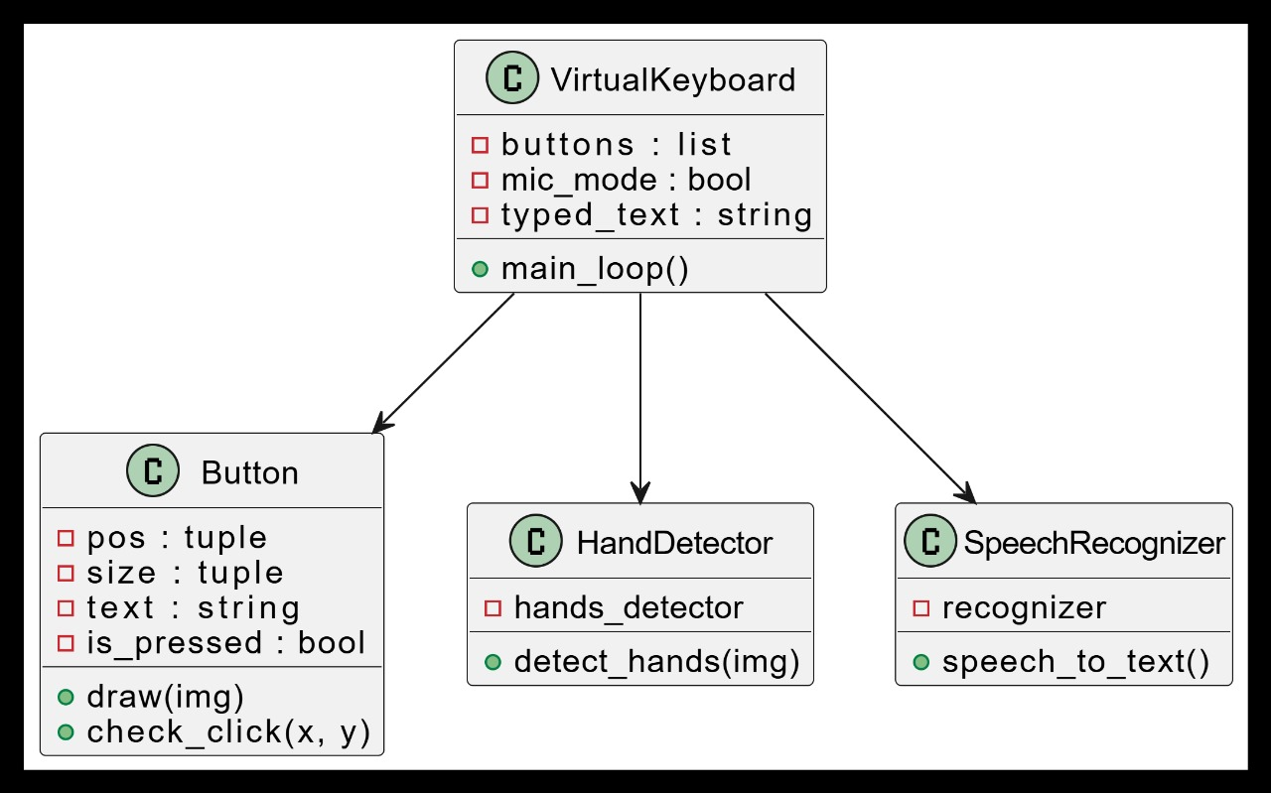
Low-Level Design:
Class Diagram

Slide 28
Low-Level Design:
The Class Diagram shows the structure of the classes involved in the system and their relationships.
Classes:
Button: Represents individual keys in the virtual keyboard.
Hand Tracking: Handles detection and tracking of the hand using Mediapipe.
SpeechRecognition: Manages the speech recognition process.
Virtual Keyboard: Manages the entire keyboard UI and user interactions.

Slide 29
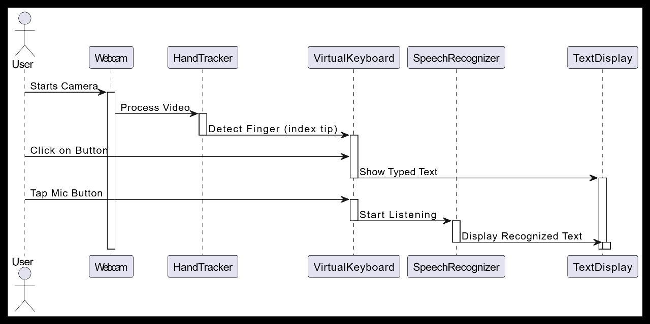
Low-Level Design:
Sequence diagram

Slide 30
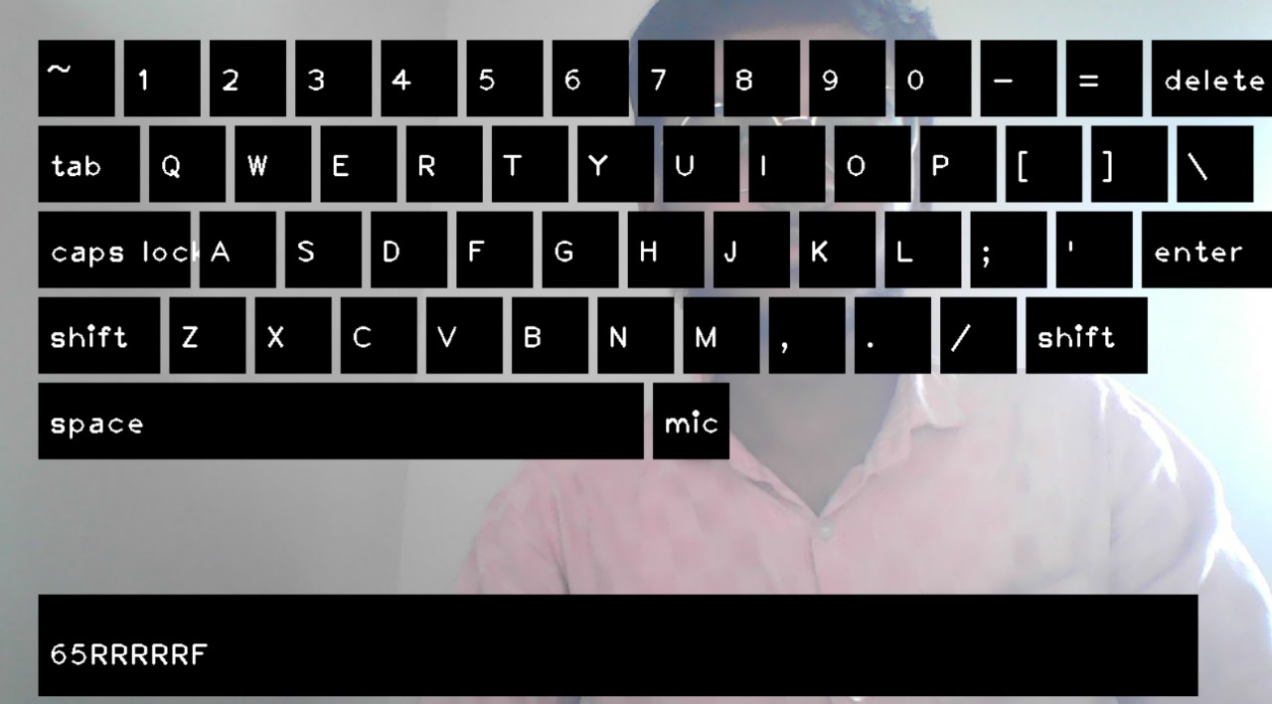
Implementation:
Virtual Keyboard Interface

Slide 31
Implementation:
1. Camera Interaction
Library Used: OpenCV.
Functionality: Captures and processes video frames.
Key Feature: Detects hand landmarks using MediaPipe.
2. Gesture Recognition
Library Used: Media Pipe.
Functionality:
Detects hand gestures.
Identifies the position of key landmarks like the index tip for button interactions.

Slide 32
Implementation:
3. Virtual Keyboard Display
Library Used: OpenCV
Functionality:
Renders a virtual keyboard on the screen.
Buttons are interactive with hand gestures.
4. Voice-to-Text Integration
Library Used: SpeechRecognition
Functionality:
Converts spoken words into text.
Activated via the "mic" button.

Slide 33
Test Cases:
Test ID | Description | Input | Steps | Expected Output | Result
TC01 | Validate hand detection | Hand gesture (index finger pointing at the key) | 1. Place the hand in front of the webcam. 2. Move fingers to check landmark tracking. | Hand landmarks detected accurately. | Pass
TC02 | Detect fingertip interaction | Hand gesture | 1. Move the index fingertip over a button. 2. Observe button response. | Button changes state when pressed. | Pass

Slide 34
Test Cases:
Test ID | Description | Input | Steps | Expected Output | Result
TC03 | Test mic activation | User clicks on the "Mic" button using hand gestures or fingertip interaction. | 1. Tap the "Mic" button using hand gestures. 2. Speak into the microphone. | Mic is activated, and system listens. | Pass
TC04 | Verify speech-to-text | User speaks a phrase (e.g., "Hello World") after activating the microphone. | 1. Speak clear phrases into the microphone. 2. Check text output on the screen. | Spoken words are accurately converted. | Pass

Slide 35
Test Cases:
Test ID | Description | Input | Steps | Expected Output | Result
TC05 | Validate space key function | User presses the "Space" key using hand gestures or fingertip interaction. | 1. Press the "Space" key using hand gestures. 2. Check text display for spaces. | Spaces are added between words. | Pass
TC06 | Test delete key function | User presses the "Delete" key using hand gestures or fingertip interaction. | 1. Press the "Delete" key using hand gestures. 2. Observe text removal. | The last character of the typed text is removed. | Pass

Slide 36
Test Cases:
Test ID | Description | Input | Steps | Expected Output | Result
TC07 | Check lighting conditions | User interacts with the virtual keyboard under different lighting conditions (bright, dim, shadowed). | 1. Perform hand gestures under dim, bright, and natural light. | System functions consistently. | Fail
TC08 | Validate responsiveness | Continuous input | 1. Rapidly move the hand over multiple buttons. 2. Check for lag in detection. | Real-time hand tracking without lag. | Fail

Slide 37
Test Cases:
Test ID | Description | Input | Steps | Expected Output | Result
TC09 | Multi-line text support | Press enter key | 1. Use "Enter" key to type across multiple lines. | Text flows across multiple lines. | Pass
TC10 | Handle unclear voice input | Noisey input | 1. Speak gibberish or remain silent after activating the mic. | Error message or ignored input. | Fail

Slide 38
1)Hagara M, Pucik J. Fingertip detection for virtual keyboard based on camera. In2013 23rd International Conference Radioelektronika (RADIOELEKTRONIKA) 2013 Apr 16 (pp. 356-360). IEEE. https://ieeexplore.ieee.org/abstract/document/6530945
2)umar S, Chandra Trivedi M, Chauhan A. Real Time Air-Written Mathematical Expression Recognition for Children’s Enhanced Learning. Neural Processing Letters. 2023 Jun;55(3):3355- https://link.springer.com/article/10.1007/s11063-022-11012-3
3)Phursule, Rajesh N., Gautami Yogesh Kakade, Abishek Koul, and Shikhar Bhasin. "Virtual Mouse and Gesture Based Keyboard." In 2023 7th International Conference On Computing, Communication, Control And Automation (ICCUBEA), pp. 1-4. IEEE, 2023. https://ieeexplore.ieee.org/abstract/document/10392123
Reference

Slide 39
4)Li YM, Lee TH, Kim JS, Lee HJ. Cnn-based real-time hand and fingertip recognition for the design of a virtual keyboard. In2021 36th International Technical Conference on Circuits/Systems, Computers and Communications (ITC-CSCC) 2021 Jun 27 (pp. 1-3).
IEEE https://ieeexplore.ieee.org/abstract/document/9501471
5)Kabulov, Bakhrom, Nadira Tashpulatova, and Marguba Akbarova. "Virtual Keyboard and Fingers." In Proceedings of the Applied Mathematics and Information Science Conference, Tashkent University of Information Technologies, Tashkent, Uzbekistan, 2024. https://ieeexplore.ieee.org/document/9011894
Reference

Slide 40
THANK YOU

