Slide 1
Operation Dim Star
✦
Finding planets in the starlight of STAC-1, STAC-2 and STAC-3
Team milkymeda

Slide 2

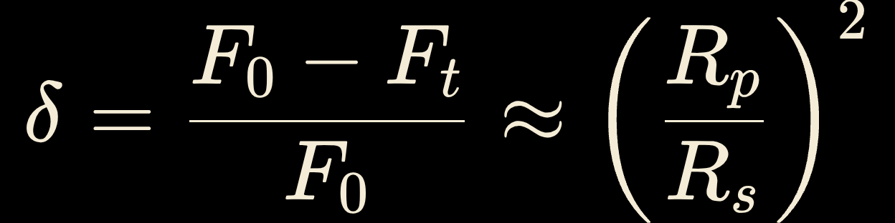



THE SIGNAL
How a tiny dip reveals a planet
Transit depth
Transit Dip
Star brightness drops slightly as planet passes
Periodic Pattern
Repeated dips at fixed intervals reveal orbit
Repeated dips at a fixed interval are the clue; flares brighten and starspots change more slowly.
Signal Analysis
Measure size, orbit and prioritize best targets
DETECT
SIZE
ORBIT
CHOOSE

Slide 3

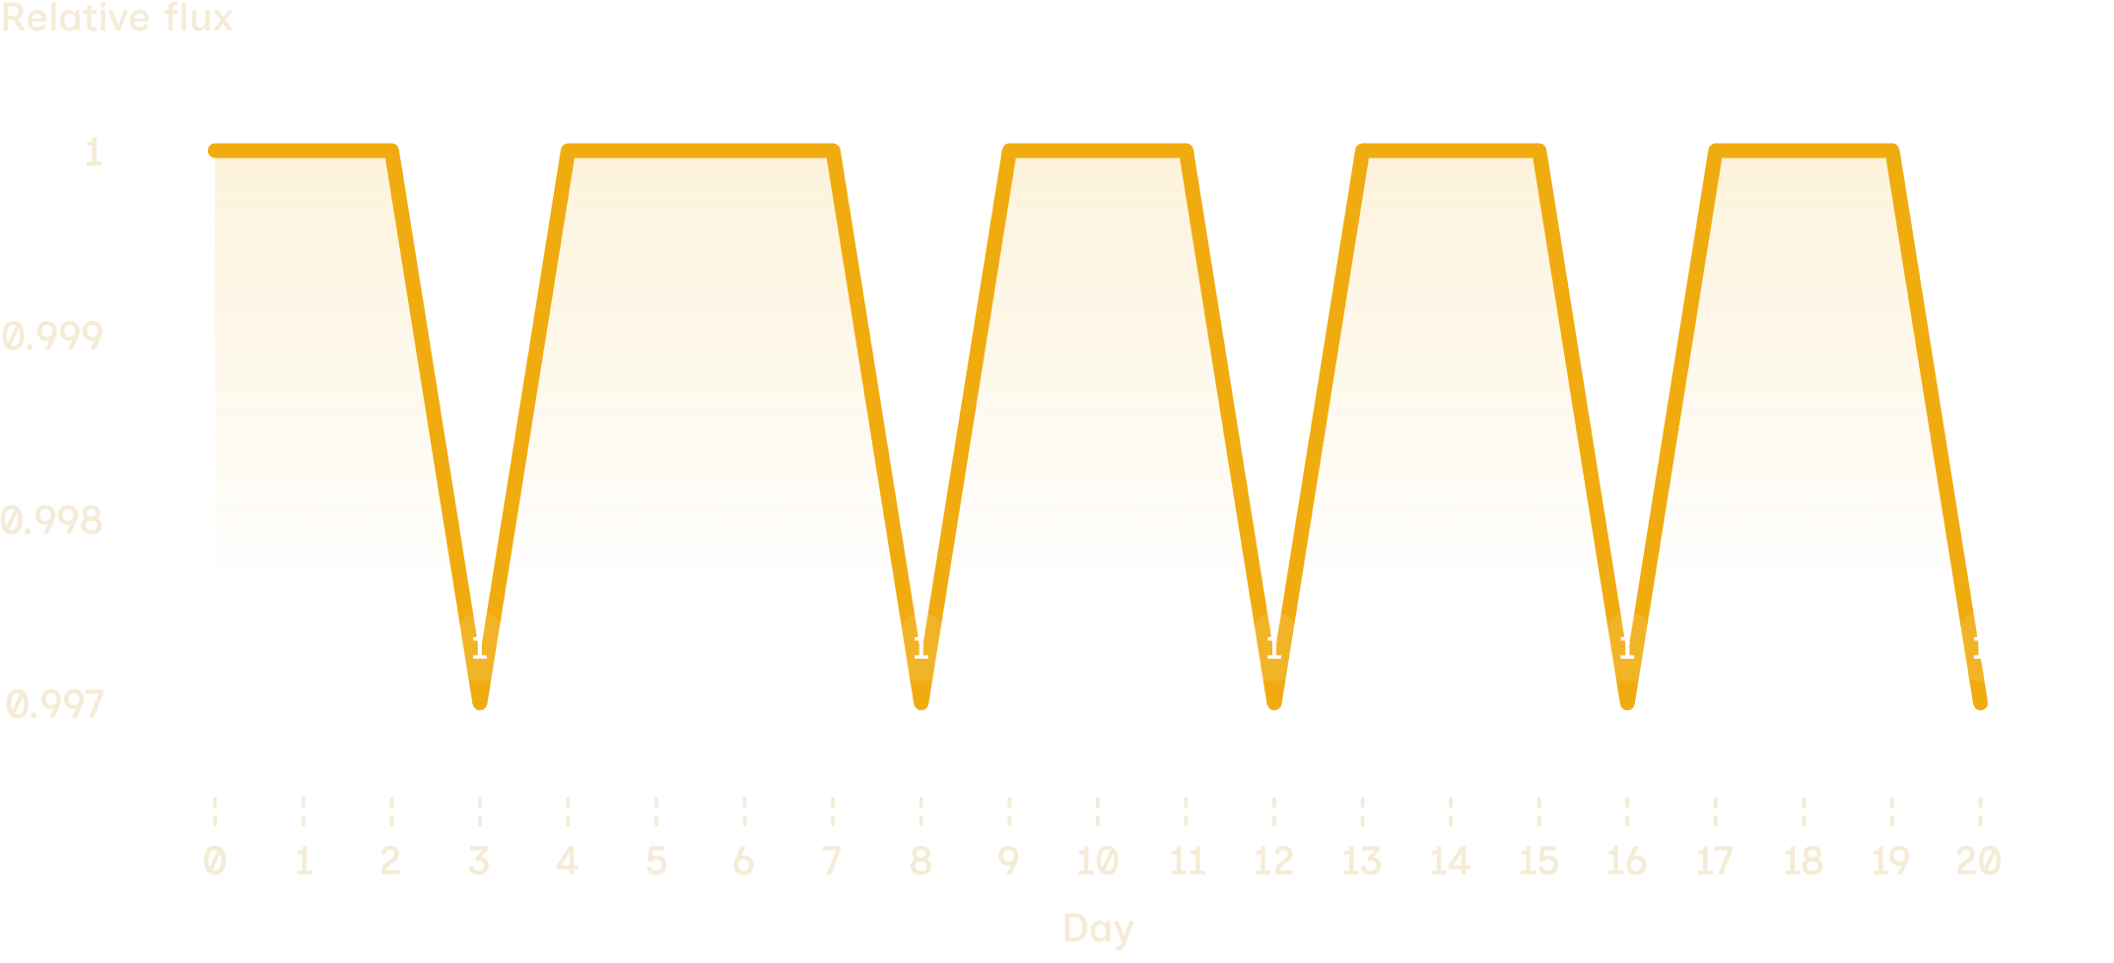
STAC-1 b · FIVE OBSERVATIONS
Five dips, one 4.2-day rhythm
Period fit
Dips to 0.9970 on days 3, 8, 12, 16, 20; δ = 0.0030.
Fit: t = t0 + nP gives P = 42/10 = 4.2 days and t0 = 3.4 d.
Predicted: 3.4, 7.6, 11.8, 16.0, 20.2 d, matching the observations when rounded.

Slide 4
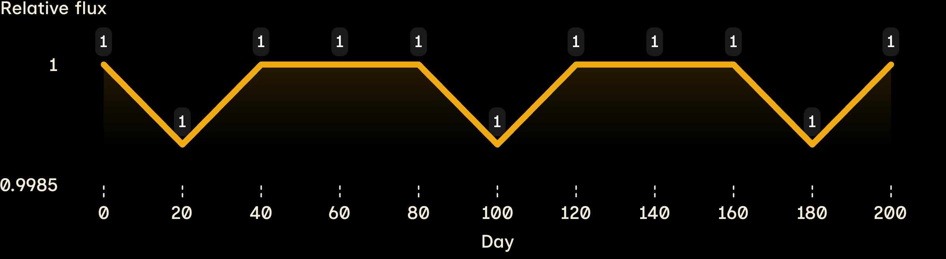

THREE DIPS · 80 DAYS APART
An 80-day signal
STAC-2 b · LONG BASELINE
Dips to 0.9990 on days 20, 100, 180. Spacing is 80 d, so P = 80 days and δ = 0.0010.
STAC-2 b
With 20-day sampling, a 26.7-day period could also fit; 40 d cannot.

Slide 5

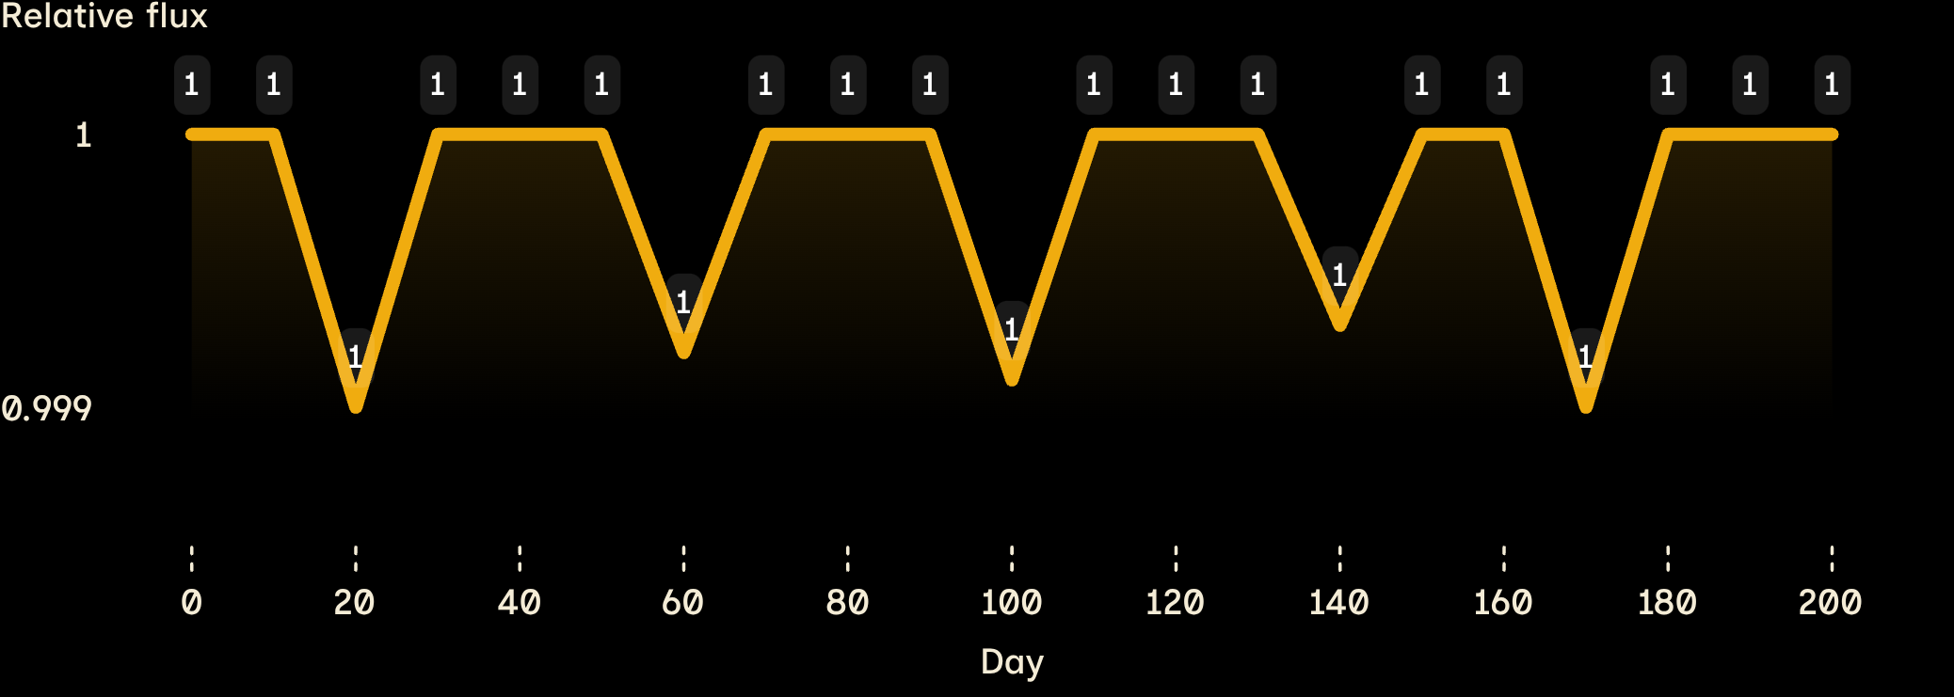
STAC-3 b · PATTERN + ANOMALY
A 40-day pattern with one mystery
Dips at days 20, 60, 100, 140: exactly 40 days apart.
Mean δ = 0.00085; extra dip at day 170 does not fit pattern.
Possible causes: flare or starspot, second planet, or glitch. We keep P = 40 d; 38 d also fits within 10-day sampling.

Slide 6
FROM DEPTH TO SCALE
Transit depth turns into planet size
The same depth does not mean the same planet size: STAC-3 is the smaller star.
STAC-1 b
STAC-2 b
STAC-3 b
5.98 R⊕
2.76 R⊕
1.59 R⊕
Rp = 696,000 × √0.0030 = 38,121 km
Rp = 556,800 × √0.0010 = 17,608 km
Rp = 348,000 × √0.00085 = 10,146 km
large Neptune-size
small Neptune-size
super-Earth

Slide 7


THREE ORBITS
Planet | a | Distance
STAC-1 b | 0.0509 AU | 7.62×10⁶ km
STAC-2 b | 0.337 AU | 5.05×10⁷ km
STAC-3 b | 0.182 AU | 2.72×10⁷ km
ORBIT SCALE
Kepler’s law gives the orbit scale
STAC-1 b is about 20× closer than Earth. All three are closer than Mercury at 0.39 AU.
In solar units.

Slide 8
LIMITS OF THE DATA
What our sampling misses
Planet | Transit probability | Transit duration | Sampling
STAC-1 b | 9.1% | 2.9 h | Readings were 10–20 days apart, so most transits could fall between measurements.
STAC-2 b | 1.1% | 6.7 h
STAC-3 b | 1.3% | 3.9 h
Next step: continuous photometry to confirm 40 vs 38 days and explain day 170.

Slide 9

FOLLOW-UP PRIORITY
STAC-3 b is our best next target
STAC-1 b
STAC-2 b
STAC-3 b
5% of habitable-zone distance · 385× Earth flux · Teq = 1128 K
53% · 3.5× Earth flux · Teq = 349 K
64% · 2.4× Earth flux · Teq = 318 K
Habitable-zone distances: 1.00 AU, 0.632 AU, 0.283 AU.
STAC-3 b is smallest at 1.59 Earth radii and the only one likely rocky; it would need a ~78-day orbit for its habitable zone.

Slide 10
CONCLUSION
Three planets, one target
Use JWST transmission spectroscopy for H₂O, CO₂, CH₄; radial velocity for mass and density; continuous photometry for the mystery dip.
STAC-1 b
STAC-2 b
STAC-3 b
hot Neptune
sub-Neptune
super-Earth and our choice for follow-up
Not habitable-zone planets yet: red-dwarf flares and possible tidal locking remain caveats.

