Slide 1
EyeDx :Deep Learning-based OCT Image Classification System

Slide 2
Team Members
V.Santhosh 3122 22 5002 117
S.Shiva sai Adithiyan 3122 22 5002 126

Slide 3
Problem Statement
Eye diseases such as diabetic retinopathy, macular degeneration, and glaucoma are becoming increasingly common, especially among aging populations and diabetics. Traditional diagnosis through Optical Coherence Tomography (OCT) imaging is time-consuming, requires expert interpretation, and is not scalable in resource-limited settings.
There is a pressing need to automate the classification of OCT images using AI and provide fast, reliable, and accessible reports to patients and doctors.
This project aims to:
Bridge the gap between AI diagnostics and clinical decision-making.
Deliver results to both doctors and patients in real-time.
Support both fully reviewed scans and quick preliminary analysis

Slide 4
Introduction
Automates OCT image classification using an on-device ML model.
Connects the diagnostic process with doctor input via a web interface.
Provides patients access to reports via a mobile app. Unlike existing cloud-dependent systems, EyeDX uses PostgreSQL for centralized data storage and ensures privacy and performance by locally running image classification on a Raspberry Pi. The entire workflow—from image acquisition to report delivery—is designed for speed, scalability, and accessibility.
This project aims to reduce diagnostic bottlenecks and provide preliminary or confirmed scan analysis to patients in a fraction of the time taken by conventional workflows.

Slide 5
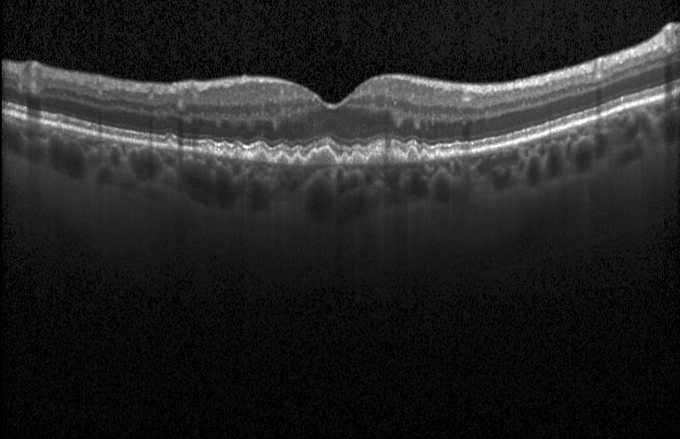
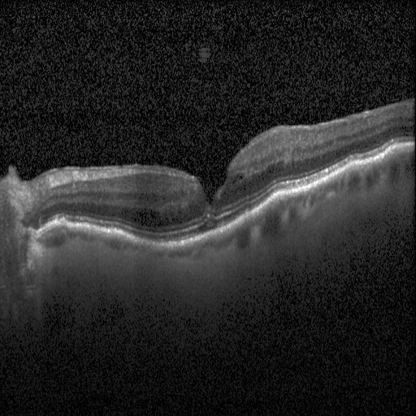
Objectives
Objective: Build a deep learning pipeline that classifies OCT scans into CNV, DME, Drusen, and Normal.
Uses MobileNetV2 for efficient classification.
Integrates with an IoT system (Raspberry Pi) for real-time classification.
Connects to a Doctor Web App and Patient Mobile App.

Slide 6
Literature Survey
Title | Authors | Year | Methodology | Summary
Classification of retinal diseases based on OCT images | Eladawi et al | 2018 | This study reviews techniques for classifying retinal diseases using optical coherence tomography (OCT), focusing on age-related macular degeneration (AMD), diabetic macular edema (DME), and choroidal neovascularization (CNV). | It evaluates deep learning approaches for early disease detection and highlights challenges in OCT image analysis, such as noise reduction and layer segmentation.
Deep learning is effective for classifying normal versus age-related macular degeneration OCT images | Lee et al | 2017 | IoT-Based Smart AgricultureDeep learning models (ResNet-50, VGG-16) are applied to classify AMD in OCT images, achieving 98.6% accuracy on a multi-institutional dataset of 109,312 images. | Transfer learning enhanced performance, with AUCs reaching 0.99 in external validation.
Classification of sd-oct images using a deep learning approach | Awais et al | 2017 | A hybrid CNN-SVM framework is developed for spectral-domain OCT classification, achieving 94.7% accuracy on the UCSD dataset. | The model combines automated feature extraction with supervised learning to distinguish AMD, DME, and normal retinas

Slide 7
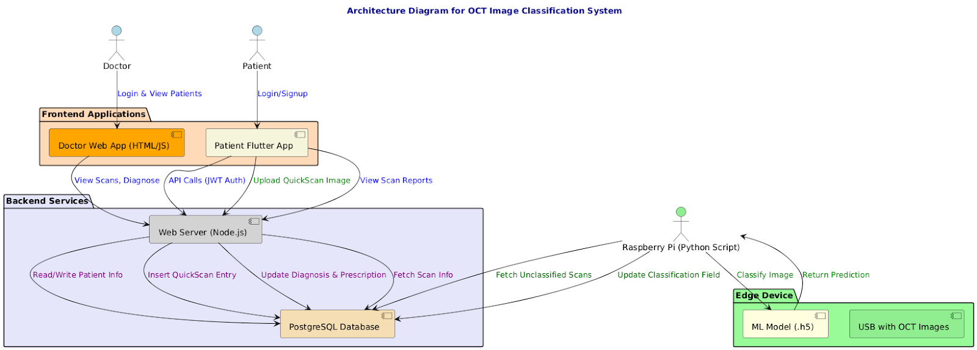

Slide 8
FUNCTIONAL REQUIREMENTS
NON-FUNCTIONAL REQUIREMENTS
Doctor Registration & Login
Signup with email and password.
Login using LoginKey and password.
Patient Registration & Login
Signup with email and password.
Login with LoginKey and password
Doctor Dashboard
Access and review OCT scans.
Fill in classification (if missing), diagnosis, and prescription.
Patient Dashboard
Access scan details, doctor’s diagnosis, and prescriptions.
Scan Upload and Classification
Raspberry Pi script reads scan from USB, classifies image, and uploads the result with filename: doctorKey$patientKey.jpg.
Automatically stores result in scans table of the database.
Security
JWT authentication for all APIs.
No sensitive data (like password) stored in plain text.
Reliability
Continuous monitoring via Raspberry Pi ensures consistent classification.
Scalability
Designed to handle increasing users and scans.
Performance
Classification should complete in <2 seconds on Raspberry Pi.
Maintainability
Clear modular backend (Node.js + PostgreSQL) and frontend separation (Flutter, HTML).
User Experience
Clean and responsive UI for both doctors and patients.

Slide 9
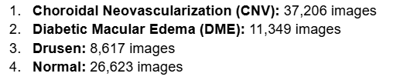
Dataset availability
Labeled Optical Coherence Tomography (OCT) – Kaggle Dataset
Classes

Slide 10
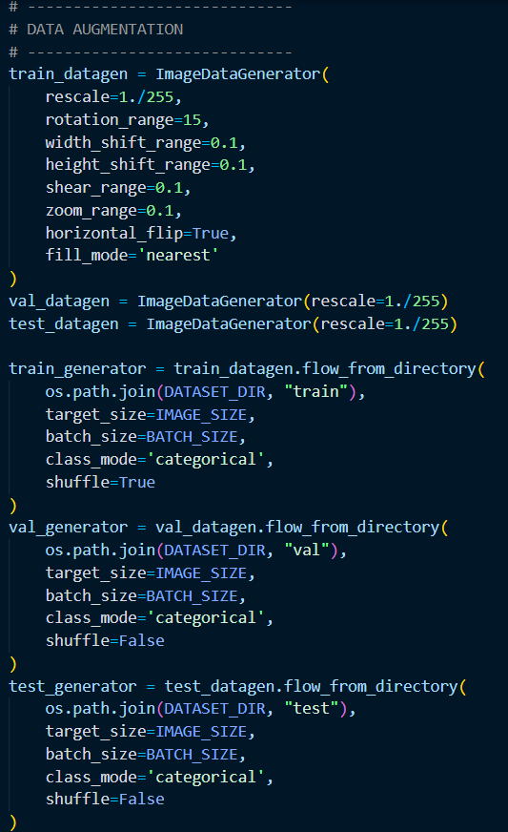
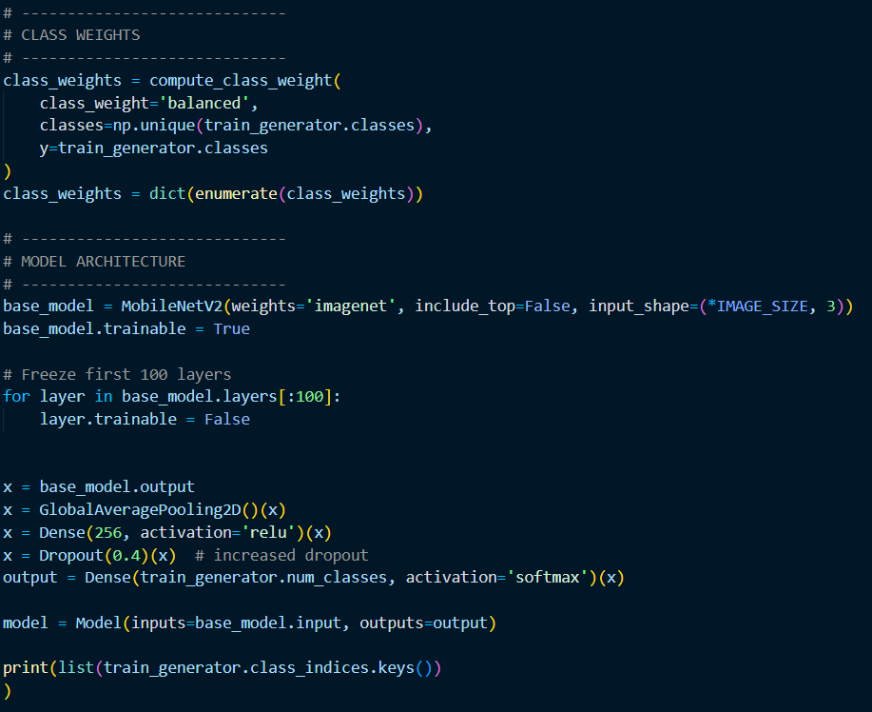
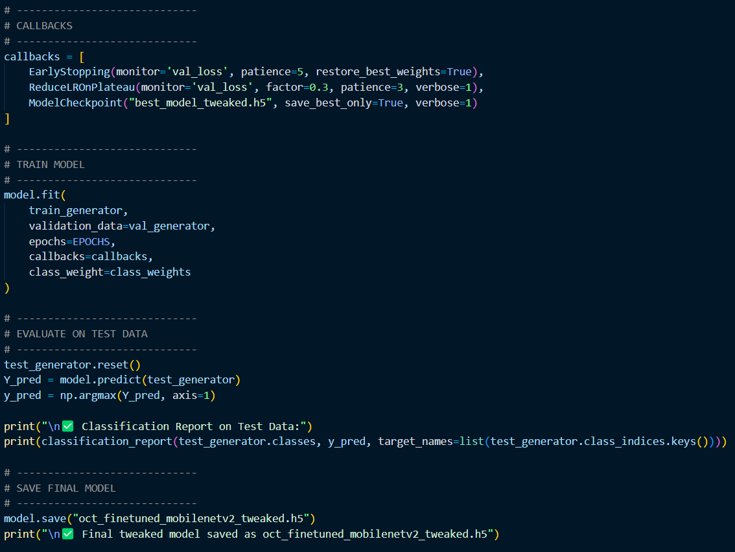
Model Prediction

Slide 11
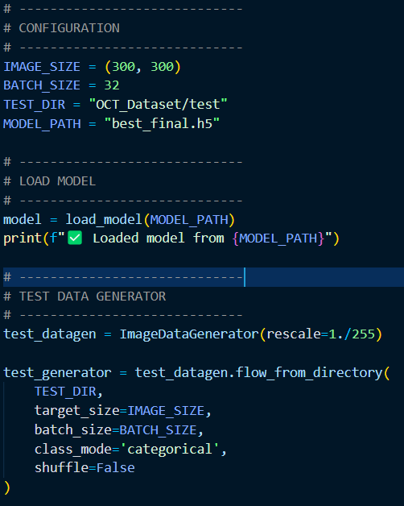
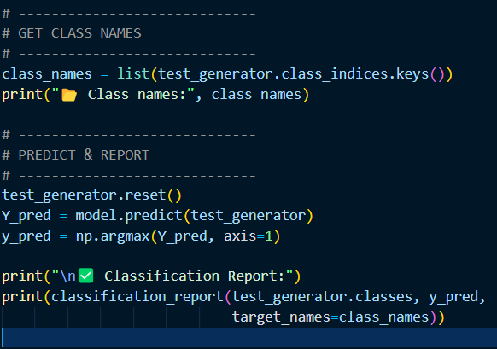
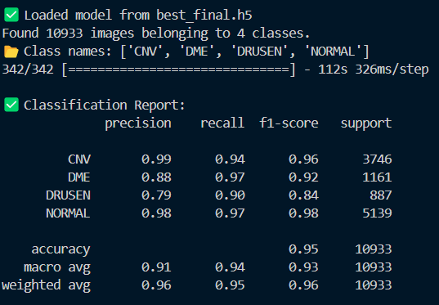
Classification Report

Slide 12
Model Information
Model Architecture
Base Model: MobileNetV2 (pre-trained on ImageNet)
Modifications:
Unfrozen last layers for fine-tuning
Added GlobalAveragePooling, Dense(256), Dropout(0.4), Output layer
Classifier Output: Softmax across 4 classes
Training Strategy
Data Augmentation used:
Rotation, shift, zoom, shear, flip
Loss Function: Categorical Crossentropy
Optimizer: Adam (1e-5)
Class Weights: To handle dataset imbalance
Callbacks:
EarlyStopping, ReduceLROnPlateau, ModelCheckpoint
Training Results
Best Accuracy: 96% on test data F1-Scores:
CNV: 0.97
DME: 0.94
DRUSEN: 0.84
NORMAL: 0.98 Macro Avg F1: 0.93
No overfitting due to augmentation + dropout

Slide 13
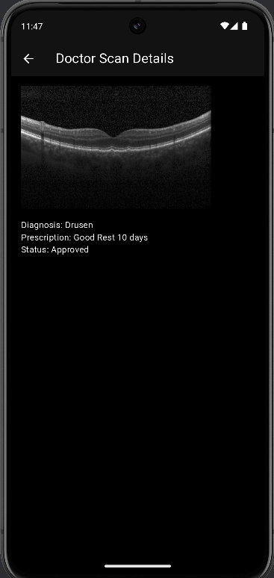
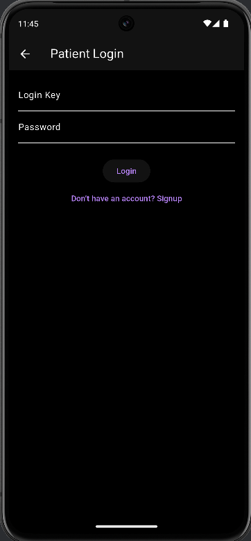
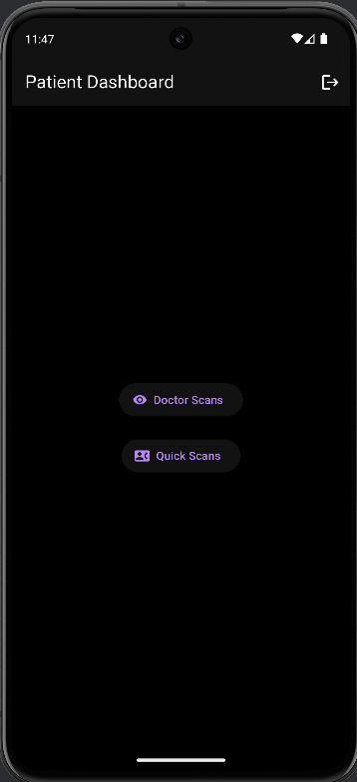
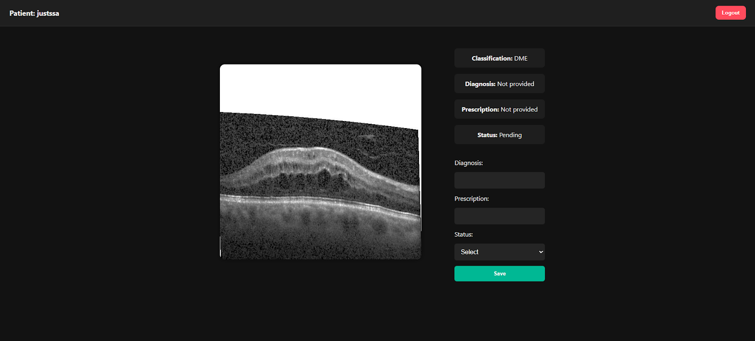
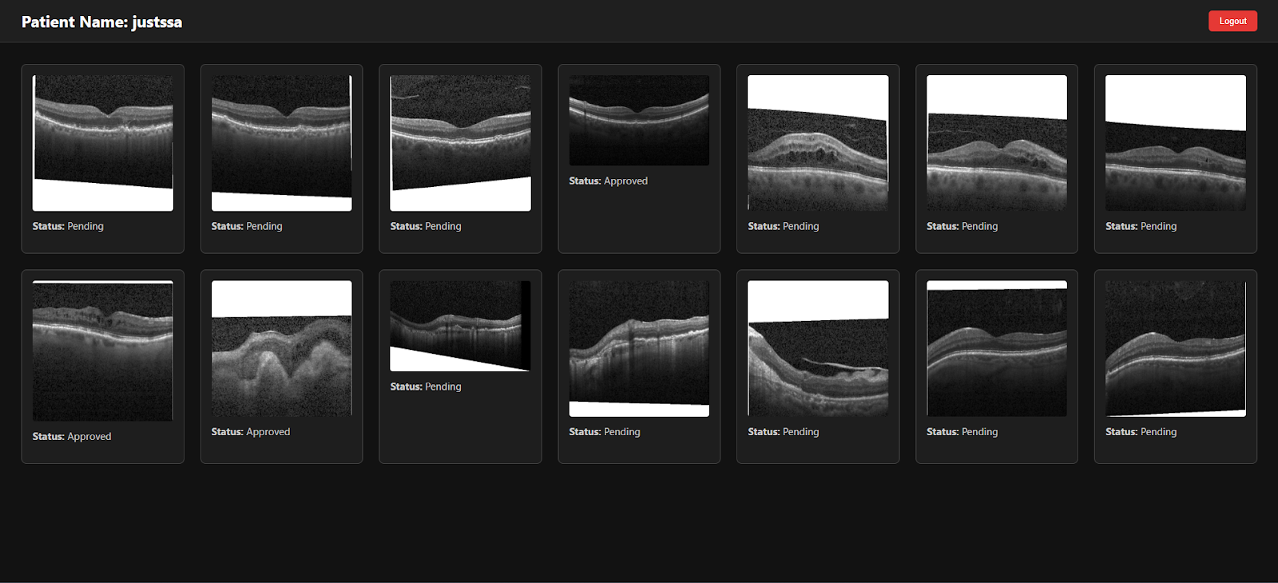
Full-Stack Architecture
Doctor Web Portal
Developed in Node.js + PostgreSQL
Doctors can review scans, approve classification, and prescribe medication
Flutter Patient App
Patients sign in with login key
View scan reports and prescriptions
Upload new scans via QuickScan feature
Backend Server
REST APIs for scan upload, fetch, classification update
Secured and lightweight
Receives data from Raspberry Pi and mobile app

Slide 14
Conclusion
EyeDx provides a low-cost, accurate, and scalable solution for automated OCT scan classification.
Aims to assist doctors, especially in resource-limited settings.
Supports early diagnosis of critical retinal conditions.

Slide 15
References
[1] Eladawi, N., Elmogy, M., Ghazal, M., Helmy, O., Aboelfetouh, A., Riad, A., Schaal, S. and El-Baz, A., 2018. Classification of retinal diseases based on OCT images. Front Biosci, 23(2), pp.247-264.
[2] Podoleanu, A.G., Rogers, J.A., Jackson, D.A. and Dunne, S., 2000. Three dimensional OCT images from retina and skin. Optics Express, 7(9), pp.292-298.
[3] Prati, F., Cera, M., Ramazzotti, V., Imola, F., Giudice, R., Giudice, M., De Propris, S. and Albertucci, M., 2008. From Bench to Bedside A Novel Technique of Acquiring OCT Images. Circulation Journal, 72(5), pp.839-843.
[4] Hood, D.C. and Raza, A.S., 2014. On improving the use of OCT imaging for detecting glaucomatous damage. British Journal of Ophthalmology, 98(Suppl 2), pp.ii1-ii9.
[5] Lee, C.S., Baughman, D.M. and Lee, A.Y., 2017. Deep learning is effective for classifying normal versus age-related macular degeneration OCT images. Ophthalmology Retina, 1(4), pp.322-327.
[6] Awais, M., Müller, H., Tang, T.B. and Meriaudeau, F., 2017, September. Classification of sd-oct images using a deep learning approach. In 2017 IEEE International Conference on Signal and Image Processing Applications (ICSIPA) (pp. 489-492). IEEE.
[7] Vermeer, K.A., Van der Schoot, J., Lemij, H.G. and de Boer, J.F., 2011. Automated segmentation by pixel classification of retinal layers in ophthalmic OCT images. Biomedical optics express, 2(6), pp.1743-1756.
[8] Abràmoff, M.D., Garvin, M.K. and Sonka, M., 2010. Retinal imaging and image analysis. IEEE reviews in biomedical engineering, 3, pp.169-208.

