Slide 1

PROJECT - I
CHARITY ORGANIZATION WEBSITE
PROJECT MEMBER:-
D. SHIVA SAI KUMAR
SUPER-15
#EDITION-1

Slide 2
CONTENTS
▪ABOUT PROJECT
▪EXISTING SYSTEM
▪OBJECTIVES AND GOALS
▪PROPOSED SYSTEM
▪HARDWARE REQUIREMENTS AND SOFTWARE REQUIREMENTS
▪RESULTS
▪FUTURE SCOPE AND ENHANCEMENT
▪CONCLUSION

Slide 3
ABOUT PROJECT
▪ Charity websites often have to juggle different goals connect clients to services, accept donations from donors, find volunteers, share news, inspire people who are interested and much more.
▪ Global Health Innovations is focused on advancing healthcare systems in underserved communities through innovative technologies.
▪ This non-profit group is located in the UK focusing on domestic and international economic policy. By using books, media outlets and continuous research they hope to educate and change opinions on free people and the liberal state of mind.

Slide 4
EXISTING SYSTEM
▪Users can browse through a list of organizations and select one to donate to.
▪Users can typically make a one-time donation or set up a recurring donation.
▪Most existing online charity systems are websites that allow users to make donations to various charitable organizations.
▪Many existing systems also offer the option to fundraise for a specific organization or campaign.
▪Some online charity system have mobile apps which have the same functionality as their website counterparts.

Slide 5
OBJECTIVE GOALS
▪ The main objectives of charity organizations typically revolve around helping those in need, alleviating suffering, promoting social justice, and making positive changes in communities.
▪Provide holistic support to underprivileged children, moving then from child labor and street living into school and a better living condition.
▪Provide basic needs to elder orphans for best possible health and well-being.
▪Uplift and empower teenage mothers to positively transform their lives.

Slide 6
PROPOSED SYSTEM
▪An online platform where charities or causes can sign up and list their projects.
▪Potential donors can browse the platform and make donations directly to the charities or causes they support.
▪Donors also have the ability to track their donations and receive regular updates on the progress of their chosen charity or cause.

Slide 7
HARDWARE REQUIREMENTS
▪ Hardware interfaces specifies the logical characteristics of each interface between the software product and the hardware components of the system. The following are some hardware requirements.
▪ Processor : i3 or above
▪ RAM : 1 GB or more.
▪ Hard disk : 40 GB or more.
▪ Monitor : Any Monitor.
▪ Keyboard : Standard Keyboard.
▪ Mouse : Two or Three Button Mouse.

Slide 8
SOFTWARE REQUIREMENTS
▪ Software Requirements specifies the logical characteristics of each interface and software components of the system. The following are some software requirements:
▪ Operating system : windows family, linux.

Slide 9
IMPLEMENTATIONS
Below are the Technologies used:
▪ HTML
▪ CSS

Slide 10
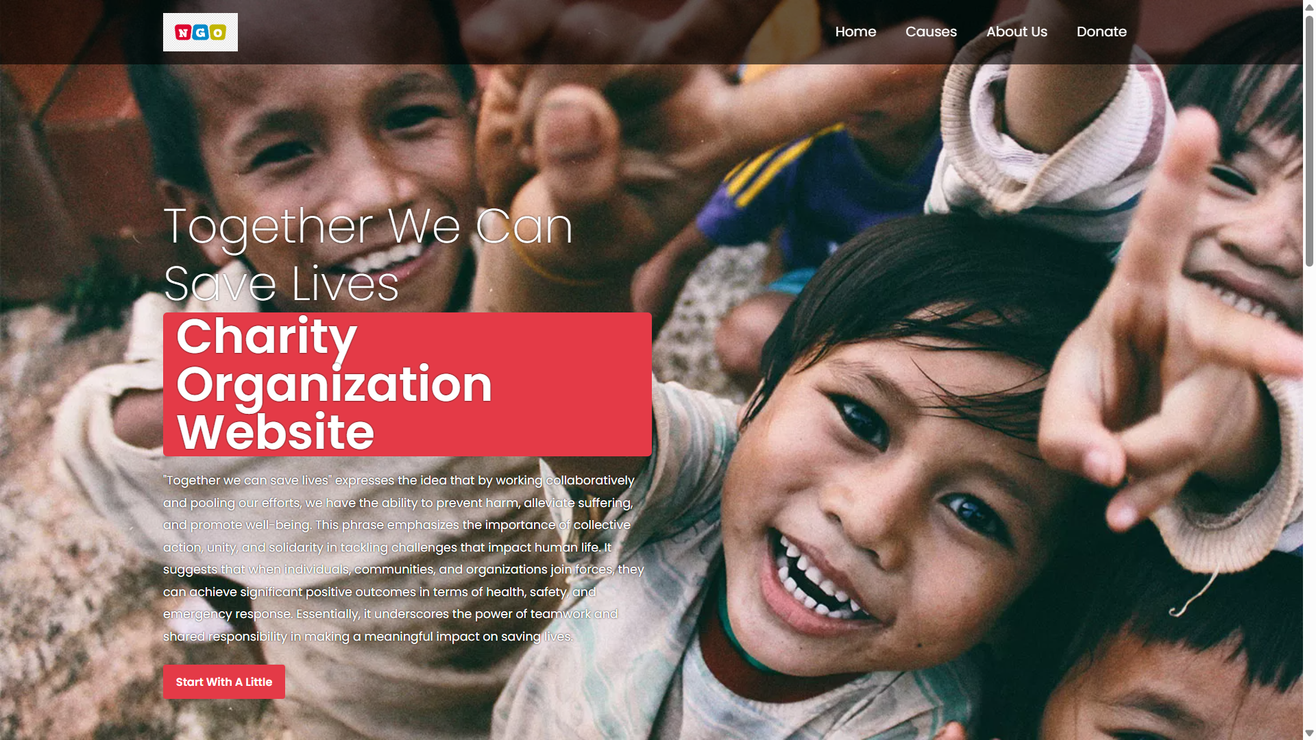
RESULTS

Slide 11
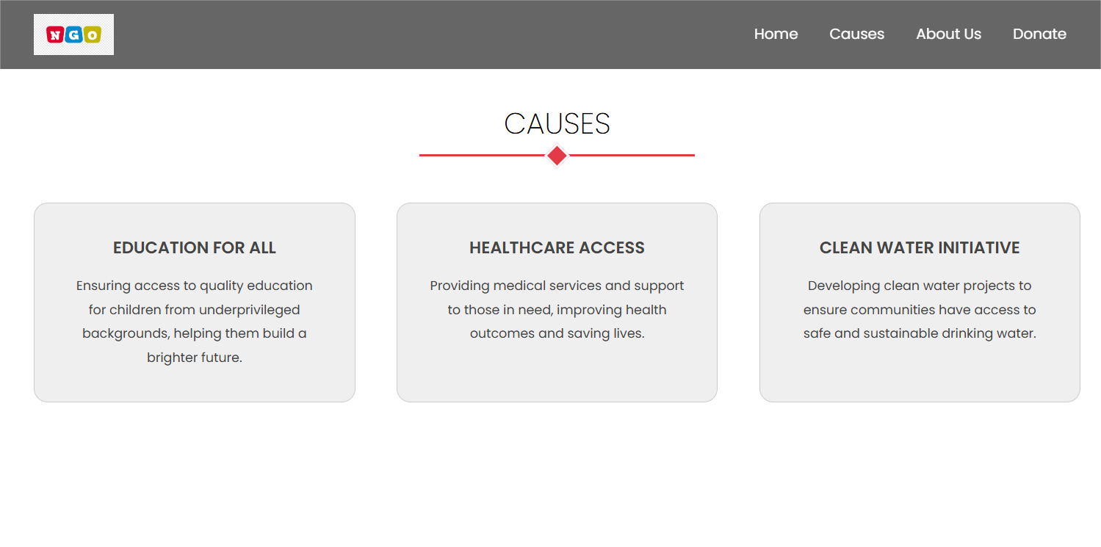

Slide 12
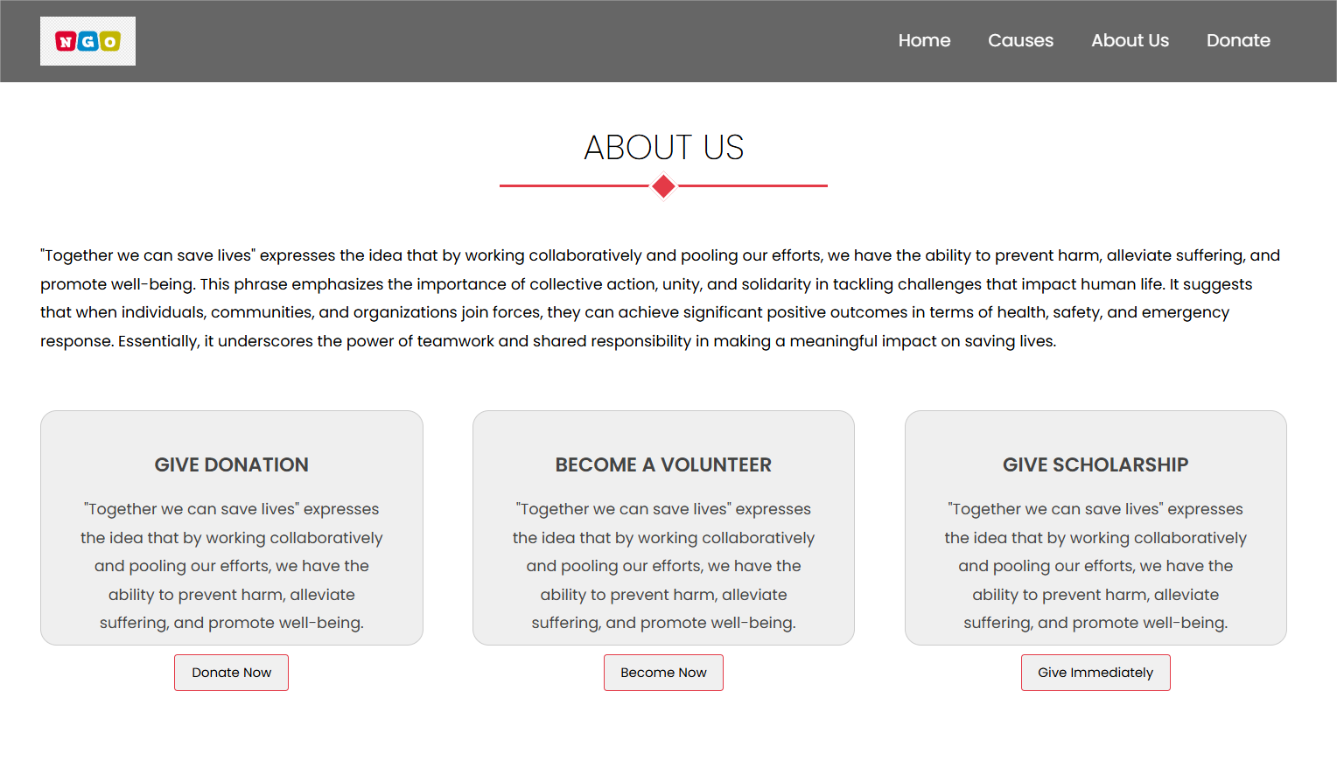

Slide 13


Slide 14
CONCLUSION
▪Charity is meant for the general betterment of society. The allocation of donations must be strictly monitored to ensure that it does not end up in the wrong hands.
▪There is much hardship in the world, and it is the fortunate man's inherit duty to help better those who are less fortunate.

Slide 15
FUTURE SCOPE AND ENHANCEMENT
Enhancing a charity organization's website involves focusing on improving user engagement, transparency, and efficiency in operations. Here are some future scope and enhancement ideas:
1.Donation Experience Optimization:
▪ Mobile Optimization: Ensure the website is fully responsive and user-friendly on mobile devices, as many donors access websites via smartphones.
2.Transparency and Impact Reporting:
▪Real-Time Updates: Provide real-time updates on how donations are being utilized and the impact they are creating.

Slide 16
THANK YOU

