Slide 1

DEPARTMENT OF COMPUTER SCIENCE AND ENGINEERING
MAJOR PROJECT SYSTEM DESIGN REVIEW
TITLE: SHIELD MASK DETECTION SYSTEM USING DEEP LEARNING
Project Guide:
Dr.G.Ashok Kumar
Associate Professor
Team Members (21MP019):
D. Bindu (22P65A0504)
K. Shiva Shankar Reddy (22P65A0506)
K. Pranay Chandra (22P65A0507)
12-04-2025
1

Slide 2

OUTLINE
Abstract
Introduction
Problem statement
Literature Survey
Existing system
Proposed system
Objective
Proposed Methodology
Requirements & Specification
Project Time Plan
System Design
Conclusion
References

Slide 3
ABSTRACT
In the wake of global health crises, wearing protective gear such as face masks and face shields has become crucial for minimizing the spread of airborne diseases. This project presents a real-time Shield Mask Detection System that leverages deep learning techniques for classifying whether individuals are wearing a face mask, face shield, both, or none.
The MobileNet model, known for its computational efficiency and accuracy, is trained on a custom dataset comprising images labeled into four categories: with mask, with shield, with both, and without protection.
The training process involves image preprocessing, augmentation, and transfer learning to enhance model performance. Upon detecting a face using Haar Cascade, the system passes the region of interest to the trained MobileNet model, which predicts the protective status in real time.
This deep learning-based detection system is designed to be deployed in public and private spaces to assist in enforcing health compliance measures. Its high accuracy, low computational cost, and real-time processing capability make it suitable for edge devices and embedded systems
Keywords:Deep Learning,CNN (Convolutional Neural Network),MobileNet,Haar Cascade,Face Detection,Shield Mask Detection

Slide 4

INTRODUCTION
The emergence of global pandemics like COVID-19 has underscored the importance of personal protective equipment (PPE) such as face masks and face shields in minimizing the spread of infectious diseases.
To ensure public safety, automated surveillance systems have become essential for monitoring compliance with health guidelines. This project aims to develop a real-time shield mask detection system using deep learning techniques.
By integrating Haar Cascade classifiers for face detection and a lightweight MobileNet-based CNN model for classification, the system can accurately determine whether individuals are wearing a face mask, a face shield, both, or none.
The system is designed for deployment in public areas such as hospitals, airports, shopping malls, and schools to help authorities monitor PPE usage effectively and efficiently.

Slide 5

PROBLEM STATEMENT
An automated, real-time PPE detection system is crucial for ensuring public compliance by accurately identifying whether individuals are wearing a face mask, face shield, both, or none—even in challenging conditions. Unlike traditional models, it must be lightweight, fast, and suitable for deployment on edge devices, enabling scalable and cost-effective implementation in public and private spaces. By leveraging deep learning and optimized architectures like MobileNet, the system ensures high accuracy with low computational demand, making it ideal for real-time monitoring in hospitals, offices, airports, and other high-traffic areas.

Slide 6

LITERATURE SURVEY
SNo. | Title/Focus | Methodology | Findings | Limitations | Future Work
1 | "Face Mask Detection using Deep Learning and MobileNetV2" | Used MobileNetV2 with transfer learning on face mask dataset | Achieved high accuracy for mask detection with low computational cost | Limited dataset diversity affecting real-time performance | Expand dataset with more variations (shield, angles, lighting)
2 | "Real-Time Face Mask and Face Shield Detection Using CNN" | Trained CNN from scratch with multi-class classification (mask, shield, none) | Capable of distinguishing between multiple protective gears | Model complexity leads to slower inference on low-end devices | Use lightweight models (like MobileNet) for real-time performance

Slide 7
LITERATURE SURVEY
3 | "Face Detection using Haar Cascade Classifier" | Used OpenCV Haar cascades for frontal face detection | Simple and fast method for face localization | Less accurate under occlusions and different lighting conditions | Combine with deep learning for better accuracy
4 | "COVID-19 Face Mask Detector with OpenCV, Keras/TensorFlow" | Fine-tuned CNN model with OpenCV face detection | Achieved real-time detection with decent accuracy | Only binary classification (mask vs. no mask) | Add more classes like face shield or incorrect mask usage

Slide 8
LITERATURE SURVEY
5 | "Lightweight CNN for Face Mask Detection" | Developed a custom lightweight CNN for fast inference | Fast and power-efficient model with reasonable accuracy | Accuracy drops in crowded or low-light scenes | Add preprocessing techniques like histogram equalization
6 | Social Distancing, Surveillance, and Stronger Health Systems as Keys to Controlling COVID-19 Pandemic (2020) | Pan American Health Organization (PAHO) | Surveillance systems Data analytics Mathematical modeling | distancing, stronger health systems in controlling COVID-19 pandemic | Does not provide detailed implementation plans or feasibility analysis

Slide 9

EXISTING SYSTEM
In existing shield or face mask detection systems, Support Vector Machine (SVM) is a commonly used machine learning algorithm for binary classification tasks such as detecting whether a person is wearing a mask or not. These systems typically involve the following steps
DISADVANTAGES:
Binary Limitation
Manual Feature Engineering
Scalability Issues

Slide 10
PROPOSED SYSTEM
The proposed Shield Mask Detection System uses deep learning to accurately identify individuals wearing face masks, face shields, both, or none. It leverages convolutional neural networks (CNNs) for robust feature extraction and classification. The system is designed to handle variations in lighting, occlusions, and face orientations. It is lightweight and optimized for real-time deployment on edge devices for large-scale public monitoring.

Slide 11

OBJECTIVE
To build a deep learning model using MobileNet CNN for classifying face protection categories: mask, shield, both, and none.To use Haar Cascade Classifier for efficient real-time face detection from video or image inputs.
To train and validate the model using a diverse dataset with labeled images representing different PPE categories.To achieve high accuracy and low latency suitable for deployment in real-time surveillance systems.
To integrate the system with camera feeds and evaluate performance in real-world scenarios.
To contribute to public health efforts by promoting and monitoring compliance with mask and shield usage.

Slide 12
PROPOSED METHODOLOGY
PROPOSED METHOD:
Pre processing
Feature extraction
CNN (MobileNetV2)
Haar Cascade

Slide 13

ADVANTAGES OF PROPOSED SYSTEM OVER EXISTING SYSTEM
ADVANTAGES:
Real-Time Performance
Lightweight & Optimized
High Accuracy

Slide 14

REQUIREMENTS & SPECIFICATION
SOFTWARE REQUIREMENTS:
Operating System : Windows 7 (or Linux/Ubuntu)
Programming Languages : Python
Libraries and Frameworks : TensorFlow, Keras, or PyTorch, OpenCV, NumPy, pandas, M Matplotlib, Seaborn
Operating System : Windows, Linux (Ubuntu, CentOS), or macOS
IDE : Google Colab
Other Tools : YOLO, MobileNet (for face detection)

Slide 15
HARDWARE REQUIREMENTS
RAM : 8GB to 16GB
Hard Disk : At least 1 TB(SSD or HDD)
Camera : High-definition webcam or CCTV camera
Power Supply : Reliable power source

Slide 16
PROJECT TIME PLAN
SNO | DURATION | TASK
 | 09.01.2025 to 11.01.2025 | Submission of abstract
2. | 20.01.2025 to 25.01.2025 | Abstract presentation
3. | 10.02.2025 to 15.02.2025 | Literature survey
4. | 24.02.2025 to 01.03.2025 | Project Design
5. | --- | --
6. | --- | --
7. | 31.03.2025 | Submission of Publication document
8. | 07.04.2025 | Submission of Final Project Document

Slide 17
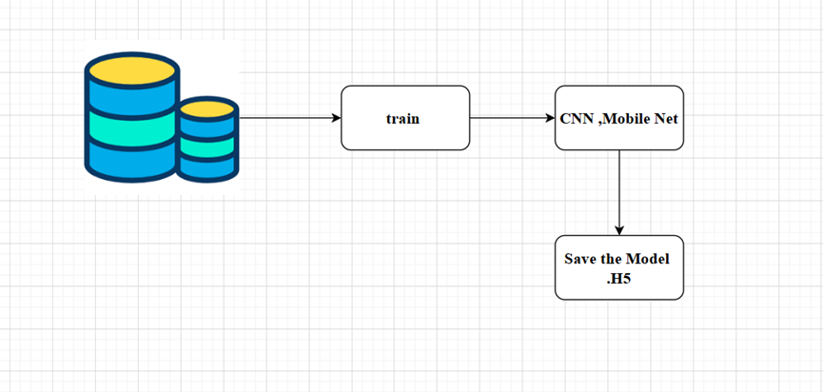
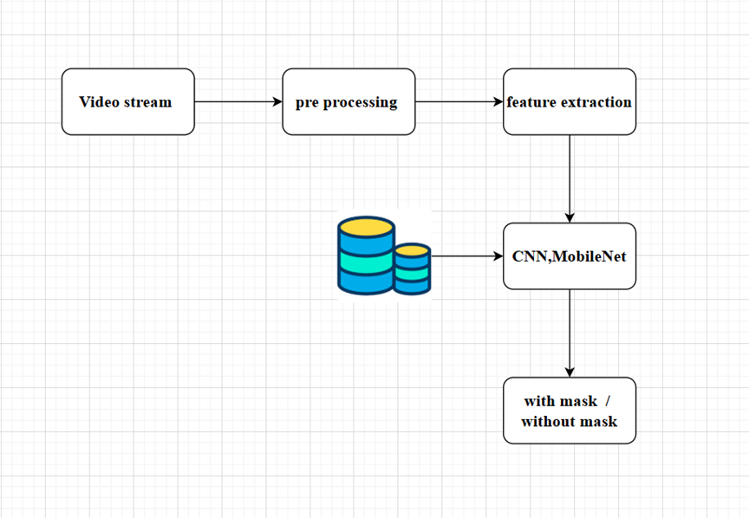
SYSTEM DESIGN
Architecture:

Slide 18
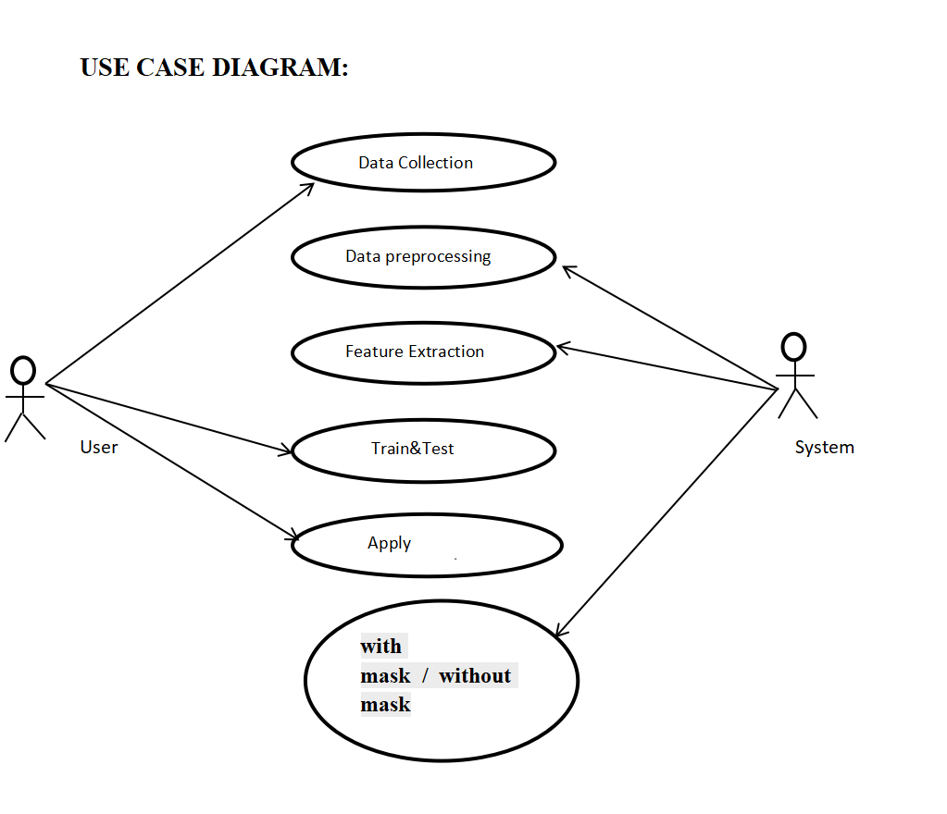
SYSTEM DESIGN
Use Case Diagram:
The use case diagram shows the process of building a face mask detection system. The user starts by collecting image or video data. This data is then preprocessed by cleaning and resizing it. Important features like eyes and mouth are extracted to help the model learn. The user and system work together to train and test the model. Once trained, the model is applied to new data, such as live video, and it predicts whether a person is wearing a mask or not.

Slide 19
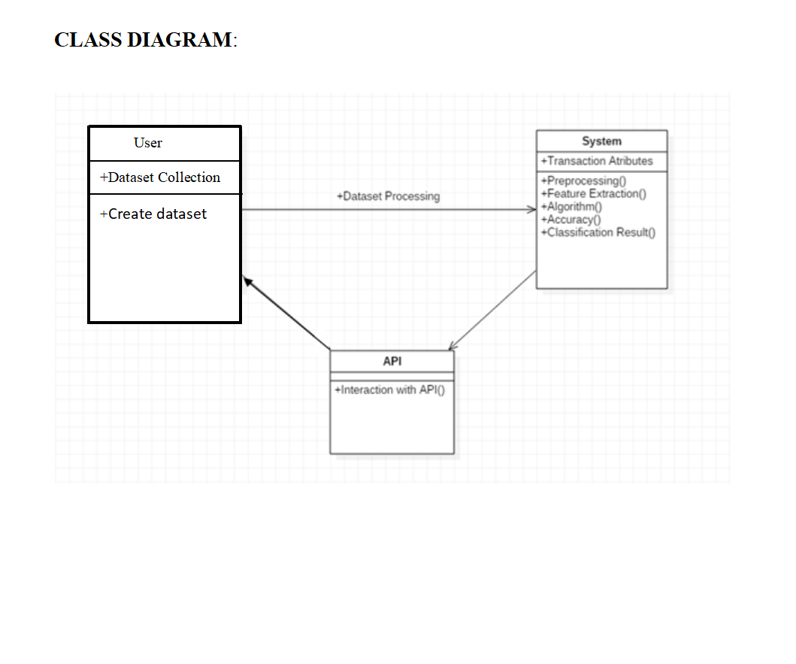
SYSTEM DESIGN
Class Diagram:
The class diagram is the main building block of object-oriented modeling. It is used for general conceptual modeling of the systematic of the application, and for detailed modeling translating the models into programming code. Class diagrams can also be used for data modeling.[1] The classes in a class diagram represent both the main elements, interactions in the application, and the classes to be programmed.

Slide 20
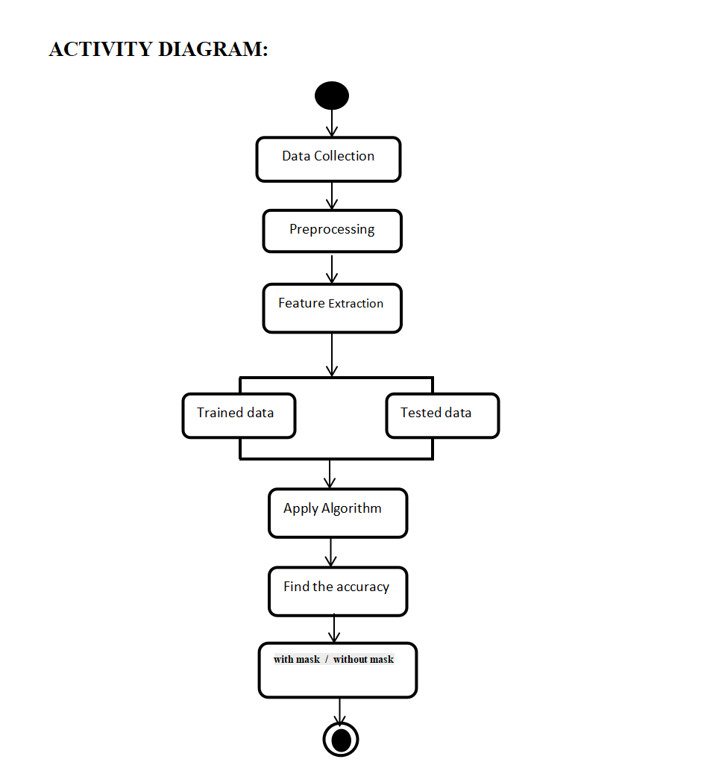
SYSTEM DESIGN
The activity diagram shows the workflow of a face mask detection system. It starts with collecting image or video data, followed by preprocessing and feature extraction. The data is split into training and testing sets. A machine learning algorithm is applied to train the model, and its accuracy is evaluated. Finally, the system predicts whether a person is with or without a mask.

Slide 21
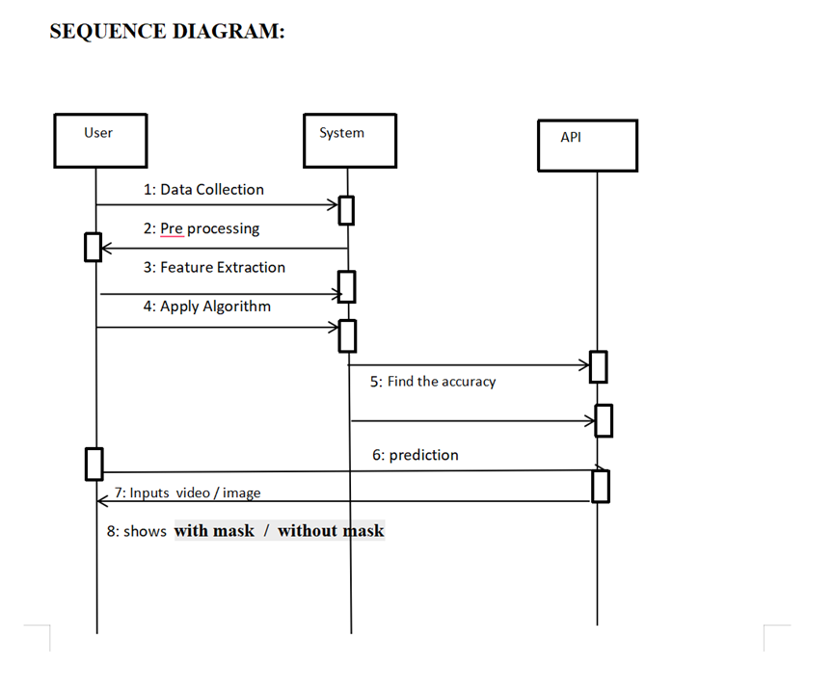
SYSTEM DESIGN
Sequence Diagram:
Data Collection – The user provides data (images/videos).
Preprocessing – The system processes the input data
Feature Extraction – Key facial features are extracted.
Apply Algorithm – The system uses a model (e.g., CNN or MobileNet).
Find the Accuracy – The system communicates with the API to evaluate model performance.
Prediction – The system asks the API to predict mask
Input (Video/Image) – The user inputs real-time video or an image.
Output – The system displays whether the face is with mask or without mask.

Slide 22
CONCLUSION
The proposed system successfully integrates Haar Cascade Classifier for real-time face detection and CNN MobileNet for efficient classification of face mask and shield usage. By leveraging deep learning, the system achieves high accuracy and speed, making it suitable for deployment in real-world environments such as public places, offices, schools, and hospitals. Unlike traditional machine learning methods, this system can accurately differentiate between individuals wearing face masks, face shields, both, or none. The real-time capability, automatic feature extraction, and flexibility make the system a valuable tool in promoting public health and safety by enforcing PPE compliance.

Slide 23
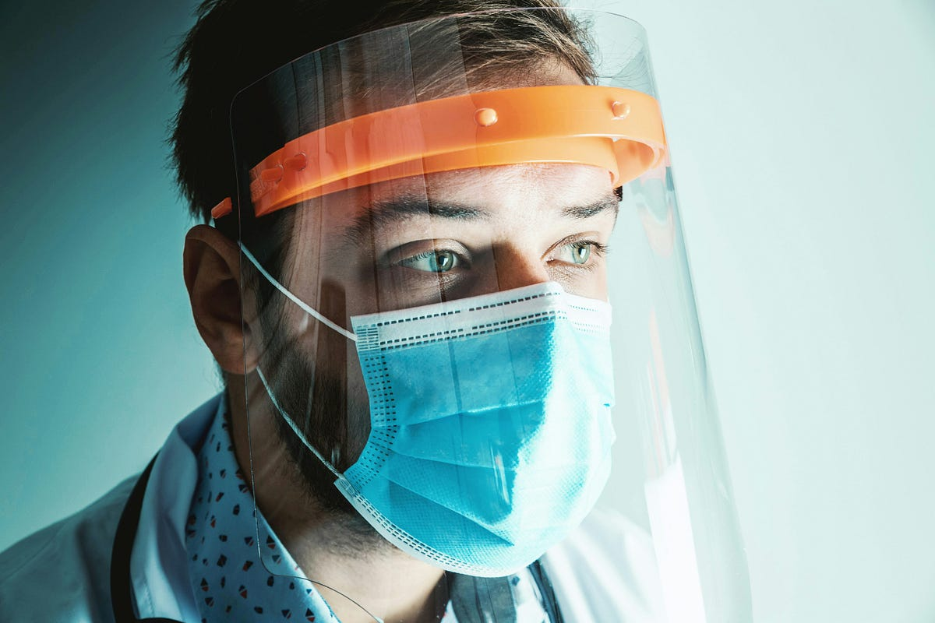
RESULT
with Mask

Slide 24
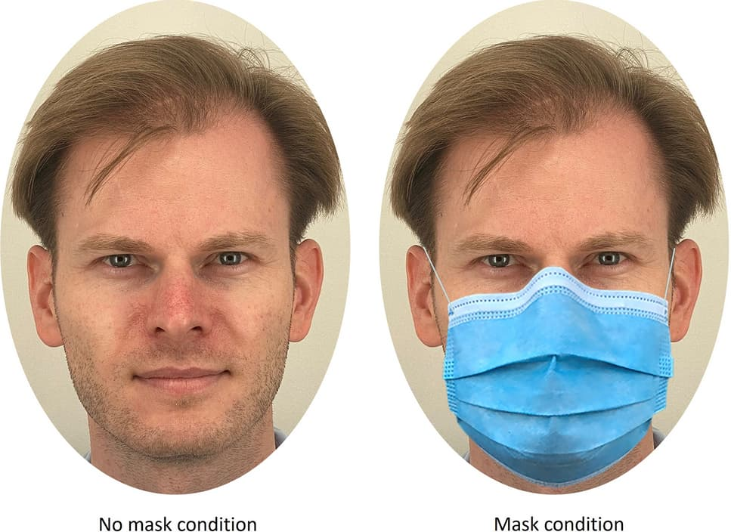

Slide 25
REFERENCES
[1] S. Abbasi, H. Abdi and A. Ahmadi, "A face-mask detection approach based on yolo applied for a new collected dataset", 2021 26th International Computer Conference Computer Society of Iran (CSICC), pp. 1-6, 2021. View Article Google Scholar
[2] M. M. Rahman, M. M. H. Manik, M. M. Islam, S. Mahmud and J.-H. Kim, "An automated system to limit covid-19 using facial mask detection in smart city network", 2020 IEEE International IOT Electronics and Mechatronics Conference (IEMTRONICS), pp. 1-5, 2020. View Article Google Scholar
[3] M. S. Islam, E. H. Moon, M. A. Shaikat and M. J. Alam, "A novel approach to detect face mask using cnn", 2020 3rd International Conference on Intelligent Sustainable Systems (ICISS), pp. 800-806, 2020. View Article Google Scholar
[4] A. Das, M. W. Ansari and R. Basak, "Covid-19 face mask detection using tensorflow keras and opencv", 2020 IEEE 17th India Council International Conference (INDICON), pp. 1-5, 2020. View Article Google Scholar
[5] S. Srinivasan, R. R. Singh, R. R. Biradar and S. Revathi, "Covid-19 monitoring system using social distancing and face mask detection on surveillance video datasets", 2021 International Conference on Emerging Smart Computing and Informatics (ESCI), pp. 449-455, 2021. View Article Google Scholar.

Slide 26
[6] J. Ieamsaard, S. N. Charoensook and S. Yammen, "Deep learning-based face mask detection using yolov5", 2021 9th International Electrical Engineering Congress (iEECON), pp. 428-431, 2021. View Article Google Scholar
[7] M. S. M. Shahar and L. Mazalan, "Face identity for face mask recognition system", 2021 IEEE 11th IEEE Symposium on Computer Applications & Industrial Electronics (ISCAIE), pp. 42-47, 2021. View Article Google Scholar
[8] S. A. Sanjaya and S. A. Rakhmawan, "Face mask detection using mobilenetv2 in the era of covid-19 pandemic", 2020 International Conference on Data Analytics for Business and Industry: Way Towards a Sustainable Economy (ICDABI), pp. 1-5, 2020. View Article Google Scholar
[9] G. Yang, W. Feng, J. Jin, Q. Lei, X. Li, G. Gui, et al., "Face mask recognition system with yolov5 based on image recognition", 2020 IEEE 6th International Conference on Computer and Communications (ICCC), pp. 1398-1404, 2020. View Article Google Scholar
[10] A. Negi, P. Chauhan, K. Kumar and R. Rajput, "Face mask detection classifier and model pruning with keras-surgeon", 2020 5th IEEE International Conference on Recent Advances and Innovations in Engineering (ICRAIE), pp. 1-6, 2020. View Article Google Scholar

Slide 27
Thank You

