Slide 1
DATA ANALYSIS OF FRAUD TRANSACTIONS

Slide 2
CONTENTS
01
02
DATA SET
TOOLS
03
DATA PRE-PROCESSING, CLEANING, PREPRATION
Introduction to Data set
Tools used in this Project
04
05
VISULIZATION
SQL QUERIES

Slide 3
01
INTRODUCTION TO DATASET

Slide 4
ONLINE TRANSACTION DATA-SET
1. step: represents a unit of time where 1 step equals 1 hour
2. type: type of online transaction
3. amount: the amount of the transaction
4. nameOrig: customer starting the transaction
5. oldbalanceOrg: balance before the transaction
6. newbalanceOrig: balance after the transaction
7. nameDest: recipient of the transaction
8. oldbalanceDest: initial balance of recipient before the transaction
9. newbalanceDest: the new balance of recipient after the transaction
10. is Fraud: fraud transaction

Slide 5
02
TOOLS USED

Slide 6
TOOLS
MySQL
Tableau
MySQL is an open-source relational database management system.
Tableau can help anyone see and understand their data by visualization.

Slide 7
03
DATA PRE-PROCESSING, CLEANING, PREPRATION

Slide 8
DATA PRE-PROCESSING
DATA CLEANING
Data preprocessing can refer to the manipulation or dropping of data before it is used in order to ensure or enhance performance, and is an important step in the data mining process.
There was a column(isFlaggedFraud ) to be dropped in the Data-Set.
Data cleaning is the process of identifying and correcting errors, inconsistencies, and inaccuracies in a dataset. This can include tasks such as removing duplicate records, handling missing or incomplete data and resolving issues with data formatting or data types.
DATA PREPRATION
Data preparation is the act of manipulating raw data into a form that can readily and accurately be analyzed

Slide 9
04
SQL QUERIES

Slide 10
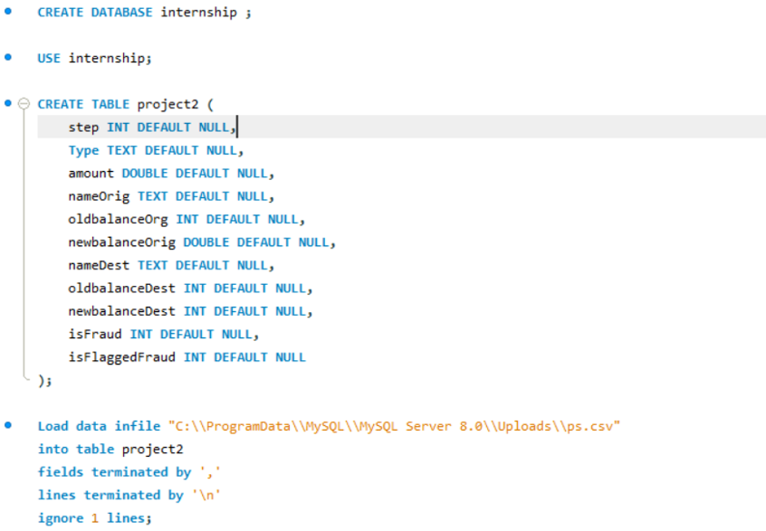

Slide 11
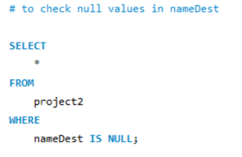
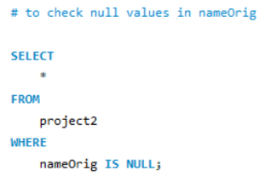

Slide 12
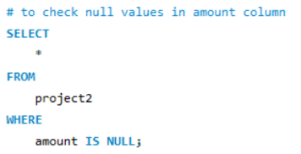
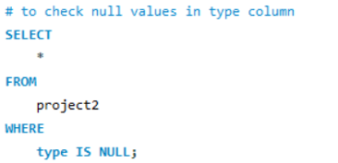

Slide 13
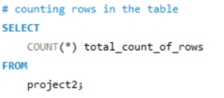

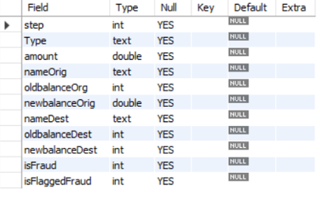


Slide 14
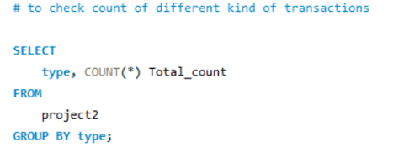
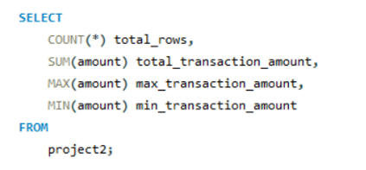
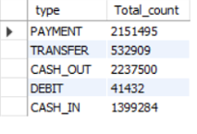

Slide 15
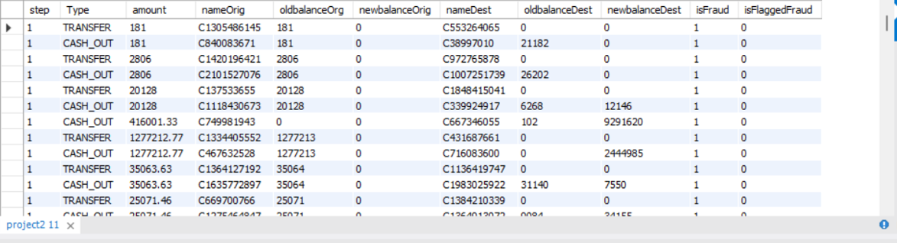

Slide 16
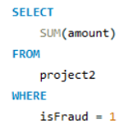
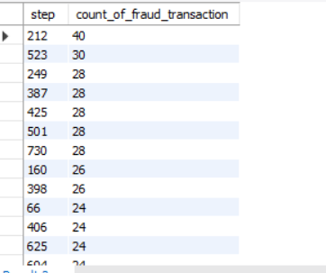


Slide 17


Slide 18
05
VISULIZATION

Slide 19
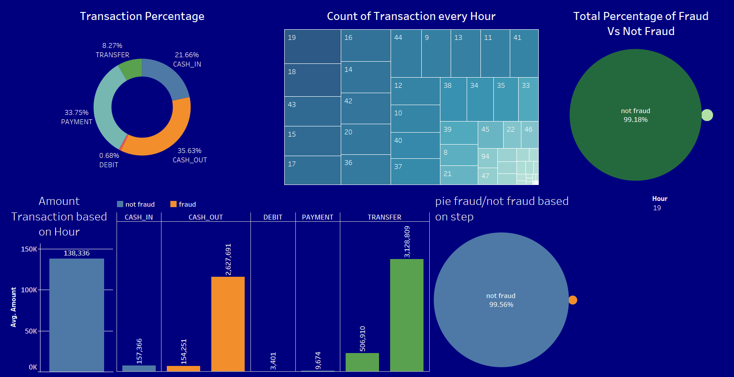

Slide 20
THANK
YOU

