Slide 1
IIT Mandi iHub and HCI Foundation* Technology in harmony with human needs Focus Area: Human-Computer Interaction (HCi) *Part of the Technology Innovation Hub (TIH) National Mission on Interdisciplinary Cyber-Physical Systems (NM-ICPS)

Slide 2



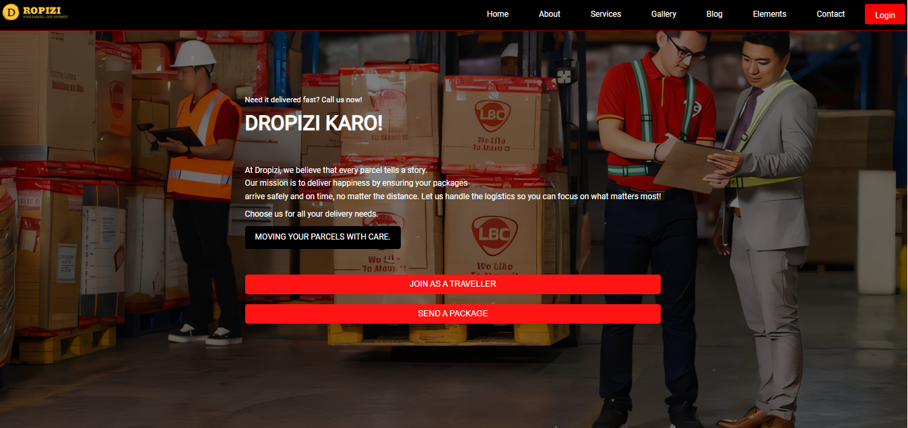

Slide 3
Brief description of Project
Dropizi is a modern parcel delivery service connecting users who need to send items with travelers
heading in the same direction, using real-world travel routes for efficient, cost-effective deliveries.
It offers an easy-to-use interface for scheduling pickups, real-time shipment tracking, and tailored
pricing, ensuring a smooth experience. Dropizi solves key problems faced by traditional courier
services like DHL and Ekart, such as delays, high costs, mishandling, and security breaches. By
utilizing shared travel routes, it provides a faster, more secure, and affordable alternative
Additionally, its LLM-based chatbot offers real-time support, enhancing user experience. Dropizi
aims to replace traditional courier partners, promoting sustainability and efficiency in parcel
delivery.

Slide 4
Context/Background
The Dropizi proposal fits into the Human-Computer Interaction (HCI) domain by focusing on
user-centered design, intuitive interaction, and accessibility. It offers a simple interface for
scheduling and tracking deliveries, utilizing geolocation-based services to suggest nearby hubs
and optimize routes. Dropizi enhances user experience through its LLM-based chatbot,
providing real-time support and reducing the need for human assistance. The platform
emphasizes responsive design, ensuring usability across devices. By promoting sustainable
delivery practices and maintaining transparency in data usage, Dropizi aligns with key HCI
principles of usability, accessibility, and ethical design.

Slide 5
Problem Statement
In the current courier industry, the focus is largely on large-scale, bulk deliveries, catering primarily to
businesses with substantial shipping needs. While this model works well for high-volume shipments, it
leaves a substantial gap in addressing the needs of individuals and small businesses that require smaller,
more personalized deliveries. These smaller shipments often come with unique requirements—whether
it’s a need for timely, dedicated delivery or simply a more affordable service option. Traditional courier
services typically operate on a centralized model, where parcels are collected at a central location, sorted,
and then dispatched in bulk to various destinations. This system is cost-effective for large shipments, but it
can lead to high costs, limited route flexibility, and longer delivery times for smaller, individualized parcels.
Consequently, individuals who need quick, low-cost delivery for a single parcel, or small businesses looking
to deliver to customers on a personalized basis, find themselves underserved and often face prohibitively
high shipping costs.This gap results in a pressing need for a courier solution that is flexible, responsive, and
economically viable for single-package deliveries. This solution should cater to individual senders, small
businesses, and ad-hoc shipments with a model that prioritizes efficiency, cost-effectiveness, and
accessibility for single parcels without the operational overhead associated with bulk deliveries. As
urbanization and e-commerce continue to grow, the demand for flexible, quick, and affordable delivery
solutions for small shipments will only increase, making it crucial to reimagine the courier service model to
address these challenges.

Slide 6
Proposed Solution
Dropizi offers a modern parcel delivery service designed to overcome the challenges faced by
traditional couriers. By connecting senders with travelers using real-world travel routes, Dropizi
ensures faster and more effective deliveries. The platform utilizes a hub-based system to
facilitate secure handling of parcels, minimizing the risk of mishandling and damage during transit.
To enhance security, Dropizi provides real-time tracking, allowing users to monitor their shipments
and address any concerns about loss or theft. Additionally, the integration of an LLM-based
chatbot offers 24/7 support, ensuring users can access information and assistance regarding their
deliveries at any time.
With a focus on efficiency, security, and user engagement, Dropizi stands as a reliable and
sustainable alternative to traditional courier services, addressing key pain points while promoting
eco-friendly practices in parcel delivery.

Slide 7
Team
Mr Kamal Kumar Gola
Project Supervisor
Institute: IIT Jodhpur, Rajasthan
Kamal Kumar Gola is an assistant professor at COER University, Roorkee, and also pursuing a Ph.D in Computer Science and Engineering from IIT, Jodhpur. His main research interest lie in Underwater Acoustic Sensor Networks, Alogorithm and Security.
Bittu Verma
Project Lead & Software Developer
Institute: COER University
Bittu is a Junior Software Developer with expertise in web technologies, including PHP, HTML, CSS, and JavaScript. He oversees the overall development of Dropizi, ensuring a user-centered design and smooth functionality across the platform.
Shiva Sharma
Frontend Developer
Institute: COER University
Shiva is dedicated to crafting an engaging user interface for Dropizi. With skills in responsive design and modern frontend frameworks, he ensures that the platform is visually appealing and accessible on all devices.
Himanshu Singh Bisht
Backend Developer
Institute: COER University
Himanshu Singh Bisht specializes in server-side programming and database management. They are responsible for developing the backend infrastructure of Dropizi, focusing on efficient data handling and secure APIs.

Slide 8
Product
Product Description
Dropizi is an innovative parcel delivery service that connects individuals who need to send items with travelers already heading in the same direction. By utilizing real-world travel routes, Dropizi ensures faster, more cost-effective deliveries compared to traditional courier services.
User-Friendly Interface: Our platform offers an intuitive interface for users to easily schedule pickups and manage deliveries.
Real-Time Tracking: Users can monitor their parcels throughout the delivery process, providing peace of mind and transparency.
Tailored Pricing: Dropizi employs a dynamic pricing model based on distance and travel routes, making it an affordable option for users.
Secure Handling: The hub-based system minimizes the risk of mishandling and ensures parcels are securely transferred.
24/7 Support: An integrated LLM-based chatbot provides real-time assistance, answering queries and enhancing the overall user experience.

Slide 9
Product Development Roadmap
Research & Planning
Backend Development
User Feedback Collection
Official Launch
Introduce New Features
Regular Updates
Prototype Design
MVP Launch
Iterative
Improvement
Performance Monitoring
Partnership Development

Slide 10
Product
Phase 1: Initial Development (Months 1-3 approx)
Milestone 1: Research & Planning
Conduct thorough market research to identify user needs and refine the service concept.
Milestone 2: Prototype Design
Create wireframes and prototypes of the user interface for both web and mobile applications.
Milestone 3: Backend Development
Develop the backend infrastructure, including database setup, API integration, and user authentication.
Phase 2: Beta Testing (Months 4-8 approx)
Milestone 4: MVP Launch
Release a Minimum Viable Product (MVP) to a select group of users for initial feedback and testing.
Milestone 5: User Feedback Collection
Gather feedback from beta users to identify bugs, usability issues, and feature requests.
Milestone 6: Iterative Improvements
Implement necessary changes based on user feedback to enhance functionality and user experience.

Slide 11
Product
Phase 3: Full Launch (Months 7-9)
Milestone 7: Official Launch
Launch Dropizi to the public with a marketing campaign to promote the service.
Milestone 8: Performance Monitoring
Monitor system performance, user engagement, and satisfaction metrics to ensure
service reliability.
Phase 4: Feature Expansion (Months 18-20)
Milestone 9: Introduce New Features
Develop and integrate additional features based on user requests, such as enhanced tracking options and referral programs.
Milestone 10: Partnership Development
Explore partnerships with local businesses and transportation services to expand reach and improve service offerings.
Phase 5: Continuous Improvement (Ongoing)
Milestone 11: Regular Updates
Continuously gather user feedback and implement regular updates to improve the platform’s functionality and user experience.

Slide 12
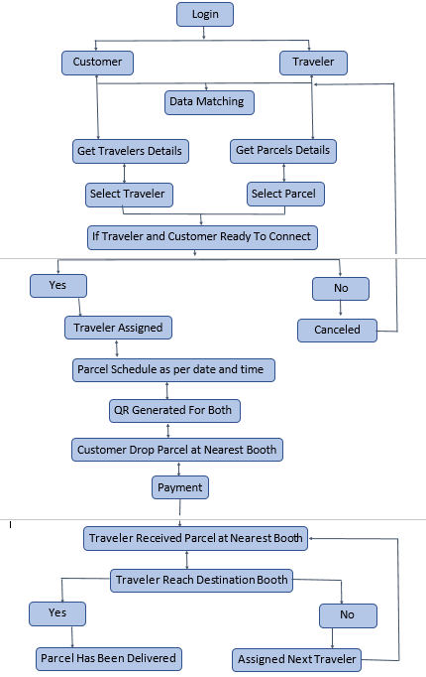
Product Working Flow Model
1. Customer and traveler both log into the system.
2. The platform matches customer with traveler based on delivery and
travel routes.
3. Customer retrieves details of potential travelers.
4. Customer selects a traveler for their parcel.
5. Traveler retrieves details of available parcels.
6. Traveler selects a parcel to deliver.
7. System checks if both customer and traveler are ready to connect.
8. If yes, traveler is assigned to the parcel; if no, the process is
canceled.
9. A delivery schedule is set based on the agreed date and time.
10. A QR code is generated for both customer and traveler.
11. Customer drops the parcel at the nearest booth using the QR code.
12. Customer makes the payment for the service.
13. Traveler picks up the parcel from the nearest booth.
14. Traveler transports the parcel to the destination booth.
15. If the parcel is delivered, the process is completed.
16. If not, the system assigns the parcel to the next available traveler.

Slide 13
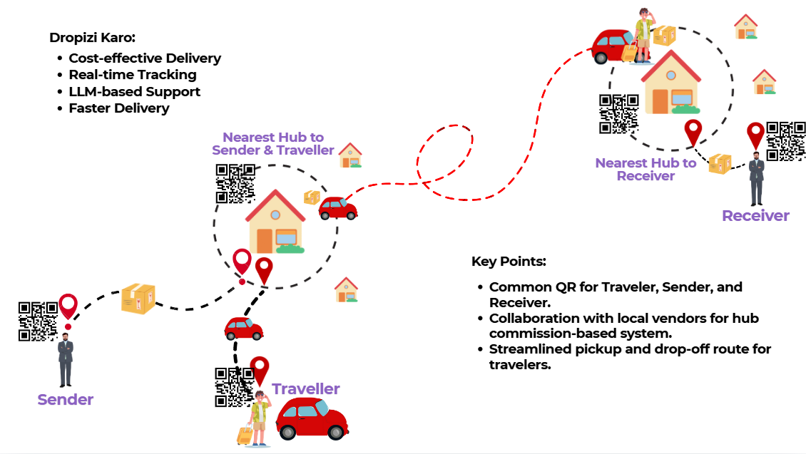
Product Working Flow Model

Slide 14
Target Market
Dropizi Market Entry Report:
Dropizi aims to provide a personalized parcel delivery solution tailored for individual senders. Unlike
Traditional courier services, Dropizi leverages a unique model by connecting people who are traveling
with those who need items delivered, offering a cost-effective and flexible alternative for personal
parcel shipments.
Market Overview of Indian Courier, Express, and Parcel (CEP) Industry:
Market Size: The Indian courier and logistics sector is valued at approximately ₹71,730 crore (USD 8.58
billion)as of 2024, with a projected growth to ₹1,33,405 crore (USD 15.93 billion) by 2030.
Growth Rate: The sector is growing at a compound annual growth rate (CAGR) of around 10.87%,
driven largelyby e-commerce but also by rising personal and SME delivery needs.
E-commerce Influence: E-commerce contributes roughly 75-80% of parcel volumes due to online
Shopping demand. However, the remaining 20-25% market segment, valued at about ₹18,750 crore, is
driven by personalshipments and individual-to-individual deliveries, where Dropizi will operate.

Slide 15
Target Market
Individual Delivery Market Segment Analysis:
Current Share: Personal parcel shipments represent an estimated 20-25% of the total market, translating to
value of around ₹18,750 crore.
Demand Drivers:
Urbanization: Rising migration and urban populations boost demand for flexible, reliable, and affordable
Parcel services for individuals.
Personalization Trend: Increasingly, customers prefer services that offer tailored, on-demand delivery,
Making a personalized delivery approach an attractive alternative.
Traveler Economy: The rise of a mobile workforce and frequent travelers creates a pool of potential
Delivery agents for the Dropizi model.
Key Competitors:
Blue Dart Express: Largest player in the Indian courier industry with a market cap of ₹17,470 crore.
Primarily targets e-commerce and corporate clients.
Gati, DTDC, Allcargo Logistics: Compete in both B2B and B2C spaces with services for document and parcel
deliveries.
Emerging Startups: Several tech-enabled courier startups focus on last-mile delivery and urban logistics but
typically serve B2B or e-commerce demands rather than personal deliveries.

Slide 16
Target Market
Dropizi’s Unique Value Proposition:
Dropizi’s entry into the market leverages:
Personalized Service: Customizable delivery options based on individual needs.
Traveler-Based Model: Offers a unique pool of delivery options, allowing for flexible pricing and routing.
Real-Time Geolocation Matching: Matching senders and travelers based on location, enabling efficient,
nearby options for parcel drop-off and pick-up.
Future Scope and Market Opportunities:
Growth of Non-E-commerce Deliveries: With the market heavily influenced by e-commerce, personalized
non-e-commerce deliveries offer a less saturated space. As personal deliveries become more common due
to urbanization, Dropizi can capture a rising demand among individuals.
Technology Integration: Leveraging advanced geolocation, predictive routing, and secure traveler-sender
matching, Dropizi can stand out as a tech-driven solution.
Partnerships with Local Businesses: Collaborating with local stores, pharmacies, and other small businesses
for quick, hyperlocal deliveries could expand Dropizi’s market reach.
Expanding the Traveler Network: Building a robust network of travelers willing to make deliveries on a
regular basis can create competitive pricing advantages, attracting more users.

Slide 17
Target Market
Financial Projections for Dropizi:
Given the potential 25% share of the CEP market focused on non-e-commerce deliveries, Dropizi’s target
market is valued at approximately ₹18,750 crore. Achieving even a modest market penetration rate of 1%
within this segment could yield annual revenue potential of approximately ₹187.5 crore.
Long-Term Financial Goals:
3-Year Goal: Capture 2-5% of the personal parcel market, aiming for ₹375-₹937.5 crore.
5-Year Goal: Expand market penetration to 7-10%, focusing on urban markets and expanding partnerships.
Dropizi is poised to capture a promising niche in the Indian courier industry. By focusing on personalized,
traveler-based parcel delivery for individuals, Dropizi can tap into an underserved segment valued at
₹18,750 crore. With strategic positioning, a focus on technology, and a commitment to customer
satisfaction, Dropizi can become a preferred option for non-e-commerce parcel shipments in India.

Slide 18
Business Model
1. Pricing Model for Parcel Delivery
Weight (kg) | Initial 50 km (₹1.5/km) | Additional Distance (₹1/km) | Weight Multiplier | Total Distance Cost (80 km) | Final Price
1 kg | ₹75 | ₹30 | 1.0 | ₹105 | ₹105
3 kg | ₹75 | ₹30 | 1.3 | ₹105 | ₹136.50
5 kg | ₹75 | ₹30 | 1.5 | ₹105 | ₹157.50
10 kg | ₹75 | ₹30 | 2.0 | ₹105 | ₹210

Slide 19
Business Model
2. Example Calculation for 3 kg Parcel over 80 km
Base Distance Cost for the first 50 km:
1.5per km×50km=₹75
Additional Distance Cost for the remaining 30 km:
1per km×30km=₹30
Total Distance Cost:
₹75+₹30=₹105
Weight Multiplier for 3 kg:
Total Cost=₹105×1.3=₹136.50

Slide 20
Business Model
3. Revenue Distribution Model
Revenue Stream | Percentage | Amount (₹)
Dropizi Platform | 15% | ₹20.48
Hub Owner | 10% | ₹13.65
Traveler | Remaining 75% | ₹102.38
4. Key Takeaways
Dropizi Platform Commission: A small percentage (15%) from each delivery transaction ensures platform sustainability.
Hub Owner's Share: 10% of the total price goes to the hub owner for facilitating delivery hubs.
Traveler’s Revenue: The traveler, who delivers the parcel, receives 75% of the total cost, making it a profitable and attractive model for frequent travelers.

Slide 21
Work Plan and Go-to-Market
Dropizi Detailed Work Plan and Timeline
Problem Identification & Market Research
Product Concept & Prototype Development
Testing & Iteration
Pilot Launch
Full-Scale Development
Go-to-Market (GtM) Strategy
Commercial Launch & Growth Phase

Slide 22
Work Plan and Go-to-Market
Phase 1: Problem Identification & Market Research
Timeline: Month 1
Tasks:
Conduct in-depth market research to validate demand.
Identify pain points in traditional courier services (cost, time delays, security).
Define customer segments, including individual users, SMEs, and travelers.
Deliverables: Problem validation report, customer segment profiles
Phase 2: Product Concept & Prototype Development
Timeline: Months 2-3
Tasks:
Design initial wireframes and UI/UX for Dropizi platform.
Develop a basic prototype for app-based parcel delivery and tracking.
Integrate key features: traveler matching, real-time tracking, and cost estimator.
Deliverables: Initial prototype, user journey maps, and feedback from initial testing.

Slide 23
Work Plan and Go-to-Market
Phase 3: Testing & Iteration
Timeline: Months 4-5
Tasks:
Conduct user testing with a focus group to gather feedback.
Make iterative improvements to the platform based on user experience and technical issues.
Implement security features for parcel tracking and payment gateway.
Deliverables: Updated prototype, test report, security assessments.
Phase 4: Pilot Launch
Timeline: Month 6
Tasks:
Launch pilot program in select cities to test platform with real users.
Partner with local hubs and onboard initial travelers.
Track key metrics like delivery times, user satisfaction, and cost savings.
Deliverables: Pilot program performance report, customer feedback analysis.

Slide 24
Work Plan and Go-to-Market
Phase 5: Full-Scale Development
Timeline: Months 7-9
Tasks:
Refine platform based on pilot feedback, adding scalability for larger user base.
Strengthen backend infrastructure and improve app reliability.
Expand feature set, including insurance options and enhanced tracking accuracy.
Deliverables: Ready-to-launch platform, comprehensive system test results.
Phase 6: Go-to-Market (GtM) Strategy
Timeline: Months 10-12
Tasks:
Finalize branding, marketing materials, and digital campaigns.
Partner with local and regional businesses for initial growth.
Launch PR campaigns targeting media and social channels to raise awareness.
Deliverables: Brand assets, partnership agreements, live campaigns.

Slide 25
Work Plan and Go-to-Market
Phase 7: Commercial Launch & Growth Phase
Timeline: Month 12+
Tasks:
Officially launch Dropizi in initial markets.
Monitor KPIs for growth, customer acquisition, and feedback.
Expand Dropizi to additional regions and onboard new partners (e.g., e-commerce
companies).
Deliverables: Performance analytics, expansion plan, customer success stories.

Slide 26
Work Plan and Go-to-Market
Go-to-Market (GtM) Plan
Target Audience: Individual users for personal deliveries, SMEs looking for reliable logistics, frequent travelers.
Marketing Channels: Social media, digital advertising, influencer partnerships, and in-app referrals.
Sales Strategy: Engage local businesses as early adopters and use word-of-mouth referrals.
Customer Retention: Regular feature updates, customer support, and loyalty incentives for frequent users.
Expansion Plans: Gradually partner with e-commerce companies like Amazon and Flipkart to broaden reach.

Slide 27
Competitive Landscape
1. DHL, FedEx, and UPS
Strengths:
Extensive global network and infrastructure for fast international and domestic deliveries.
Strong brand reputation, high reliability, and established customer trust.
Advanced tracking systems and guaranteed delivery times, appealing to business clients.
Weaknesses:
High operational costs, leading to higher customer pricing.
Limited flexibility for personalized deliveries, especially for individual and casual users.
Often lack adaptability for smaller-scale, personal deliveries, which makes Dropizi’s individual delivery focus a unique differentiator.
2. India Post
Strengths:
Broadest network in India, even reaching remote rural areas.
Affordable pricing options, making it appealing to budget-conscious customers.
Government-backed, ensuring high trust and extensive customer base in India.
Weaknesses:
Limited technology integration, leading to slower parcel tracking updates.
Often faces delays and reliability issues, especially in urban and fast-paced delivery contexts.Fewer options for real-time support and customized delivery, which Dropizi can leverage with real-time tracking and personalized options.

Slide 28
Competitive Landscape
3. Dunzo and Swiggy Genie
Strengths:
Focused on intra-city, fast, and convenient deliveries, making them ideal for same-day and last-mile deliveries.
Strong technology integration with user-friendly apps and real-time tracking.
Large, established customer base in urban areas.
Weaknesses:
Limited to major cities, which restricts scalability to regional and inter-city delivery.
Often high pricing for larger or long-distance parcels.
Service model is not geared towards connecting travelers, which Dropizi’s community-driven, travel-based model can offer for cost-saving and reach.
4. Porter and Delivery
Strengths:
Wide reach across India, capable of handling large volumes of parcels for SMEs and businesses.
Well-developed logistics infrastructure, often used by e-commerce companies.
Reliable for large and bulk deliveries with competitive pricing options.
Weaknesses:
Primarily business-focused, with fewer options for personal or casual deliveries.
Service experience can lack personalization for individual users, especially when compared with Dropizi’s traveler-based model.

Slide 29
Competitive Landscape
Differentiators and Competitive Edge of Dropizi
Traveler-Based Delivery Model: Dropizi’s model allows individuals already traveling in a certain direction to deliver parcels along their routes. This community-driven approach reduces logistical costs, offers more flexible delivery times, and encourages a faster, more sustainable delivery method. By connecting senders directly with verified travelers, Dropizi ensures a unique level of personalized service not commonly found in traditional courier systems.
Cost Efficiency and Customizable Pricing: Dropizi offers affordable, tiered pricing tailored to parcel size, weight, and delivery distance. Unlike competitors, who often have fixed or high costs for personalized service, Dropizi’s pricing flexibility appeals to individuals and small businesses looking for cost-effective logistics solutions without sacrificing speed or security.
Hub-Based Delivery Network for Improved Reach: With a growing network of local hubs, Dropizi strategically leverages pickup and drop-off points, making it easier to handle last-mile delivery while minimizing travel requirements for both senders and travelers. This adds scalability and provides a localized presence that competitors often lack, especially in semi-urban and rural areas.
Real-Time Tracking and Communication Through Dropizi’s integrated tracking and communication tools, senders can receive live updates on their parcel status and contact the traveler directly. This creates a transparent, user-friendly experience that instills trust and enhances convenience, providing an edge over many traditional courier services.

Slide 30
Competitive Landscape
Unique Focus on Personal Deliveries: Dropizi fills a market gap by catering to personal delivery needs, making it ideal for individuals sending gifts, sensitive items, or urgent documents. Traditional services often prioritize business shipments, whereas Dropizi centers on individual users, providing a more personalized and secure approach.
Scalable Partnerships with E-Commerce: Dropizi aims to partner with online shopping giants like Amazon and Flipkart, enabling quick, cost-effective delivery solutions for e-commerce businesses. This enhances the platform’s scalability, creating a significant competitive edge by extending its reach into the rapidly growing e-commerce sector.

Slide 31
Funding Details from Other Investors
There are no investors in our project till now.

Slide 32
Ask from IIT Mandi iHub
Phase | Budget Item | Cost (₹) | Justification
Phase 1: Market Research & Validation | Market Research | 50,000 | Funds for conducting surveys, focus groups, and competitive analysis to understand market needs.
 | Problem Validation Report | 20,000 | Preparation of in-depth report on market gaps and validation of the problem statement.
Subtotal |  | 70,000
Phase 2: Product Concept & Prototype | UI/UX Design | 60,000 | Engaging a designer to develop wireframes and initial interface concepts.
 | Prototype Development | 1,50,000 | Basic app prototype with core features like traveler matching and cost estimation.
 | Testing and User Journey Maps | 30,000 | Cost for initial user testing, refining journey maps, and collecting feedback.
Subtotal |  | 2,40,000
Funding Requirements: Specify how much funding you are seeking.
Use of Funds: Explain how you will allocate the capital (e.g., product development, marketing, hiring).
Investment Terms: If applicable, outline the terms of the investment.

Slide 33
Ask from IIT Mandi iHub
Phase | Budget Item | Cost (₹) | Justification
Phase 3: Testing, Iteration & Patent | User Testing | 50,000 | Conducting rigorous testing for bugs, usability, and performance.
 | Patent Filing | 80,000 | Legal fees for filing patents to protect Dropizi’s unique features.
 | Platform Iterations | 1,00,000 | Iterative development costs based on user feedback.
Subtotal |  | 2,30,000
Phase 4: Pilot Launch | Marketing & Outreach | 1,00,000 | Advertising and promotional campaigns in pilot cities to build brand awareness and attract early users.
 | Hub Partnerships | 50,000 | Engaging with and onboarding local hub partners in pilot areas.
 | Data Analytics | 40,000 | Tracking metrics like delivery times, costs, and satisfaction.
Subtotal |  | 1,90,000

Slide 34
Ask from IIT Mandi iHub
Phase | Budget Item | Cost (₹) | Justification
Phase 5: Full-Scale Development | Feature Expansion | 1,20,000 | Adding insurance options, enhanced tracking, and backend scalability features.
 | Backend & Infrastructure Scaling | 2,00,000 | Ensuring app stability, security, and performance as user base grows.
 | Comprehensive System Testing | 1,00,000 | Full testing to ensure robustness and reliability before commercial launch.
Subtotal |  | 4,20,000
Phase 6: Go-to-Market (GtM) | Branding & Digital Marketing | 1,50,000 | Finalizing brand assets, executing targeted digital campaigns, and influencer marketing.
 | Partnership Outreach | 80,000 | Building relationships with SMEs and local businesses for initial traction.
 | Customer Support & Onboarding | 60,000 | Costs for initial customer support setup and onboarding materials.
Subtotal |  | 2,90,000

Slide 35
Ask from IIT Mandi iHub
Phase | Budget Item | Cost (₹) | Justification
Phase 7: Commercial Launch & Growth | Post-Launch Operations | 1,00,000 | Ongoing expenses for customer service, server maintenance, and support staff.
 | Expansion to New Markets | 1,50,000 | Costs for expanding Dropizi to other regions, onboarding new hubs, and partnerships.
 | Continuous Improvement & R&D | 50,000 | Continuous feature enhancements and technology upgrades.
Subtotal |  | 3,00,000
Total Budget |  | ₹17,40,000

Slide 36
Thank You! For any queries, contact: Mr. Ankush Pathania at ankush@ihubiitmandi.in or call at 7018242838

