Slide 1
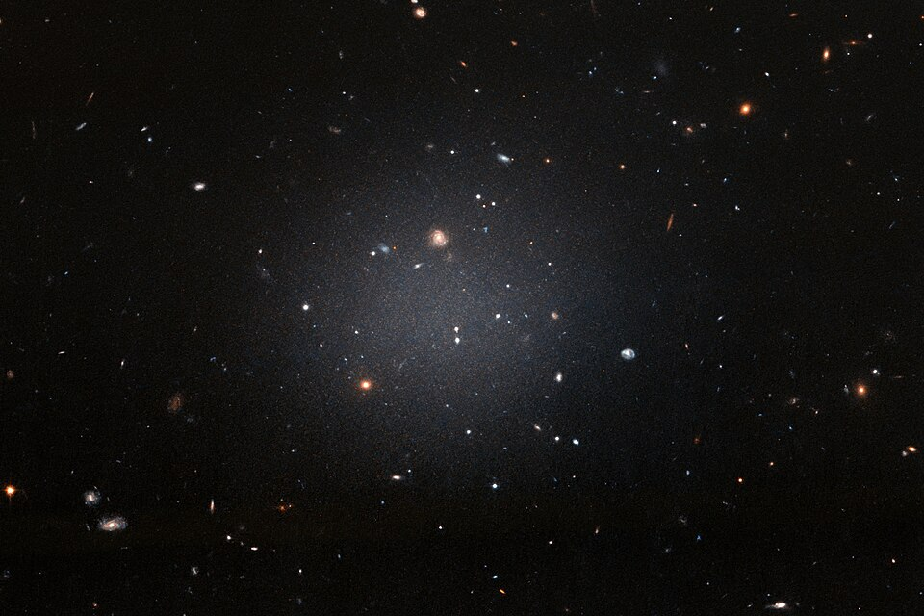
.
B.TECH PROJECT / DEPARTMENT OF PHYSICS
Probing Dark Matter
in Ultra-Diffuse
Galaxies
Using Velocity Dispersion
A Newtonian Jeans analysis of DF2, DF4 & Dragonfly 44
SHIVASHEESH · 230121051
Supervisors: Dr. Sovan Chakraborty · Dr. Sayan Chakrabarti
Target systems and kinematic data drawn from van Dokkum et al. (2018, 2019) and Danieli et al. (2019).
Notes:
Good morning, respected professors. My B.Tech project is titled “Probing Dark Matter in Ultra-Diffuse Galaxies Using Velocity Dispersion.”
This work was carried out under the guidance of Dr. Sovan Chakraborty and Dr. Sayan Chakrabarti.
The main idea is quite simple: even when we cannot see dark matter directly, we can study its gravitational effect through the motion of stars. In this project, I use that idea to study three ultra-diffuse galaxies: DF2, DF4, and Dragonfly 44.

Slide 2
.
01 / INTRODUCTION
Why Ultra-Diffuse Galaxies?
A FAINT APPEARANCE CAN HIDE A MASSIVE HALO
Dwarf-like stellar content, but sizes comparable to much larger galaxies.
Stellar and globular-cluster velocities probe gravity beyond visible light.
DF2 / DF4 are low-dark-matter candidates; DF44 is a contrasting high-dispersion case.
TESTING GROUND
Their diffuse baryons and unusual dispersions make gravity and dark-halo assumptions easier to discriminate.
DRAGONFLY 44
Coma cluster · spectroscopically resolved stellar velocities
UDG context: van Dokkum et al. (2015) · DF2: van Dokkum et al. (2018)
DF4: Danieli et al. (2019) · DF44: van Dokkum et al. (2019)
Key observable: line-of-sight velocity dispersion, σLOS(R)
SHIVASHEESH · B.TECH PHYSICS · IIT GUWAHATI
02
Notes:
First, what makes these galaxies interesting?
Ultra-diffuse galaxies, or UDGs, have relatively few stars spread over a surprisingly large area. So, they are very faint, even though their sizes can be comparable to those of much brighter galaxies.
But here is the key point: being faint does not necessarily mean having little mass. A galaxy may contain a great deal of dark matter that we cannot see.
We are looking at three contrasting examples. DF2 and DF4 have been discussed as galaxies that may contain relatively little dark matter. Dragonfly 44, on the other hand, has much larger measured stellar velocity dispersions and is usually modelled as dark-matter dominated.
This contrast makes UDGs useful testing grounds. They let us ask whether ordinary stellar matter is enough under Newtonian gravity, and they also motivate comparisons with alternative gravitational models. My project focuses only on the Newtonian case.

Slide 3
.
02 / GOAL
The Question We Set Out to Answer
CENTRAL QUESTION
Can stellar mass alone explain the observed LOS velocities?
01
Compute
02
Compare
03
Infer
Predict σLOS(R) from observed stellar profiles using Newtonian Jeans modelling.
Test predictions against DF2/DF4 globular clusters and DF44 stellar dispersions.
If stars fall short, fit an NFW halo and examine parameter degeneracies.
Scope: Newtonian baselines only · modified-gravity models are not fitted
SHIVASHEESH · B.TECH PHYSICS · IIT GUWAHATI
03
Notes:
The central question of my project is: Can the visible stellar mass alone explain the motions that we observe?
To answer this, I followed three steps.
First, I calculated the expected line-of-sight velocity dispersion from the assumed stellar mass profiles.
Second, I compared those predictions with published observations. For DF2 and DF4, the observations come from globular clusters, which are compact groups of stars orbiting the galaxy. For DF44, we have spatially resolved measurements from the galaxy's integrated starlight.
Finally, where the stellar-only calculation falls short, I introduced a dark-matter halo and examined how well its parameters can be constrained.

Slide 4
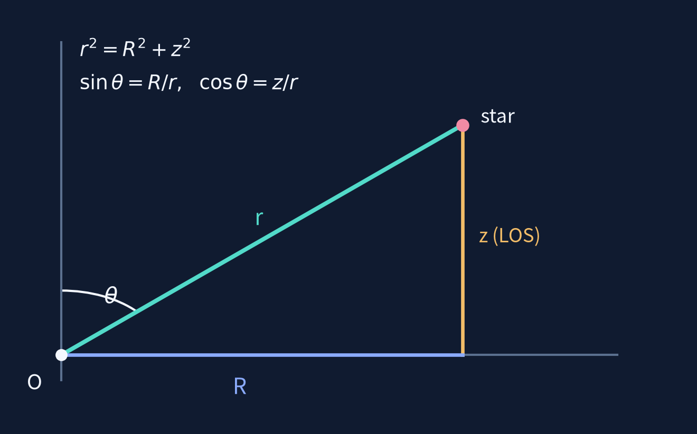

.
03 / METHODOLOGY · 1 OF 3
From Mass to an Observable Dispersion
Jeans equation → radial velocity variance → projected LOS dispersion
1) START FROM DYNAMICAL EQUILIBRIUM
LOS GEOMETRY
STELLAR PROFILE
→
ENCLOSED MASS
→
JEANS SOLVER
→
LOS PROJECTION
→
OBSERVATIONS
ρ⋆(r)
M(<r)
σr²(r)
σLOS(R)
compare
Relates tracer density, anisotropy and the gravitating mass.
2) SOLVE FOR THE RADIAL SECOND MOMENT
SPHERICAL JEANS EQUATION
WHAT THE TELESCOPE MEASURES
For constant β, integrate the Jeans equation outward from r.
d(νσr²)/dr + (2β/r)νσr² = −ν GM(<r)/r²
σLOS(R)
3) PROJECT TO WHAT THE TELESCOPE MEASURES
At fixed projected radius R, stars at many 3D radii r contribute through different LOS depths z.
ν: tracer density M: total gravitating mass β: orbital anisotropy
Projection averages stellar velocity variance over the full sightline, not at a single 3D radius.
Average the local LOS variance over all z at fixed projected radius R.
LOCAL LOS VARIANCE
Stationary · spherical · collisionless · constant β
SHIVASHEESH · B.TECH PHYSICS · IIT GUWAHATI
04
Notes:
This slide shows the physical calculation behind the project.
We start with a stellar density profile, which tells us how the stars are distributed. By integrating this density, we calculate the stellar mass enclosed within a given radius.
Next comes the spherical Jeans equation. It relates the tracer density, the gravitational field, velocity dispersion and the random motions of stars in a galaxy assumed to be approximately spherical and in dynamical equilibrium.
Solving this equation gives the radial velocity dispersion, sigma-r: a measure of how widely the stars' radial velocities are spread.
But a telescope does not measure that radial component directly. It measures only the velocity component along our line of sight.
In this diagram, capital R is the distance projected on the sky, while small r is the true three-dimensional radius. At the same projected R, stars at several depths can contribute to the observation.
So we project the radial and tangential motions along the line of sight, weighted by the stellar density. This gives the predicted quantity sigma-LOS of R.
Finally, we compare that prediction with the measured data. The anisotropy parameter, beta, tells us whether stellar orbits are more radial or more tangential.

Slide 5
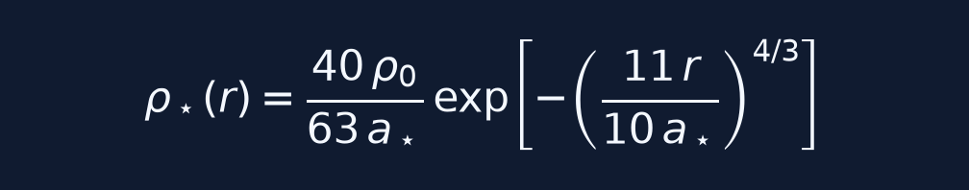
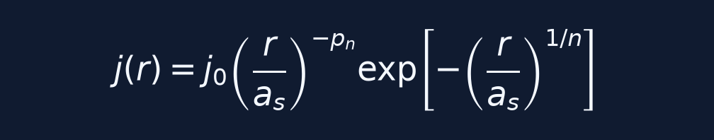

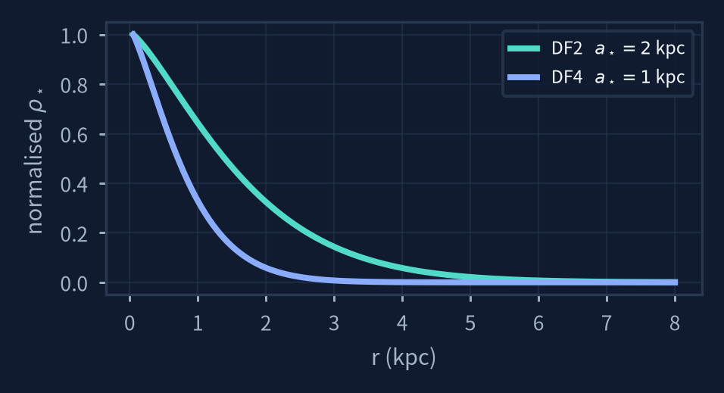
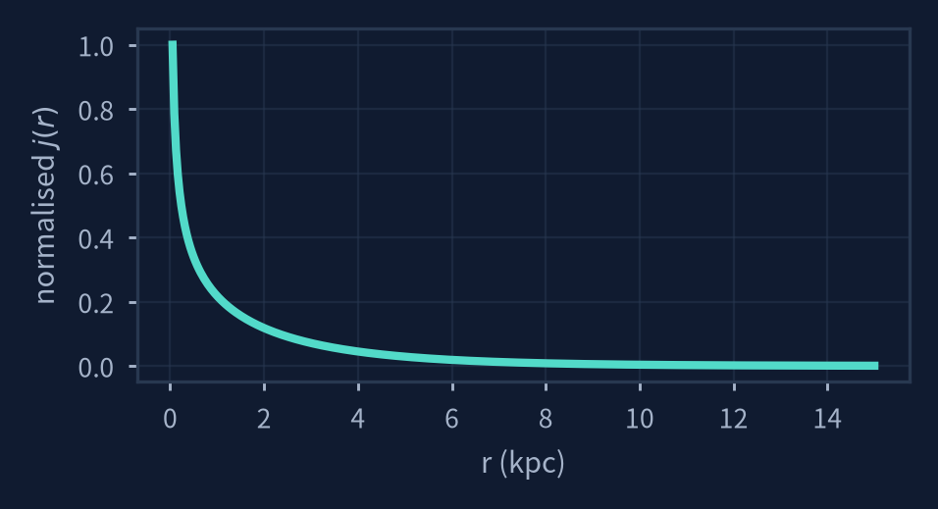
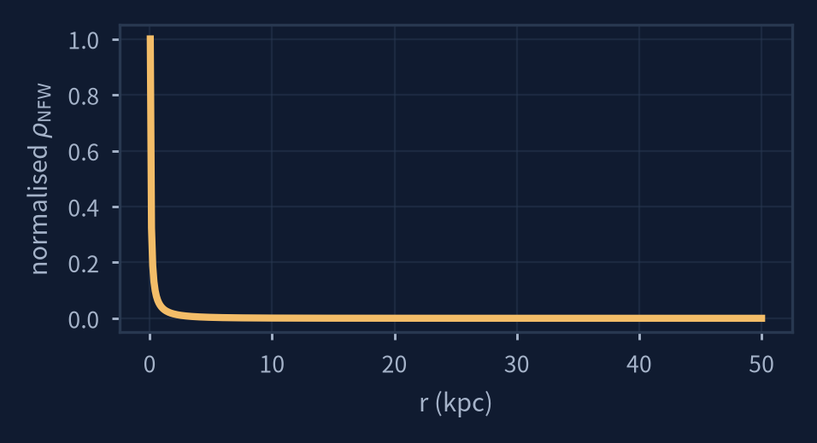
.
03 / METHODOLOGY · 2 OF 3
Three Galaxies, Two Stellar Prescriptions
Profiles used in the code: each model needs a density law, parameter values, and the resulting radial shape.
DF2 / DF4 · STARS ONLY
DF44 · STARS (SÉRSIC)
DF44 · DARK HALO (NFW)
DF2 & DF4
DF44 · STARS
DF44 · DARK HALO
Stars only
Sérsic tracer
NFW component
Compact exponential-type 3D density law
Deprojected light model; the stars trace the kinematics
Additional gravitating mass, stellar tracer unchanged
Stars only
Sérsic-based tracer
NFW component
Compact exponential-type 3D density law
Deprojected light model; stars trace the observed kinematics
Add unseen gravitating mass while keeping the stellar tracer unchanged
DF2: a⋆ = 2 kpc, ρ₀ = 1.25 × 10⁷ M⊙ kpc⁻²
DF4: a⋆ = 1 kpc, ρ₀ = 1.15 × 10⁷ M⊙ kpc⁻²
Both isotropic: β = 0
n = 0.94, Rₑ = 4.7 kpc
aₛ = 3.10 kpc, pₙ = 0.413
L_tot = 2.33 × 10⁸ L⊙, Υ⋆ = 1
c = 10 for the illustrative shape
Baseline fit solves for M₂₀₀ (and optionally c)
Stellar tracer ν(r) stays fixed
ρ⋆(r) ∝ exp[−(11r/10a⋆)⁴ᐟ³]
j(r) ∝ r⁻ᵖ exp[−(r/aₛ)¹ᐟⁿ]
ρNFW(r) = ρₛ / [x(1+x)²]
DF2: a⋆ = 2 kpc
DF4: a⋆ = 1 kpc
Both isotropic (β = 0)
n = 0.94 · Re = 4.7 kpc
M⋆ = 2.33 × 10⁸ M⊙
x = r/rₛ · c = r₂₀₀/rₛ
Mtotal = M⋆ + MNFW
For DF44, the stars set the tracer profile ν(r); the NFW halo alters only the total enclosed mass M(<r).
In DF44: dark matter changes M(r), not the stellar tracer ν(r).
SHIVASHEESH · B.TECH PHYSICS · IIT GUWAHATI
05
Notes:
Here are the density profiles used in the calculation. The curves show how their densities vary with radius.
Let me go back to the previous slide once. Yeah, here we can see that In Jeans Eqn, only mass matters. So, the common part of using these densities is somehow I will get the mass and put it in the Jeans eqn and calculate velocity dispersion.
For DF2 and DF4, we use the compact three-dimensional stellar density law adopted in the reference study. For these baseline calculations, the stellar motions are assumed isotropic, meaning there is no preferred direction of random motion.
For DF44, we model the stars using a Sérsic-based three-dimensional profile.
In the third panel is the NFW dark-matter profile. It describes a halo whose density falls with radius.
A key distinction is that adding the NFW halo changes the gravitating mass in the Jeans equation. It does not change which stars we use as the tracers.

Slide 6
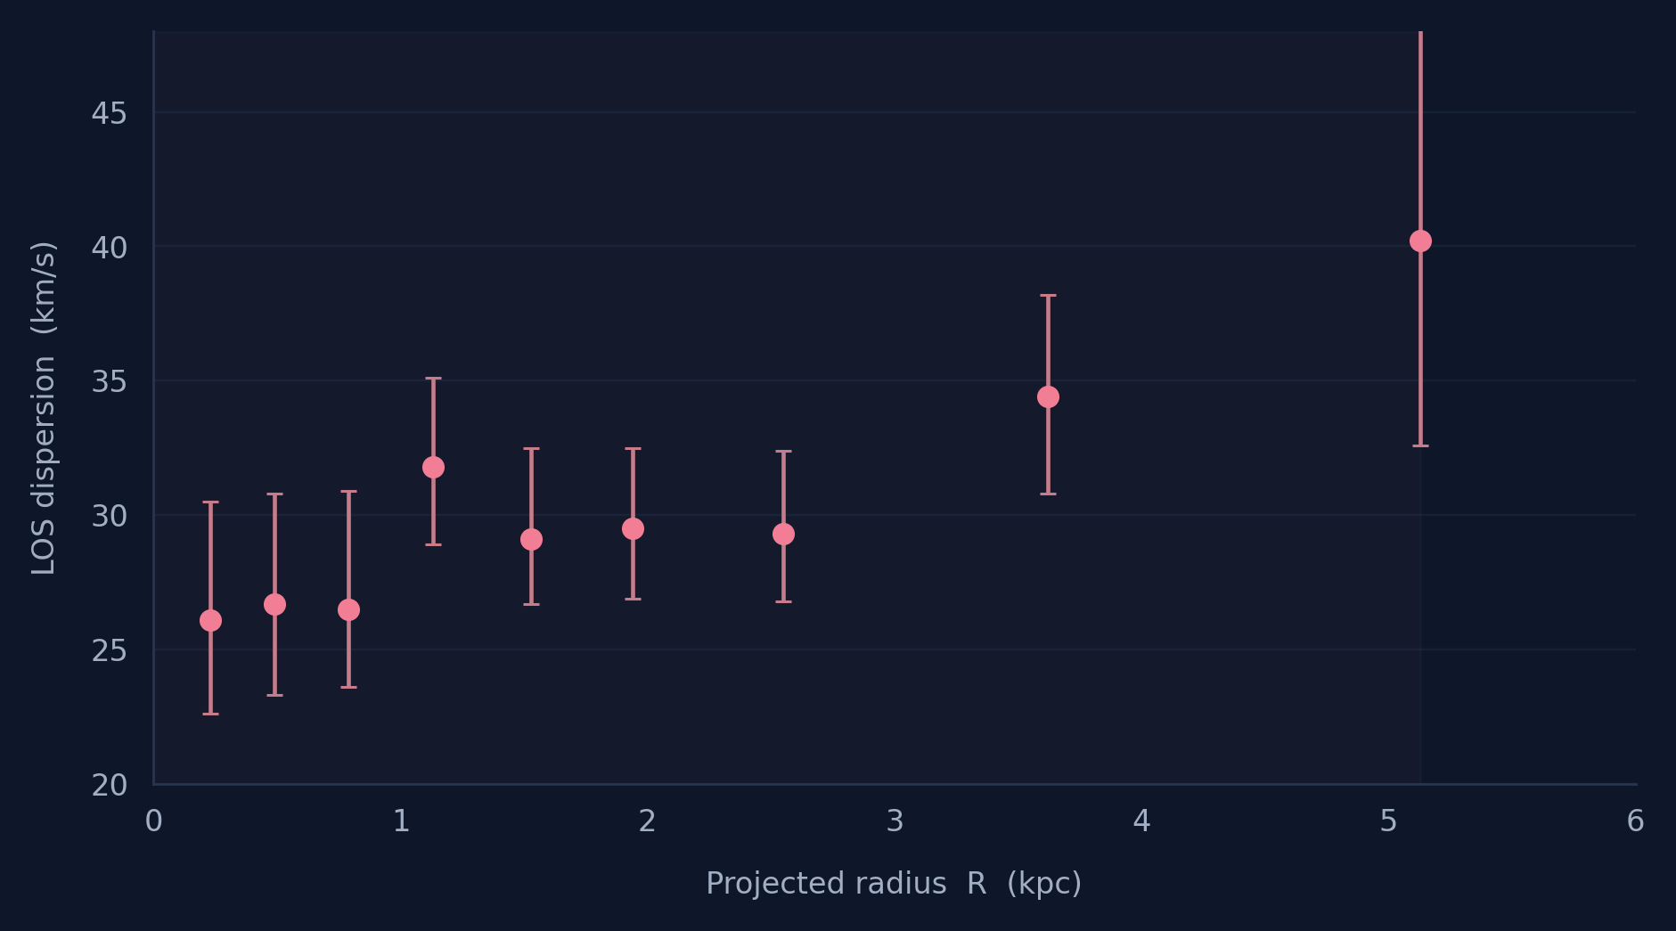
.
03 / METHODOLOGY · 3 OF 3
Nine DF44 Measurements, Two Fit Strategies
FIT THE OBSERVED PROFILE
χ² = Σ [(σmodel − σobs)/si]²
One-sided asymmetric errors; independent bins
Baseline
Fit M₂₀₀ and β · c = 10 fixed
Sensitivity test
Fit M₂₀₀, β and c · 2 ≤ c ≤ 40
VAN DOKKUM ET AL. (2019) · TABLE 2
SciPy bounded trust-region least squares · nine measurements
SHIVASHEESH · B.TECH PHYSICS · IIT GUWAHATI
06
Notes:
For Dragonfly 44, the published dataset contains nine stellar velocity-dispersion measurements at different projected radii, extending to just over 5 kiloparsecs.
I used Python with NumPy and SciPy to evaluate the Jeans and line-of-sight integrals numerically. Then I fitted the model using a chi-square objective that accounts for the published asymmetric uncertainties.
There are two main fitting strategies.
In the fixed-concentration fit, I keep the NFW concentration at 10 and optimize the halo mass, M-200, together with the orbital anisotropy, beta.
In the free-concentration fit, concentration becomes a third fitting parameter, allowed to vary between 2 and 40.
The purpose of the second fit is to test how strongly the inferred halo mass depends on that assumption.

Slide 7
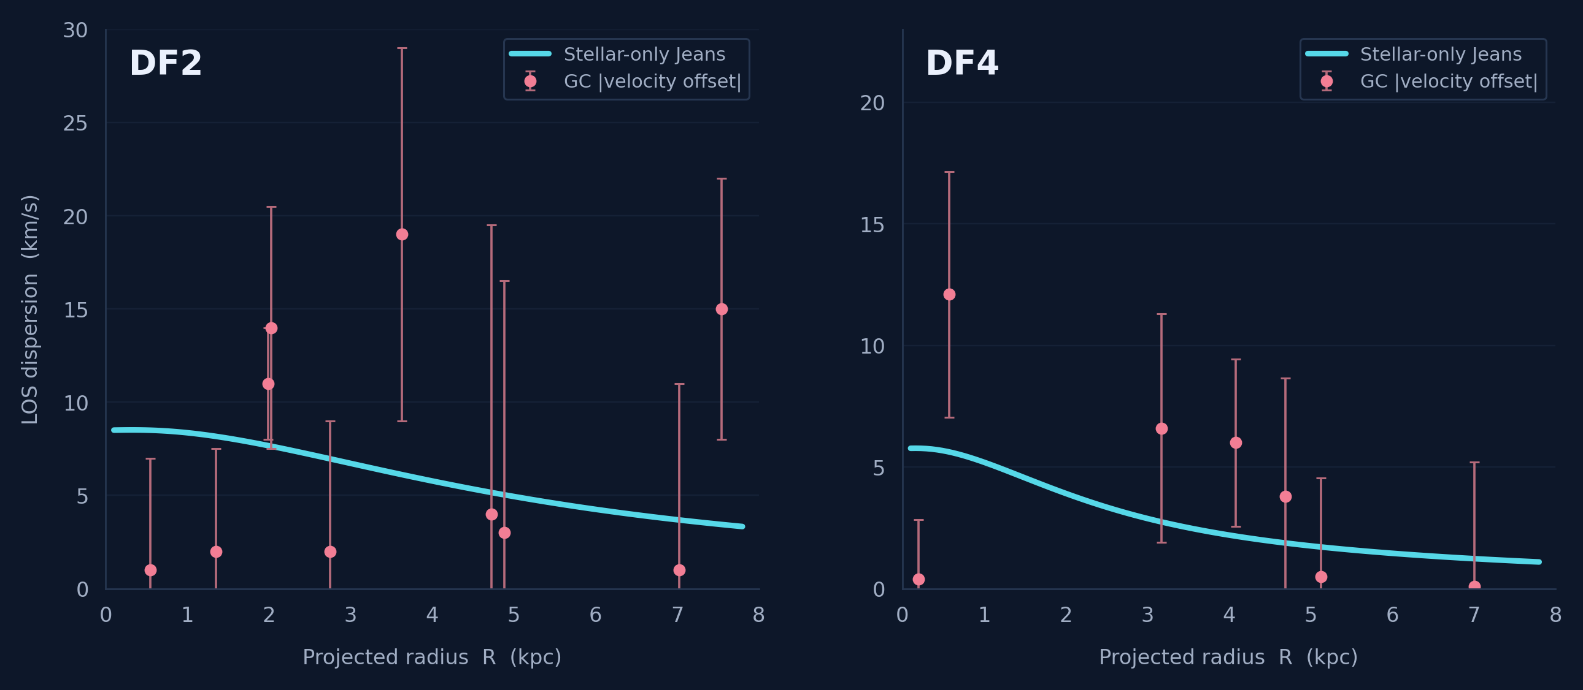
04 / RESULTS · 1 OF 3
DF2 and DF4: Stellar-Only Predictions
AT R = 1 KPC
8.36
km/s · DF2
5.20
km/s · DF4
Compatible with selected GC velocities.
Stellar-only σ_LOS at R = 1 kpc: 8.36 km/s (DF2) · 5.20 km/s (DF4). Individual GC offsets span ≈1–19 km/s (DF2) and ≈0.1–12.1 km/s (DF4).
Pink dots are individual globular-cluster |velocity offsets|, not local dispersion measurements.
SHIVASHEESH · B.TECH PHYSICS · IIT GUWAHATI
07
Notes:
Let us start with DF2 and DF4.
The blue-green curves are our stellar-only predictions for the line-of-sight dispersion. Both curves decline as we move away from the galaxy centre.
At a projected radius of 1 kiloparsec, the predictions are 8.36 kilometres per second for DF2, and 5.20 kilometres per second for DF4.
The pink points come from individual globular-cluster velocities. More precisely, they show the absolute velocity offset of each cluster relative to its galaxy's systemic velocity.
Pause briefly.
That distinction matters: a single cluster's velocity offset is not the same thing as a measured velocity dispersion. Therefore, I use this figure as a qualitative consistency check, not as a formal statistical fit.
Within the adopted assumptions and sparse data, the stellar-only predictions are compatible with the observed velocity scale. This does not prove that these galaxies contain no dark matter.

Slide 8
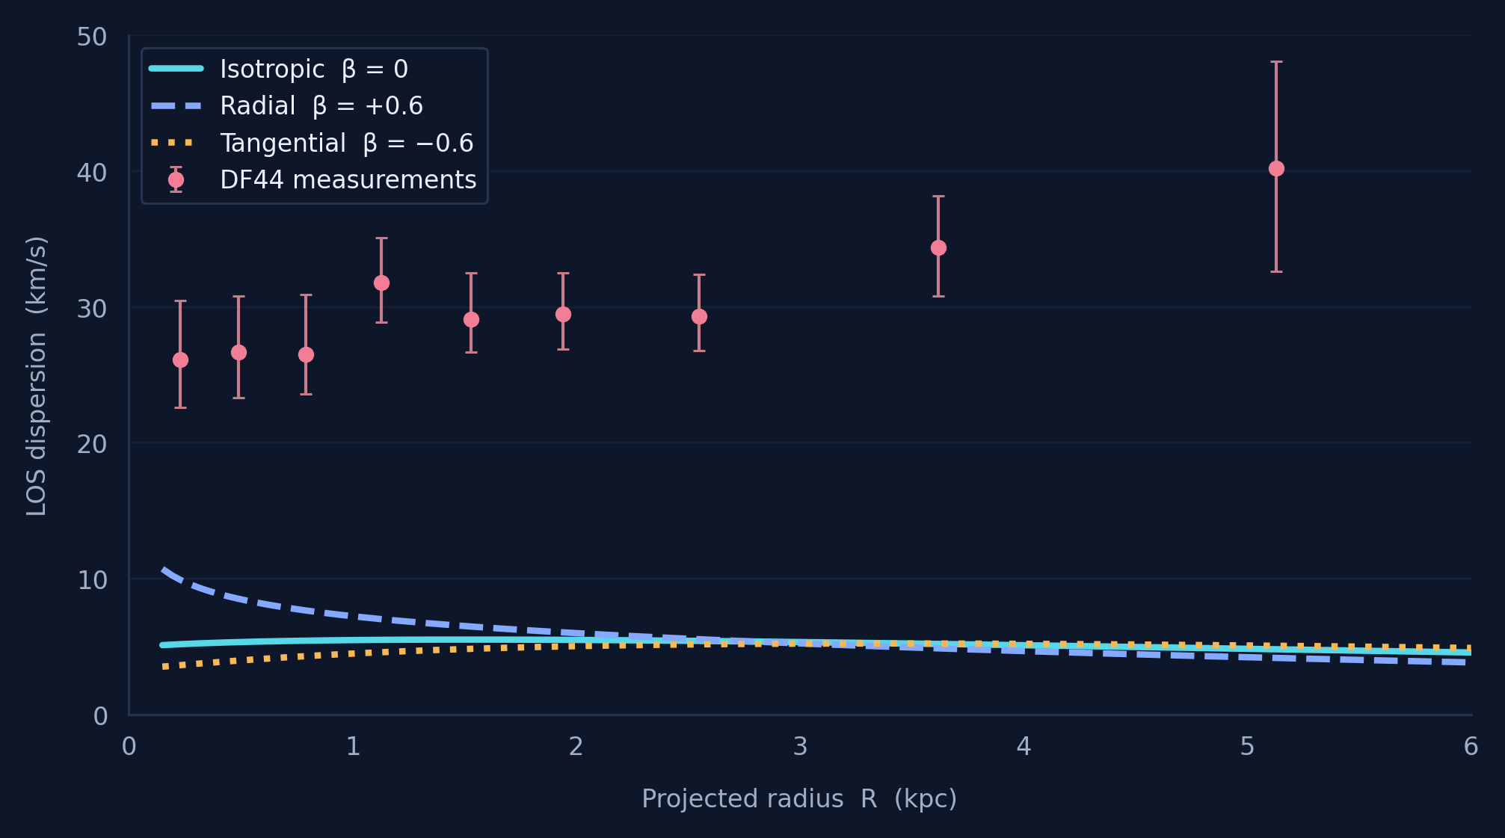
04 / RESULTS · 2 OF 3
DF44: Stellar Mass Alone Falls Short
OBSERVED
26–40
km/s across measured bins
STARS ONLY
4.5–7.2
km/s at 1 kpc; β tested: −0.6, 0, +0.6
Observed σ_LOS ≈ 26–40 km/s over R ≈ 0.23–5.13 kpc · at R = 1 kpc the stellar-only curves give 4.5–7.2 km/s for β = −0.6 … +0.6
β = +0.6 is a formal Jeans curve, but violates central phase-space consistency for this tracer.
SHIVASHEESH · B.TECH PHYSICS · IIT GUWAHATI
08
Notes:
DF44 gives a very different result.
Here, the pink points are actual measurements of the galaxy's stellar velocity dispersion. They range from approximately 26 to 40 kilometres per second over the measured radial bins.
The three low-lying curves are the stellar-only Newtonian predictions for different choices of orbital anisotropy: isotropic, radially biased, and tangentially biased.
At 1 kiloparsec, these models predict only about 4.5 to 7.2 kilometres per second.
So changing the direction of stellar orbits affects the shape of the curve, but in these three examples, it does not come close to explaining the observed amplitude.
There is also a caution: the strongly radial beta-equals-plus-0.6 curve is a formal Jeans solution, but it is not physically admissible at the centre for our adopted tracer profile.

Slide 9
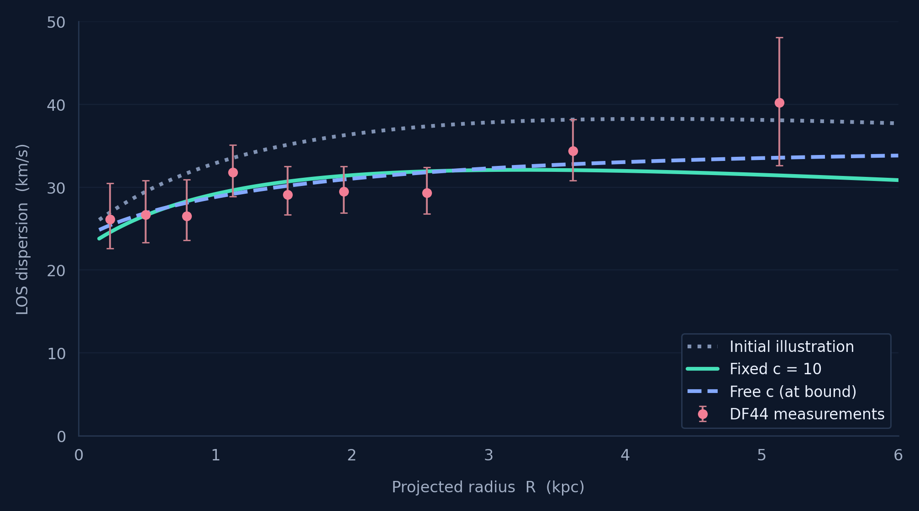
04 / RESULTS · 3 OF 3
DF44: A Dark Halo Fits the Observations
BASELINE · C = 10 FIXED
3.57 × 10¹⁰
M⊙ · β = −0.65
χ² / dof = 4.00 / 7
SENSITIVITY · C FITTED
1.20 × 10¹²
M⊙ · c = 2 (bound) · β = −0.27
χ² / dof = 2.92 / 6
Both fits: ≈ 4.2 × 10⁹ M⊙ of halo mass enclosed within r½ ≈ 6.3 kpc.
SHIVASHEESH · B.TECH PHYSICS · IIT GUWAHATI
09
Notes:
Now we add a dark-matter halo to DF44.
The fitted NFW curves come much closer to the observed pink points.
In the baseline fit, with concentration fixed at c equals 10, the best-fitting halo mass, M-200, is approximately 3.57 times 10 to the power 10 solar masses. The anisotropy is about minus 0.65, indicating tangentially biased stellar motions. The chi-square is about 4 for 7 degrees of freedom.
Now look at the sensitivity test, where concentration is allowed to vary.
That fit gives a much larger M-200, around 1.2 times 10 to the power 12 solar masses, but the concentration reaches c equals 2, exactly the lower boundary we imposed. This is not a measurement showing that the true concentration is 2.
The most interesting result is that these two very different halos contain almost the same amount of mass within about 6.3 kiloparsecs: roughly 4.2 billion solar masses of dark matter.
So the observed stars are sensitive mainly to the mass in the region they occupy. Extrapolating that information out to the full halo radius can produce very different estimates of M-200.

Slide 10
05 / DISCUSSION
What Can the Data Actually Tell Us?
DF2 / DF4
DF44
HALO INFERENCE
Stars can suffice
Extra gravitating mass
Inner mass ≠ M₂₀₀
Selected GC velocities are consistent with the stellar-only curves. Thus, we do not need dark matter modelling.
The observed stellar dispersions exceed the tested stellar-only Newtonian predictions.
Concentration and anisotropy are degenerate; the free-c fit runs to a boundary.
WHAT REMAINS UNCERTAIN
Spherical equilibrium · fixed tracer profiles · 9 DF44 bins · no aperture/seeing convolution · no credible intervals
Bottom line: dispersion constrains gravity locally; outer-halo mass requires model assumptions.
SHIVASHEESH · B.TECH PHYSICS · IIT GUWAHATI
10
Notes:
Putting the results together, we find two different behaviours.
For DF2 and DF4, the stellar-only predictions are broadly compatible with the small globular-cluster datasets used here, although the comparison is not enough to establish their exact dark-matter content.
For DF44, the tested stellar-only models fall well below the observed dispersion, while a stellar-plus-NFW model provides a good description within Newtonian gravity.
However, a good fit is not the same as a unique measurement of the halo.
The inferred mass depends on the concentration and the orbital anisotropy. Different combinations can reproduce similar observed dispersions, especially when the data cover only the inner few kiloparsecs.
The main lesson is that velocity dispersion is a powerful probe of gravity, but its interpretation depends on the model assumptions.

Slide 11
06 / LIMITATIONS
What This Project Does Not Yet Resolve
01
Parameter degeneracy
02
Dynamical assumptions
Different combinations of M₂₀₀, c and β can reproduce very similar DF44 σ_LOS(R). The data constrain the inner dynamical mass more robustly than the outer halo mass.
The Jeans analysis assumes spherical symmetry, dynamical equilibrium and a constant anisotropy β. Real galaxies may deviate from all three.
03
Tracer-model uncertainty
04
Limited observational leverage
For DF44 the stellar light is used as the tracer; for DF2/DF4 the globular-cluster sample is sparse and may not follow the stellar density exactly.
Only nine DF44 bins and a handful of GC velocities are used here; aperture/seeing convolution and full Bayesian uncertainty propagation were not implemented.
Takeaway: the Newtonian fits are informative, but the inferred halo parameters remain model-dependent.
SHIVASHEESH · B.TECH PHYSICS · IIT GUWAHATI
11
Notes:
I want to end with the main limitations of this analysis.
The first is parameter degeneracy. Halo mass, concentration, and anisotropy can compensate for one another, so the outer halo mass is not uniquely determined by these data.
Second, the model assumes spherical symmetry, dynamical equilibrium, and constant anisotropy. Real galaxies may not satisfy these assumptions exactly.
Third, for DF2 and DF4 we approximate the spatial distribution of globular clusters using the stellar density profile. Those tracer populations need not be identical.
And finally, the observations are limited: we have only nine dispersion bins for DF44 and small globular-cluster samples for DF2 and DF4. We also have not included detailed observational aperture effects or a full uncertainty analysis.
A natural next step would be Bayesian fitting with physically motivated concentration priors and better treatment of the tracer distributions.

Slide 12
Thank you.
Questions & discussion
Shivasheesh · 230121051 · IIT Guwahati
Notes:
To conclude, this project shows how we can use stellar motions to test whether visible mass alone explains a galaxy's dynamics, and where our conclusions remain uncertain.
Thank you. I would be happy to take your questions.

Slide 13
Q&A REFERENCE MATERIAL
Backup slides
Assumptions · Galaxy types · Why UDGs · Data acquisition · Jeans physics
NFW parameters · c bounds · Degeneracies · Fit diagnostics · Alternatives
NOT PART OF THE 15-MINUTE TALK
Notes:
Talk duration target: null
Speaker cues:
Appendix navigation only. The main talk ended with the Thank you slide.
[Sources]
- User-provided 2026 B.Tech LaTeX report and reproducible notebook, supplied with this presentation request.

Slide 14
Q&A / BACKUP
Assumptions Behind the Jeans Model
DYNAMICS
OBSERVABLES AND APPROXIMATIONS
Spherical symmetry and dynamical equilibrium
DF2/DF4 GCs approximated by stellar tracer profile
Collisionless tracers; no mean rotation/streaming
Adopted distances and constant stellar M/L
Constant velocity anisotropy β
Nine DF44 bins treated as independent
Newtonian gravity; stars + optional NFW halo
Model sampled at bin radii; no aperture/PSF convolution
Gas contribution neglected
No Bayesian confidence intervals or halo prior
SHIVASHEESH · B.TECH PHYSICS · IIT GUWAHATI
B1
Notes:
Talk duration target:
Speaker cues:
These model assumptions are not automatically verified by getting a good chi-square. Unmodeled systematics can shift inferred halo mass and orbital anisotropy.
[Sources]
- User-provided 2026 B.Tech LaTeX report and reproducible notebook, supplied with this presentation request.
- Bhatia, Chakrabarti & Chakraborty 2023, Physical Review D 108, 064021, https://doi.org/10.1103/PhysRevD.108.064021
- Bhatia, Chakrabarti & Chakraborty 2025, Physical Review D 112, 024034, https://doi.org/10.1103/2k1h-fj16

Slide 15
Q&A / BACKUP
Galaxy Types — and Where UDGs Fit
MORPHOLOGY
APPEARANCE
KINEMATIC CLUE
UDG IS NOT A HUBBLE TYPE
Spiral
Disk + arms
Rotation often prominent
“Ultra-diffuse” describes low surface brightness and large effective radius, not a unique shape.
Elliptical
Smooth stellar body
Dispersion often important
Lenticular (S0)
Disk without clear arms
Rotation + dispersion
Irregular
No regular morphology
Kinematics vary
A UDG can have different morphologies and very different halo properties.
Dwarf spheroidal
Faint, pressure-supported
Dispersion tracer
SHIVASHEESH · B.TECH PHYSICS · IIT GUWAHATI
B2
Notes:
Talk duration target:
Speaker cues:
Do not treat UDG as an additional rung in the Hubble tuning fork. It is a structural surface-brightness/size selection, and UDGs can look elliptical or disk-like. The degree of rotational support also varies by object; our selected systems are treated as dispersion supported.
[Sources]
- User-provided 2026 B.Tech LaTeX report and reproducible notebook, supplied with this presentation request.
- Bhatia, Chakrabarti & Chakraborty 2023, Physical Review D 108, 064021, https://doi.org/10.1103/PhysRevD.108.064021
- Bhatia, Chakrabarti & Chakraborty 2025, Physical Review D 112, 024034, https://doi.org/10.1103/2k1h-fj16

Slide 16
Q&A / BACKUP
Why Study UDGs Specifically?
01
Large stellar extent
Low surface brightness makes visible matter an incomplete guide to the potential.
02
Contrasting dynamical cases
DF2 / DF4 and DF44 invite a controlled comparison within similar-looking systems.
03
Observable stellar motions
Spectroscopy provides velocities where imaging alone cannot weigh hidden matter.
SHIVASHEESH · B.TECH PHYSICS · IIT GUWAHATI
B3
Notes:
Talk duration target:
Speaker cues:
UDGs are valuable because their appearance and dynamical content can differ dramatically. Three examples do not establish a universal distribution of halo masses. They do provide a clean computational demonstration of how to translate observed light and kinematics into an assumed Newtonian mass model.
[Sources]
- User-provided 2026 B.Tech LaTeX report and reproducible notebook, supplied with this presentation request.
- Bhatia, Chakrabarti & Chakraborty 2023, Physical Review D 108, 064021, https://doi.org/10.1103/PhysRevD.108.064021
- Bhatia, Chakrabarti & Chakraborty 2025, Physical Review D 112, 024034, https://doi.org/10.1103/2k1h-fj16

Slide 17
Q&A / BACKUP
Why Measure Velocity Dispersion?
Random stellar motions trace gravity
HALF-LIGHT MASS CROSS-CHECK
M½ ≈ 3 ⟨σLOS²⟩ r½ / G
σ² ∼ GM(<r)/r
Useful when ordered rotation is weak or poorly measured.
4.8 × 10⁹
Doppler broadening gives LOS velocities, not full 3D motions.
M⊙ · DF44 dynamical mass within r½
Illustrative Wolf estimator: r½ ≈ 6.3 kpc, global dispersion ≈ 33 km/s.
SHIVASHEESH · B.TECH PHYSICS · IIT GUWAHATI
B4
Notes:
Talk duration target:
Speaker cues:
Velocity dispersion traces the potential through the dynamical balance of randomly moving stars. It cannot by itself uniquely distinguish mass and orbital anisotropy. The Wolf half-light estimator yields a rough mass of 4.8e9 solar masses for sigma about 33 and rhalf about 6.3 kpc. Because DF44 has rising dispersion and the radius lies outside the outermost projected bin, this is a cross-check, not a precision independent measurement.
[Sources]
- User-provided 2026 B.Tech LaTeX report and reproducible notebook, supplied with this presentation request.
- Wolf et al. 2010, MNRAS 406, 1220, https://arxiv.org/abs/0908.2995
- van Dokkum et al. 2019, Astrophysical Journal 880, 91, https://doi.org/10.3847/1538-4357/ab2914

Slide 18
Q&A / BACKUP
How Are the Velocity Data Measured?
DF44 · INTEGRATED STARLIGHT
DF2 / DF4 · GLOBULAR CLUSTERS
1
Collect spatially resolved galaxy spectra
Obtain individual cluster spectra and Doppler velocities.
2
Combine light into radial spectral bins
Subtract systemic velocity to obtain each cluster offset.
3
Measure Doppler broadening of absorption lines
Only a sparse cluster sample is available; membership affects dispersion inference.
4
Infer stellar LOS dispersion and uncertainty
Only projected positions and LOS velocities are accessible with these measurements.
SHIVASHEESH · B.TECH PHYSICS · IIT GUWAHATI
B5
Notes:
Talk duration target:
Speaker cues:
This distinction matters a great deal. DF44 uses binned stellar velocity dispersions inferred from broadened absorption lines in integrated light. DF2 and DF4 provide individual GC velocities, not separately measured radial-bin dispersions; a population dispersion must be inferred statistically and is uncertain with so few tracers. Our plots overlay GC absolute velocity offsets on a stellar-only curve, without a full likelihood for individual GC velocities.
[Sources]
- User-provided 2026 B.Tech LaTeX report and reproducible notebook, supplied with this presentation request.
- van Dokkum et al. 2019, Astrophysical Journal 880, 91, https://doi.org/10.3847/1538-4357/ab2914
- Bhatia, Chakrabarti & Chakraborty 2023, Physical Review D 108, 064021, https://doi.org/10.1103/PhysRevD.108.064021

Slide 19
Q&A / BACKUP
Where Do the Jeans and LOS Equations Come From?
COLLISIONLESS BOLTZMANN → VELOCITY MOMENTS
∂f/∂t + v·∇ᵣf − ∇Φ·∇ᵥf = 0
Stationary spherical, no mean streaming → first velocity moment → radial Jeans equation.
RADIAL JEANS EQUATION
LOS GEOMETRY
d(νσr²)/dr + (2β/r)νσr² = −νGM/r²
σ²los,local = σr²(1 − βR²/r²)
For constant β: multiply by r²ᵝ and integrate outward.
Project and density-weight along the full line of sight.
SHIVASHEESH · B.TECH PHYSICS · IIT GUWAHATI
B6
Notes:
Talk duration target:
Speaker cues:
The collisionless Boltzmann equation preserves phase-space density along stellar trajectories. Its zeroth moment is the continuity equation; multiplying by radial velocity and integrating over velocity yields the radial Jeans equation under spherical steady-state assumptions. The local LOS velocity variance has radial and tangential geometric weights, and after substituting beta becomes sigma_r^2(1-beta R^2/r^2). Project this quantity with nu along z to obtain the observable.
[Sources]
- User-provided 2026 B.Tech LaTeX report and reproducible notebook, supplied with this presentation request.
- Bhatia, Chakrabarti & Chakraborty 2025, Physical Review D 112, 024034, https://doi.org/10.1103/2k1h-fj16
- Binney & Tremaine, Galactic Dynamics (2008)

Slide 20
Q&A / BACKUP
NFW Parameters: rₛ, r₂₀₀, M₂₀₀, c
DENSITY AND ENCLOSED MASS
CONCENTRATION
ρNFW(r) = ρₛ / [x(1+x)²]
c = r₂₀₀ / rₛ
M(<r) = M₂₀₀ F(r/rₛ) / F(c)
For the baseline DF44 fit:
F(y) = ln(1+y) − y/(1+y)
c = 10 · r₂₀₀ ≈ 68 kpc
rₛ ≈ 6.8 kpc
r₂₀₀: mean interior density = 200 ρcrit
M₂₀₀: mass enclosed inside r₂₀₀
rₛ: NFW scale radius
SHIVASHEESH · B.TECH PHYSICS · IIT GUWAHATI
B7
Notes:
Talk duration target:
Speaker cues:
NFW profile has inner density slope about −1 and outer density slope about −3. r200 is conventional and does not mark a physical cutoff. M200 is not the literal total mass at infinity. c is the ratio of r200 to r_s. The characteristic density rho_s and r_s can be derived from M200 and c. For the baseline fit M200=3.57e10, c=10, r200 ~68 kpc, rs ~6.8 kpc.
[Sources]
- User-provided 2026 B.Tech LaTeX report and reproducible notebook, supplied with this presentation request.
- Navarro, Frenk & White 1997, Astrophysical Journal 490, 493, https://doi.org/10.1086/304888
- Dutton & Macciò 2014, MNRAS 441, 3359, https://arxiv.org/abs/1402.7073

Slide 21
Q&A / BACKUP
Fixed c vs Free c — What Does c = 2 Mean?
FIXED CONCENTRATION
FREE CONCENTRATION
c = 10 is imposed
c searched in [2, 40]
Optimizer adjusts only M₂₀₀ and β.
Two free parameters → nine bins minus two = seven nominal degrees of freedom.
Optimizer adjusts M₂₀₀, β and c.
The best permitted solution hits c = 2, the lower imposed search bound.
M₂₀₀ = 3.57 × 10¹⁰ M⊙
c = 2 is not measured
The bounds were chosen for this sensitivity experiment; the data do not determine them.
SHIVASHEESH · B.TECH PHYSICS · IIT GUWAHATI
B8
Notes:
Talk duration target:
Speaker cues:
Emphasize that a numerical bound is simply an optimizer constraint. We chose 2 <= c <=40; c=2 does not mean the galaxy is observed to have concentration 2. It means the allowed minimum lies at the boundary of this chosen search. Extending the range or imposing a cosmologically motivated prior could change the inferred mass and concentration. The free-c model has 3 fitted parameters, c-fixed only 2. Do not call this a measured halo concentration.
[Sources]
- User-provided 2026 B.Tech LaTeX report and reproducible notebook, supplied with this presentation request.
- User-provided 2026 B.Tech LaTeX report and reproducible notebook, supplied with this presentation request.
- Dutton & Macciò 2014, MNRAS 441, 3359, https://arxiv.org/abs/1402.7073

Slide 22
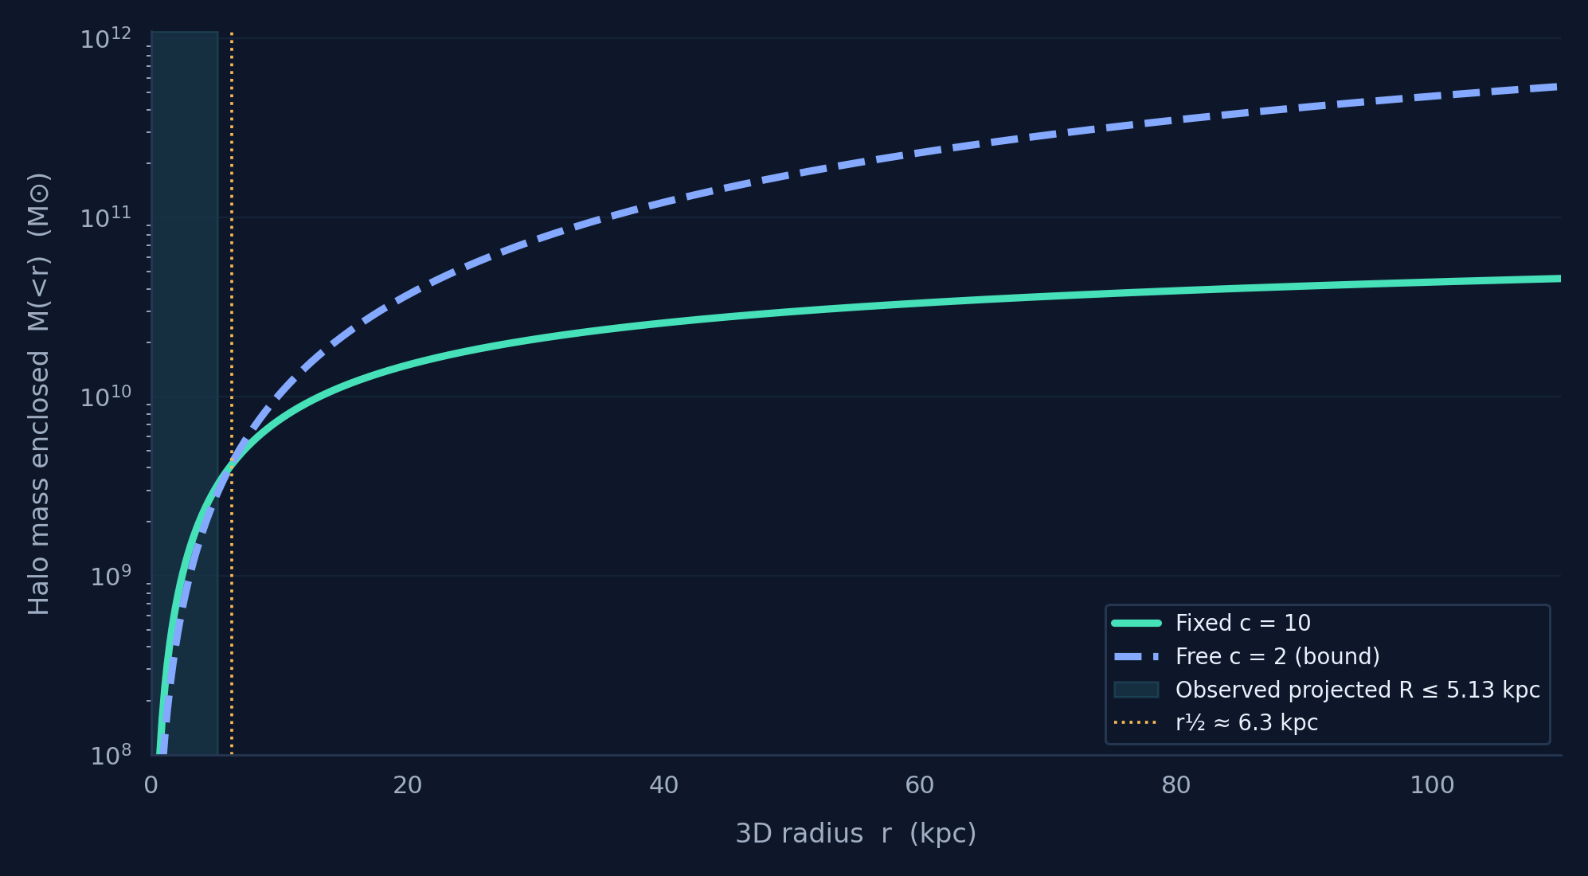
Q&A / BACKUP
Why Can Two Very Different Halos Both Fit?
SAME INNER REGION
≈ 4.2 × 10⁹
M⊙ inside ≈6.3 kpc, for both fits
DIFFERENT OUTER HALO
M₂₀₀ differs by a factor ~34 because the concentration differs.
β also changes LOS projection.
SHIVASHEESH · B.TECH PHYSICS · IIT GUWAHATI
B9
Notes:
Talk duration target:
Speaker cues:
Use the plot to illustrate NFW mass concentration degeneracy. The lines have nearly the same enclosed halo mass around 6.3 kpc and much different masses at the outer halo, which is not probed directly by the measured dispersion bins. Matching inner mass at one radius is not sufficient for exactly equal LOS curves because the full mass profile and anisotropy are also involved. Shaded region marks measured projected R range, not a sharp boundary of the 3D Jeans integration.
[Sources]
- User-provided 2026 B.Tech LaTeX report and reproducible notebook, supplied with this presentation request.
- Navarro, Frenk & White 1997, Astrophysical Journal 490, 493, https://doi.org/10.1086/304888
- van Dokkum et al. 2019, Astrophysical Journal 880, 91, https://doi.org/10.3847/1538-4357/ab2914
- Dutton & Macciò 2014, MNRAS 441, 3359, https://arxiv.org/abs/1402.7073

Slide 23
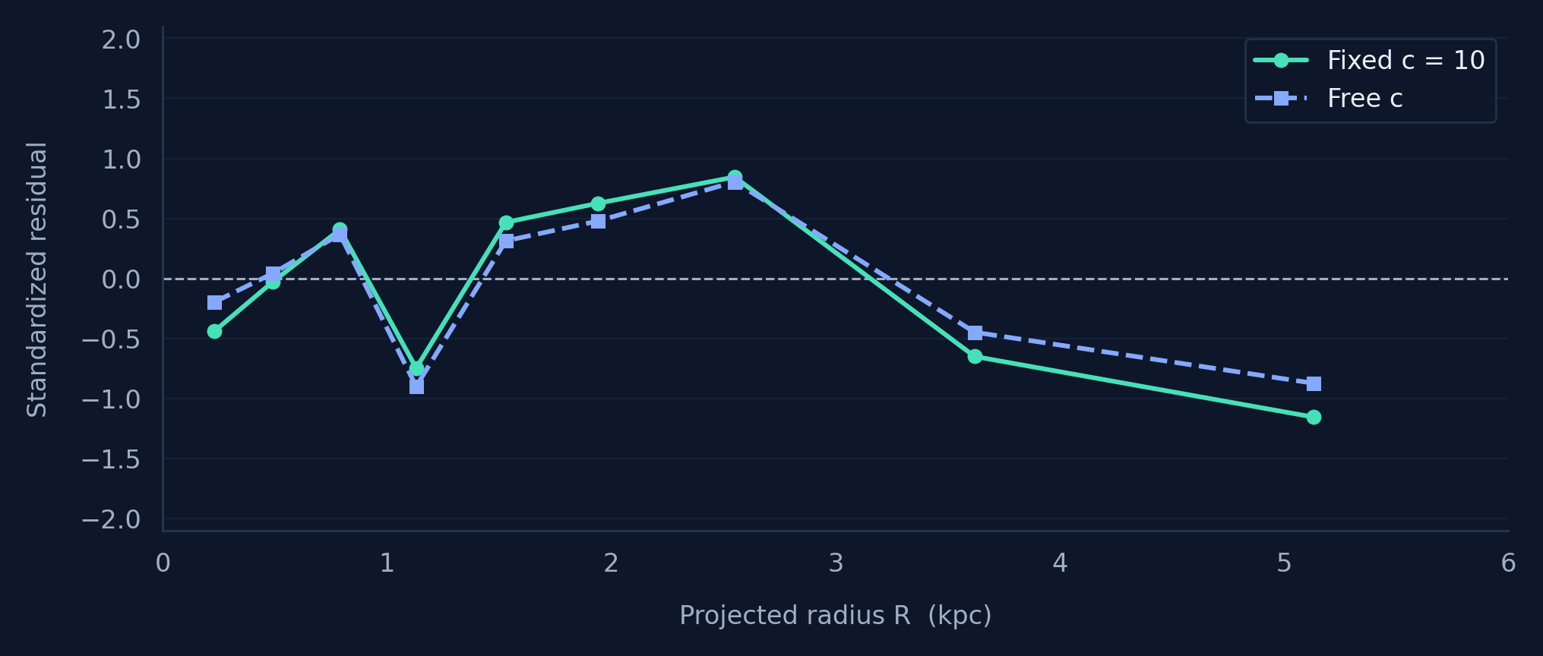
Q&A / BACKUP
Goodness of Fit and Residual Diagnostics
FIT STATISTIC
χ²red = χ² / (N − k)
Fixed c: 4.00 / 7 = 0.57
Free c: 2.92 / 6 = 0.49
Δχ² ≈ 1.08 for one extra parameter; a small gain, with c at the imposed boundary.
SHIVASHEESH · B.TECH PHYSICS · IIT GUWAHATI
B10
Notes:
Talk duration target:
Speaker cues:
The residuals are (prediction minus observed)/the one-sided observational uncertainty. The chi-square is a piecewise Gaussian least-squares objective and assumes independent bins. Reduced chi-square less than 1 can reflect small-sample variation or conservative uncertainties; it does not prove model uniqueness. The free-c improvement is only around 1.1 in chi-square, and the parameter sits at a bound, so a standard asymptotic chi-square significance claim would require caution. No confidence intervals are computed.
[Sources]
- User-provided 2026 B.Tech LaTeX report and reproducible notebook, supplied with this presentation request.
- van Dokkum et al. 2019, Astrophysical Journal 880, 91, https://doi.org/10.3847/1538-4357/ab2914
- Bhatia, Chakrabarti & Chakraborty 2025, Physical Review D 112, 024034, https://doi.org/10.1103/2k1h-fj16

Slide 24
Q&A / BACKUP
Does Every Jeans Solution Describe a Physical Galaxy?
CUSP SLOPE–CENTRAL ANISOTROPY THEOREM
INTERPRETATION
γ₀ ≥ 2β₀
A positive numerical Jeans variance does not guarantee a globally non-negative phase-space distribution function.
For the adopted DF44 tracer approximation:
γ₀ ≈ 0.413 → β₀ ≤ 0.206
Tangential β < 0 is not excluded by this theorem, but this theorem alone does not prove full self-consistency.
A constant β = +0.6 violates this necessary condition at the centre.
SHIVASHEESH · B.TECH PHYSICS · IIT GUWAHATI
B11
Notes:
Talk duration target:
Speaker cues:
For a finite central potential, a nonnegative phase-space distribution requires the central tracer cusp gamma0 to be at least twice the central orbital anisotropy beta0. Our approximate deprojected Sérsic tracer has gamma0 near 0.413, so beta0 must be <=0.2065 for a constant radial bias in that adopted model. Thus beta=.6 is a formal Jeans curve but not globally physical. Note that the exact Sérsic deprojection differs near the centre, and no full positive distribution function was constructed even for the preferred negative-beta model.
[Sources]
- User-provided 2026 B.Tech LaTeX report and reproducible notebook, supplied with this presentation request.
- An & Evans 2006, ApJ 642, 752, https://arxiv.org/abs/astro-ph/0511686
- Bhatia, Chakrabarti & Chakraborty 2025, Physical Review D 112, 024034, https://doi.org/10.1103/2k1h-fj16

Slide 25
Q&A / BACKUP
DF2 / DF4: Distance, Membership and Robustness
Distance
Different adopted distances change inferred luminosity, size, mass and dynamical interpretation.
Sparse sample
A handful of globular-cluster velocities gives a noisy estimate of dispersion.
Membership
Excluding or including a possible interloper can shift the inferred dispersion.
Tracer mismatch
GC number density may not follow stellar luminosity density, as assumed here.
SHIVASHEESH · B.TECH PHYSICS · IIT GUWAHATI
B12
Notes:
Talk duration target:
Speaker cues:
Do not state that DF2 or DF4 contains literally no dark matter. Source-study conclusions are sensitive to the assumed distance, GC membership, and small-number statistics. Our model only demonstrates that the selected stellar-only curves are compatible with the individual velocity offsets being compared, not a full likelihood-based dynamical mass inference.
[Sources]
- User-provided 2026 B.Tech LaTeX report and reproducible notebook, supplied with this presentation request.
- Bhatia, Chakrabarti & Chakraborty 2023, Physical Review D 108, 064021, https://doi.org/10.1103/PhysRevD.108.064021
- van Dokkum et al. 2018, Nature 555, 629
- van Dokkum et al. 2019, ApJ Letters 874, L5

Slide 26
Q&A / BACKUP
Other Halo Models, Gravity and Next Steps
01 / EXTENSION
02 / EXTENSION
03 / EXTENSION
NFW vs cored halo
Modified gravity
More robust inference
A central dark-matter core may allow less tangential anisotropy than a cusped NFW profile.
The source papers also study alternative gravity prescriptions, not implemented in this project.
Use measured GC tracer profiles, aperture/seeing convolution and Bayesian priors with uncertainty intervals.
The current project tests Newtonian model families; it cannot uniquely establish a gravity theory.
SHIVASHEESH · B.TECH PHYSICS · IIT GUWAHATI
B13
Notes:
Talk duration target:
Speaker cues:
Alternative halo profiles are an important systematic. van Dokkum 2019 found cored halo solutions for DF44 that can allow nearly isotropic motions. The two Bhatia studies compare Newtonian and modified gravity predictions, but the present computational reproduction implements only the Newtonian baselines. Priorities for next work are a full aperture/PSF-convolved likelihood, more data and a cosmological concentration–mass prior with credible intervals; MCMC sampling alone does not remove degeneracies.
[Sources]
- User-provided 2026 B.Tech LaTeX report and reproducible notebook, supplied with this presentation request.
- Bhatia, Chakrabarti & Chakraborty 2023, Physical Review D 108, 064021, https://doi.org/10.1103/PhysRevD.108.064021
- Bhatia, Chakrabarti & Chakraborty 2025, Physical Review D 112, 024034, https://doi.org/10.1103/2k1h-fj16
- van Dokkum et al. 2019, Astrophysical Journal 880, 91, https://doi.org/10.3847/1538-4357/ab2914
- Dutton & Macciò 2014, MNRAS 441, 3359, https://arxiv.org/abs/1402.7073

