Slide 1
Shivas A.
821721104054
Final Project

Slide 2
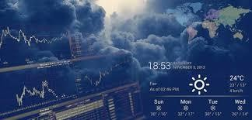
Weather Prediction ( Rnn )

Slide 3


AGENDA
"Utilizing Recurrent Neural Networks for Weather Prediction" involves data acquisition, preprocessing, and RNN architecture design. Model training includes hyperparameter tuning and preventing overfitting, while evaluation metrics like MAE and RMSE assess performance. Forecasting with RNNs involves generating and visualizing predictions. Challenges include weather complexity, necessitating ongoing research for accuracy improvements. Future directions may explore additional data integration and hybrid models. Ethical considerations encompass the impact of inaccurate forecasts on decision-making.
Introduction
Data Acquisition and Preprocessing
RNN Architecture Design
Model Training
Model Evaluation
Forecasting
Challenges and Future Directions
Conclusion
References
3/21/2024 Annual Rev iew

Slide 4

PROBLEM STATEMENT
“In weather forecasting, the complex and dynamic nature of atmospheric phenomena poses challenges for accurate predictions. Leveraging Recurrent Neural Networks (RNNs) offers potential solutions due to their ability to handle sequential data. However, deploying RNNs effectively requires addressing data preprocessing, model architecture design, training
optimization, and model evaluation. This study aims to explore RNNs’ application in weather prediction to develop a robust forecasting framework. By improving forecast accuracy, the framework aims to enhance decision- making in sectors reliant on weather data, such as agriculture, transportation, and disaster management.”

Slide 5

PROJECT OVERVIEW
Utilize Recurrent Neural Networks (RNNs) to enhance weather forecasting accuracy. By analyzing historical weather data and training RNN models, the project aims to develop a robust forecasting framework capable of generating more precise predictions for various weather parameters, benefiting decision-making in multiple sectors.
This project seeks to boost weather prediction accuracy through Recurrent Neural Networks (RNNs). By analyzing historical weather data and training RNN models, the aim is to create a reliable forecasting system providing precise predictions for various weather parameters, benefiting sectors reliant on weather information.

Slide 6
WHO ARE THE END USERS?
The end users of the weather forecasting system enhanced with Recurrent Neural Networks (RNNs) include various stakeholders across different sectors, such as:
Agriculture: Farmers rely on accurate weather forecasts to plan planting, irrigation, and harvesting activities.
Transportation: Airlines, shipping companies, and logistics firms use weather forecasts to optimize routes, schedules, and fuel consumption.
Energy: Energy providers use weather predictions to anticipate demand, manage energy
production, and optimize renewable energy sources like solar and wind.
Emergency Management: Government agencies and disaster response teams utilize weather forecasts to prepare for and respond to natural disasters such as hurricanes, floods, and wildfires.
Construction: Construction companies depend on weather forecasts to schedule outdoor
activities and mitigate risks associated with adverse weather conditions.

Slide 7

YOUR SOLUTION AND ITS VALUE PROPOSITION
Our solution leverages Recurrent Neural Networks (RNNs) to enhance weather forecasting accuracy, delivering timely and reliable predictions. This improves decision-making across sectors, optimizing resource allocation and reducing weather-related disruptions. With adaptability and scalability, our solution offers tailored forecasts to meet specific user needs efficiently.
By incorporating Recurrent Neural Networks (RNNs) into weather forecasting, our solution ensures superior accuracy, enabling precise decision-making for diverse end users.
With scalable and customizable features, it optimizes resource allocation and reduces operational risks associated with adverse weather conditions, fostering resilience and efficiency across various sectors.

Slide 8

THE WOW IN YOUR SOLUTION
The “wow” factor in our solution lies in its ability to harness the power of Recurrent Neural Networks (RNNs) to revolutionize weather forecasting. By seamlessly integrating advanced machine learning techniques, we elevate accuracy to new heights, providing timely and reliable predictions that empower users to make informed decisions and navigate unpredictable weather with confidence.
Our solution’s “wow” factor extends beyond traditional forecasting methods by offering a cutting-edge approach with Recurrent Neural Networks (RNNs). Through this innovative technology, we unlock unparalleled accuracy, delivering forecasts that transcend expectations and empower users with actionable insights, ultimately transforming how they navigate and respond to weather dynamics.
3/21/2024 Annual Rev iew

Slide 9
MODELLING
Teams cam add wireframes
For weather prediction using Recurrent Neural Networks (RNNs):
Collect historical weather data.
Preprocess data (clean, normalize).
Design RNN architecture (e.g., LSTM).
Train model on training data.
Evaluate model performance.
Make forecasts for future weather conditions.
Validate and deploy model for practical use.
Incorporate advanced RNN architectures like LSTM or GRU for better temporal modeling. Experiment with different hyperparameters and regularization techniques to optimize model performance. Visualize forecasted weather patterns and validate predictions against real-world observations. Continuously update and improve the model to maintain accuracy and relevance in dynamic weather conditions.

Slide 10
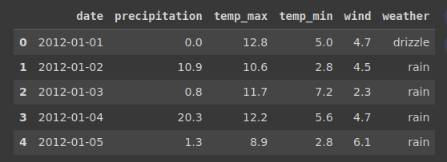
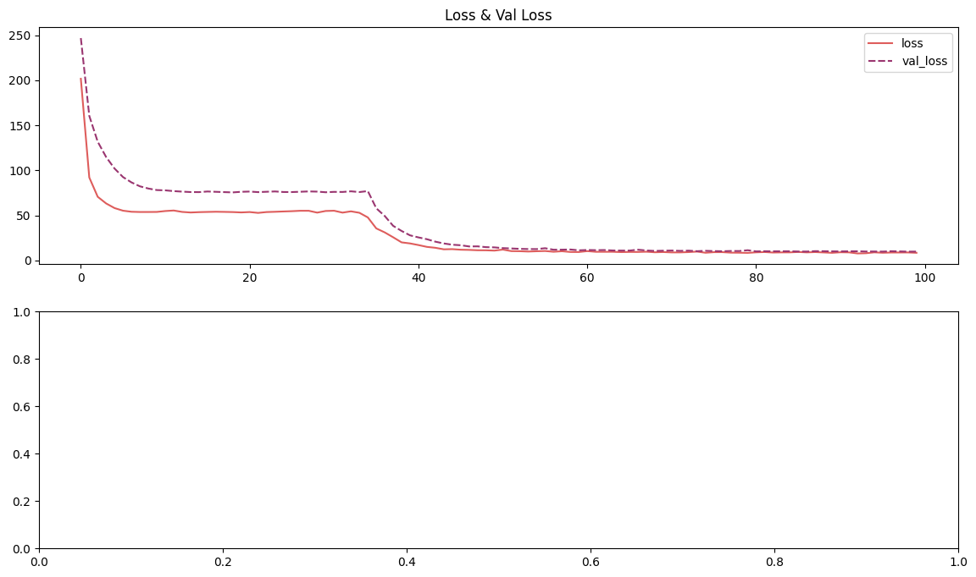
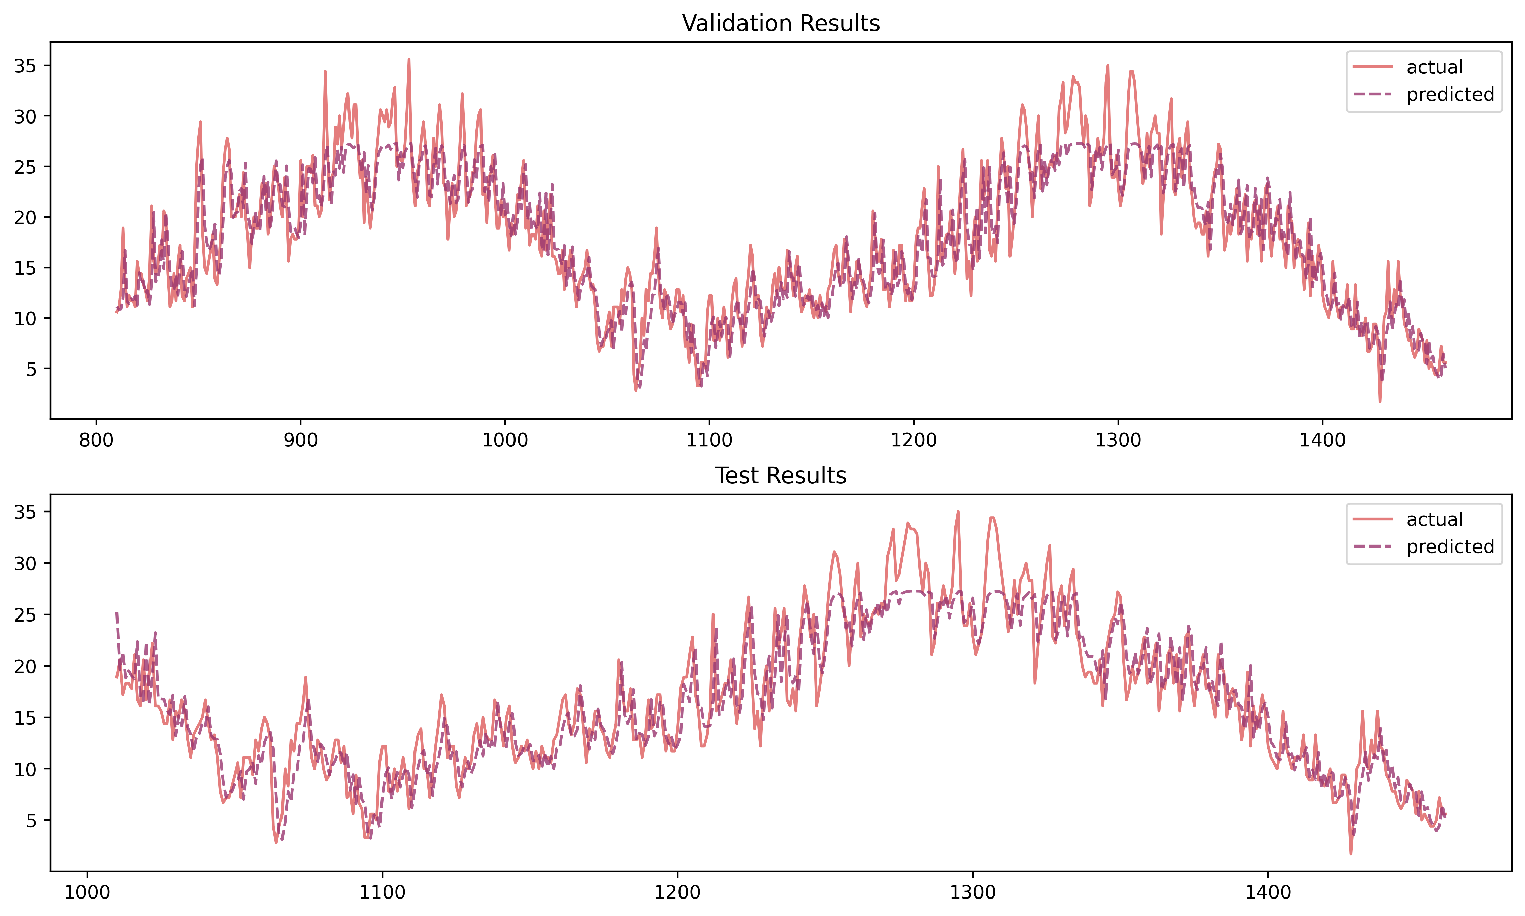
RESULTS
Weather Data Prediction

