Slide 1


Introduction to
STS4006: Advanced competitive coding II
Career Development Centre (CDC)
VIT-AP University

Slide 2
Course Details
Course Code | STS4006
Course Title | Advanced Competitive Coding II
Credits Assigned | 3
Pre-Requisites | STS3007
Anti-Requisites

Slide 3
Slot Details
Class ID
Slot Allotted | 3(D1,D2,A2)
Number of Hours / Week | 3 Hours
Timings
Total Number of Hours Required | 45 Hours (As Per Syllabus)

Slide 4
Course Objectives/ Why this Course?
This course is designed to enhance programming skills and logical thinking in competitive coding.
It will focus on the implementation and application of advanced data structures such as linked lists, queues, stacks, trees, and graphs, along with dynamic programming techniques.
Through this, you will strengthen your problem-solving abilities and improve your proficiency in tackling complex programming challenges.

Slide 5
Course Outline
Number of Modules | 4 | Total number of classes required: 45
Module 1 | Data Structures(LinkedList ,Stack , Queue) | No. of Hours: 12hrs
Loop Detection Sort the bitonic DLL Segregate even & odd nodes in a LL Merge sort for DLL Minimum Stack The Celebrity problem Iterative Tower of Hanoi Stock Span problem Priority Queue using DLL Sort without extra Space Stack permutations
Major takeaways from Module 1 | You will get used to different data structures like LinkedList , Stacks and queues
Activities from Module 1

Slide 6
Course Outline
Module 2 | Data Structures: Trees , Graphs | No. of Hours: 12hrs
Recover the BST Views of a Tree Vertical Order Traversal Boundary Traversal BFS,DFS Dial’s Algorithm
Major takeaways from Module 2 | Learning about the logic developing and usage of Trees and Graphs
Activities from Module 2
Bellman-Ford Algorithm
Topological Sort
Heap Sort
Binomial Heap
K ary heap
Winner Tree

Slide 7
Course Outline
Module 3 | Maps, Sets, Hashing | No. of Hours: 3hrs
HashMap to Tree Map Types of Sets Distributing items when a person cannot take more than two items of same type
Major takeaways from Module 3 | Learning about the Maps and sets usages and also about hashing
Activities from Module 3

Slide 8
Course Outline
Module 4 | Dynamic Programming | No. of Hours: 15 hrs
Introduction - Basic Fibonacci problem Longest Common Subsequence Longest Increasing Subsequence Longest Bitonic Subsequence Longest Palindromic Subsequence Subset sum problem 0-1 Knapsack
Major takeaways from Module 4 | Learn about the Dynamic programming and how it is efficient compared to other approaches
Activities from Module 4
Traveling Salesman
Coin change
Shortest common supersequence
Levenshtein Distance Problem
Rod Cutting Problem
Wildcard Pattern Matching
Pots of gold game

Slide 9
Course Outcome
Proficiency in Data Structures: Develop a deep understanding of advanced data structures such as linked lists, queues, stacks, trees, and graphs, and effectively implement them in programming.
Dynamic Programming Mastery: Apply dynamic programming techniques to solve optimization problems and complex coding challenges efficiently.
Improved Problem-Solving Skills: Enhance logical thinking and analytical skills to approach and solve competitive programming problems.
Algorithm Optimization: Learn to optimize algorithms for time and space efficiency in real-world scenarios.
Readiness for Competitive Programming: Build confidence and expertise to participate in coding competitions by solving diverse and challenging problems.
Practical Application: Gain hands-on experience in coding with a focus on practical problem-solving using data structures and algorithms.

Slide 10
Reference Materials
The Reference materials will be directly shared to your VTOP and other materials needed will be shared by the faculty to your mails directly.

Slide 11
Tentative Evaluation Policy and Grading Criteria
Assessment Tests |  |  | Weightage | 70%
Type of Exam | Total Marks | Weightage | Duration | Number of Question
CAT 1 + CAT2 | 50 | 15%CAT1 + 15% CAT2 | 1 Hour | 10 MCQS+2 Coding Questions
FAT | 100 | 40% | 1 Hour 30 Minutes | 30 MCQS+2 Coding Questions
Internal Assessments |  |  | Weightage | 30%
Type of Assessment | Total Marks | Weightage | Remarks
Quiz 1 | 20 | 10 % | Tentative Date
Quiz 2 | 20 | 10 % | Tentative Date
Assignment(s) + Activities | 20 | 10 % | Tentative Dates will be shared later
Exam Type: Closed Book
Grading Policy: Absolute
Pass Criteria: ≥ 50% weightage
Absolute Grading Policy
S | A | B | C | D | E | F
90-100 | 80-89 | 70-79 | 60-69 | 55-59 | 50-54 | 0-54

Slide 12
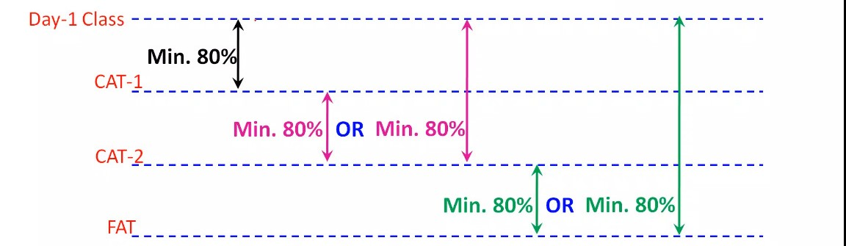
Attendance Policy
Attendance will be taken both manually and through biometric attendance marking system.
Any kind of relaxation in the attendance policy will be informed and handled by the academics team. Course faculty is not authorized to mark a student present, who was absent for a class, under any circumstances.
Course faculty is not authorized to approve medical/family emergency leaves/ODs, etc., even if it is communicated through mentors/faculty co-ordinators.
If a student is eligible for OD for working under an authority, the same is to be communicated through the said authority to academics office. Course faculty is not authorized to mark OD/ ML.
For any attendance related quires, please write to:

Slide 13
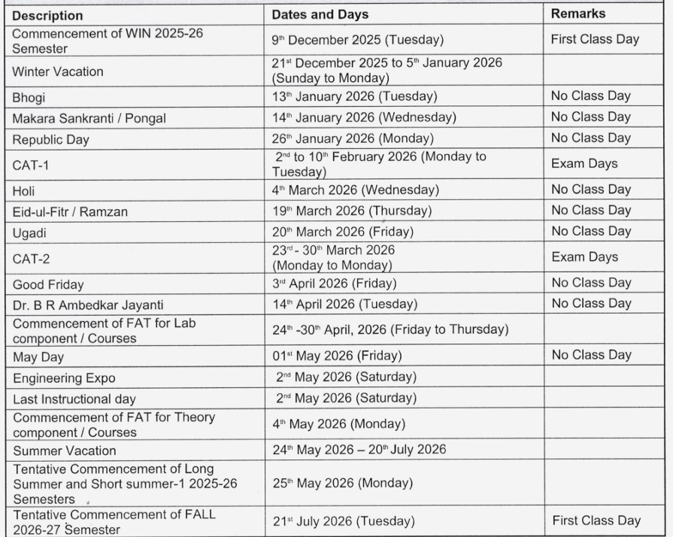
Academic Calendar – WIN Semester 2024-25 (Regular)

Slide 14
Details of the Course Faculty
Name | Sravani Sarisa
Company | FACEPREP
Mail ID | sravani.facevitap@gmail.com (faculty) sanjay.facevitap@gmail.com(Face coordinator)
Cabin Details | AB1, 305
Free hours for doubt clearance | Wednesday – 10 am to 11 am, Friday –10 am to 11 am

Slide 15
General Instructions
Students are allowed to enter the class within the first 5 minutes of the session without seeking permission. However, entry after 5 minutes will not be permitted without a valid reason.
The use of mobile phones during class should be avoided. In case of an emergency call, please step outside the classroom to take the call and return afterward.
If you have any concerns or issues, feel free to address them during the class or email me using the contact provided in the previous slides.
Regarding any attendance issues kindly follow the below mentioned format
To : sravani.facevitap@gmail.com
Cc : sanjay.facevitap@gmail.com
Subject: Attendance issue | Reg No | Date
Body of the letter :
Register number :
Name :
Course code :
Slot :
Faculty Name :
Mention about the Issue :
Format should be followed otherwise mail will not be considered.

Slide 16
General Instructions
Regarding Assignment Submission mail format
To: sravani.facevitap@gmail.com
Subject : STS4006 | Assignment -01 | Reg No | Slot
Body :
Name :
Reg No:
No of questions :
Problem Statement Name :
Format should be followed otherwise mail will not be considered.

Slide 17
Thank You…

