Slide 1
Shiva Teja Chintala
Koushal Vanam
Identifying Misinformation in News Articles Using NLP and Machine Learning

Slide 2
Research Question:
How can Natural Language Processing (NLP) and Machine Learning (ML) techniques can be used to effectively detect and classify misinformation in news articles?

Slide 3
Background:
In the digital age, the internet has become a major source of information, but it has also led to a rise in fake news—deliberate misinformation aimed at influencing the public for political, financial, or social reasons. This has eroded trust in credible media and complicated crisis management, as seen during COVID-19. Thus, there is a need for automated systems to quickly identify false information, as traditional fact-checking is too slow and costly.

Slide 4
Datasets:
•The datasets were collected from Hugging Face, an online platform that provides access to various NLP datasets for training and developing machine learning models. Hugging Face is well-known for hosting open-source datasets and models, making it a reliable source for research and development in the NLP space.
•Dataset Names:
Fake.csv (Fake News Dataset)
True.csv (Real News Dataset)
•The two datasets have approximately 20,000 news articles, creating a balanced dataset for training machine learning models to classify real vs. fake news.

Slide 5
Text Cleaning Process
Noise Removal:
Removed unnecessary formatting elements, such as HTML tags, special characters, and emojis, to retain only meaningful textual content.
Lowercasing:
Standardized the text by converting all words to lowercase, ensuring that similar words like "Hello" and "hello" are treated identically.
Punctuation Removal:
Discarded punctuation marks, as they generally do not contribute semantic meaning, simplifying the text for analysis.
Stop words Removal:
Filtered out common words like "is," "and " "the," which are typically less informative and don’t aid in distinguishing between real and fake news.
Numbers Removal:
Removed numerical values or converted them to words, focusing on linguistic content, as numbers may not add value to the analysis.

Slide 6
Preprocessing steps in NLP
1.Tokenization:
Sentence Tokenization: Separated text into individual sentences to analyze sentence-level context.
Word Tokenization: Split the text into individual words or tokens, allowing for detailed word-level analysis.
2. Stemming: Reduced words to their base form (e.g., "running" to "run") to minimize variations and reduce dimensionality.
3. Lemmatization: Mapped contextually related words with similar meanings to a single base word (e.g., "better" to "good"), helping to standardize vocabulary and enhance the model's understanding of semantics.
4. Word2Vec Embeddings: Used Word2Vec to map words into a dense vector space based on their context, capturing semantic relationships. Each sentence was converted to an average word vector, allowing the model to interpret meaning from context.

Slide 7
Exploratory Data Analysis (EDA)
•Key Steps
Data Cleaning: Removed null values, standardized dates, labeled categories (fake = 0, real = 1).
Feature Engineering: Added features like word count and average word length per article.
•Visualizations & Findings
Subject Distribution: Revealed frequent topics in fake vs. real news.
Text Characteristics: Real news tends to have higher word count and concise language.
Timeline Analysis: Noted spikes in fake news during key events.
•N-Gram Analysis
Identified common bi-grams and tri-grams, showing distinct language structures between categories.

Slide 8
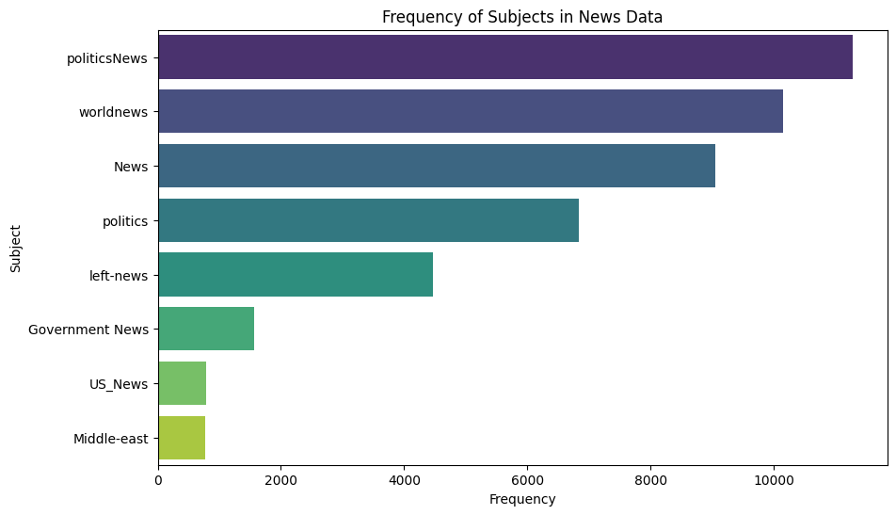
Visualizations
This bar graph illustrates the distribution of subject frequencies within the dataset, highlighting "world News" and "Politics News" as the most prevalent subjects.

Slide 9
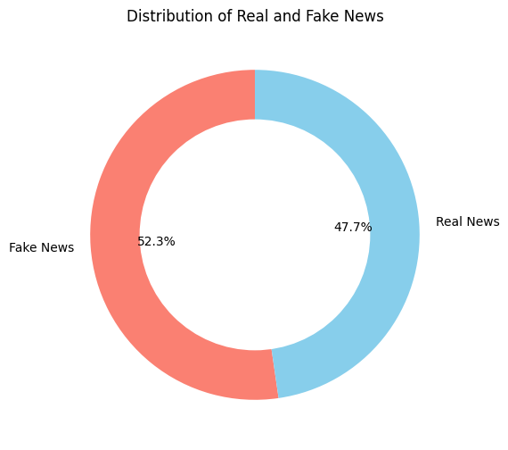
The Donut chart illustrates the distribution of real and fake data in the dataset, showcasing a fair balance between the two categories.

Slide 10
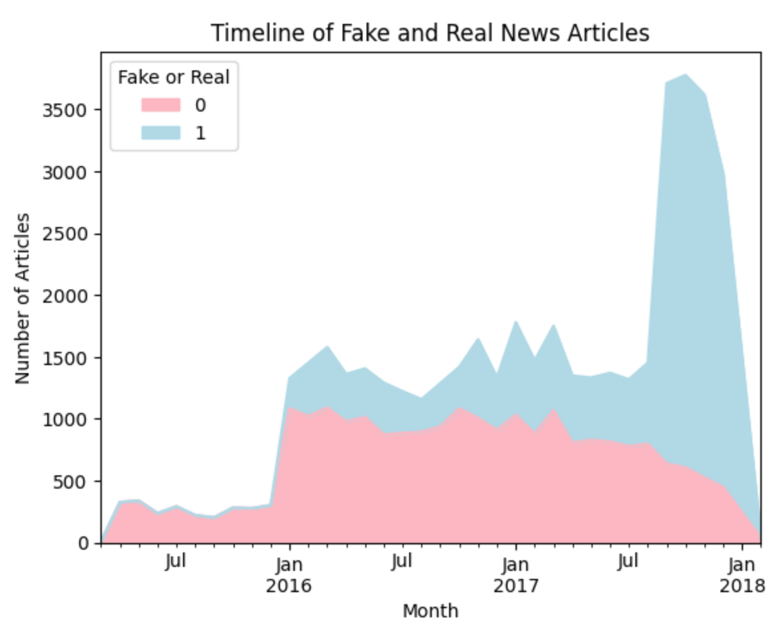
Timeline Visualization of Fake and Real News Articles:
This shows the distribution of fake and real news articles over time, highlighting notable patterns. There is a marked increase in the number of articles, both real and fake, during Jan of 2016, coinciding with heightened political events. Another significant spike is observed towards the end of 2017, indicating a surge in published articles during this period. This trend suggests that misinformation and news dissemination tend to intensify around key events, which could be crucial for understanding when misinformation spikes and applying targeted detection strategies.

Slide 11
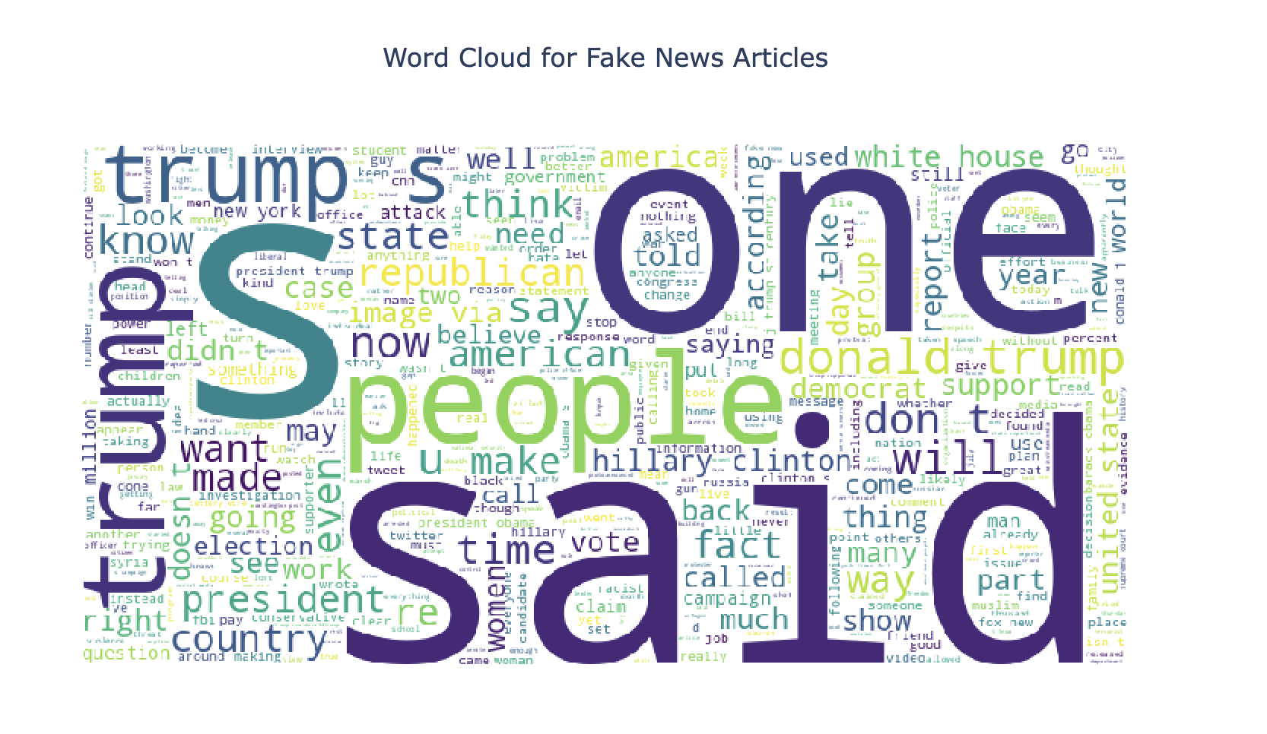
Word Cloud for fake neews article
From the word cloud, we can observe that the most commonly used words in fake news articles seem to be "said", "Donald Trump", "American", "people", "according", "women”, "Hillary Clinton"

Slide 12
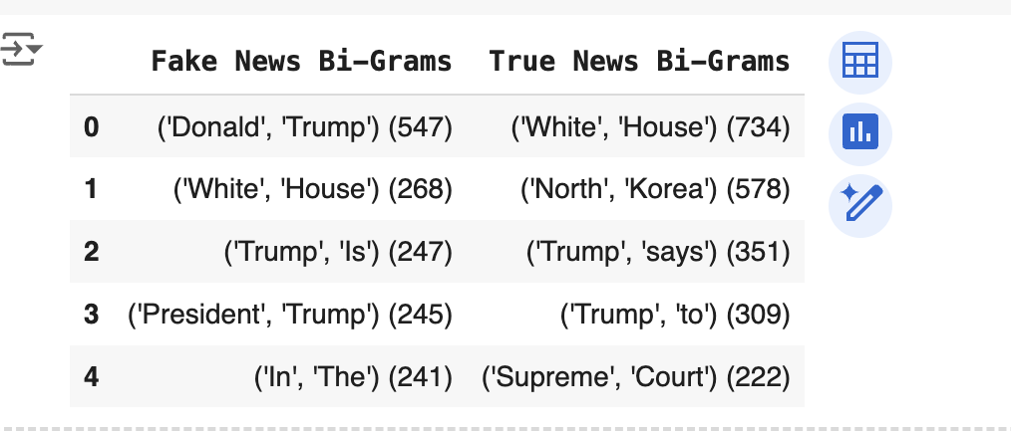
N-gram Analysis:
BI-Gram Analysis:
In fake news titles, 'Donald Trump' appears 547 times, showing a strong focus on sensationalism or possible political bias. This frequent mention suggests an aim to attract attention or stir controversy in fabricated stories. 'White House' follows closely with 268 appearances, reinforcing the theme of political intrigue or manipulation.
Conversely, in true news titles, 'White House' dominates with 734 appearances, highlighting the importance of political coverage and government affairs in real news. 'North Korea' comes second with 578 appearances, indicating a significant focus on international relations and geopolitical developments.

Slide 13
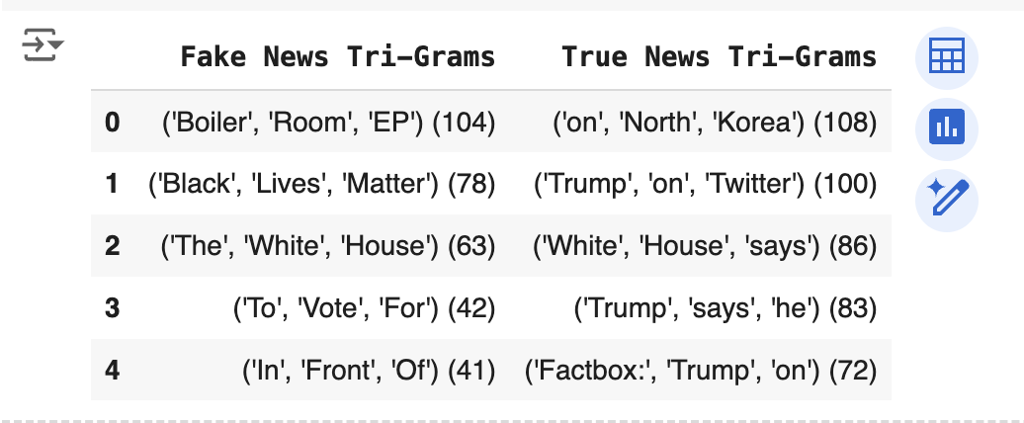
Tri-Gram Analysis:
Fake News Tri-Grams: Common phrases like 'Boiler Room EP' and 'Black Lives Matter' reflect a focus on sensationalism and controversial topics, often designed to grab attention without context or credibility.
True News Tri-Grams: Frequent phrases like 'On North Korea' and 'White House says' demonstrate an emphasis on objective reporting, credible sources, and factual coverage of events.

Slide 14
Model Development
Parallel Processing:
Objective: Speeds up text preprocessing for large datasets.
How It Works:
Data is divided into smaller chunks.
Each chunk is processed simultaneously using multiple CPU cores.
Key Benefit: Significant reduction in preprocessing time, enabling faster workflows.
Word2Vec Embeddings:
Purpose: Converts words into high-dimensional vectors to capture semantic relationships.
Principle: Words with similar meanings have similar vector representations.
Advantage: Facilitates better understanding of text semantics for downstream tasks like classification and clustering.
Average Word Vector Representation
Concept: Converts sentences into fixed-length vectors by averaging word embeddings.
Steps:
Each word is represented as a vector in the Word2Vec model.
Vectors are averaged element-wise to create a single representation for the sentence.

Slide 15
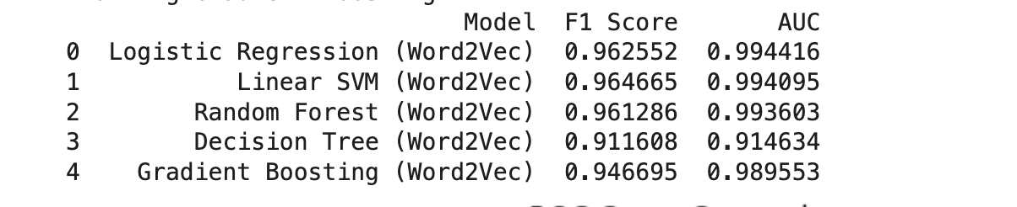
Evaluation Metrics:
We trained five machine learning models: Logistic Regression, Linear SVM, Random Forest, Decision Tree, and Gradient Boosting.
All models used Word2Vec embeddings to capture contextual relationships within the text data.

Slide 16
The models were evaluated using F1 Score and AUC (Area Under the ROC Curve) to measure their accuracy and ability to distinguish between fake and real news.
Logistic Regression and Linear SVM demonstrated the highest F1 Scores and AUC values, indicating their strong classification performance.
Random Forest and Gradient Boosting also performed well, showcasing their robustness in handling complex patterns.
The Decision Tree model showed relatively lower performance, highlighting its limitations in capturing nuanced data relationships.

Slide 17
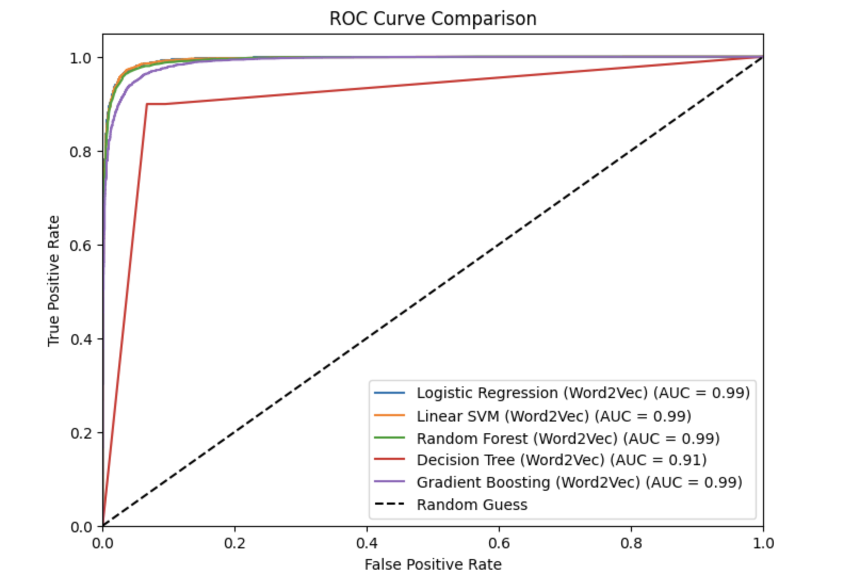
ROC Curve
• The Area Under the ROC Curve (AUC) is presented as a summary metric of the classifier's overall discrimination ability, with values ranging from 0.91 to 0.99 across the different classifiers evaluated using Word2Vec embeddings. A higher AUC value demonstrates the superior ability of the classifier to distinguish between real and fake news effectively.

Slide 18
"Evaluation of GPT for Fake News Detection"
Explored transformer-based models like GPT to classify fake and real news articles. GPT achieved a precision of 47% and an F1-score of 64% for fake news, while for real news, it attained a precision of 100% and an F1-score of 4%, highlighting its capability in contextual understanding.

Slide 19
User Interface with Stream lit
Streamlit was used to create a web application incorporating Logistic Regression, Linear SVM, and GPT-3 models for fake news detection. The app allows users to input text, select a model, and receive real-time probabilities indicating whether the news is fake or real.
This interactive tool enhances user accessibility and provides immediate feedback on news credibility, demonstrating the practical application of combining traditional machine learning and advanced transformer-based models like GPT-3 to tackle misinformation.

Slide 20
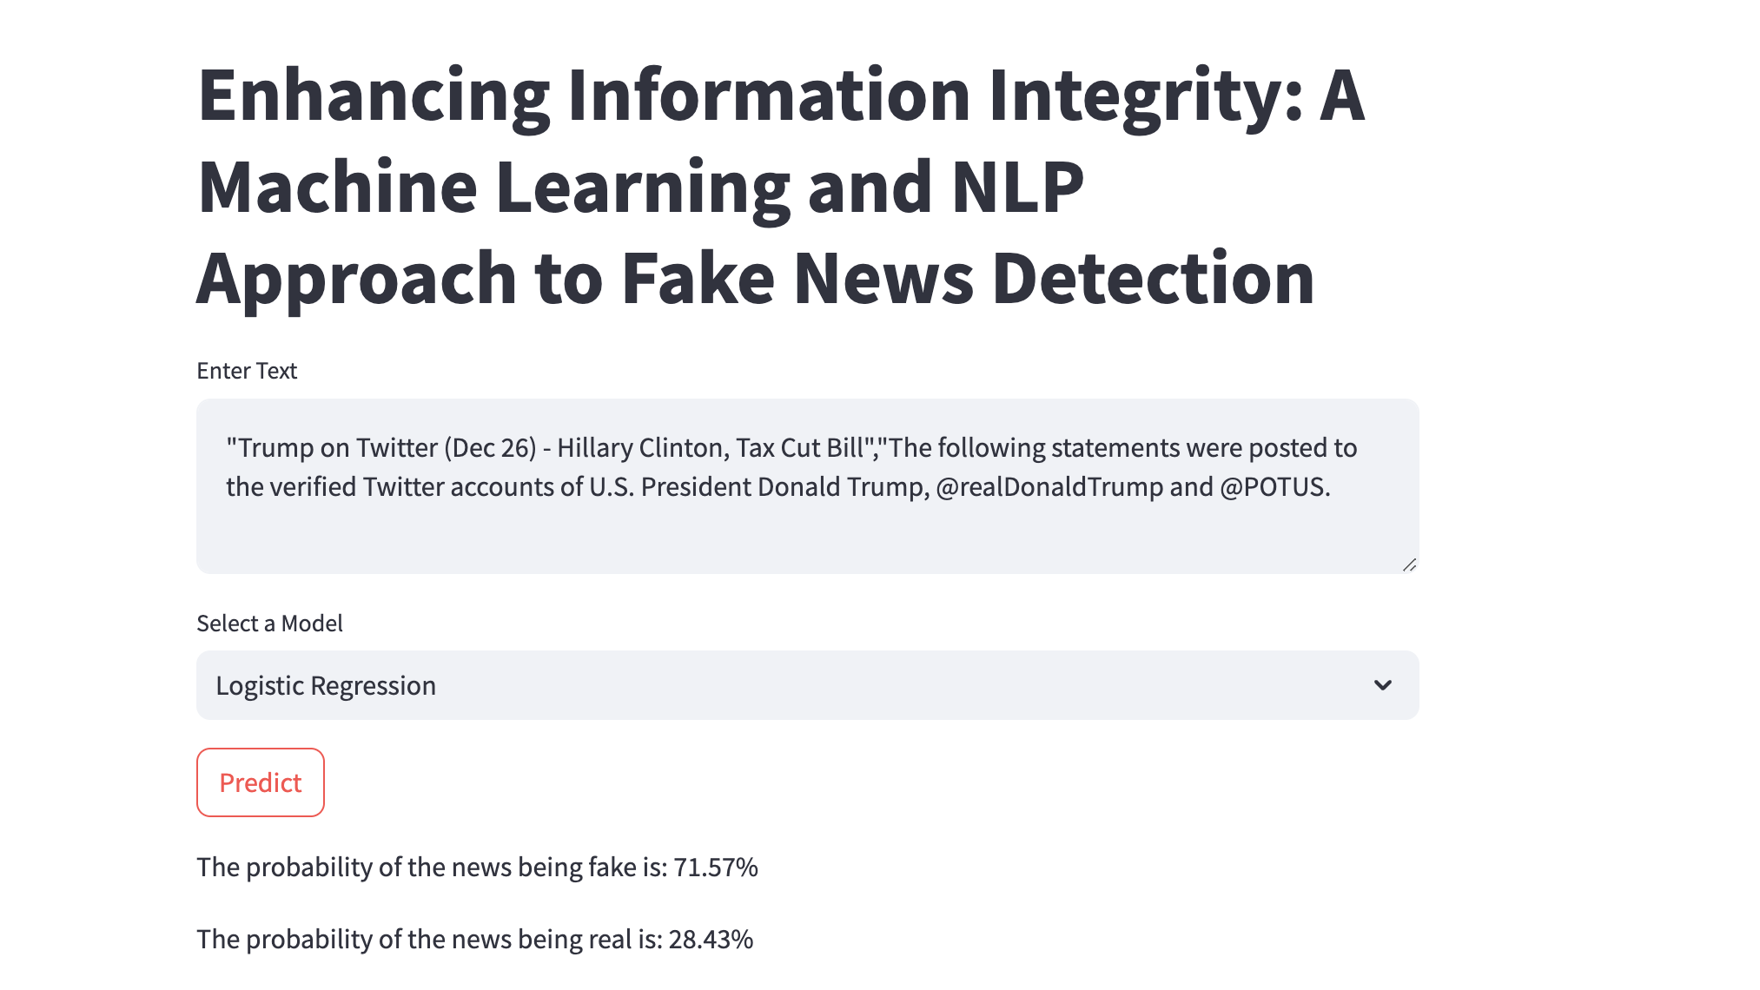

Slide 21
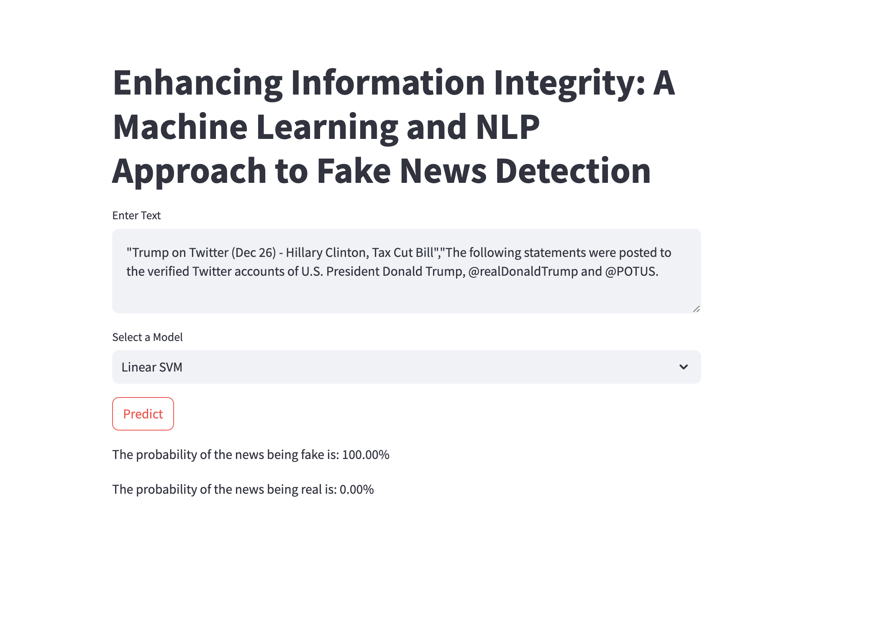

Slide 22
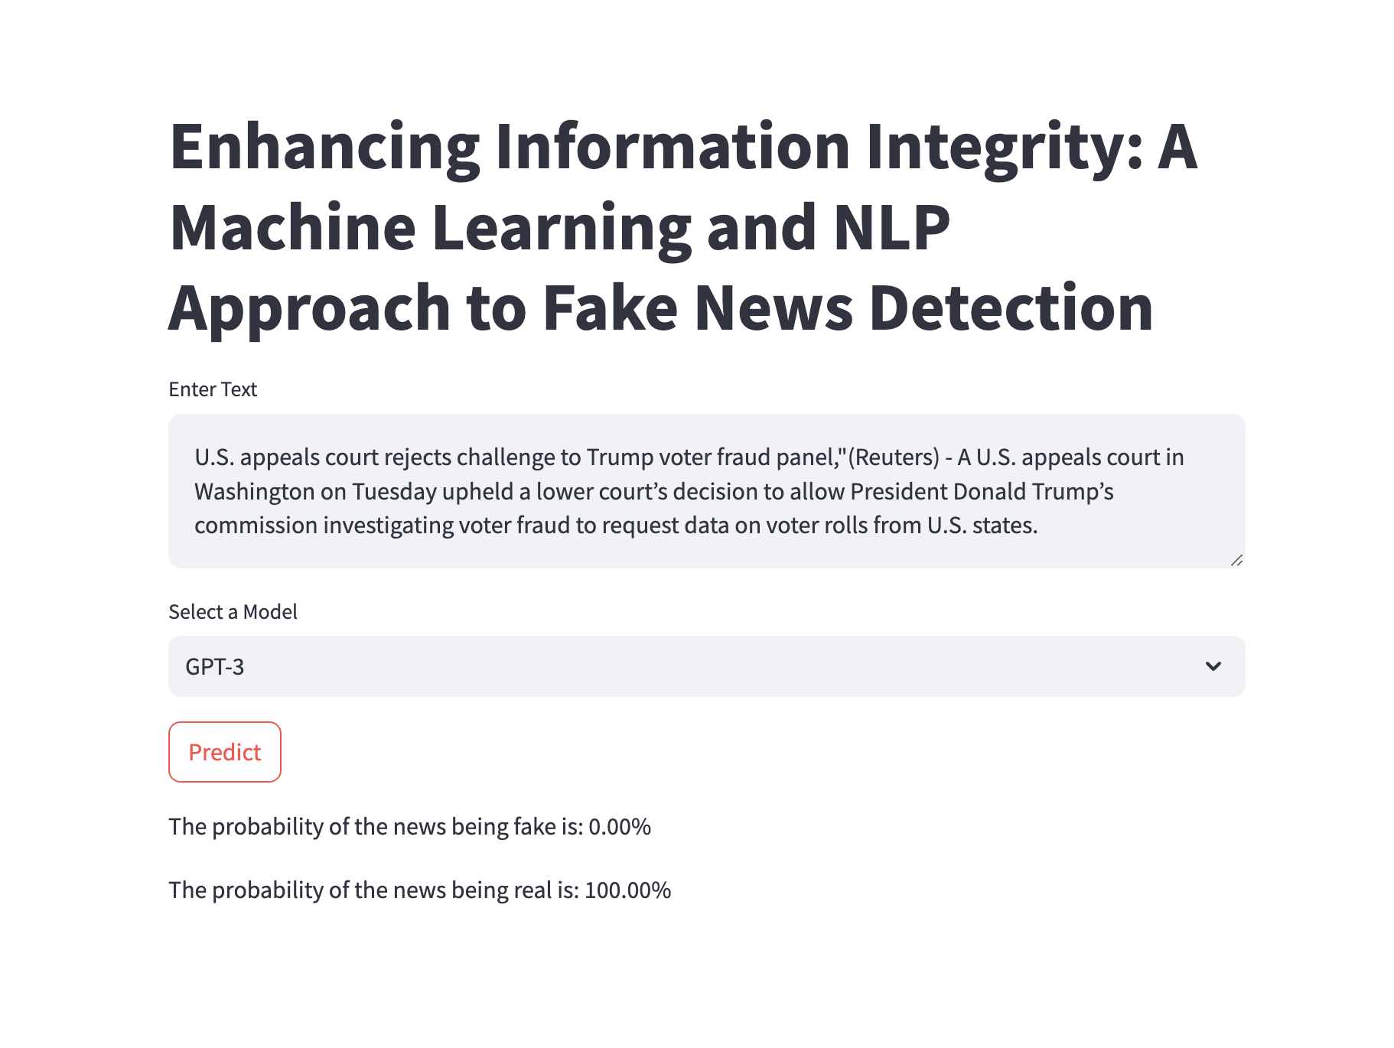

Slide 23
Future Work
Model Optimization: Fine-tune models using domain-specific datasets and explore ensemble techniques to enhance prediction accuracy.
Real-Time Integration: Implement real-time news monitoring to detect and alert users about misinformation as it emerges.
Multi-Language Support: Expand capabilities to detect fake news across multiple languages using multilingual transformer models.

Slide 24
Thank you....

