Slide 1

PREDICTION ANALYSIS AND FORECASTING of CITY BANK AND WELLS FARGO BANK
BY,
SHIVA TEJA CHINTALA
VAMSI KASUKURTHI
KOUSHAL VANAM

Slide 2
Problem Statement
To forecast the stock prices of City Bank and Wells Fargo for a future period.
To evaluate the effectiveness of SARIMA and LSTM models in financial time series forecasting.
To compare the performance of these models to determine which is more suited for stock price predictions.

Slide 3
Data Collection
The two stocks named City Bank and Wells Fargo are collected from Yahoo Finance.
The time period of data collection is from 01-01-2015 to 04-01-2024.
Focused on daily closing prices to analyze stock performance over time.

Slide 4
Architecture
Data Source
Data Processing
Training and Testing
Models
(SARIMA and LSTM)
Predictions
Visualizations
Modelling and Fitting

Slide 5

STEPS INVOLVED:
Data Collection: Gathered stock prices from Yahoo Finance.
Data Preprocessing: Prepared data for analysis, handling missing values.
Model Development: Developed SARIMA and LSTM models based on the processed data.
Evaluation: Assessed model performance using RMSE (Root Mean Square Error) and compared forecasts.
Tools: Python, yfinance for data retrieval, pandas for data manipulation, statsmodels for SARIMA, TensorFlow/Keras for LSTM.

Slide 6
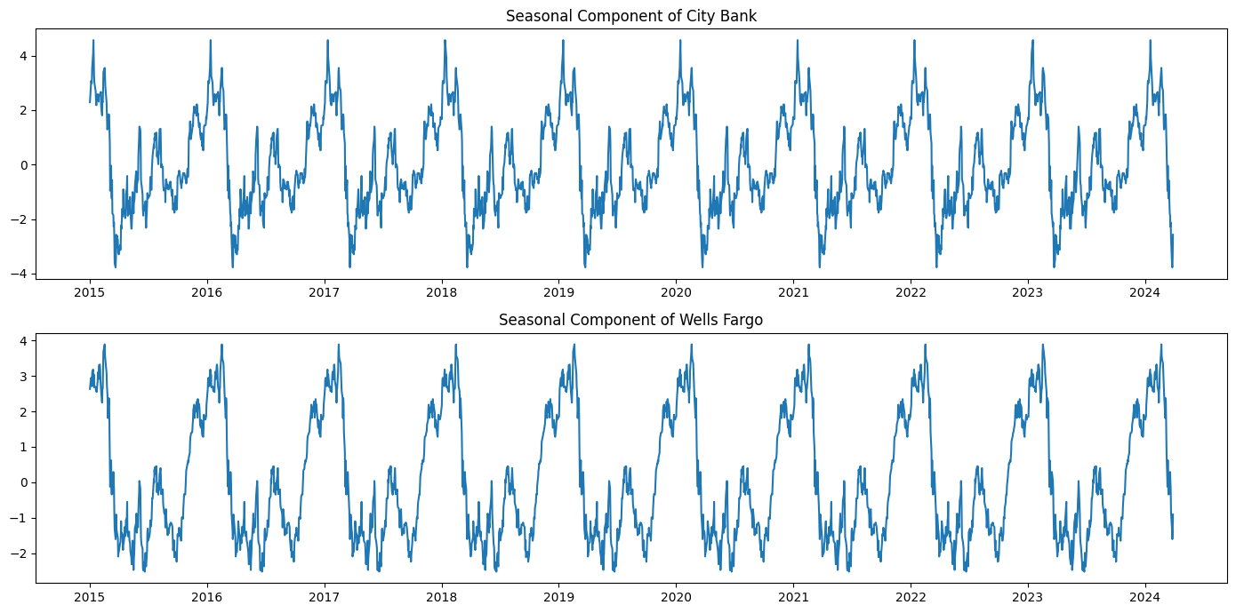
Seasonality Analysis :
The patterns observed here reflect consistent movement that repeat
over a specific time period which indicates seasonality in the data.

Slide 7
Testing for Stationarity
The Augmented Dickey-Fuller (ADF) test, a statistical technique used to check for stationarity, was applied to the closing prices of City Bank and Wells Fargo stocks in our analysis.
 | City Bank p - Value | Wells Fargo P- value
Before Stationarity | 0.06 | 0.213
After Stationarity | 2.33e-11 | 2.03e-10

Slide 8
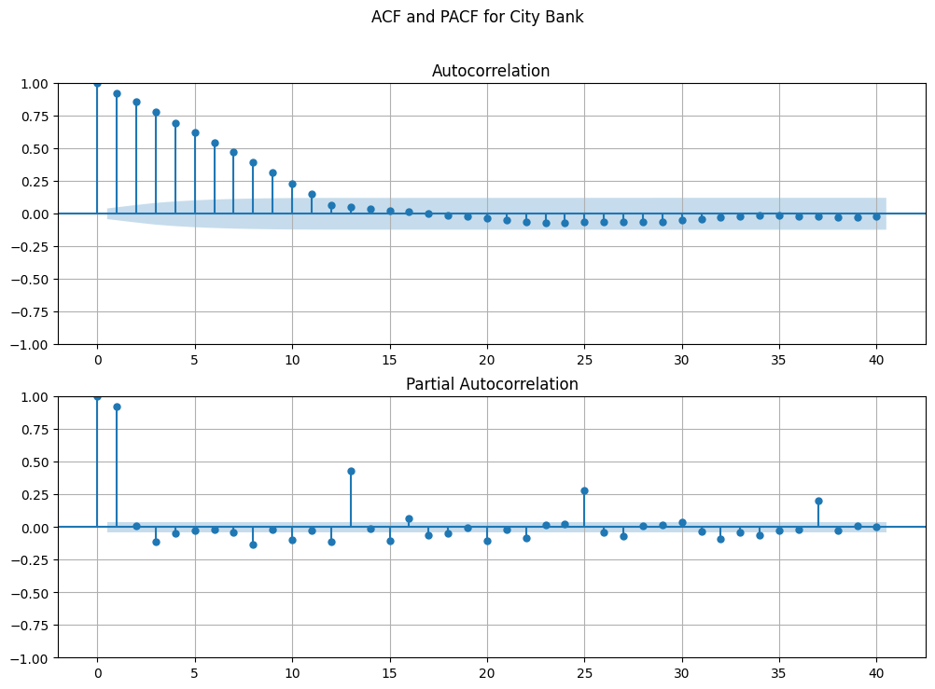
Auto Correlation and Partial Correlation:
For City Bank: AR, I and MA values would be 1,1,0 respectively

Slide 9
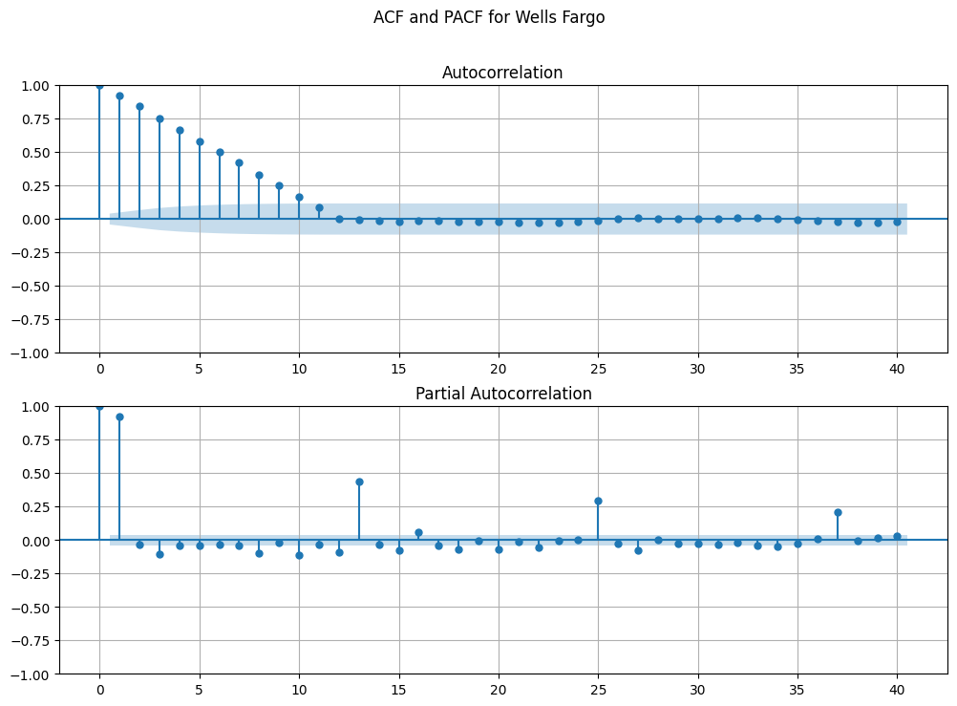
For Wells Fargo Bank: AR, I and MA values would be 1,1,0 respectively

Slide 10
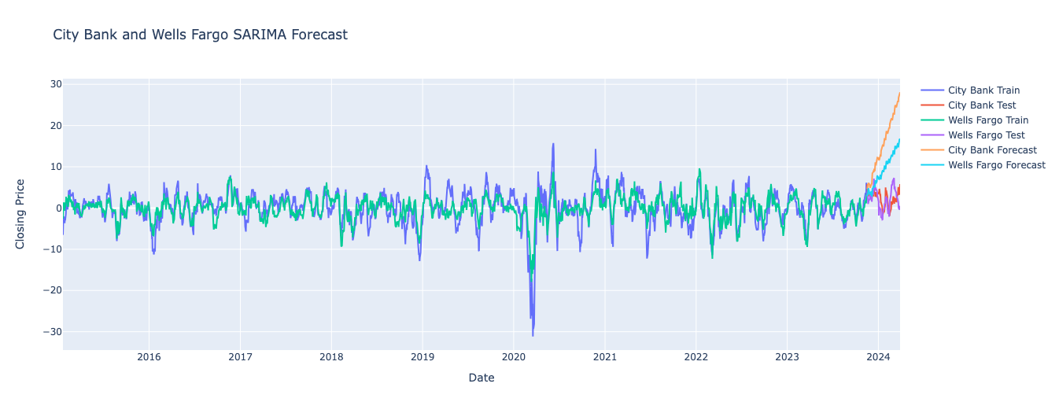
SARIMA Model:
Root Mean Squared Error (RMSE) values obtained for both City Bank (15.584308480917725) and Wells Fargo (8.757585708950899)
SARIMA forecast shows that this steep change may indicate an error.

Slide 11
IMPLEMENTING LSTM
created a new Data Frame with the closing prices of both stocks
Dropped the null values
Scaled the data using MinMax scaler
split the data into training and testing sets
create training and testing data for the LSTM model

Slide 12
LSTM Model Build
Model Initialization: A Sequential model is initialized.
LSTM Layers:
The first LSTM layer has 50 units and return_sequences=True, indicating that it returns sequences instead of just the output at the last time step.
The second LSTM layer is also set to have 50 units and return_sequences=True.
The third LSTM layer has 50 units.
Dense Layer:
A Dense layer is added to the model with 2 units and is used because its a regression task.
Model Compilation:
The model is compiled with the 'mean_squared_error' loss function and the 'adam' optimizer. 'Mean squared error' is a common loss function for regression tasks, and 'adam' is a popular optimizer.
Training:
The model is trained using the training data (X_train and y_train) for 30 epochs.
The batch size is set to 32, which means the model's weights are updated after processing each batch of 32 samples.
A validation split of 10% is used, which means that 10% of the training data is reserved for validation during training to monitor model performance.

Slide 13
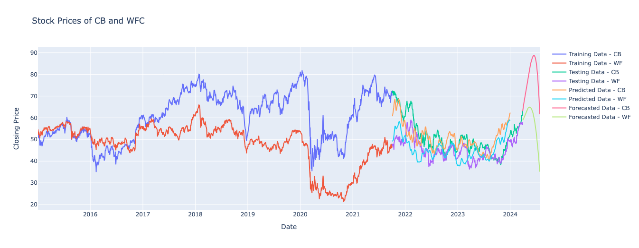
RMSE Values:
City Bank Test RMSE: 1.84
Wells Fargo Test RMSE: 1.65

Slide 14
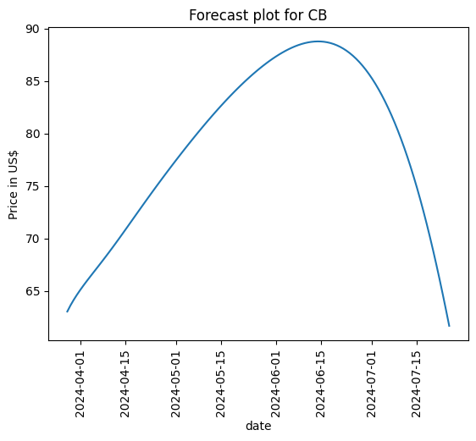
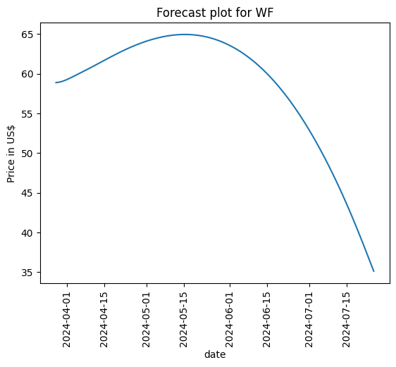
LSTM Forecast Plots

Slide 15
CONCLUSION
According to the RMSE values, the LSTM model outperformed the SARIMA model in projecting the closing stock prices of both banks.
The smaller RMSE number suggests that Wells Fargo's LSTM model forecast was somewhat more accurate than City Bank's.

Slide 16

THANK YOU

