Slide 1

Smart Health Guide: AI-Powered Healthcare Companion
Shiva Teja Chintala
Vamsi Kasukurthi
Koushal Vanam

Slide 2

Introduction:
The Smart Health Guide project seeks to provide reliable, and easily accessible healthcare advice via an AI-powered assistant.
It uses powerful Natural Language Processing (NLP) models to deliver individualized solutions to user health requests depending on their age, gender, and symptoms.
This approach meets the requirement for accurate medical information by combining Large Language Models (LLMs) and real-time data from the internet.
It shows the most recent and accurate healthcare information through live web search.

Slide 3
System Architecture
User Interaction Layer: Gradio interface captures user input and displays results.
Application Layer:
LangChain : Coordinates tool usage and manages agents.
Conversational Memory: Stores recent interactions to maintain conversational flow.
AI Layer: OpenAI GPT models process health queries and generate responses.
External Tools Layer: DuckDuckGo Search Tool fetches the latest information.

Slide 4

Features
General Health Search: A tool that retrieves recent information to answer health queries using DuckDuckGo Search.
Conversational Agent: An advanced natural language understanding system (based on OpenAI GPT models) that interprets queries and provides actionable advice.
Personalized Query Responses: Age, gender, and symptoms are considered to provide specific guidance that aligns with each user's health context.
Contextual Memory: The system retains recent user interactions to maintain conversational flow and ensure consistent answers.

Slide 5
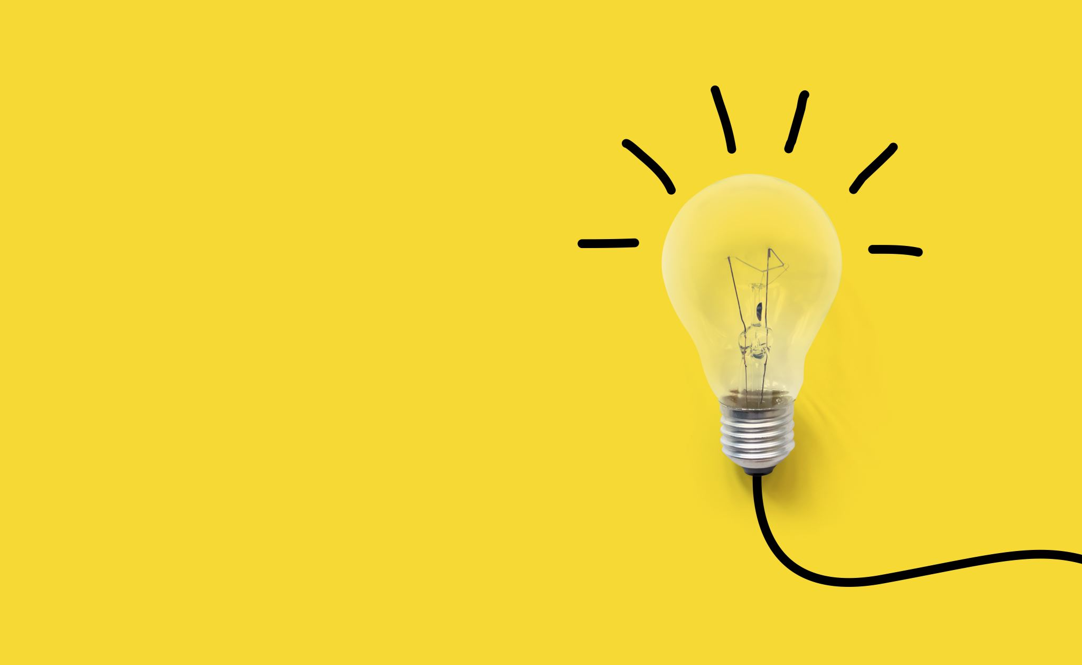
Prompt Template
In this structured template, all available tools are listed, and detailed descriptions are provided for each. This ensures that the agent can effectively decide which tool to use based on the problem at hand. By incorporating these elements into its structure, the custom prompt template supports agents in making decisions that are accurate, efficient, and well-suited to user needs.
Custom Output Parser Class:
The custom output parser class interprets the responses generated by the language model and determines the appropriate next step for the agent. If the response contains "Final Answer," the parser identifies and returns the final response to the user. Otherwise, it scans for "Action" and "Action Input" using regular expressions and identifies the next tool to be used.

Slide 6
Agent Execution:
The AI agent orchestrates tool usage and model inference to generate comprehensive answers to health-related queries. When a user submits a question, the agent:
Processes the prompt by dynamically incorporating relevant context using the custom prompt template.
Selects the appropriate tools based on user input, such as DuckDuckGo Search or other available resources.
Executes the required actions through the OpenAI language model, which interprets the prompt and identifies the necessary tools and steps to answer the query effectively.
Generates a final response that incorporates information from web searches, recent conversation history, and the language model's capabilities.

Slide 7
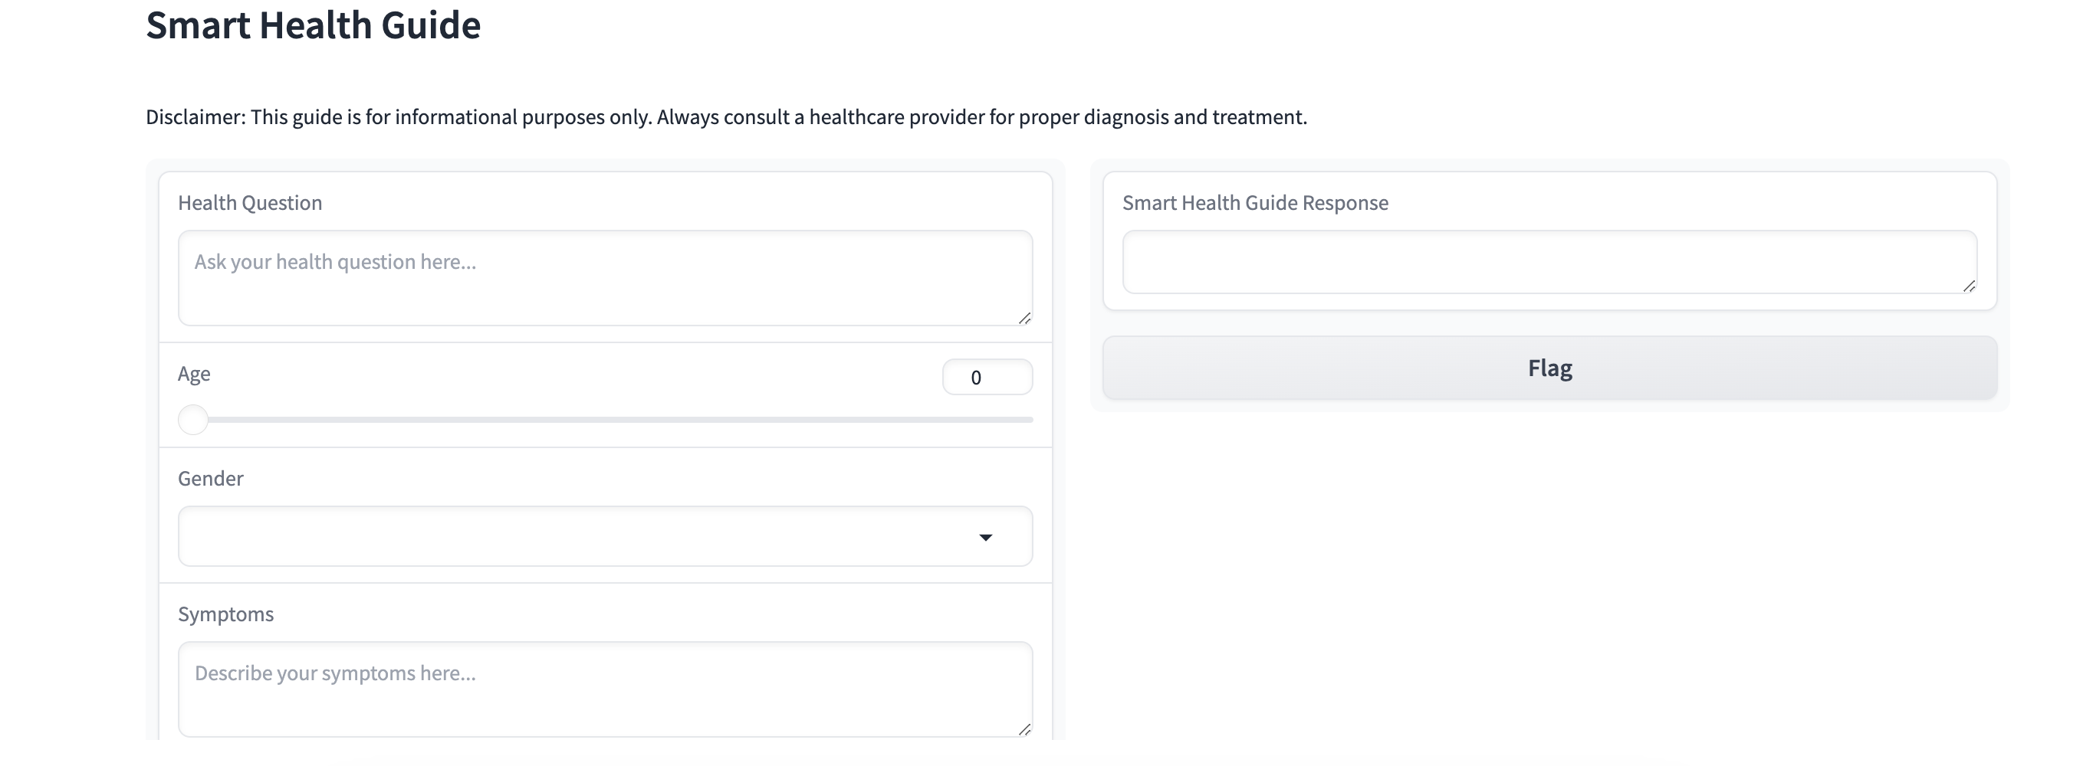
User Interface:
The Gradio interface is used in the project. It features input fields as shown below

Slide 8
Example (Symptoms):
Input: "I've been feeling tired and have had frequent headaches. What could be causing these symptoms
Observation: A headache and fatigue are often a symptom of something else — and it can be hard to narrow down or pinpoint the exact cause. "Headache and fatigue are two different symptoms," says Dr. Vyas. Allergies, Hay Fever, and Fatigue. Symptoms: Fatigue, headache, itchiness, nasal congestion, and drainage. Allergic rhinitis is a common cause of chronic fatigue. But allergic rhinitis often can ... Chronic fatigue. Vestibular neuronitis. Dehydration. Seeking help. Outlook. Prevention. FAQ. Many different conditions, including ear infections and low blood sugar, can make you feel both dizzy ... Common Symptoms. Even though fatigue is a symptom of some underlying condition, it can still cause a combination of mental and physical symptoms, including Weakness. Lack of energy. Constant tiredness or exhaustion. Lack of motivation. Difficulty with concentration. Difficulty starting and completing tasks. feel like a pulsing, throbbing, or tightening feeling. vary in intensity from mild to severe. Other symptoms can include nausea or vomiting. sweating. sensitivity to lights, sounds, or smells. a ...
Final Answer: Based on the information from the General Health Search, it is recommended that you schedule an appointment with your doctor to discuss your symptoms and possible causes. They will be able to provide a proper diagnosis and treatment plan to help alleviate your fatigue and headaches. In the meantime, make sure to prioritize rest and hydration, and try to identify any potential triggers for your symptoms. Take care of yourself and don't hesitate to seek medical help if your symptoms persist or worsen.

Slide 9
Example (Mental Health):
Input: I've been feeling anxious and stressed lately. What are some common practices for managing stress?
Observation: Learn how to cope with stress in the short and long term with these tips and techniques. From guided imagery and meditation to exercise and social support, find out what works best for you. Learn how to cope with stress with physical activity, healthy diet, meditation, laughter, social contact, assertiveness, yoga and sleep. Find out how stress can affect your health and well-being, and what you can do to manage it. Learn how to cope with stress and prevent burnout with science-based strategies, exercises and worksheets. Find out what stress and burnout are, how they affect your health and wellbeing, and how to reduce their impact with positive psychology. Learn effective stress management tips and techniques to cope with stress at work and home. Find out how to identify the sources of stress, cut out unhealthy habits, practice the 4 A's, and more. Learn how stress affects your body and mind, and how to cope with it using relaxation techniques, products and services. Find out how to reset and recalibrate your alarm system with Mayo Clinic's expert advice and resources.
There are many different techniques and strategies for managing stress. It's important to find what works best for you and to make it a regular part of your routine.
Final Answer: Some common practices for managing stress include physical activity, healthy diet, meditation, social support, and relaxation techniques. It's important to find what works best for you and make it a regular part of your routine to maintain good mental health.

Slide 10
Example (Diet and Nutrition):
Input: Could you provide guidance on a balanced diet for someone with high blood pressure?
Observation: High blood pressure and high LDL cholesterol levels are two major risk factors for heart disease and stroke.. Foods in the DASH diet are rich in the mineral's potassium, calcium and magnesium. The DASH diet focuses on vegetables, fruits and whole grains. It includes fat-free or low-fat dairy products, fish, poultry, beans and nuts. The diet limits foods that are high in salt, also called sodium. Including certain foods in your diet, especially ones in potassium and magnesium, may help lower your blood pressure levels ( 1, 3 ). Here are the 17 best foods for high blood pressure. 1. Citrus ... Fats and oils: 2-3 daily servings (1 teaspoon vegetable oil or soft margarine, 1 tablespoon low-fat mayonnaise, 2 tablespoons light salad dressing) Sweets: less than 5 servings per week. (1 ... A balanced diet is crucial for staying healthy and keeping your blood pressure in check. Certain foods can even have an immediate impact on your blood pressure, for better or worse, so your food ... Dietary and lifestyle choices can help manage high blood pressure. A balanced diet focusing on moderate intakes of fruits, vegetables, oats, nuts, lentils, herbs, and spices can be beneficial. In ... It seems like the DASH diet is a good option for someone with high blood pressure. It includes a variety of healthy foods and limits those that can contribute to high blood pressure.
Final Answer: The DASH diet, which focuses on vegetables, fruits, whole grains, and low-fat dairy products, is a good option for managing high blood pressure. It also limits foods high in salt, which can contribute to high blood pressure.

Slide 11
Example (Chronic Diseases):
Input: "What lifestyle changes can help in managing diabetes?
Observation: A blood sugar level below 90 milligrams per deciliter (mg/dL), which is 5.0 millimoles per liter (mmol/L), is too low. The snack you have before exercise should contain about 15 to 30 grams of carbs. Or you could take 10 to 20 grams of glucose products. This helps prevent a low blood sugar level. Learn how to manage your diabetes by eating healthy, exercising, getting checkups, relieving stress, quitting smoking, and watching your alcohol intake. These six tips can help you lower your blood sugar, prevent heart disease, and improve your health. Learn how to adopt a healthy lifestyle that can help you manage your diabetes and improve your health. Find out what foods to eat, how to be active, how to quit smoking and how to manage stress. Get tips, recipes and resources from the American Heart Association. Most people with diabetes have type 2, but all forms of diabetes require multidimensional management strategies. Being proactive about life with diabetes, taking medications as directed, and ... After receiving a type 2 diabetes diagnosis, management involves various strategies, including lifestyle changes and medications. Initially, these lifestyle changes and treatments may slow or stop ...
It seems like there are a lot of different lifestyle changes that can help manage diabetes. It's important to remember that everyone's body is different, so it's important to work with your doctor to find the best combination of lifestyle changes and medical treatment for you.
Final Answer: Some lifestyle changes that can help manage diabetes include eating healthy, exercising regularly, getting regular checkups, managing stress, quitting smoking, and limiting alcohol intake. It's important to work with your doctor to find the best combination of lifestyle changes and medical treatment for your specific needs.

Slide 12
Example (Post-Treatment Care):
Input: " How should I care for myself after a dental extraction?"
Observation: Immediate Post-Extraction Care Bite on Gauze: Immediately after the extraction, your dentist will place gauze over the extraction site. Bite firmly on the gauze for at least 30 minutes to help control bleeding and promote clot formation. Change the gauze as needed and avoid vigorous rinsing or spitting to prevent blood clot dislodging. Wisdom teeth extraction is an outpatient surgery that usually takes about 1 hour. The oral surgeon will either give you local or general anesthetic before beginning the surgery. After the surgery ... Answer: In the initial stages of post-tooth extraction recovery, opting for soft foods to prevent irritation at the extraction site is advisable. Suitable options include soups, yogurt, and mashed potatoes. As healing progresses and discomfort diminishes, a gradual transition to a normal diet can occur. Summary. After surgery to remove a wisdom tooth, it may take 7-10 days for the swelling to go down and 2 weeks to recover fully. Caring for the wound — for instance by using a rinse from 24 ... Dry socket is a distinct kind of pain that follows dental extraction. Early-stage dry socket usually begins one to three days after your tooth has been pulled. Dry socket symptoms include Severe pain in the first few days after an extraction. Pain that radiates from the extraction site outward toward your ear, eye, or neck. Based on my search, it seems like the most important thing to do after a dental extraction is to take care of the wound and prevent any complications. It's also important to eat soft foods and gradually transition to a normal diet as you heal. It's normal to experience some pain and swelling, but if you experience severe pain or other symptoms like dry socket, it's important to contact your dentist for further care.
Final Answer: To care for yourself after a dental extraction, make sure to follow your dentist's instructions for post-extraction care, eat soft foods, and monitor for any complications. If you experience severe pain or other concerning symptoms, contact your dentist for further care.

Slide 13
Conclusion
The Smart Health Guide is an AI-powered medical assistant that responds to user health questions in an accurate and sympathetic manner. The guide makes sure that customers receive personalized advice depending on their symptoms, age, and gender by utilizing OpenAI's complex language models, a flexible prompt template, and comprehensive tools like DuckDuckGo Search. Its intuitive Gradio-based interface makes it easy to navigate and access, while the memory system allows for consistent and context-aware conversations.

Slide 14
Future Work
Incorporating multilingual capabilities to help users from different linguistic backgrounds access healthcare information in their preferred language.
enhancing the knowledge base by integrating more specialized medical databases and scientific literature could enable the guide to provide even more accurate and specialized advice.
Incorporating machine learning algorithms to analyze user trends and feedback will help refine response quality and improve the guide's adaptability.
Implementing voice recognition and conversational AI features could transform the guide into a truly interactive health assistant, making it easier for users to engage in real-time, natural dialogues about their health concerns.

Slide 15

Thank you

