Slide 1
Add Your Website
Keeper
Submitted by: Shivaksh Sharma
2110992079
G-19

Slide 2
Add Your Website
Enter title
Introduction
Welcome to the comprehensive presentation for Keeper, your go-to web-based note-taking application. This presentation is designed to provide a deep understanding of Keeper's features, functionalities, and how to make the most of the application.

Slide 3
Technologies Used:
HTML
CSS
H
C
ReactJS
Rjs
J
Javascript

Slide 4
Add Your Website
Enter title
Key Components
Main Component: App
Custom Component: Notes, To-Do list etc.
State Variables: keyword and searches
External Dependencies
User Interface Elements

Slide 5
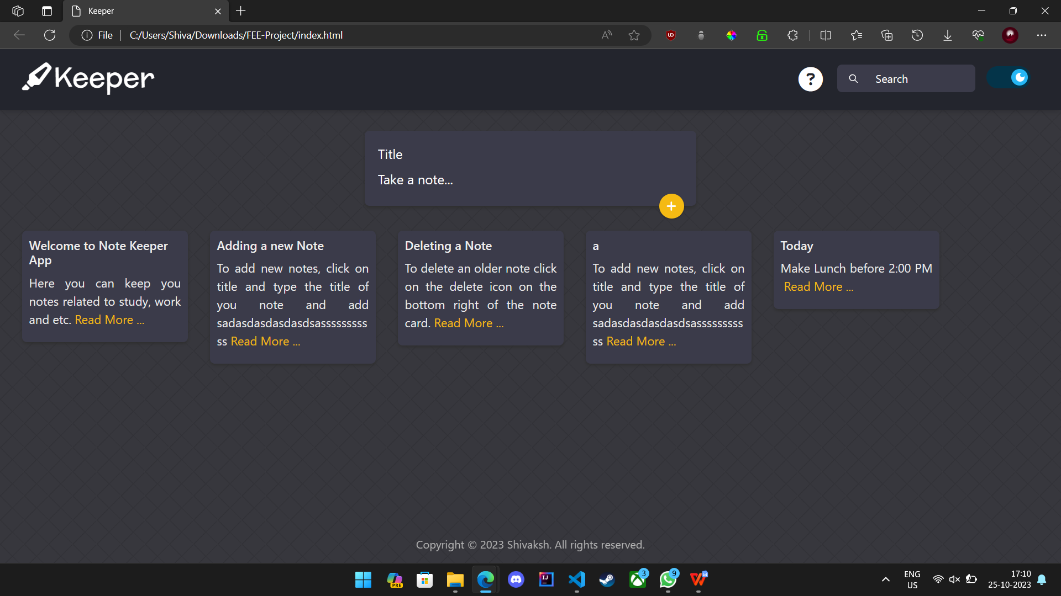
A Preview of the App

Slide 6
Add Your Website
Enter title
Conclusion
State Management: The use of React state variables (notes and search) to manage and update the
application's data and user input.
Dynamic Filtering: Implementing real-time filtering of users data data based on user provided search queries.
Component-Based Architecture: Utilizing React components to modularize the user interface
and encapsulate functionality.
User Interaction: Allowing users to search for specific cryptocurrencies and see key information
about them in real-time

