Slide 1
Apache Airflow: Basic Understanding
Speaker- Akhil Garg (Lead Engineer @ EPAM Systems)
18 May 2024, Apache Meetup

Slide 2
Introduction
Apache Airflow
Open source platform for programmatically managing workflows.
Allows users to define workflows as Directed Acyclic Graphs (DAGs)
Execute them as a series of tasks.

Slide 3
Usages
Apache Airflow
Data processing
ETL (Extract, Transform, Load)
Machine learning pipeline orchestration
CI/CD (Continuous Integration/Continuous Deployment) workflows

Slide 4
Benefits
Apache Airflow
Scalability
Flexibility
Monitoring and alerting
Dependency management
Extensibility

Slide 5
Shortcomings
Apache Airflow
Complexity of setup and configuration
A learning curve for new users
Lack of built-in support for real-time workflows
Performance overhead for small-scale workflows

Slide 6
Architecture
Apache Airflow architecture consists of several components
Scheduler: Responsible for scheduling DAG runs and managing task execution.
Executor: Executes tasks on worker nodes.
Metadata Database: Stores metadata related to DAGs, tasks, and executions.
Web Server: Provides a user interface for monitoring and managing workflows.
Worker Nodes: Execute tasks as directed by the scheduler.

Slide 7
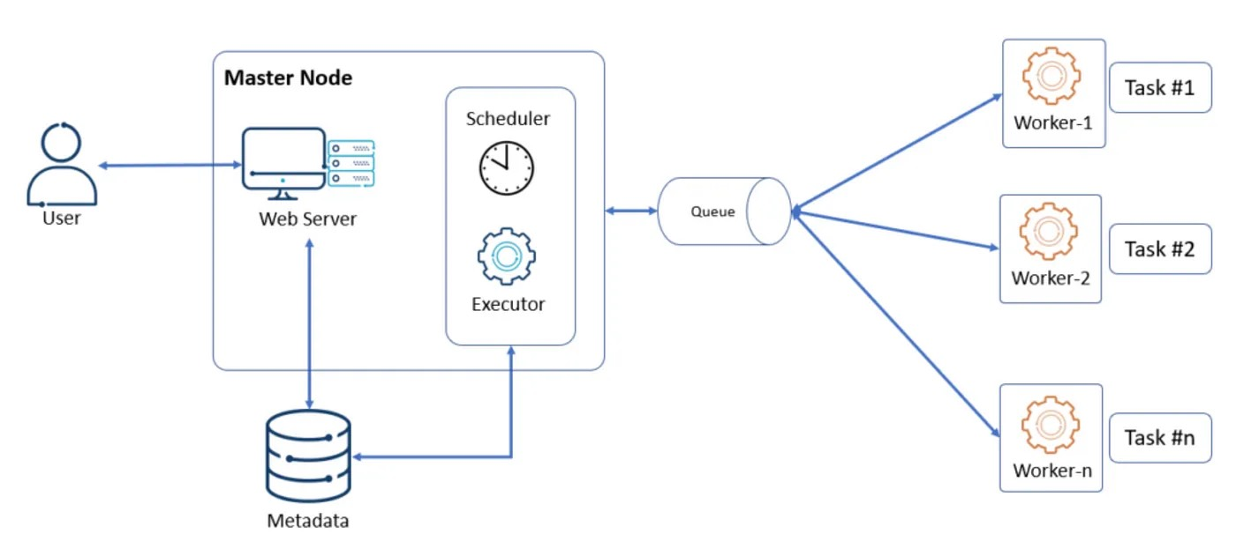

Slide 8
DAG (Directed Acyclic Graphs)
Represent workflows as a collection of tasks with dependencies between them
DAGs have a specific order of execution and cannot have cycles

Slide 9
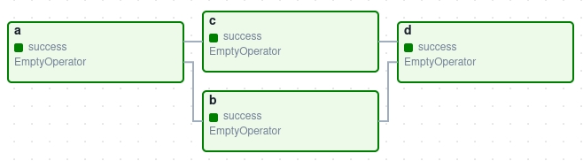

Slide 10
Operators
Operators define individual tasks within a DAG
Determine what gets done in each task.
Ex. Bash, Branch, Python, Dummy, ShortCircuit

Slide 11
Simple DAG
Simple DAG consists of a sequence of tasks that execute in a linear fashion, one after the other.
Each task performs a specific action, such as extracting data from a source, transforming it, and loading it into a destination.

Slide 12
Complex DAG
Complex DAG consists of a sequence of tasks that execute in a non-linear fashion, where one task can have many other branches tasks.
At such branch task, we use branch operator where it checks for the value of the output of the current task and based on the value it determines next task.
This way any complex workflow can be formed.

Slide 13
Installation
&
Demo

Slide 14

CONNECT WITH ME
https://www.linkedin.com/in/akhilgarg1990

