Slide 1
P-N JUNCTION DIODE

Slide 2
P-N JUNCTION :-A p–n junction is a boundary or interface between two types of semiconductor material, p-type and n-type, inside a single crystal of semiconductor. It is created by doping.

Slide 3
Electronic Symbol …..the triangle shows indicated the direction of current
P type
N type
Depletion layer forms an insulator between the 2 sides

Slide 4
Formation of depletion layer
the excess electrons in the N region cross the junction and combine with the excess holes in the P region.
N region loses its electrons ……becomes + vlY charged
P region accepts the electrons ……becomes –vly charged
At one point , the migratory action is stopped.

Slide 5
An additional electrons from the N region are repelled by the net negative charge of the p region.
Similarly,
An additional holes from the P region are repelled by the net positive charge of the n region.
Net result
a creation of a thin layer of each side of the junction ……….which is depleted (emptied) of mobile charge carriers…. This is known as DEPLETION LAYER
..Thickness is of the order of 10⁻⁶meter.

Slide 6
The depletion layer contains no free and mobile charge carriers but only fixed and immobile ions.
Its width depends upon the doping level..
Heavy doped……..thin depletion layer
lightly doped……..thick depletion layer

Slide 7
POTENTIAL BARRIER
The electrons in the N region have to climb the potential hill in order to reach the P region
Electrons trying to cross from the N region to P region experience a retarding field of the battery and therefore repelled. Similarly for holes from P region.
Potential thus produced are called ..potential barrier
Ge..0.3 V Si ..0.7V

Slide 8
PN junction can basically work in two modes, (A battery is connected to the diode )
forward bias mode ( positive terminal connected to p-region and negative terminal connected to n region)
reverse bias mode ( negative terminal connected to p-region and positive terminal connected to n region) .

Slide 9
Forward biased PN junction
. It forces the majority charge carriers to move across the junction ….decreasing the width of the depletion layer.

Slide 10
Once the junction is crossed, a number of electrons and the holes will recombine .
For each hole in the P section that combines with an electron from the N section, a covalent bond breaks and an electron is liberatyed which enters the positive terminal
Thus creating an electron hole pair.
Current in the N region is carried by ….electrons
Current in the P region is carried by …. Holes.

Slide 11
Reverse biased pn junction
If the + of the battery is connected to the n-type and the – terminal to the p-type,
the free electrons and free holes are attracted back towards the battery, hence back from the depletion layer, hence the depletion layer grows.
Thus a reverse biased pn junction does not conduct current.
Notes:
11

Slide 12
Thus the P N junction diode allows the electrons flow only when P is positive .
This property is used for the conversion of AC into DC ,Which is called rectification.

Slide 13
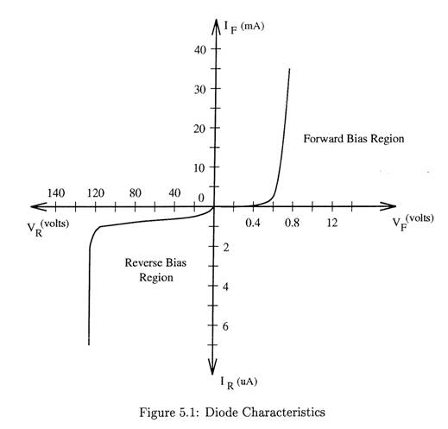

Slide 14
ADVANTAGES:
No filament is necessary
Occupies lesser space
Long life.

Slide 15
APPLICATIONS-
….as rectifiers to convert AC into DC.
As an switch in computer circuits.
As detectors in radios to detect audio signals
As LED to emit different colours.

Slide 16
Thank you

