Slide 1


Slide 2
Definition
Odd Man out means, you will have series of numbers or words in that you need to find out one word or number which is not suitable for that group. You need to complete the series also.

Slide 3
1) Select the odd one out
A. Geometry
B. Algebra
C. Calculus
D. Thermodynamics
D. Thermodynamics
All except Thermodynamics are topics of Mathematics.

Slide 4
2) Select the odd one out
A. Spoon
B. Sword
C. Knife
D. Fork
B. Sword
All except sword are used in kitchen

Slide 5
3) Select the odd one out
A. Cat
B. Dog
C. Fox
D. Rabbit
C. Fox
Except fox rest are pets.

Slide 6
4) Select the odd one out
A. Sun
B. Moon
C. Universe
D. Star
C. Universe

Slide 7
5) Select the odd one out
A. Zinc
B. Aluminum
C. Copper
D. Mercury
D. Mercury

Slide 8
6) Select the odd one out
A. Tree
B. Fruit
C. Leaf
D. Flower
A. Tree

Slide 9
7) Select the odd one out
A. Physics
B. Chemistry
C. Geography
D. Botany
C. Geography

Slide 10
8) Select the odd one out
A. Post
B. Electricity
C. Telephone
D. Telegram
B. Electricity

Slide 11
9) 3, 5, 11, 14, 17, 21
A. 21
B. 17
C. 14
D. 03
C. 14
Numbers except 14 is an odd number

Slide 12
10) 8, 27, 64, 100, 125, 216, 343
A. 27
B. 100
C. 125
D. 343
B. 100
The pattern is 2³, 3³, 4³, 5³, 6³, 7³. But, 100 is not a perfect cube.

Slide 13
11) 396, 462, 572, 427, 671, 264
A. 396
B. 427
C. 671
D. 264
B. 427
In each number except 427, the middle digit is the sum of other two.

Slide 14



PATTERN COMPLETION

Slide 15
Definition
Pattern completion refers to the ability to identify and recreate missing parts or elements within a given pattern or design.

Slide 16
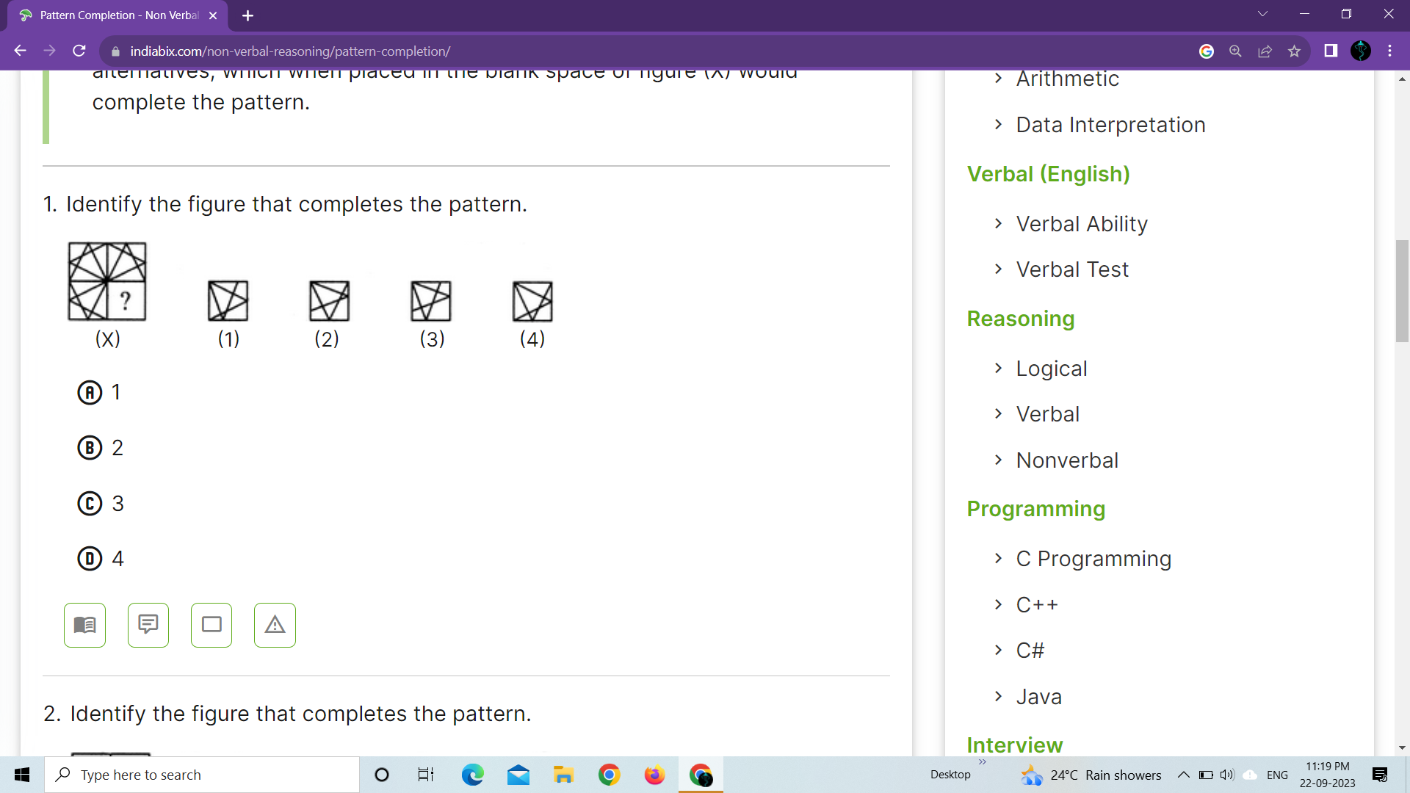
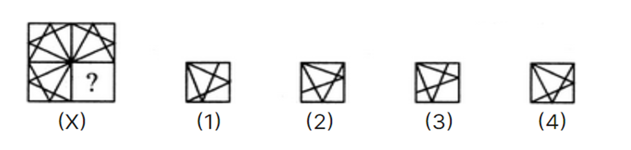
1. Identify the figure that completes the pattern.

Slide 17
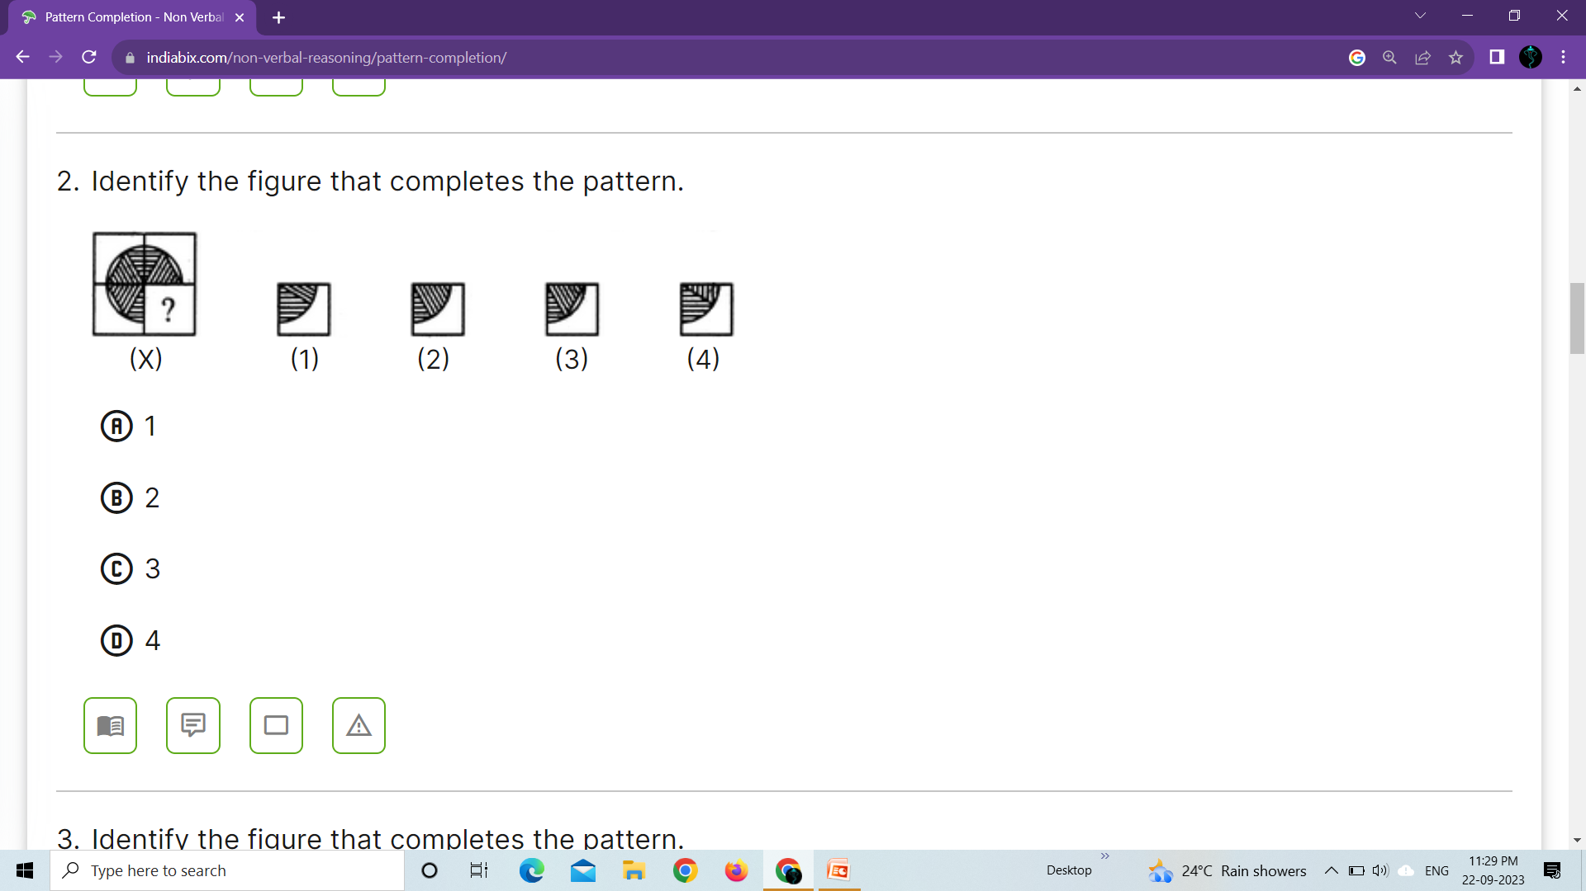
2. Identify the figure that completes the pattern.

Slide 18
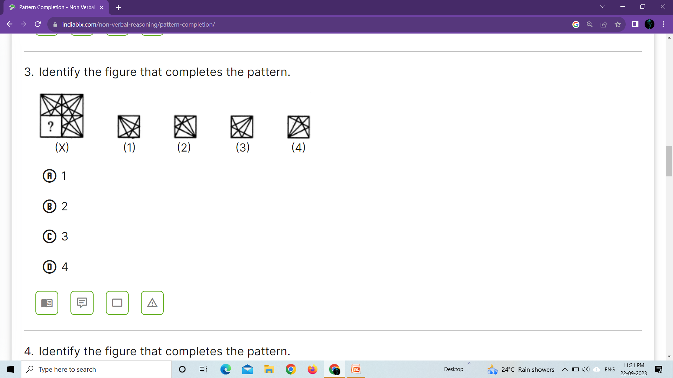
3. Identify the figure that completes the pattern.

Slide 19
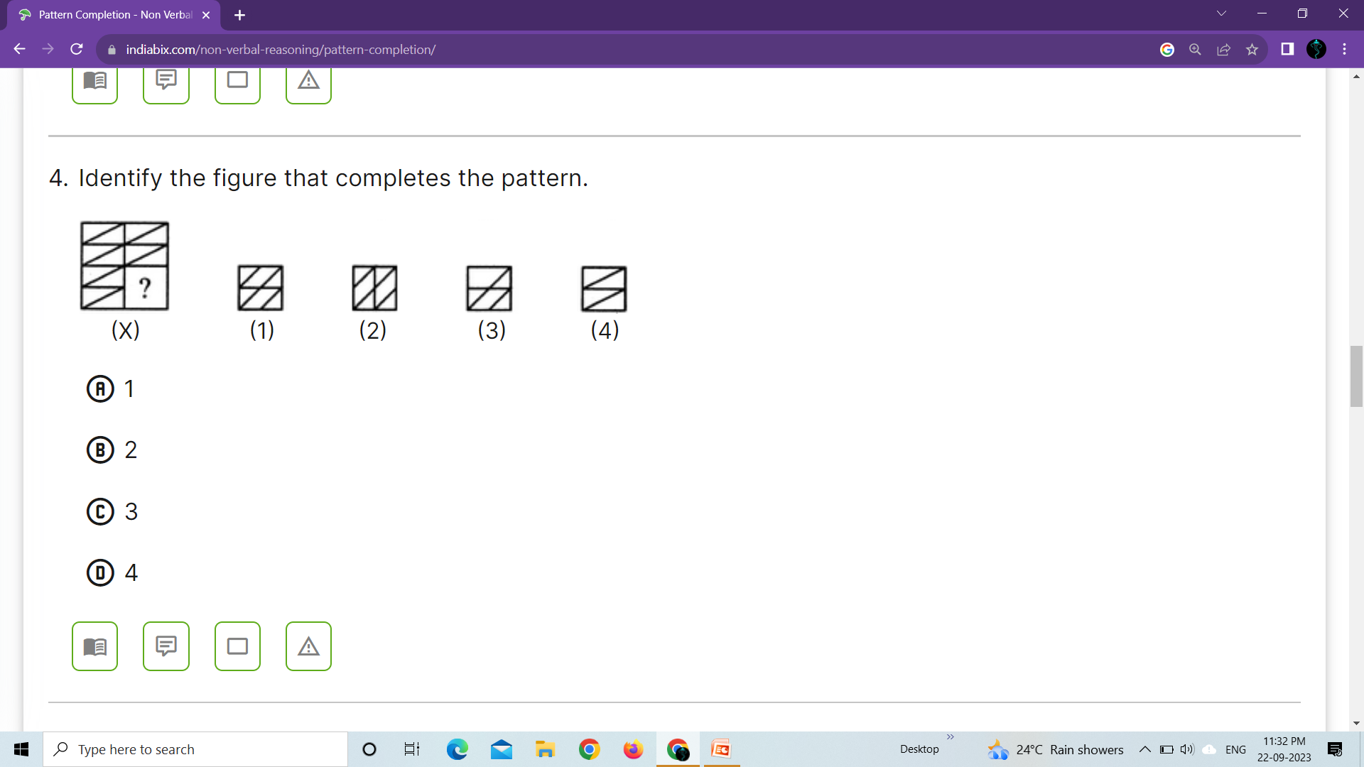
4. Identify the figure that completes the pattern.

Slide 20
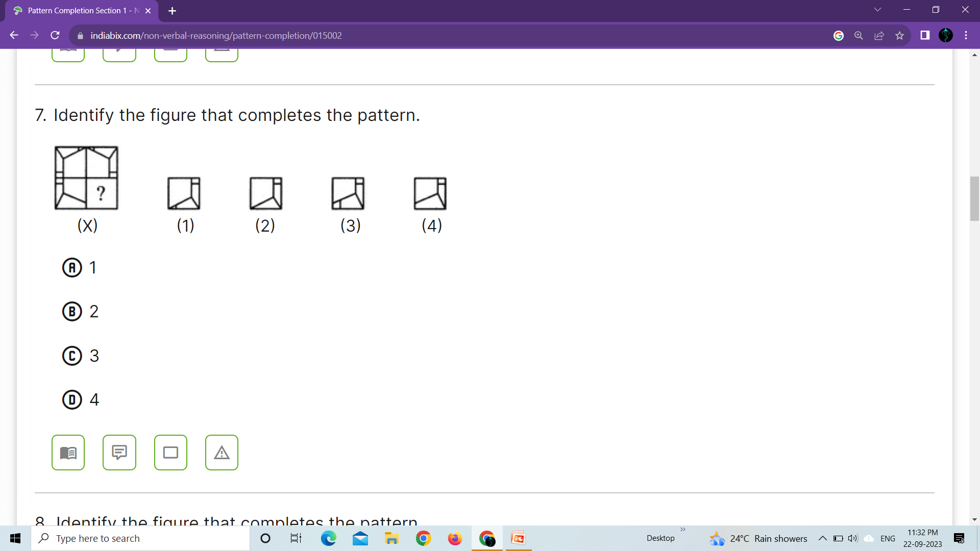
5. Identify the figure that completes the pattern.

Slide 21
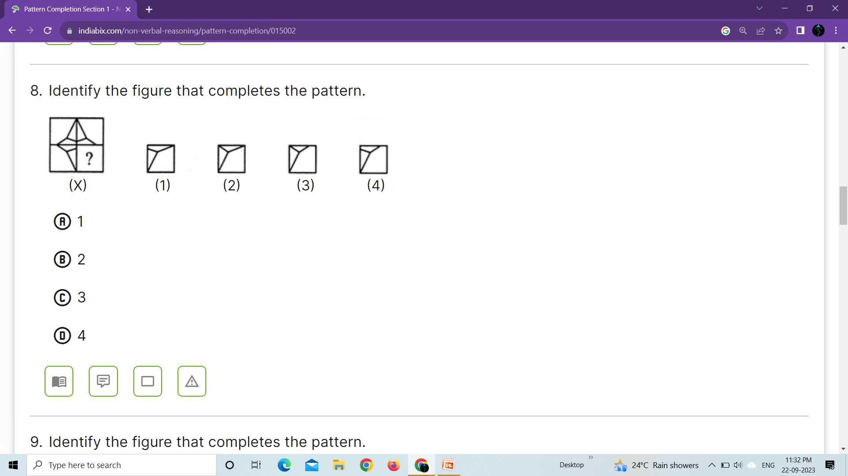
6. Identify the figure that completes the pattern.

Slide 22
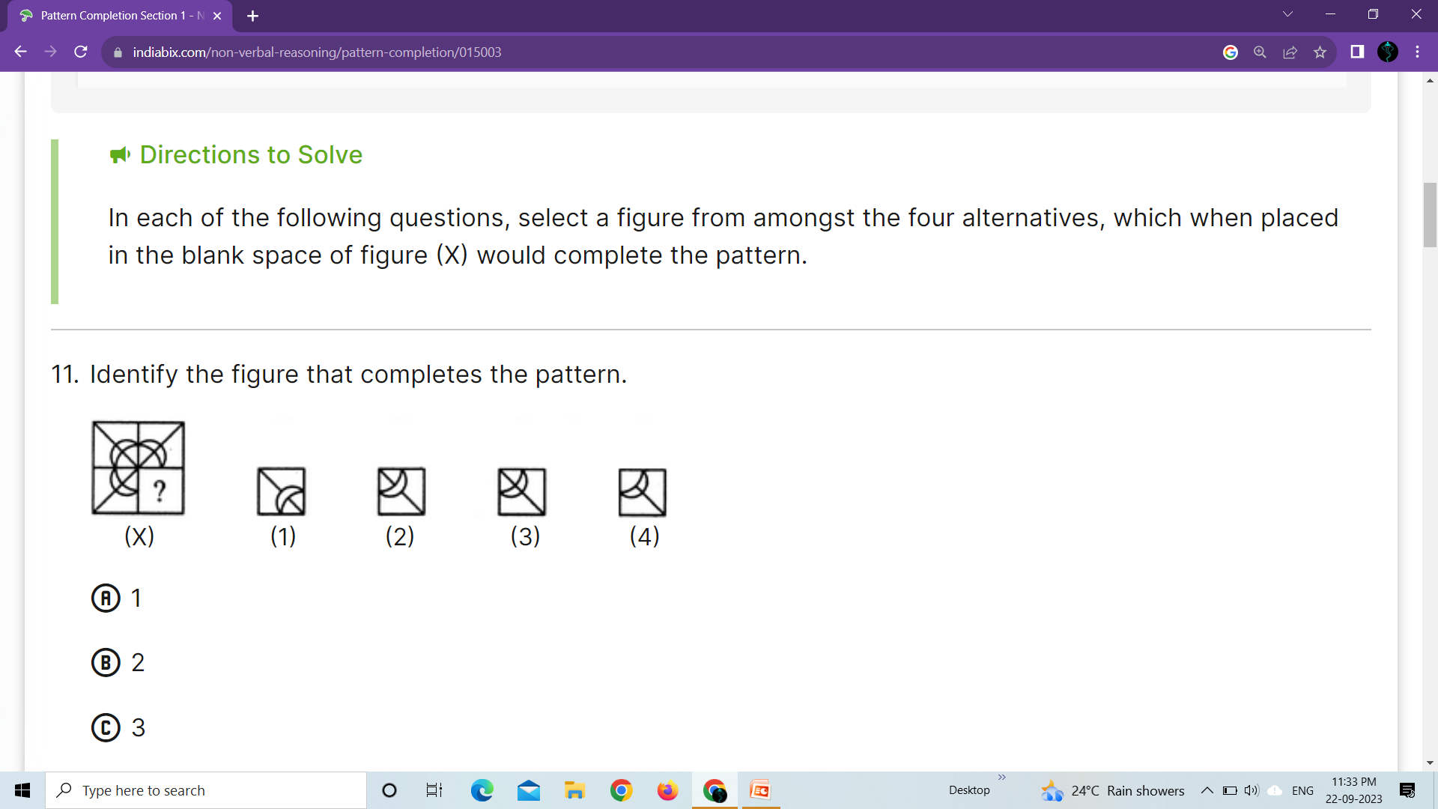
7. Identify the figure that completes the pattern.

Slide 23
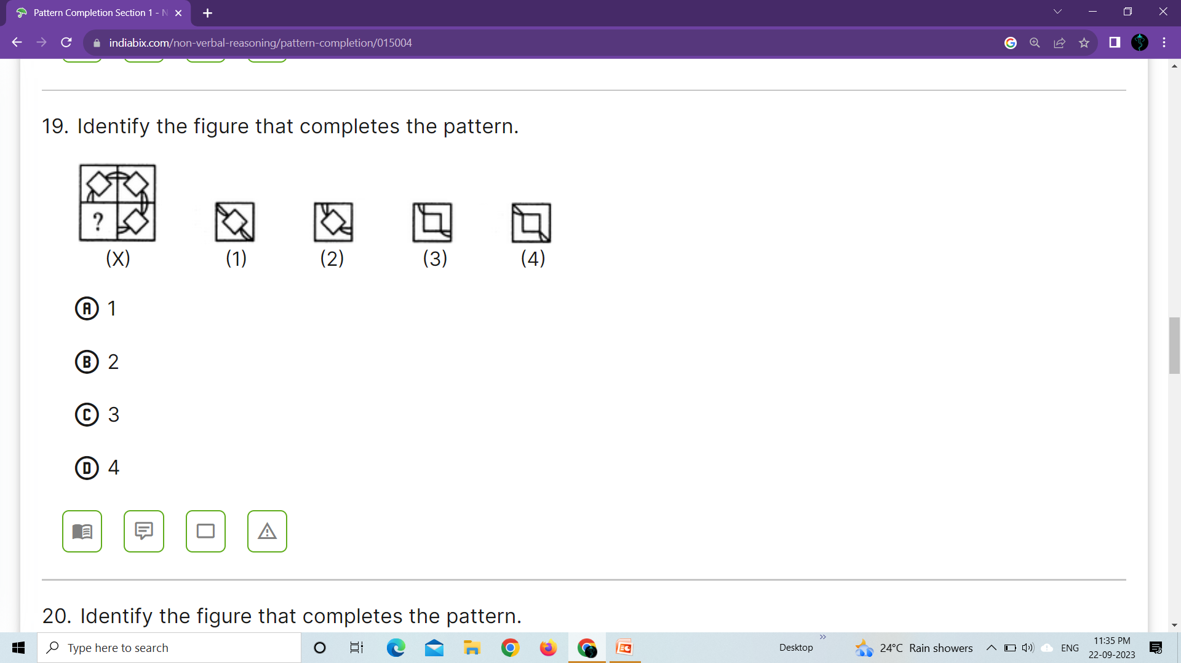
8. Identify the figure that completes the pattern.

Slide 24
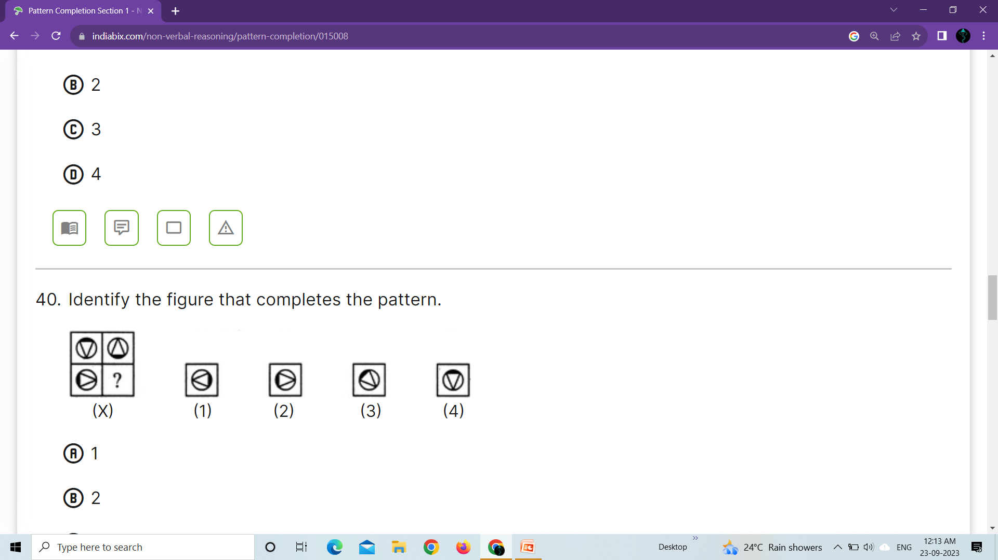
9. Identify the figure that completes the pattern.

Slide 25
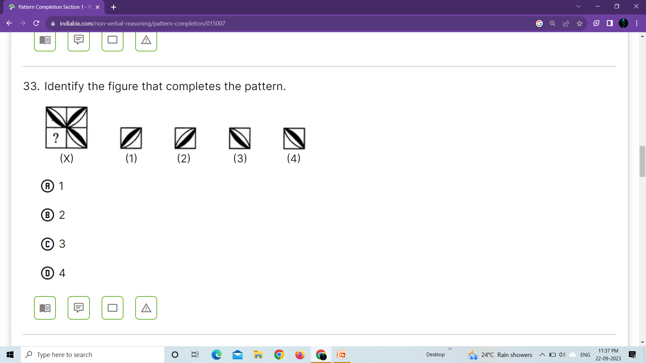
10. Identify the figure that completes the pattern.

Slide 26
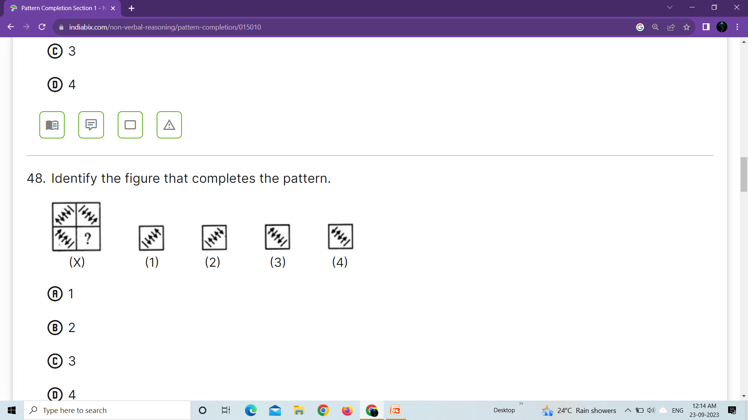
11. Identify the figure that completes the pattern.

Slide 27
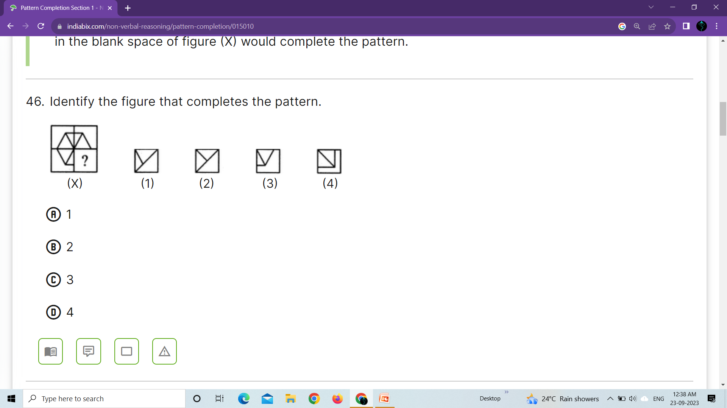
12. Identify the figure that completes the pattern.

Slide 28
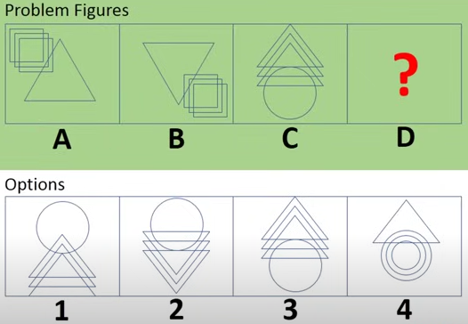

Slide 29
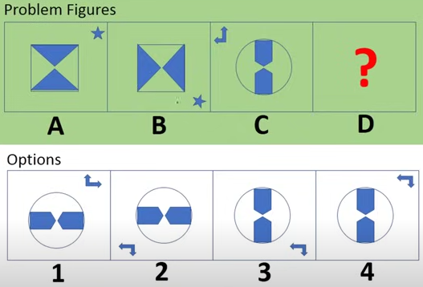

Slide 30
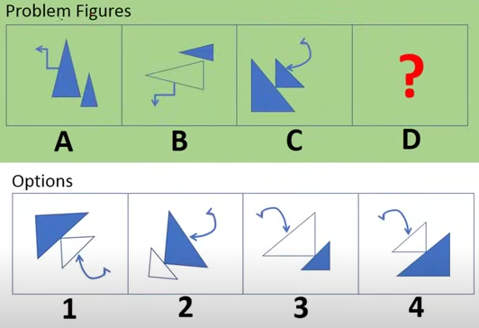

Slide 31
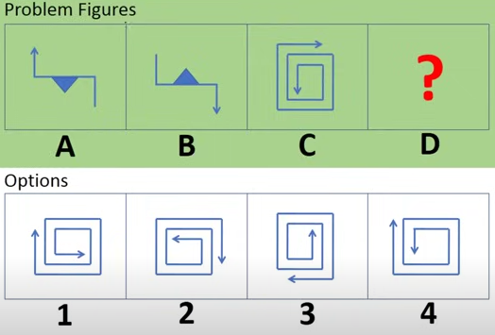

Slide 32
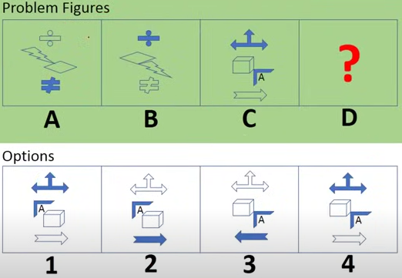

Slide 33
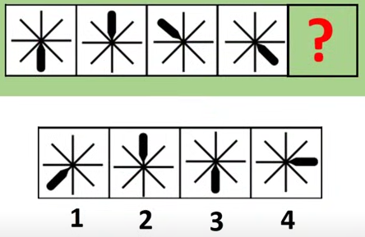

Slide 34
Degree Rotation 180 and 45

Slide 35
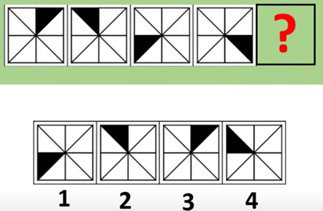

Slide 36
Colour Triangle gap is there

Slide 37
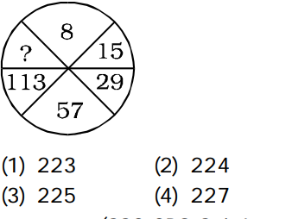

Slide 38
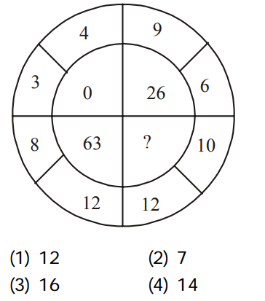

Slide 39
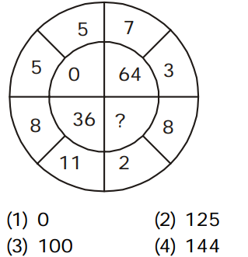

Slide 40
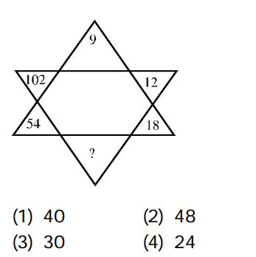

Slide 41
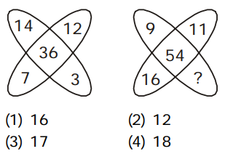

Slide 42
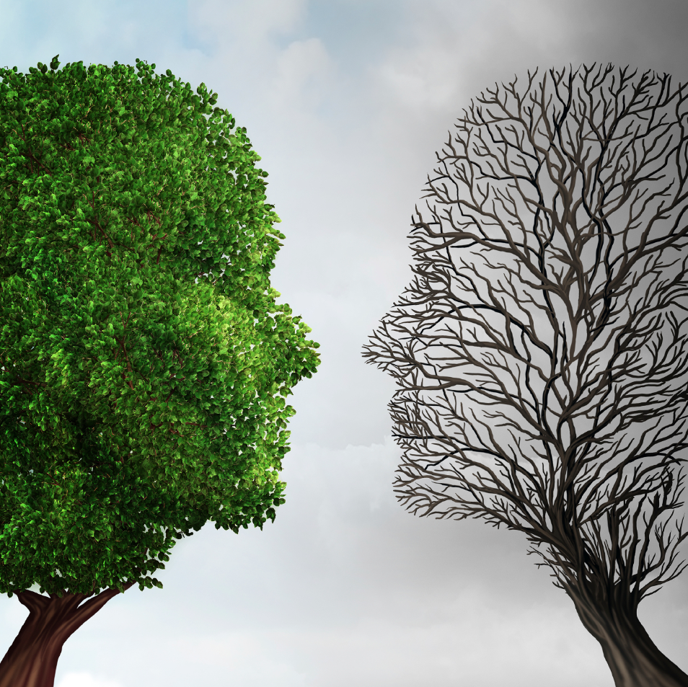


Slide 43
Definition
A comparison of two like or unlike things based on their resemblance of a particular aspect.

Slide 44
TYPES OF ANALOGY
1.Synonyms
2.Antonyms
3.Object/Purpose
4.Source/Product
5.Part/Whole

Slide 45
SYNONYMS
Bad : Awful :: Terrible : Horrible
Good : Fine :: Excellent : Great
Hot : Burning :: Fiery : Boiling
Cold : Chilly :: Freezing : Frosty
Easy : Simple :: Effortless : Straightforward
Hard : difficult. :: Challenging : Tough
Big : Large :: Huge : Giant

Slide 46
Small : Tiny :: Little : Mini
Friendly : Kind :: Mean. : Aggressive
Rough. : Scratchy :: Smooth : Silky
Delicious : Yummy :: Gross : Yucky
Adorable : Cute :: Scary : Creepy
Long : Prolonged :: Magnify : Enlarge
Maximum : Highest :: Minimum : Least
Minor : Slight :: Negligent : Irresponsible
Nice : Pleasant :: Numerous : Many
Observe : Notice :: Offend : Upset
Optimistic : Positive :: Ordinary : Usual
Forbid : Prohibit :: Forgive : Pardoned
Fresh : New :: Friend : Buddy

Slide 47
ANTONYMS
Good : Bad :: Black : White
Smile : Frown :: Pretty : Ugly
Near : Far :: Open : Closed
Strong : Weak :: Love : Hate
Hammer : Nail :: Comb : Hair
White : Black. :: Up : Down
Big : Small :: Tall : short
Fast : Slow :: Early : Late

Slide 48
Correct : Mistaken :: Dangerous : Safe
Credit : Debit :: Positive : Negative
Long : Short :: Magnify : Reduce
Huge : Small :: Idle : Busy
Immature : Mature :: Impartial : Prejudiced
Independent : Dependent :: Insane. : Sane
Intelligent : Ignorant :: Internal : External
Irrelevant : Relevant :: Join : Separate
Keep : Discard :: Large : Small
Least : Most :: Ordinary : unusual
Old : Young :: Always : Never
Open : Close :: Up : Down

Slide 49
OBJECT - PURPOSE
Keyboard : Type :: Painter : Paint
Pen : Write :: Book : Read
Knife : Cut :: Shove : Dig
Scissors : Cut :: Eraser : Erase
Food : Live :: Vehicle : Travel
Pencil : writing :: crayon : coloring
Fork : eating :: chair : sitting

Slide 50
SOURCE - PRODUCT
Wood : Baseball Bat :: Oranges : Orange Juice
Field : Corn :: Pond :Fish
Mine : Diamonds :: Oyster Shells : Pearls
Sheep : Wool :: Silkworm : Silk
Palm Tree : Coconuts :: Maple Tree : Syrup
Paddy : Rice :: Bog : Cranberries

Slide 51
PART - WHOLE
Wheel. : Bike :: Page : Book
Steering Wheel :Automobile :: Branch : Tree
Toe : Foot :: Finger : Hand
Paw : Dog :: Claw : Bird
Classroom : School :: Book : Library
Nose : Face :: Leaves : Branch

Slide 52
1) Odometer is to mileage as compass is to
A. Direction
B. Hiking
C. Needle
D. Speed
A. Direction

Slide 53
Answer: A
Explanation:
An odometer is an instrument used to measure mileage. A compass is an instrument used to determine direction.

Slide 54
2.Marathon is to race as hibernation is to
A. Winter
B. Bear
C. Dream
D. Sleep
D. Sleep

Slide 55
Answer: D
Explanation:
A marathon is a long race and hibernation is a lengthy period of sleep.

Slide 56
3.Window is to pane as book is to
A. Novel
B. Glass
C. Cover
D. Page
D. Page

Slide 57
Answer: D
Explanation:
A window is made up of panes, and a book is made up of pages

Slide 58
4. Cup is to coffee as bowl is to
A. Dish
B. Soup
C. Spoon
D. Food
B. Soup

Slide 59
Answer: B
Explanation:
Coffee goes into a cup and soup goes into a bowl.

Slide 60
5.Yard is to inch as quart is to
A. Gallon
B. Ounce
C. Milk
D. liquid
B. Ounce

Slide 61
Answer: B
Explanation:
A yard is a larger measure than an inch (a yard contains 36 inches). A quart is a larger measure than an ounce (a quart contains 32 ounces).

Slide 62
6.Elated is to despondent as enlightened is to
A. Aware
B. Ignorant
C. Miserable
D. Tolerant
B. Ignorant

Slide 63
Answer: B
Explanation:
Elated is the opposite of despondent; enlightened is the opposite of ignorant.

Slide 64
7.Optimist is to cheerful as pessimist is to
A. Gloomy
B. Mean
C. Petty
D. Helpful
A. Gloomy

Slide 65
Answer: A
Explanation:
An optimist is a person whose outlook is cheerful. A pessimist is a person whose outlook is gloomy.

Slide 66
8.Reptile is to lizard as flower is to
A. Petal
B. Stem
C. Daisy
D. alligator
C. Daisy

Slide 67
Answer: C
Explanation:
A lizard is a type of reptile; a daisy is a type of flower.

Slide 68
9. Play is to actor as concert is to
A. Symphony
B. Musician
C. Piano
D. Percussion
B. Musician

Slide 69
Answer: B
Explanation:
An actor performs in a play. A musician performs at a concert

Slide 70
10.Sponge is to porous as rubber is to
A. Massive
B. Solid
C. Elastic
D. Inflexible
C. Elastic

Slide 71
Answer: C
Explanation:
A sponge is a porous material. Rubber is an elastic material

Slide 72
11.Careful is to cautious as boastful is to
A. Arrogant
B. Humble
C. Joyful
D. Suspicious
A. Arrogant

Slide 73
Answer: A
Explanation:
Careful and cautious are synonyms (they mean the same thing). Boastful and arrogant are also synonyms

Slide 74
12.Pen is to poet as needle is to
A. Thread
B. Button
C. Sewing
D. Tailor
D. Tailor

Slide 75
Answer: D
Explanation:
A pen is a tool used by a poet. A needle is a tool used by a tailor.

Slide 76
13.Secretly is to openly as silently is to
A. Scarcely
B. Impolitely
C. Noisily
D. quietly
C. Noisily

Slide 77
Answer: C
Explanation:
Secretly is the opposite of openly, and silently is the opposite of noisily.

Slide 78
14.Embarrassed is to humiliated as frightened is to
A. Terrified
B. Agitated
C. Courageous
D. Reckless
A. Terrified

Slide 79
Answer: A
Explanation:
If someone has been humiliated, they have been greatly embarrassed. If someone is terrified, they are extremely frightened

Slide 80
15.Pride is to lion as shoal is to
A. Teacher
B. Student
C. Self Respect
D. Fish
D. Fish

Slide 81
Answer: D
Explanation:
A group of lions is called a pride. A group of fish swim in a shoal

Slide 82
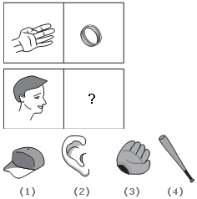
16. What should come in place of Question Mark?

Slide 83
Answer: Option 1
Explanation:
Hand is to ring as head is to cap. A ring is worn on a person's hand; a cap is worn on a person's head.

Slide 84
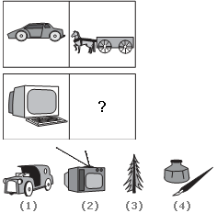
17. What should come in place of Question Mark?

Slide 85
Answer: Option 4
Explanation:
Car is to horse and buggy as computer is to pen and ink. This relationship shows the difference between modern times and times past.

Slide 86
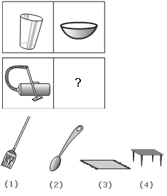
18. What should come in place of Question Mark?

Slide 87
Answer: Option 1
Explanation:
Cup is to bowl as vacuum cleaner is to broom. This is another relationship about function. The cup and bowl are both used for eating. The vacuum cleaner and broom are both used for cleaning.

Slide 88
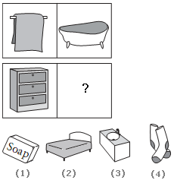
19. What should come in place of Question Mark?

Slide 89
Answer: Option 2
Explanation:
Towel is to bathtub as chest of drawers is to bed.

Slide 90


