Slide 1
ANALYSIS OF ROAD CRACKS AND REPORT
_Jyotsna Mane

Slide 2
AIM & INTRODUCTION
The aim of the project is to check the regular maintenance of the roads and bridges and providing an interface which enhances the experience , so more précised focus can be given .
The project focuses on the idea of keeping the past data ,checking the roads for cracks .
The project is mainly classified into 3 parts .Data cleaning,image processing and sending alert message to users.
Within this project it might be easier to look after the roads since automation process tends to make it easier
This will also help to alert people who commute through a route for a particular mishap on the road such as cracks ,heavy rain etc.

Slide 3
Features : -
DATA CLEANING: Checking for incorrect or missing data.
Data saving: The system saves this entry in its excel for later viewing.
Data viewing:The system allows user to view road history as and when needed.
Image processing:The application allows user to capture the image and analyse it
Twilio: Sending alert message to the users
Data visualisation : - A visual overview of road will be shown.

Slide 4
REQUIREMENTS
Software Requirements:
Windows 7 or Higher.
Python.
Data wrapper
Twilio
Hardware Requirements:
Processor: i5.
Hard Disk: 50Gb.
RAM: 8Gb.
Camera(with a better vision)

Slide 5
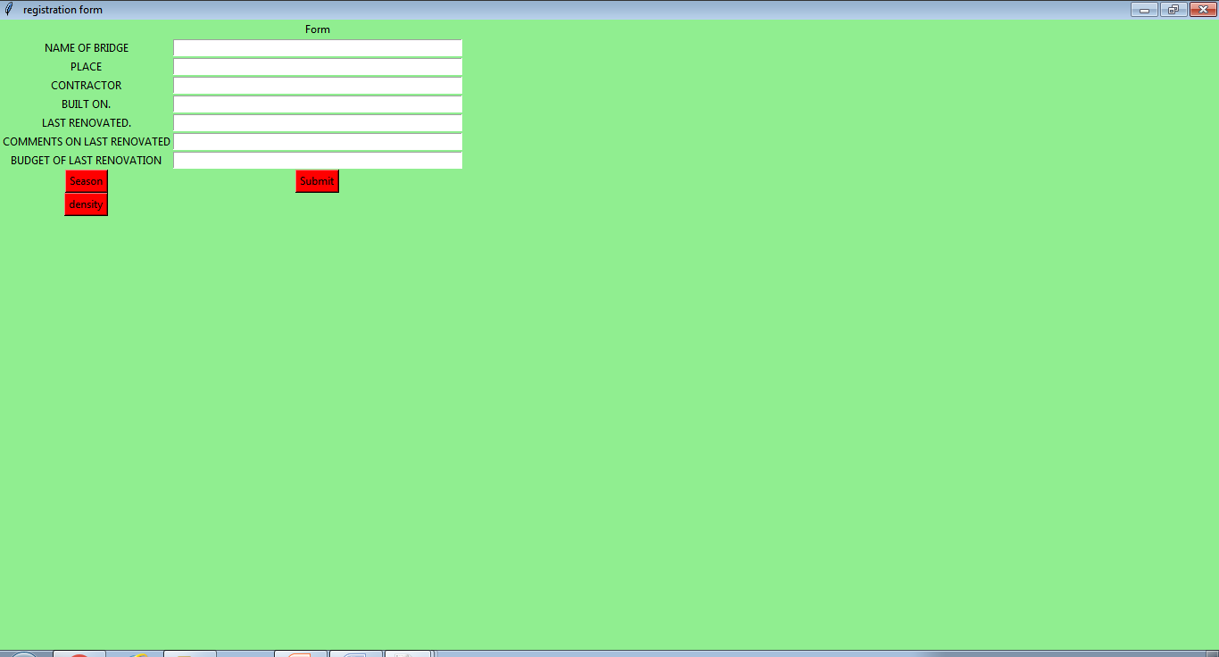
WORKING

Slide 6
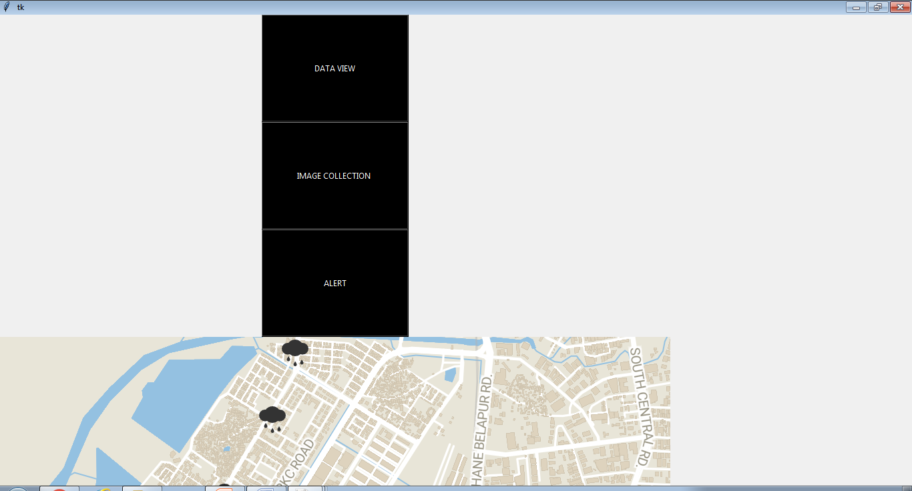

Slide 7
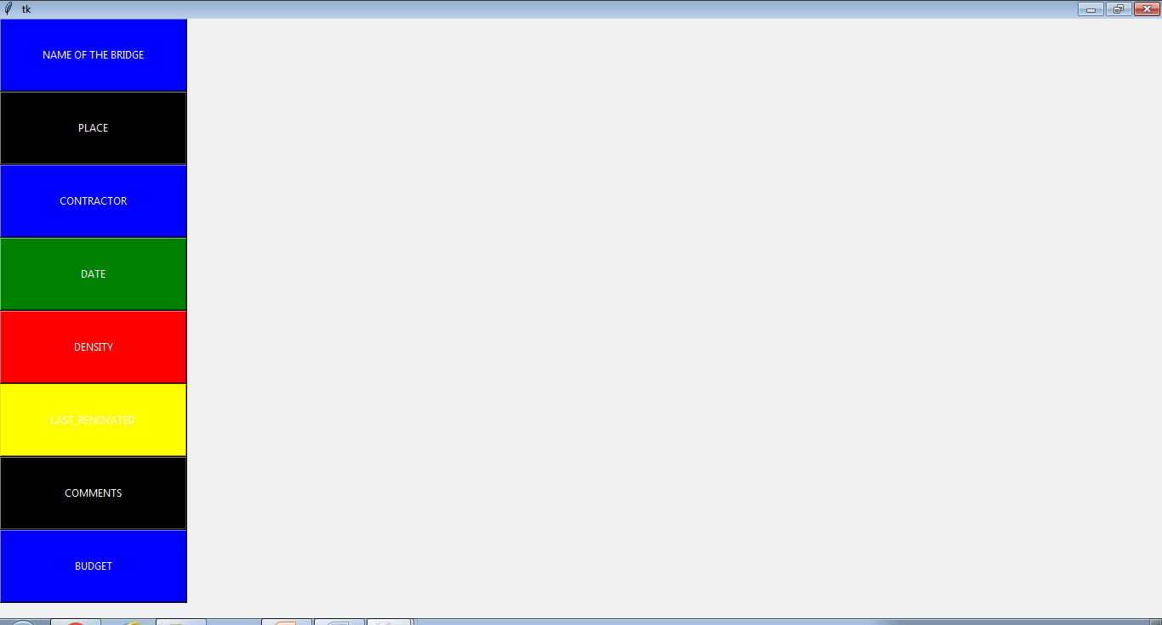

Slide 8
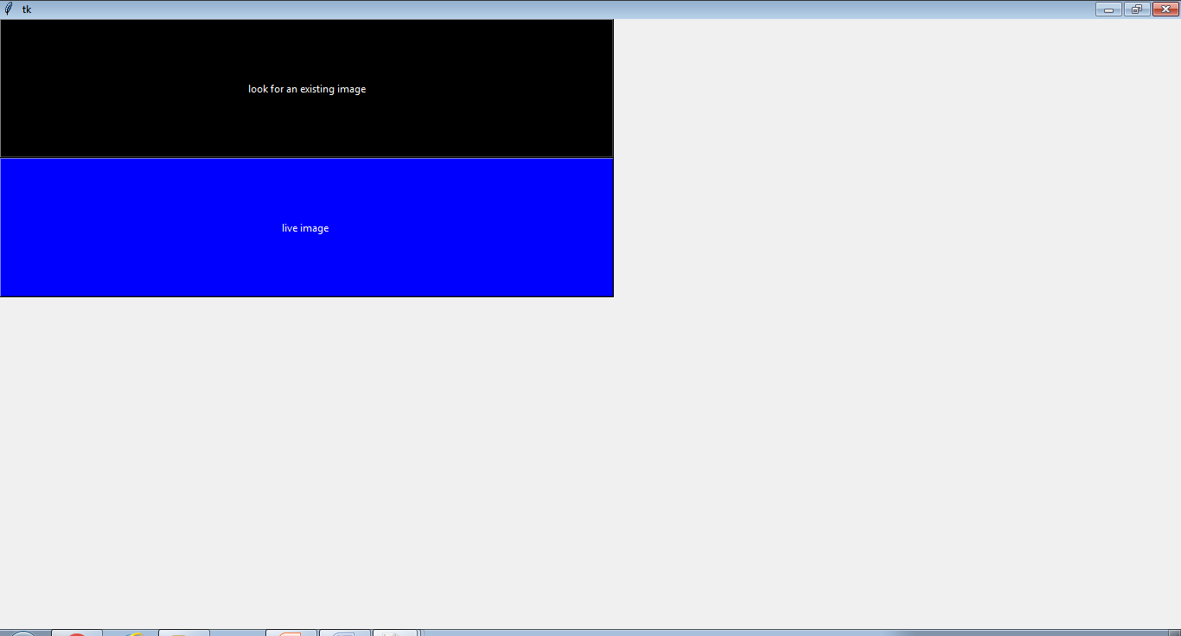

Slide 9
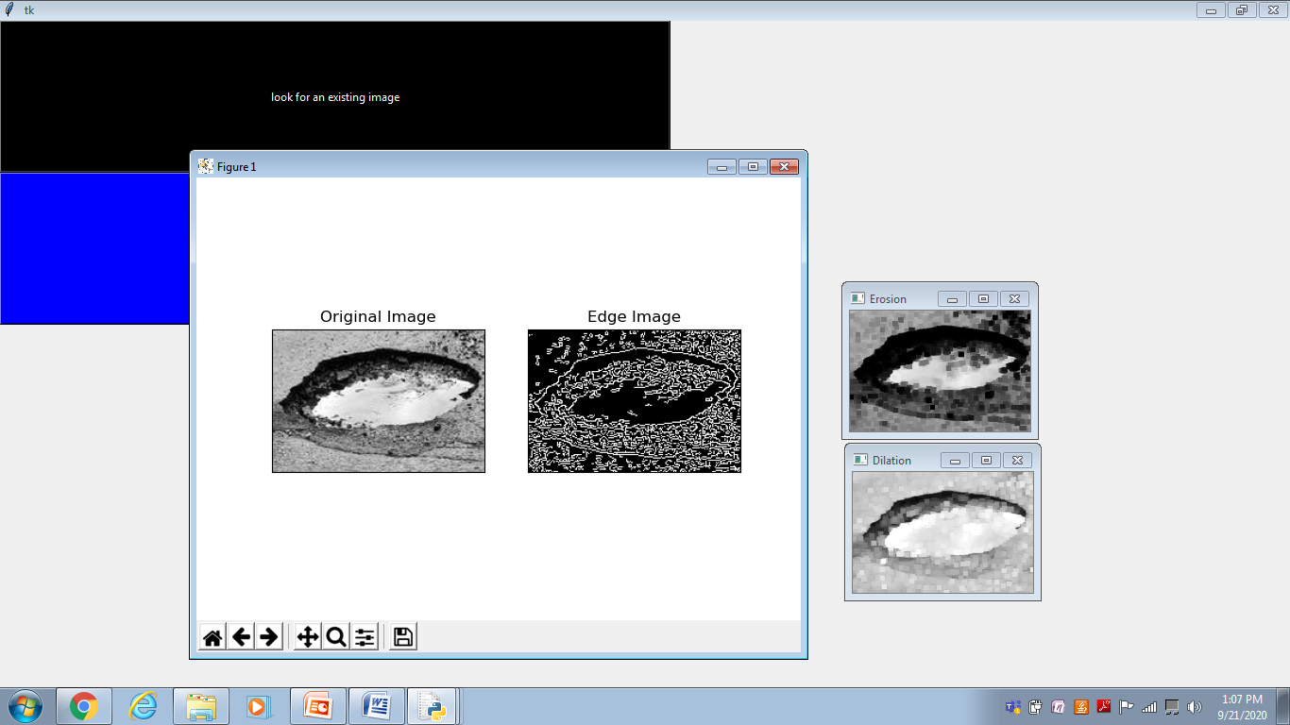

Slide 10
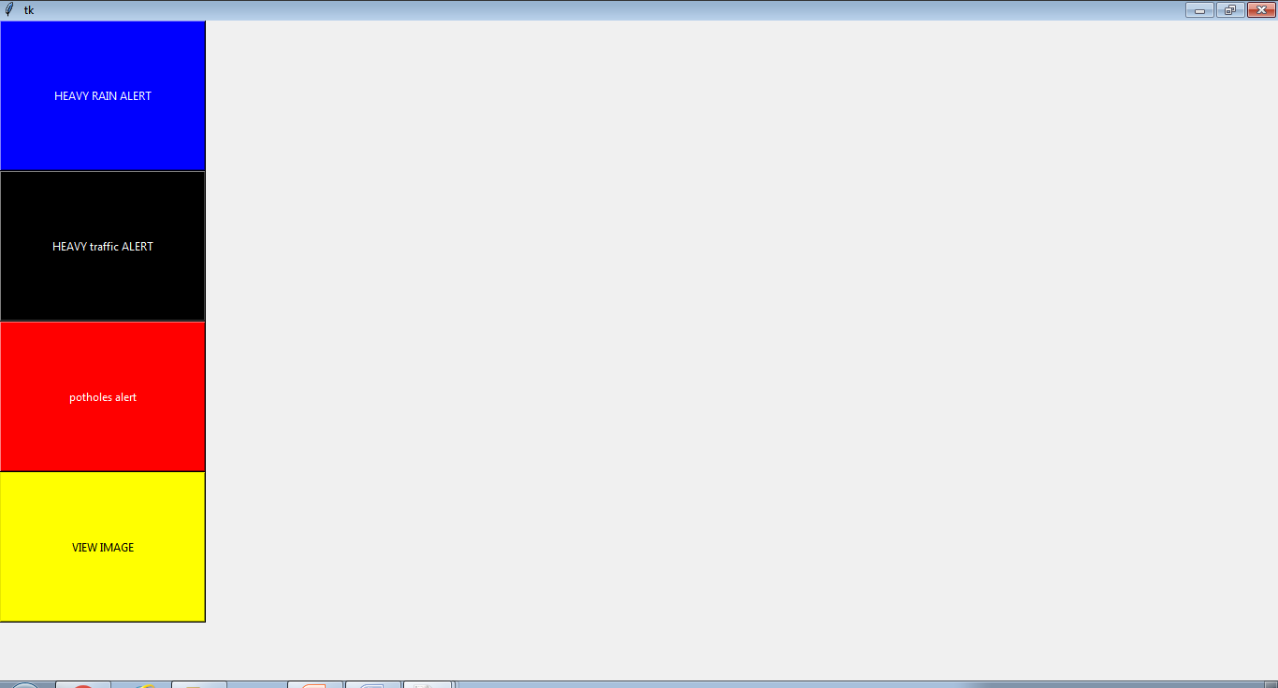

Slide 11
FUTURE ENHANCEMENT
Being a desktop application ,we thrive to enhance it in the following direction
Using drones to capture
Using machine learning so no human intervention will be needed
Giving live time updates
Keeping transparent data with people

Slide 12
ADVANTAGES
1:The system can be used as per the connection available.
2:It excludes the use of paper entries/registers.
3:Alert message can also be send using this.
4:Saves time and reduces human intervention.
5: The system is flexible and secured to be used.

Slide 13
DISADVANTAGES
1:24*7 analysis may not be available which may lead to missing data
2:The user must have a brief knowledge about the language for better understanding

Slide 14
Conclusion
It will provide a smooth interface for the users
Data keeping will be easy and therefore will increase the work intrest
It will also help to alert users thus will help in reducing accidents

Slide 15
THANK YOU

