Slide 1
WIND ENERGY AND ITS IMPORTANCE BY- SHIV CHANDRA 11904848 B.TECH(CSE) 2019-2023

Slide 2
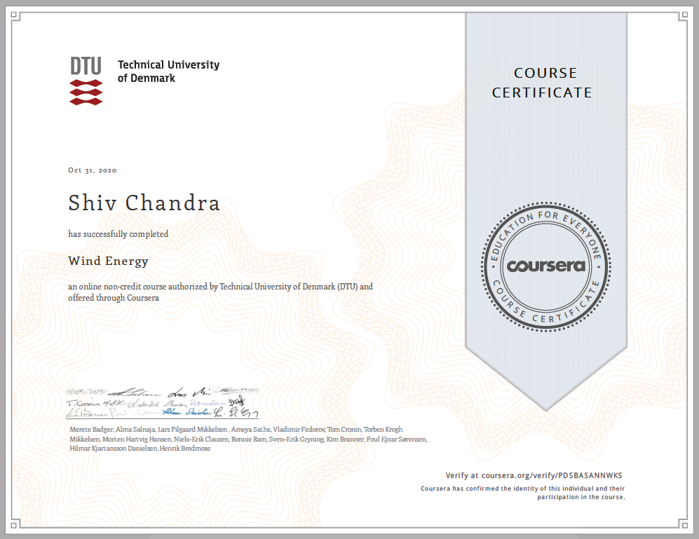
CERTIFICATE

Slide 3
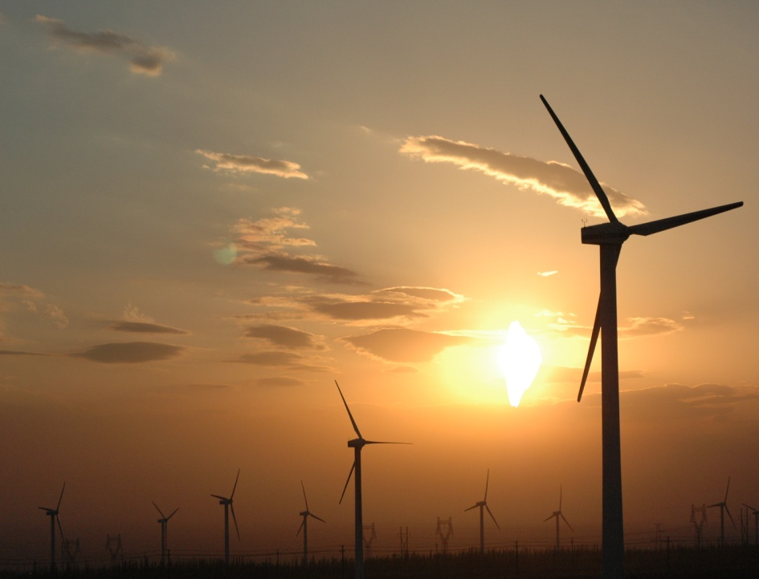
INTRODUCTION
Wind energy or is a Non-Conventional source of energy. It describes the process by which wind is used to generate electricity.
Wind turbines convert the kinetic energy in the wind into mechanical power. Wind Turbines convert the energy in wind to electricity by rotating propeller-like blades around a rotor.
The rotor turns the drive shaft,
which turns an electric generator.
It is a sustainable, renewable
energy source that has a much
smaller impact on the environment.

Slide 4
OBJECTIVES
The objectives which has been covered are:-
Details on Wind Resources and its importance
Applicability of Wind Energy.
Account for the configuration and energy production of different wind turbine designs.
Details about thrust and power for a wind turbine
Details on turbine blade based on different material’s properties
Perform simple calculations calculating the cost of energy from wind
Applying a strategy for controlling the rotor speed of a variable speed wind turbine.
Different technologies used in Wind Energy Process.

Slide 5
IMPORTANCE
The project is environment friendly.
India has good wind potential to harness wind energy.
A permanent shield against ever increasing power prices. The cost per kwh reduces over a period of time as against rising cost for conventional power projects.
The cheapest source of electrical energy.
Least equity participation required, as well as low cost debt is easily available to wind energy projects.
A real fast track power project, with the lowest gestation period; and a modular concept.
Operation and Maintenance (O&M) costs are low.
No marketing risks, as the product is electrical energy.

Slide 6
APPLICABILITY
“Wind power is the most efficient technology to produce energy in a safe and
environmentally sustainable manner: it is zero emissions, local, inexhaustible, competitive and it creates wealth and jobs”
The wind energy is used to propel the sailboats in river and seas to transport men and materials from one place to another.
Wind energy is used to run pumps to draw water from the grounds through wind mills.
Wind energy has also been used to run flourmills to grind the grains like wheat and corn into flour.
Now-a-days wind energy is being used to generate electricity which is the best source of renewable energy.

Slide 7
SCOPE OF WIND ENERGY
The global offshore wind capacity is set to increase fifteen-fold by 2040 to reach about $1 trillion of cumulative investment, according to the recent International Energy Agency (IEA) report.
India’s well-developed wind power industry has the capability and experience to help meet the country’s climate and energy security goals. With the total wind installed capacity of around 35,815 MW as of 30th April 2019.
India is the world’s fourth largest country in terms of total wind installations after China, the USA and Germany. Wind power has become one of the key renewable energy sources for power generation in India.
India has a share of at least 6-7% to the country’s electricity generation mix at present.
The power from green sources such as wind and solar are aimed to fulfil several goals such as energy security, economic development, climate change mitigation, rural development and employment generation.

Slide 8
WIND RESOURCES
There is a difference between the wind profile during the night and during the day. The geostrophic wind is a wind that drives the wind near the surface.
It's the wind speed at about 1 kilometre’s height. It's characteristic that the wind varies a lot near the surface during the day and at night.
During the night it's difficult for the energy to come to the ground because of the reduced momentum flux and the wind speed reduces near the ground.
Although the wind speed is low near the ground, it increases fairly fast with height and at a height of about 100 meters it can sometimes even be faster than the neutral wind speed.
During the day there is a better of connection to the geostrophic wind. You have a higher wind speed during the day then during the night.

Slide 9
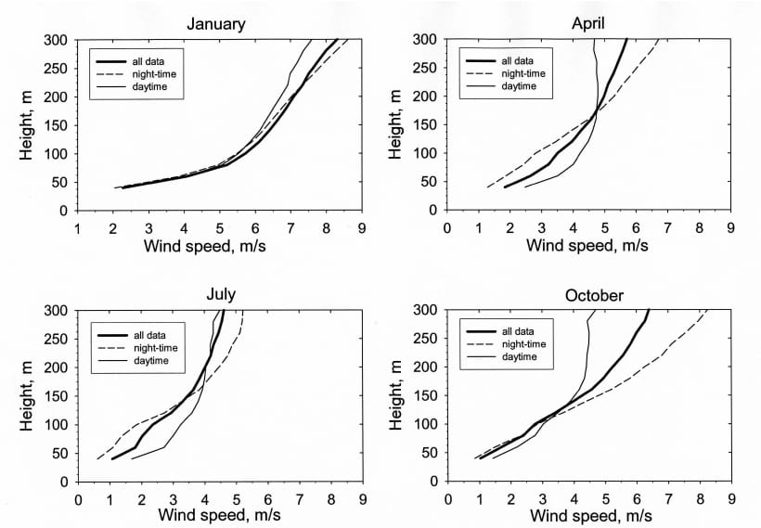
WIND PROFILE
Monthly wind profile during day and night

Slide 10
ECONOMICS OF WIND ENERGY
Capital & Revenue in Wind Energy Farm
For the operation, of a 2 Megawatt machine, which is a very common size these days, we're looking at about:-
40,000 Euro per machine, per year.
1 Euro= 87.70 in Indian Currency
Therefore, it will cost=40,000*87.70= 35, 08,000 Rs.
In India, you do need Rs 30-35 lakhs as capital investment to debut in the most talked-about virgin investment avenue.
According to Indian Wind Turbine Manufacturers Association says to install the least capacity wind generator of 250 kilowatts the minimum capacity that can be installed.
Cost of operation, maintenance and insurance works out to Rs 40,000-50,000 a year. Wind turbine manufacturers give a one-year warranty on an installed turbine.

Slide 11
ENERGY GENERATED
Capacity of wind energy farm=50 Megawatts
No. of hours in a year=365*24=8760 Hours
Therefore, total energy produced
=50*8760*25% (capacity factor)
=50*8760*0.25
=109500 Megawatts
=110 Giga watts of energy

Slide 12
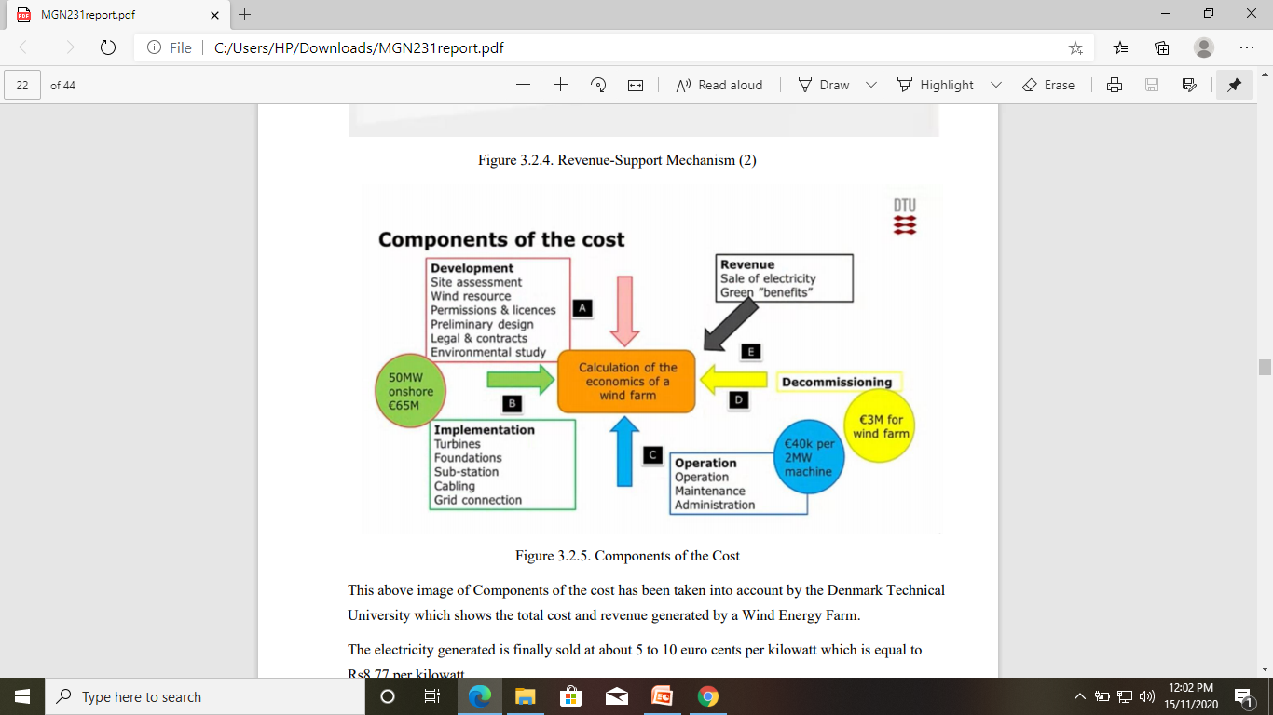
COMPONENTS OF THE COST
This image of Components of the cost has been taken into account by the Denmark Technical University which shows the total cost and revenue generated by a Wind Energy Farm. The electricity generated is finally sold at about 5 to 10 euro cents per kilowatt which is equal to Rs 8.77 per kilowatt.

Slide 13
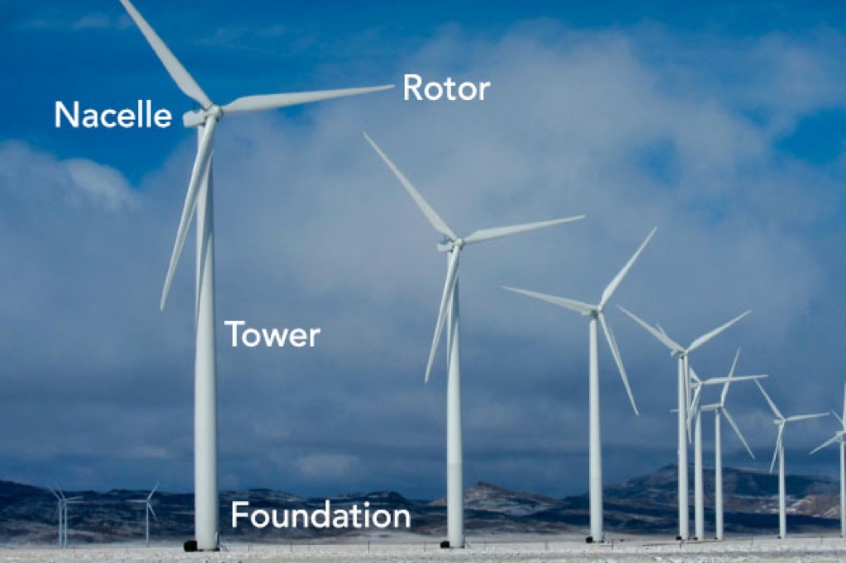
WIND ENERGY TECHNOLOGY
Components used:
Rotor- It generates aerodynamic torque from the wind.
Nacelle- It converts the torque into electrical power.
Tower-It holds nacelle and rotor blades up in the wind and provides access to the nacelle.
Foundation- It ensures that the turbine stays upright.

Slide 14
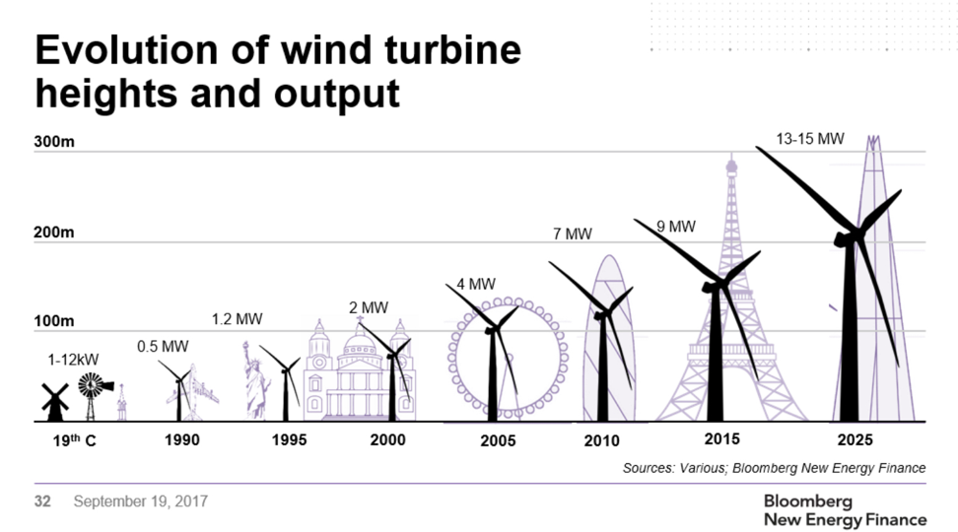
WIND TURBINE EVOLUTIONS

Slide 15
MATERIAL SELCTION
Wind turbines have been made from different materials such as wood, aluminum, and composites.
Modern wind turbines are usually made from composites such as carbon fibers and fiber glass. The wide use of composite materials turns to its relative high stiffness to weight ratio in addition to its ability to form complex shapes.
Composites are found to be efficient with the large increase in wind turbines’ size and capacities. They also can be tailored to satisfy different stiffness and weight requirements.
Composite fiber can be used in different orientation to improve the blade directional stiffness in addition to bending and rigidity.

Slide 16
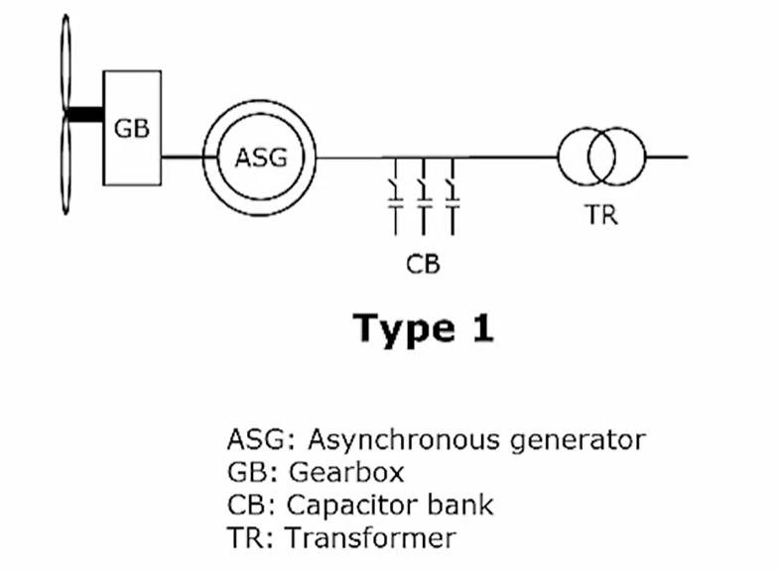
ELECTRIC SYSTEM
There are 4 main different types of wind turbines:-
TYPE 1->

Slide 17
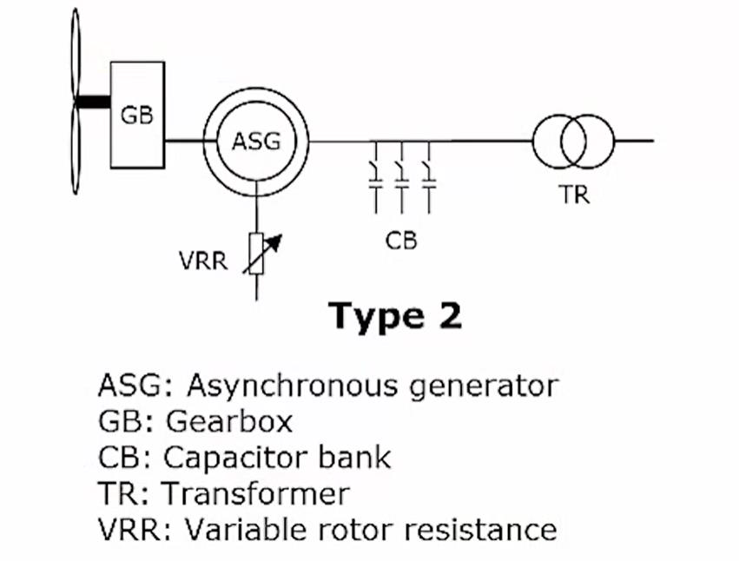
TYPE 2->

Slide 18
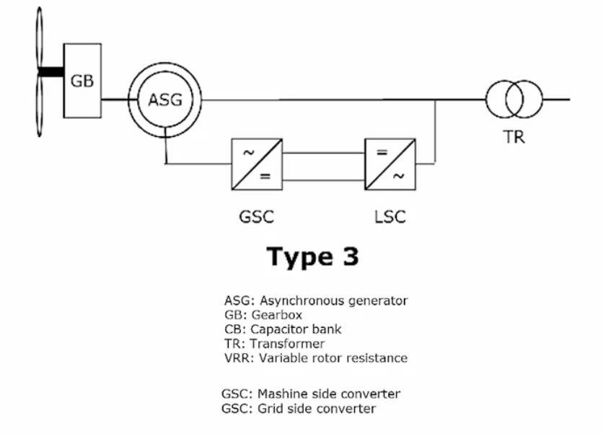
TYPE 3->

Slide 19
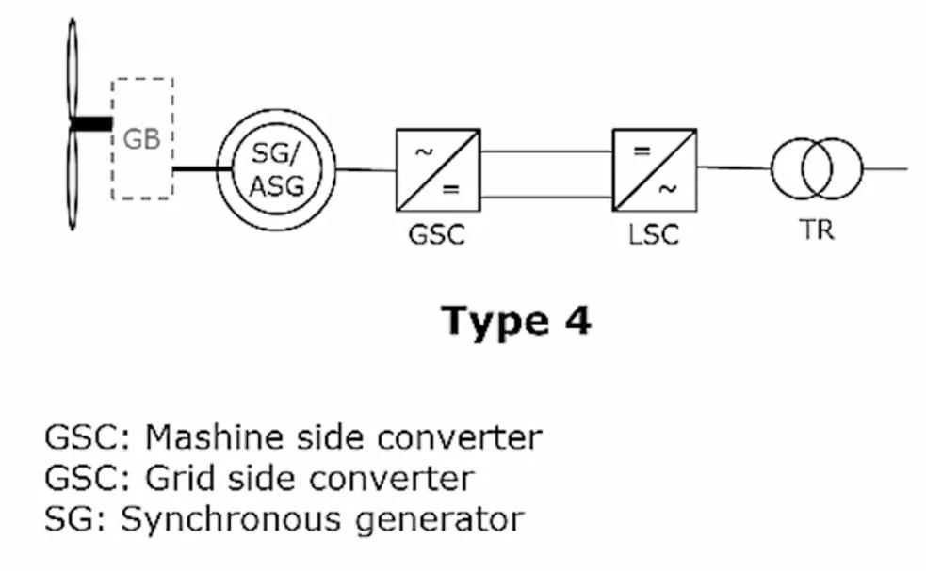
TYPE 4->

Slide 20
THANK YOU

