Slide 1
NexGuard : RFID Lock System with Intrusion Alert
ADIT, CVM University
MDP Mini Project
Semester - 6
Prepared By: Hetvi Modi(12102040601028)
Shiven Patel(12102040601064)
Guided By: Dr. Dhaval Tailor

Slide 2
Team Details
No. | Enrollment No. | Student Name
1 | 12102040601028 | Hetvi Modi
2 | 12102040601064 | Shiven Patel

Slide 3
Index
Problem Statement
Proposed Solution
Key Features
Components
Working
Project Planning
Future Work

Slide 4
Problem Statement
Problem
The project aims to create an RFID-based locker security system to protect valuable assets, utilizing RFID technology, reed switch sensors, and email notifications. It seeks to grant authorized access through RFID cards while promptly alerting users via email and triggering alarms for unauthorized attempts. Through seamless integration of access control and intrusion detection, the system ensures comprehensive security for safeguarding assets within lockers, enhancing peace of mind for users.
Target Audience
Organizations and Businesses
Security Professionals
Technology Enthusiasts

Slide 5
Proposed Solution
The proposed solution for the NexGuard RFID Lock System involves integrating RFID technology, reed switch sensors, email notifications, and a solenoid lock mechanism to create a robust security system for protecting locker assets. Authorized access is granted through RFID cards, while reed switch sensors monitor door states to detect unauthorized attempts and trigger alarms. Real-time email notifications provide instant alerts to designated recipients, enhancing security measures. Additionally, a solenoid lock ensures secure access only for authorized users, while future integration with a mobile application promises enhanced remote monitoring and control capabilities for users.

Slide 6
Key Features: RFID-Based Access Control: Utilizes RFID technology to grant authorized access to lockers via RFID cards or tags embedded with unique identification codes. Reed Switch Sensors: Monitors the state of locker doors in real-time, detecting unauthorized access attempts or tampering and triggering alarms. Email Notification System: Sends immediate email alerts to predefined recipients upon detection of access events, providing real-time notifications for enhanced security monitoring. Solenoid Lock Mechanism: Controls the locking mechanism of lockers, ensuring secure access only for authorized users with valid RFID credentials. Buzzer Alarm: Provides audible alerts in conjunction with email notifications, alerting nearby individuals to unauthorized access attempts or security breaches. ESP8266 Microcontroller: Facilitates communication between hardware components, executes control logic, and manages the system's operation.

Slide 7
Components
RFID Reader
RFId card/tags
Reed Switch sensor
ESP32 module
Buzzer
Solenoid Lock
Power supply
Relay Module

Slide 8
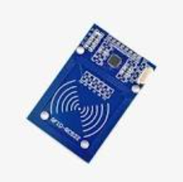
RFID Reader
The RFID reader communicates wirelessly with RFID tags to read their unique identification codes, enabling access control.
It consists of an antenna to transmit and receive radio waves, a transceiver to process signals, and a decoder to interpret data.

Slide 9
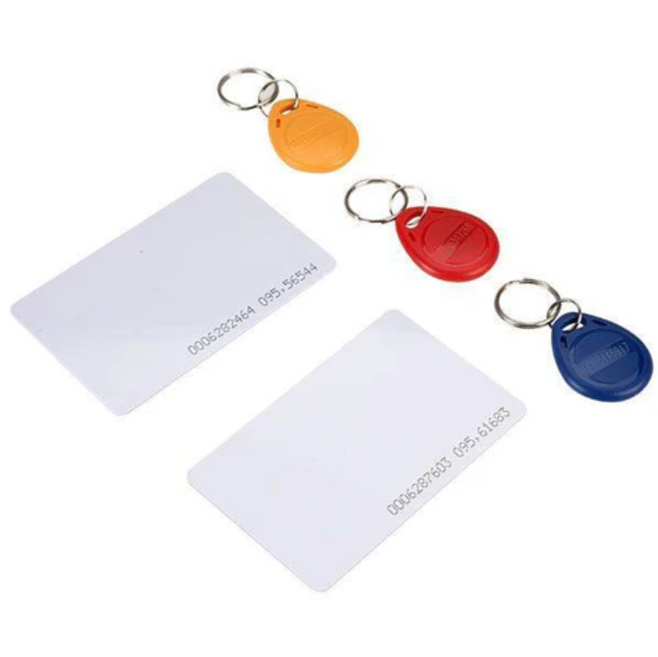
RFID card/tags
RFID cards or tags store unique identification codes and transmit them to RFID readers when in proximity, facilitating access control.
Advanced RFID cards/tags may offer additional security features such as encryption to prevent unauthorized access.

Slide 10
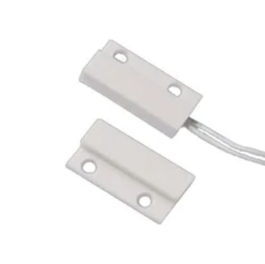
Reed Switch Sensor
Reed switch sensors detect the opening or closing of locker doors by changes in magnetic fields, providing real-time status information.

Slide 11
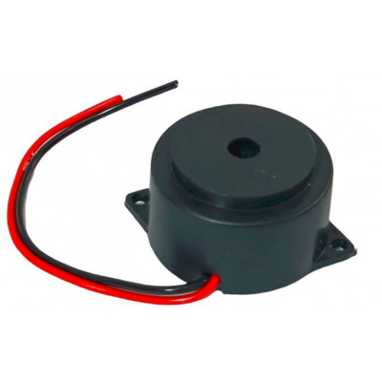
Buzzer
For detection and alert for invalid users and non-registered id’s.

Slide 12
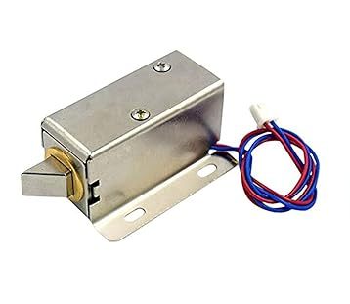
Solenoid Lock
A solenoid lock is an electromechanical device that controls access to lockers by physically securing or releasing the locking mechanism.

Slide 13
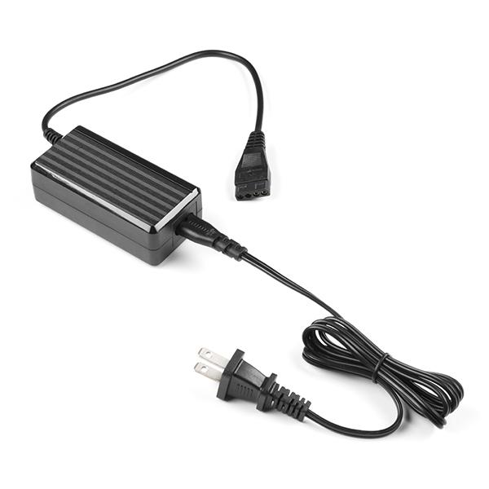
Power supply
Powers the whole system and uses techniques to efficient use and power friendly for long life and extended periods of time.

Slide 14
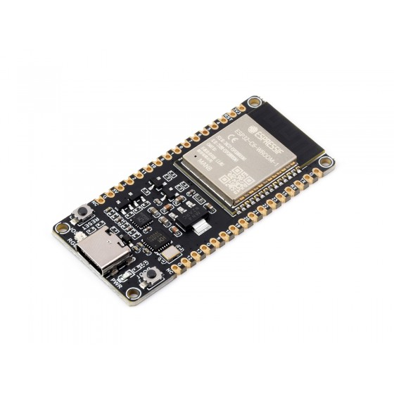
ESP32 module
The ESP32 is a versatile microcontroller module with integrated WiFi and Bluetooth capabilities, suitable for IoT applications.
It facilitates communication between hardware components, executes control logic, and manages the system's operation.

Slide 15
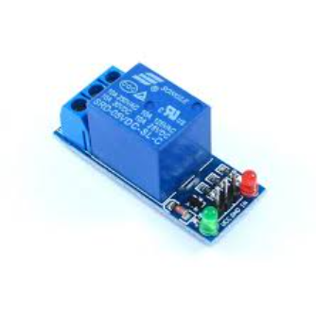
Relay Module
A relay module is an electromechanical switch that uses an electromagnet to control the switching of a circuit.
It allows the microcontroller to control high-power devices such as solenoid locks by providing isolation between the low-voltage control signal and high-voltage load.

Slide 16
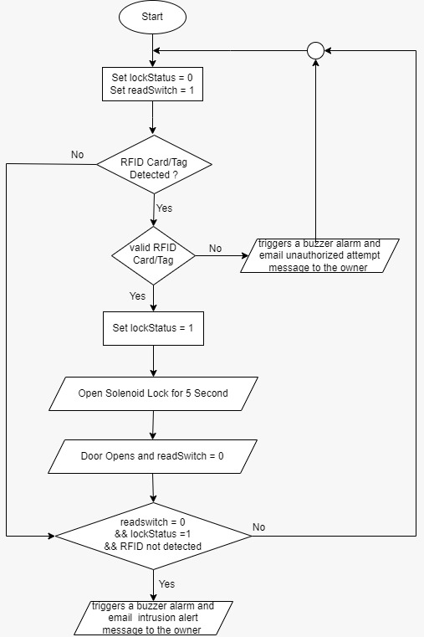
Working

Slide 17
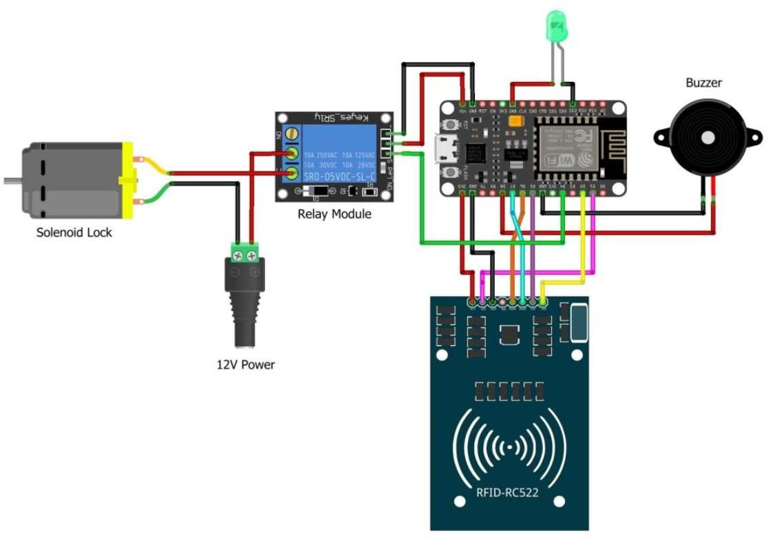

Architecture

Slide 18
Project Planning
Progress Timeline
ID | Task | Start | Finish | Duration | Year-2024
 |  |  |  |  | Month
 |  |  |  |  | Jan |  |  |  | Feb |  |  |  | Mar |  |  |  | Apr
 |  |  |  |  | 1w | 2w | 3w | 4w | 1w | 2w | 3w | 4w | 1w | 2w | 3w | 4w | 1w | 2w
1 | Research | 13/1/24 | 17/2/24 | 6 weeks
2 | Designing | 21/1/24 | 3/3/24 | 7 weeks
3 | Project implementation | 10/2/24 | 31/3/24 | 6 weeks
6 | Testing and Validating | 4/4/24 | 8/4/24 | 4 Days

Slide 19
Future Work
Mobile Application Development:
Develop a mobile application compatible with iOS and Android platforms to complement the existing hardware system.
Design an intuitive user interface (UI) that allows users to remotely monitor and control the RFID lock system from their smartphones.
Implement features such as real-time status updates, remote lock/unlock functionality, and notification settings customization within the app.
2. Enhanced Security Features:
Implement biometric authentication methods (e.g., fingerprint or facial recognition) within the mobile app for enhanced security.
Enable two-factor authentication (2FA) for user logins to prevent unauthorized access to the system.
Implement end-to-end encryption for communication between the mobile app and the RFID lock system to protect sensitive data.

Slide 20
3. Advanced Monitoring and Analytics:
Integrate advanced monitoring and analytics features into the mobile app to provide insights into access patterns, security breaches, and system performance.
Implement data visualization tools (e.g., charts, graphs) to present access event history and system health metrics in an easily understandable format.
Enable proactive alerts and notifications for anomalies or suspicious activities detected by the system, enhancing security awareness for users.
By embarking on these future endeavors, the NexGuard RFID Lock System can evolve into a comprehensive and versatile security solution that seamlessly integrates with mobile devices, offers advanced features for monitoring and control, and provides enhanced security and convenience for users.

Slide 21
Thank You

