Slide 1
C-Share
Electronic Health Record (EHR)

Slide 2
Story
Notes:
Image from: https://www.officepracticum.com/blog/understanding-the-basics-of-ehrs/
- Sam

Slide 3
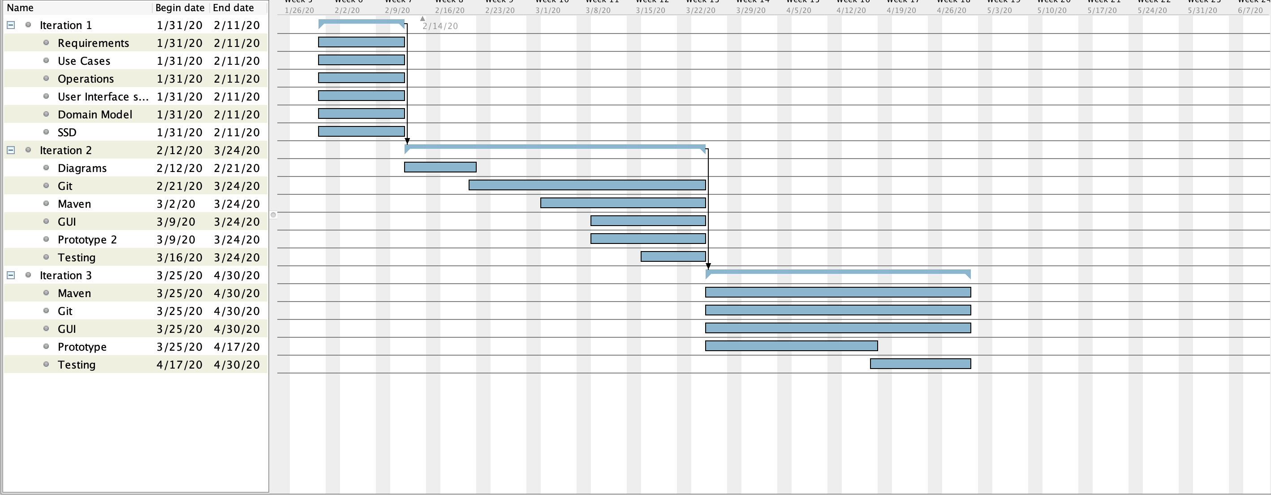
Gantt diagram
Notes:
- Katie

Slide 4
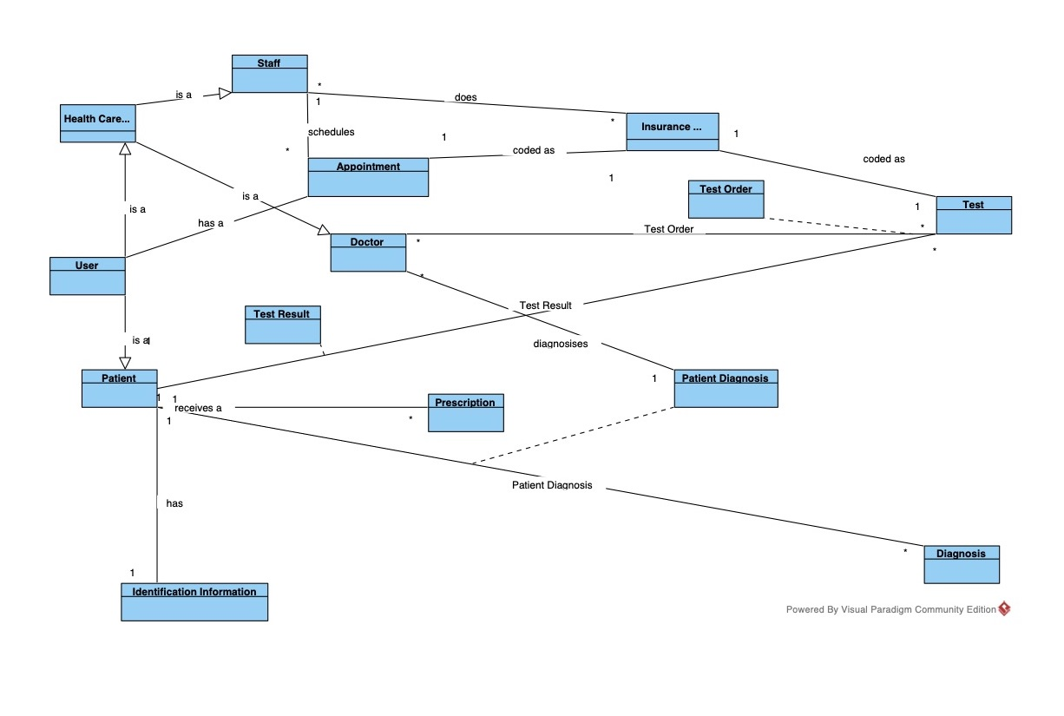
Domain model
Notes:
- Sam

Slide 5
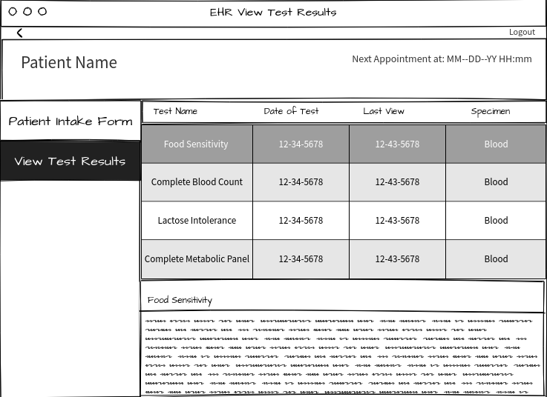
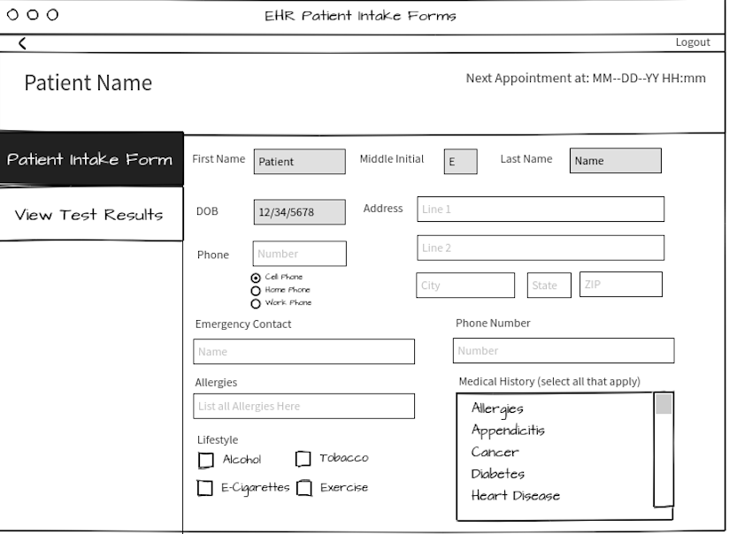
User Interface
Notes:
- Jordan

Slide 6
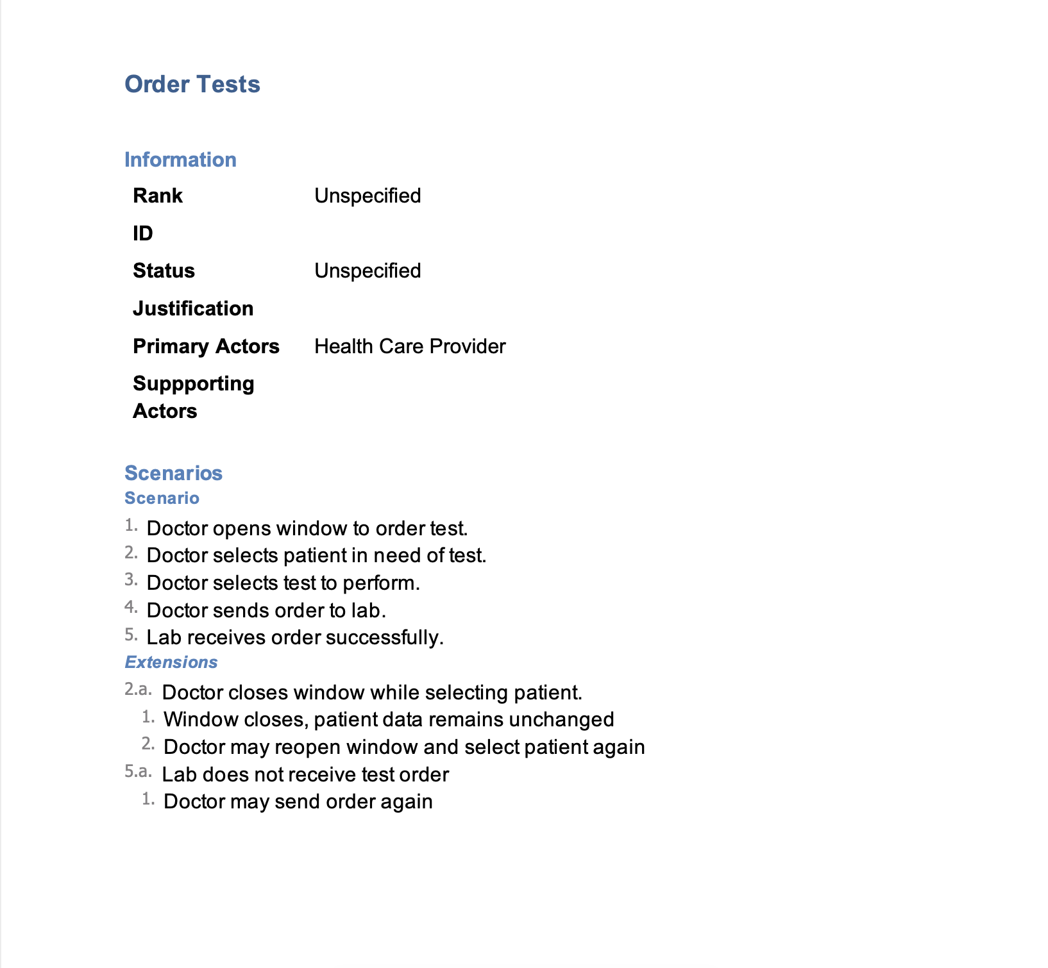
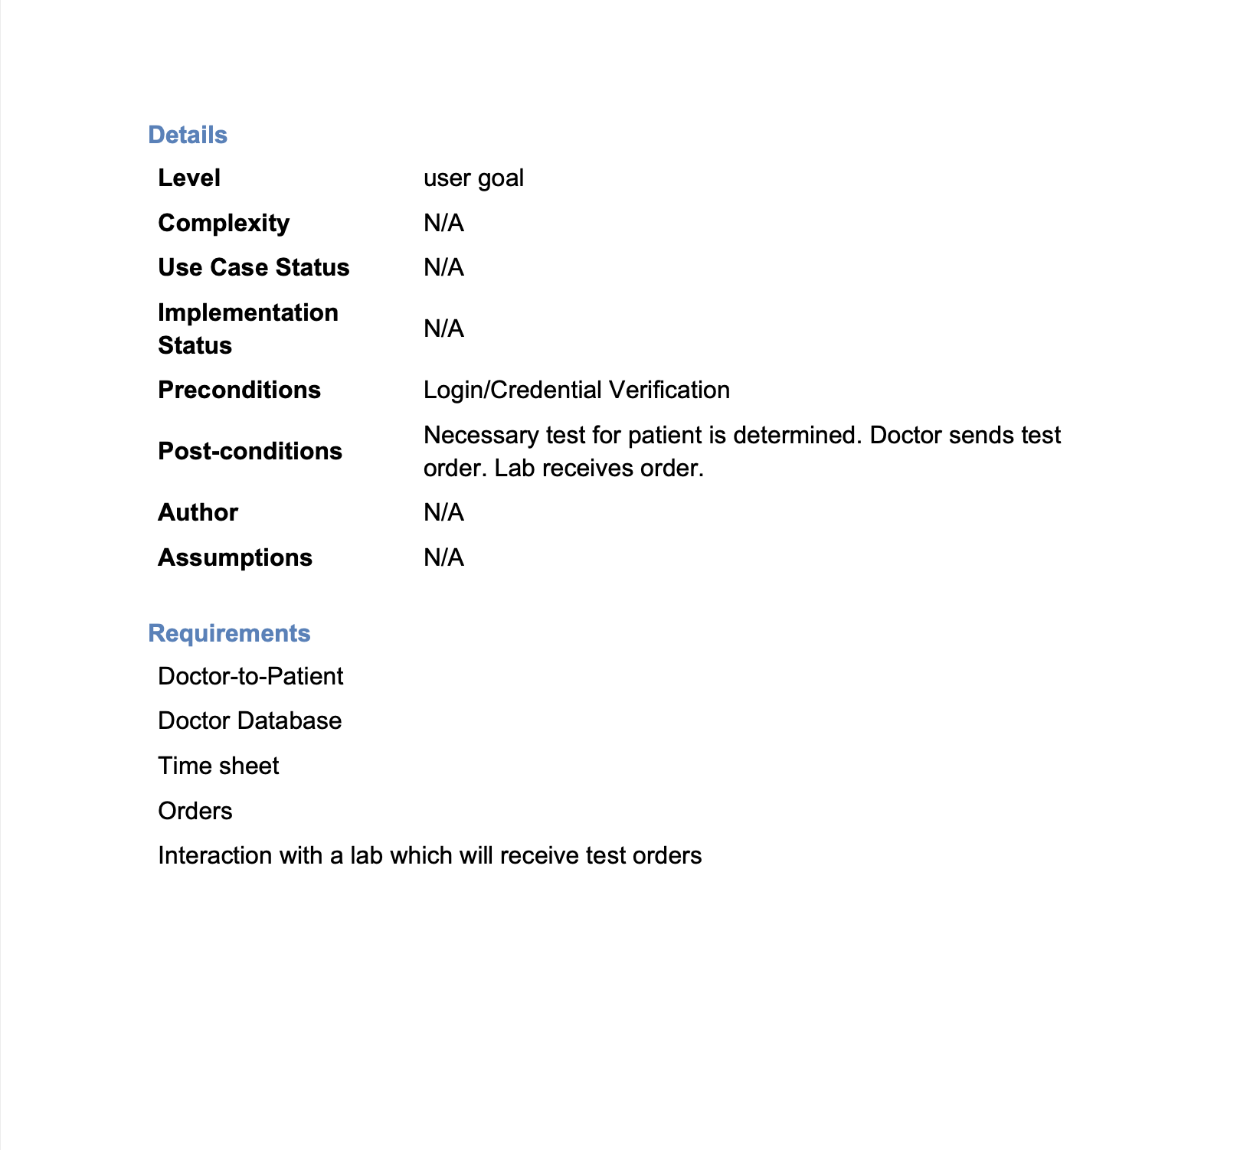
Use case: Order Tests
Notes:
- Matthew

Slide 7
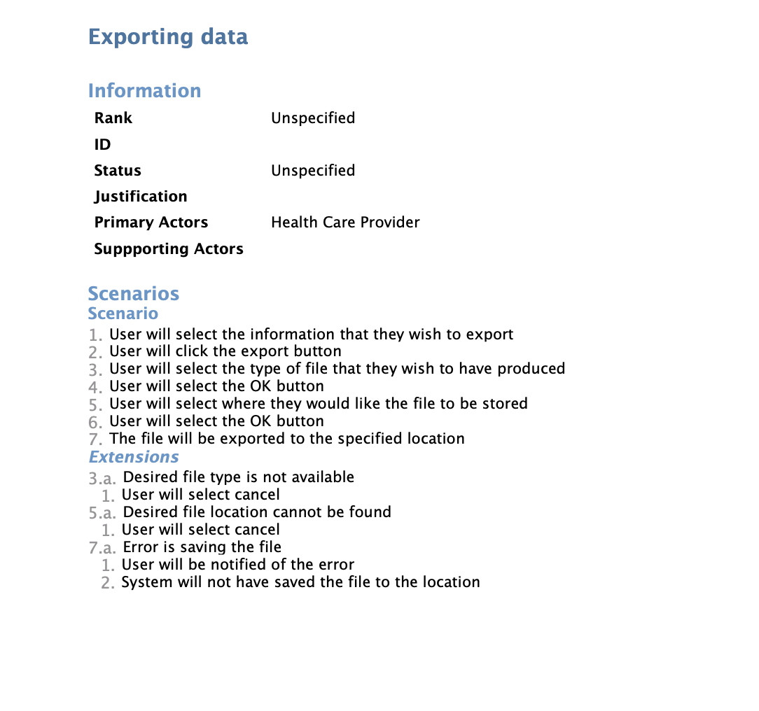
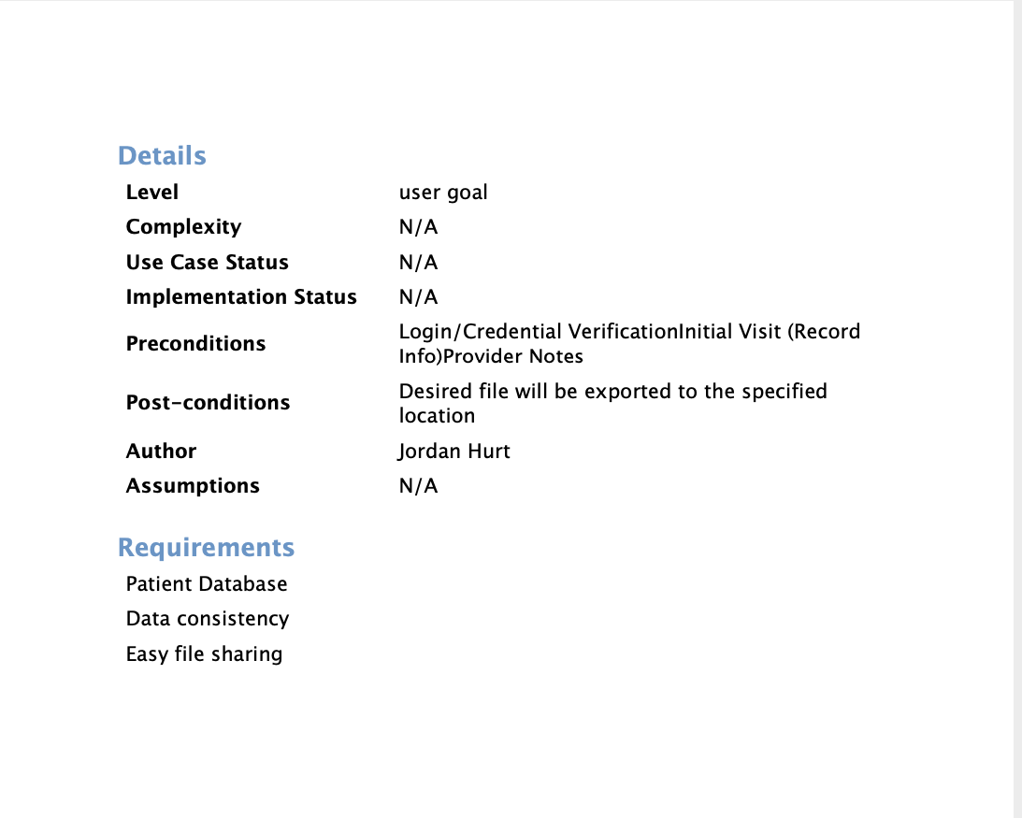
Use Case: Exporting Data
Notes:
- Jordan

Slide 8
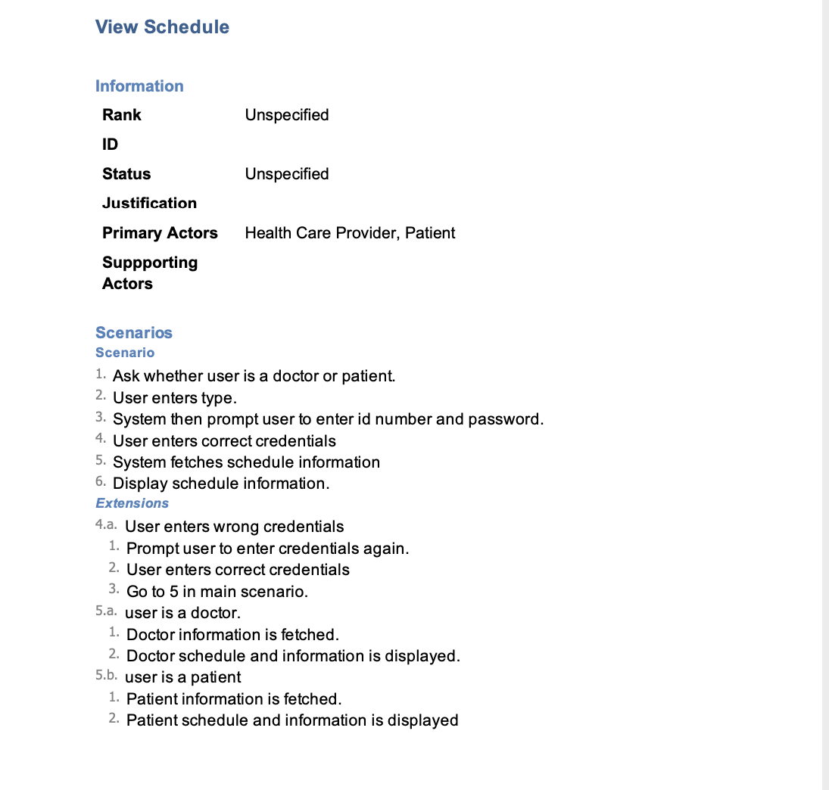
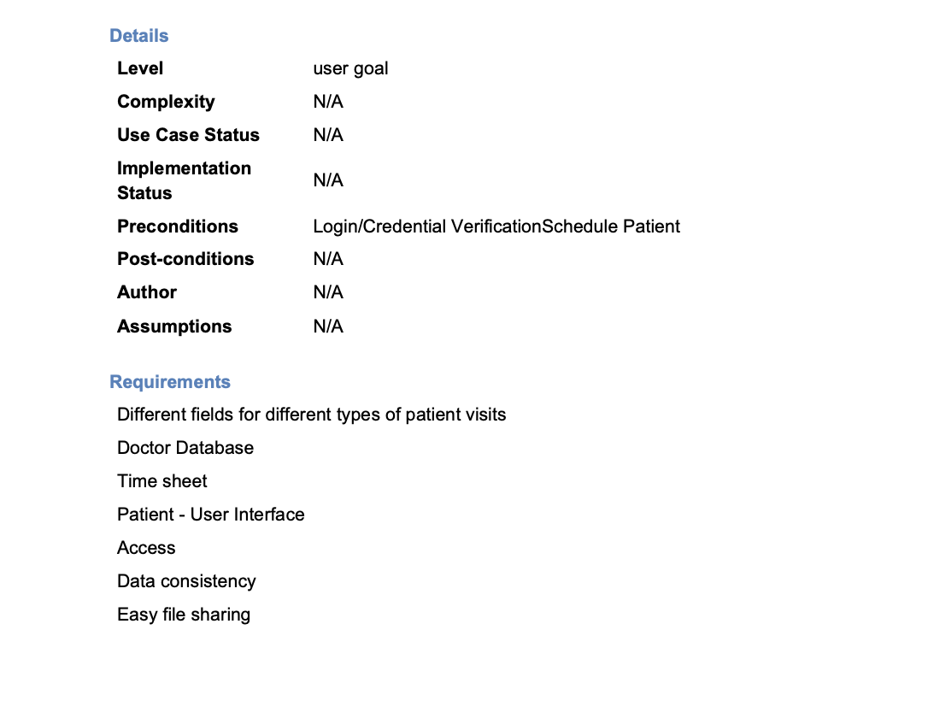
Use case: View Schedule
Notes:
- Alejandro

Slide 9
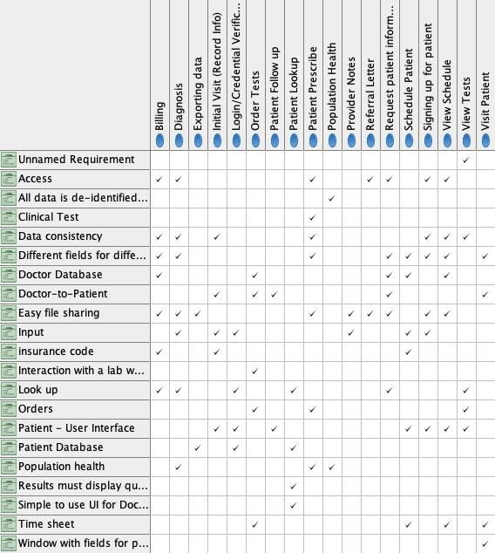
Traceability Matrix
Notes:
- all

Slide 10
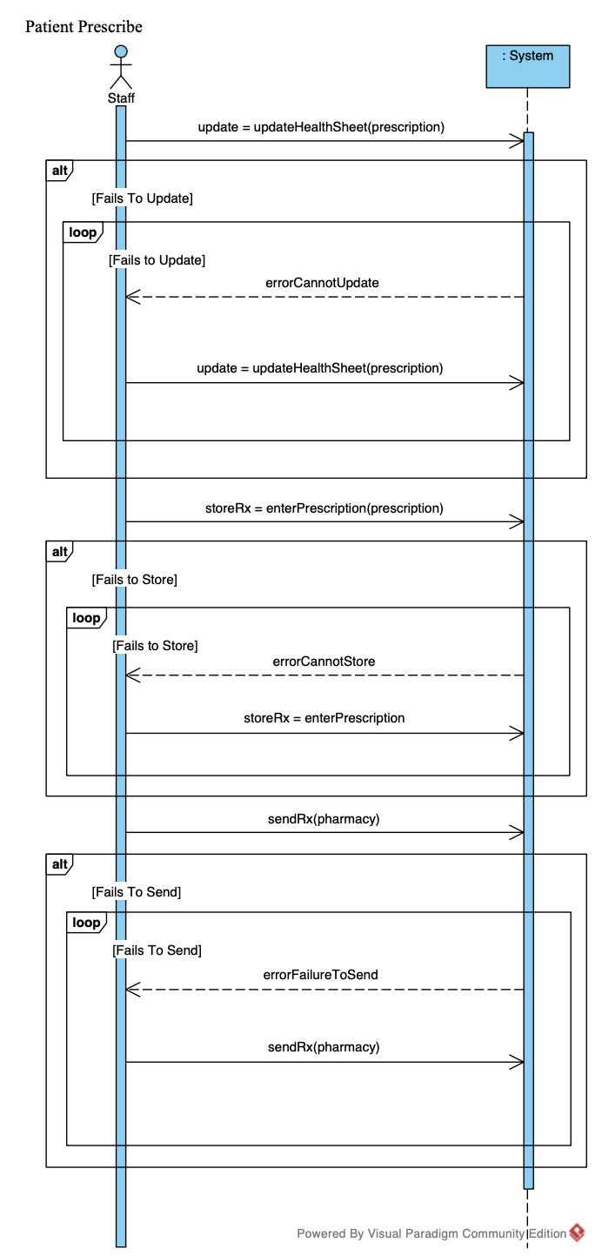
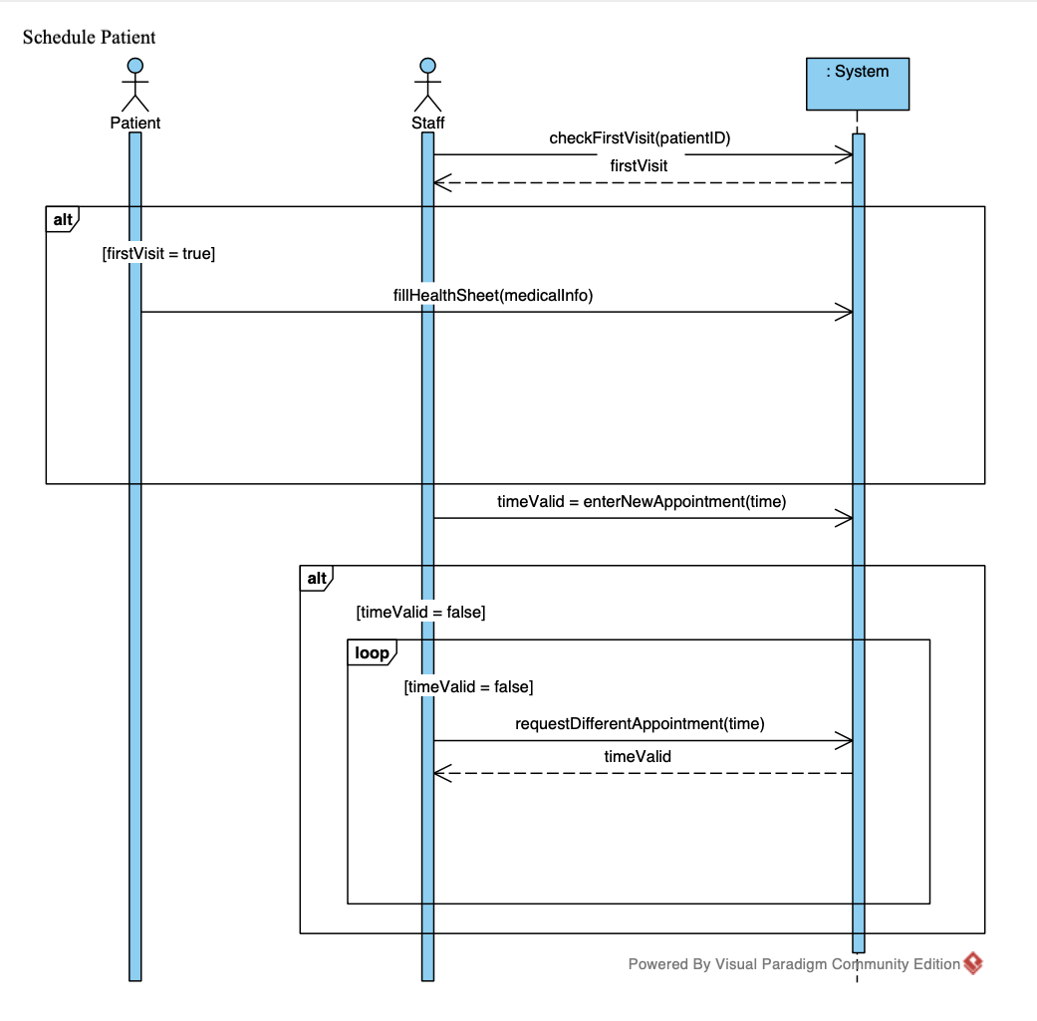
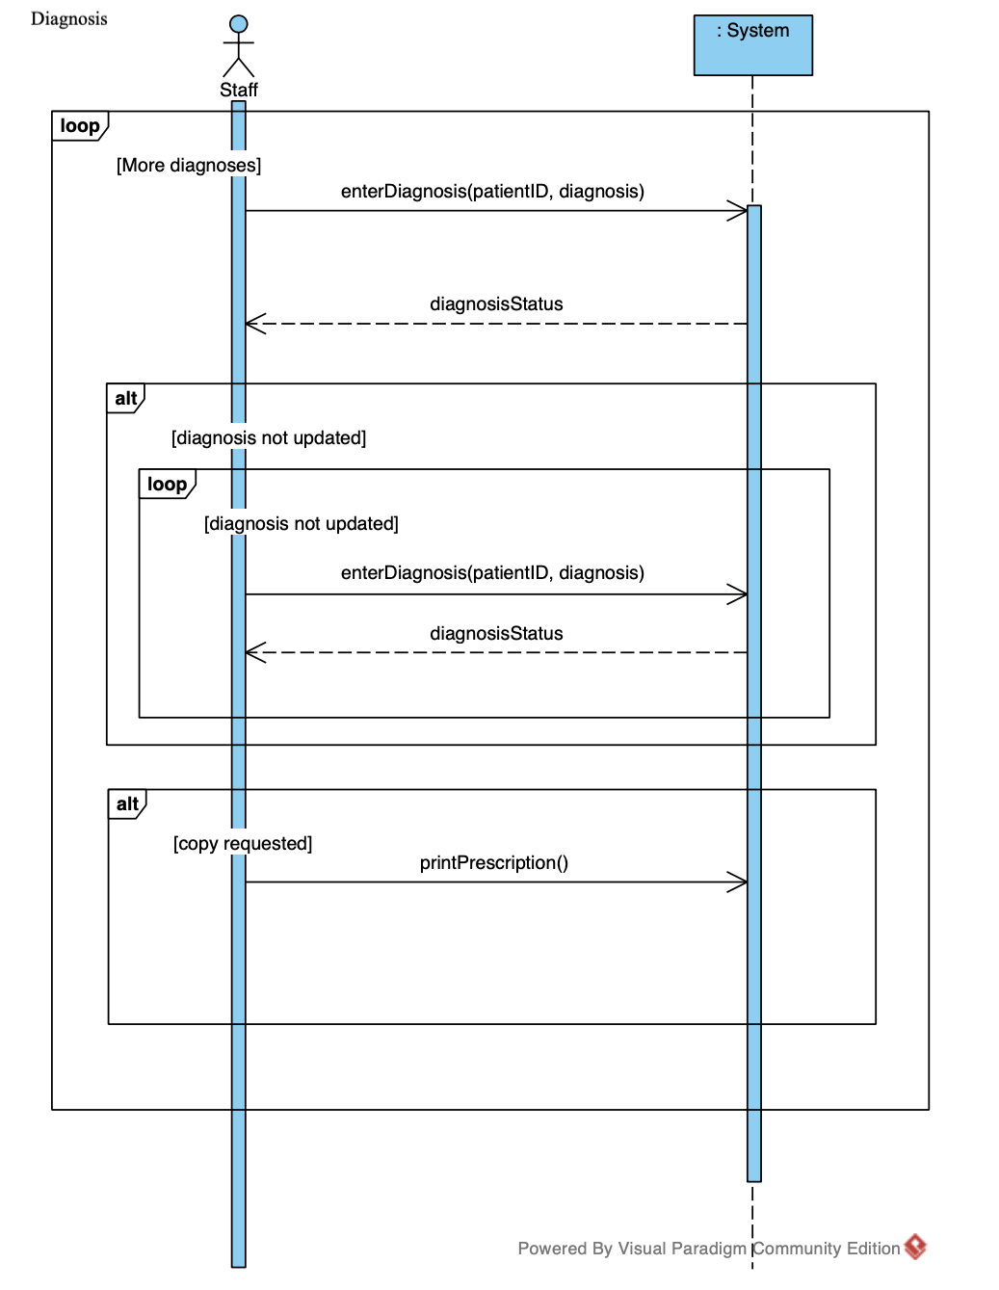
system Sequence diagram
Schedule Patient
Diagnosis
Patient Prescribe
Notes:
- John

Slide 11
Credit and links
Team Website: https://shenoisam.github.io/Software1/

