Slide 1
C-Share
Electronic Health Record (EHR)

Slide 2
Story
Notes:
Image from: https://www.officepracticum.com/blog/understanding-the-basics-of-ehrs/

Slide 3
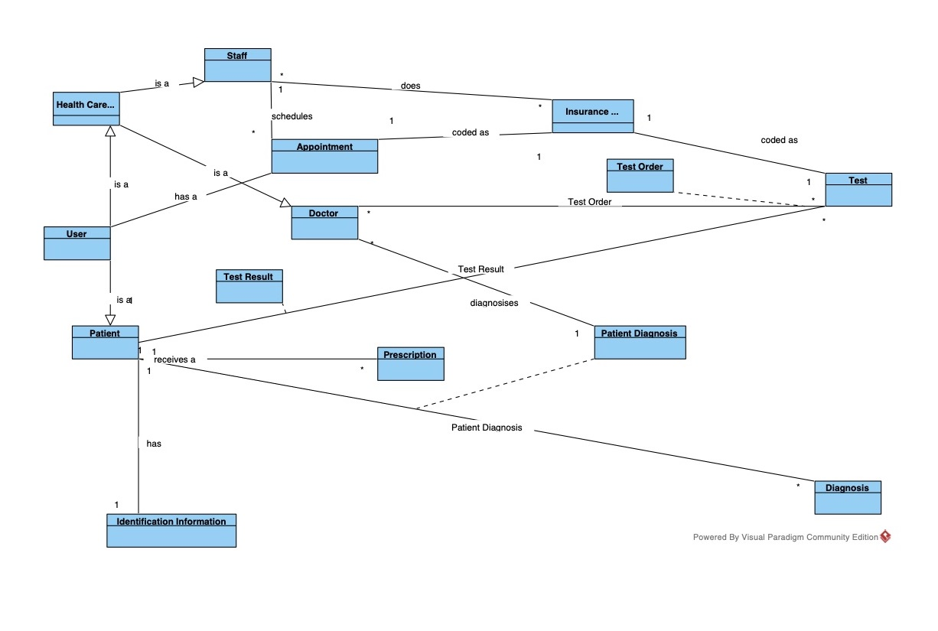
Domain model

Slide 4
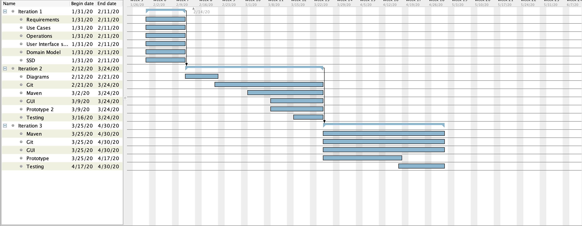
Gantt diagram

Slide 5
Sequence system diagram
Schedule Patient
Diagnosis
Patient Prescribe

Slide 6
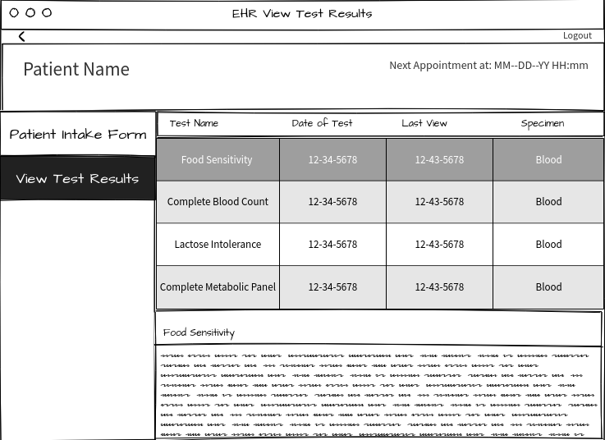
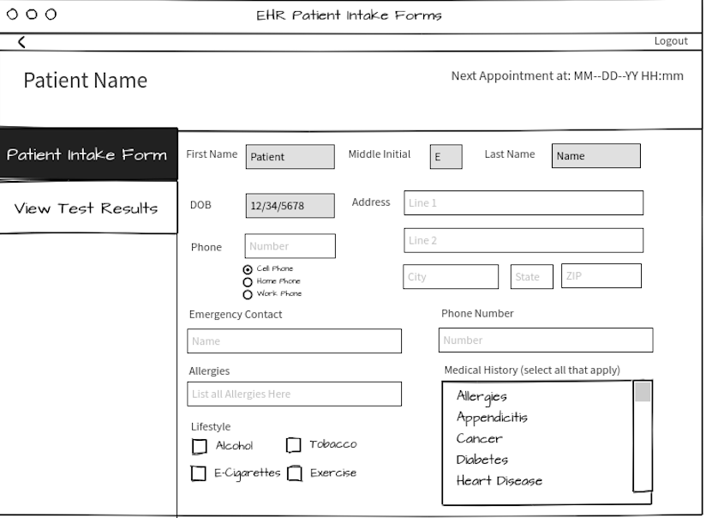
User Interface

Slide 7
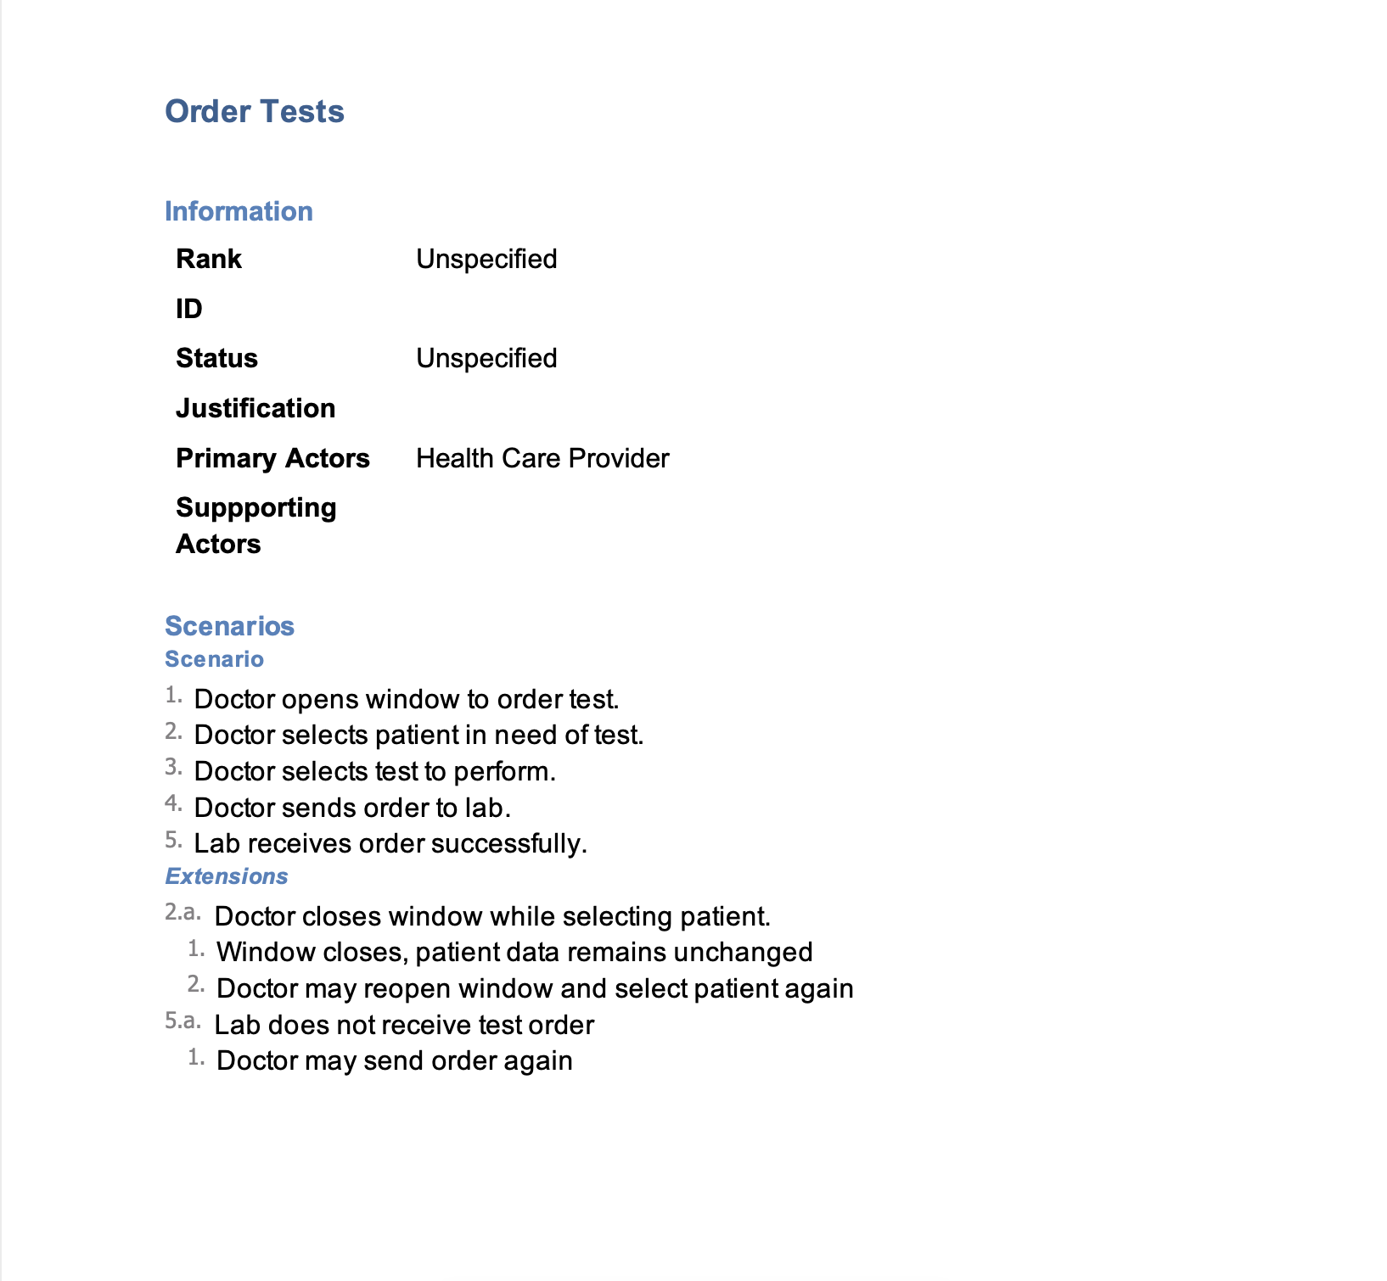
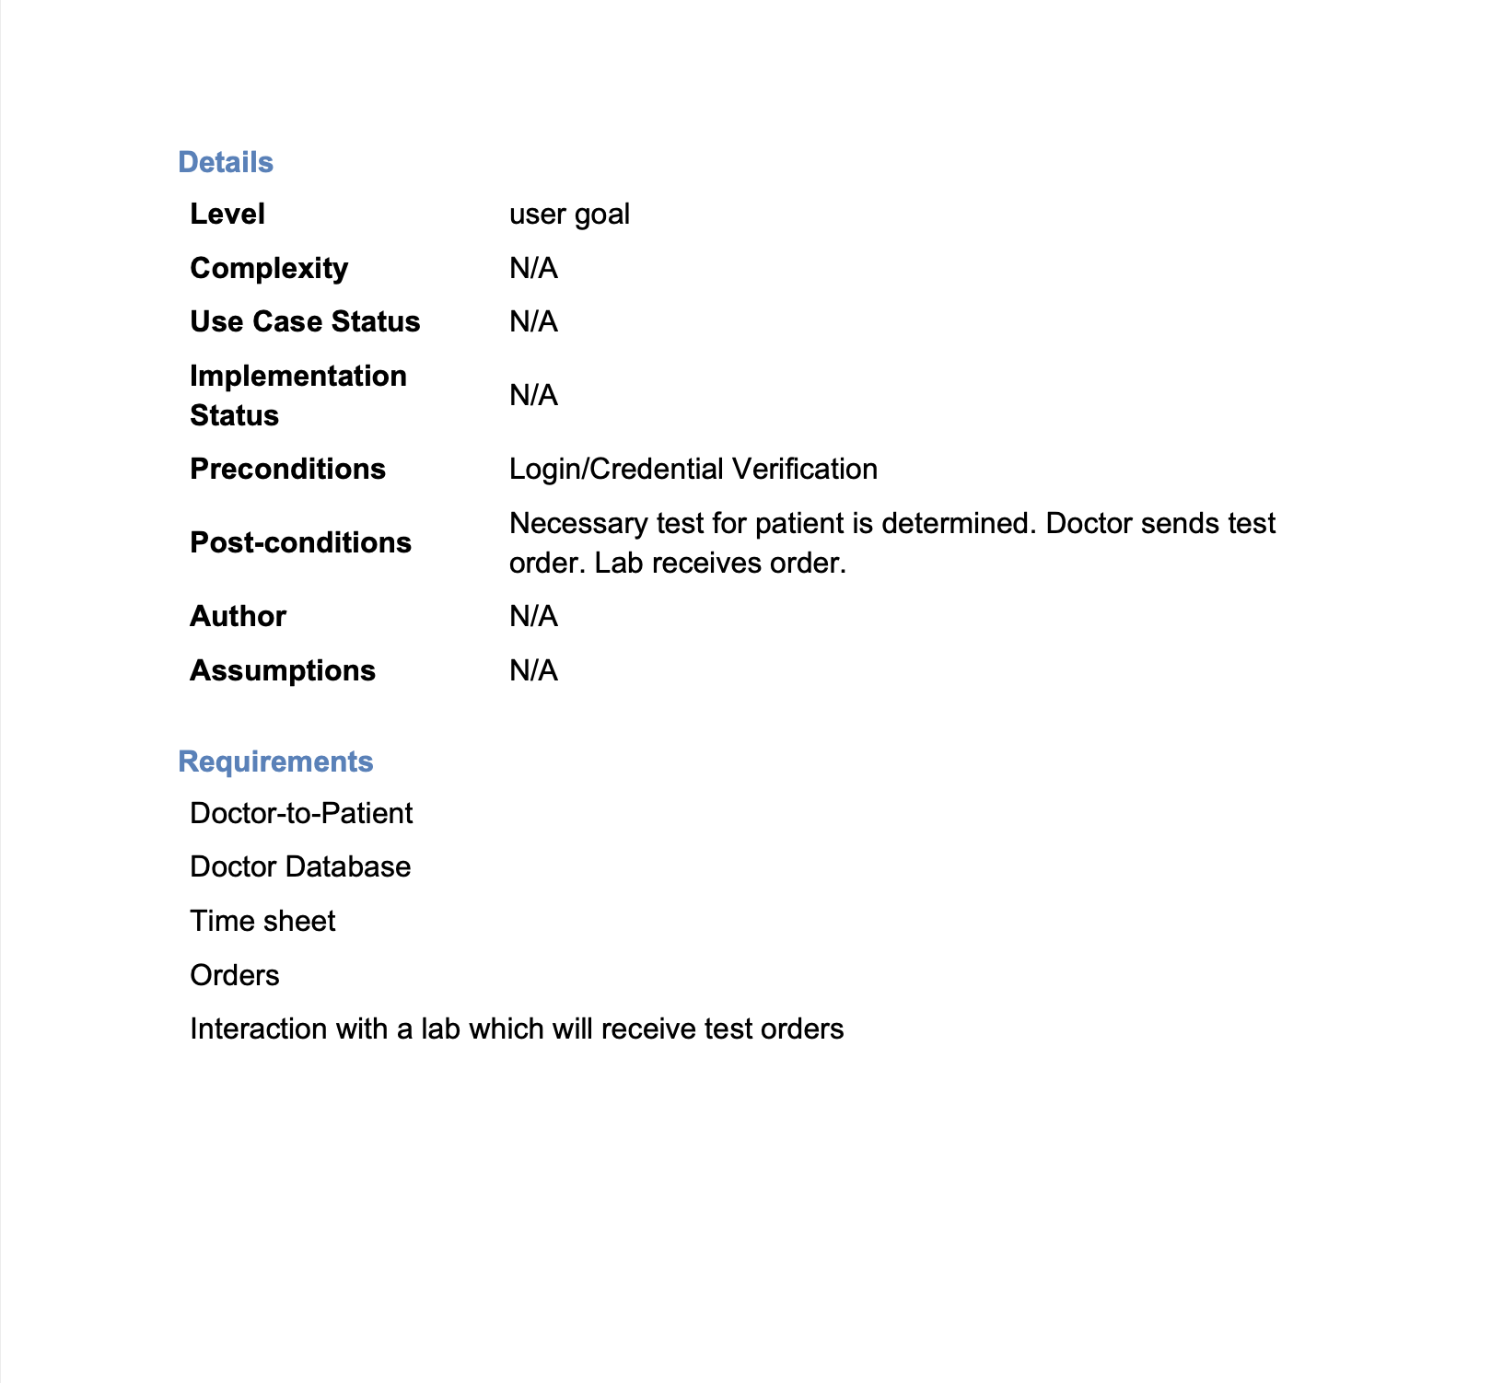
Use case: Order Tests

Slide 8
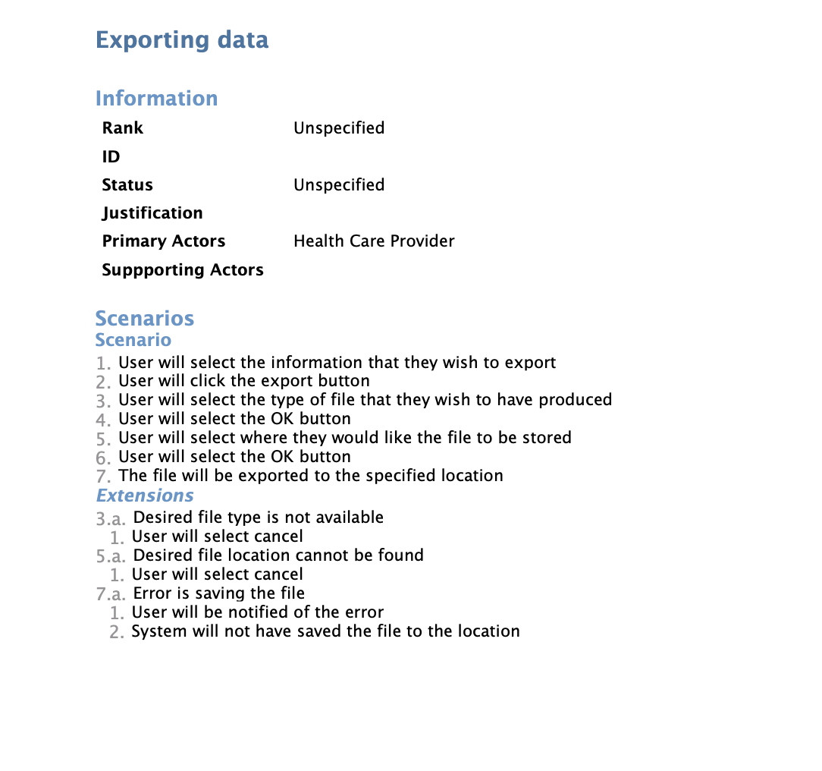
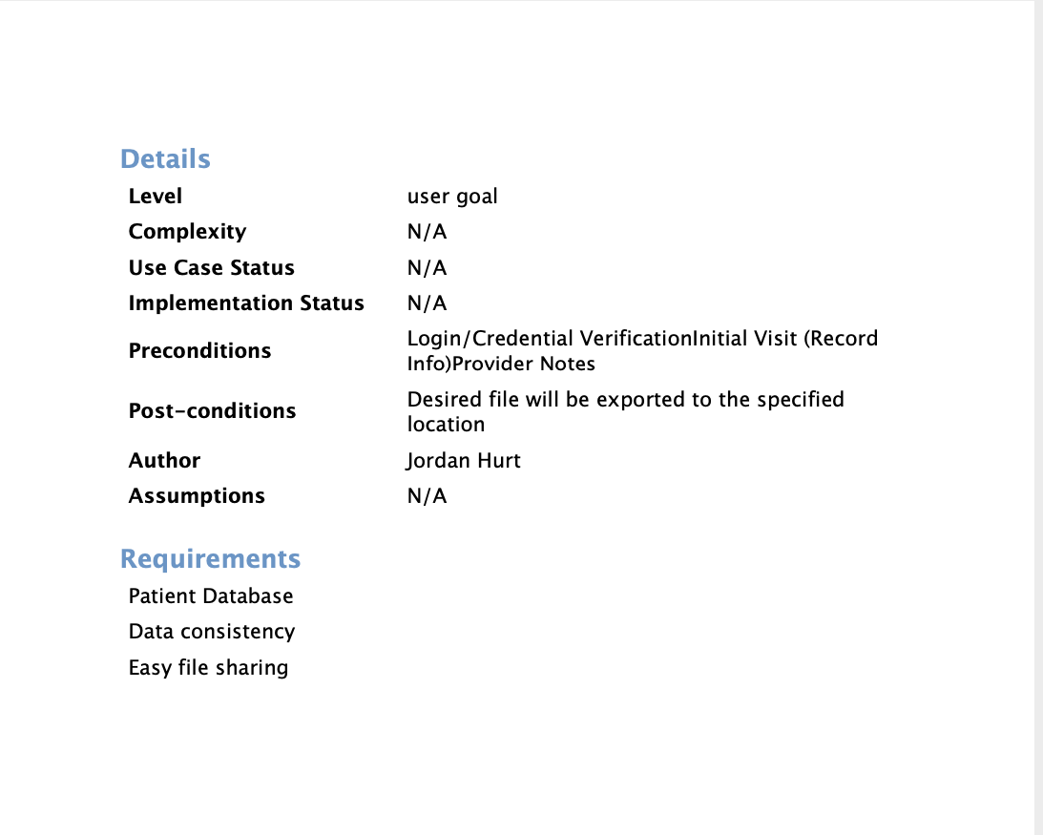
Use Case: Exporting Data

Slide 9
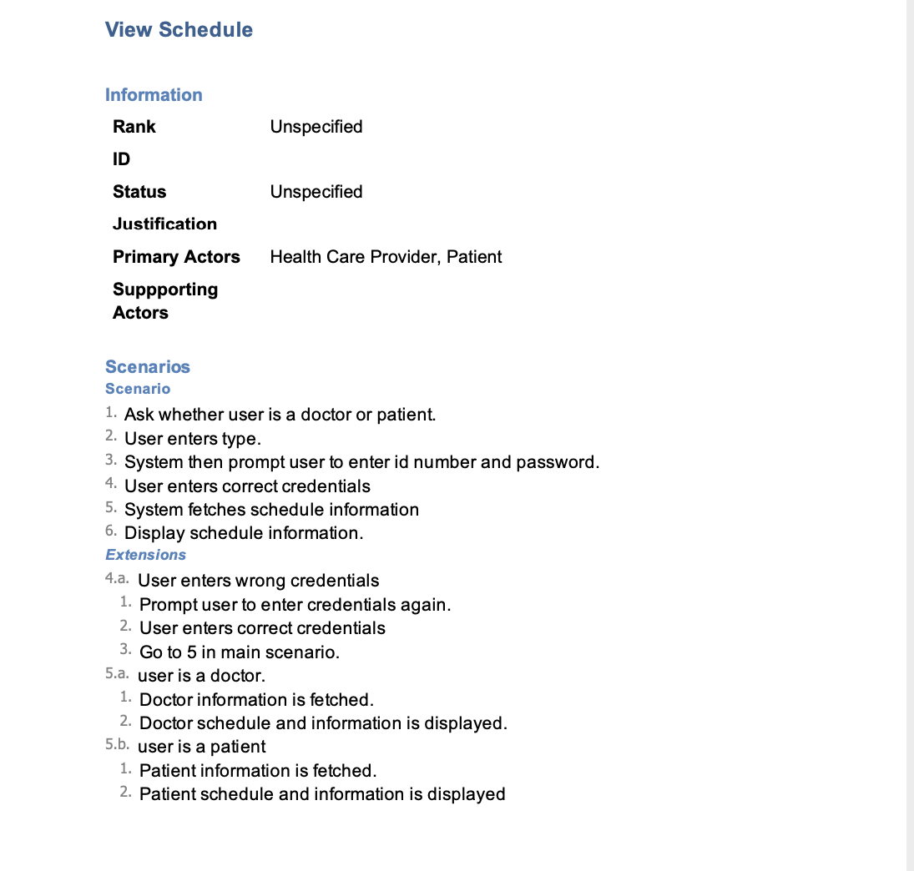
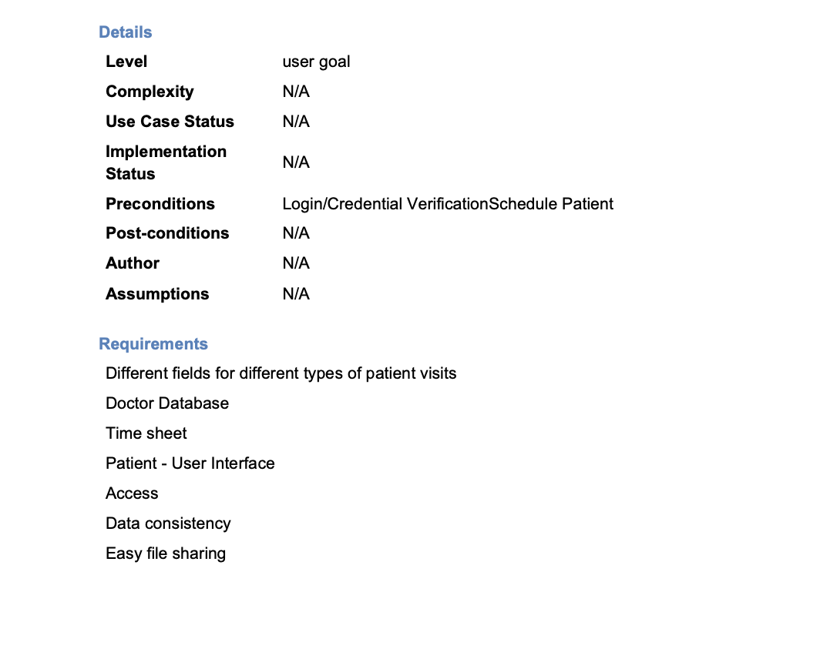
Use case: View Schedule

Slide 10
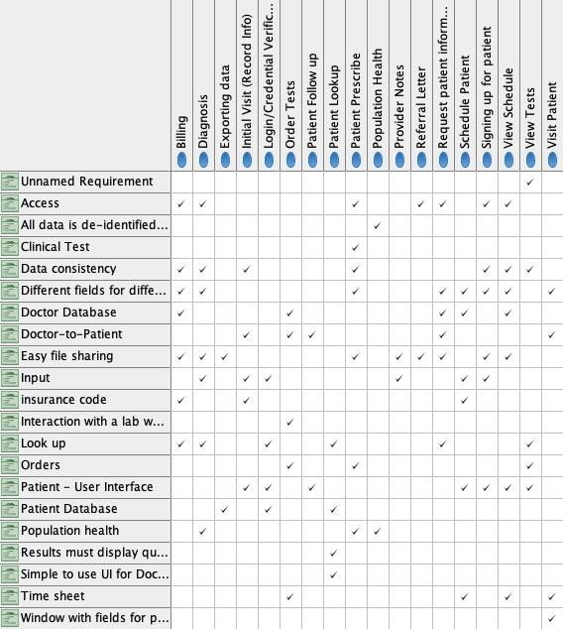
Traceability Matrix

Slide 11
Credit and links
Team Website: https://shenoisam.github.io/Software1/

