Slide 1

#SHELL SCRIPTING 10 REAL TIME SCENARIOS
By Praveen Singampalli [09-07-2022 ]
-----FOLLOW ME FOR BOOTCAMP UPDATES----
INSTAGRAM/ TWITTER – SINGAM4DEVOPS
LINKEDIN – PRAVEEN SINGAMPALLI
TELEGRAM - SINGAM4DEVOPS_DISCUSS
Please do share my channel link with 10 of your friends
https://www.youtube.com/channel/UCBz4yaxNxfiz1XYh-07UfWQ

Slide 2
Shell Scripting commands
1) sed -n '1,3'p test.sh ------> prints 1 to 3 lines
2) awk '{print}' test.sh -------> prints the whole file
3) awk ’/Manager/{print}’ test.sh prints lines with "manager" word
4) awk -F'[.]' '/^version/{print $1"."$2"."$3"."$4+1}’ test.sh
version=20.1.2.3 --🡪 Version Incerement
5) sed -i ‘s/tenth/eleven/g’ test.sh -> Replace a value in a file
6) myVar=`echo $hello | sed 's/=/ /g' | awk '{print $2}'`

Slide 3
AUTOMATION 1 - IF ELSE BLOCK WITH JFROG REST API
CICD=true
WORKSPACE=/apps/opt/users/
JOB_BASE_NAME=Test_demo
if [[ $CICD == true ]]
Then
echo "CI/CD pipe line check"
file="${WORKSPACE}/html/basic_report.html"
REPORTNAME=${JOB_BASE_NAME}_${BUILD_NUMBER}. Test_demo_10
echo "CICD Check starting"
if [ -f "$file" ]; then
echo "testReport file found sending to artifactory”. -T--🡪 Target
curl -H X-JFrog-Art-Api:Token -T $file https://oneartifactorycloud/artifactory/CICD/Reports/$REPORTNAME.html
curl -H X-JFrog-Art-Api:Token -T $file https://oneartifactorycloud/artifactory/CICD/Reports/$REPORTNAME.html
else
echo "testReport not found"
fi
fi

Slide 4
AUTOMATION 2 - For Loop With Jira Rest API
for ip in $(cat ip.txt) 10.118,10.119
do
curl -u GITLAB:Token -X PUT --data '{"update":{"labels":[{"add":”’”$TEAMNAME-$version"'"}]}}' --header "Content-Type: application/json" https://jira.com/rest/api/2/issue/2341 curl -u GITLAB:Token -X PUT --data '{"update":{"comment":[{"add":{"body":"'"$version"'"}}]}}' --header "Content-Type: application/json" https://jira. com/rest/api/2/issue/$line
echo "Name read from file - $line"
done
vim forloop.sh
for line in $(cat test.sh)
do
echo $line
done
sh forloop.sh
IN CLI
$ip
Echo $ip
10.118
2341
3555
67778

Slide 5
AUTOMATION 3 - Array Declaration To check Jar Process
#!/bin/bash
array=(helloservice hiservice nameservice managerservice teamservice)
for line in "${array[@]}"
do
COUNT=`ps -ef | grep helloservice | grep -v grep | wc -l`. RUNNING , 3
MAX=2
echo $line
echo $COUNT
if [ $COUNT -gt $MAX ]
then
echo $line
PROCS=`ps -ef| grep $line | grep -v grep | awk '{print $2, $11, $12, $13}' | sort -k 4`
JAR=`echo "${PROCS}" | awk -F"-Djar_name=| " '{print $5}'`
echo $JAR
JAR_RUN=`echo $JAR | sed 's/ /,/g'`
echo $JAR_RUN
cd /apps/nnos/vzomega/scripts
./mail.sh $line $JAR_RUN $COUNT
fi
done
array=(helloservice hiservice nameservice managerservice teamservice)
for line in "${array[@]}"
do
echo $line
done
Testfilename - arrayloop.sh
IN CLI

Slide 6
AUTOMATION 4-Archive The Data With Find/Mtime/Tar/Name Command
cd /apps/logs/backup.txt
find . -type f -mtime +7-exec mv '{}' /apps/logs/Log_Backup \;
cd /apps/logs/Log_Backup
find /apps/logs/Log_Backup -type f -name '*log*' > include-file
tar -cvf $(hostname)_$(date +%Y%m%d%H%M%S).tar.gz -T include-file
find -type f -name '*log*' -exec rm -rf {} \;
find -type f -mtime +3 -name '*.tar.gz' -exec rm '{}' \;
exit

Slide 7
AUTOMATION 5 - Playing With Dates And While loop
ONE=14
dataset_date=`date`
Fourteendaysold=`date -d "$dataset_date - $ONE days" +%F`
echo $Fourteendaysold
TWO=7
dataset_date=`date`
sevendaysold=`date -d "$dataset_date - $TWO days" +%F`
echo $sevendaysold
date1=`echo $sevendaysold | sed 's/-//g’`
date2=`echo $Fourteendaysold | sed 's/-//g'`
echo $date1 with $date2
#!/bin/sh
a=0
while [ $a -lt 10 ]
do
echo $a
a=`expr $a + 1`
done
IN TERMINAL

Slide 8
AUTOMATION 6 - SendEmail To Team
/usr/sbin/sendmail -i -t <<
Subject: $1 server process status
From: Email1
To: Email2
Hi Team,
Please check for $1 service in TEST server which has $3
process running with below list of KIT IDs
$2
Regards,
ShineInCareer
MESSAGE_END
Vim hello.sh
echo $1 service in TEST server which has $3 $2
sh hello.sh linkedin place good
IN CLI

Slide 9
Special Variables in Shell
Vim hello.sh
sh hello.sh linkedin place good
echo $# -🡪 3
echo $? 🡪 Exit value of last command
echo $0. -🡪 Stores the first input [linkedin]
echo $0 service in TEST server which has $3 $2
CASE 1 :
echo "With *:”
for arg in "$*"; do echo "<$arg>"; done
CASE 2:
echo "With @:”
for arg in "$@"; do echo "<$arg>"; done
With *:
<linkedin place good>
With @:
<linkedin>
<place>
<good>
1) $# Stores the number of command-line arguments that were passed to the shell program.
2) $? Stores the exit value of the last command that was executed.
3)$0 Stores the first word of the entered command (the name of the shell program).
4) $* Stores all the arguments that were entered on the command line ($1 $2 ...).
5) "$@" Stores all the arguments that were entered on the command line, individually quoted ("$1" "$2" ...).

Slide 10
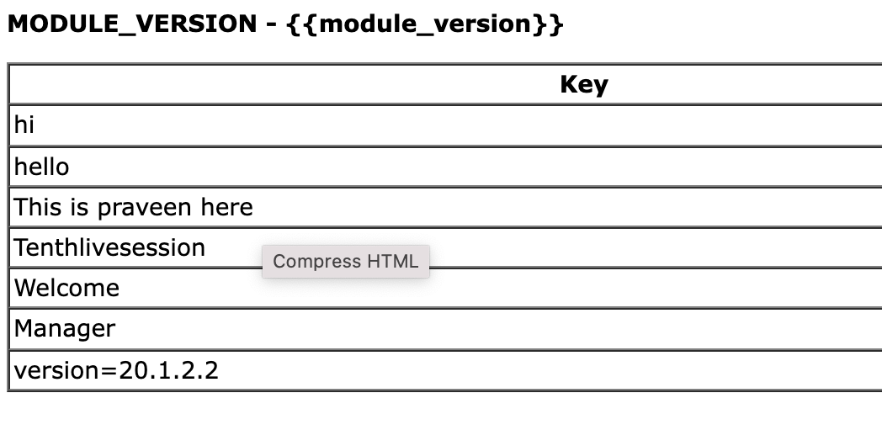
AUTOMATION 8 - Creating HTML File
cat > html <<'EOF'
<html>
<body>
<p><strong>MODULE_VERSION - {{module_version}}</strong></p>
<table border="1" cellspacing="0" cellpadding="2.5" valign="top"
width="100%" align="justify"
style="width: 100%; max-width: 1200px; background-color: #ffffff">
<tr>
<th>Key</th>
</tr>
EOF
Paste test.sh test2.txt tesxt100.txt | while read key dog zebra; do
cat >> jira.html <<EOF
<tr>
<td>$ key </td>
</tr>
EOF
done

Slide 11
AUTOMATION 9 - Sonar/GitLab Rest API
{
"employee": {
"name": "sonoo",
"ID": 56000,
"Status": true
}
}
cat status.json| jq '.employee’
cat status.json| jq '.employee.name'
curl -u "GITLAB:$gitlab” "https://sonar/api/qualitygates/project_status?projectKey=${sonarProjectKey}&branch=${PIPELINE_GIT_BRANCH}" >> status.json
cat status.json | jq '.projectStatus .status' > status.txt
sed 's/"//g' status.txt >> QG.txt
echo "status=$(sed -n '1p' QG.txt)"
if [ $(sed -n '1p' QG.txt) == 'ERROR' ]
then
echo -e "*****$RED QUALITY GATE ERROR $NC*****"
echo "Check https://sonar/dashboard?id=${sonarProjectKey}"
exit 1
else
echo "*****$GREEN QUALITY GATE OKAY $NC******"
echo "To validate check https://sonar/dashboard?id=${sonarProjectKey}"
fi
curl --request POST --header "PRIVATE-TOKEN: $TOKEN" "https://gitlab/api/v4/projects/$PROJECT_ID/protected_branches?name=$MS_TARGET_BRANCH&push_access_level=40&merge_access_level=40" >> protectedbranches.txt

Slide 12
AUTOMATION 10 - To Check the process of a Jar
(java –jar helloworld). Id runtime cpu mem RAM App -🡪 CPU RAM MEM HARDWARE. (AWK, SED, GREP,PIPE)
**hello=`ps -ef | grep -i helloworld- 20.1.2.3.jar | awk '{print $13}’`
sed -i 's/mdreject.html/index.html/g' web.xml
**sed -i 's/'"$version"'/'"$newversionCode"'/’ test.sh
date1=`echo $date| sed 's/-//g’`
**cat branch.json | jq '.branches[0].name' | tr -d '"' >> branch.txt
ls -ltr | head -10

Slide 13

#DevOps Help
#LiveSessions
#Referral
#OneToOne Sessions (320+ calls in which 200+ were free)
#Guided more than 2500+ DevOps Engineers
#JobHelp
#ResumeBuilding
#InterviewExperience
#Many Successful Stories and testimonials ☺☺
#Thank you for being the part of my family and let’s grow together

