Slide 1
WELCOME TO
FOODIE WORLD
:Presented by Shivendra

Slide 2
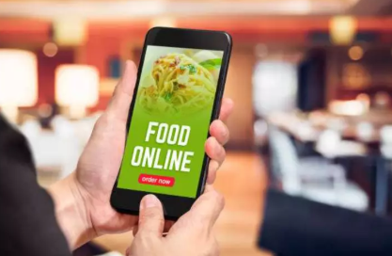
CONTENT
Introduction
Home page look
Objectives
Technologies
Features
Scope

Slide 3
Introduction:
An online food ordering website allows your business –
To accept the orders
To manage the orders
Place order for delivery
Customers browse a digital menu, either on an app or website
Place and pay for their order online

Slide 4
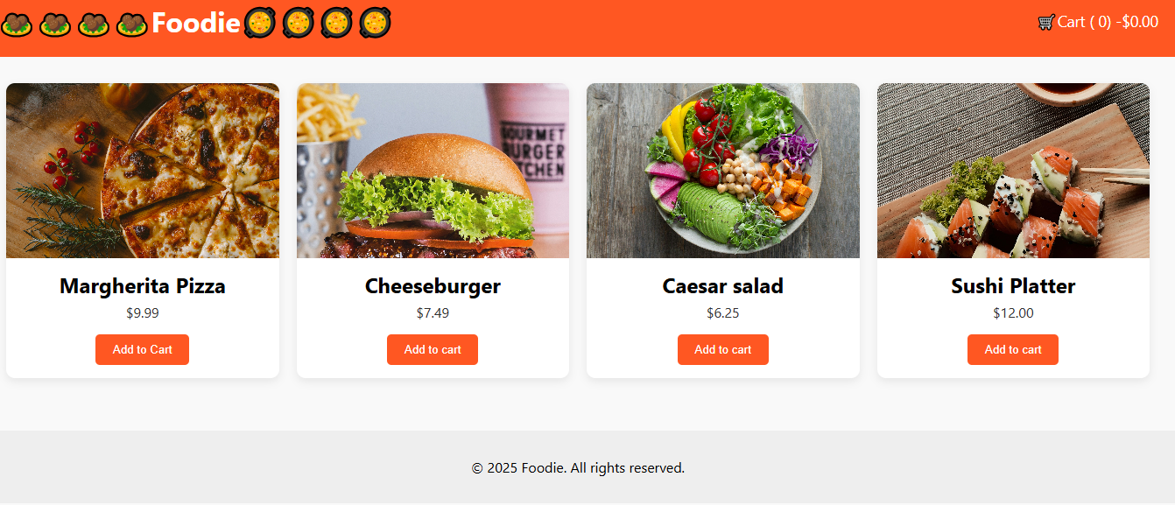
Home Page Look:

Slide 5
OBJECTIVES:
The general objectives of the study is to develop a reliable, convenient and accurate ordering system.
To develop a system that will surely satisfied the customer
To design a system able to accommodate to huge amount of orders at a time
To improve the communication between the client and the server and minimize the time of ordering

Slide 6

TECHNOLOGIES USE:
HTML
CSS
JAVA SCRIPT

Slide 7
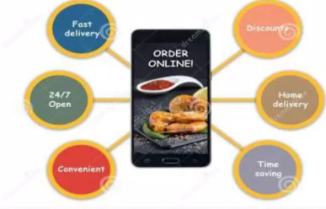
FEATURES:
Time saving
Home delivery
Accessible to any device like mobile and laptop
Add to cart option present

Slide 8
THANK YOU

